Slide 1




Replacement of Distribution Water Main in South Avenue
including Continental Place, Cable Way and Arlington Place
Project RED-386
Community Board Presentation
Eric Adams
Mayor
Thomas Foley
Commissioner

Slide 2

agenda
About the Project
Project Location
Construction Overview
During Construction
Community Impacts
Outreach and Notification
2

Slide 3
About the Project
Notice To Proceed: 7/18/2022
Projected Start: Fall 2022
Projected Completion: Spring 2024
Contractor: Perfetto Enterprises Co. Inc.
Total Budget: $6.56 Million
3

Slide 4
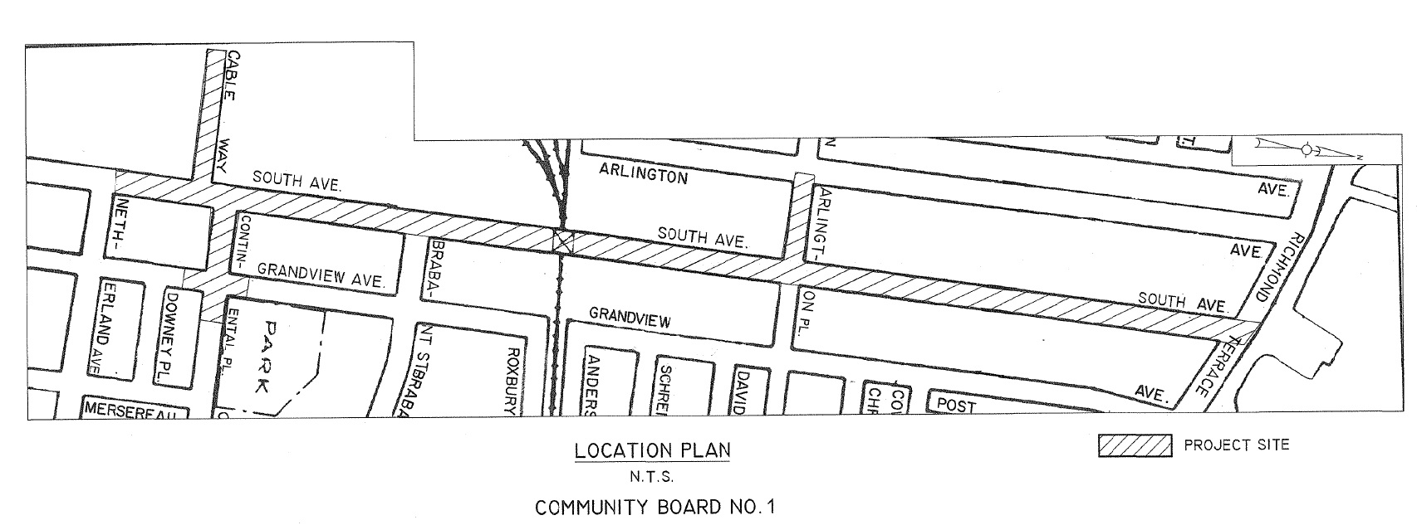

Project Location

Slide 5
South Avenue between Netherland Ave and Continental Place
20” Water Main
12” Water Main

Slide 6
South Avenue between Continental Place and Arlington Place
20” Water Main

Slide 7
South Avenue between Arlington Place and Richmond Terrace
20” Water Main
12” Water Main

Slide 8
CLICK TO EDIT HEADLINE TEXT
Edit text
Construction Overview
8
8

Slide 9
Construction Overview
Working Hours During Construction: Monday to Friday: 9:00 AM to 4:00 PM
Preliminary Work
In the ground (DEP Work)
Above ground (DOT Work)
Utilities
Community Outreach
Permits and scheduling
Street tree guards and pruning
Street markings, soil samples and test pits
Storm Water Pollution Prevention
Preconstruction Photographs
Street Cutting / Trench Set-up
Watermains
Fire hydrants
Curbs and sidewalks (as needed)
Street reconstruction
DOT pavement markings
Sodding
9

Slide 10
Distribution Water Main Replacement
South Avenue between Netherland Avenue and Richmond Terrace
Cable Way between South Avenue and Dead End
Continental Place between South Avenue and Grandview Avenue
Arlington Place between South Avenue and Arlington Avenue
Trench Reconstruction
South Avenue between Netherland Avenue and Richmond Terrace
Cable Way between South Avenue and Dead End
Continental Place between South Avenue and Grandview Avenue
Arlington Place between South Avenue and Arlington Avenue
Curb to Curb Restoration
Intersection of Grandview Avenue and Continental Place

Slide 11
CLICK TO EDIT HEADLINE TEXT
Edit text
During construction
11
11

Slide 12
Traffic Patterns During Construction
Contractors will maintain the following:
Personnel, signage, and safe work site for pedestrians and vehicles
Pedestrian access to buildings and sidewalks
Keep a minimum width of 5 feet for access to sidewalks and crosswalks
Maintain one lane of traffic on South Avenue. Flaggers to assist with two-way traffic.
Bus stop relocation when within work zone.
12

Slide 13
CLICK TO EDIT HEADLINE TEXT
Edit text
Community Impacts
13
13

Slide 14
COMMUNITY IMPACTS & MITIGATIONS
Work within DEP Noise Code and Dust Control Regulations.
Provide 72-hour notice to impacted areas.
Post advance Contractor’s 24-hour notice to impacted areas for parking restrictions and confirmed water shutdowns.
Keep storage site and MPT area clean & safe.
Professional rodent control inspector to monitor/maintain Rodent Control Station.
14

Slide 15
COMMUNITY IMPACTS & MITIGATIONS (cont’d)
Parking may be temporarily restricted when necessary; signs to be posted in advance.
Garbage pick-up may be affected and will be coordinated with appropriate stakeholders.
Individuals with special needs should contact the CCL. DDC field staff will work to minimize inconvenience.
In order to expedite the completion of work driveway access will be restricted during working hours.
15

Slide 16
How will this project benefit you?
COMMUNITY IMPROVEMENTS
The purpose of the project is:
Replace aging water main pipes to improve water distribution throughout the community with increased water capacity
16

Slide 17
CLICK TO EDIT HEADLINE TEXT
Edit text
OutREach and notification
17
17

Slide 18
COMMUNITY OUTREACH
DCC’s Office of Community Outreach + Notification (OCON)
works with CB’s, BID’s, local businesses, and other community stakeholders impacted by construction.
Community Construction Liaison (CCL)
DDC has assigned Frank Lurito of Promina Engineering as the dedicated on-site Community Construction Liaison. The CCL can be reached at:
Email: southavered386ccl@gmail.com
Telephone: 718.669.0500
Field Office: 201 Arlington Ave, Suite 2H
Staten Island, NY 10303
18

Slide 19
COMMUNITY OUTREACH (cont’d)
CCL responsibilities are as follows:
First point of contact; maintain on-site presence and communication.
Identify, resolve, and/or proactively address issues and inquiries.
Distribute advisory updates/weekly construction activities newsletter.
Provide 72-hour and 24-hour (confirmation or cancellation) advisories for work impacts by email and door to door.
19

Slide 20
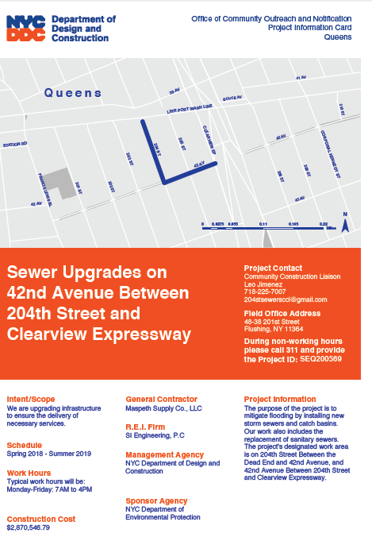
SAMPLE COMMUNICATIONS
Project
information card
advisory
newsletters
Look ahead Weekly bulletin
20

Slide 21
Thank you!
Q&A
CCL: Frank Lurito
Email: southavered386ccl@gmail.com

