Slide 1




RECONSTRUCTION OF ARTHUR KILL ROAD – PHASE 1 FROM RICHMOND AVENUE TO CLARKE AVENUE
PROJECT ID: HWR1140A
Resident Engineer: Yogesh Ravanan, P.E.
Community Construction Liaison: Carrie Agar
Zohran K. Mamdani
Mayor
Community Board Presentation
December 2025
Michael Flynn
Commissioner, DOT
Eduardo del Valle, AIA, LEED-AP, DBIA
Acting Commissioner, DDC
Lisa Garcia
Commissioner, DEP

Slide 2

agenda
About the Project
Project Improvements
Project Location
Streetscape Upgrades
Utility Upgrades
Community Impacts During Construction
Community Outreach and Notification
2

Slide 3

About the project
3
3

Slide 4
About the Project
Notice To Proceed: 12/22/2025
Anticipated Start: Winter 2026
Anticipated Completion: Summer 2029
Contractor: DiFazio Industries, LLC
Total Budget: $70.0 Million
Typical Work Hours: 9AM to 4PM (Day) 9PM to 5AM (Night) – As Needed Monday to Friday
4

Slide 5
Project improvements
5
5

Slide 6
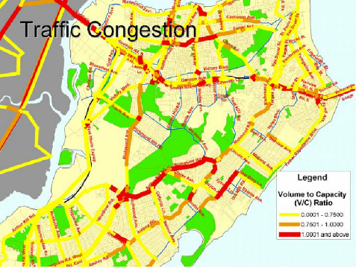

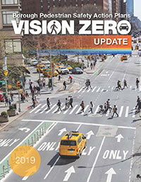

Project Improvements
Additionally:
Streetscape Arthur Kill Road
Replace Aging Water Mains/Hydrants
Improve ADA Compliance
Improve Traffic Signalization
Install Green Infrastructure
Relieve Congestion
Provide Shared Use Path
Achieve Vision Zero Goals
Upgrade Storm Drainage System
6

Slide 7
Project location
7
7

Slide 8
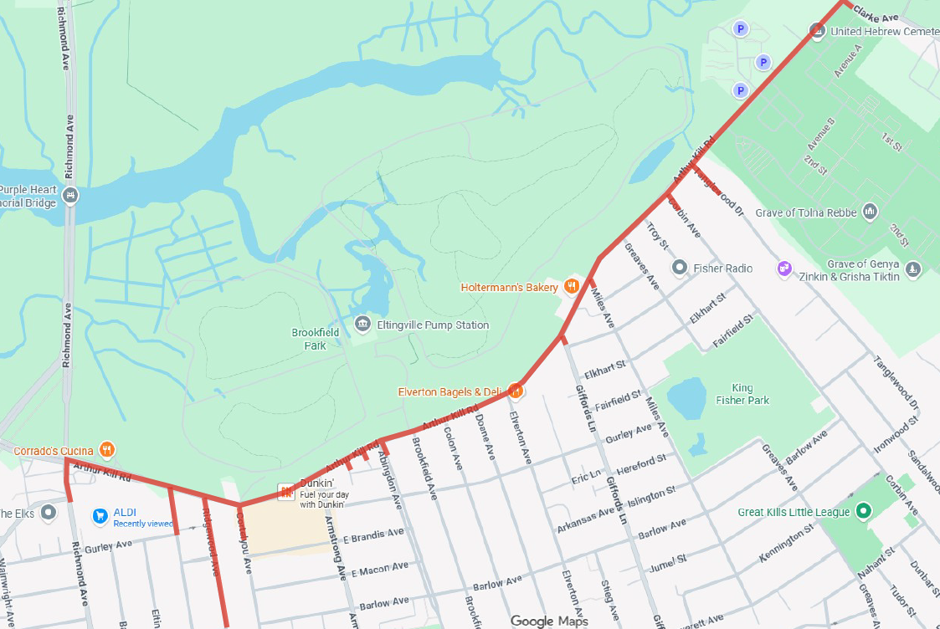
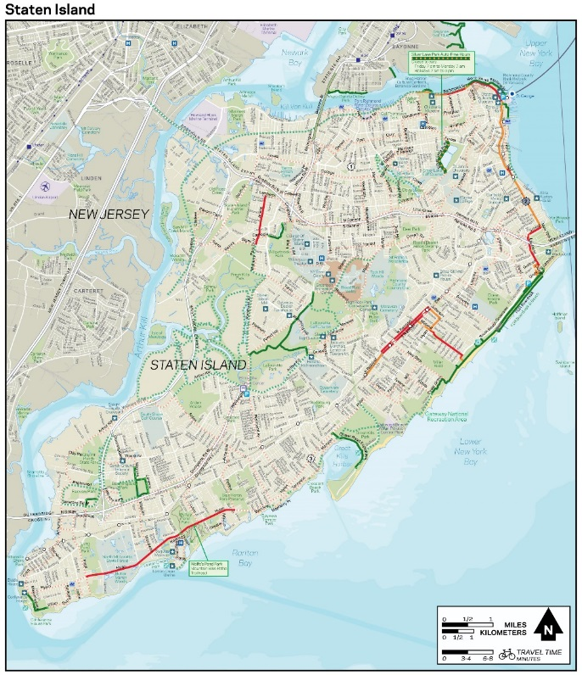
Project Location
Arthur Kill Road from Richmond Avenue to Clarke Avenue, including side streets as indicated.
N
Project Location
8

Slide 9
STREETSCAPE upgrades
9
9

Slide 10
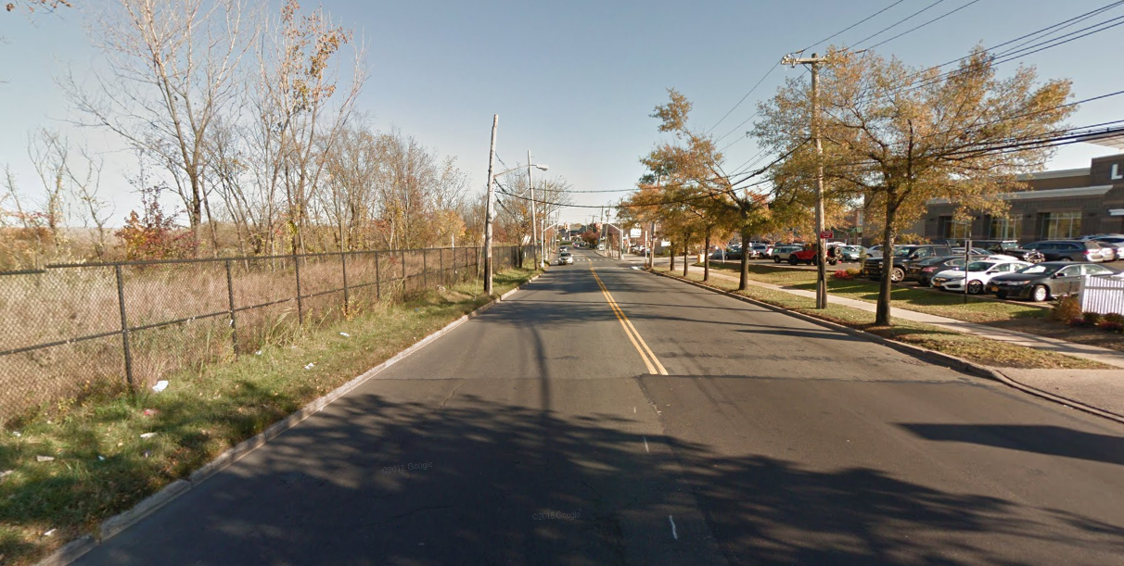
Current Conditions (Arthur Kill Road Looking East)
No Median
N
No Sidewalk
Single Lane in Each Direction

Slide 11
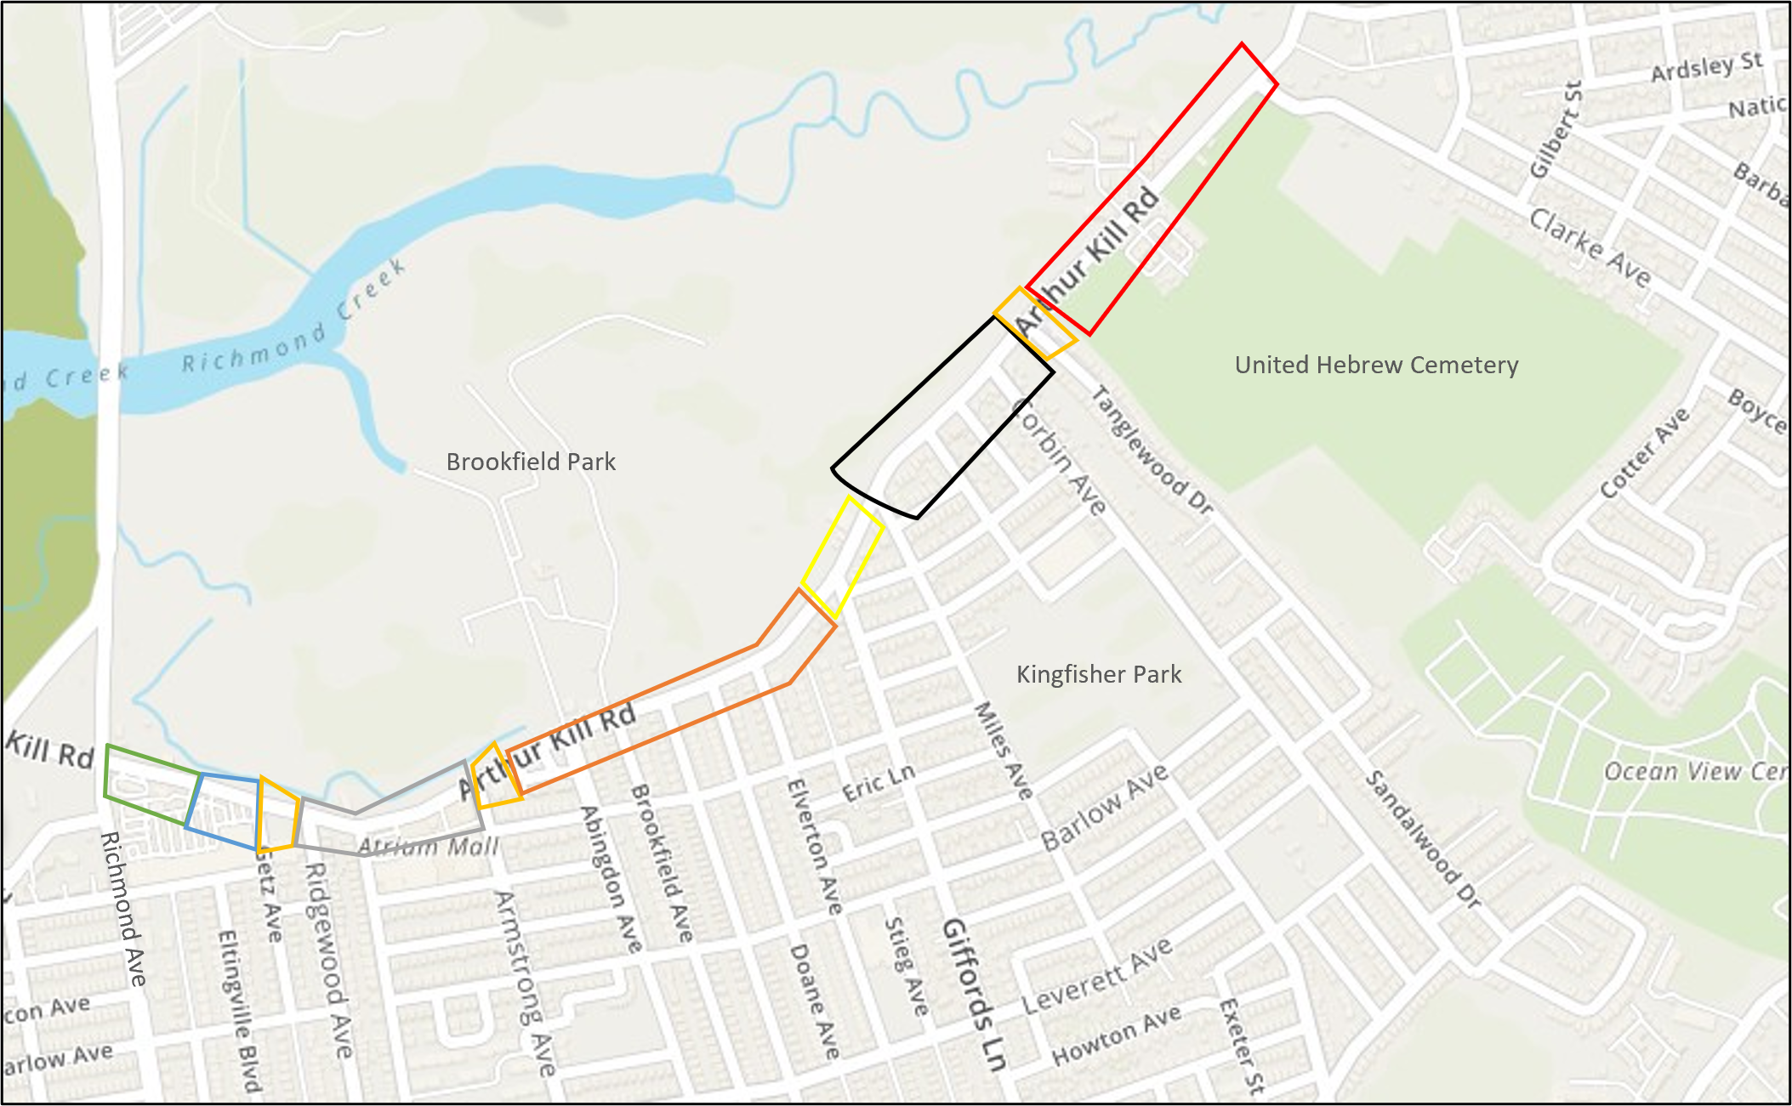
Sections Key Plan
N
Section 1
Section 2
Section 3
Section 4
Section 5
Section 6
Section 7
Section 8

Slide 12
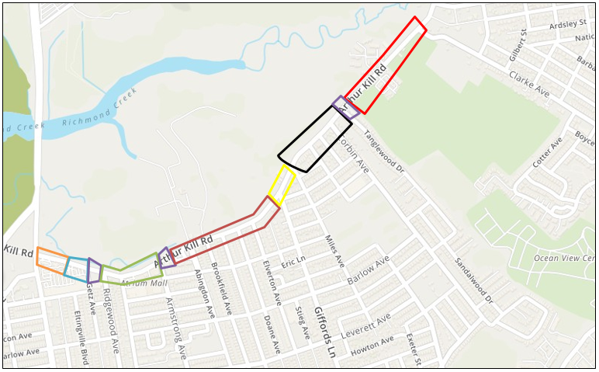
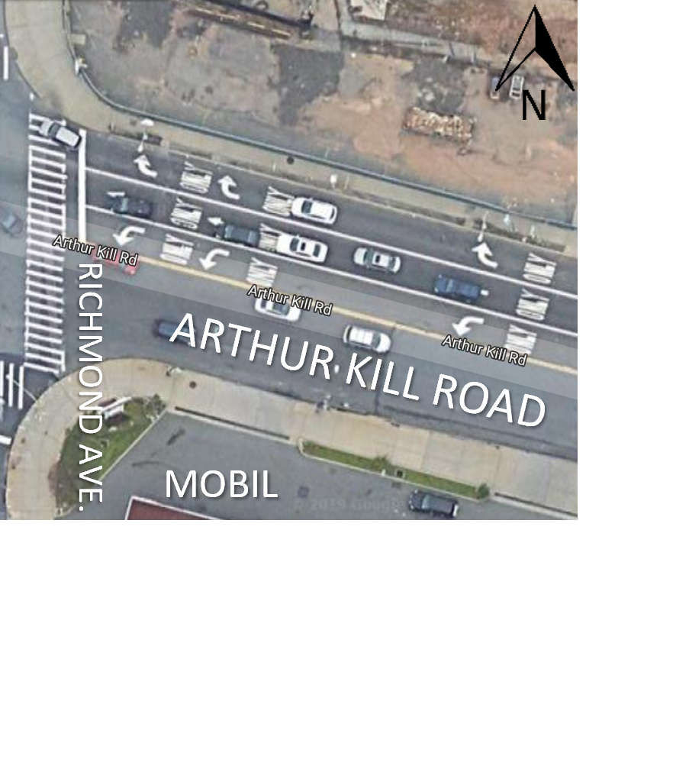
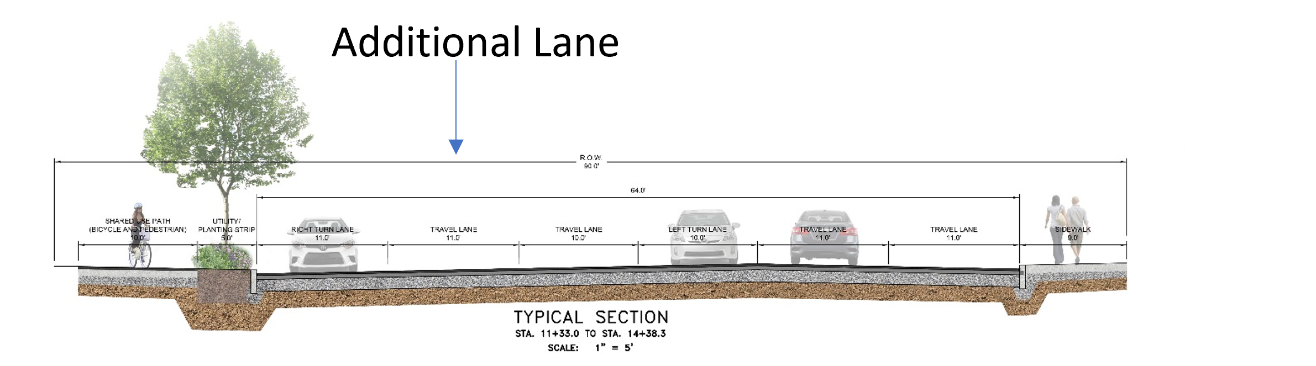
N
Intersection of Arthur Kill Road and Richmond Avenue
(Section 1)
Existing 5 Lanes-
3 Lanes West Bound
2 Lanes East Bound
Proposed 6 Lanes-
4 Lanes West Bound
2 Lanes East Bound
No Median
Shared Use Path for Bicycles and Pedestrians
Utility Planting Strip
Intersection of Richmond Avenue and Arthur Kill Road

Slide 13
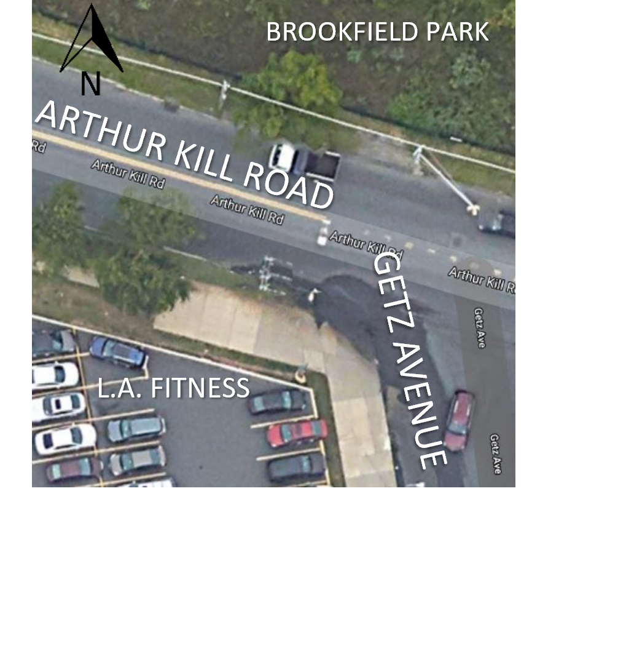
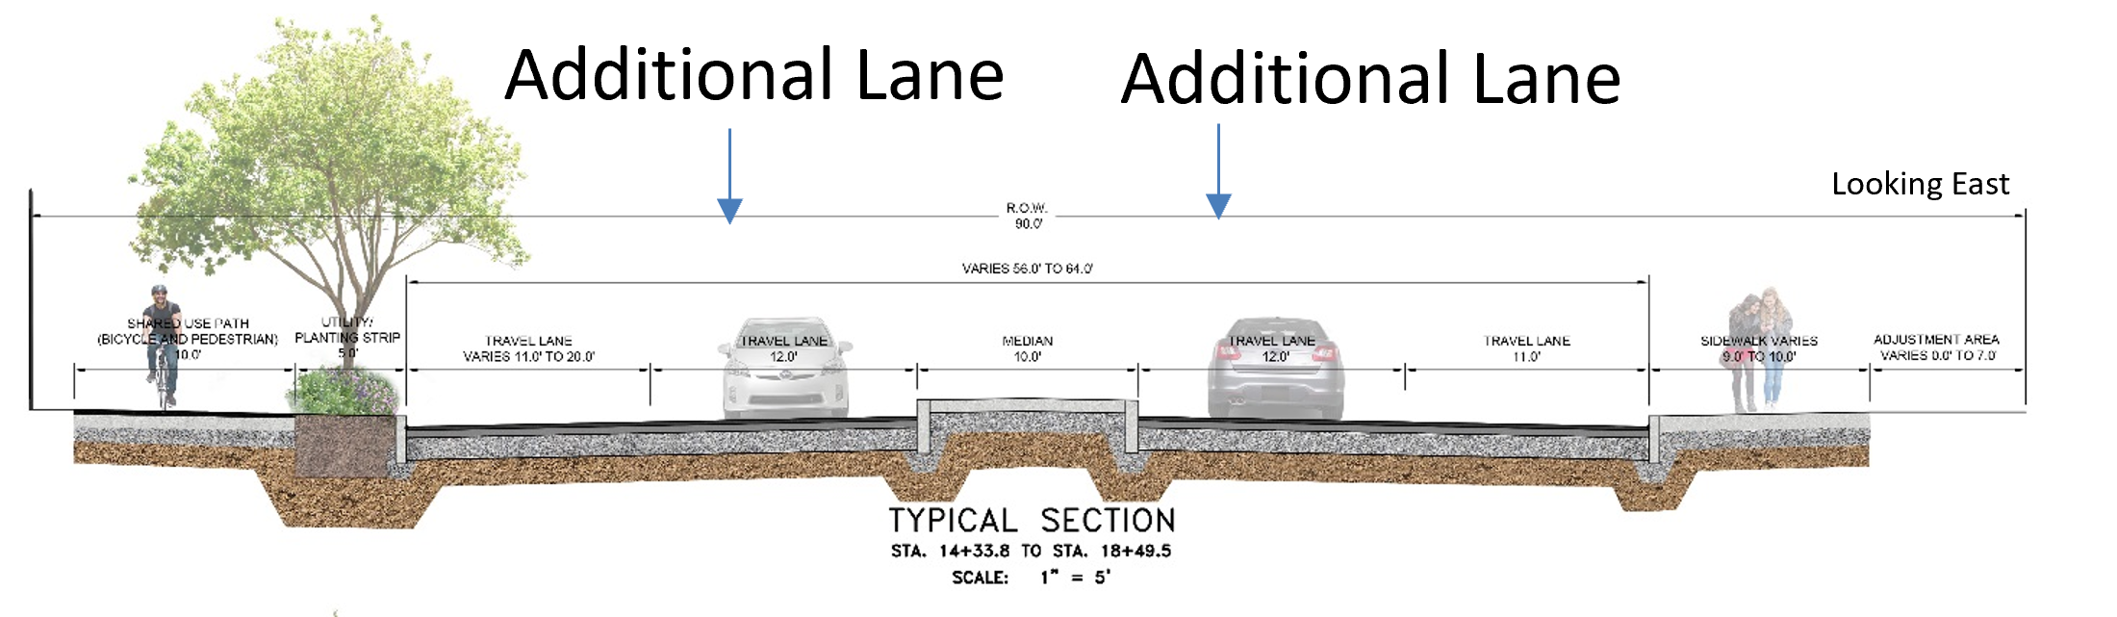
N
Arthur Kill Road and Getz Avenue
(Section 2)
Existing 2 Lanes-
1 Lane West Bound
1 Lane East Bound
Proposed 4 Lanes-
2 Lanes West Bound
2 Lanes East Bound
Median
Shared Use Path for Bicycles and Pedestrians
Utility Planting Strip
Intersection of Arthur Kill Road and Getz Ave.

Slide 14
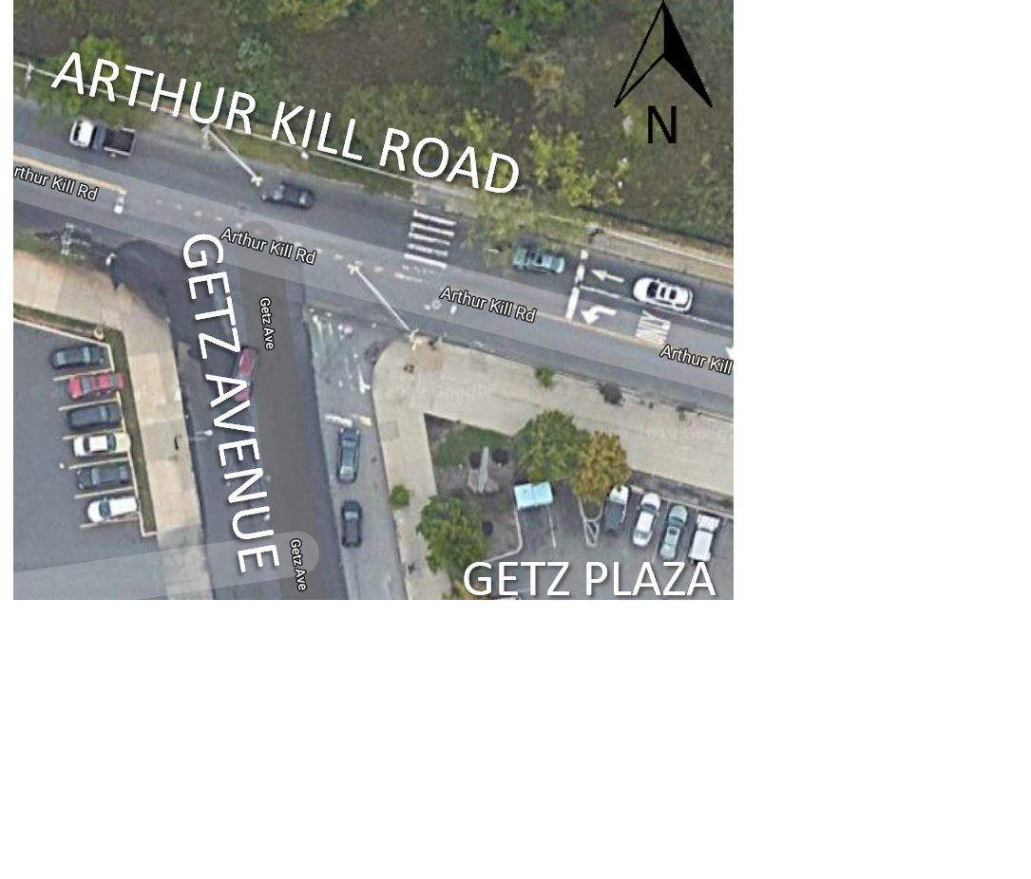
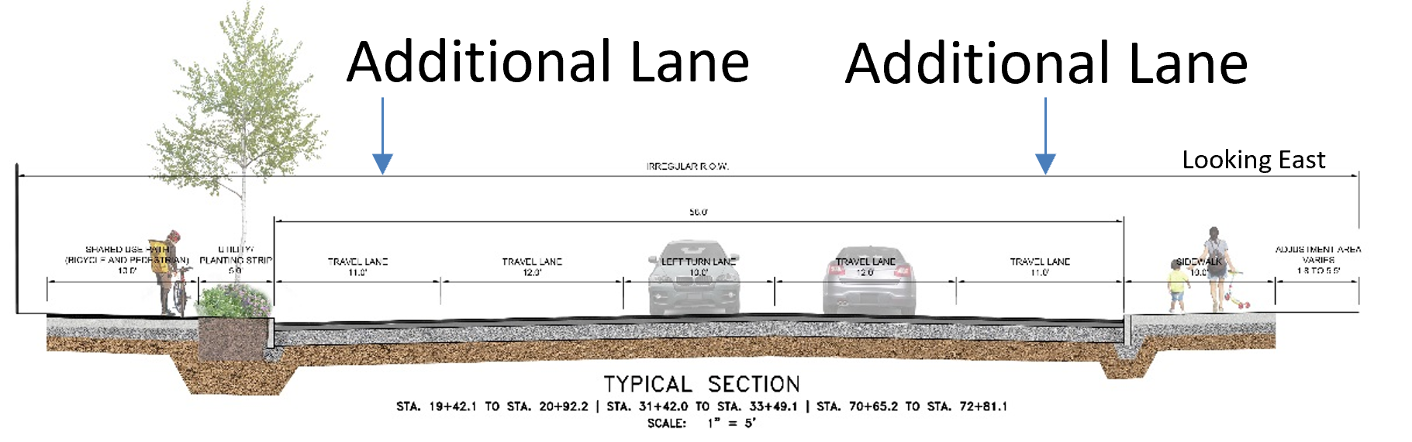
Intersections of Arthur Kill Road and Getz Avenue/
Armstrong Avenue/Tanglewood Drive
(Section 3)
N
Existing 2 Lanes-
2 Lanes West Bound
1 Lane East Bound
Intersections of Arthur Kill Road and
- Getz Avenue
- Armstrong Avenue
- Tanglewood Drive
Proposed 5 Lanes-
3 Lanes West Bound
2 Lanes East Bound
No Median
Shared Use Path for Bicycles and Pedestrians (Ends at Tanglewood Drive Intersection)
Utility Planting Strip

Slide 15
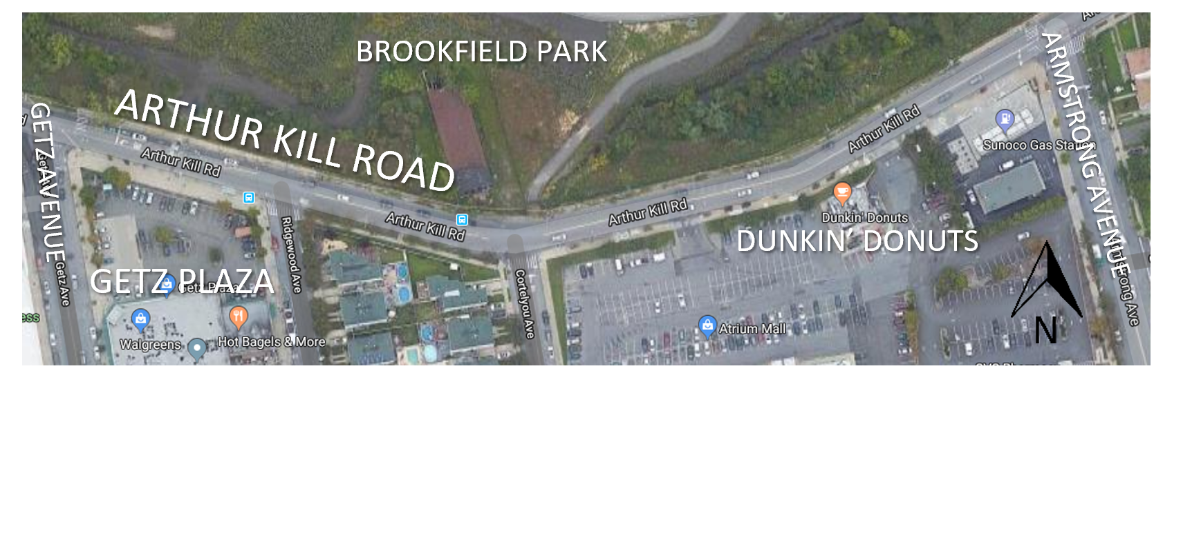
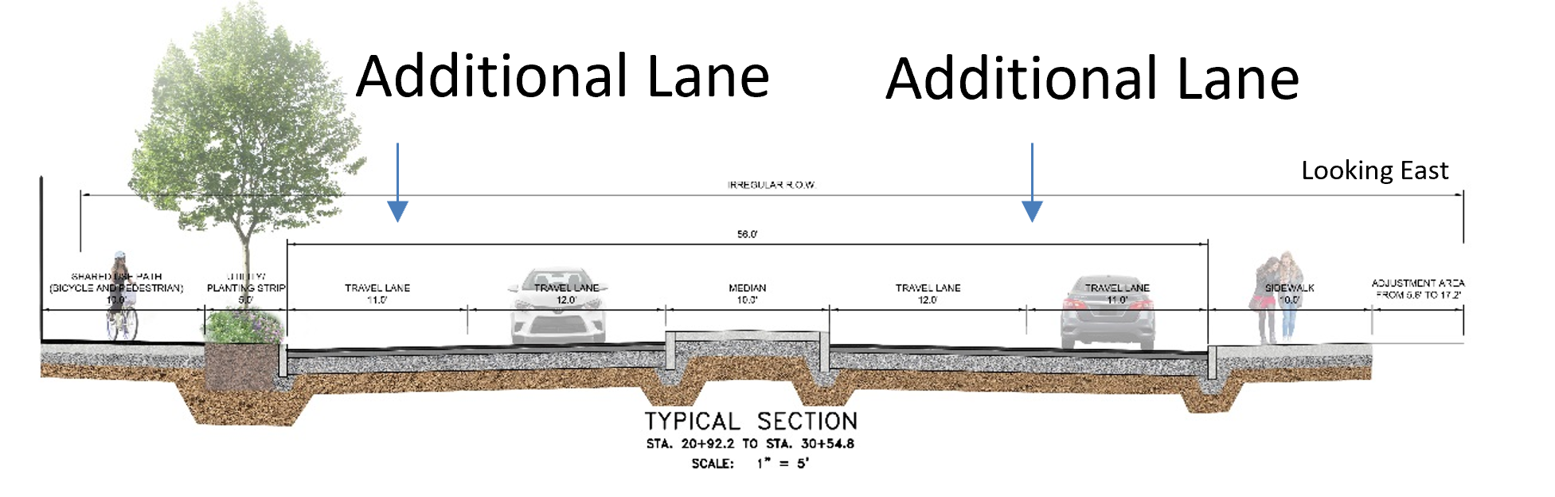
N
Arthur Kill Road between Getz Avenue and
Armstrong Avenue
(Section 4)
Existing 2 Lanes-
1 Lane West Bound
1 Lane East Bound
Proposed 4 Lanes-
2 Lanes West Bound
2 Lanes East Bound
Median
Shared Use Path for Bicycles and Pedestrians
Utility Planting Strip
Traffic Signal Added at Cortelyou Intersection
Arthur Kill Road between Getz Avenue and Armstrong Avenue

Slide 16
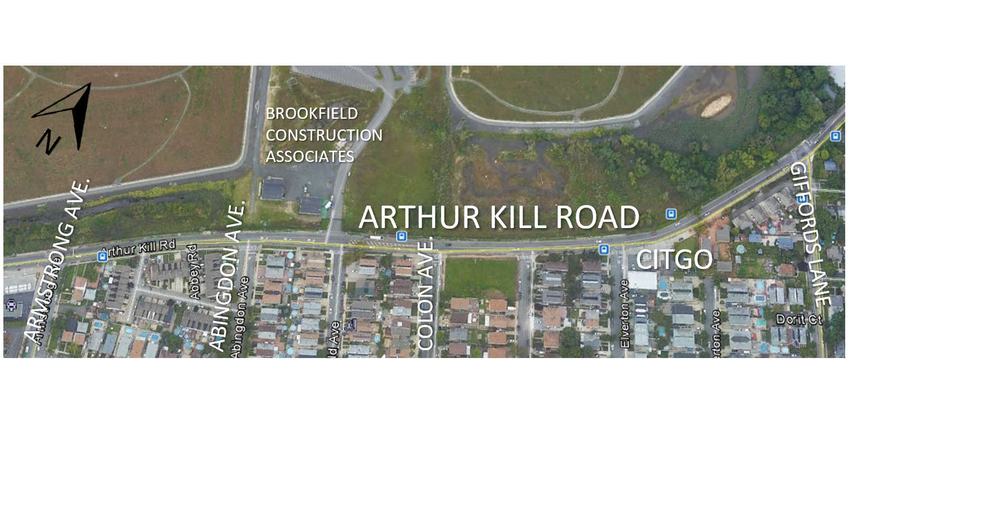
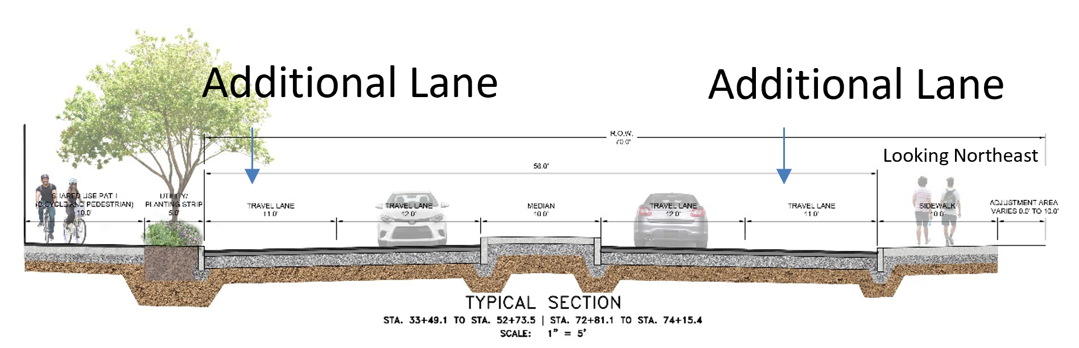
N
Arthur Kill Road between Armstrong Avenue and
Giffords Lane
(Section 5)
Arthur Kill Road between Armstrong Avenue and Giffords Lane
Existing 2 Lanes-
1 Lane West Bound
1 Lane East Bound
Proposed 4 Lanes-
2 Lanes West Bound
2 Lanes East Bound
Median
Shared Use Path for Bicycles and Pedestrians
Utility Planting Strip

Slide 17
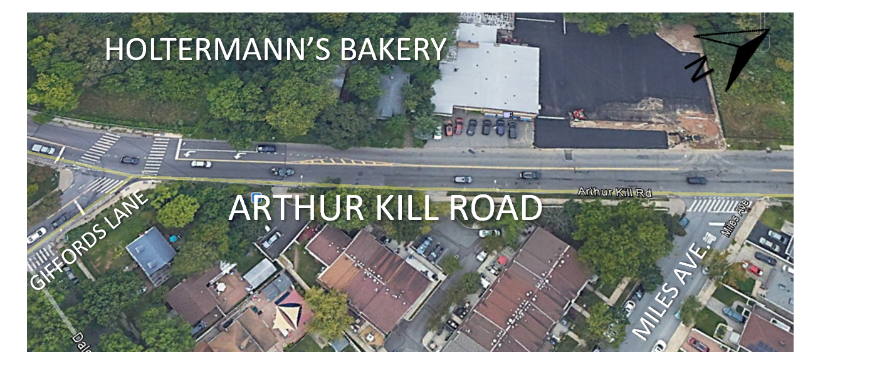
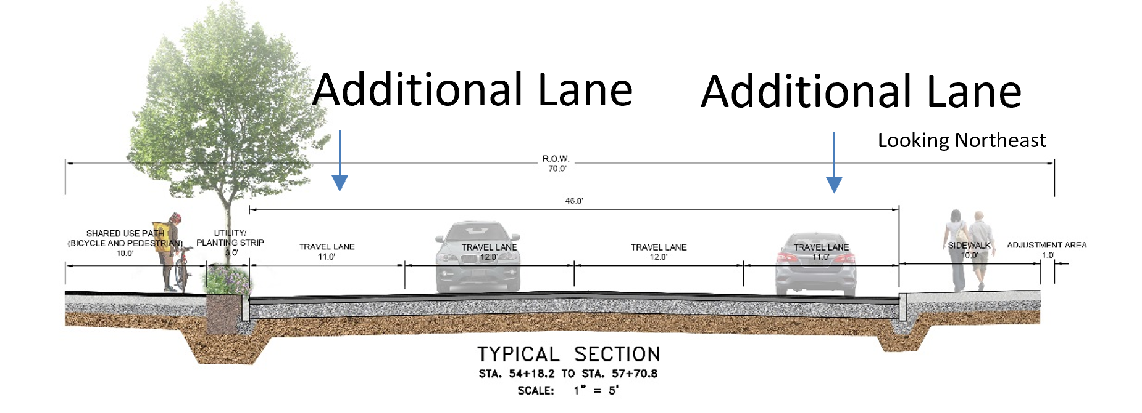
N
Arthur Kill Road between Giffords Lane and
Miles Avenue
(Section 6)
Existing 2 Lanes-
1 Lane West Bound
1 Lane East Bound
Proposed 4 Lanes-
2 Lanes West Bound
2 Lanes East Bound
No Median
Shared Use Path for Bicycles and Pedestrians
Utility Planting Strip
Arthur Kill Road between Giffords Lane and Miles Avenue

Slide 18
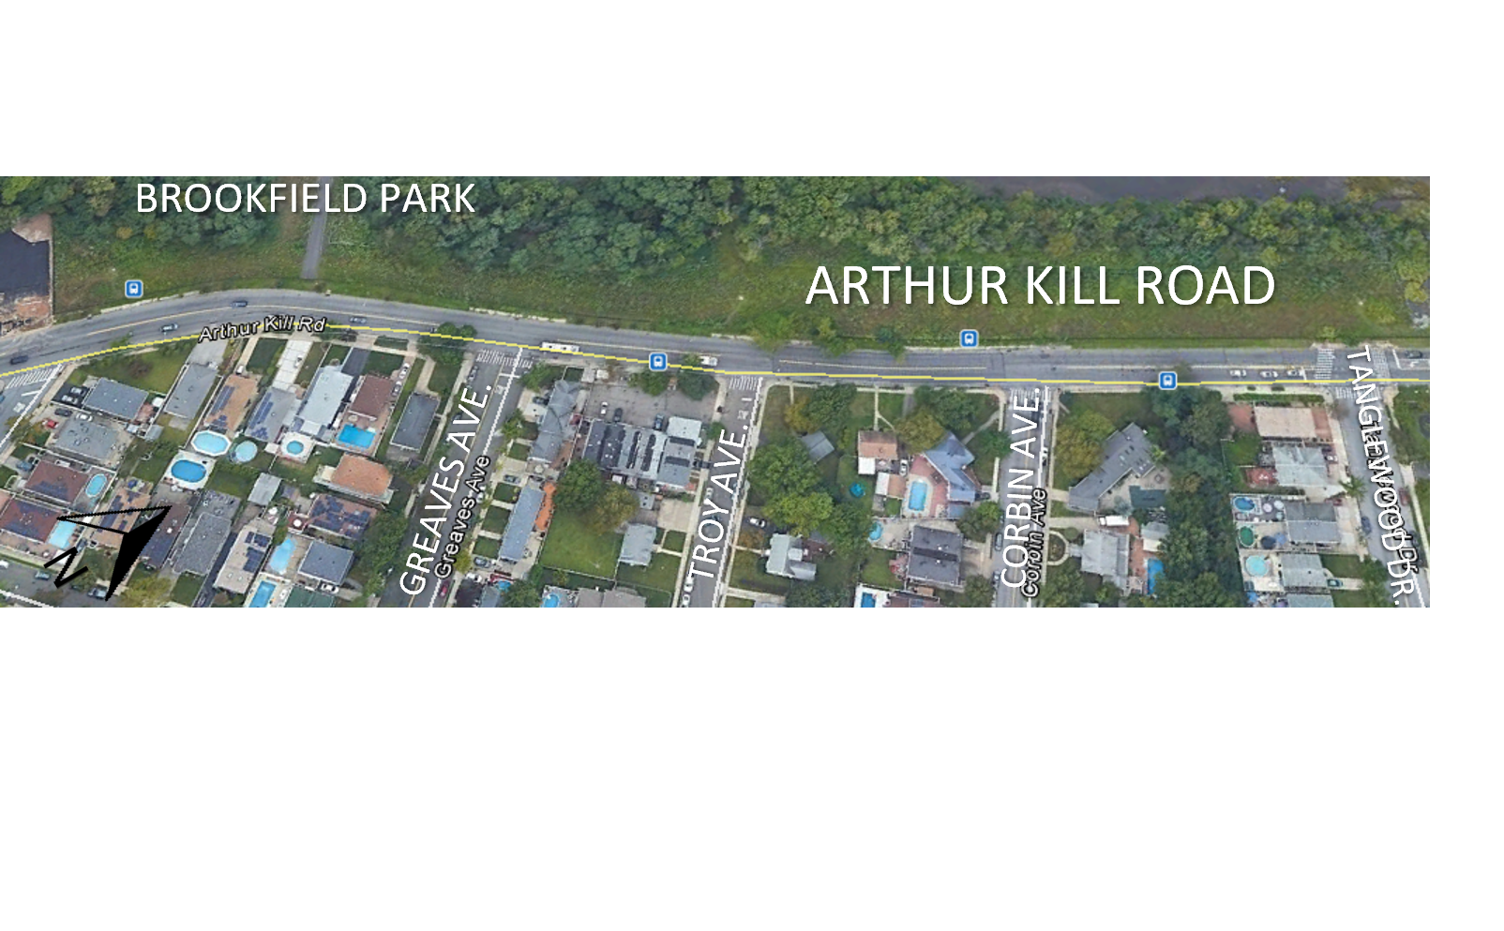
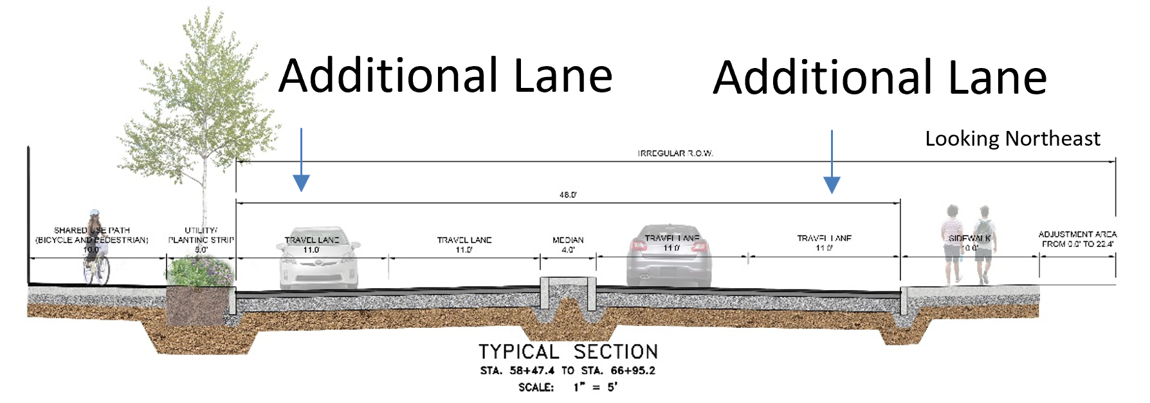
N
Arthur Kill Road between Miles Avenue and
Tanglewood Drive
(Section 7)
Existing 2 Lanes-
1 Lane West Bound
1 Lane East Bound
Proposed 4 Lanes-
2 Lanes West Bound
2 Lanes East Bound
Median
Shared Use Path for Bicycles and Pedestrians
Utility Planting Strip
Arthur Kill Road between Miles Avenue and Tanglewood Drive

Slide 19
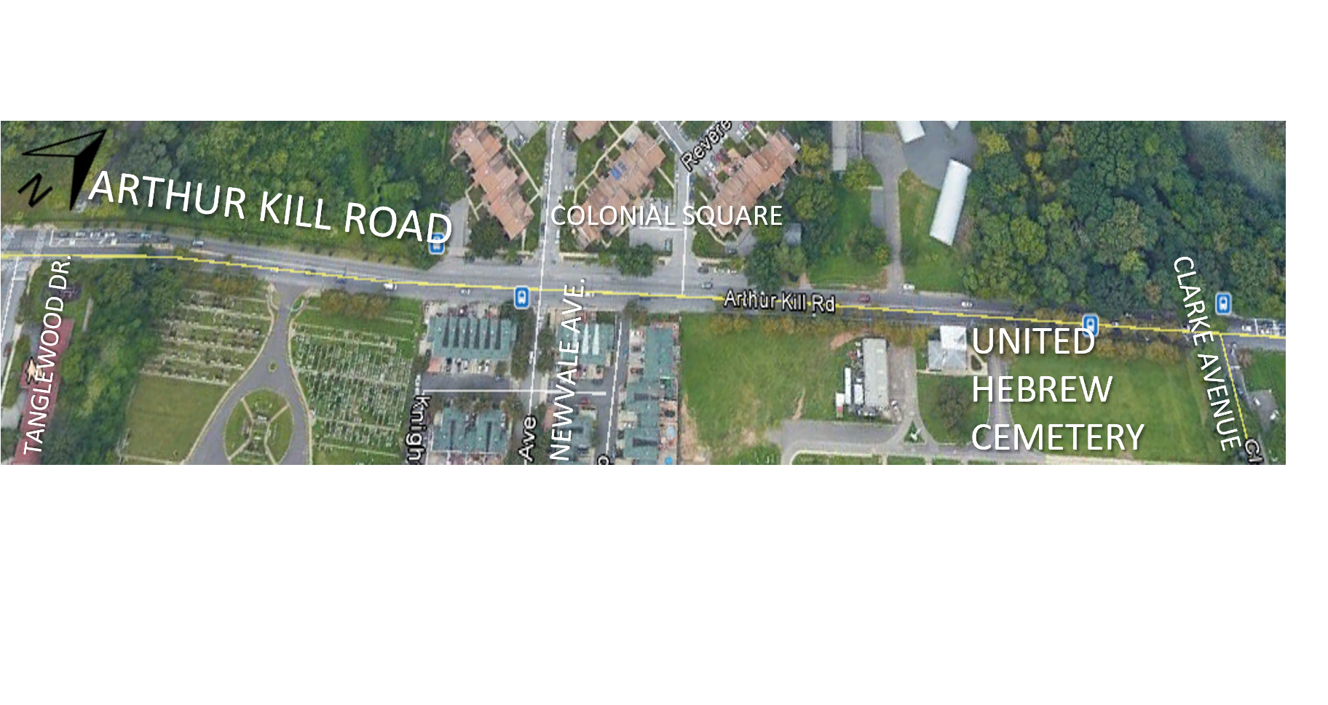
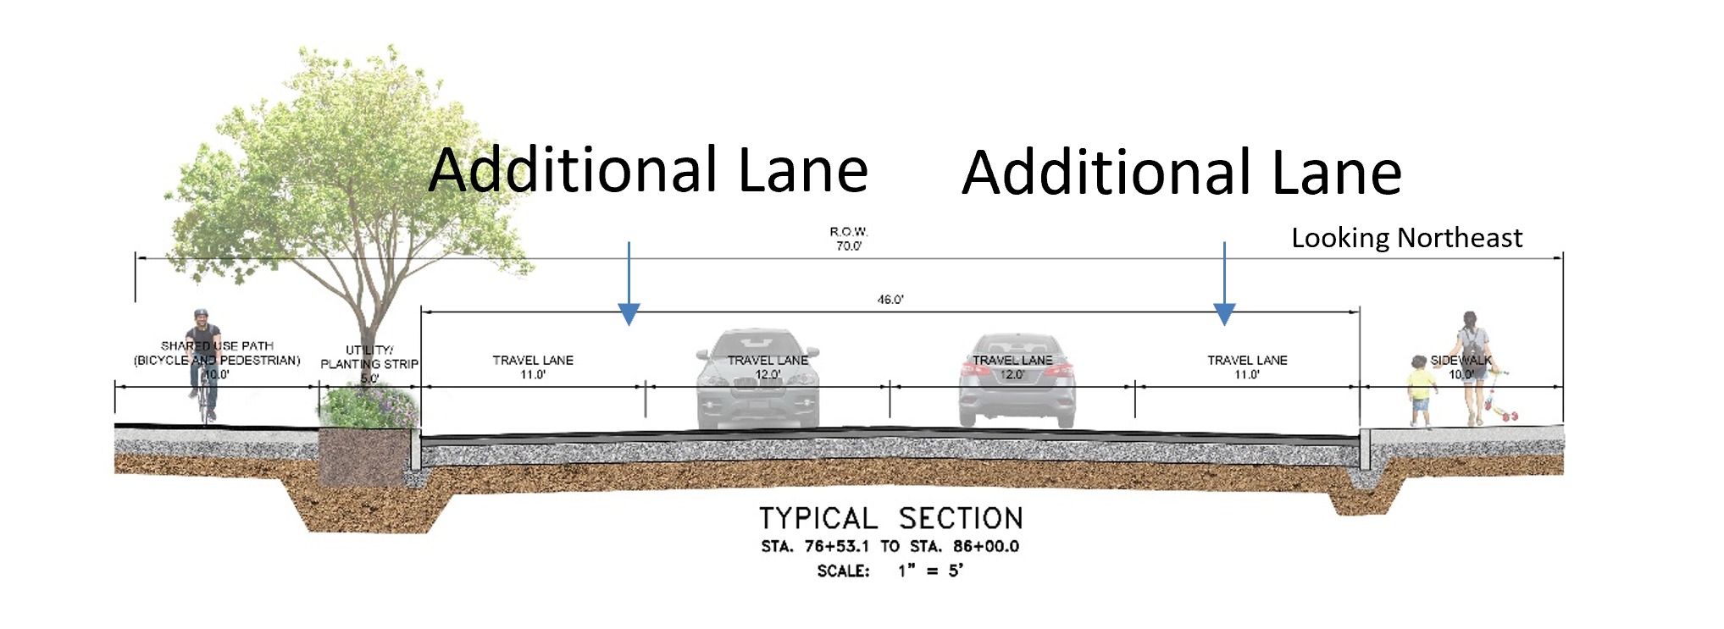
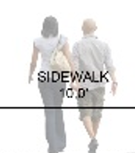
N
Arthur Kill Road between Tanglewood Drive and
Clarke Avenue
(Section 8)
Existing 2 Lanes-
1 Lane West Bound
1 Lane East Bound
Proposed 4 Lanes-
2 Lanes West Bound
2 Lanes East Bound
No Median except for small stretch
Utility Planting Strip
Arthur Kill Road between Tanglewood Drive and Clarke Avenue

Slide 20
utility upgrades
20
20

Slide 21
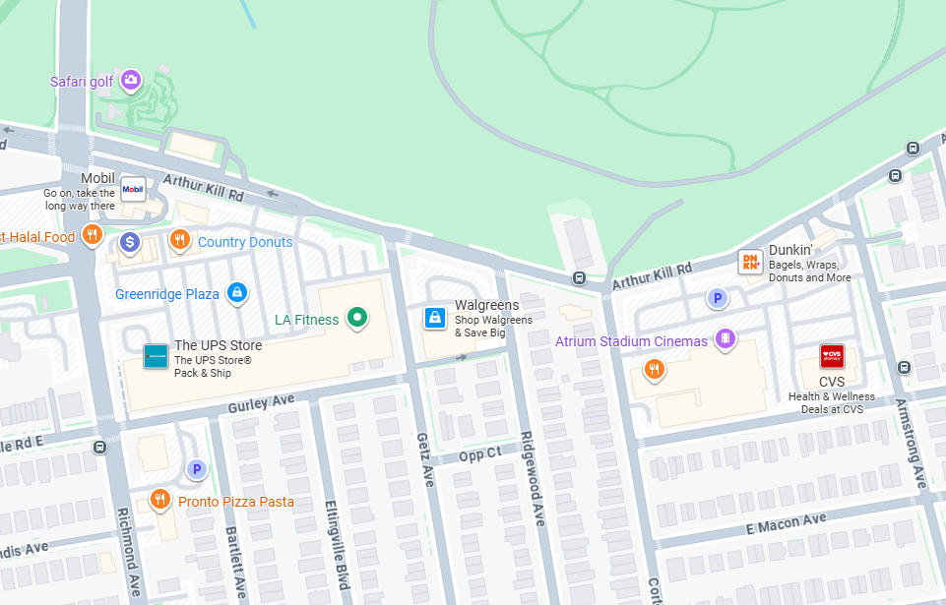
Arthur Kill Road from Richmond Avenue to Armstrong Avenue
N
Legend
Water Main
Storm Sewer
Sanitary Sewer

Slide 22
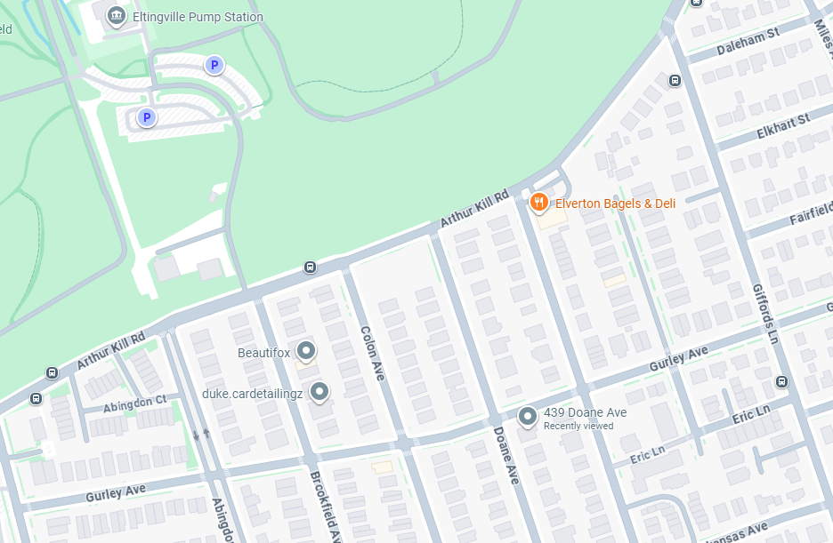
Arthur Kill Road between Armstrong Avenue and Giffords Lane
N
Legend
Water Main
Storm Sewer
Sanitary Sewer

Slide 23
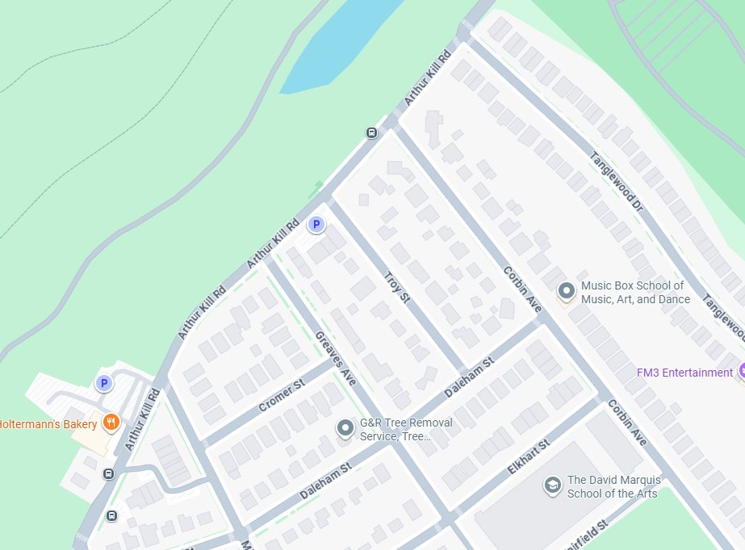
Arthur Kill Road between Giffords Lane and Tanglewood Drive
N
Legend
Water Main
Storm Sewer
Sanitary Sewer

Slide 24
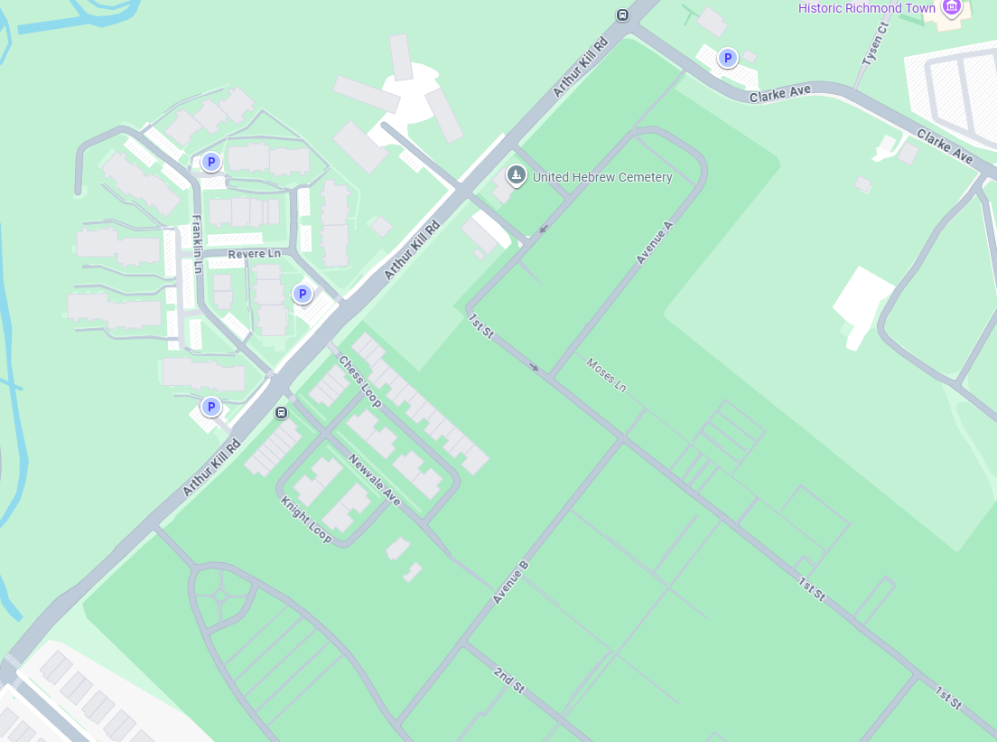
Arthur Kill Road between Tanglewood Drive and Clarke Avenue
N
Legend
Water Main
Storm Sewer
Sanitary Sewer

Slide 25
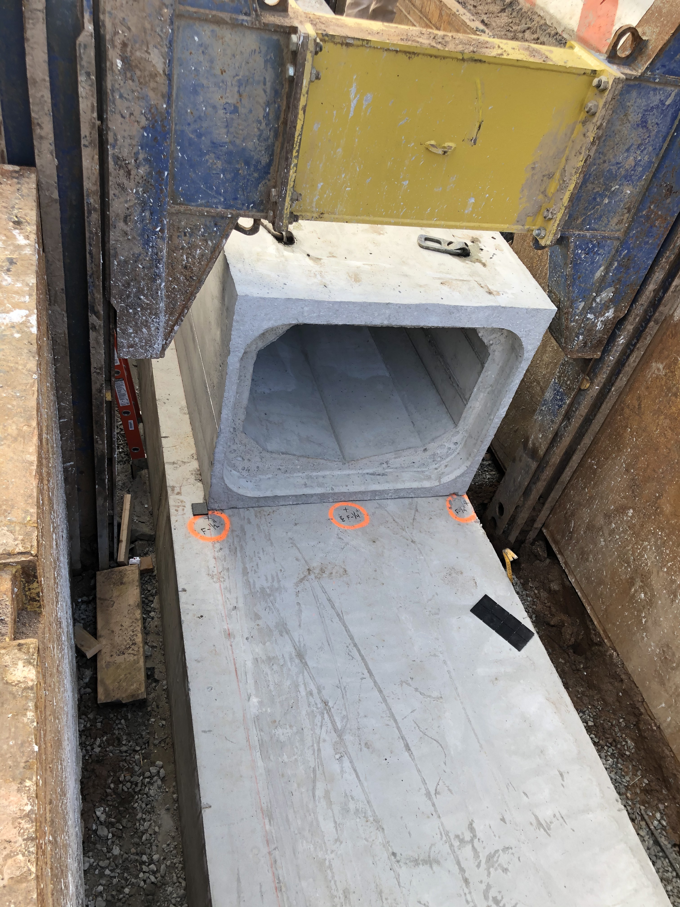
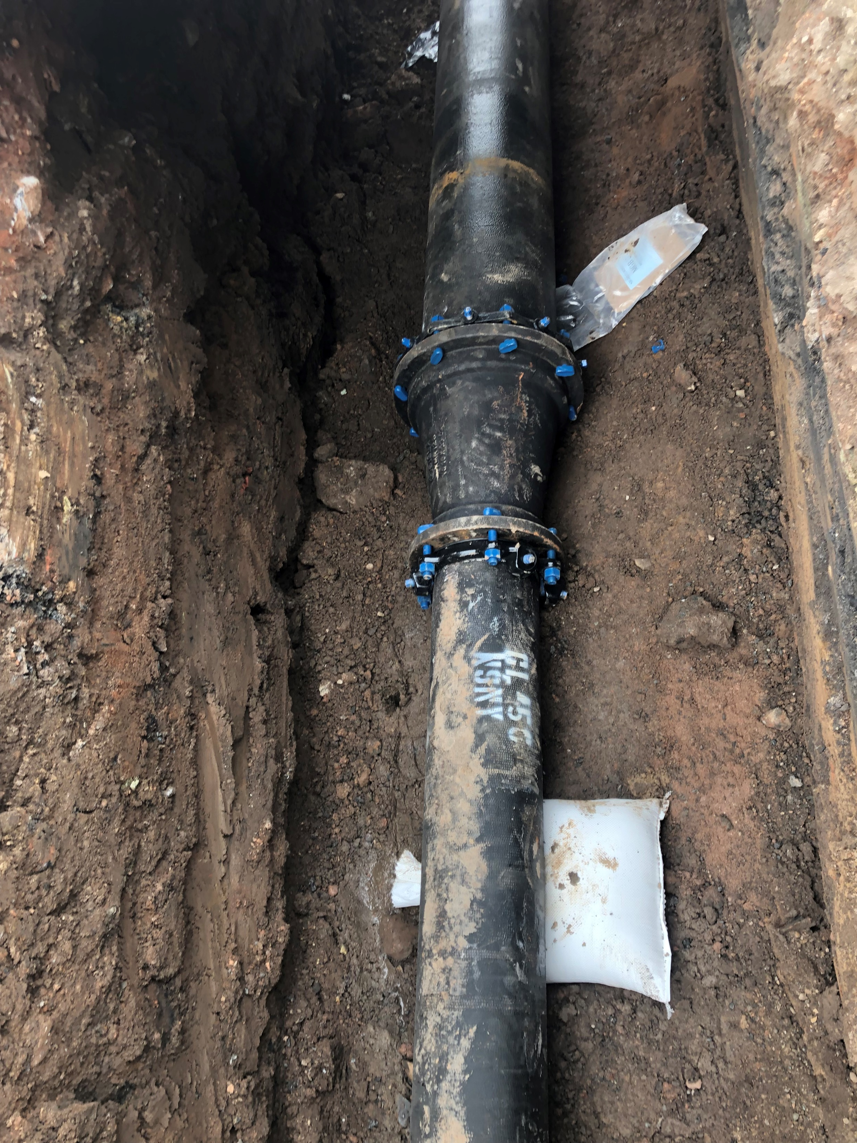
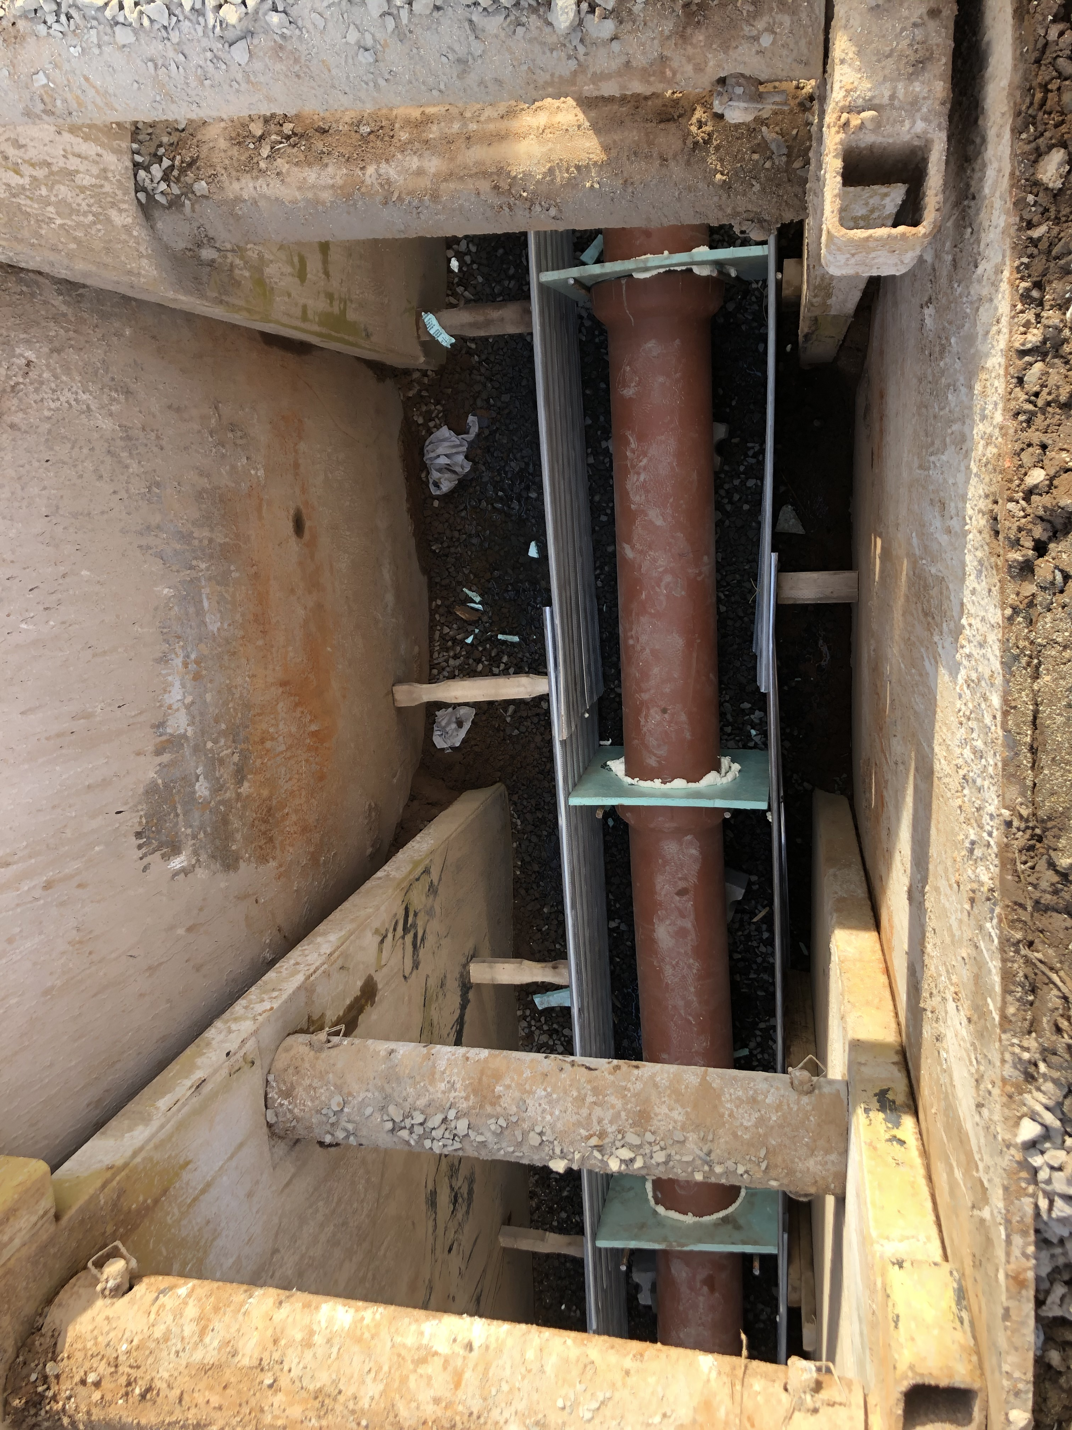
Utility Upgrades (cont.)
Water Main
Storm Sewer
Sanitary Sewer

Slide 26
Community impacts During construction
26
26

Slide 27

Community Impacts During Construction
Vehicles/Pedestrian Impacts
Temporary traffic patterns/detours on Arthur Kill Road and side streets.
Two lanes of traffic (one each way) will be maintained on Arthur Kill Road with flaggers to assist with traffic during work hours.
Traffic Enforcement Agents will be utilized at Richmond Avenue intersection.
Pedestrian access to all buildings will be maintained.
Minimum five (5’) feet access to sidewalks and crosswalks will be maintained.
Bus stops will be temporarily relocated within affected work zone.
27

Slide 28
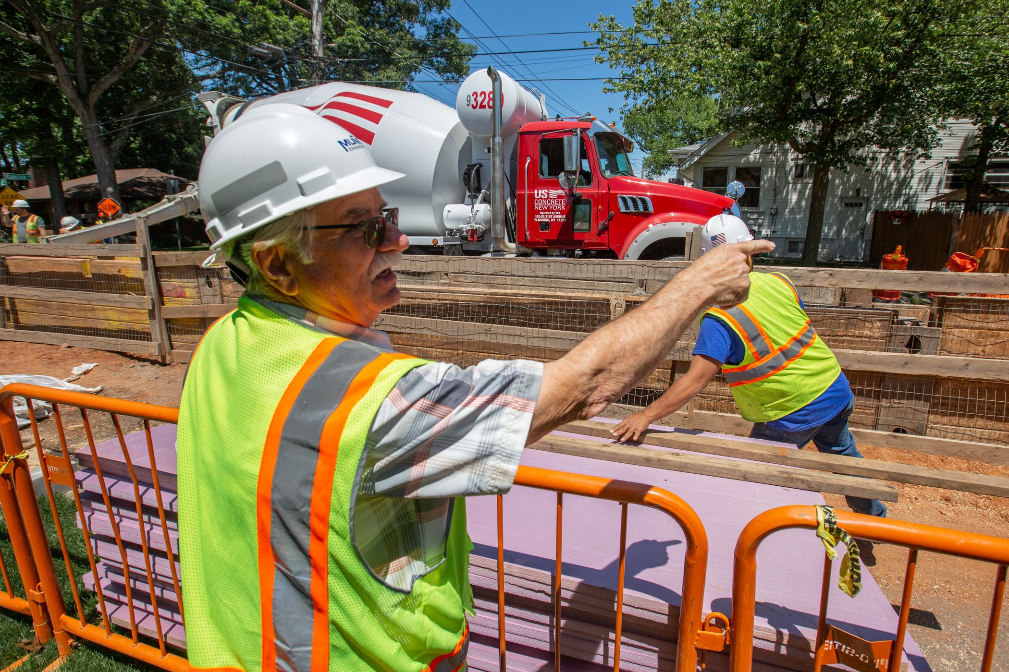
Community Impacts During Construction (cont.)
Constituent Impact
Contractor will work within DEP Noise Code and Dust Control Regulations
Storage area and work zone will be kept clean and safe.
Professional rodent control inspector will monitor and maintain rodent control stations.
Garbage pick-up may be affected and will be coordinated appropriately.
Driveway access may be restricted during work hours.
Individuals with special needs should contact the CCL.
DDC staff will work to minimize inconvenience.
28

Slide 29
Community Outreach and notification
29
29

Slide 30
Community Outreach
DCC’s Office of Community Outreach + Notification (OCON)
Works with Community Boards, Business Improvement Districts, local businesses, and other community stakeholders impacted by construction.
Community Construction Liaison (CCL)
DDC has assigned Carrie Agar of M & J Engineering as the dedicated on-site Community Construction Liaison. The CCL can be reached at:
Email: HWR1140ACCL@gmail.com
Telephone: 347.962.8586
Field Office: 4434 Amboy Road, Suite 2E
Staten Island, NY 10312
30

Slide 31
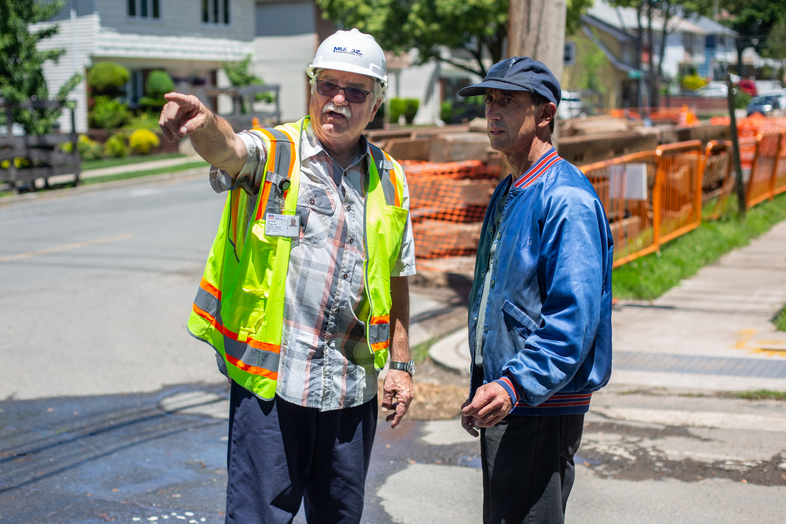
Community Outreach (cont.)
CCL Responsibilities
First point of contact so please direct all concerns & issues to the CCL.
Maintain on-site presence and communication.
Identify and proactively address resident/business concerns.
Distribute 72-hour and 24-hour advisories for upcoming work.
Distribute advisories and weekly construction activities bulletins.
31

Slide 32

Community Outreach (cont.)
Community Notifications
72-hour Advanced Advisory will be provided, followed by a 24-hour confirmation notice.
24-hour confirmation notices will be issued prior to water shutoffs and driveway interruptions.
Specific instructions will be provided prior to water shutoff.
If your water service is not restored within three (3) hours of the indicated times on the shutoff notice, please contact the Community Construction Liaison (CCL).
Notifications will be posted door to door and distributed via email (if provided).
Anyone can join the email distribution list.
32

Slide 33
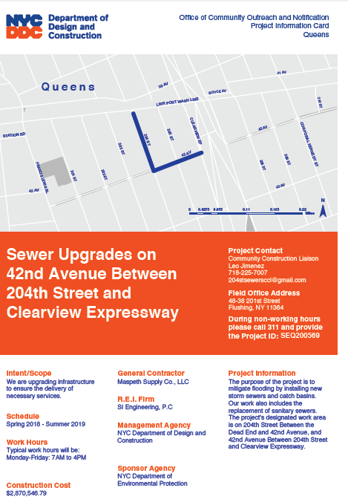
Sample Communications
Project information card
advisory
Project update
Look ahead Weekly bulletin
33

Slide 34
Thank you!
Resident Engineer: Yogesh Ravanan, P.E.
CCL: Carrie Agar
Cell: 347.962.8586
Email: HWR1140ACCL@gmail.com

