Slide 1
Replacement of 72” Trunk Main Park Slope and Flatbush Avenue
Project ID: BED798
Honorable Shahana hanif
NYC Council Member, CD 39
March 15, 2022
Eric Adams
Mayor
Thomas Foley, P.E.
Commissioner

Slide 2
Project Data
Project ID: BED798
Construction Start Early 2018
Contractor: Triumph Construction Corp.
Original Contract Value: $37M
Anticipated Completion: Fall 2023
Field Office: 187 4th Avenue
Replacement of 72” Trunk Main in Flatbush Avenue

Slide 3
Scope of Work
Installation of:
New 8”, 12”, and 20” distribution water mains
New 72” trunk water main to provide water to South Brooklyn
Combined sewers with catch basins and manholes
Reconstruction of the 8th Avenue Triangle (collaboration with North Flatbush BID)
Replacement of 72” Trunk Main in Flatbush Avenue

Slide 4
Completed Distribution Water
Main Work Locations
Baltic Street between 4th Avenue and 5th Avenue
Butler Street between 4th Avenue and Gregory Place
Douglass Street between 4th Avenue and 5th Avenue
Flatbush Avenue between Carlton Avenue and 8th Avenue
Intersection of Flatbush Avenue and Sterling Place
St. John’s Place between 6th Avenue and Plaza Street West
8th Avenue between Berkeley Place and Flatbush Avenue
Intersections along 6th Avenue
Replacement of 72” Trunk Main in Flatbush Avenue

Slide 5
Completed Distribution Water Mains

Slide 6
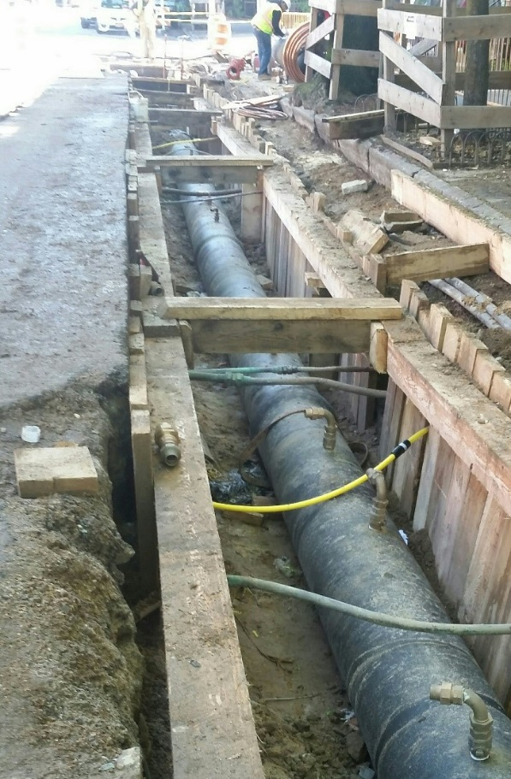
New 20” distribution water main in 6th Avenue between Berkeley Place and Union Street
Replacement of 72” Trunk Main in Flatbush Avenue

Slide 7
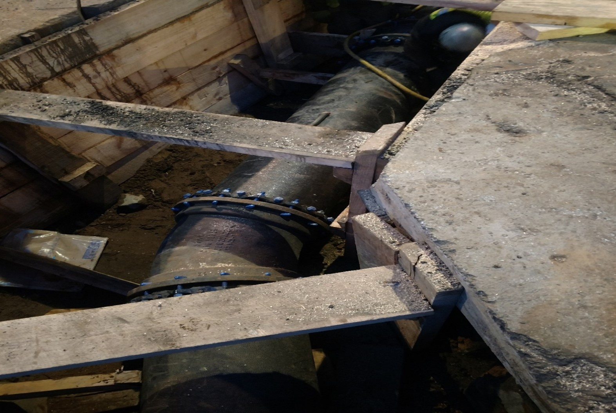
New 20” distribution water main in the intersection of Flatbush Avenue and Sterling Place
Replacement of 72” Trunk Main in Flatbush Avenue

Slide 8
Completed Combined Sewers Work Locations
Park Place between 5th Avenue and 6th Avenue
St. John’s Place between 5th Avenue and Plaza Street West
8th Avenue between St. John’s Place and Lincoln Place
6th Avenue between Sterling Place and Union Street
Replacement of 72” Trunk Main in Flatbush Avenue

Slide 9
Completed Combined Sewers

Slide 10
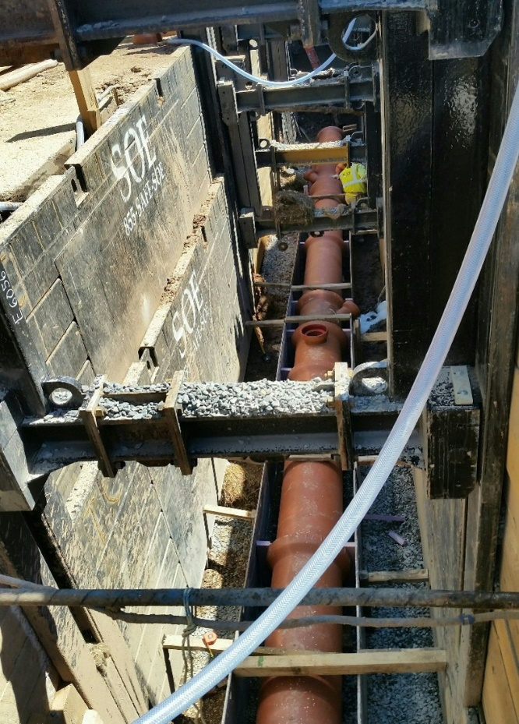
New 15” sewer in St. John’s Place between 5th Avenue and 6th Avenue
Replacement of 72” Trunk Main in Flatbush Avenue

Slide 11
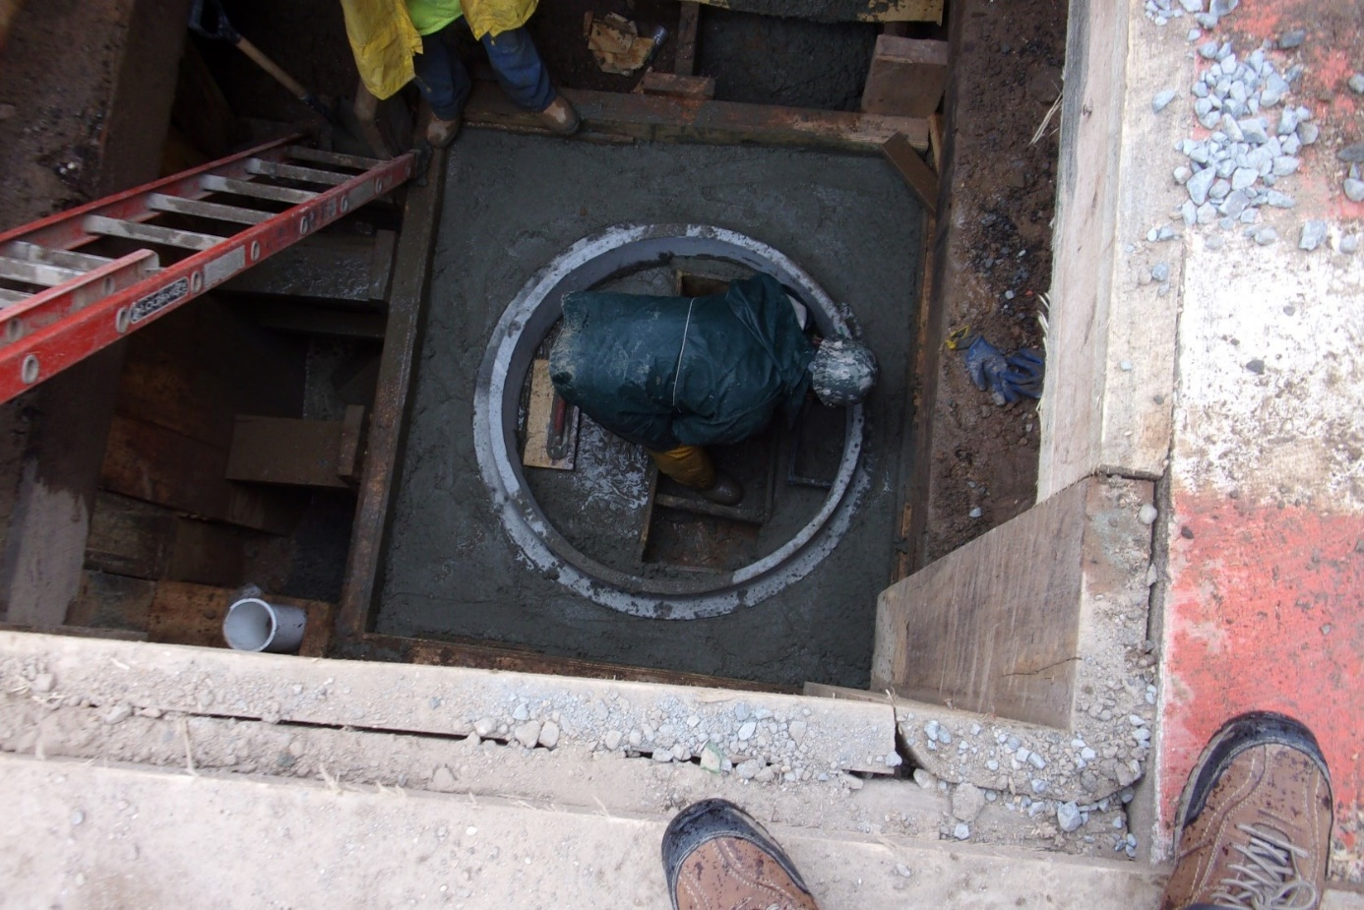
New sewer manhole in the intersection of 5th Avenue and
Douglass Street
Replacement of 72” Trunk Main in Flatbush Avenue

Slide 12
Remaining Combined Sewers Work Locations
6th Avenue between Park Place and Sterling Place
May 2022
Intersection of 6th Avenue and Sterling Place
May 2022
Replacement of 72” Trunk Main in Flatbush Avenue

Slide 13
Remaining Combined Sewers

Slide 14
Completed 72” Trunk Main Work Locations
St. John’s Place between 5th Avenue and 8th Avenue
8th Avenue between Flatbush Avenue and Lincoln Place
Flatbush Avenue between Sterling Place and 8th Avenue (In Progress)
Sterling Place between Flatbush Avenue and Vanderbilt Avenue (In Progress)
Replacement of 72” Trunk Main in Flatbush Avenue

Slide 15
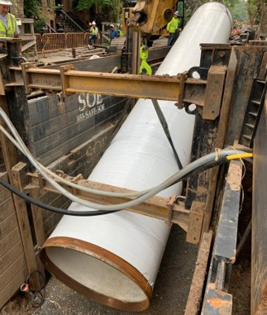
Lowering the new 72” steel trunk main into the trench on
St. John’s Place between 5th Avenue and 6th Avenue
Replacement of 72” Trunk Main in Flatbush Avenue

Slide 16
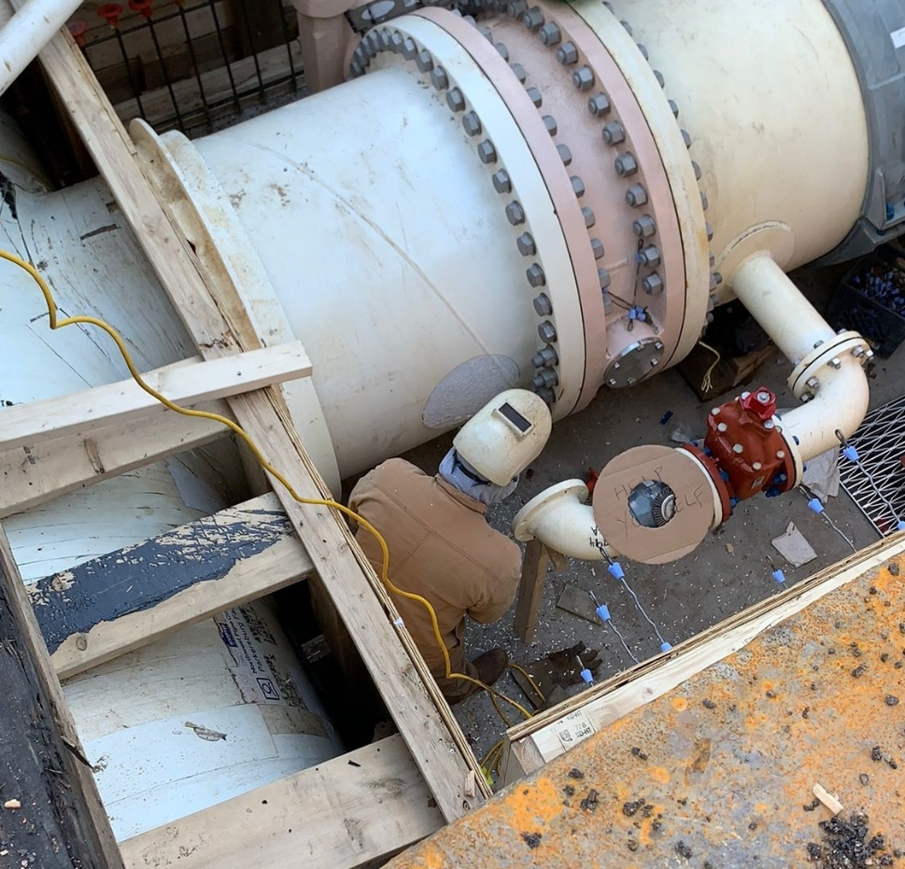
Welding of the new 72” steel trunk main in the intersection of St. John’s Place and 8th Avenue
Replacement of 72” Trunk Main in Flatbush Avenue

Slide 17
Completed 72” Steel Trunk Water Main

Slide 18
Remaining 72” Trunk Main Work Locations
6th Avenue between Park Place and Union Street
Summer 2022
Park Place between 5th and 6th Avenue
First Quarter 2023
Replacement of 72” Trunk Main in Flatbush Avenue

Slide 19
Remaining 72” Steel Trunk Water Main

Slide 20
Completed Roadway Restoration Locations
Baltic Street between 4th Avenue and 5th Avenue
Butler Street between 4th Avenue and Gregory Place
Douglass Street between 4th Avenue and 5th Avenue
St. John’s Place between 5th Avenue and 6th Avenue (Partial)
Replacement of 72” Trunk Main in Flatbush Avenue

Slide 21
Completed Roadway Restoration

Slide 22
Remaining Roadway Restoration Locations
Flatbush Avenue between 8th Avenue and Sterling Place
April 2022
St. John’s Place between 6th Avenue and Plaza Street
To Be Determined
8th Avenue between Lincoln Place and Flatbush Avenue
To Be Determined
6th Avenue between Union Street and Park Place
To Be Determined
Park Place between 5th Avenue and 6th Avenue
To Be Determined
Replacement of 72” Trunk Main in Flatbush Avenue

Slide 23
Remaining Roadway Restoration

Slide 24
Reconstruction of 8th Avenue Triangle
In the Summer of 2022, reconstruction will include installation of new:
Granite Curb
NYC Park Benches
Shrubs and Trees
Plaque
Replacement of 72” Trunk Main in Flatbush Avenue

Slide 25
8th Avenue Triangle

Slide 26
Reconstruction of 8th Avenue Triangle

Slide 27
8th Avenue Triangle Rendering

Slide 28
Q&A
Thank you!
Eric Adams
Mayor
Thomas Foley, P.E.
Commissioner

