Slide 1
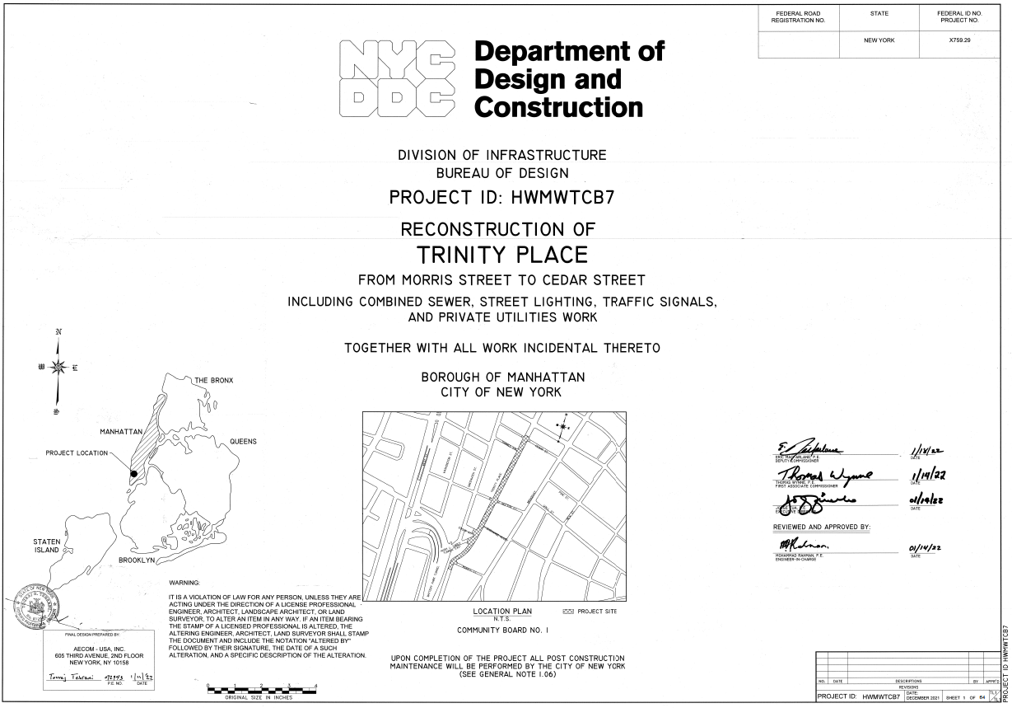

HWMWTCB7 – Reconstruction of Trinity Place
NTP: September 18, 2023
Original Contract Amount: $18,903,881.37
Current Contract Amount: $18,903,881.37
Supervision : NV5
Contractor: MFM Contracting Corp
Original Completion Date: 9/16/27
Projected Completion Date: 09/27/29
% of Work Completed: 33%
% of Time Elapsed: 60.62 %

Slide 2
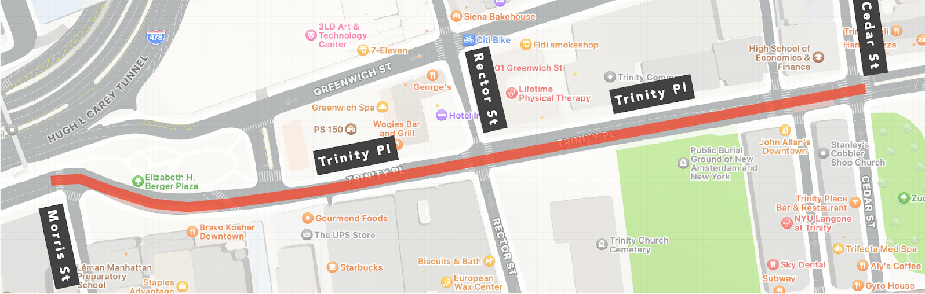

HWMWTCB7 – Reconstruction of Trinity Place
Scope of Work:
Four (4) Blocks Full Roadway Reconstruction
New Granite Curbs and Sidewalks
ADA Compliant Ramps
Catch Basins
Water main upgrade (added scope)
Steam main upgrade (added scope)
Wayfinding Sign, leaning bars and benches
Traffic signals & Streetlights
Installation of New 9” Concrete Road Base with 3” Asphalt
Replace 150 L.F. of 15” Combined sewers
ConEd and ECS Private upgrade Work under Joint Bid
Projected Completion Date: 09/27/29
% of Work Completed: 33%

Slide 3
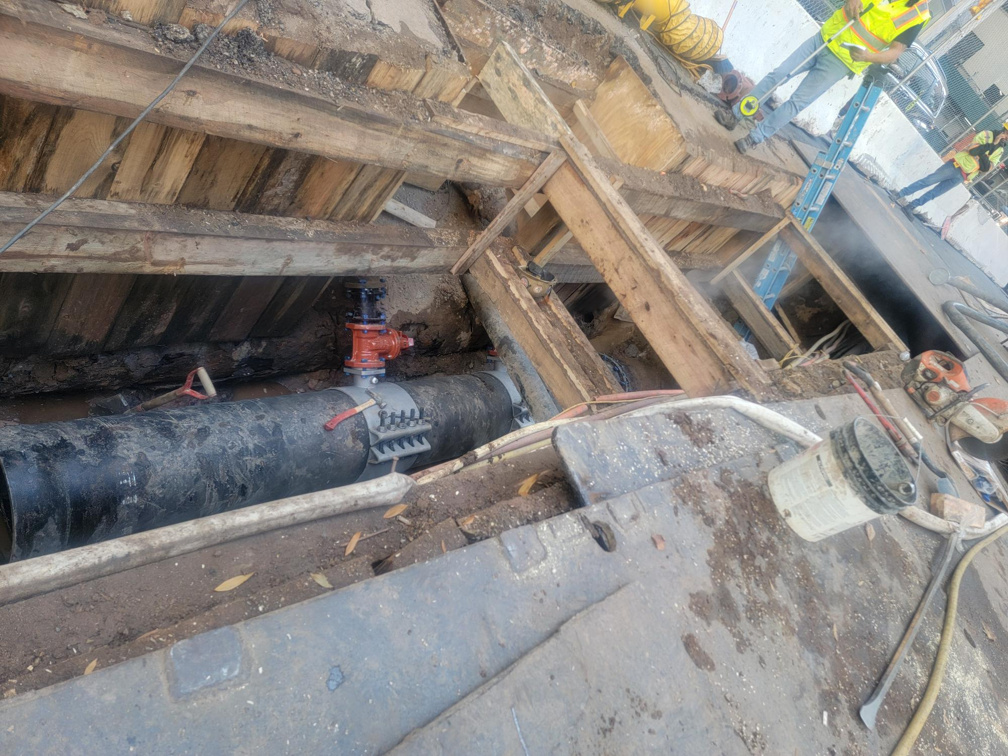
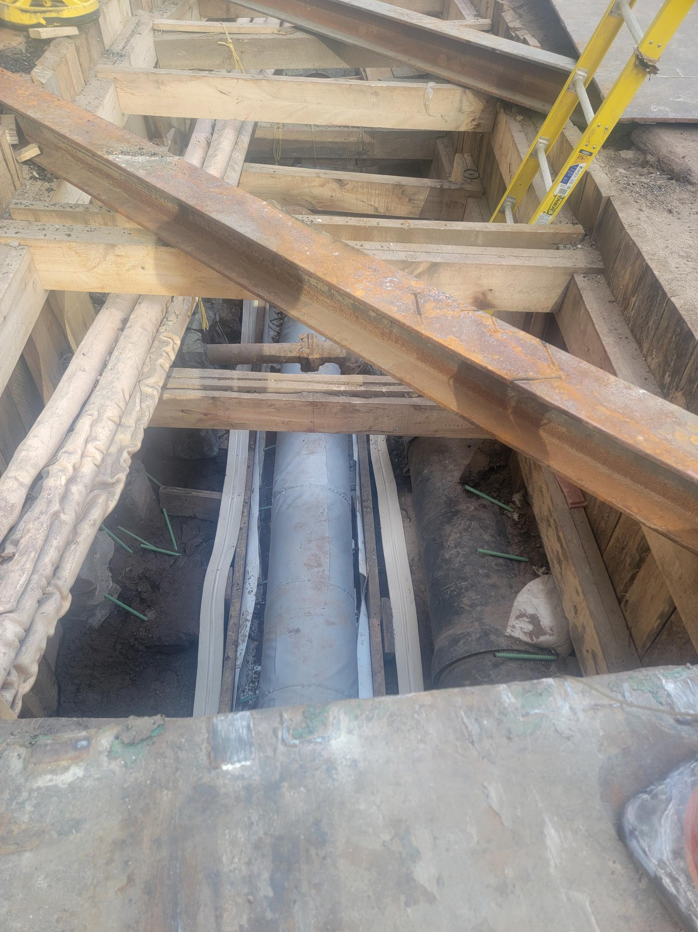
HWMWTCB7 – Reconstruction of Trinity Place (work completed)
16”Steam main repair
New 20” ductile Iron watermain
Trinity Pl between Morris St and Edgar St
Projected Completion Date: 09/27/29
% of Work Completed: 33%

Slide 4
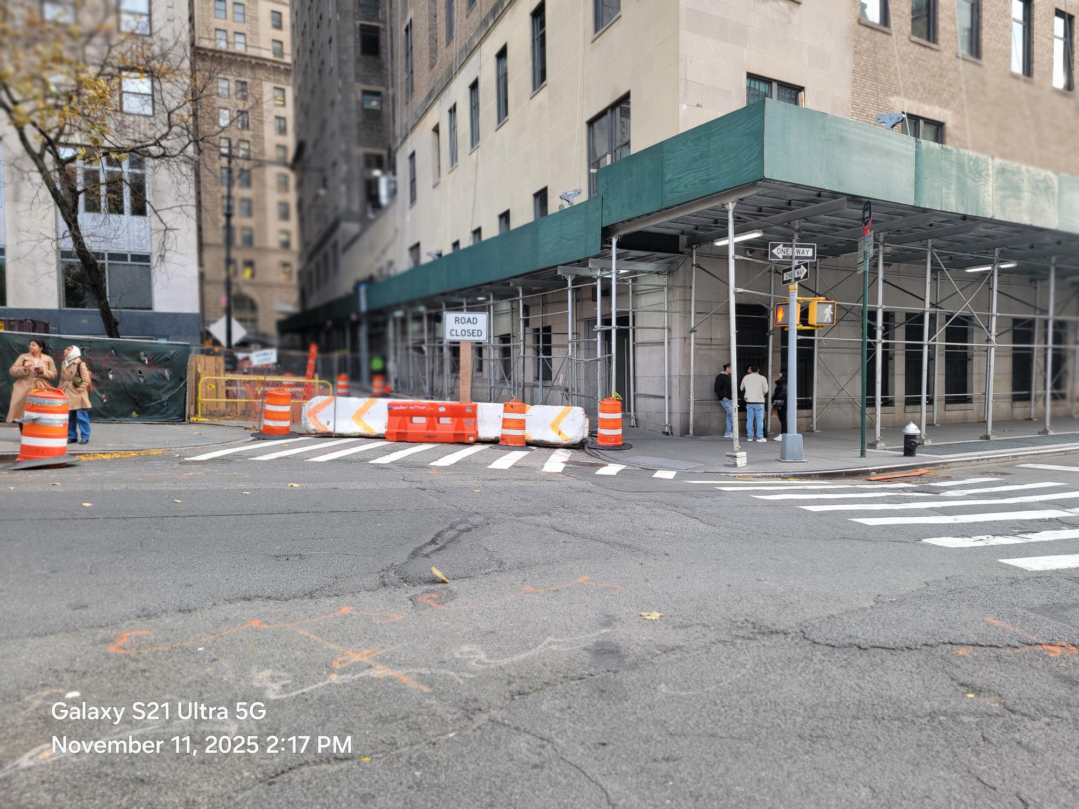
HWMWTCB7 – Reconstruction of Trinity Place
MPT Set up:
Morris Street between Broadway & Trinity Place
Full Roadway closure, 24/7
Both sidewalks accessible 24/7
Projected Completion Date: 01/17/29
% of Work Completed: 31%

Slide 5
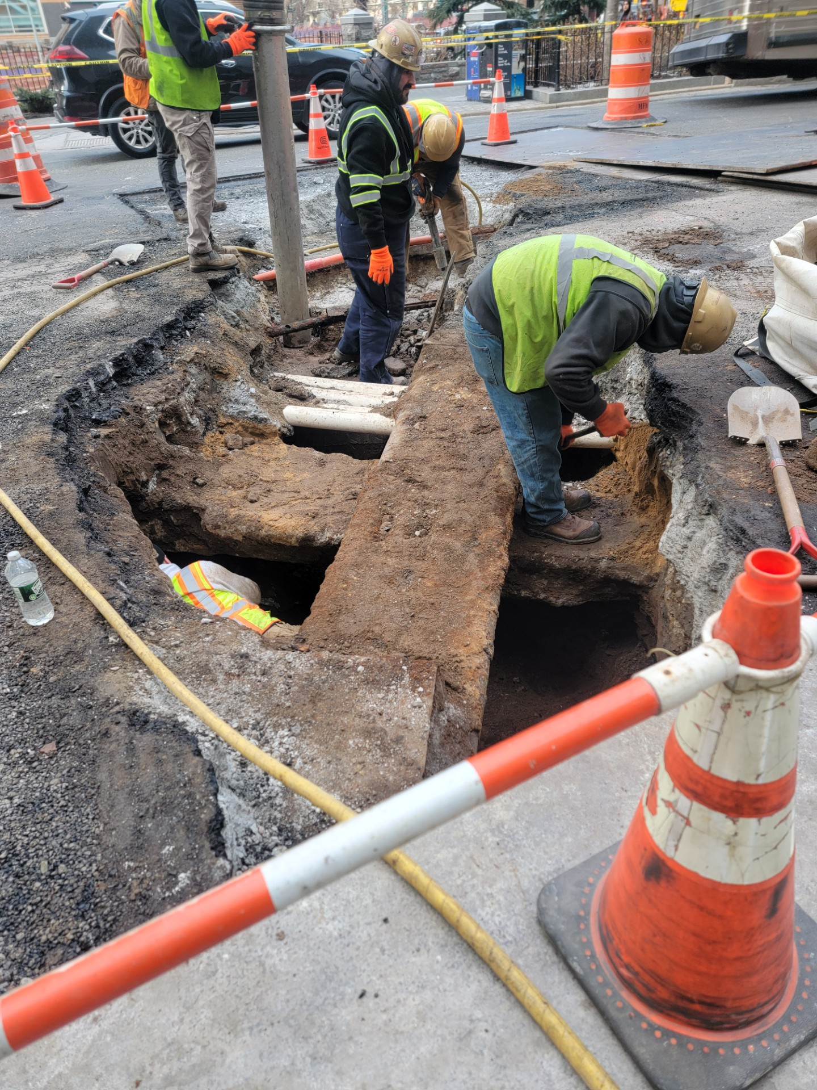
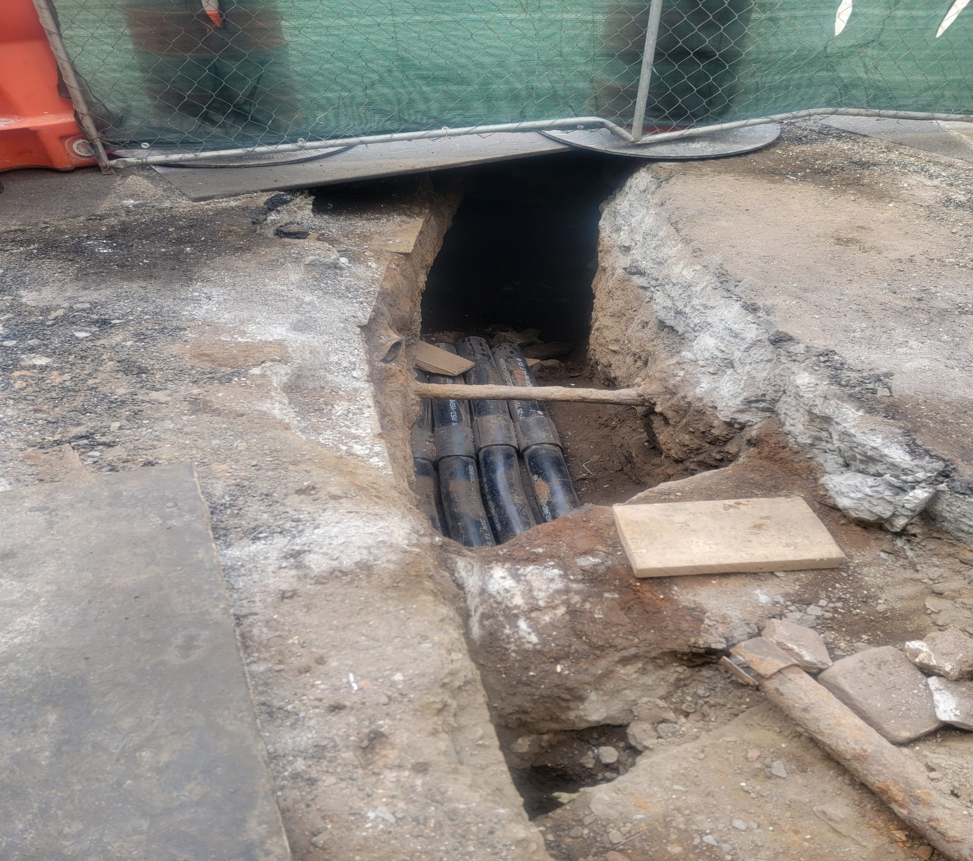
HWMWTCB7 – Reconstruction of Trinity Place
New electric steel conduits on Morris Street
Mass excavation for ConEd utilities Upgrade at Morris Street & Trinity Place
Projected Completion Date: 09/17/29
% of Work Completed: 33%

Slide 6
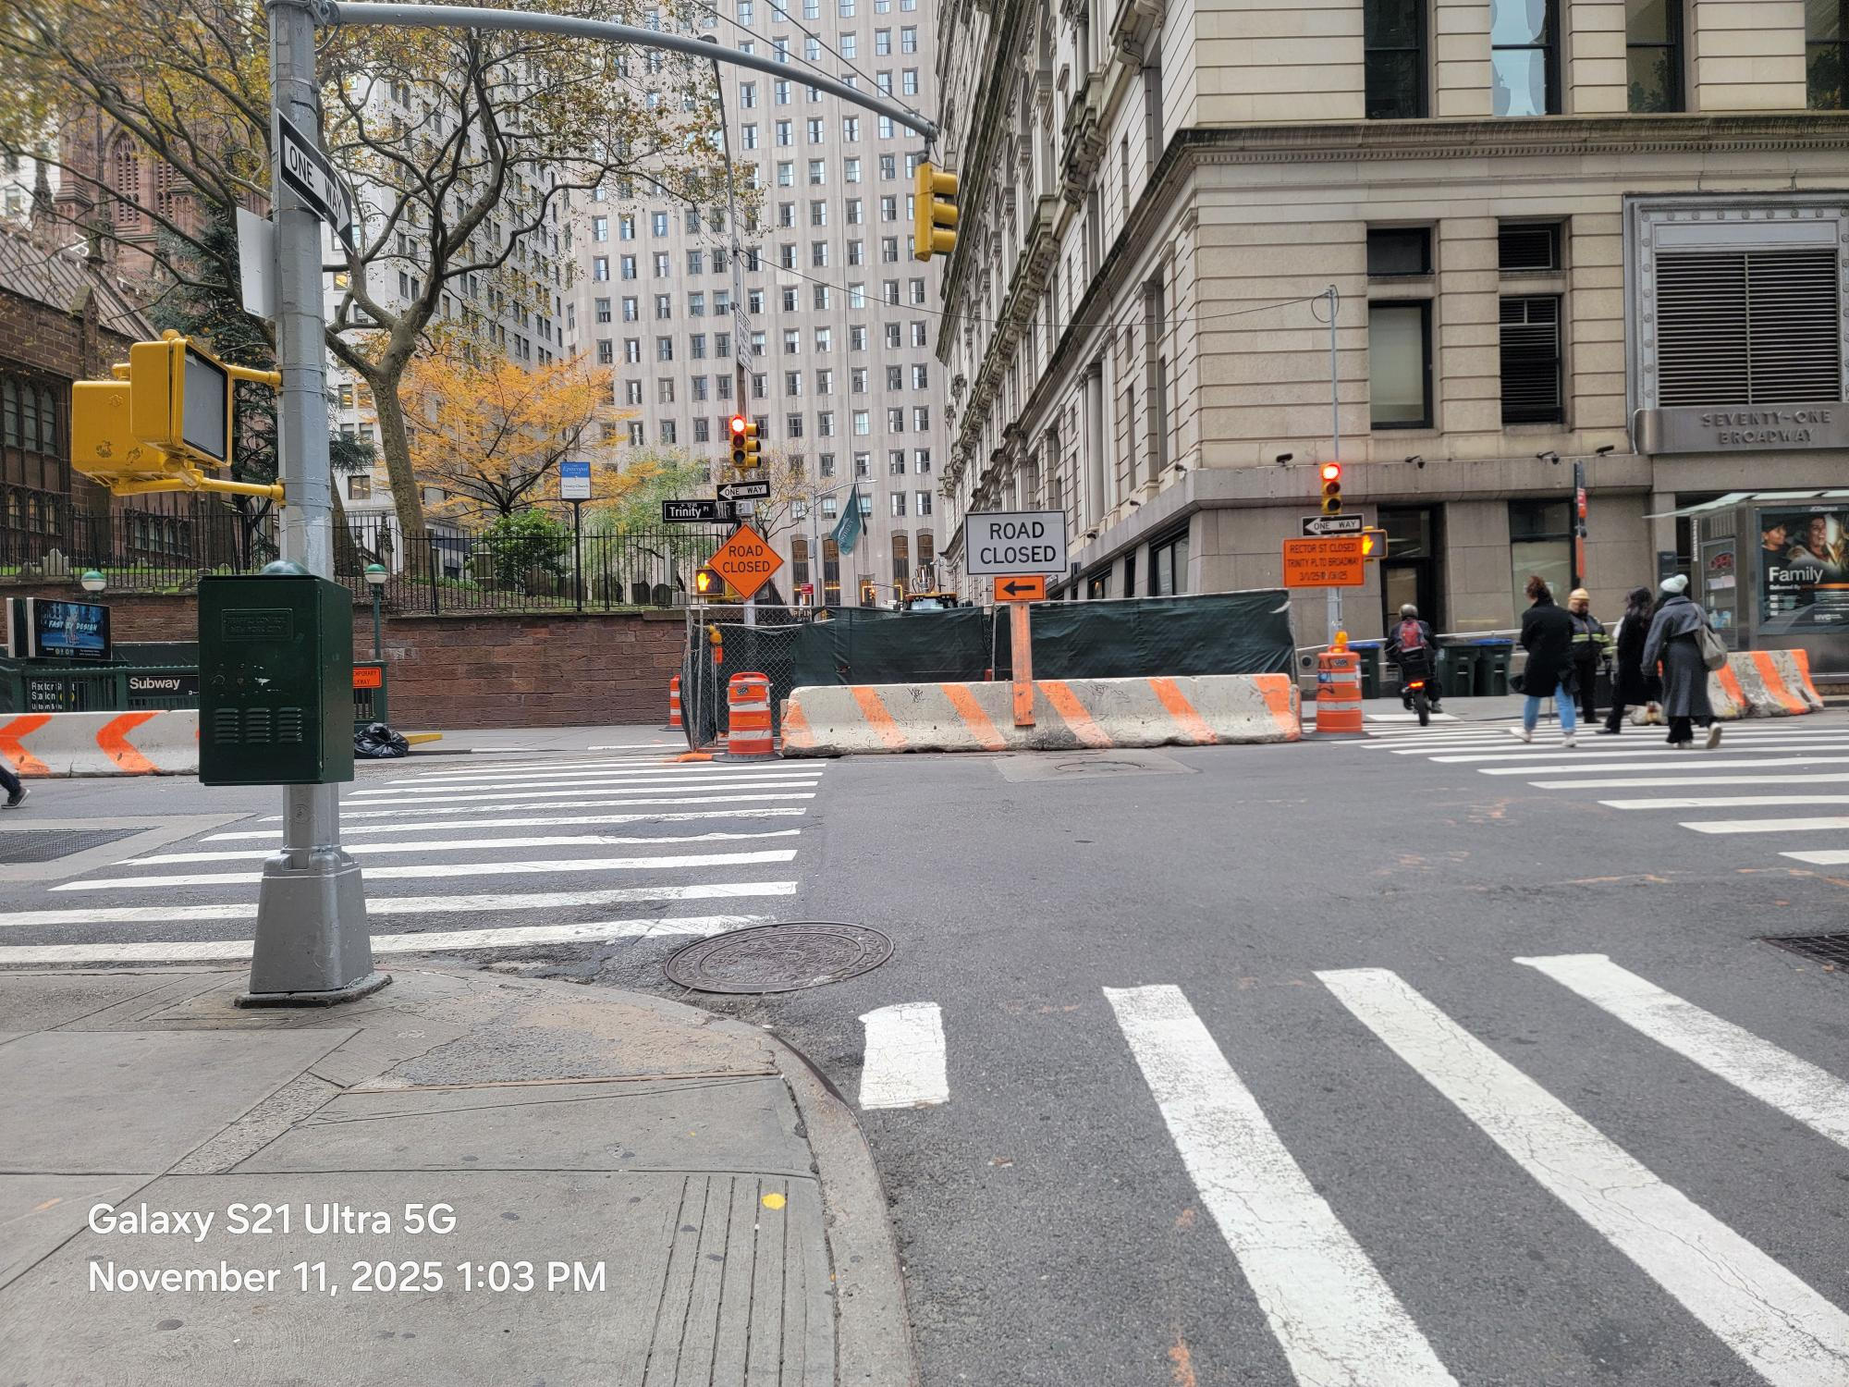
HWMWTCB7 – Reconstruction of Trinity Place
Rector St. between Trinity Pl & Broadway
Full Roadway closure, 24/7
South sidewalk open 24/7
Access for businesses maintained
at all times.
Rector Street Closure for ConEd & ECS Utilities Upgrade
Projected Completion Date: 09/27/29
% of Work Completed: 33%

Slide 7
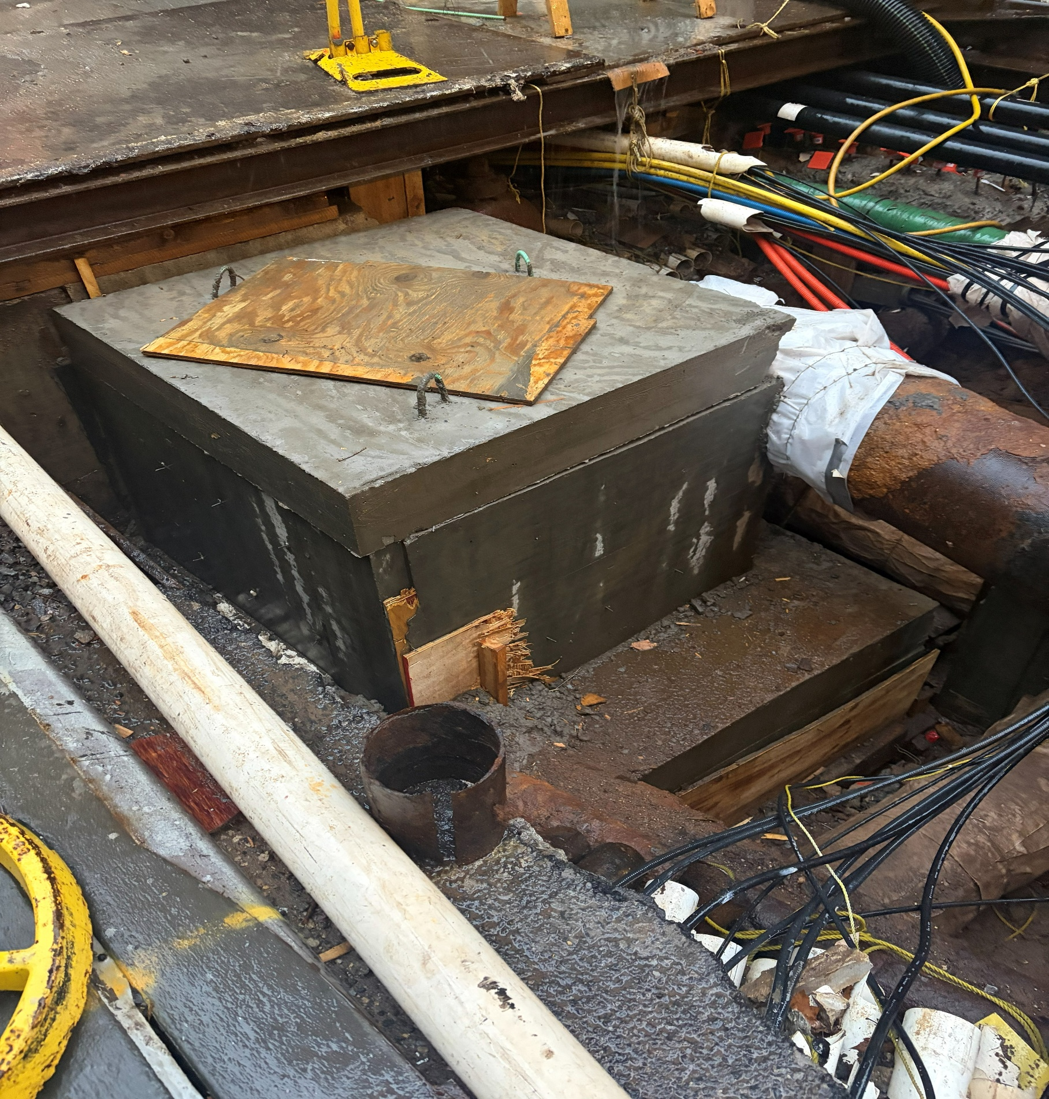
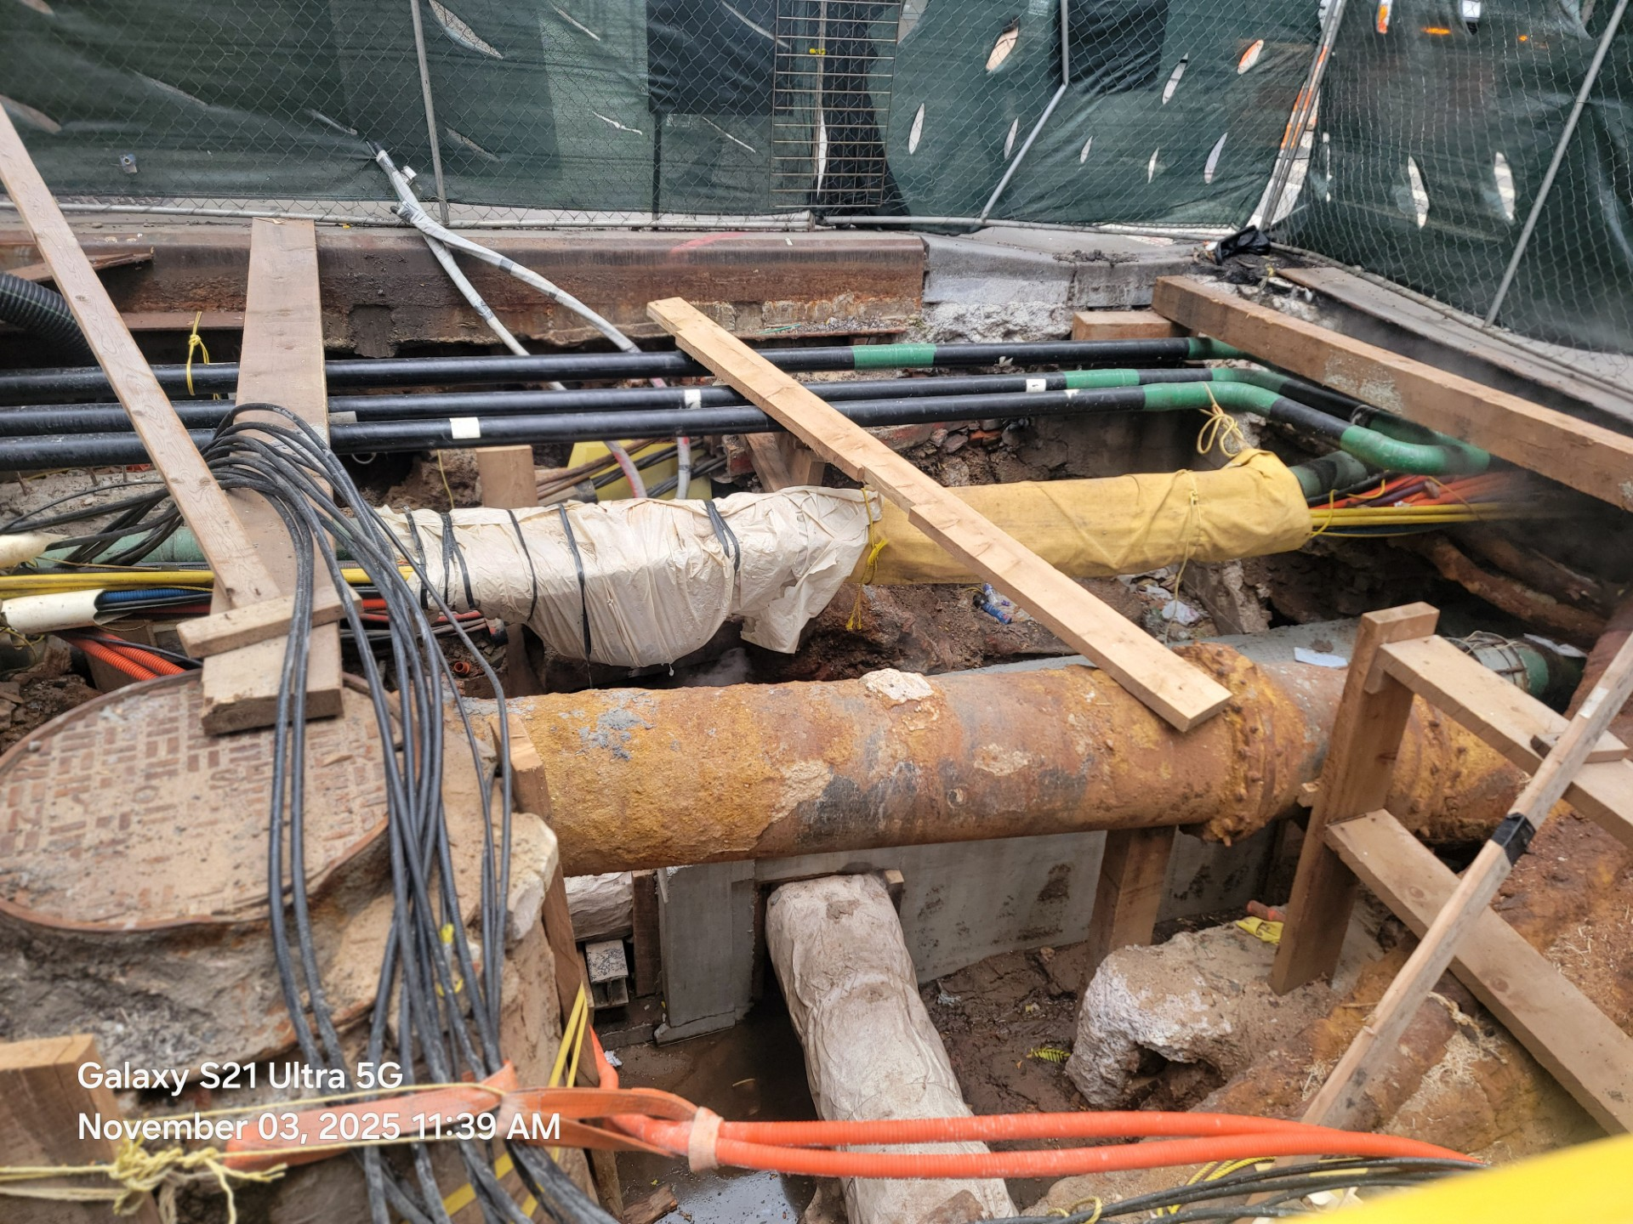
HWMWTCB7 – Reconstruction of Trinity Place
New sewer manhole
New 4” gas pipes
Damaged sewer manhole to be replaced
Rector Street Between and Trinity Pl & Broadway
Projected Completion Date: 09/27/29
% of Work Completed: 33%

Slide 8
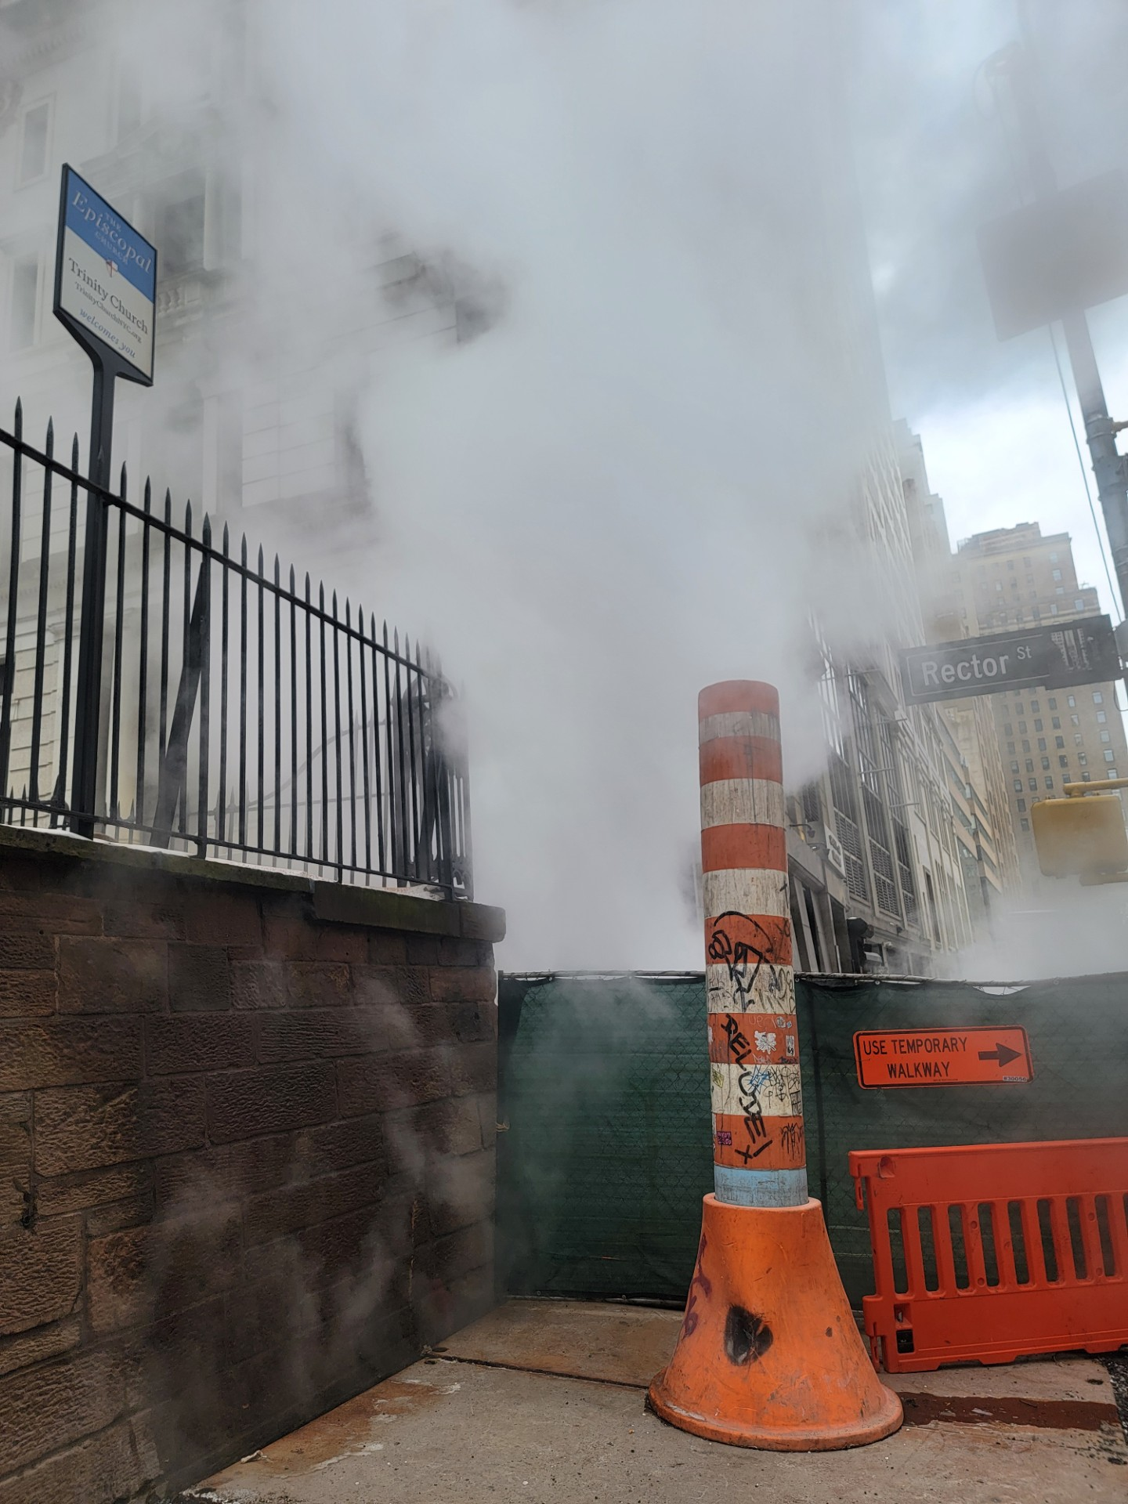
HWMWTCB7 – Reconstruction of Trinity Place
Steam leak is delaying
the gas upgrade work
Steam leak
Rector Street Between and Trinity Pl & Broadway
Projected Completion Date: 09/27/29
% of Work Completed: 33%

Slide 9
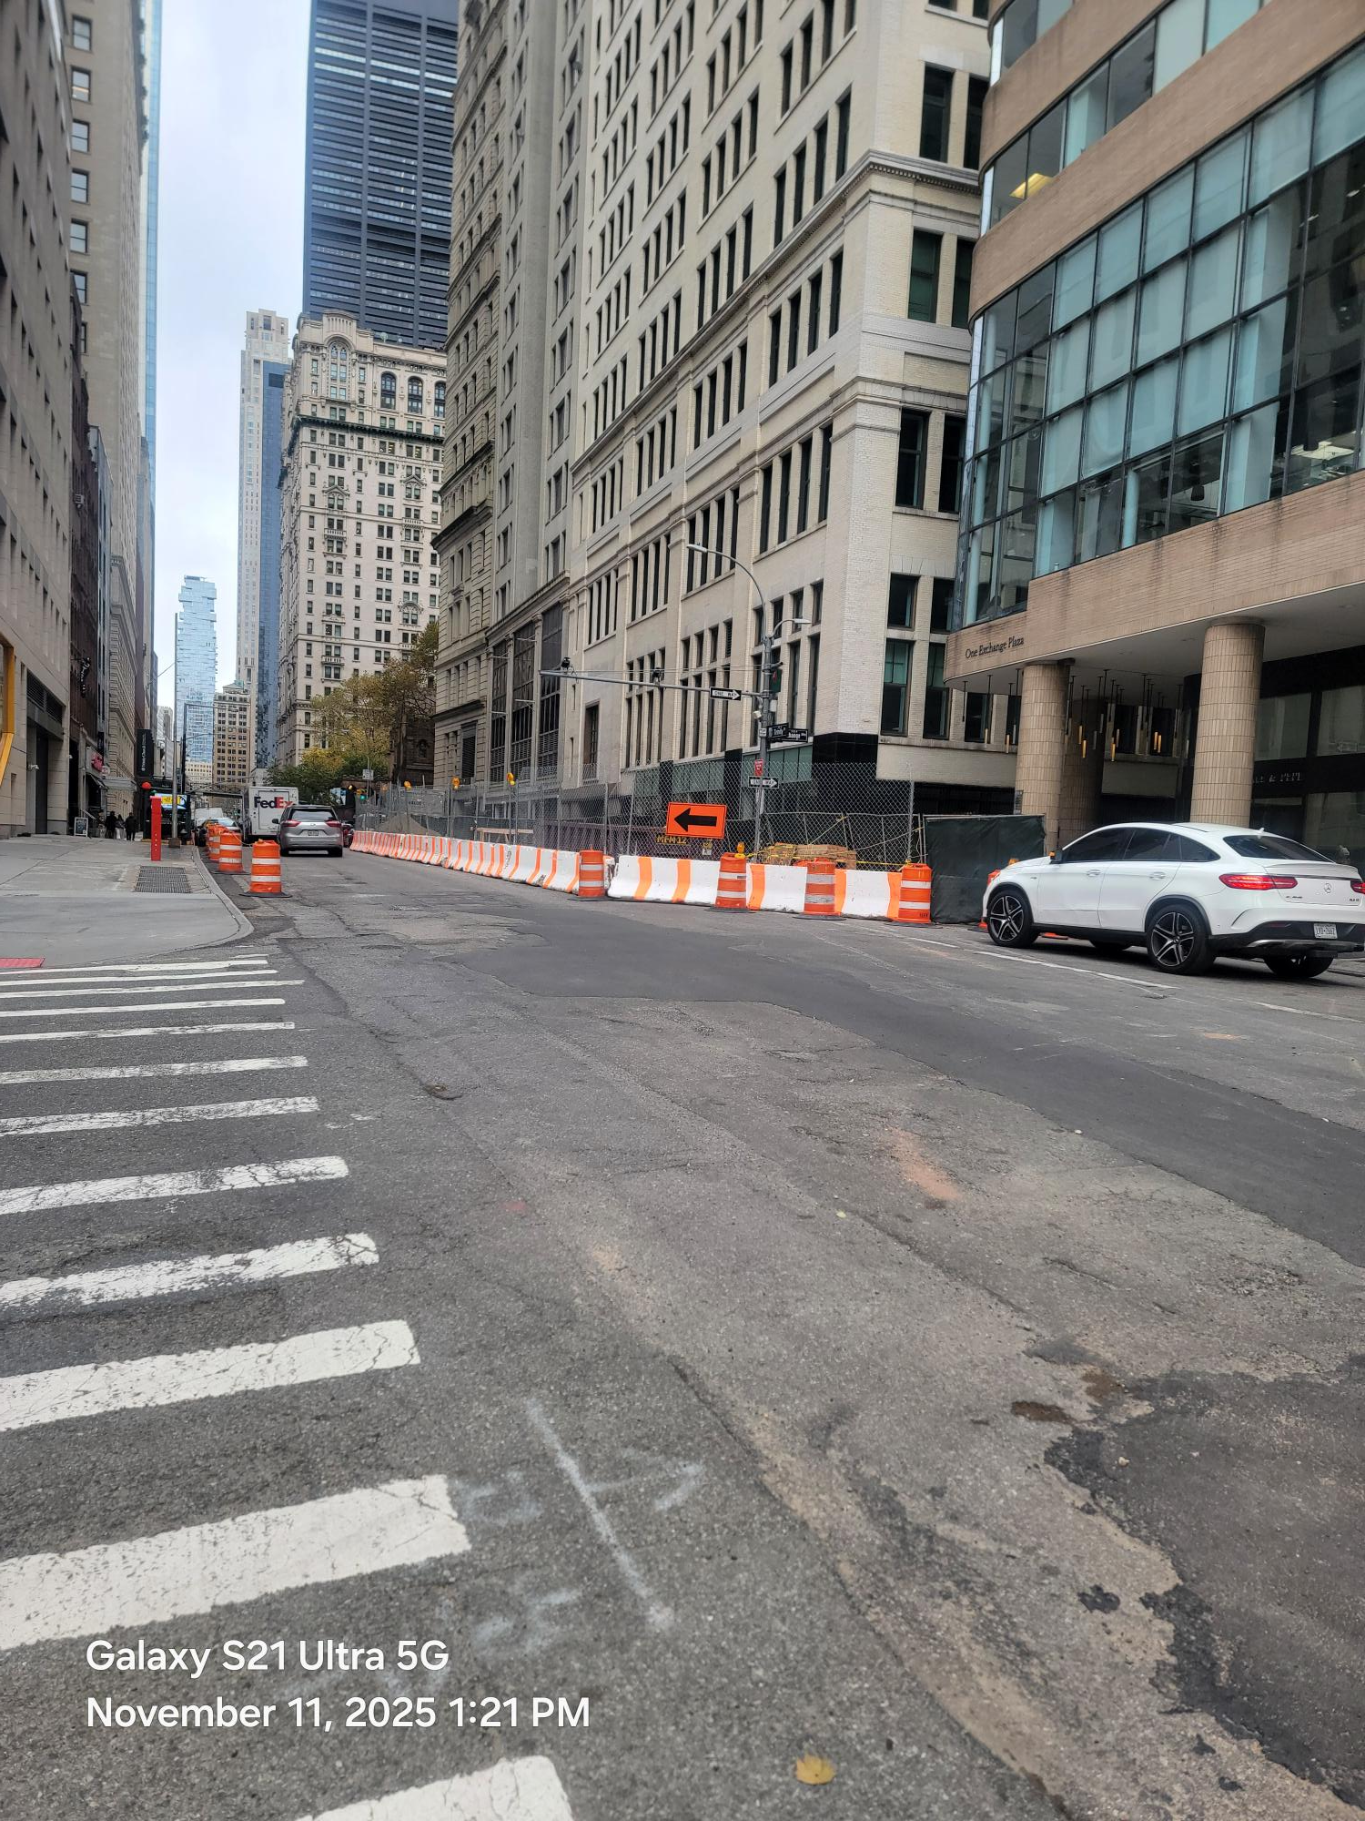
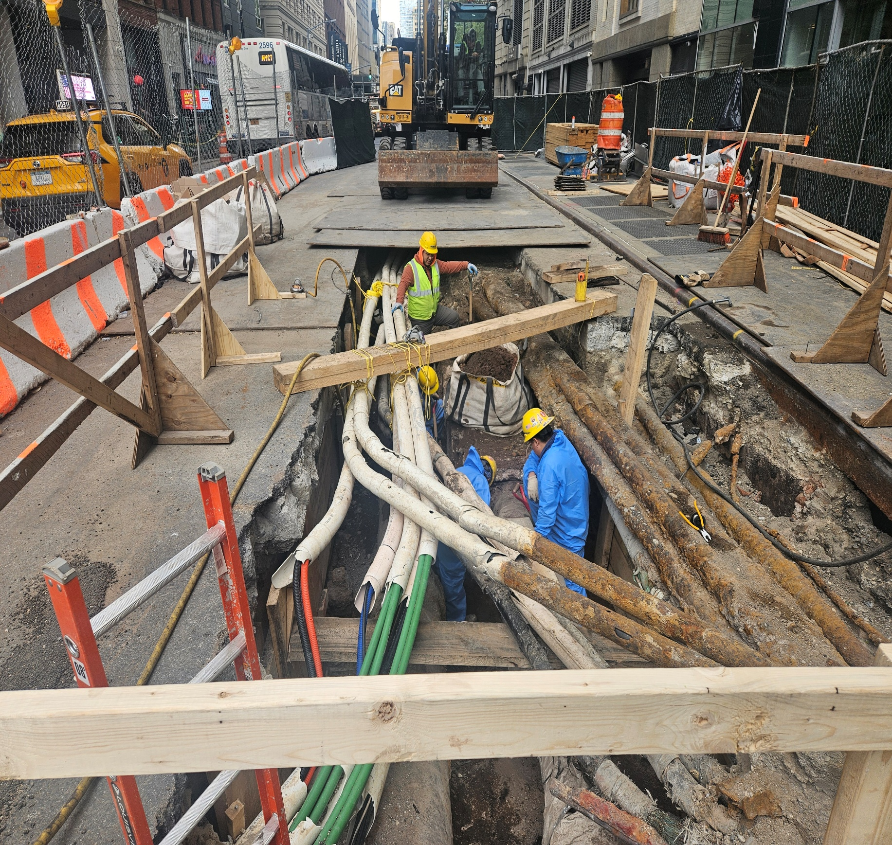
HWMWTCB7 – Reconstruction of Trinity Place
MPT Set Up at Exchange Alley &Trinity Pl
Utilities Relocation prior to new catch basin and
hydrant installation
Utilities relocation for catch basin & Hydrant installation
Trinity Pl between Exchange Alley & Rector St
Projected Completion Date: 09/27/29
% of Work Completed: 33%

Slide 10
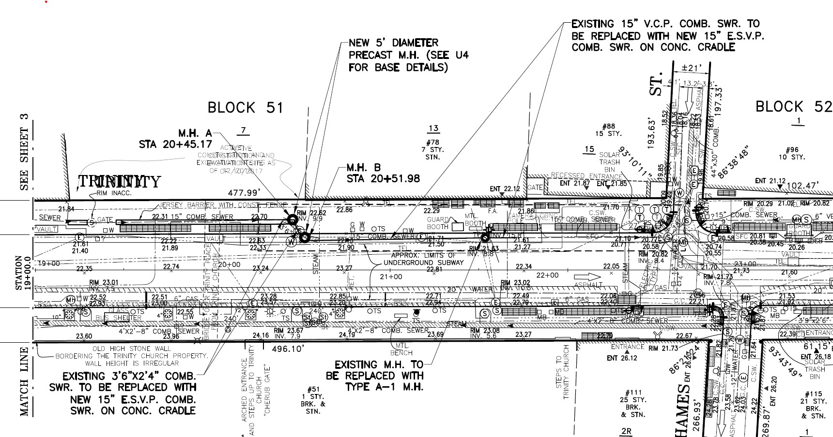
HWMWTCB7 – Reconstruction of Trinity Place
86 Trinity Place
Projected Completion Date: 09/27/29
% of Work Completed: 33%
Sewer plans

Slide 11
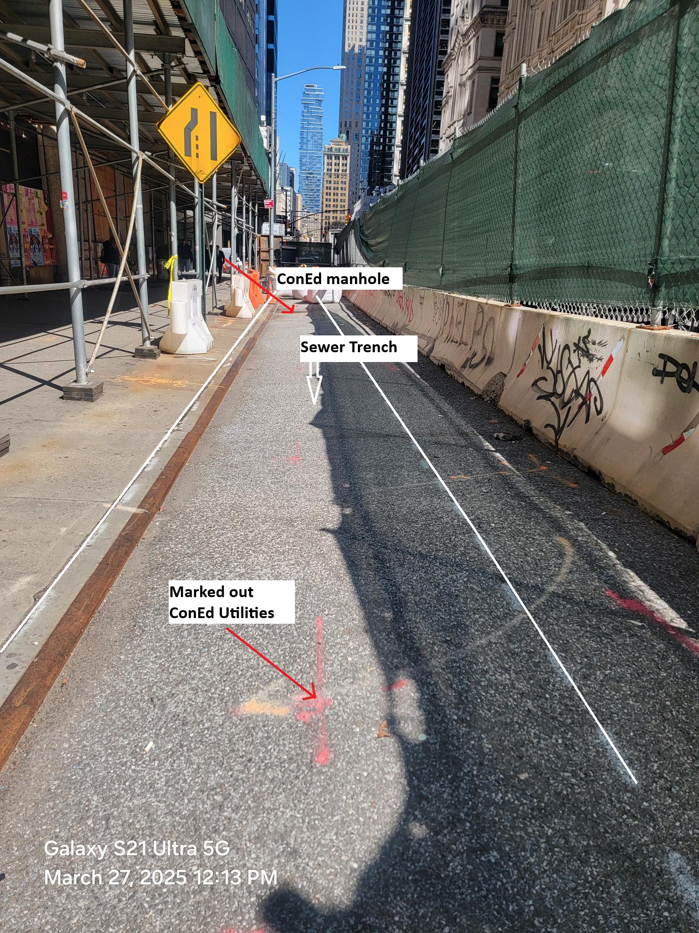
HWMWTCB7 – Reconstruction of Trinity Place
86 Trinity Place
Sewer Trench in front
of 86 Trinity Place
Projected Completion Date: 09/27/29
% of Work Completed: 33%

Slide 12
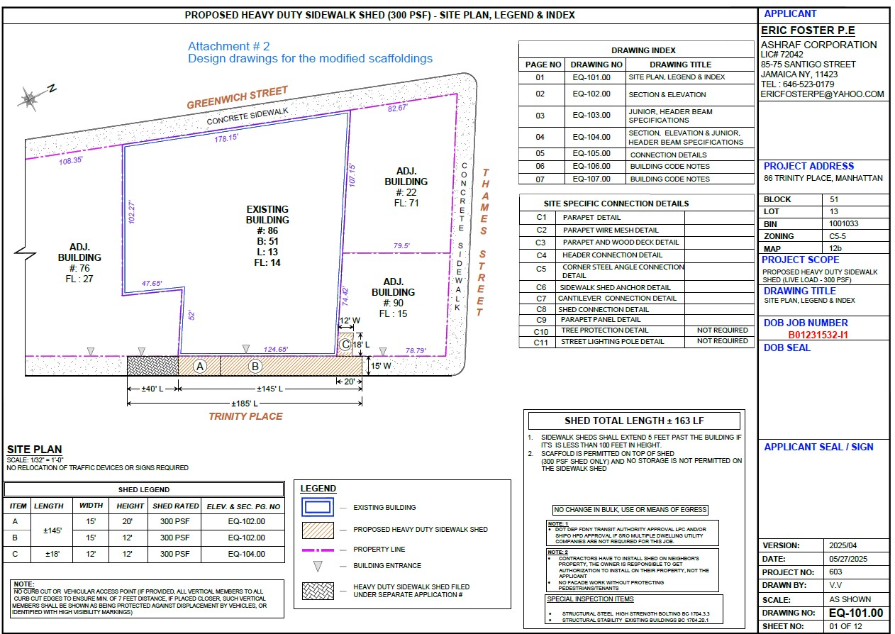
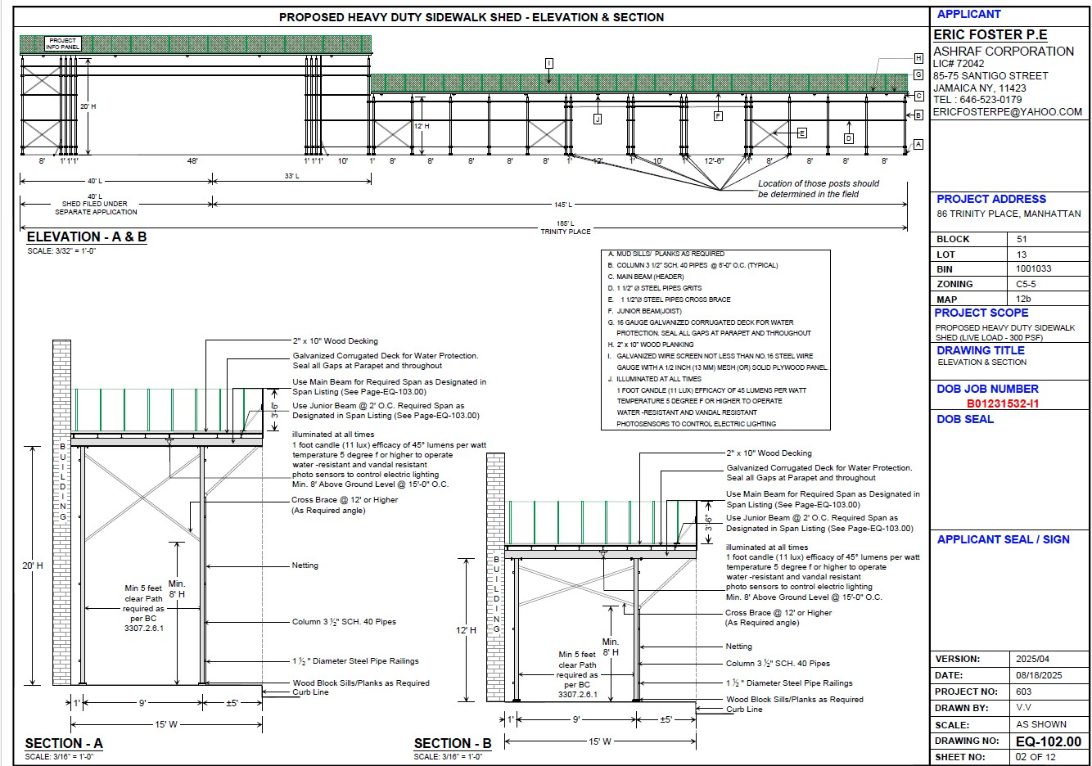
HWMWTCB7 – Reconstruction of Trinity Place
Projected Completion Date: 09/27/29
% of Work Completed: 33%
Design of modified scaffolding

Slide 13
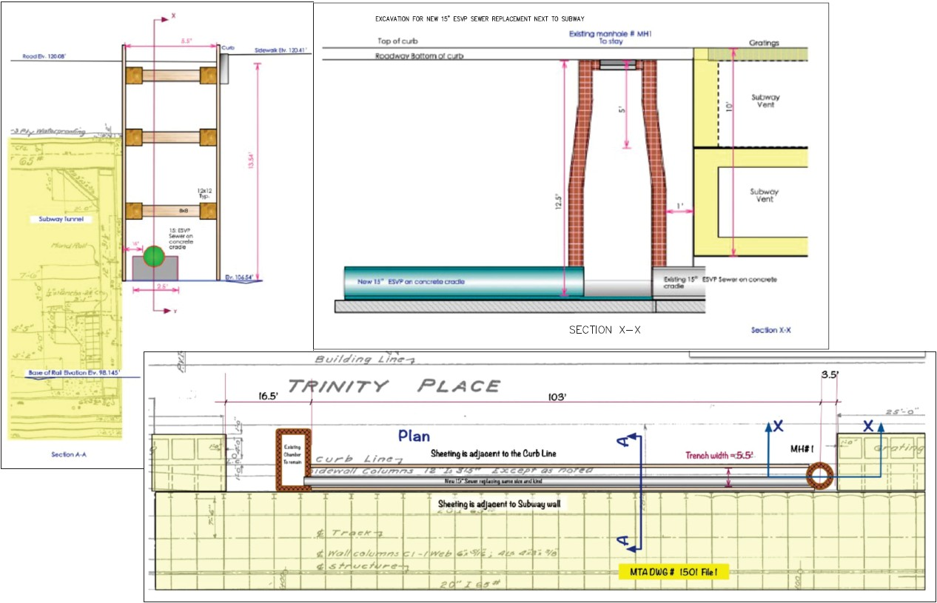
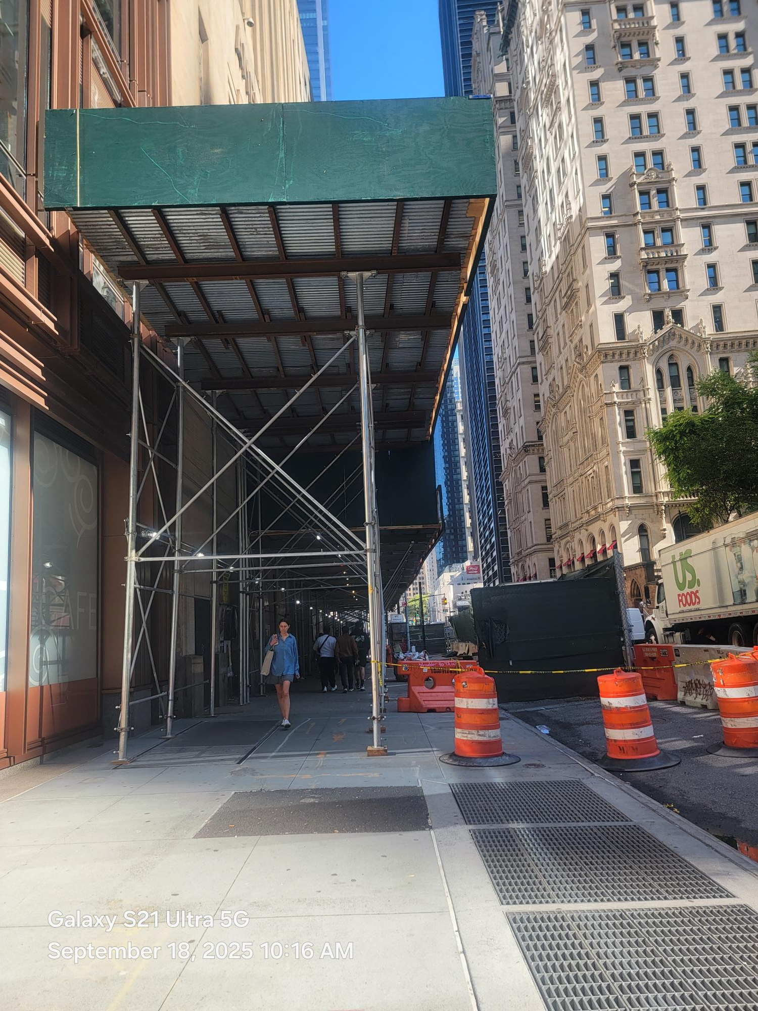
HWMWTCB7 – Reconstruction of Trinity Place
86 Trinity Place
New scaffolding looking north
(Incomplete)
Projected Completion Date: 09/27/29
% of Work Completed: 33%
Sheeting design

Slide 14



Thank You!

