Slide 1
Community boards #4, 5
Distribution water main replacement along 7th avenue between W. 14th St. and w.34th St.
PROJECT ID: med669
BOROUGH OF Manhattan
Eric Adams
Mayor
Thomas Foley
Commissioner
June 2022

Slide 2
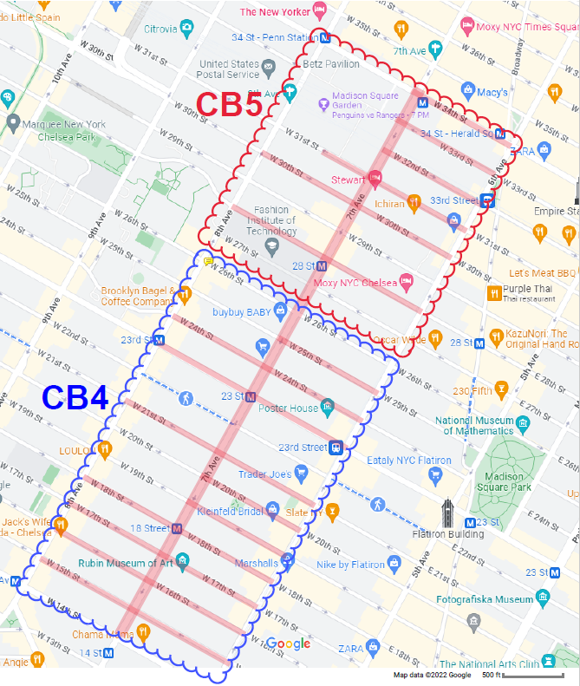
Project Limits:
7th Avenue between W. 14th Street and W. 34th Street
W. 15th St. between 6th Avenue and 8th Avenue
W. 16th St. between 6th Avenue and 8th Avenue
W. 17th St. between 6th Avenue and 8th Avenue
W. 18th St. between 6th Avenue and 8th Avenue
W. 19th St. between 6th Avenue and 7th Avenue
W. 20th St. between 6th Avenue and 7th Avenue, including the intersection at 7th Ave
W. 21st St. between 6th Avenue and 8th Avenue
W. 23rd St. between 6th Avenue and 8th Avenue
W. 24th St. between 6th Avenue and 8th Avenue
W. 25th St. between 6th Avenue and 7th Avenue, including the intersection at 7th Ave
W. 26th St. and 7th Avenue intersection
W. 27th St. and 7th Avenue intersection
W. 28th St. between 6th Avenue and 8th Avenue
W. 29th St. and 7th Avenue intersection
W. 30th St. between 6th Avenue and 8th Avenue
W. 31st St. between 6th Avenue and 8th Avenue
W. 32nd St. between 6th Avenue and 7th Avenue
W. 33rd St. between 6th Avenue and 7th Avenue, including the intersection at 7th Ave
W. 34th St. between 6th Avenue and 7th Avenue, including the intersection at 7th Ave
MED669 – Distribution Water Main Replacement
Borough of Manhattan
PROJECT LIMITS

Slide 3
Project goals:
Improve water distribution and fire protection
Lessen water main breaks and service disruptions
Replace/upgrade ±36,000 L.F. of aging distribution water main
Replace defective water main valves
Replace fire hydrants
MED669 – Distribution Water Main Replacement
Borough of Manhattan
PROJECT GOALS

Slide 4
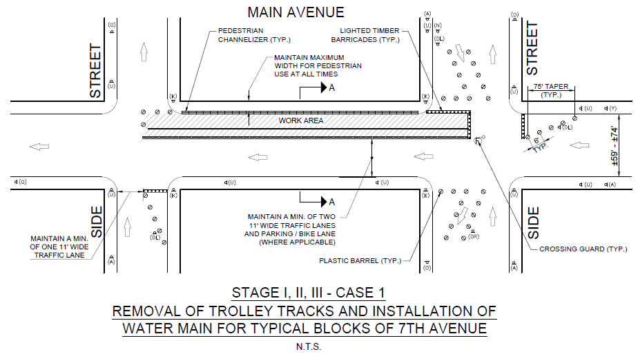
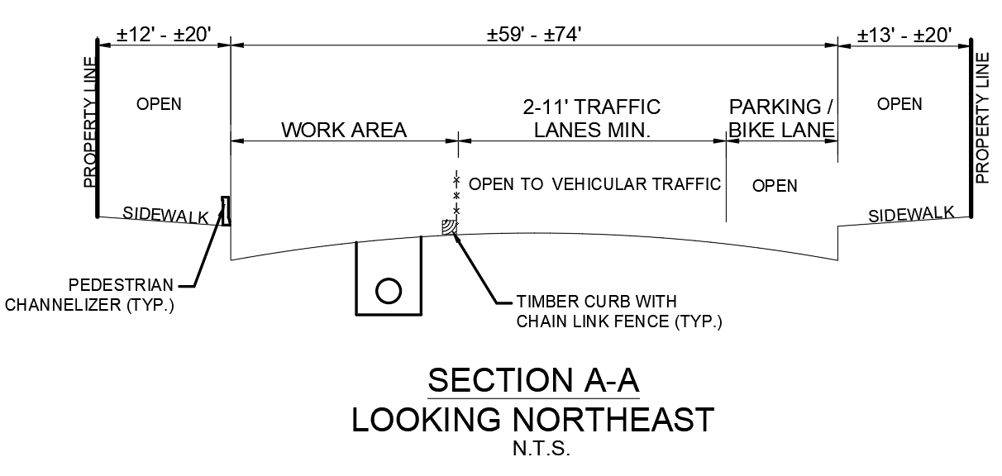
TYPICAL MAINTENANCE AND PROTECTION OF TRAFFIC
MED669 – Distribution Water Main Replacement
Borough of Manhattan
MPT

Slide 5
COMMUNITY IMPACTS DURING CONSTRUCTION
Roadway lane closures, as necessary
Temporary loss of parking
Temporary relocation of bus stops
Scheduled water main shut-downs
Night-time and weekend hours for construction may be necessary
Open restaurants coordination
MED669 – Distribution Water Main Replacement
Borough of Manhattan
COMMUNITY IMPACTS

Slide 6
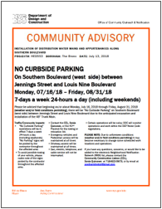
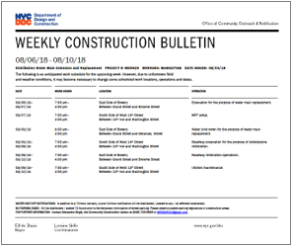
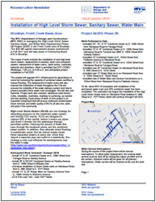
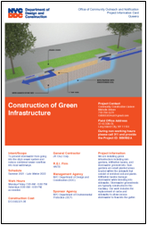
COMMUNITY construction LIAISON INVOLVEMENT
Keeping You Informed.
The on-site CCL works directly with the project team. CCL will address community concerns, respond to inquiries, attend meetings, as needed, as well as distribute project related materials to keep the community informed and notified.
PROJECT​ INFORMATION CARD (PIC)​
​ADVISORIES
WEEKLY ​LOOK AHEAD
BULLETIN
QUARTERLY ​ NEWSLETTERS​
6
MED669 – Distribution Water Main Replacement
Borough of Manhattan
COMMUNITY LIAISON INVOLVEMENT

Slide 7
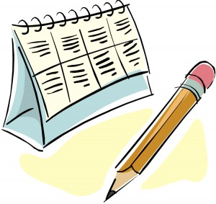
Project Schedule (FY24)
• 40% Final Design (Mass Mailing 1) – February 8, 2022
Alignment Meeting with Utilities – March 10, 2022
• 75% Final Design (Mass Mailing 2) – July 2022
• Final Design Completion – December 2022
• Expected Construction Duration – 2023 to 2027 (est. 4 yrs.)
June 2022 – Community Board #4,5 Presentation
December 2022 –
Anticipated Design Completion
Fall 2023 –
Anticipated Construction Start
Fall 2027 – Anticipated Construction Completion
MED669 – Distribution Water Main Replacement
Borough of Manhattan
Project schedule

Slide 8
Thank you
Eric Adams
Mayor
Thomas Foley
Commissioner

