Slide 1
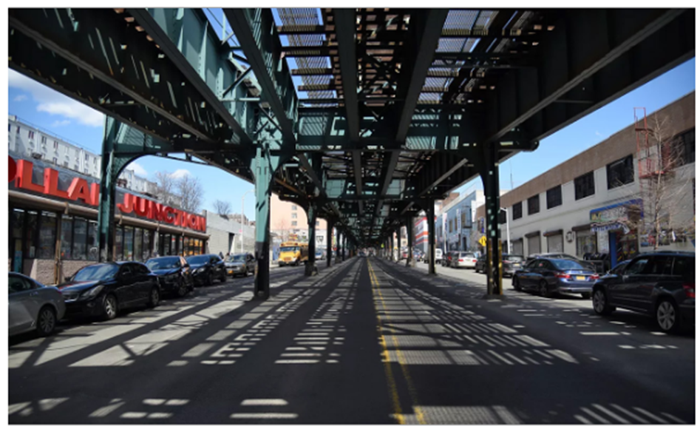
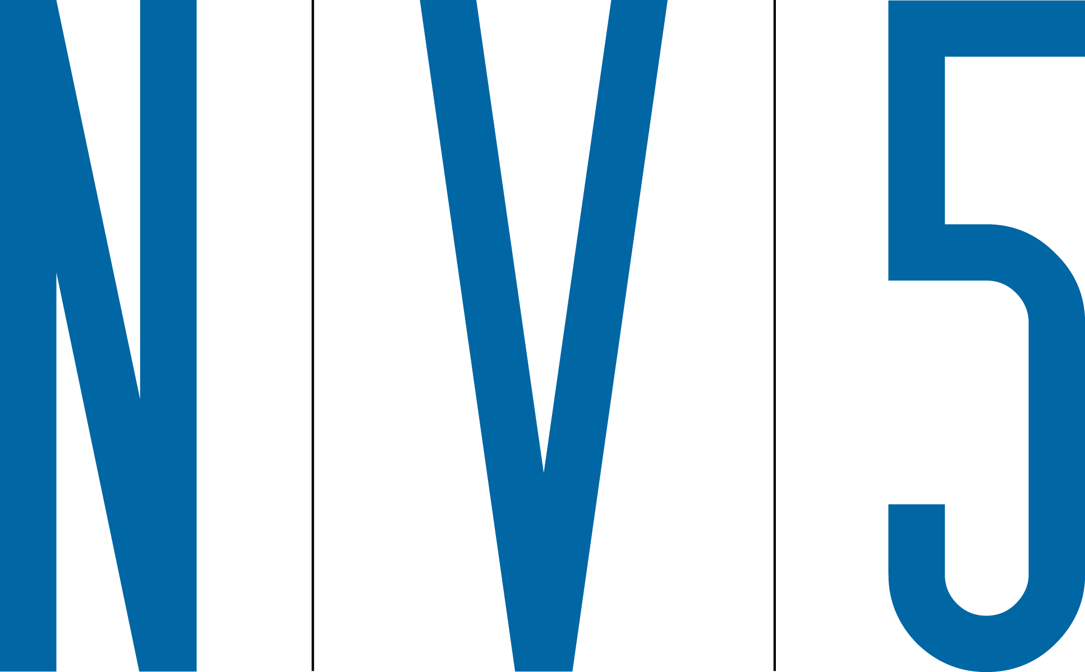
JEROME AVENUE AREA-WIDE PEDESTRIAN SAFETY AND STREETSCAPE IMPROVEMENTS PROJECT ID: HWXJEROME
Bronx Community Board 4
June 2025
1

Slide 2
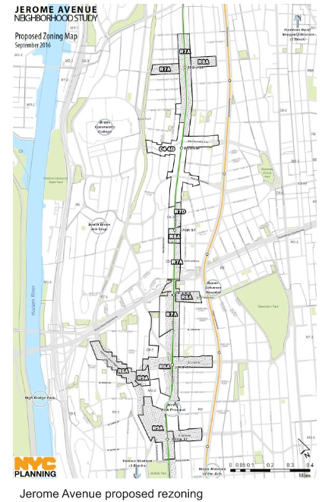
JEROME AVENUE NEIGHBORHOOD PLAN
Fulfilling commitments to a historically underserved community
Four-year effort with over 40 public events
Rezoning for affordable housing approved by NYC City Council 2018
Implementation of capital plan commitments
Improve existing and create new open spaces and streetscapes commensurate to the anticipated new residential and commercial uses along Jerome Avenue as a result of the rezoning

Slide 3
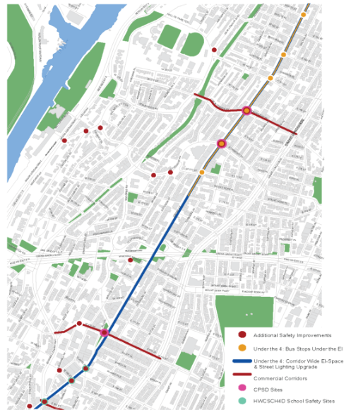
PROJECT GOALS, OBJECTIVES, AND COMPONENTS
Creating a safe, pedestrian-friendly, multimodal transit corridor to meet the needs of current and future residents, workers and transit riders.
Optimizing bus operations by constructing six “Bus Stops Under the El”
Employing corridor-wide pedestrian safety improvements
Enhancing multimodal connections
Establishing transit nodes and new communal spaces

Slide 4
TRANSPORT AND SAFETY
Developing safe transit and pedestrian connections underneath the elevated train structure
Vision Zero Priority Corridor
Create ADA-compliant bus stops
Improve conditions for passengers
Shorten crossing distances at intersections
Clarify sight lines
Better define street and open space
Enhanced lighting

Slide 5
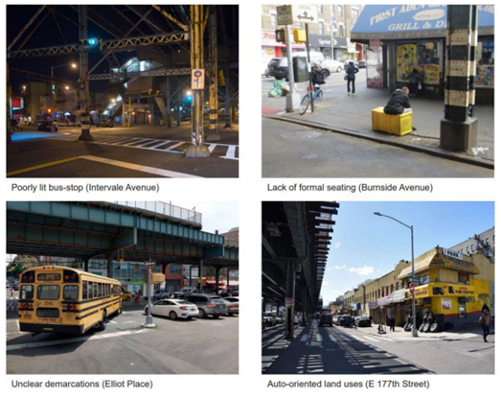
PEDESTRIANS AND VEHICLES
Improving pedestrian safety, bolstering transit connections, and reclaiming underutilized public space
Additional lighting for bus stops, sidewalks and open spaces
Clarify demarcations and optimize roadway space
Provide enhanced pedestrian amenities (seating, street furniture and trees, etc.)
Create overall streetscape cohesion and legibility

Slide 6
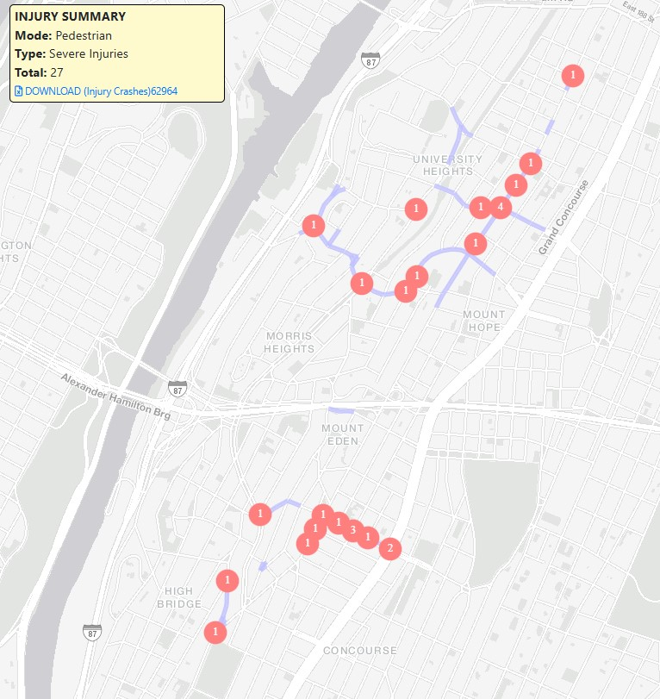
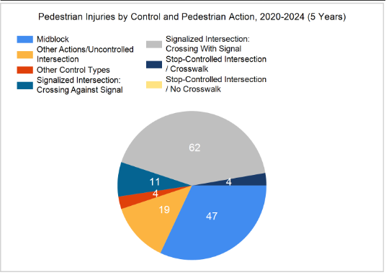
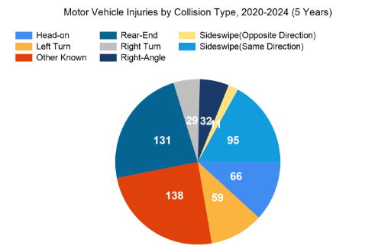
SAFETY DATA
Severe Pedestrian Injury Summary

Slide 7
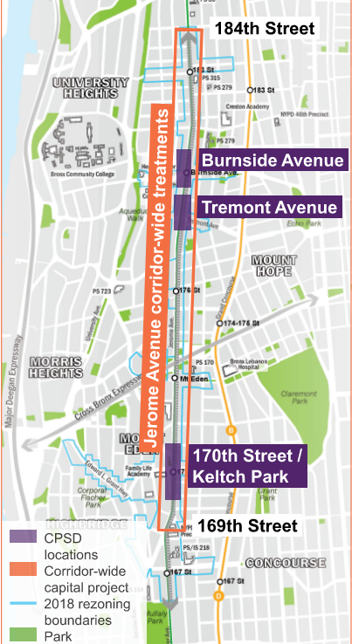
CPSD STUDY

Slide 8
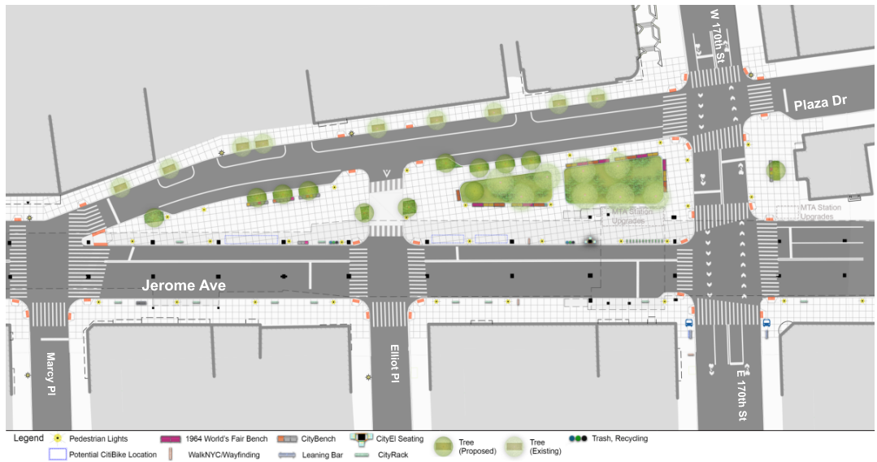
CPSD STUDY – KELTCH PARK

Slide 9
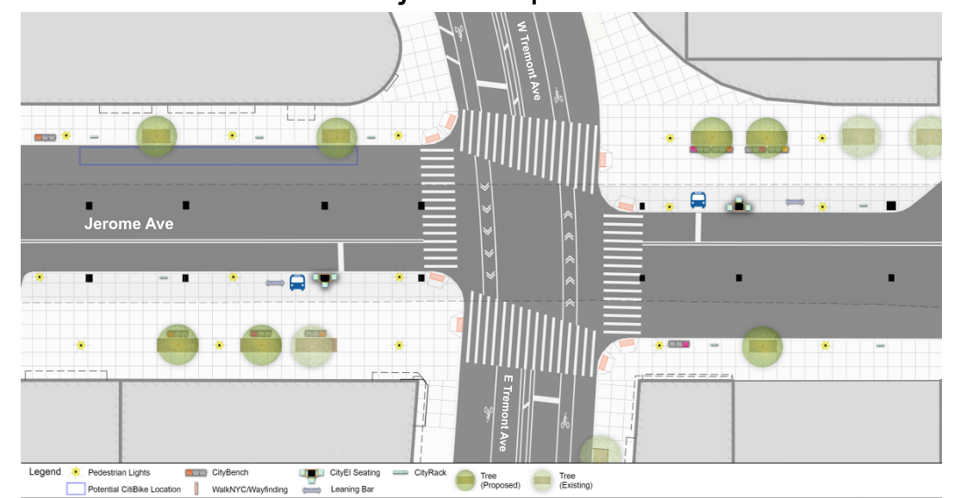
CPSD STUDY – JEROME AVE/TREMONT AVE

Slide 10
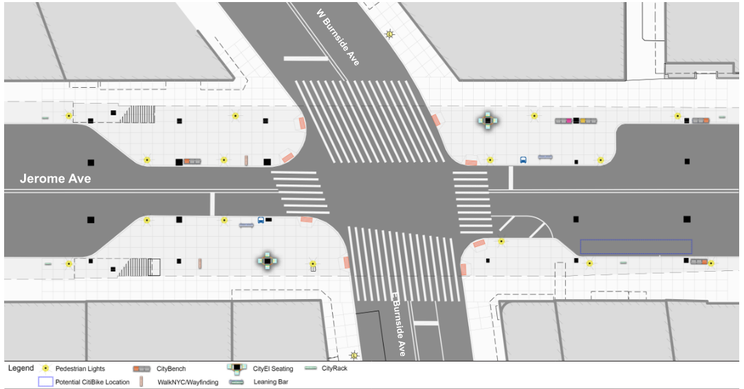
CPSD STUDY – JEROME AVE/BURNSIDE AVE

Slide 11
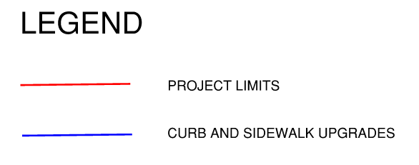
PROJECT LOCATION

Slide 12
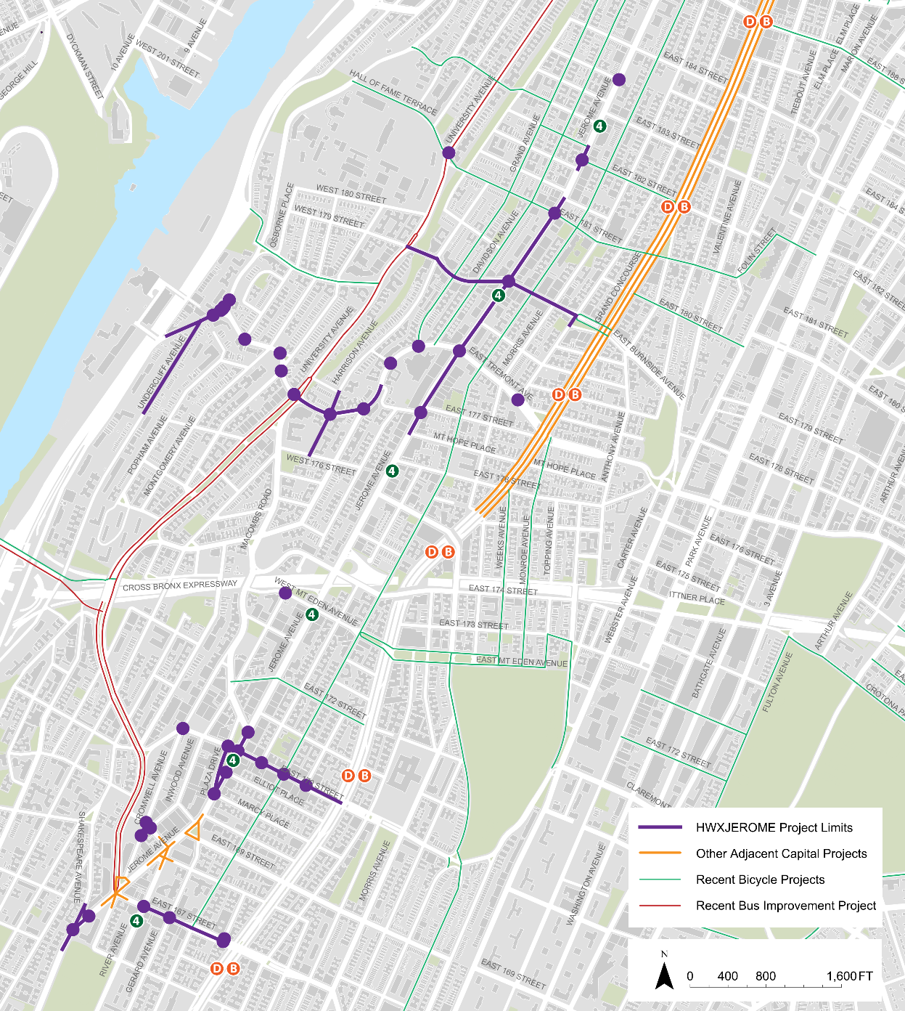
ADJACENT PROJECTS
Tremont Avenue Corridor Safety Project
West Mount Eden Avenue Pedestrian Access Project
Safe Routes to Schools - Bronx (HWCSCH4D)
Grand Concourse Phase II-IV
Utility/Infrastructure Upgrades

Slide 13
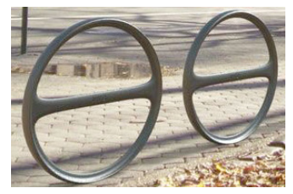
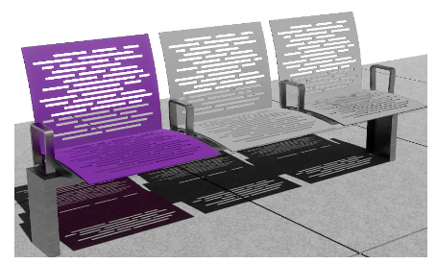
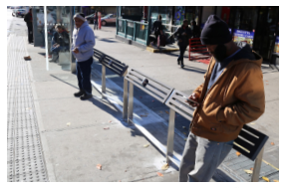
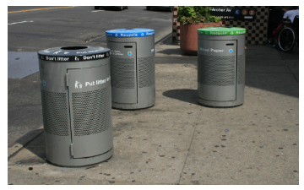
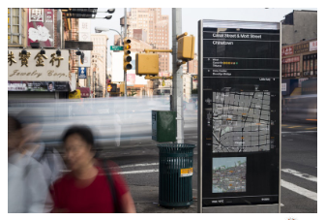
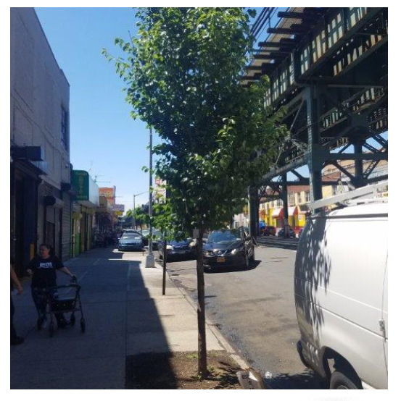
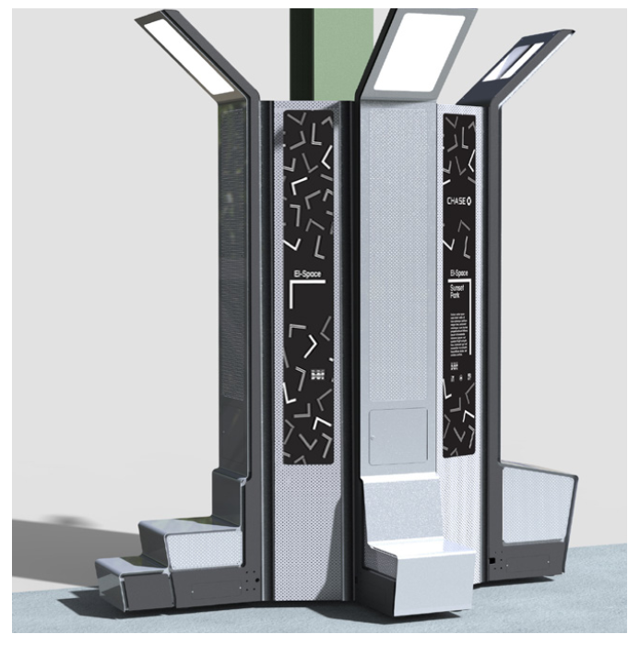
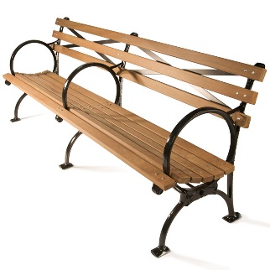
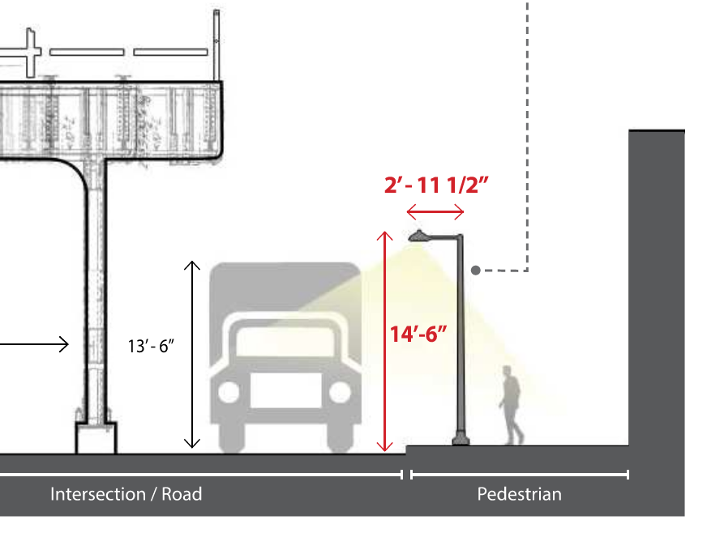
PUBLIC REALM IMPROVEMENTS
Fostering climate resilient transit options: public transportation, walking, cycling, recreating
Quality-of-life amenities include benches, bike racks, lighting, wayfinding signs, concessions, trees and green infrastructure
Transit-related features include “CityEl” providing seating, lighting and digital and analog community information and displays
CityRack
CityBench
Leaning Bar
Trash and Recycling Receptacles
WalkNYC Wayfinding
Street Trees
CityEl
1939 World’s Fair Bench
Flushing Meadow

Slide 14
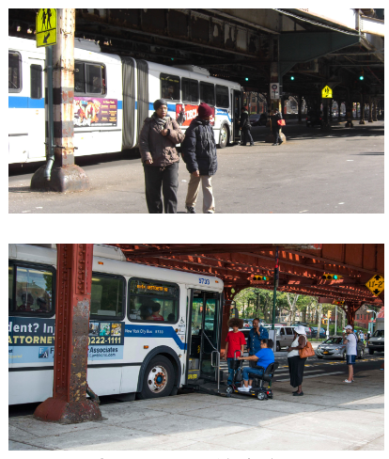
BUS STOPS UNDER THE EL
Providing important transit links for passengers unable to climb the stairs to the elevated train stations
Extending existing sidewalks to the bus lanes for safer, more comfortable boarding
Increasing bus ridership by facilitating easier mode transitions

Slide 15
BUS STOPS UNDER THE EL

Slide 16
BUS STOPS UNDER THE EL

Slide 17
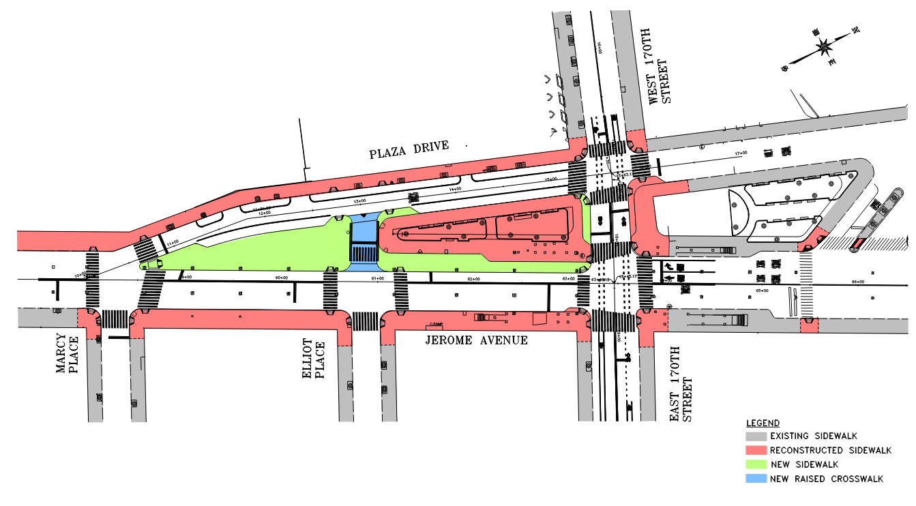
KELTCH PARK

Slide 18
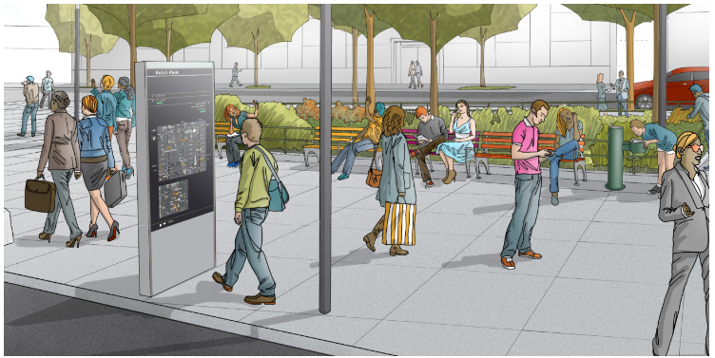
KELTCH PARK

Slide 19
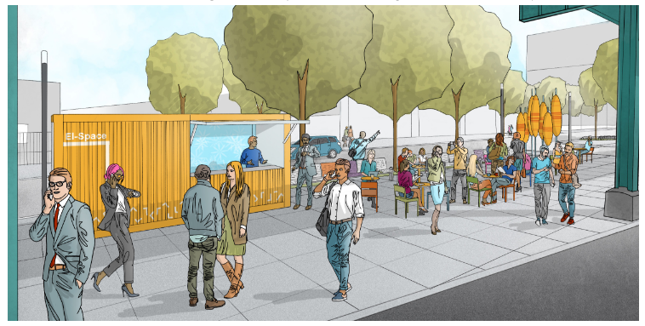
KELTCH PARK

Slide 20
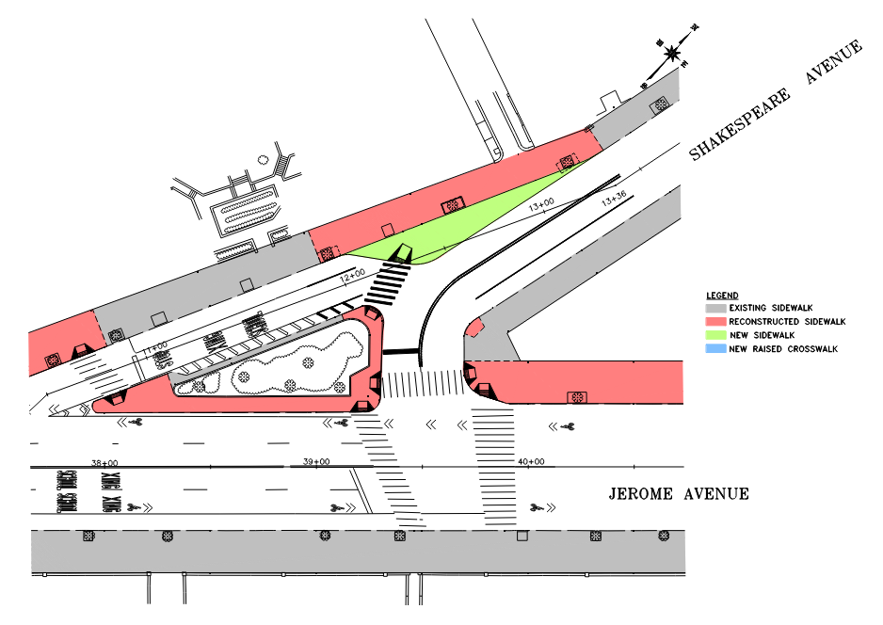
JEROME AVE/SHAKESPEARE AVE
Jerome Avenue and Shakespeare Avenue

Slide 21
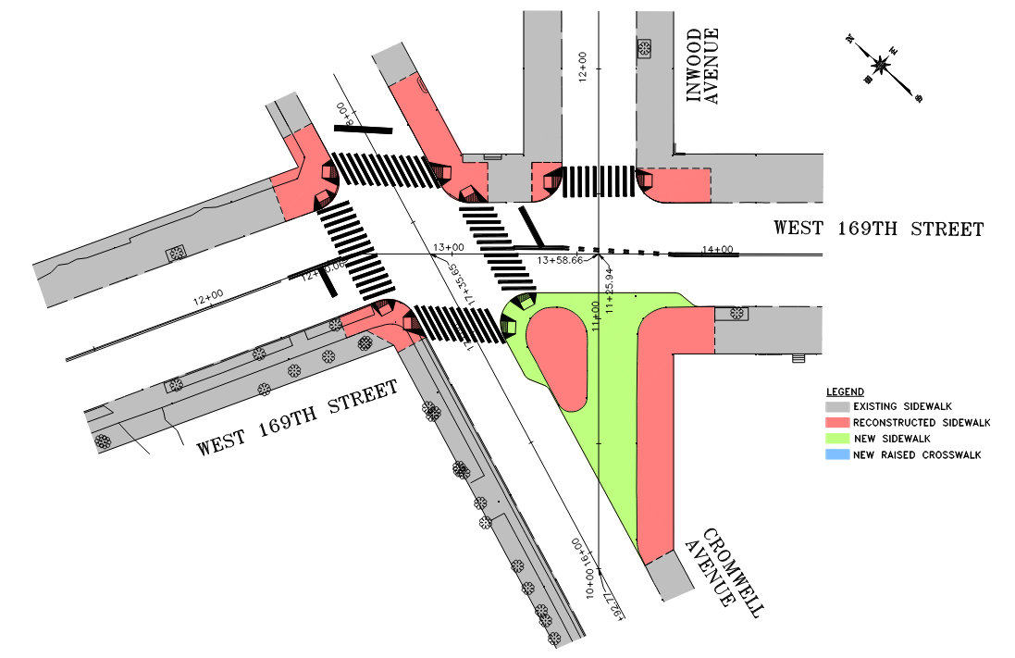
169TH ST/CROMWELL AVE
West 169th Street and Cromwell Avenue

Slide 22
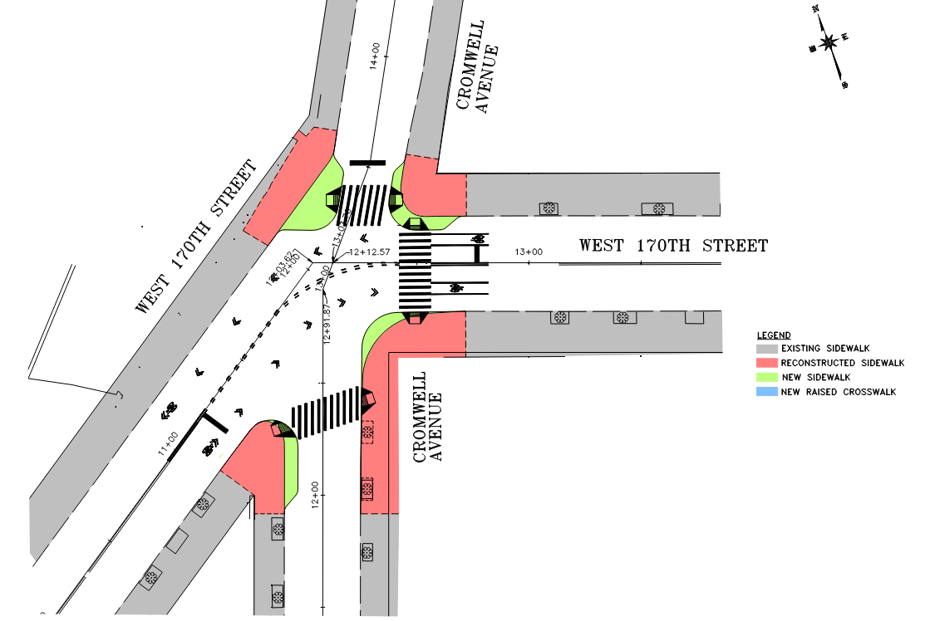
170TH ST/CROMWELL AVE
West 170th Street and Cromwell Avenue

Slide 23
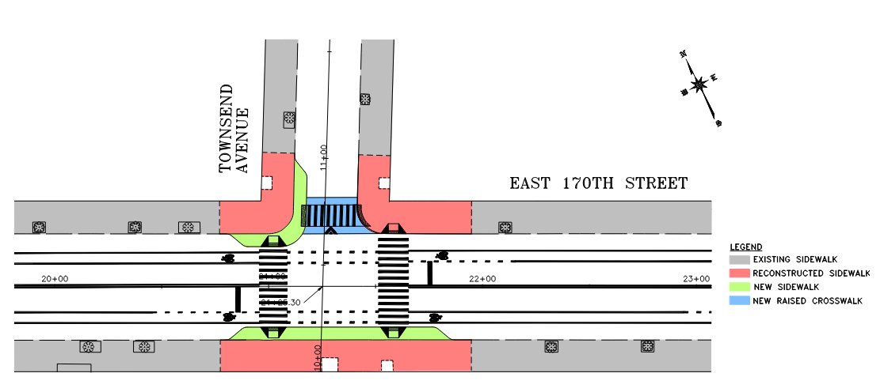
170TH ST/TOWNSEND AVE
East 170th Street and Townsend Avenue

Slide 24
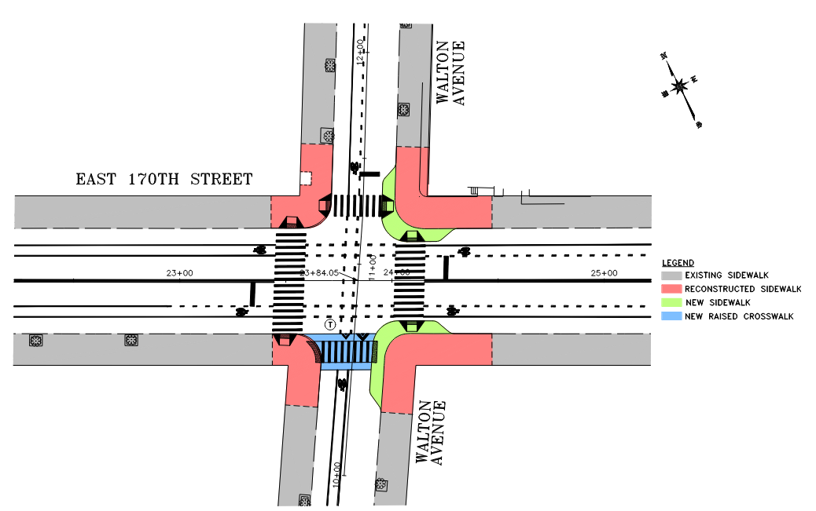
170TH ST/WALTON AVE
East 170th Street and Walton Avenue

Slide 25
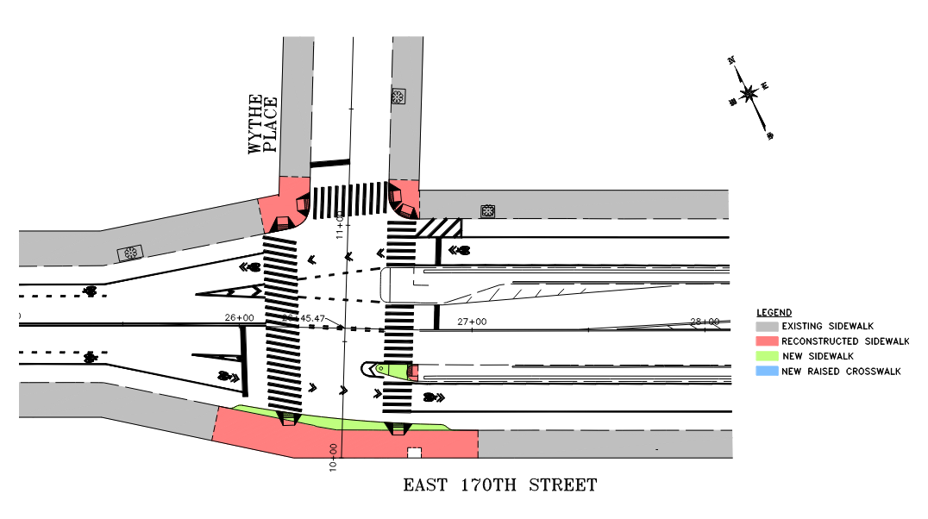
170TH ST/WYTHE PL
East 170th Street and Wythe Place

Slide 26
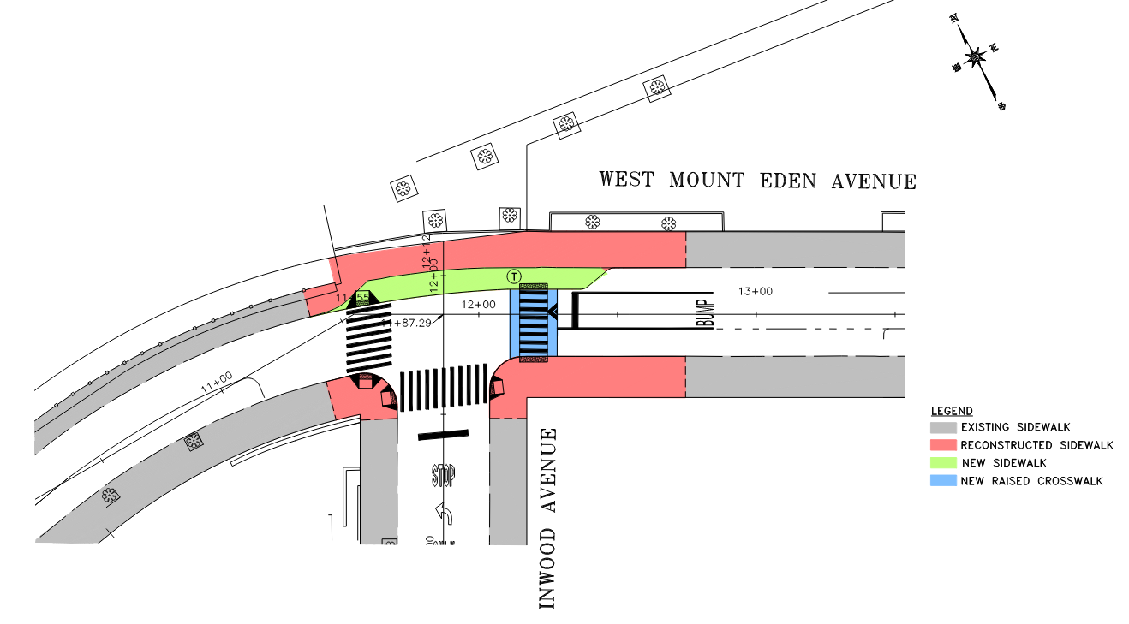
MOUNT EDEN AVE/INWOOD AVE
West Mount Eden Avenue and Inwood Avenue

Slide 27
PROJECT SCHEDULE
Design Start: 5/17/2022
Design Completion: 1/24/2026
DDC Law Review and Approval: 6/23/2026
Construction Start: 1/15/2027

Slide 28
QUESTIONS

Slide 29
APPENDIX
Jerome Avenue and 177th Street
Jerome Avenue and Tremont Avenue
Jerome Avenue and Burnside Avenue
Jerome Avenue and Clinton Avenue
Jerome Avenue and 182nd Street to Buchanan Place
Jerome and North Avenue
West Tremont Avenue and Harrison Avenue
West 181st Street and Hall of Fame
Sedgwick Avenue and Tremont Avenue
West Tremont and Grand Avenue
Sedgwick and Grand Avenue

Slide 30
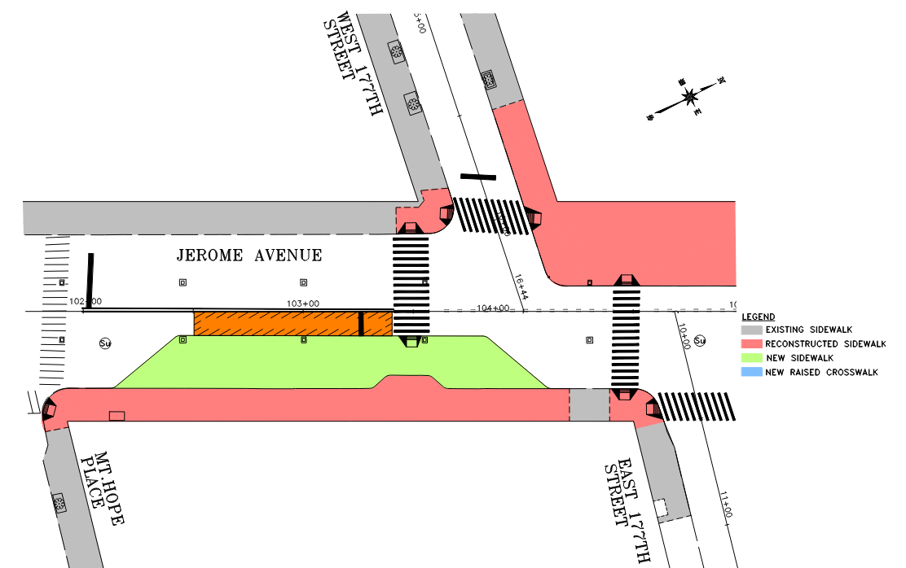
JEROME AVE/177TH ST

Slide 31
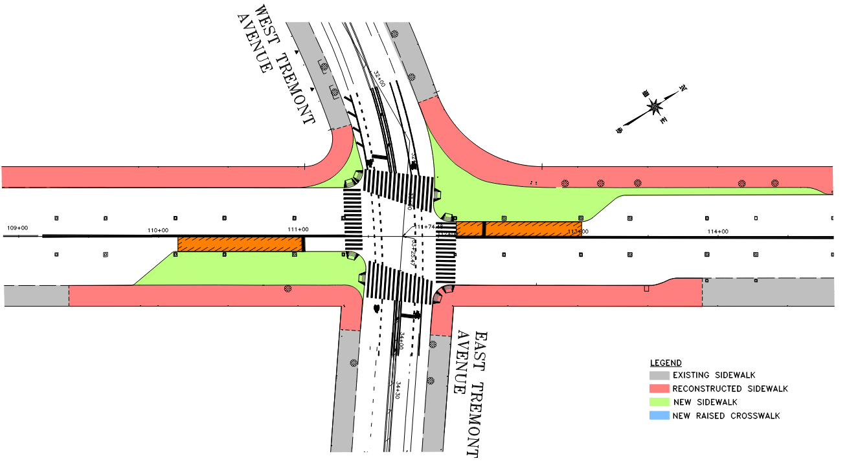
JEROME AVE/TREMONT AVE

Slide 32
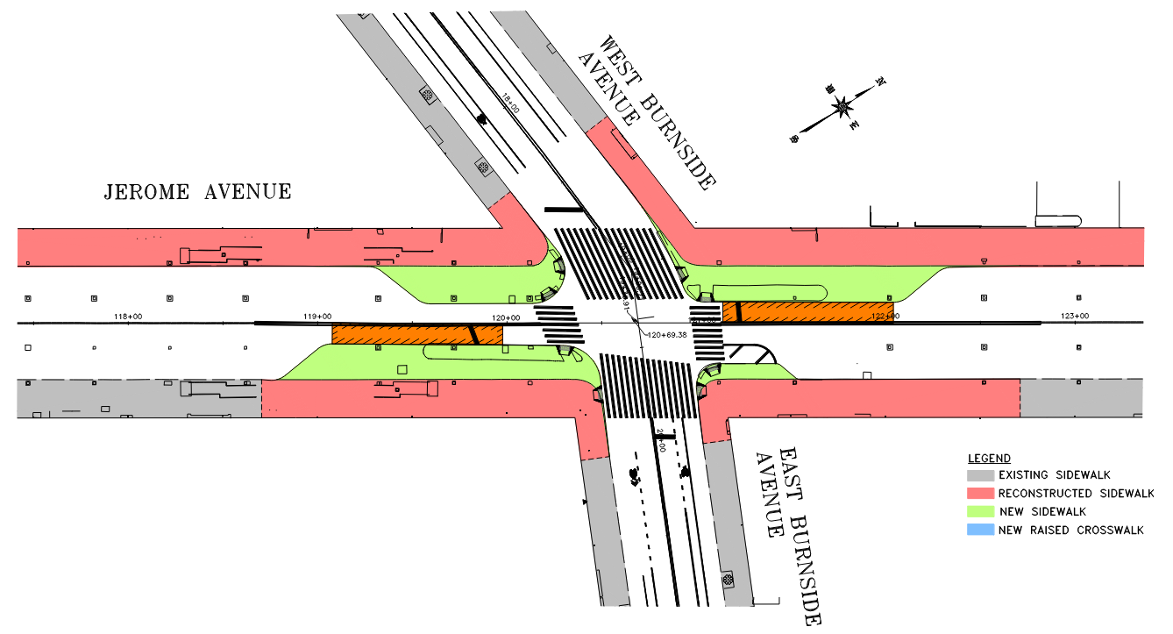
JEROME AVE/BURNSIDE AVE

Slide 33
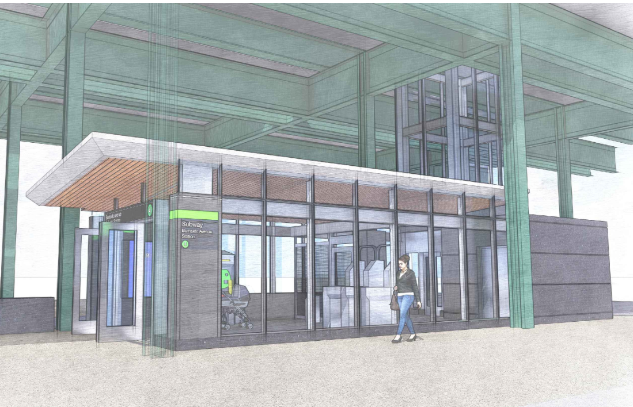
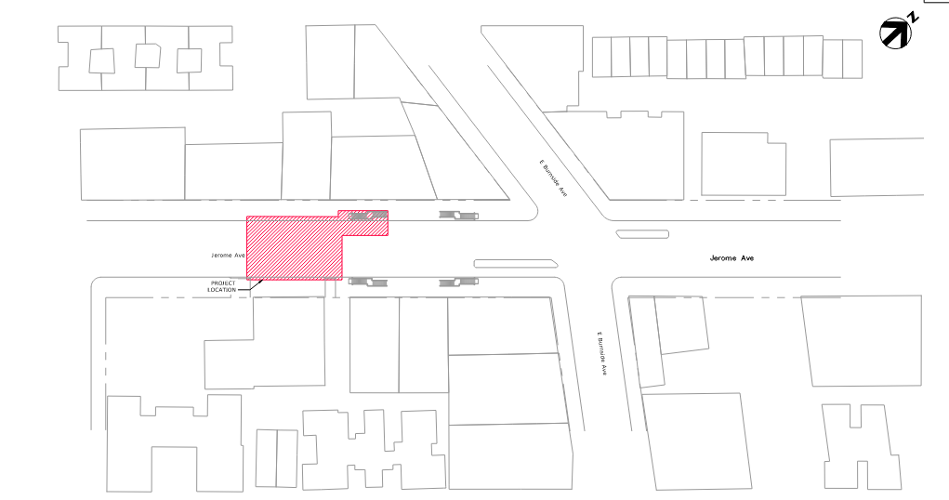
MTA BURNSIDE ELEVATOR PROJECT

Slide 34
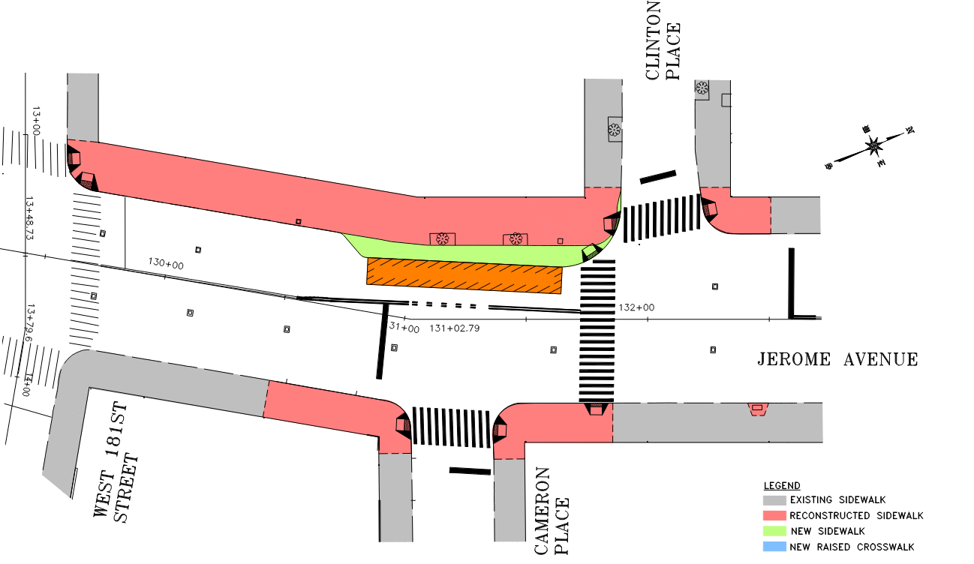
JEROME AVE/CLINTON AVE

Slide 35
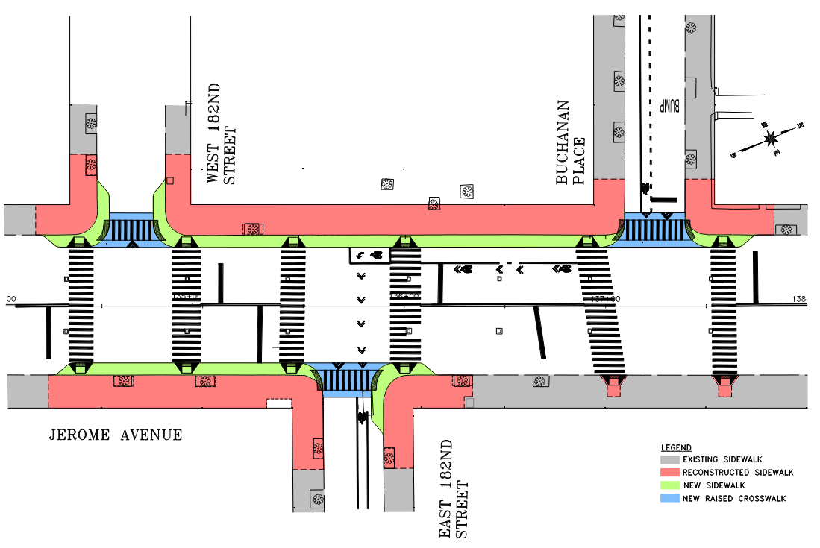
JEROME AVE/182ND ST AND BUCHANAN PL

Slide 36
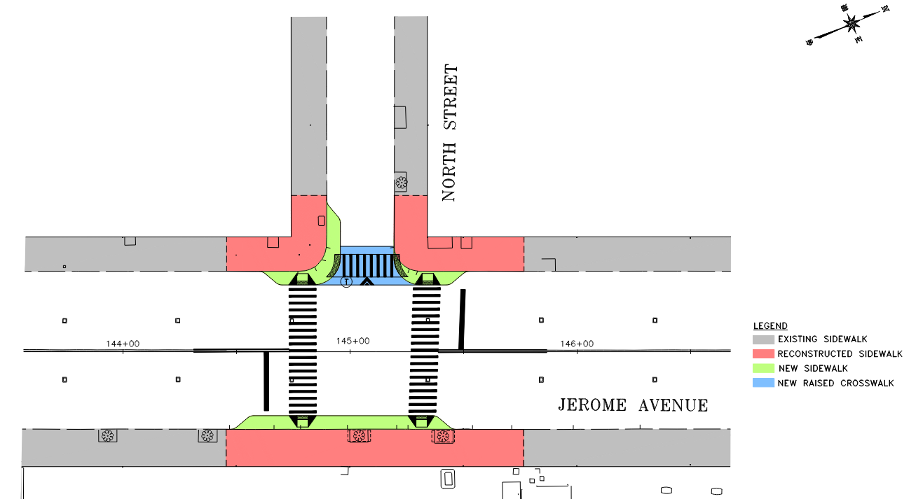
JEROME AVE/NORTH AVE

Slide 37
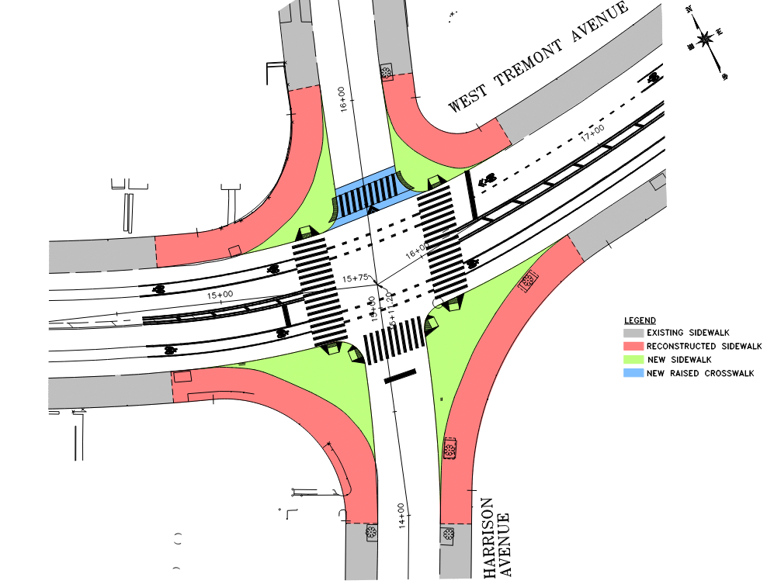
WEST TREMONT AVE/HARRISON AVE

Slide 38
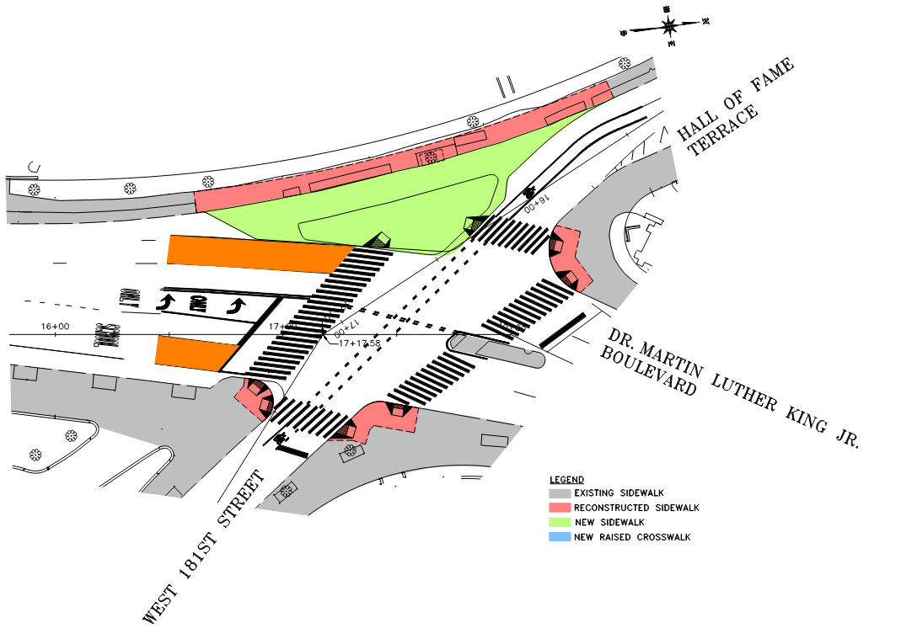
WEST 181ST ST/HALL OF FAME

Slide 39
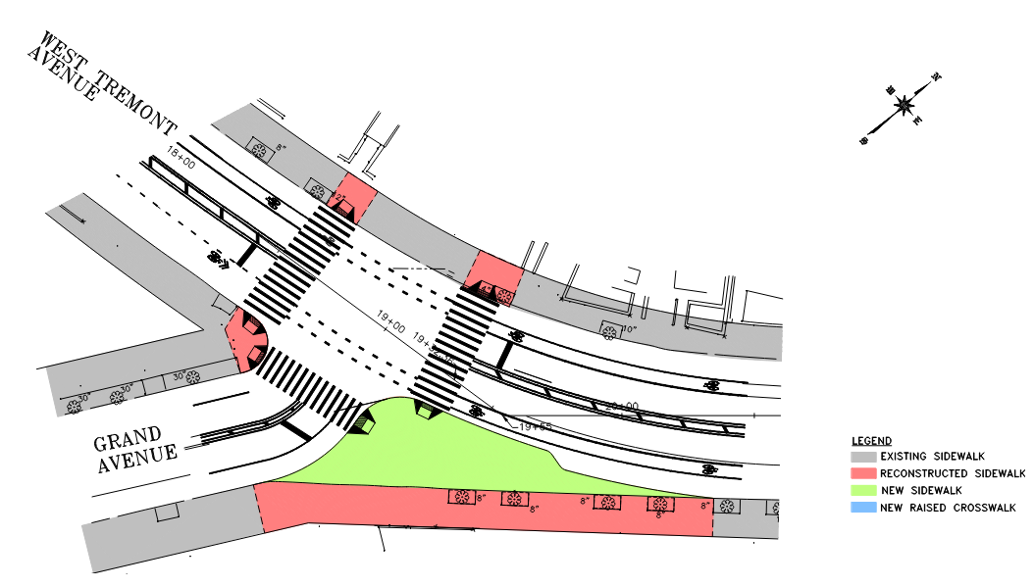
WEST TREMONT AVE/GRAND AVE

Slide 40
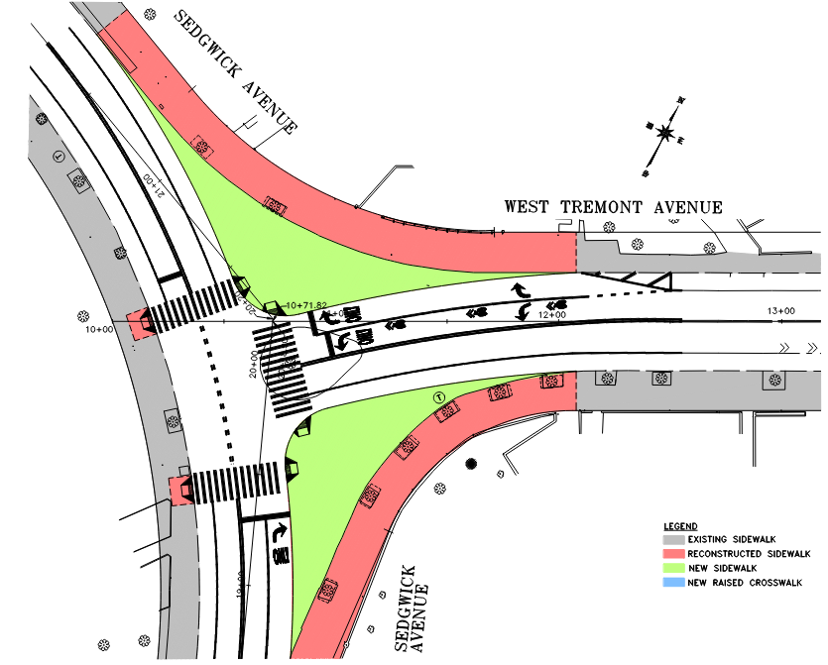
WEST TREMONT AVE/SEDGWICK AVE

Slide 41
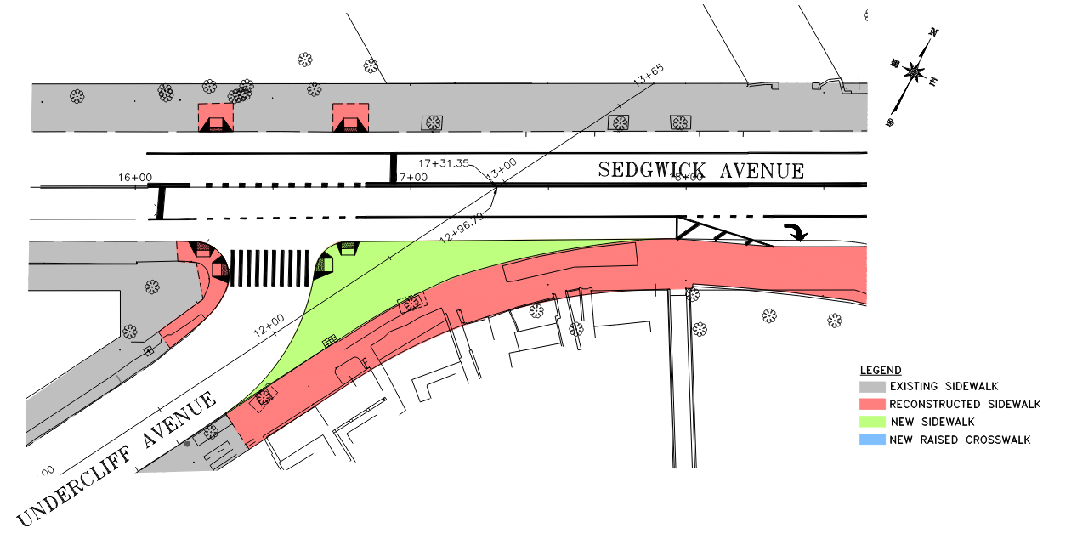
SEDGWICK AVE/UNDERCLIFF AVE

