Slide 1



M A N H A T T A N C O M M U N I T Y B O A R D # 12
S O U T H B R O N X E A S T - W E S T C R O S S T O W N S B S –
B R O N X / M A N H A T T A N
P R O J E C T B O R O U G H
I D : H W X 1 0 0 S B C O F M A N H A T T A N
Zohran K. Mamdani
Mayor
Paul A. Ochoa
Commissioner
May 4, 2 0 2 6

Slide 2


Agenda:
Project Overview
Project Limits
Project Goals
Proposed Storage
Typical Maintenance and Protection of Traffic
Community Impacts & Mitigation
Community Outreach
Project Schedule
Q&A
HWX100SBC – South Bronx East-West Crosstown SBS Borough of Manhattan
AGENDA
2

Slide 3

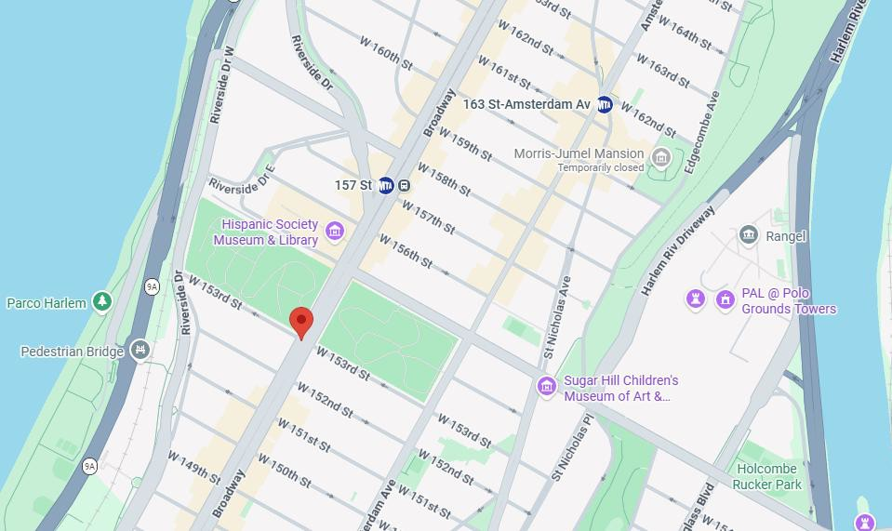


OVERVIEW:
Manhattan transit operations and pedestrian safety improvements located in: CB9, CB10, & CB12
CB 12
CB 10
CB 9
HWX100SBC – South Bronx East-West Crosstown SBS
Borough of Manhattan
PROJECT GOALS
3

Slide 4

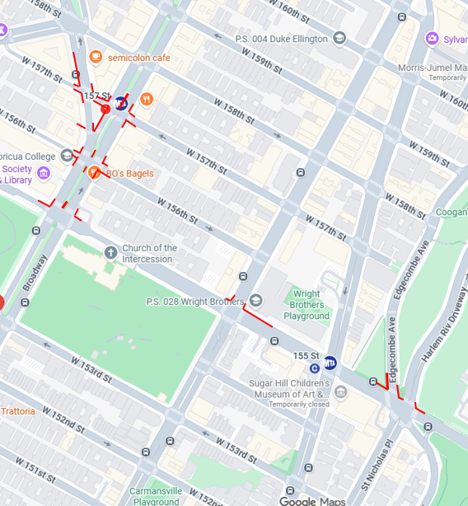
PROJECT LIMITS: CB12
On Broadway between W 157th ST & W 155th St
Traffic signal relocation
New manhole installation
Catch basin removal
Existing gas valve
Sidewalk expansion
Signal pole relocation
Street light relocation
Sidewalk reconstruction
On Amsterdam Ave & W 155th St
Expansion of sidewalk/ bus bulb installation
Traffic light/signal relocation
Streetlight/traffic signal with pedestrian sign removal
Fire hydrant relocation
On Nicholas Pl & W 155th St
New 15” combined Sewer Installation
Sidewalk expansion
Manhole installation
CB 12
Amsterdam Ave
W 155th St
St Nicholas Ave
HWX100SBC – South Bronx East-West Crosstown SBS
Borough of Manhattan
PROJECT LIMITS
4

Slide 5

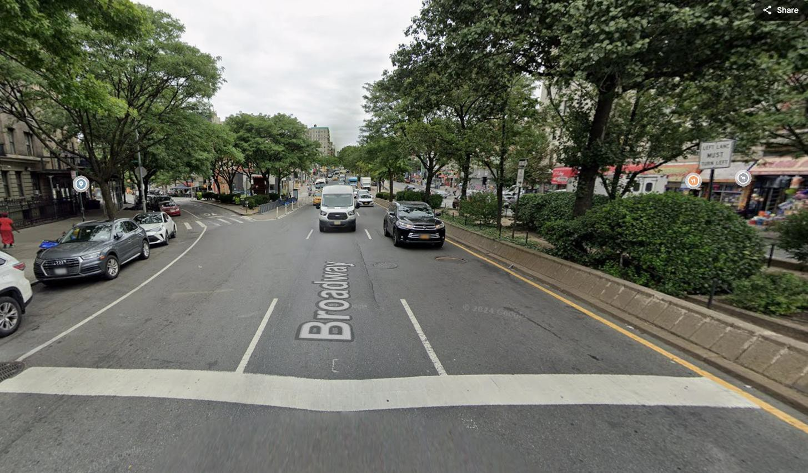
PROJECT GOALS:
Improve transit operations with the addition of bus pads, bus bulbs, curb and median extensions, and pedestrian refuge islands.
This project will build upon prior operational DOT street improvements by permanently building out the above transit amenities along the corridor.
HWX100SBC – South Bronx East-West Crosstown SBS
Borough of Manhattan
PROJECT GOALS
5

Slide 6
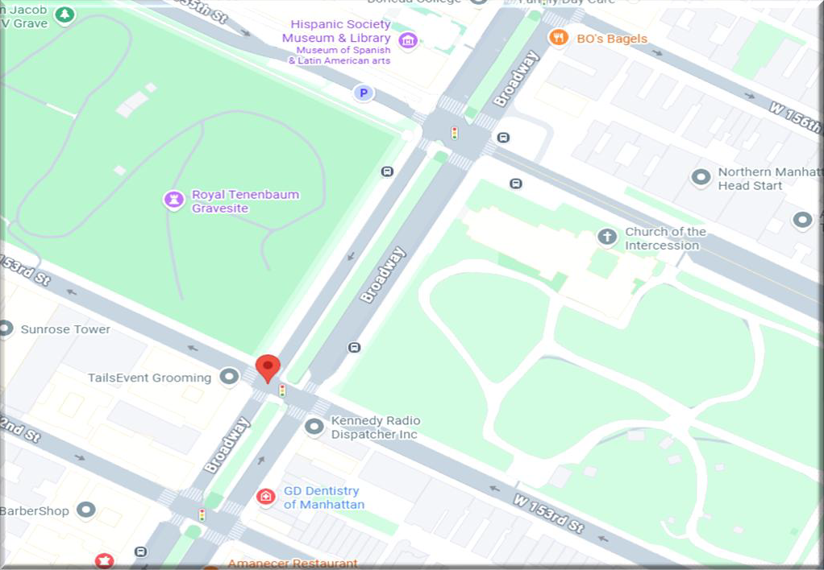
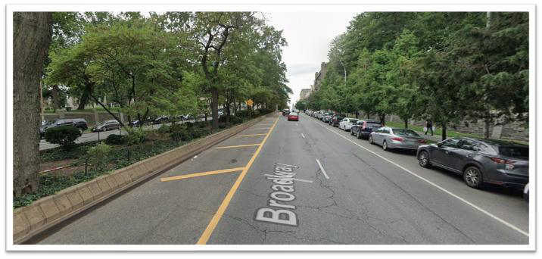
PROJECT STORAGE: CB 12
The shaded area is a tentative location for staging. The contractor will determine if he will utilize this space as we get closer to the start of work in Manhattan or once on-site
Though the space selected for storage is within CB 9 limits, it will likely remain the staging area for the work that falls with CB 12 as the limits are so close to one another.
Anticipated staging area will be on
Broadway between W 153rd St – W 155th St.
This area is a no standing area on Broadway which will help to minimize the impact to parking.
Photo for reference – flow of traffic on Broadway facing SW

Slide 7
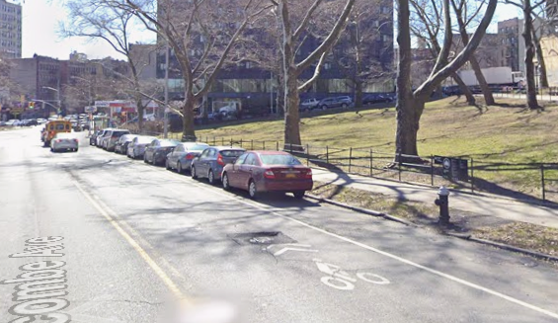
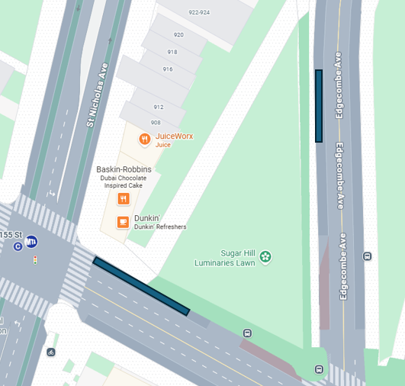
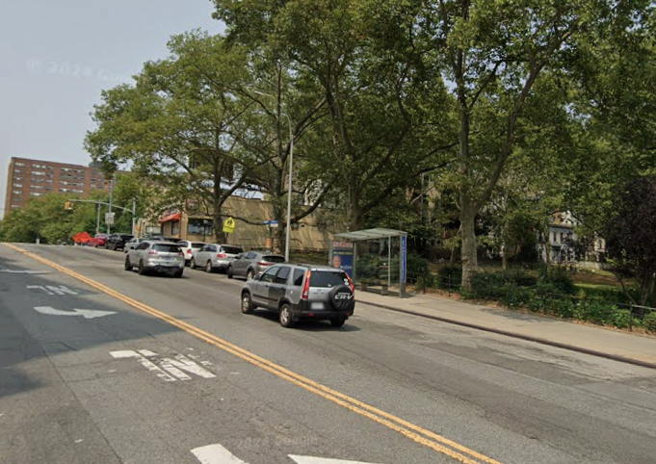
CONT’D PROJECT STORAGE: CB 12
Bus Stop
Edgecombe Ave between W 155th ST and W 158th St
Staging area On W 155th St between St Nicholas Ave and Edgecombe Ave.
Storage stops before bus lane.
Small temporary storage for the pipes as there is concern for storing them on a hill.
Just before a pump, taking about 4 spaces.
Once pipes have been installed, the spaces will be returned.
W 155th ST
E 155th St between St Nicholas Ave and Edgecombe Ave

Slide 8
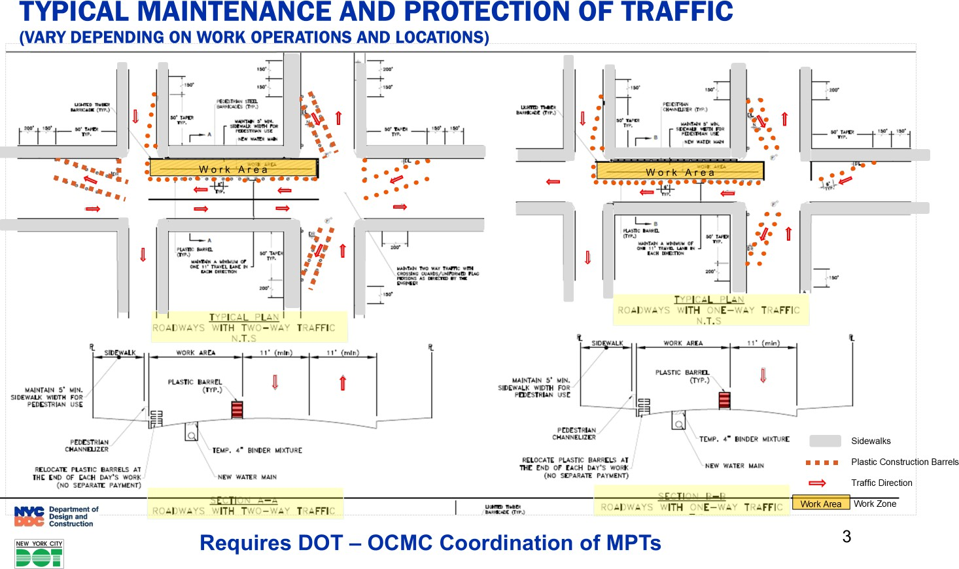

TYPICAL MAINTENANCE AND PROTECTION OF TRAFFIC
Contract Provisions:
Traffic Enforcement Agents (TEAs) have been approved on this project to maintain traffic flow.
Contractor will provide flaggers at key points throughout work zones to safely maintain movement of construction vehicles.
For illustration purposes only
HWX100SBC – South Bronx East-West Crosstown SBS
Borough of Manhattan
MPT
7

Slide 9

COMMUNITY IMPACTS DURING CONSTRUCTION
Roadway lane closures, as necessary
Temporary loss of parking at certain work zones
Temporary relocation of bus stops
Scheduled water main service shut-downs
•
Street Vendors/ Dining Out NYC coordination, as needed
Weekend hours for construction may be necessary
HWX100SBC – South Bronx East-West Crosstown SBS
Borough of Manhattan
COMMUNITY IMPACTS
8

Slide 10

COMMUNITY IMPACTS & MITIGATIONS
Contractor shall:
Work within DEP Noise Code Regulations
Keep storage site areas clean and safe
Cover trucks delivering fill material
Provide professional rodent control inspector to monitor/maintain Rodent Control Station
Garbage pick-up may be affected and will be coordinated with appropriate stakeholders and in coordination with DSNY.
TRAFFIC PATTERNS
Contractors shall maintain the following:
Signage and personnel to ensure a safe work site for pedestrians and vehicles
Maintain pedestrian access to sidewalks, crosswalks and buildings
Always maintain emergency/ through way traffic
Plate and open roadway traffic when site is unattended/ not in use
Parking and driveway access may be restricted when necessary; coordination is done on a case-by-case basis;
signs will be posted in advance of work to avoid towing of vehicles.
Full roadway closures – intermittent and when necessary
9

Slide 11
COMMUNITY OUTREACH PROCEDURES:
Community Construction Liaison (CCL) responsibilities are as follows:
First point of contact, maintain on-site presence and communications.
Identify, resolve, and/or proactively address issues and inquiries.
Distribute advisories and weekly construction activities newsletter.
Provide 72-hour and 24-hour (confirmation or cancellation) advisories for work impacts by email and door to door.
Attend community board monthly DSC meetings and other community meetings as necessary, to keep the community informed of the project schedule and impacts.
10
10

Slide 12
COMMUNITY OUTREACH CONT’D
DDC’s Office of Community Outreach + Notification (OCON) works with CB’s, BID’s, local businesses, and other community stakeholders impacted by construction.
DDC has assigned a dedicated on-site Community Construction Liaison (CCL)
The CCL assigned to this project is: Tara Figueroa, her information is listed below: Email: sbx.mansbs@hwx100sbc.com
Phone: 917-471-9825
Field Office Location: 400 E 167th St, 3rd fl
Bronx, NY 10456 Field Office Hours: 7AM to 3:30PM
DDC Project Lead: Kristen Cawthorn, cawthorkr@ddc.nyc.gov / 929.206.1334
11

Slide 13
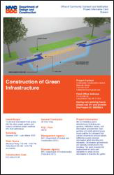
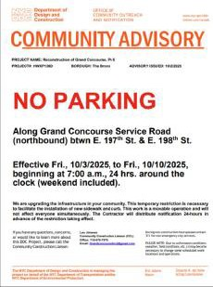
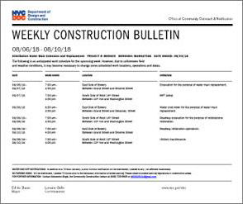
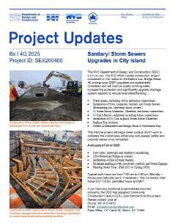


COMMUNITY CONSTRUCTION LIAISON INVOLVEMENT
Keeping You Informed
The on-site CCL works directly with the project team. CCL will address community concerns, respond to inquiries, attend meetings, as needed, as well as distribute project related materials to keep the community informed and notified.
PROJECT INFORMATION CARD (PIC)
ADVISORIES WEEKLY LOOK AHEAD BULLETIN
QUARTERLY UPDATES
14
HWX100SBC – South Bronx East-West Crosstown SBS Borough of Manhattan
COMMUNITY LIAISON INVOLVEMENT
14

Slide 14




PROJECT SCHEDULE
Design Completion - September 2024
Construction Start - Early 2026
Construction start for Manhattan: Tentative – early summer 2026
Anticipated Construction Completion – Summer/Fall 2028
2019-
Design Start
2022-2023 -
Community Board, BID & Elected Officials Presentation meetings
April 2023-Mass Mailing #1
October 2023-
Mass Mailing #2
Fall 2024-Design Completion
Early 2026 Construction Start.
Summer/Fall 2028 Anticipated Construction Completion
HWX100SBC – South Bronx East-West Crosstown SBS
Borough of Manhattan
PROJECT SCHEDULE
15

Slide 15

T H A N K Y O U
Q & A
Zohran K. Mamdani
Mayor
Paul A. Ochoa
Commissioner

