Slide 1
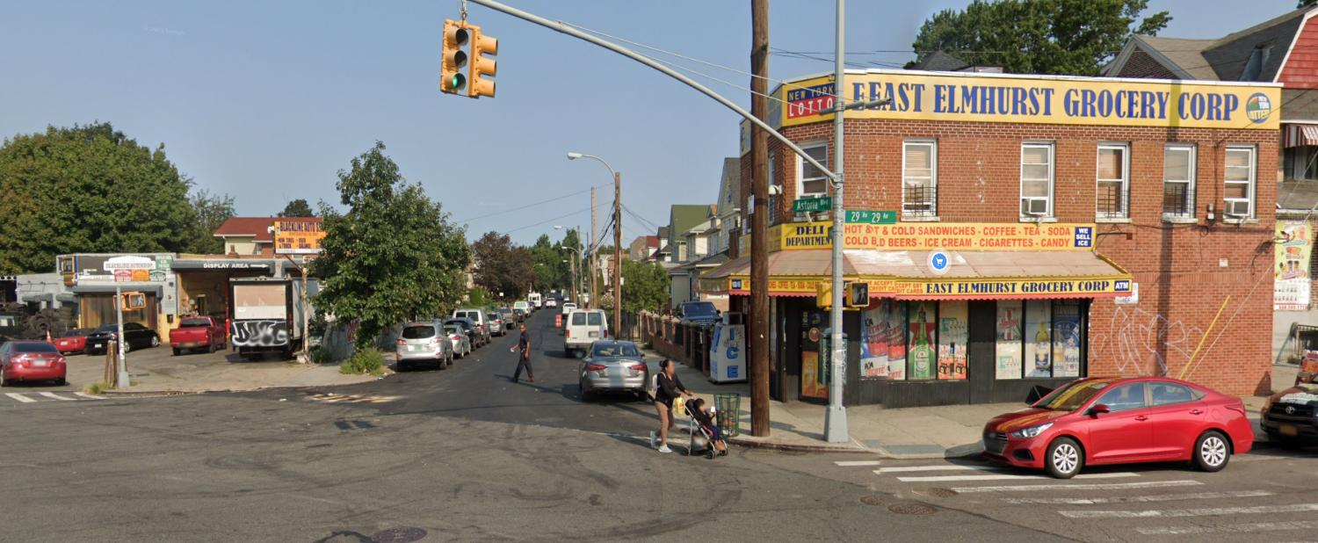


Project ID: HWQ1201
Astoria Boulevard Safety Improvements
Borough of Queens
QUEENS COMMUNITY BOARD NO. 3 – TRANSPORTATION COMMITTEE
February, 2026

Slide 2
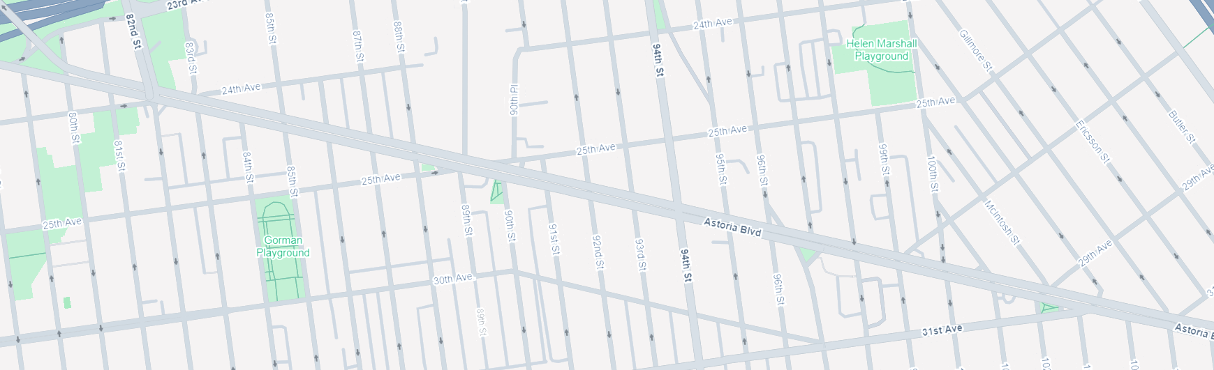

Project Overview
“LOCATION A”
“LOCATION B”
“LOCATION C”
ESTIMATED CONSTRUCTION COST: $15.6M Project
PROJECT IS BROKEN DOWN INTO 3 DIFFERENT LOCATIONS ALONG ASTORIA BOULEVARD
LOCATION A:
ASTORIA BOULEVARD BETWEEN 80TH STREET & 84TH STREET
24th AVENUE BETWEEN 81ST STREET & 84TH STREET
LOCATION B
ASTORIA BOULEVARD BETWEEN 88TH STREET & 90TH STREET
25TH AVENUE BETWEEN 88TH STREET & 90TH STREET
LOCATION C
ASTORIA BOULEVARD BETWEEN 102ND STREET & HUMPHREYS STREET
$1.00M from Reso Fund
$2.00M HUD Funding – Non City Fund
REMAINING FUNDS PROVIDED BY CITY
Crash Summary, 2019-2021 (3 years)
 | Total Crashes
Pedestrian | 3
Bicyclists | 3
Motor Vehicle Occupant | 59
Total | 65

Slide 3
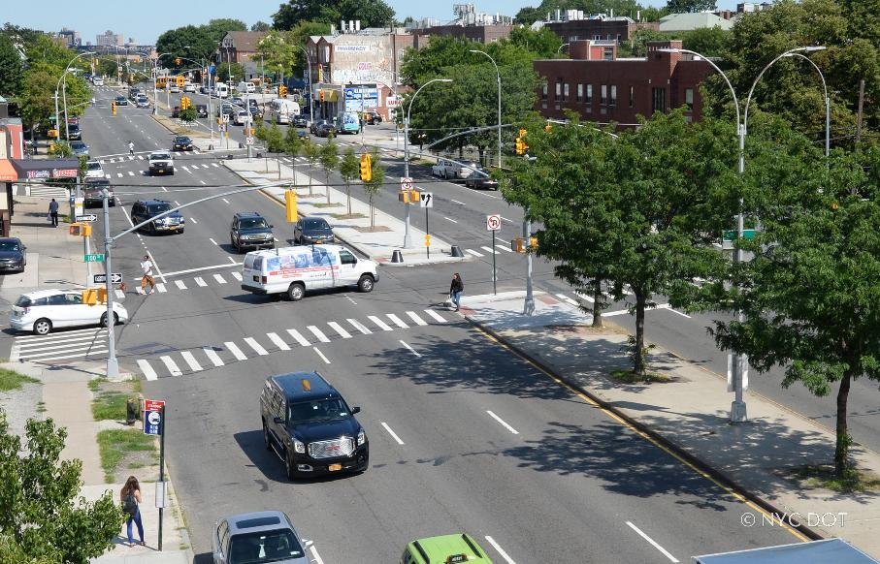
PROJECT GOALS
ENHANCE PEDESTRIAN SAFETY AND SHORTEN PEDESTRIAN CROSSINGS
IMPROVE PEDESTRIAN CIRCULATION
CREATE ADA COMPLIANT CROSSINGS/RAMPS
REDUCE CONFLICTS BETWEEN PEDESTRIANS, CARS & BIKES
IMPROVE BUS STOP & BOARDING CONDITION FOR PEDESTRIANS
nyc.gov/dot

Slide 4
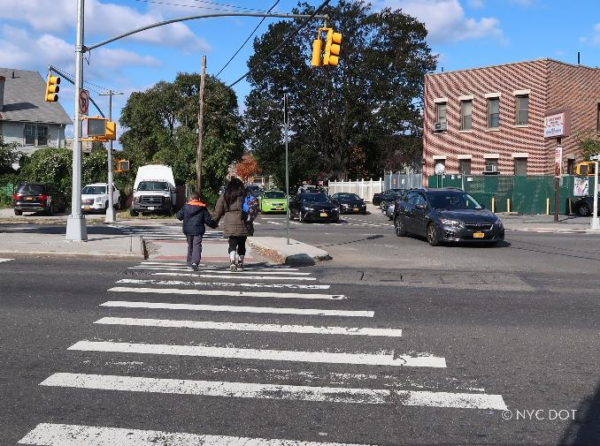
SCOPE OF WORK
CONSTRUCT NEW CURB, CURB RAMPS & MEDIAN TIP EXTENSIONS
CONSTRUCT NEW BUS BULBS
CONSTRUCT NEW RETAINING WALLS
CREATE NEW LEFT TURN BAYS & CROSSWALKS
IMPROVE BICYCLE LANE CONNECTIVITY
ADD LANDSCAPING, BENCHES AND LEANING BARS AT VARIOUS LOCATIONS
RELOCATE EXISTING FIRE HYDRANTS TO NEW CURB LINE AS NEEDED
RESET UTILITY MANHOLES AND GRATES TO RECONSTRUCTED ROADWAY SURFACE
INSTALL ROADWAY DRAINAGE CATCH BASINS AS NEEDED TO REDUCE PONDING. NEW CATCH BASINS TO CONNECT TO EXISTING STORM SEWER SYSTEM. NO MAJOR STORM SEWER PIPE RECONSTRUCTION ANTICIPATED.

Slide 5
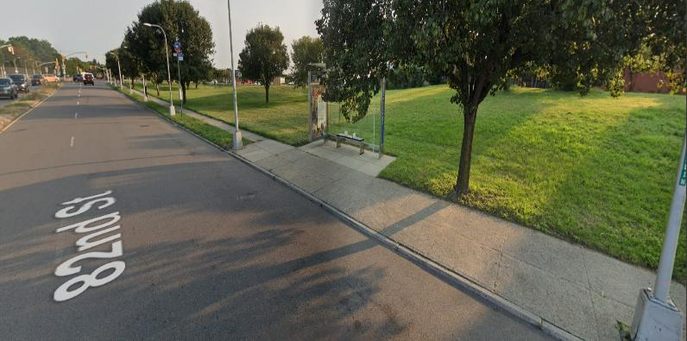
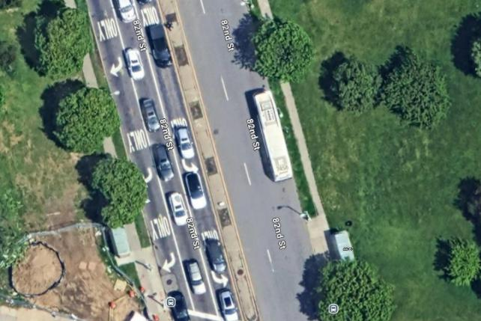
Existing Conditions – Location A
82nd St
Astoria Blvd & 82nd Street:
No Bus Bulb or Bus Pad
5

Slide 6
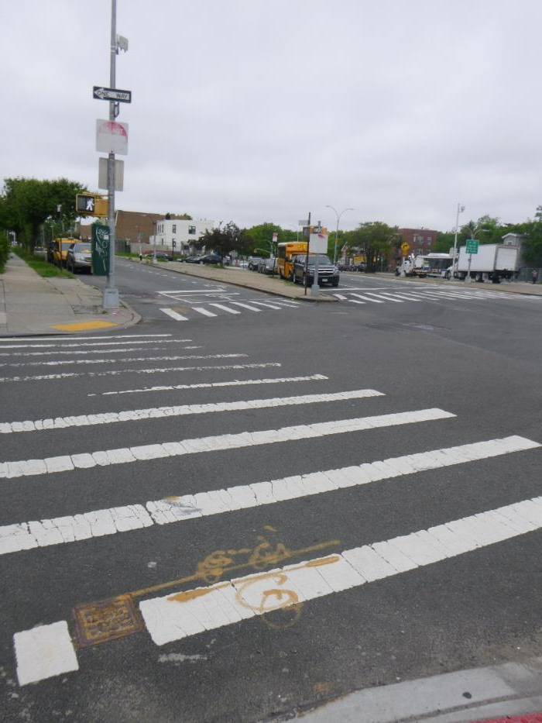
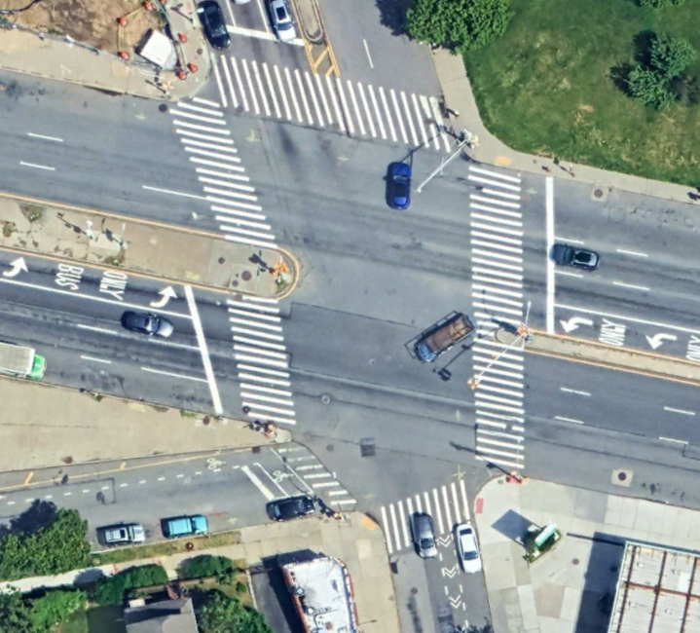
Existing Conditions – Location A
Astoria Blvd, 82nd Street & 24th Ave:
Long Walking Distance for Pedestrians to Cross Major Roadway
82nd St
Astoria Blvd
24th Ave

Slide 7
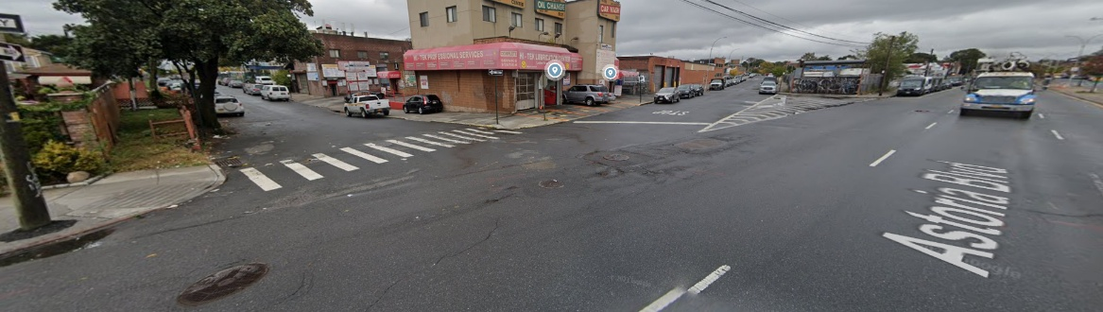
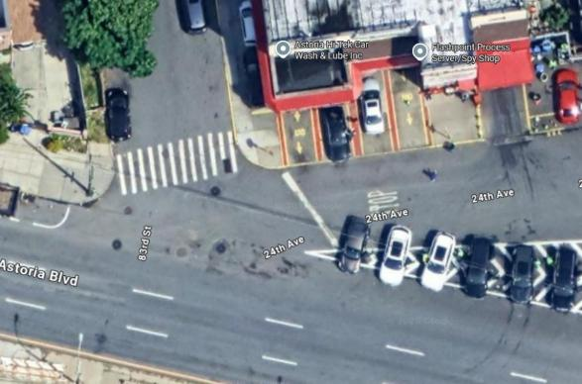
Existing Conditions – Location A
24th Ave
83rd St
83rd St
24th Ave
Astoria Blvd & 24th Avenue:
No Pedestrian Access Route
Astoria Blvd
7

Slide 8
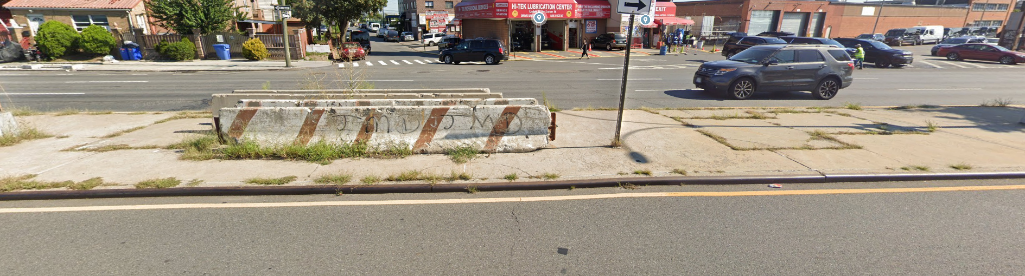
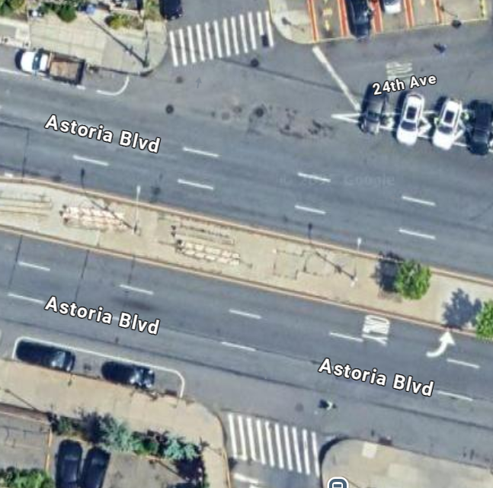
Existing Conditions – Location A
Astoria Blvd & 83rd Street:
No Pedestrian Crossing

Slide 9
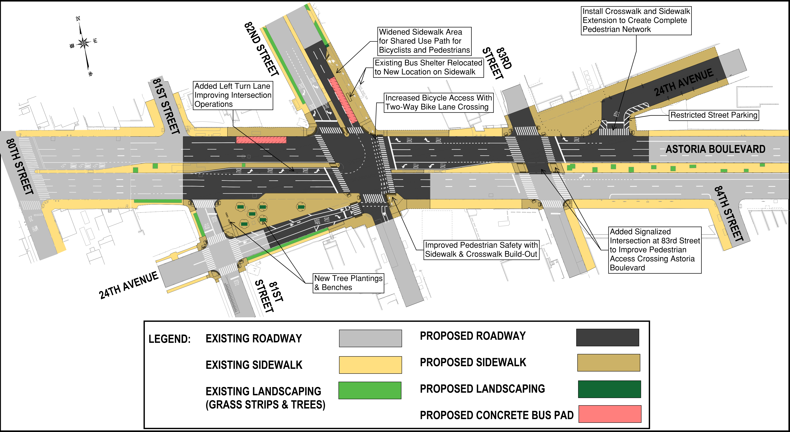
PROJECT IMPROVEMENTS – LOCATION A

Slide 10
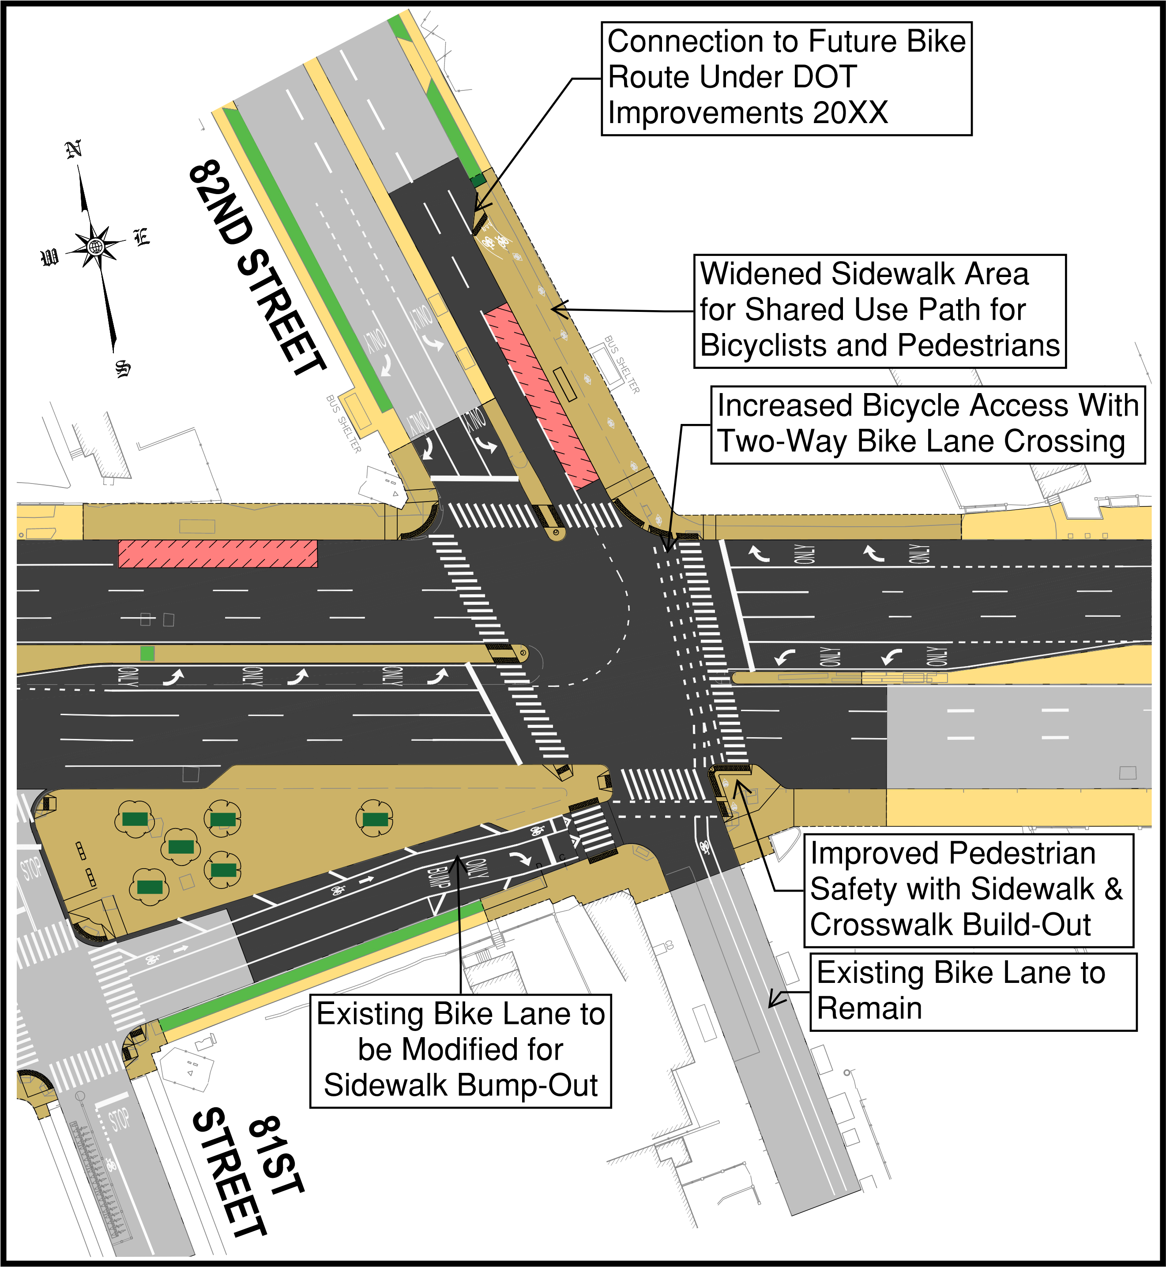
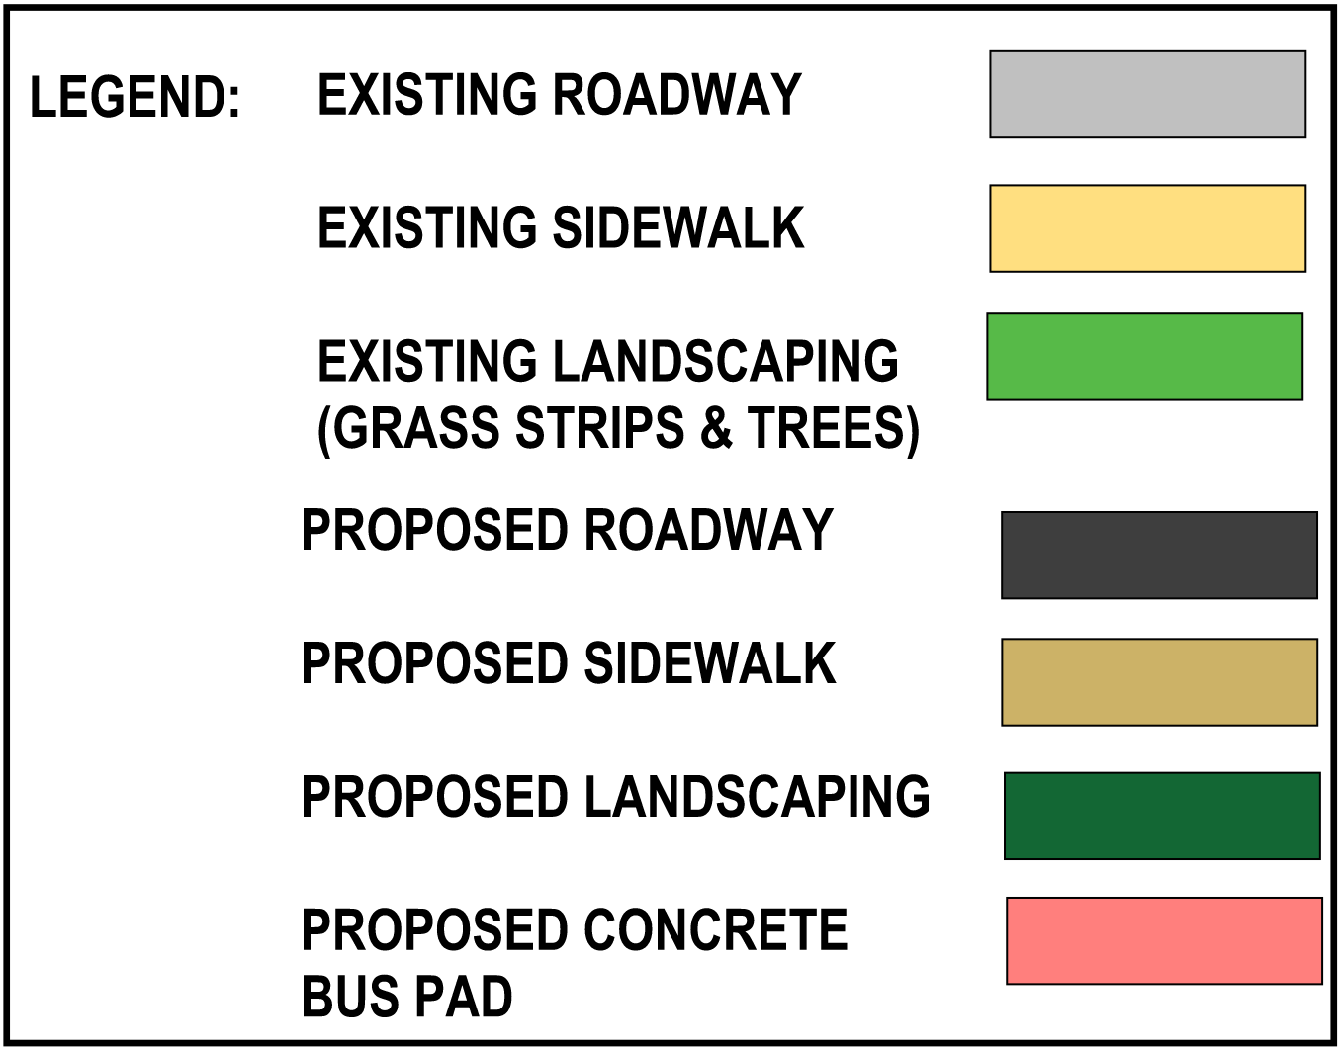
PROJECT IMPROVEMENTS LOCATION A – BICYCLE LANE CONNECTIVITY

Slide 11
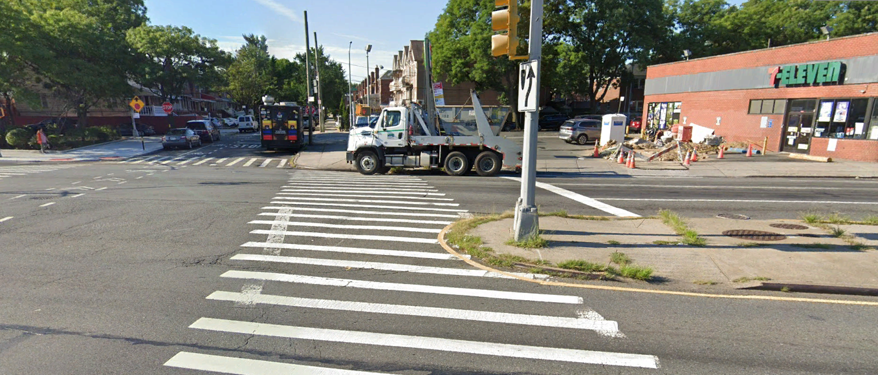
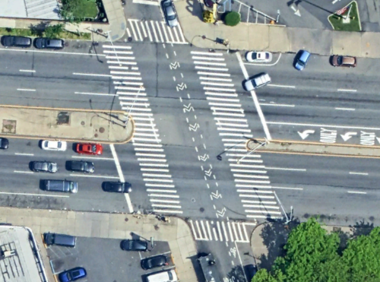
Existing Conditions – Location B
88th Street
Astoria Blvd
Astoria Blvd
Astoria Blvd & 88th Street:
Non-ADA Compliant Median Island and Corner Ramps for Pedestrian Crossing
88th Street
11

Slide 12
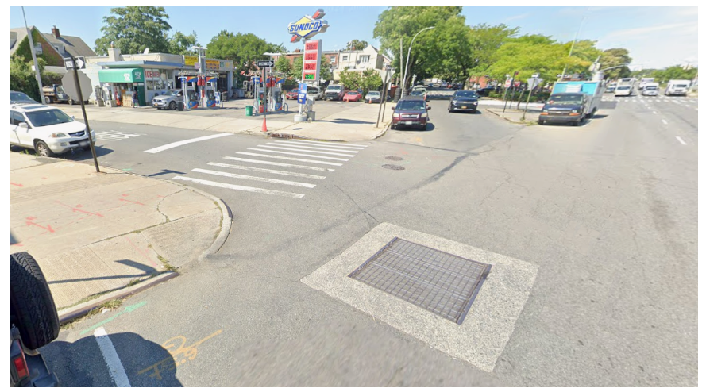
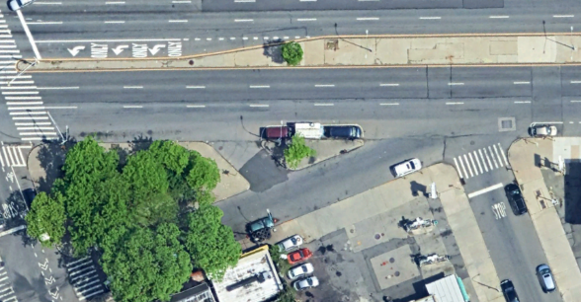
Existing Conditions – Location B
89th Street
25th Ave
Astoria Blvd
Astoria Blvd
Astoria Blvd & 89th Street & 25th Avenue:
No Pedestrian Access Route and Long Walking Distance for Pedestrian Crossing
25th Ave
89th Street
12

Slide 13
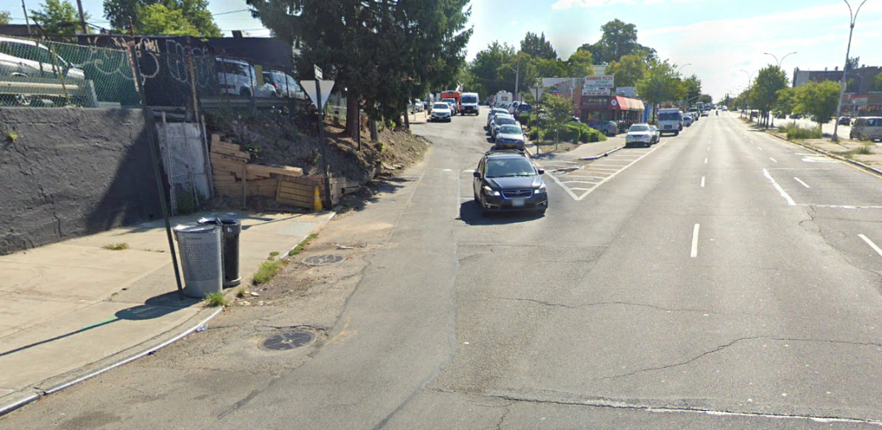
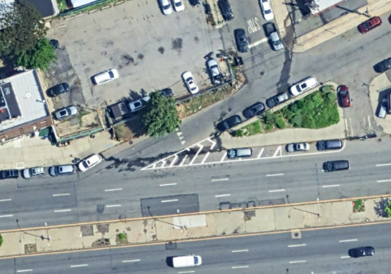
Existing Conditions – Location B
90th Place
25th Ave
Astoria Blvd
90th
Place
25th Ave
Astoria Blvd & 90th Place & 25th Avenue:
No Pedestrian Access Route
Astoria Blvd
13

Slide 14
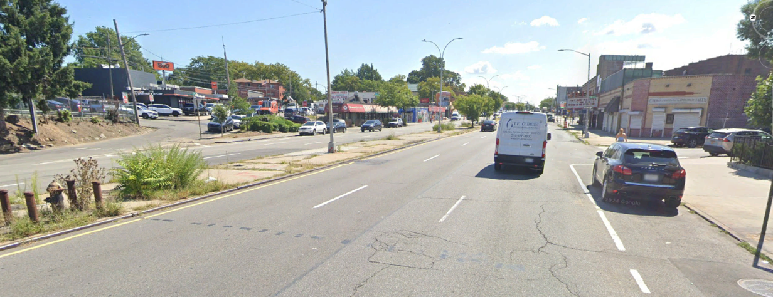
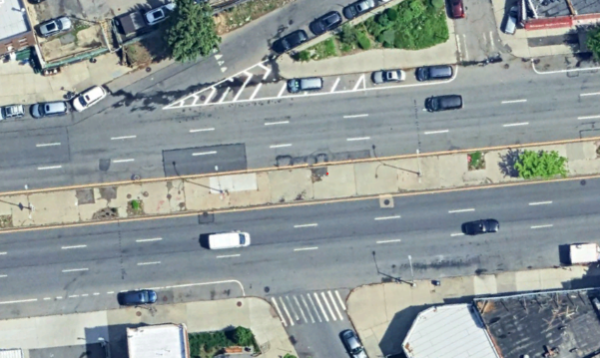
Existing Conditions – Location B
90th Place
25th Ave
90th Street
Astoria Blvd
25th Ave
Astoria Blvd
Astoria Blvd & 90th Place & 91st Street:
No Pedestrian Crossing
90th
Street
14

Slide 15
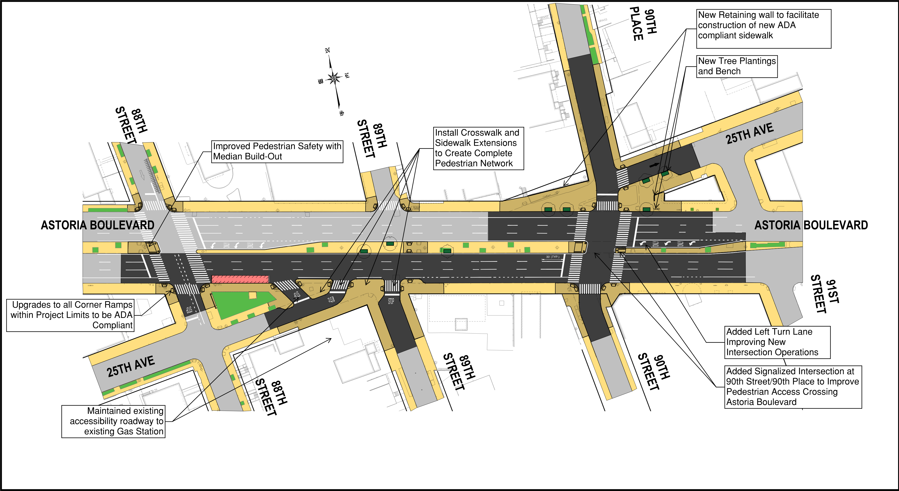
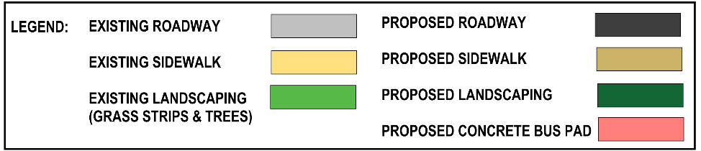
PROJECT IMPROVEMENTS – LOCATION B

Slide 16
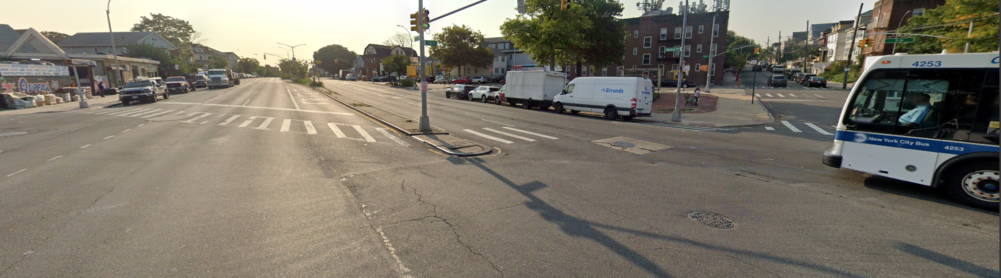
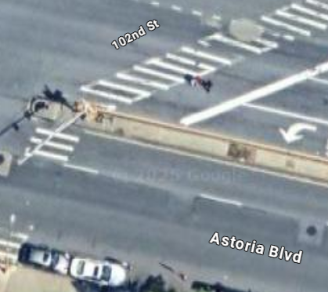
Existing Conditions – Location C
102nd St
Astoria Blvd
Astoria Blvd & 102nd Street: Non-ADA Compliant Median Island for Pedestrian Crossing
16

Slide 17
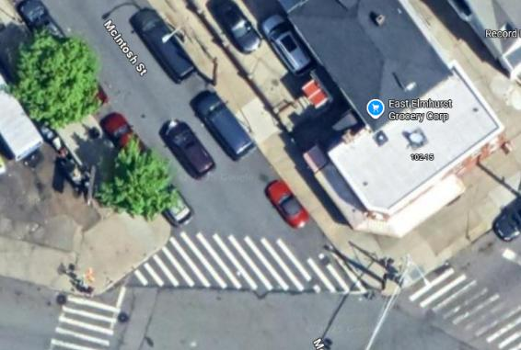
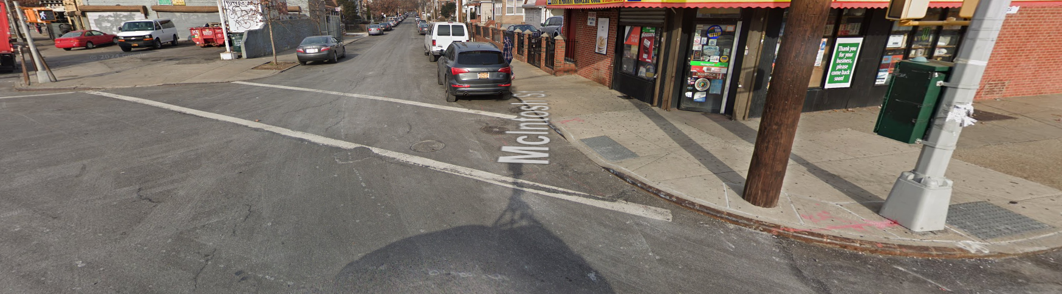
Existing Conditions – Location C
Astoria Blvd & McIntosh St / 29th Ave:
Skewed Crosswalk for Pedestrians to Cross Major Roadway
McIntosh St
Astoria Blvd
Astoria Blvd
17

Slide 18
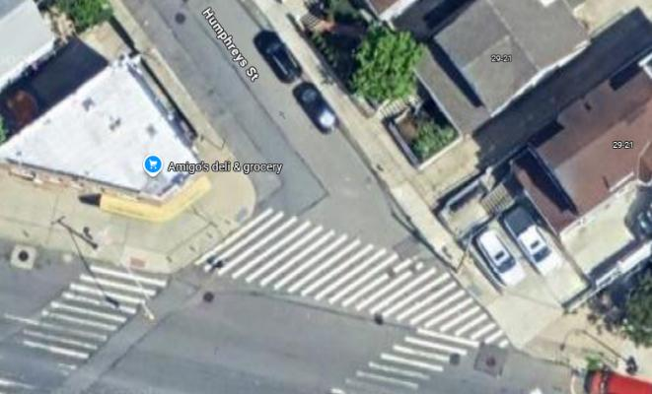
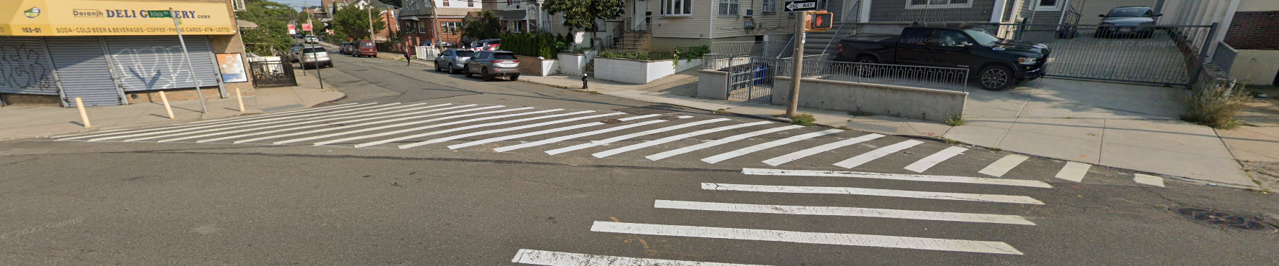
Existing Conditions – Location C
Astoria Blvd & Humphreys Street:
Skewed Crosswalk for Pedestrians to Cross Major Roadway
Humphreys St
Astoria Blvd
18

Slide 19
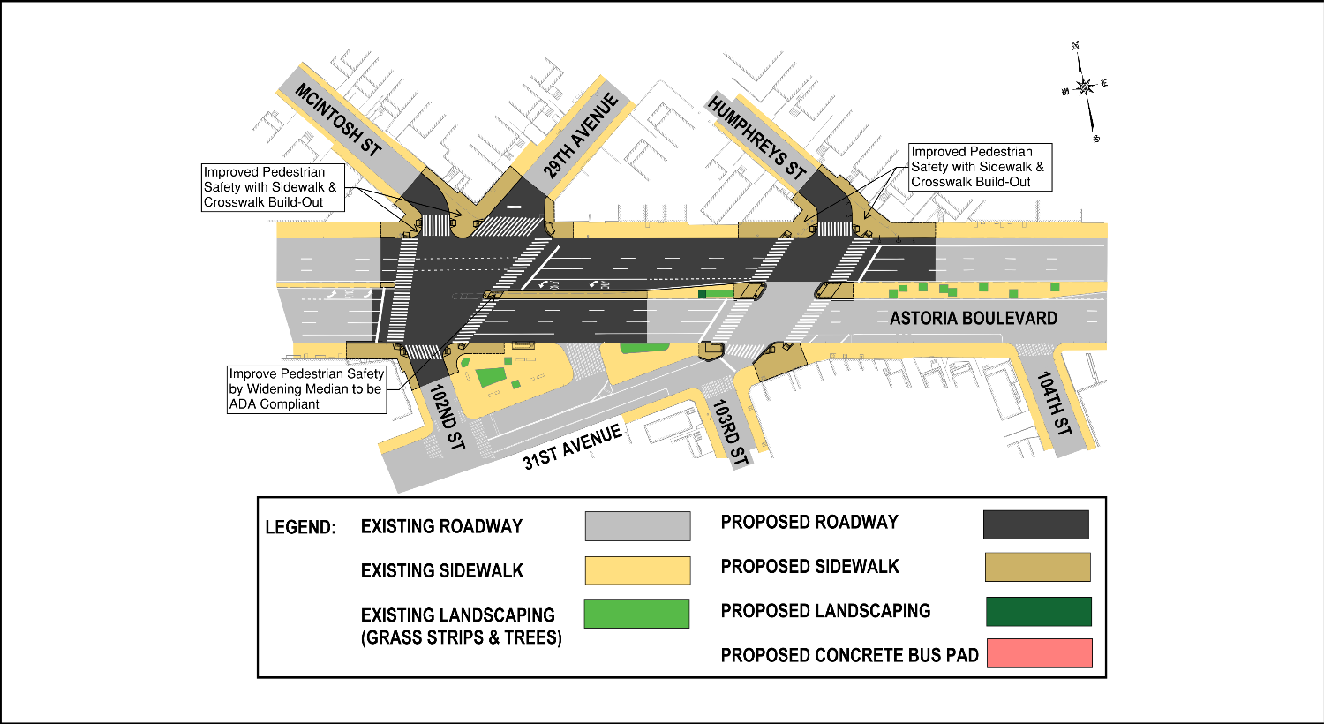
PROJECT IMPROVEMENTS – LOCATION C

Slide 20
PROJECT SCHEDULE
2026
2026
2027
2027
2029
January | Community Presentation and Outreach
February | Queens Community Board 3 Transportation Committee Presentation
January | Design Completion
Fall | Construction Begins (Estimated duration of construction procurement is 9 months)
Fall | Construction Ends (Estimated duration for full project construction is 24 months)

Slide 21
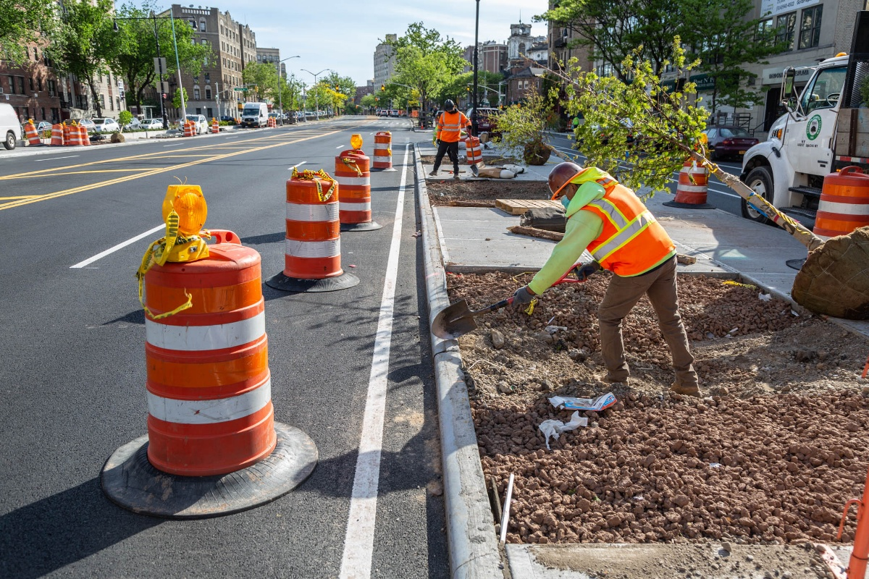
CONSTRUCTION PHASE
CONSTRUCTION STAGING TO MINIMIZE IMPACTS TO DRIVERS AND PEDESTRIANS ALONG THIS ROUTE DURING PEAK HOURS
CONTINUOUS COORDINATION WITH COMMERICIAL PROPERTIES TO REDUCE DISRUPTIONS TO BUSINESS ACTIVITIES
TREE IMPACTS WILL BE COORDINATED WITH NYC PARKS DEPARTMENT
POTENTIAL FOR SHORT TERM LANE CLOSURE AND REDUCED STREET PARKING
5. MEASURES TAKEN TO REDUCE SEDIMENT RUNOFF FROM CONSTRUCTION ACTIVITIES

Slide 22
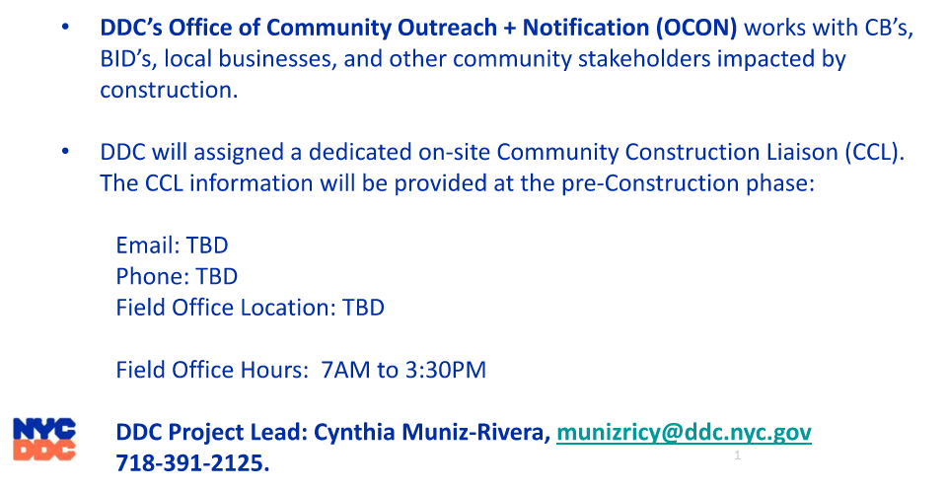
COMMUNITY OUTREACH

Slide 23
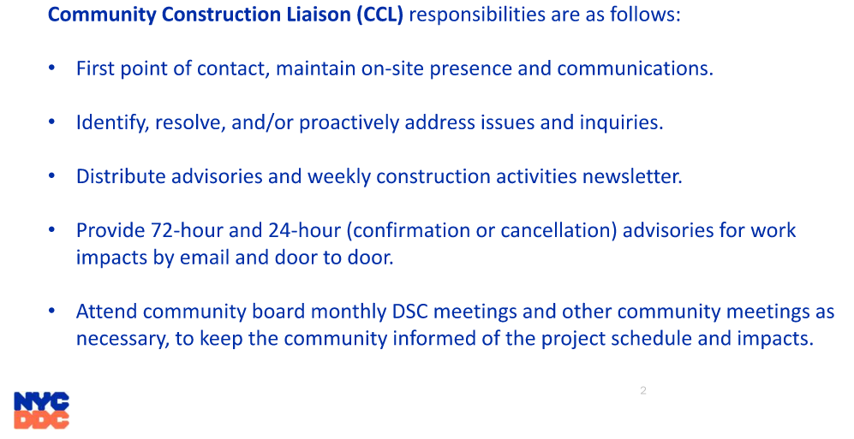
COMMUNITY OUTREACH (continued)

Slide 24
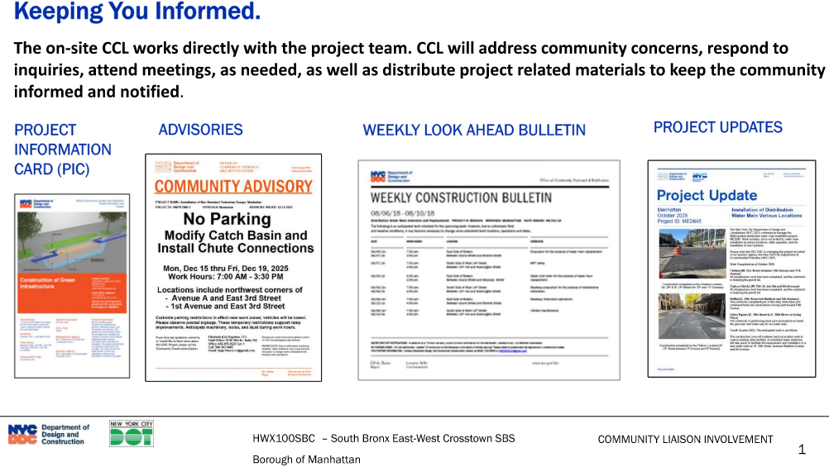
COMMUNITY CONSTRUCTION LIASON INVOLVEMENT

Slide 25
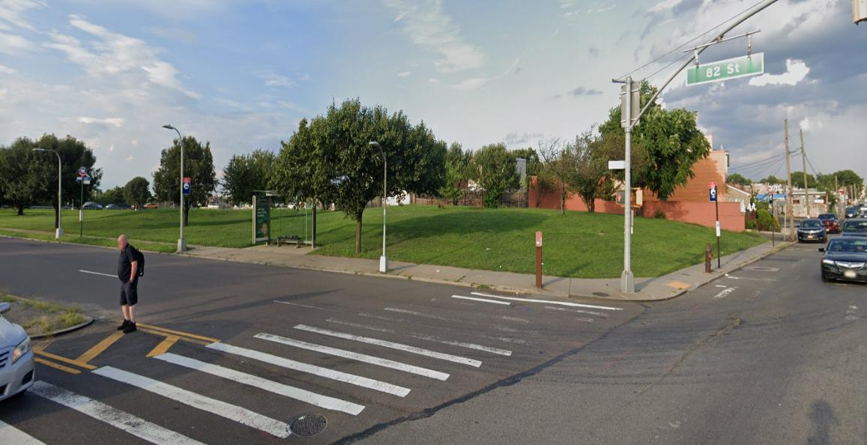


Questions?
Thank You

