Slide 1
Reconstruction of Montefiore Park & Plaza
Bill de Blasio
Mayor
Lorraine Grillo
NYC DDC Commissioner
February 3, 2021

Slide 2
agenda
About the Project
Completed Work
Remaining Work
Park Construction Progress
Final Renderings of the Park
Q & A
2

Slide 3
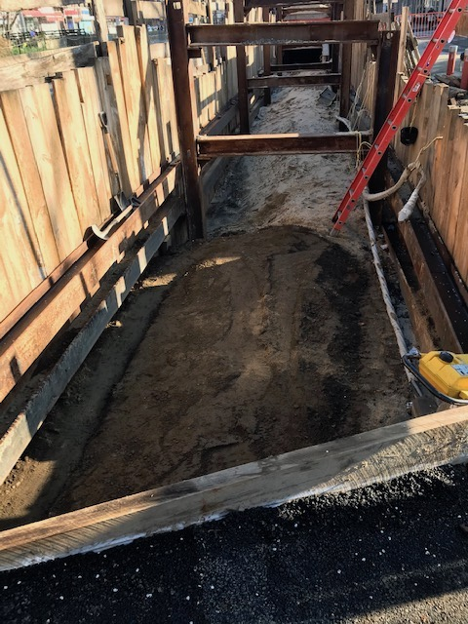
A brief description of the project
Scope of Work
Project Locations
Construction Overview

Slide 4
Scope of Work
Montefiore Park is being reconstructed completely, and it includes expansion onto Hamilton Place in order to create a pedestrian plaza.
New distribution water mains and trunk main replacement improve water delivery and flow to the neighborhood including fire hydrants.
Upgrades to utilities such as Con Edison increases reliability and improves service.
4

Slide 5
Scope of Work (continued)
Roadway improvements consist of full street resurfacing, bus stop reconstruction, and installation of catch basins and sewer manholes for better stormwater drainage.
Streetscaping upgrades include street lighting and traffic signal work, replacement of curbs and sidewalk, narrowing of roadways at intersections, and NYC WayFinding installation.
5

Slide 6
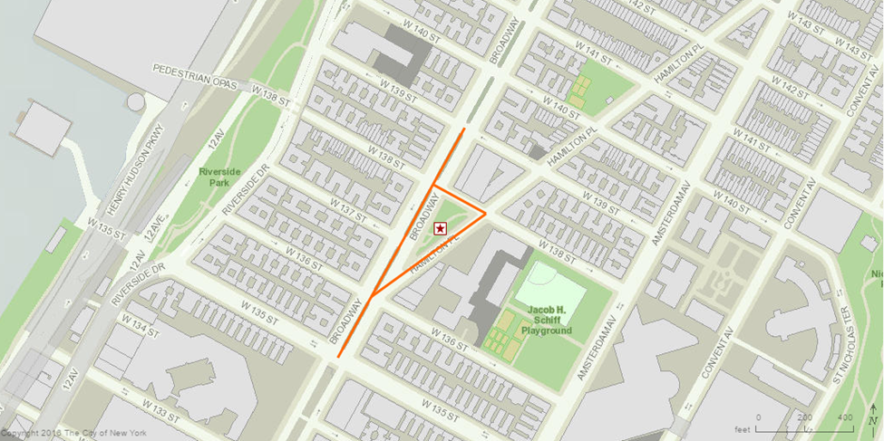
Project Locations
Broadway between W135th St. & W139th St.
Hamilton Pl. between W136th St. & W. 138th St.
W138th St. between Broadway & Hamilton Pl.

Slide 7
Construction Overview
Completed Work:
New Water Mains & Trunk Main Replacement
Private Utility Upgrades
New Catch Basins & Sewer Manholes Installation
Full Street Resurfacing & Bus Stop Reconstruction
7

Slide 8
Construction Overview
Remaining Work In Progress:
Park & Plaza Reconstruction including new benches, drinking fountain, granite paving and walls, lampposts, planting areas with trees, and steel fencing (for planting areas only)
Streetscaping including completion of sidewalk replacement and NYC WayFinding installation
8

Slide 9
CLICK TO EDIT HEADLINE TEXT
Edit text
PARK CONSTRUCTION
PROgress PHOTOS
9
9

Slide 10
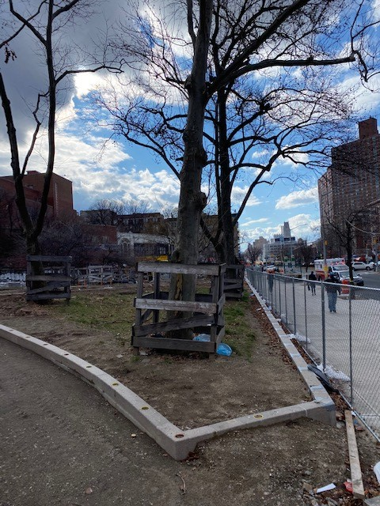
Granite Walls & Headers around West Planting Area

Slide 11
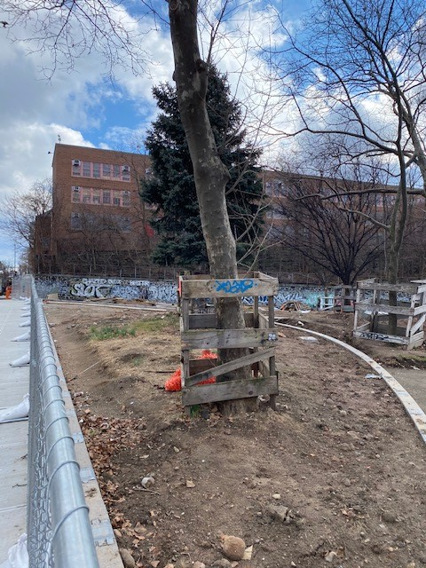
Granite Walls & Headers around North Planting Area

Slide 12
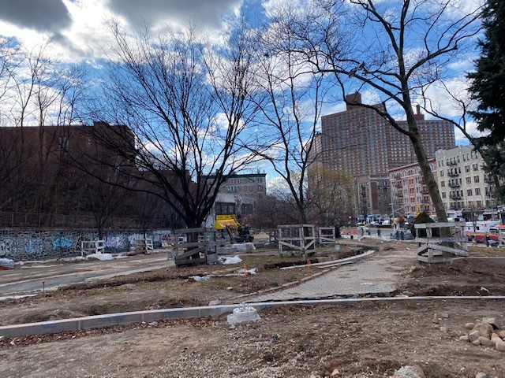
Foundation for Lamppost

Slide 13
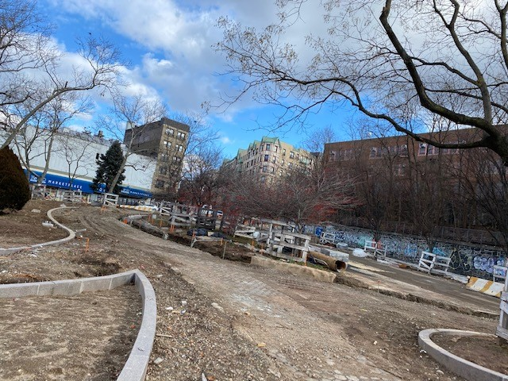
Excavation for Precast Concrete Paving

Slide 14
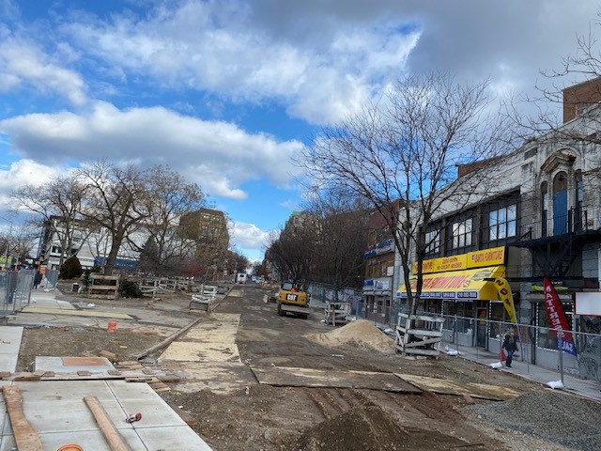
Excavation/ Demolition/ Grading of Hamilton Pl. between Broadway & W138th St. (for expanding park/plaza limits)

Slide 15
CLICK TO EDIT HEADLINE TEXT
Edit text
FINAL RENDERINGS OF THE PARK ANTICIPATED COMPLETION DATE:
SUMMER 2021
15
15

Slide 16
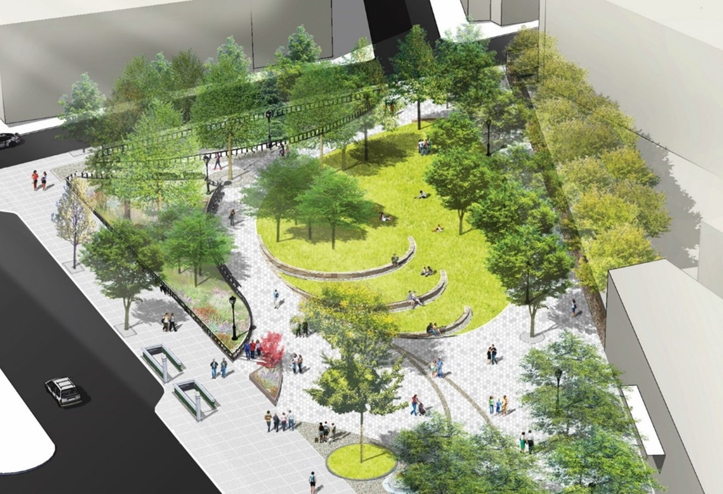
Rendering of New Granite Masonry Wall at South Side of Lawn

Slide 17
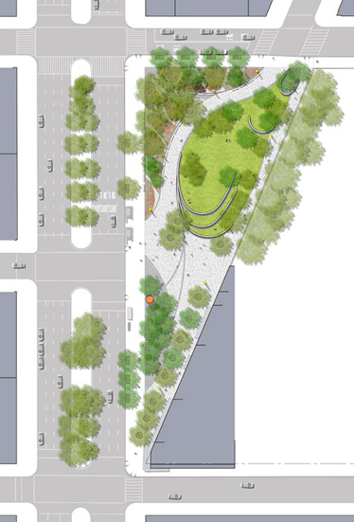
General Aerial View of New Park

Slide 18
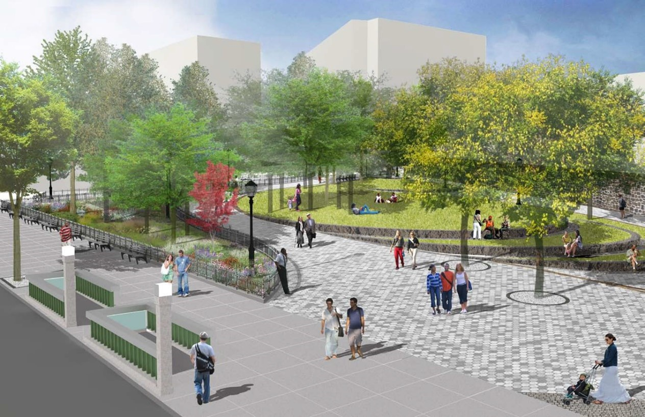
View of New Park Looking Northeast

Slide 19
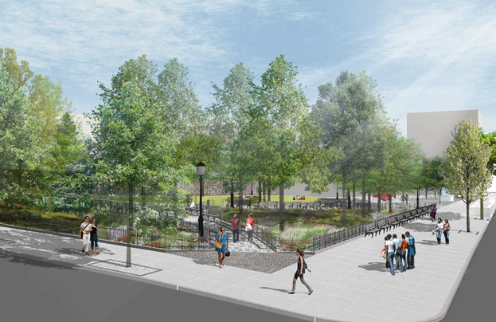
View of New Park Looking Southeast

Slide 20
Thank you!
Q&A

