Slide 1



Manhattan Construction - CB1 Quality of Life Meeting
July 16th, 2025
Eric Adams
Mayor
Eric C Macfarlane, P.E., M.ASCE, NAC, ENV-SP
First Deputy Commissioner
Ali Mallick, P.E.
Associate Commissioner | Construction Management
Thomas Foley, P.E., CCM, DBIA, NAC
Commissioner
Thomas Wynne, P.E.
Deputy Commissioner | Infrastructure
Walkman Wong, P.E.
Assistant Commissioner | Infrastructure | Manhattan Construction

Slide 2
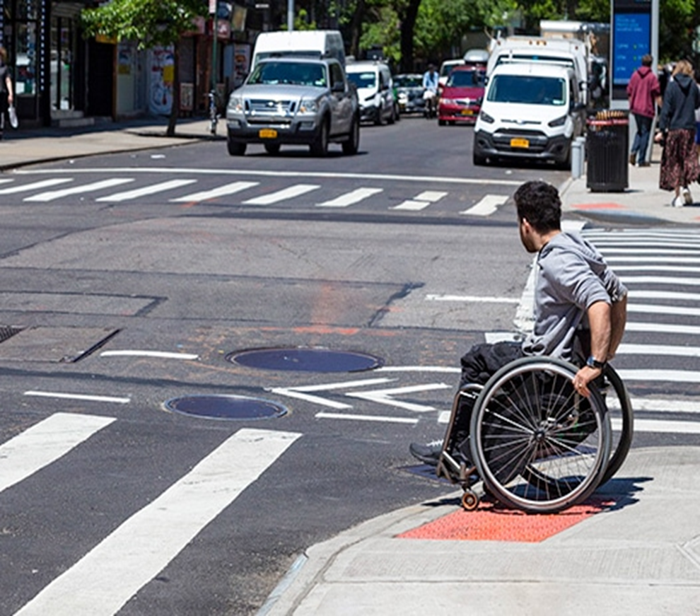

HWP19CWLM – Installation of Complex And Landmark Pedestrian Ramps
Scope of Work:
Construction of complex and landmark pedestrian ramps
Pavement marking
Curbs and sidewalk reconstruction
Street lighting and traffic signal replacements
Curb alignment modifications
Water main work and hydrant relocation
Catch basins, sewer manholes and chute connections
Locations Within Community Board 1:
1. Beaver Street & Hanover Street - Sf
2. Broadway & Leonard Street - UG
3. Broadway & Walker Street - UG
4. Church Street & Duane Street - UG
5. Franklin Street & Varick Street - Sf
6. Franklin Street & W Broadway Street - SF
7. Hudson Street & Duane Street - UG
8. Jay Street & Hudson Street - UG
9. Jay Street & Staple Street - UG
10. Laight Street & Collister Street - UG
11. North Moore Street & Hudson Street - Sf
12. Thomas Street & West Broadway Street - UG
13. White Street & 6th Avenue - Sf

Slide 3
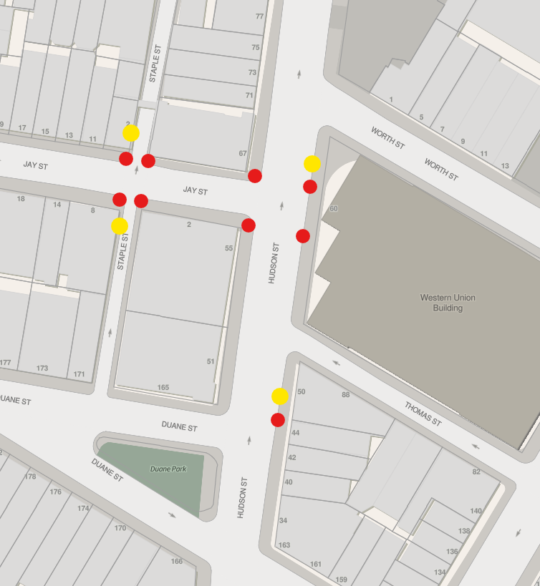
HWP19CWLM – Installation of Complex And Landmark Pedestrian Ramps
Progress and Status:
  Time Elapsed 41.96%
  Percent Complete 38.50%
Current Active Site:
Jay Street & Staple Street
Pending Site:
Laight Street & Collister Street
Phase 1 Completed:
Hudson Street & Jay Street
Hudson Street & Duane Street
Phase 1: (Underground)
Excavation
Utilities coordination for installation interferences
Catch basin, Manhole & chute connection Installation
Watermain & Hydrant connection
Yellow – Catch Basin
Red – Pedestrian Ramp

Slide 4
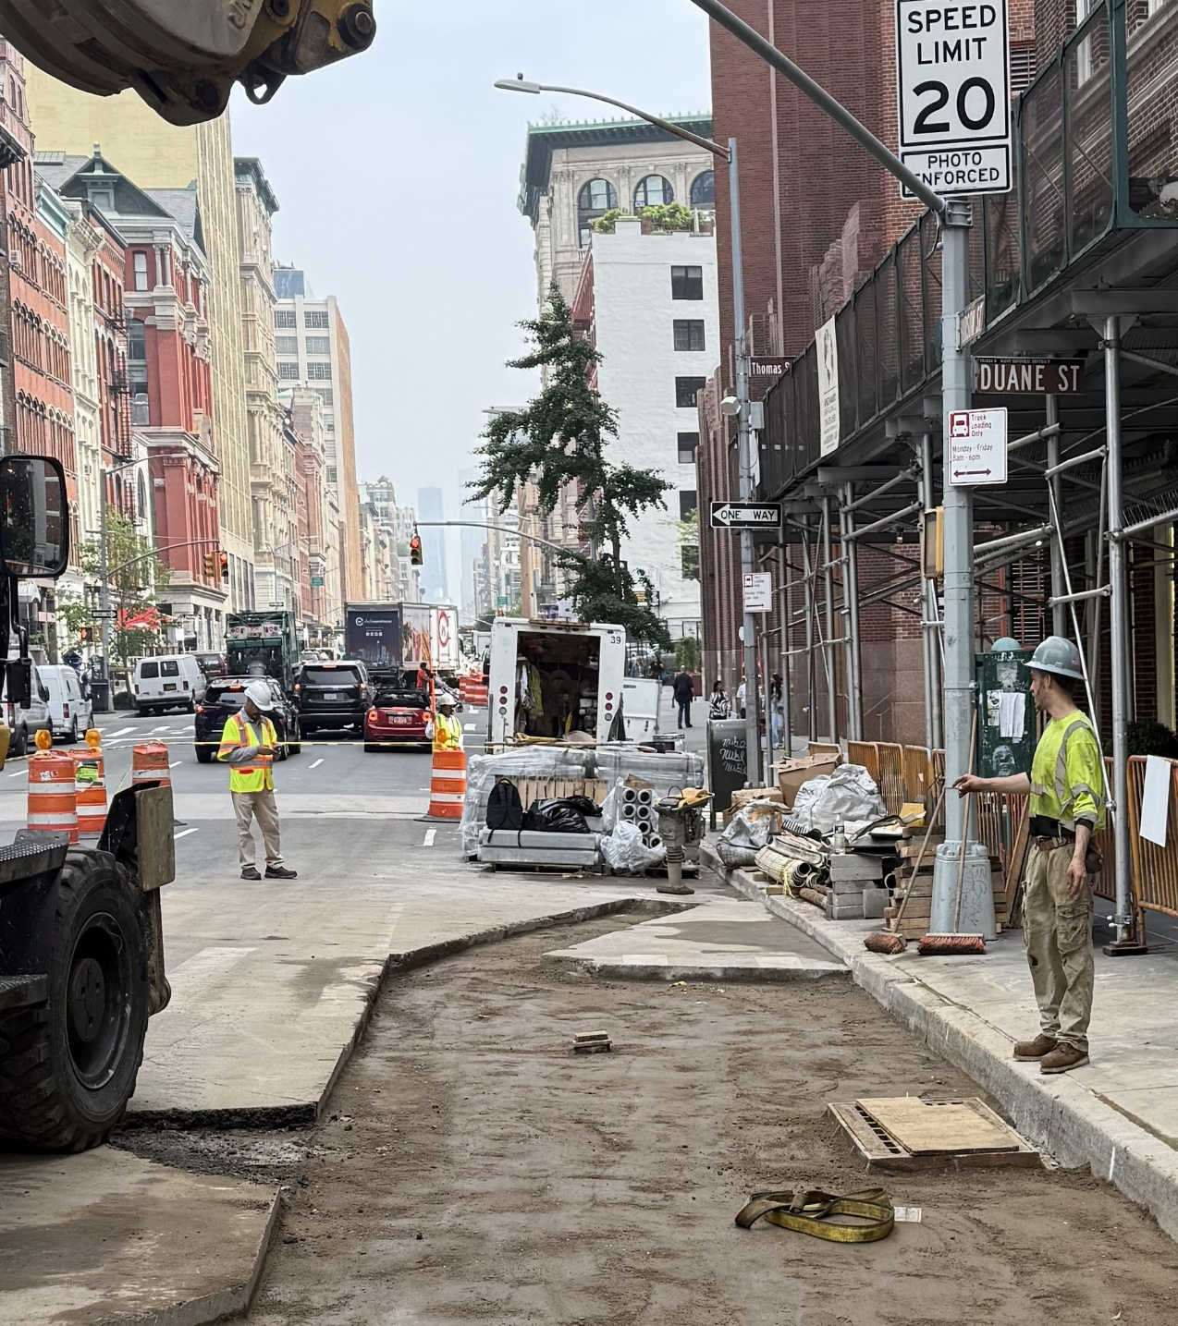
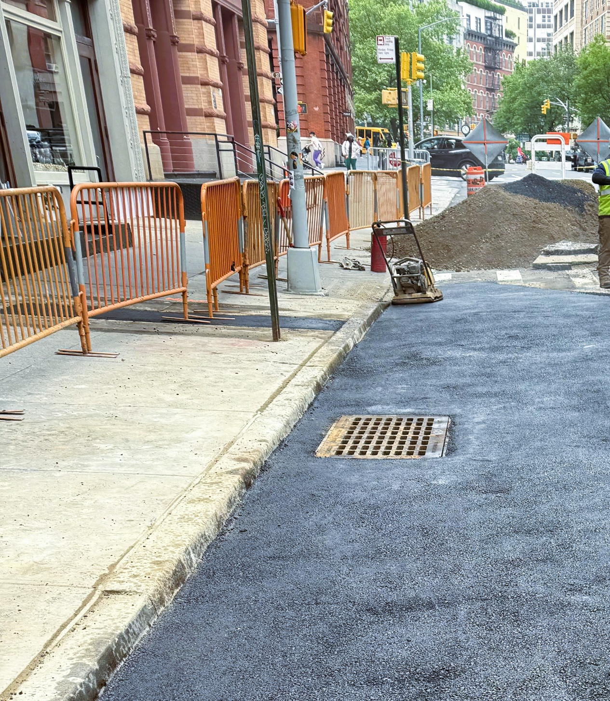
HWP19CWLM – Installation of Complex And Landmark Pedestrian Ramps
Backfilled after Chute Connection was completed; Laid and compacted Asphalt
Hudson Street & Duane Street

Slide 5
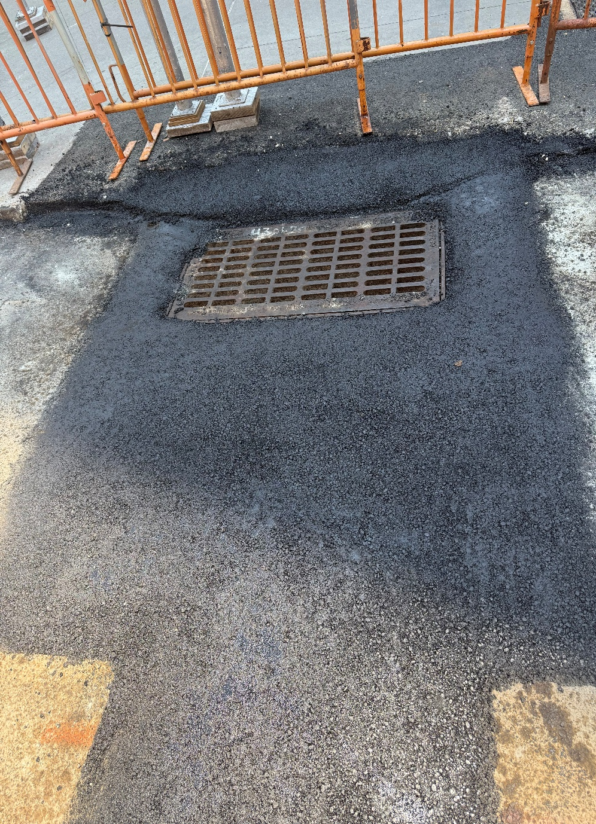
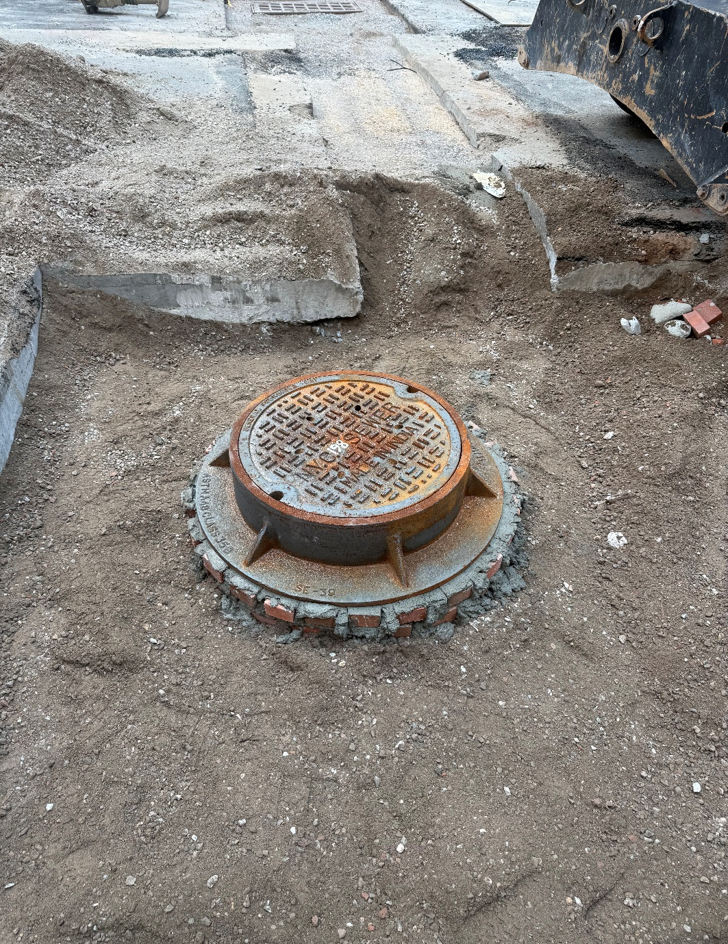
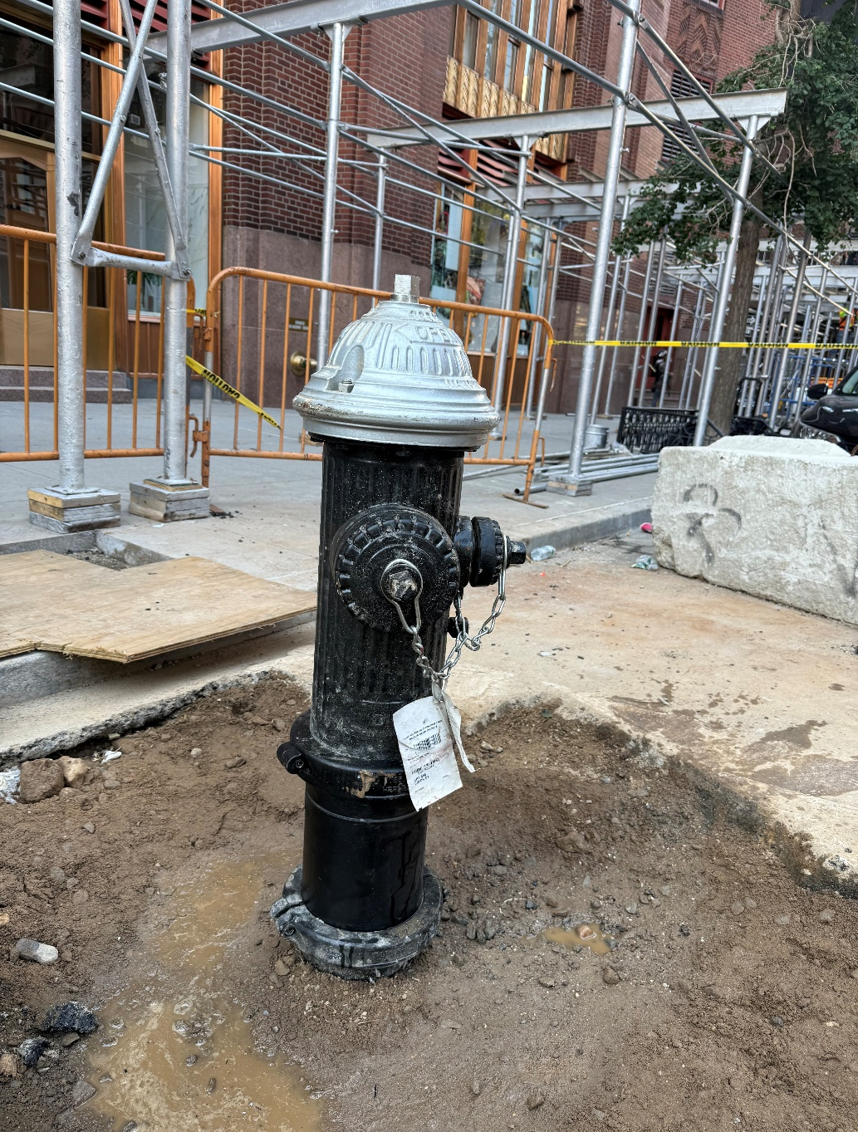
HWP19CWLM – Installation of Complex And Landmark Pedestrian Ramps
Catch Basin
Sewer Manhole
New Hydrant Installed & shifted west
Jay Street & Hudson Street

Slide 6

Presented By: RE, Maaz Mansoor
Project HWP19WLM Contact info:
CCL, Loretta Loutan
Email: HWP19CWLMCCL@gmail.com
Cell: 929.757.7012
Office: 212.391.3910
Thank You!

