Slide 1



Reconstruction of Dumbo / Vinegar Hill Area
Project ID: HWKKP005
Honorable Lincoln Restler
Council Member, CD 33
DUMBO Town hall
July 28, 2022
Eric Adams
Mayor
Thomas Foley, P.E.
Commissioner

Slide 2

Project Agenda
Project Data
Work Completed
Work in Progress
Proposed Work Schedule
Q&A
2

Slide 3
Project Data
Project ID: HWKKP005
Construction Start: Winter 2019
Contractor: Halcyon Construction Corp.
Contract Value: $98,529,578
Percentage of Work Completed: 50.58%
Field Office Location: 25 Chapel Street, 7th Floor, Brooklyn, NY 11201
3

Slide 4
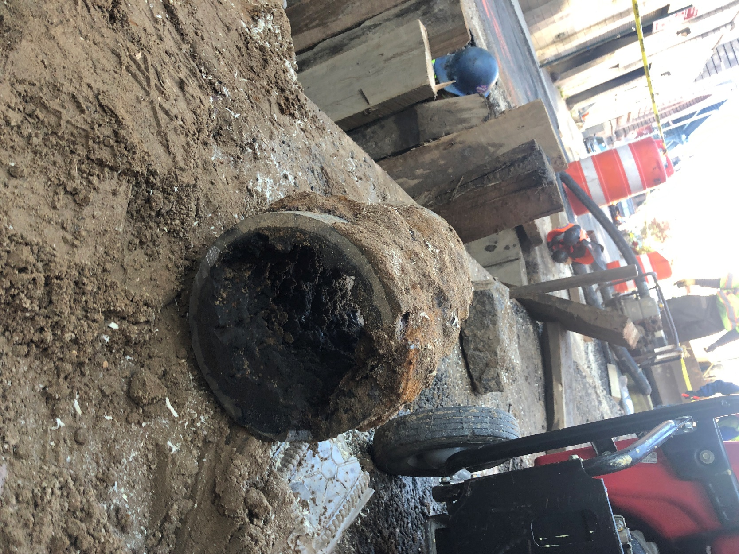
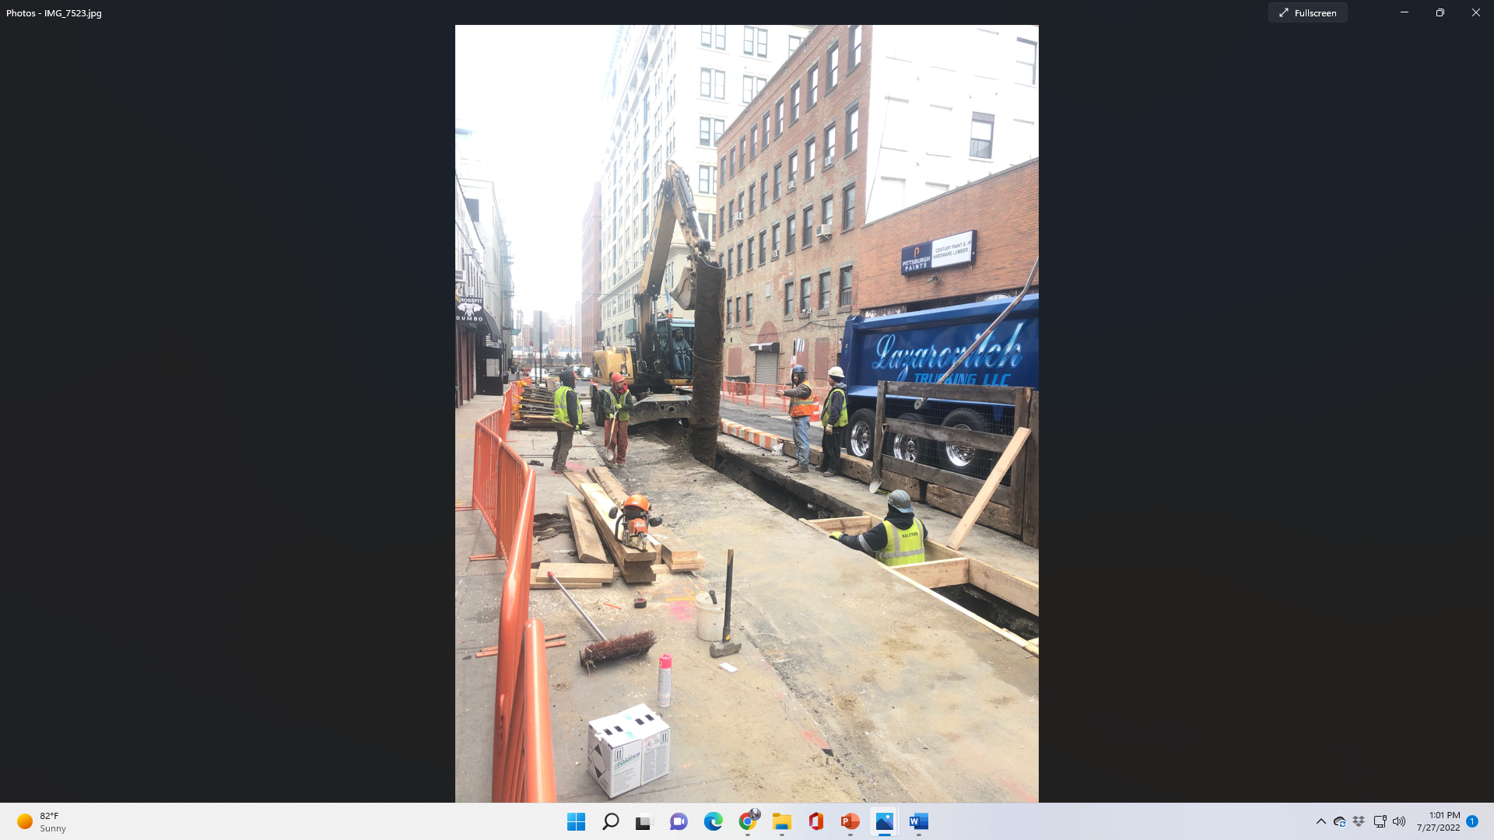
Work Completed
Water Main
Old 8” Water Main removed from Front Street in November 2019.
Old 20” Water Main removed from Pearl Street in February 2020.
4

Slide 5
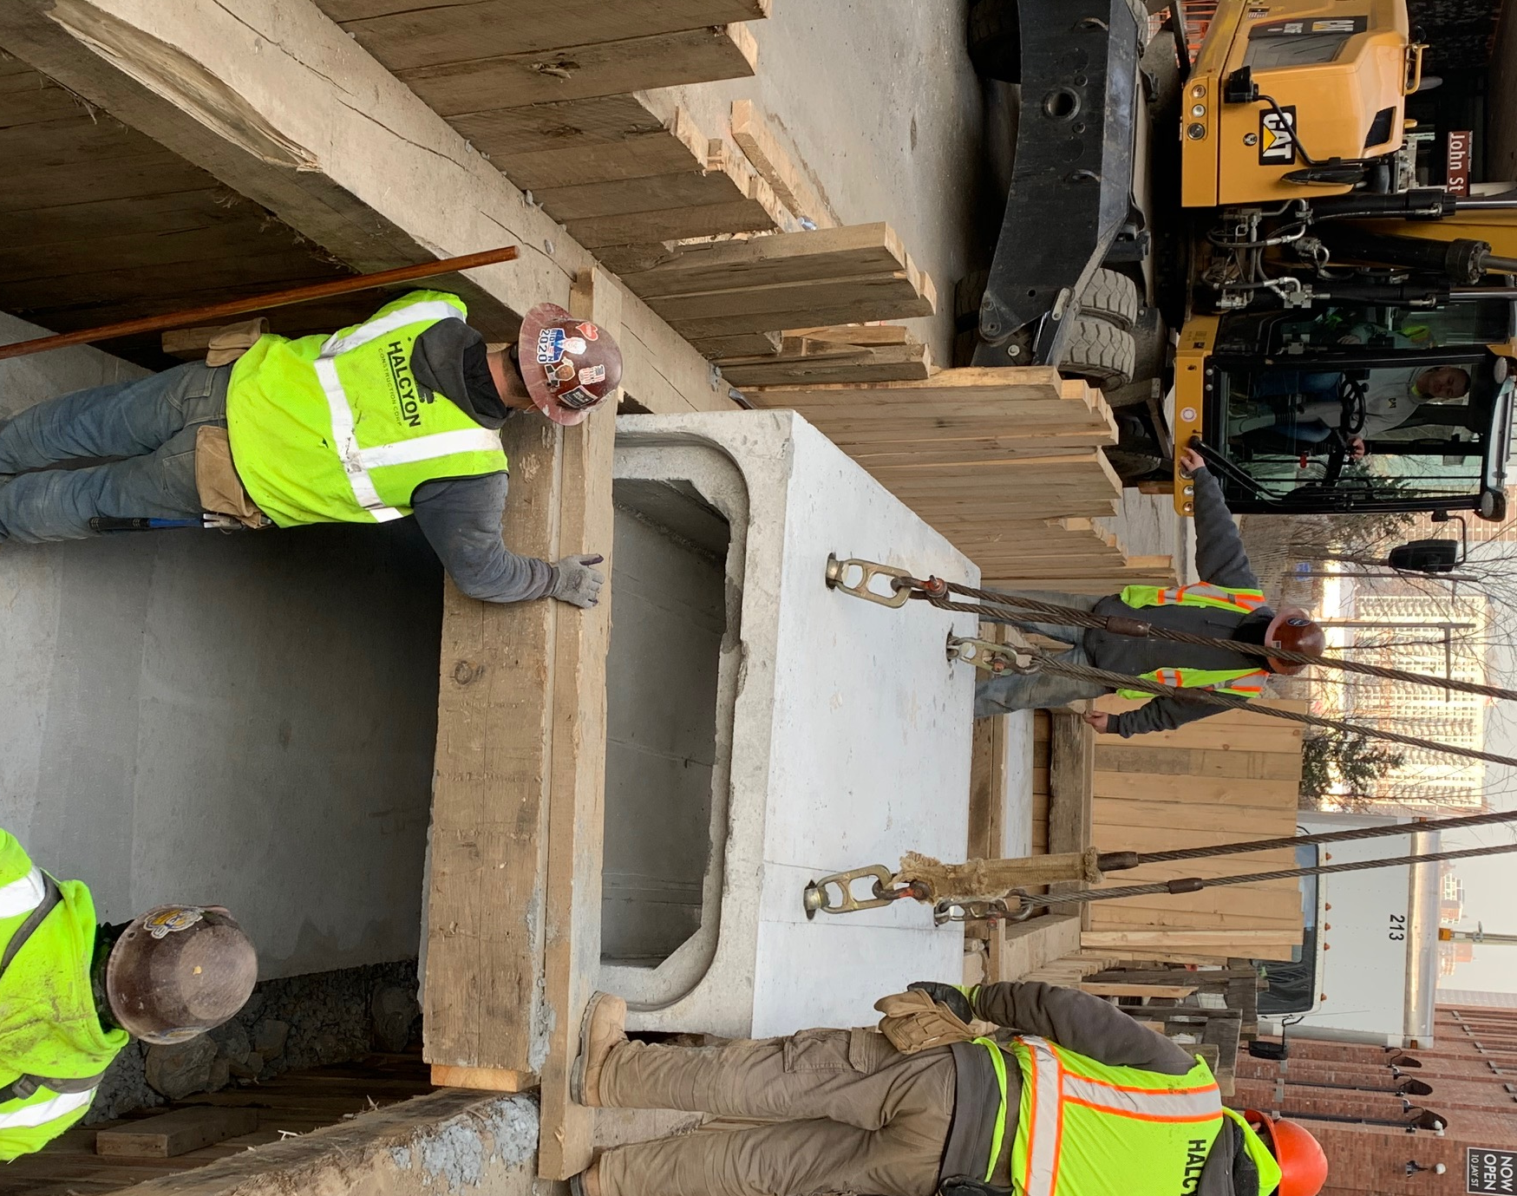
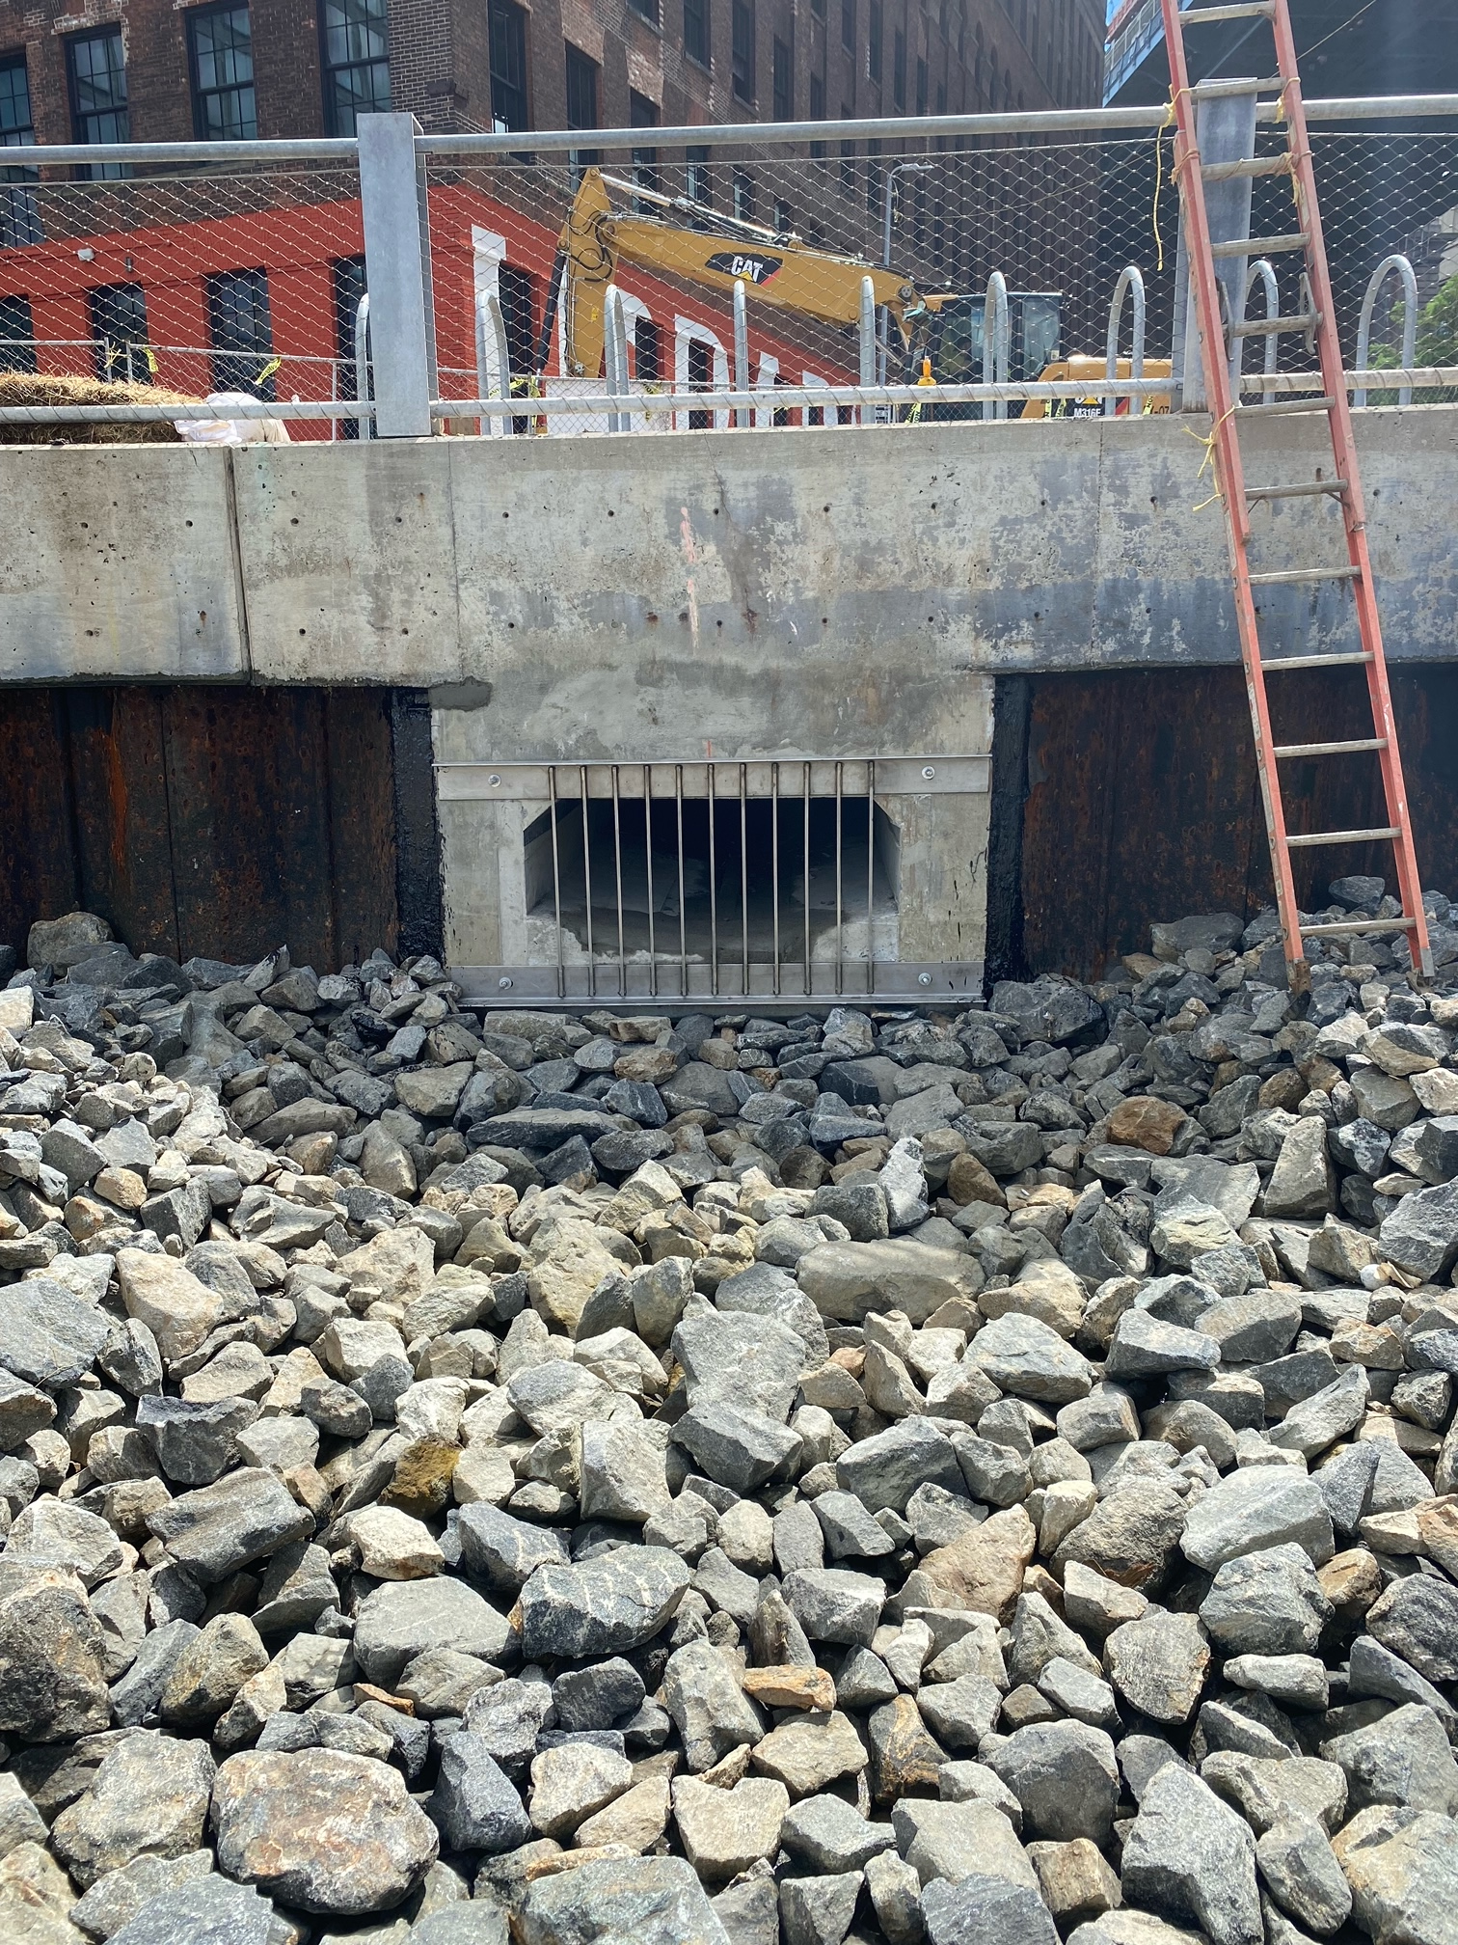
Work Completed
Box Storm Sewer & Outfall
Box Storm Sewer installed on Pearl Street between John Street & Water Street.
Outfall installed at the intersection of Adams Street & John Street.
5

Slide 6
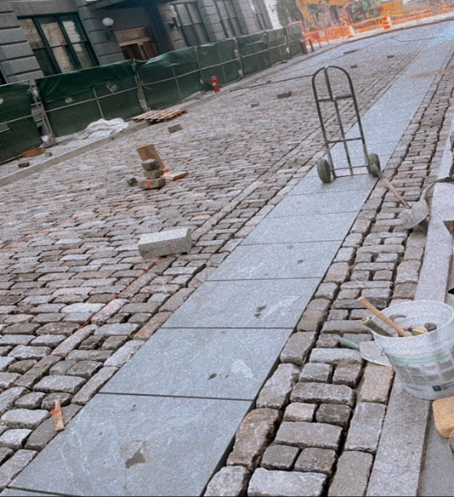
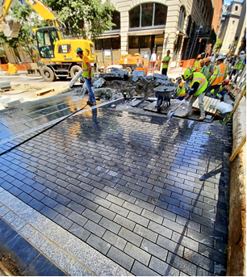
Work Completed
Final Roadway Restoration
Historic Belgian Block and granite bike path for Roadway Restoration on Main Street between Water Street & Front Street.
Intersection of Main Street & Water Street.
6

Slide 7
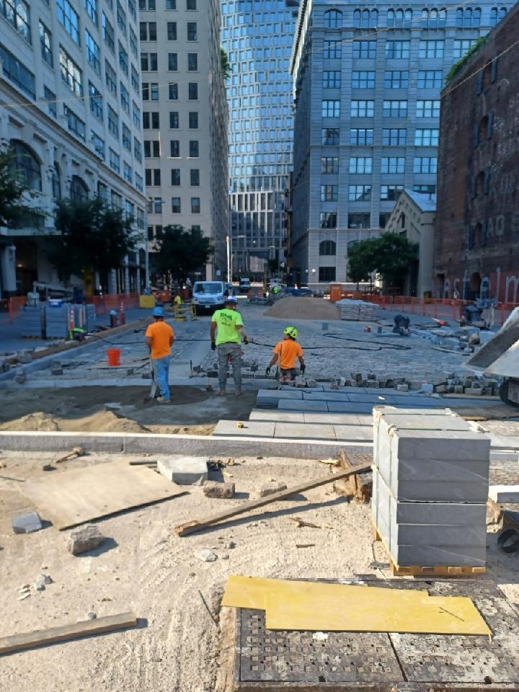
Work in Progress
Final Roadway Restoration
Granite bike path with historic Belgian Block installation for Roadway Restoration on Main Street between Plymouth Street & Water Street.
7

Slide 8
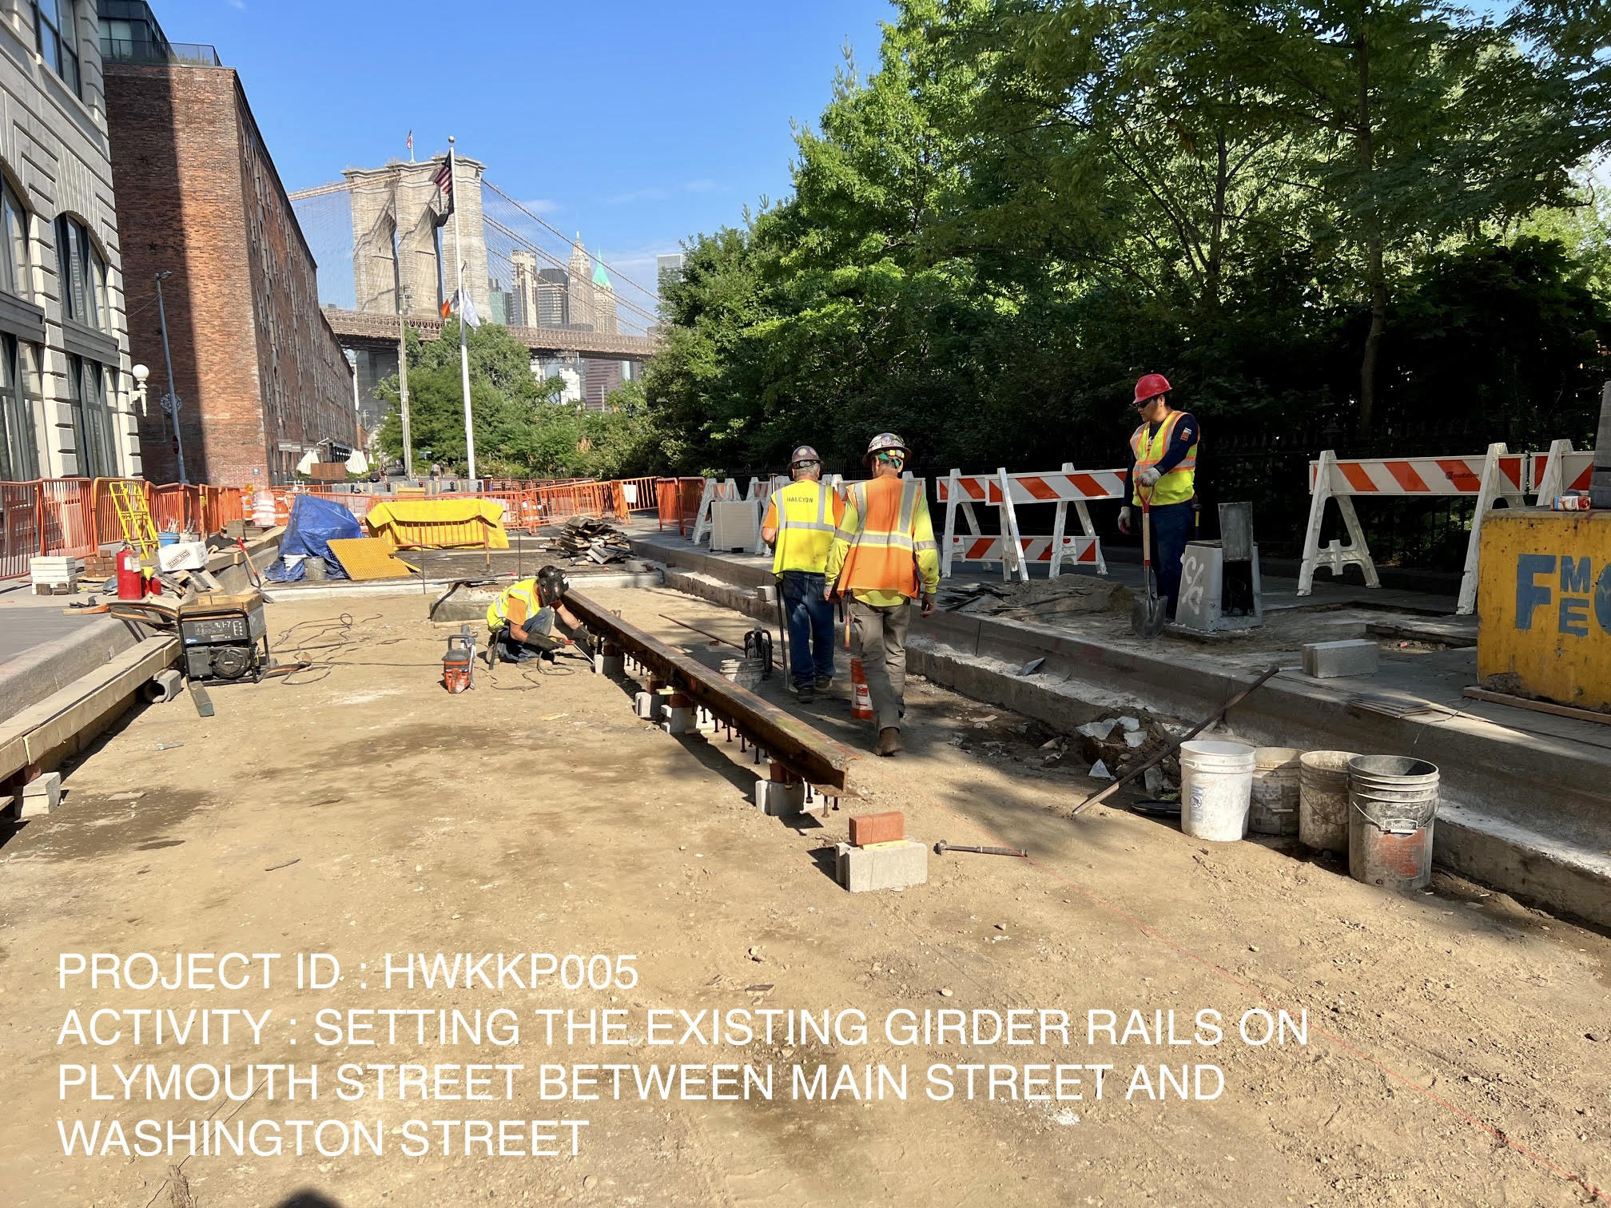
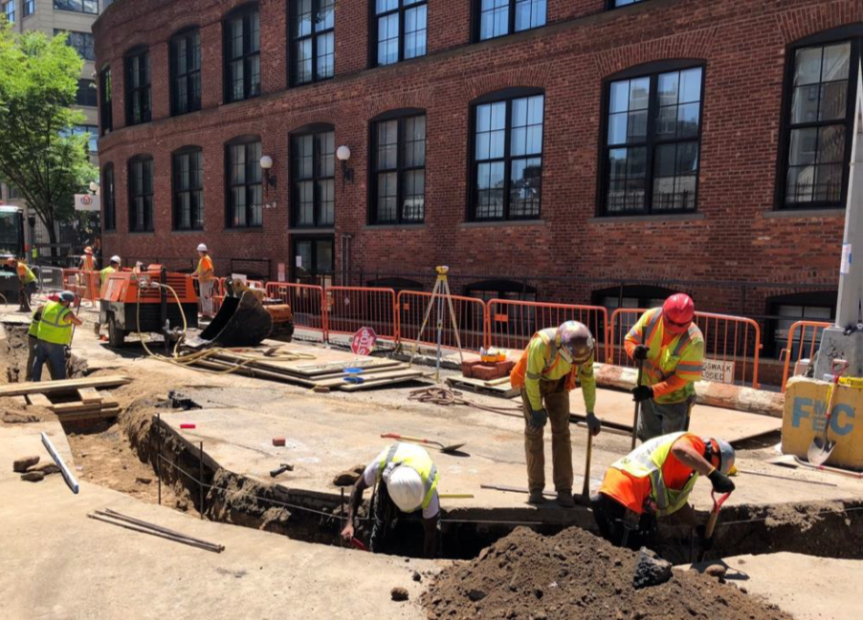
Work in Progress
Excavation / Installation
Rail track installation on Plymouth Street between Main Street & Washington Street.
New curb line excavation / installation on the west side of Adams Street between Plymouth Street & Water Street.
8

Slide 9
Proposed Work Schedule
Complete final Roadway Restoration on Main St. between Water St. and Plymouth St.
Continue final Roadway Restoration on Plymouth St. between Main St. & Washington St.
Complete curb/sidewalk installation on Adams St. between Plymouth St. & Water St.
Begin curb/sidewalk installation on Adams St. between Water St. & Front St.
Install catch basins at various locations.
Complete the emergency layout for Con Ed on Plymouth St. between Washington St. & Main St.
Complete layout for Con Ed / Private utility work on Gold St. / Water St. intersection.
9

Slide 10
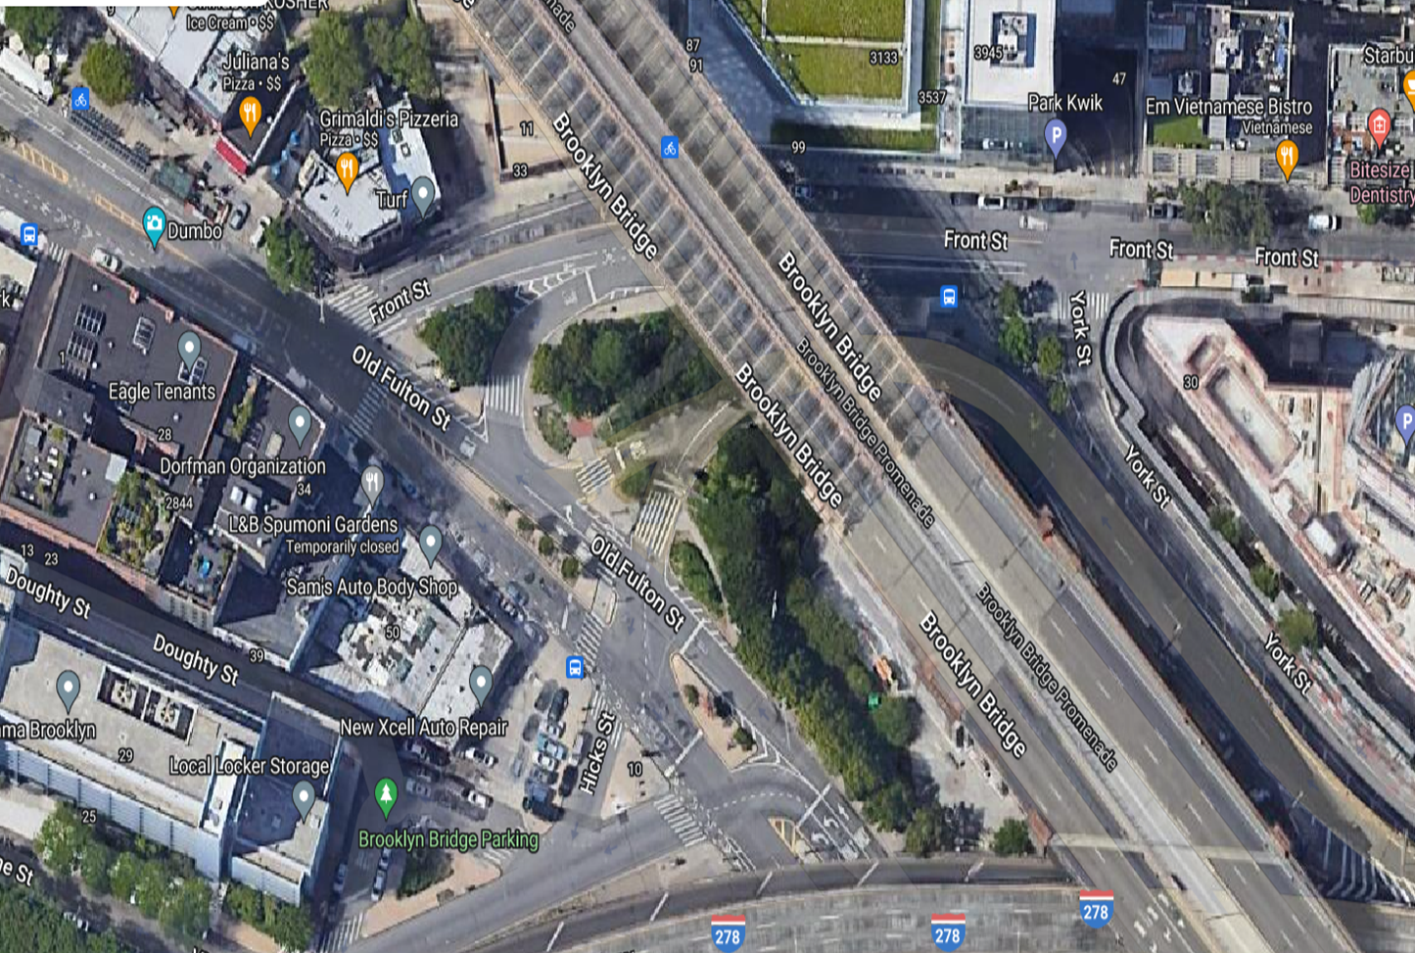

Proposed Work Schedule
Beginning August 1st, 2022, a total of two NYCDOT VMS signs will be installed at the following locations capturing those heading into Dumbo:
York Street & Front Street
Old Fulton Street & Hicks Street
10

Slide 11
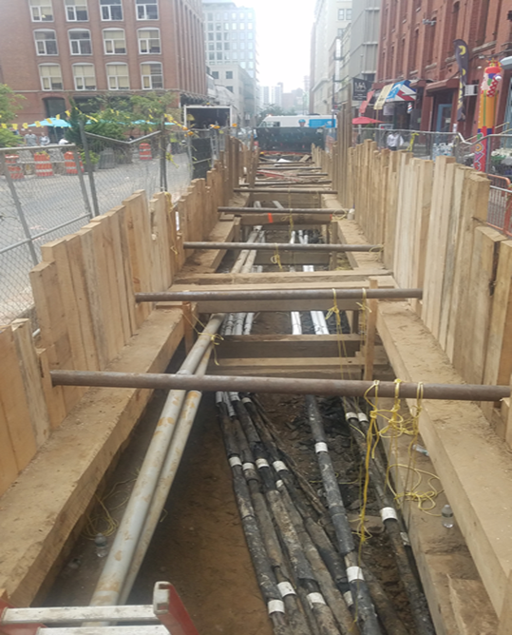
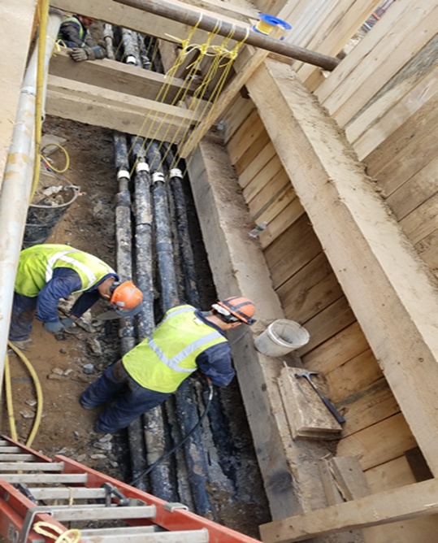
Project Challenges
Underground utility work interferences on Pearl Street between Water Street and Front Street.
11

Slide 12
Q&A
Thank you!

