Slide 1
4th Avenue Safety Improvements
Phase A
PROJECT ID: HWK1669A
Community Board 7, Brooklyn
Transportation Committee
JUNE 10TH 2025
Eric Adams
Mayor
Thomas Foley, P.E.
Commissioner

Slide 2
agenda
About the Project
Construction Overview
Location
Community Impacts
Outreach and Notification
2

Slide 3
About the Project
Project: 4th Avenue Safety Improvement Phase A
Project ID#: HWK1669A
Borough : Brooklyn
Registration No: 20211424976
Supervision : M & J Engineering, PC
Contractor : J R Cruz Corp.
Notice to Proceed: Winter 2021
Contract Completion Date : Spring 2026
Total Budget: $49,311,198.09 (with registered change order
3

Slide 4
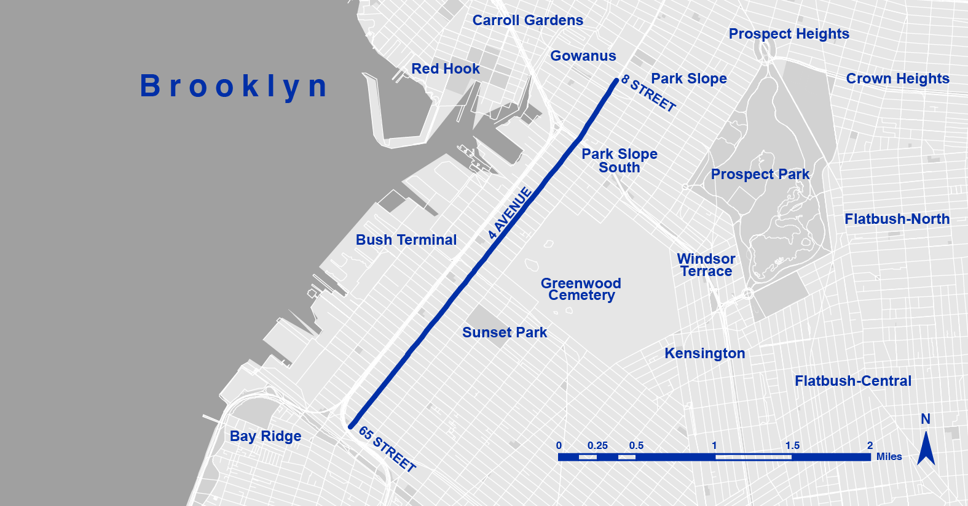
Project location
Overview
4th Avenue from 8th Street to 64th Street, Gowanus, Park Slope, Greenwood Heights, and Sunset Park neighborhoods.

Slide 5
Construction Overview
64th – 37th Street – Completed & planted with exception of
39th – 40th Street
58th – 60th Street – Signal work still remains & MTA Antenna Placement.
40th Street Intersection – National Grid to install South Side Crosswalk in Median.
59th – 58th / 47th – 45th – MTA & JRCRUZ to raise dry fire standpipes in median.
5

Slide 6
Construction Overview
33rd – 30th Street – Signal work remaining & awaiting delivery of new MTA Subway gratings for installation – planting still to be done.
6

Slide 7
Construction Overview – Current work location
27th – 24th Street – Currently under construction.
20th Street – Prospect Ave – Under construction.
7

Slide 8
LOCATIONS NOT STARTED
37th – 36th Street – (BACK TO DESIGN)
(awaiting -changes associated with Subway hatches not shown on contract drawings. )
30th – 27th Street – Not started
24th – 20th Street – Not started
8

Slide 9
Working Hours During Construction
Work hours on this project will vary by location.
Work Hours: Monday - Friday; 7am-6pm and/or 10pm-6am (at vents).
Saturday work, as necessary.
The contractor will follow all DOT – OCMC Allowable Hours, as per OCMC stipulated issued street permits.
9

Slide 10
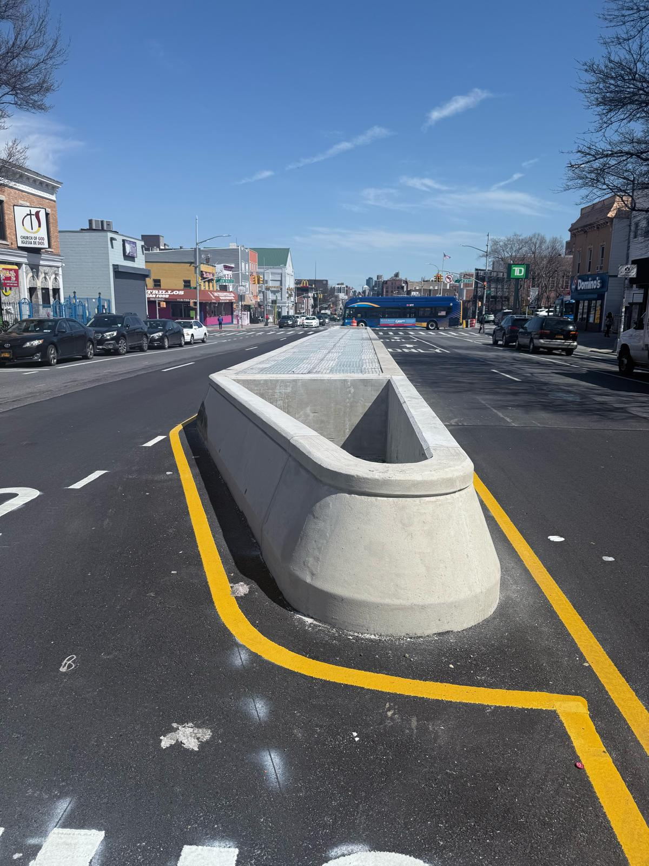
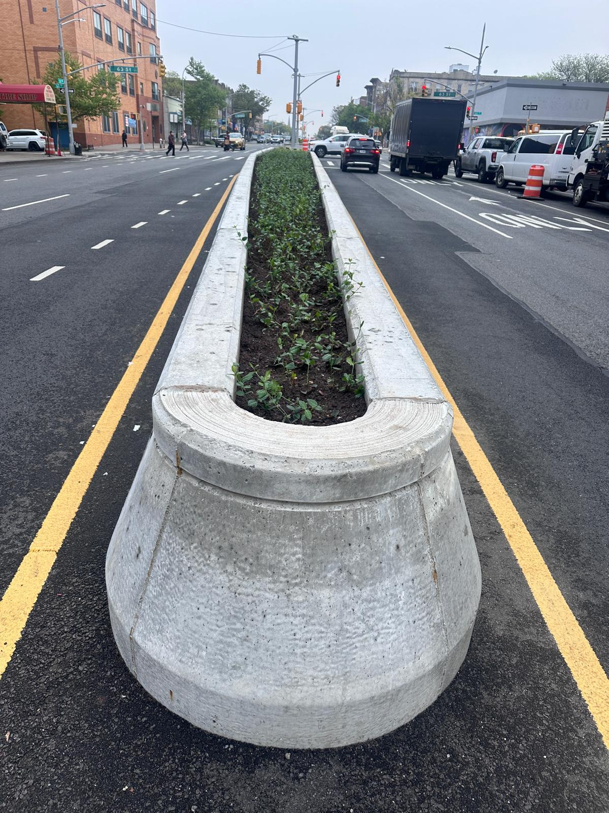
PROGRESS PICTURES
10

Slide 11
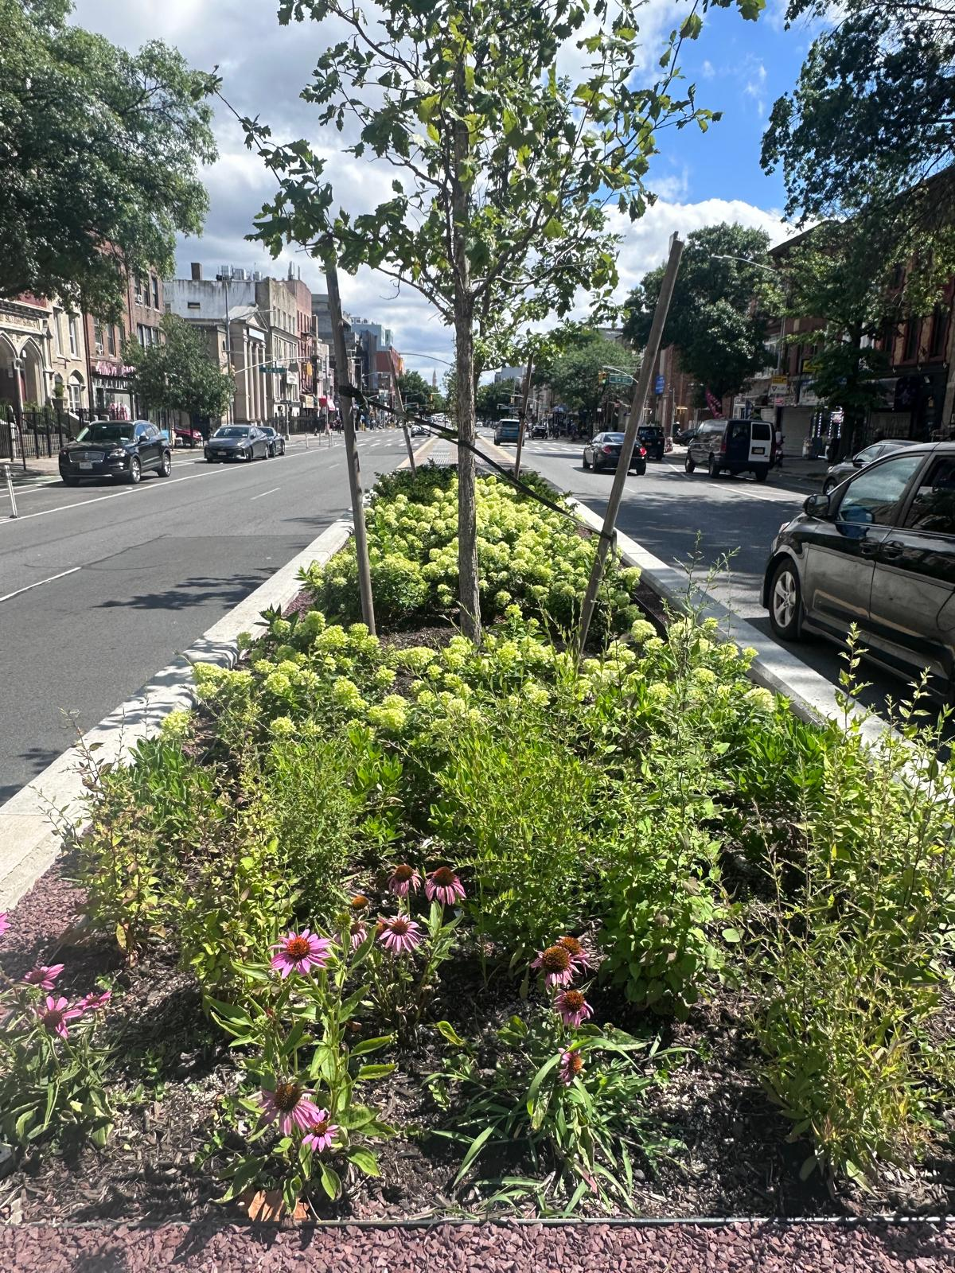
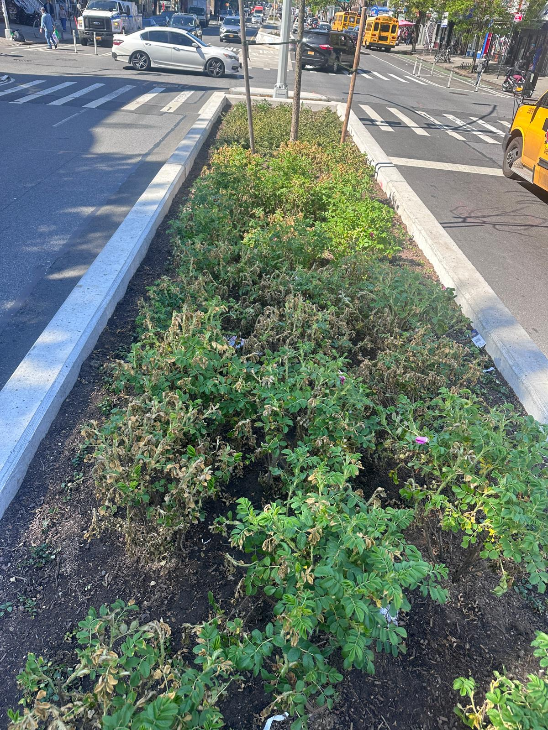
11

Slide 12
COMMUNITY OUTREACH
CCL contact information:
Name: Judith Ogoe
Email: 4thavesafetyphaseaccl@gmail.com
Field Office: 331 37th Street, Brooklyn, NY 11232
Telephone : 347-689-3850
DDC Website: www.nyc.gov/ddc
DDC Video: www.nyc.gov/webuild
During Non-Working hours, please call 311 and give the Project ID: HWK1669A
12

Slide 13
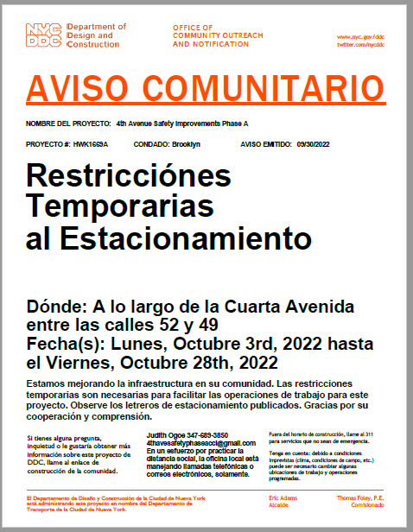
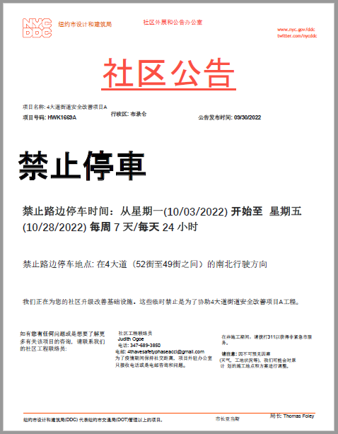
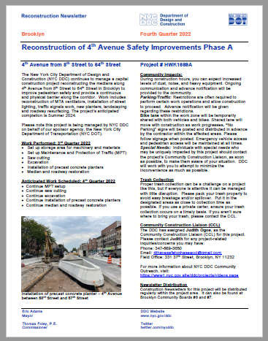
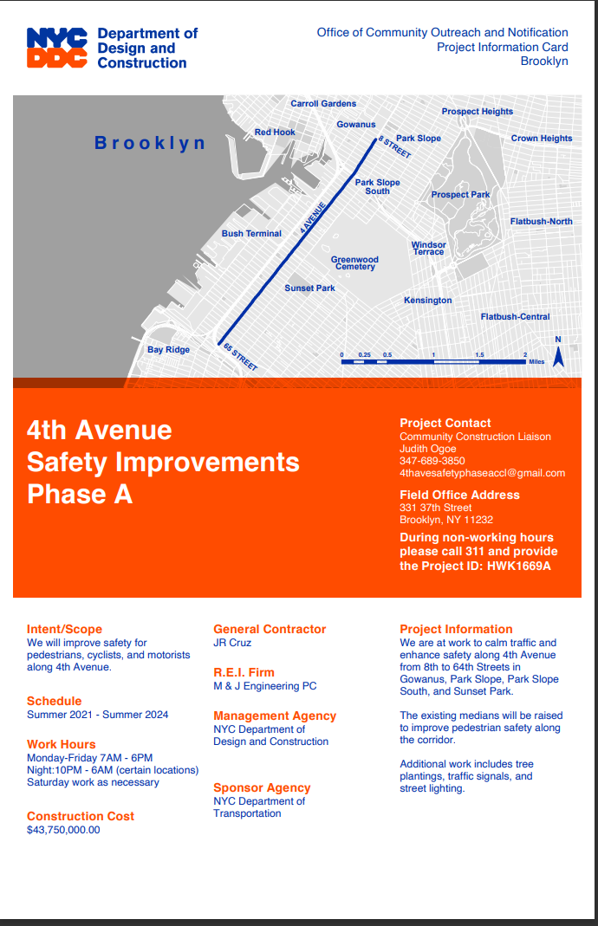
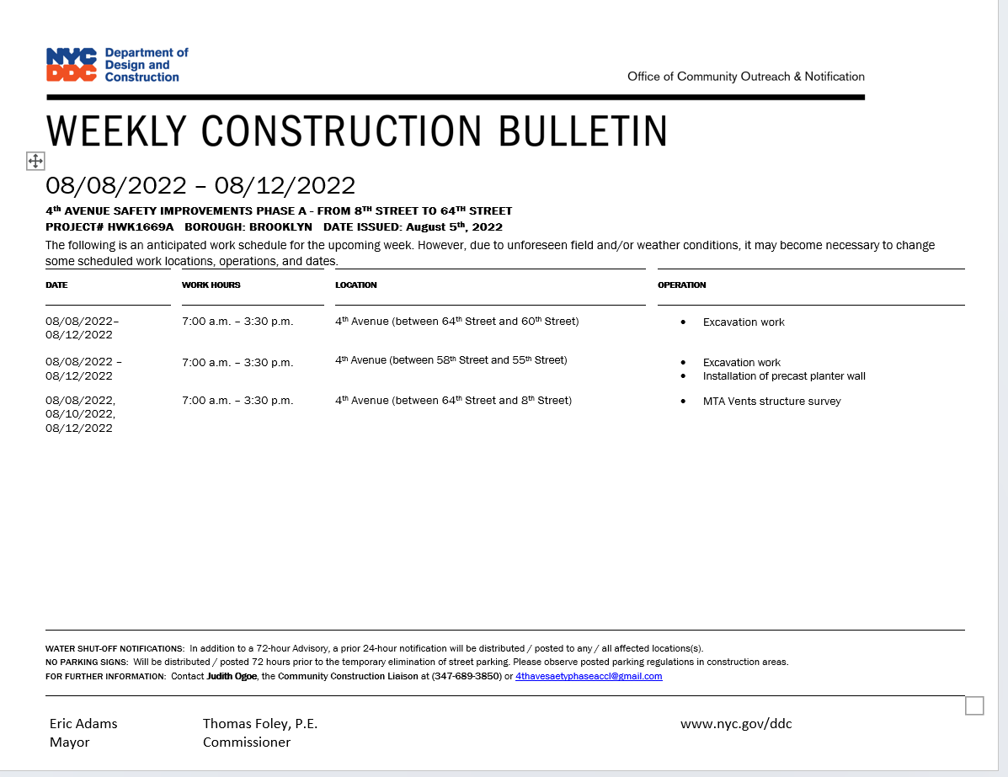
SAMPLE COMMUNICATIONS
advisory
newsletters
Project information
card
Look ahead
Weekly
bulletin
13

Slide 14
Thank you!

