Slide 1
4th Avenue Safety Improvements
Phase A
PROJECT ID: HWK1669A
Community Board 7, Brooklyn
Transportation Committee
October 6th, 2022
Eric Adams
Mayor
Thomas Foley, P.E.
Commissioner

Slide 2
agenda
About the Project
Construction Overview
Location
Community Impacts
Outreach and Notification
Q & A
2

Slide 3
About the Project
Project: 4th Avenue Safety Improvement Phase A
Project ID#: HWK1669A
Borough : Brooklyn
Registration No: 20211424976
Supervision : M & J Engineering, PC
Contractor : J R Cruz Corp.
Notice to Proceed: Winter 2021
Contract Completion Date : Summer 2024
Total Budget: $43,750,000
3

Slide 4
How will this project benefit you?
Community Improvements
This project will completely redesign 4th Avenue in Brooklyn from 8th to 64th Streets in order to enhance safety for all users along this major thoroughfare.
Key elements of the redesign will include:
Raised medians to calm traffic and improve safety for pedestrian, cyclist and motorist along 4th Avenue.
Pedestrian refuge islands.
4

Slide 5
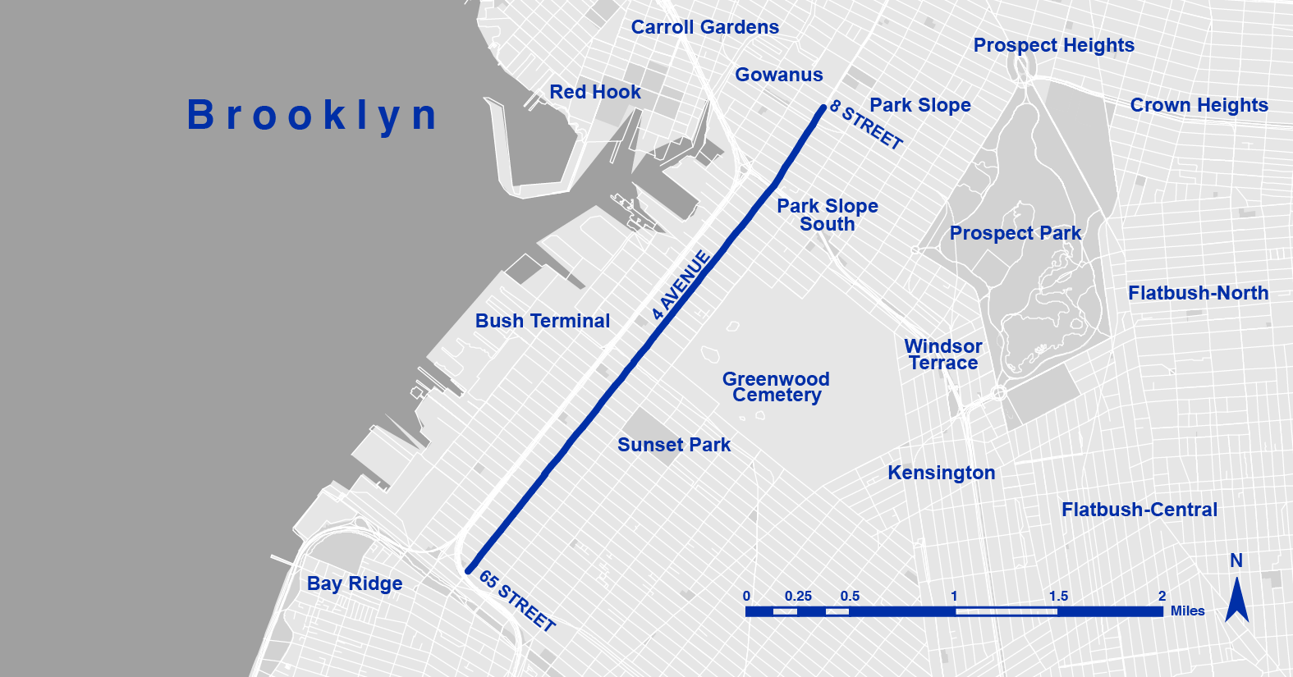
Project location
Overview
4th Avenue from 8th Street to 64th Street through the Gowanus, Park Slope, Greenwood Heights, and Sunset Park neighborhoods.

Slide 6
Construction Overview
Outreach
Permits and scheduling
Demolition and reconstruction of the medians from 8th Street to 64th Street.
Reconstruction of MTA vents along 4th Avenue
New traffic signals and street lighting to be installed
New pavement markings along 4th Avenue and at streets intersections
Planting of new trees and scrubs at the newly constructed median
6

Slide 7
CLICK TO EDIT HEADLINE TEXT
Edit text
During construction
Three blocks stretches
7
7

Slide 8
Working Hours During Construction
Work hours on this project will vary by location.
Work Hours: Monday - Friday; 7am-6pm and/or 10pm-6am (at vents).
Saturday work, as necessary.
The contractor will follow all DOT – OCMC Allowable Hours, as per OCMC stipulated issued street permits.
8

Slide 9
What to expect on each 3-block stretch
There will be No Standing Anytime within the construction area.
Shared bike lane with vehicle
There will be visible signage
9

Slide 10
Why shared lane?
As per DOT permit; Contractor is to maintain a two-lane traffic
13ft shared lane
10ft travel lane
Combine lane = 23 ft
10

Slide 11
What to expect on each 3-block stretch
Start to finish:
72 hour Advance Notification
Set up Barrel/signage – No Standing Anytime
Begin striping
Place Concrete barrels
Saw cutting/demolition of existing Median
Excavation
Set precast planter walls
Pour concrete
Back fill
Restoration, pavement and asphalt road
Remove barrels and restore traffic pattern
11

Slide 12
Winter Season:
Contractor will be required to remove snow within the work zone.
12

Slide 13
Traffic Patterns During Construction
Contractor will maintain the following:
Crossing Guards, signage, and safe work site for pedestrians, cyclists, and vehicles
Keep a minimum width of 5’ access on sidewalks and crosswalks
Bike lane within the work zone will be temporarily shared with vehicles
13

Slide 14
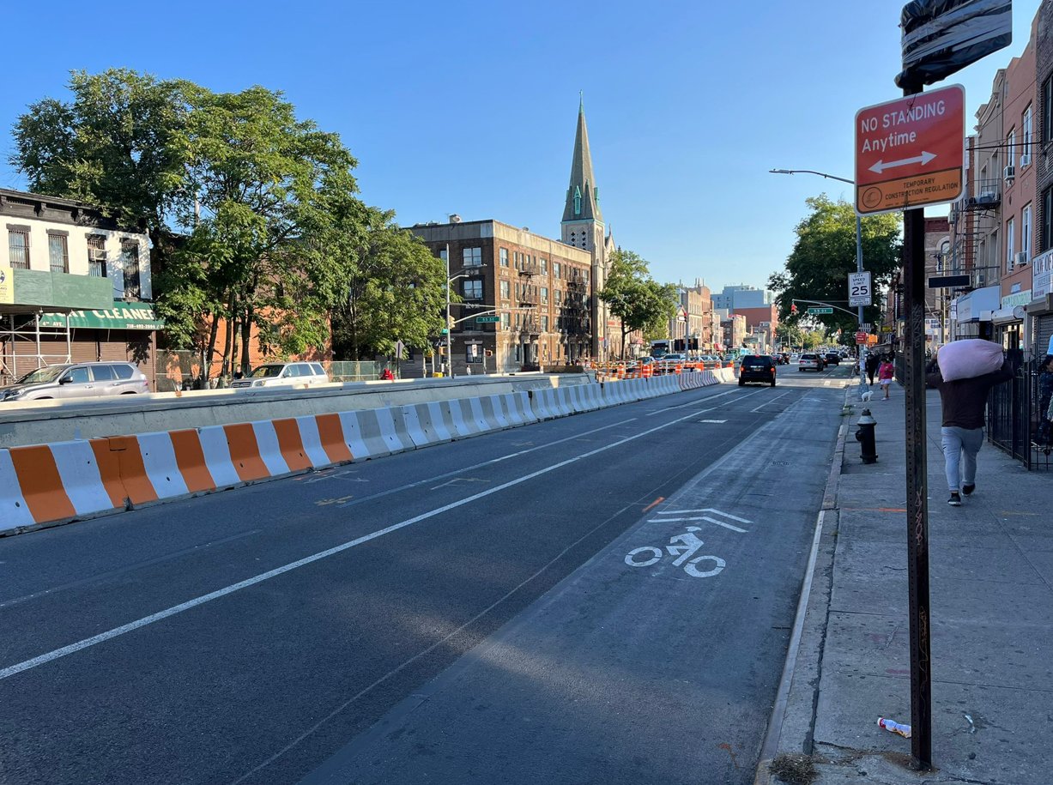
Maintenance and Protection of Traffic Set up:
14

Slide 15
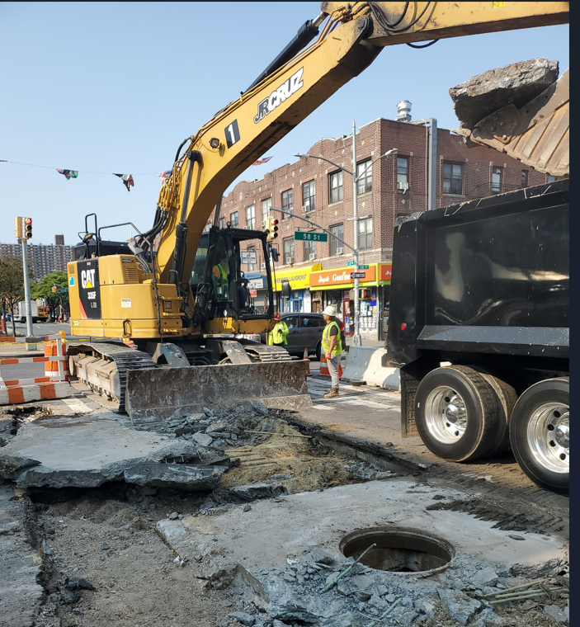
Median Excavation :
15

Slide 16
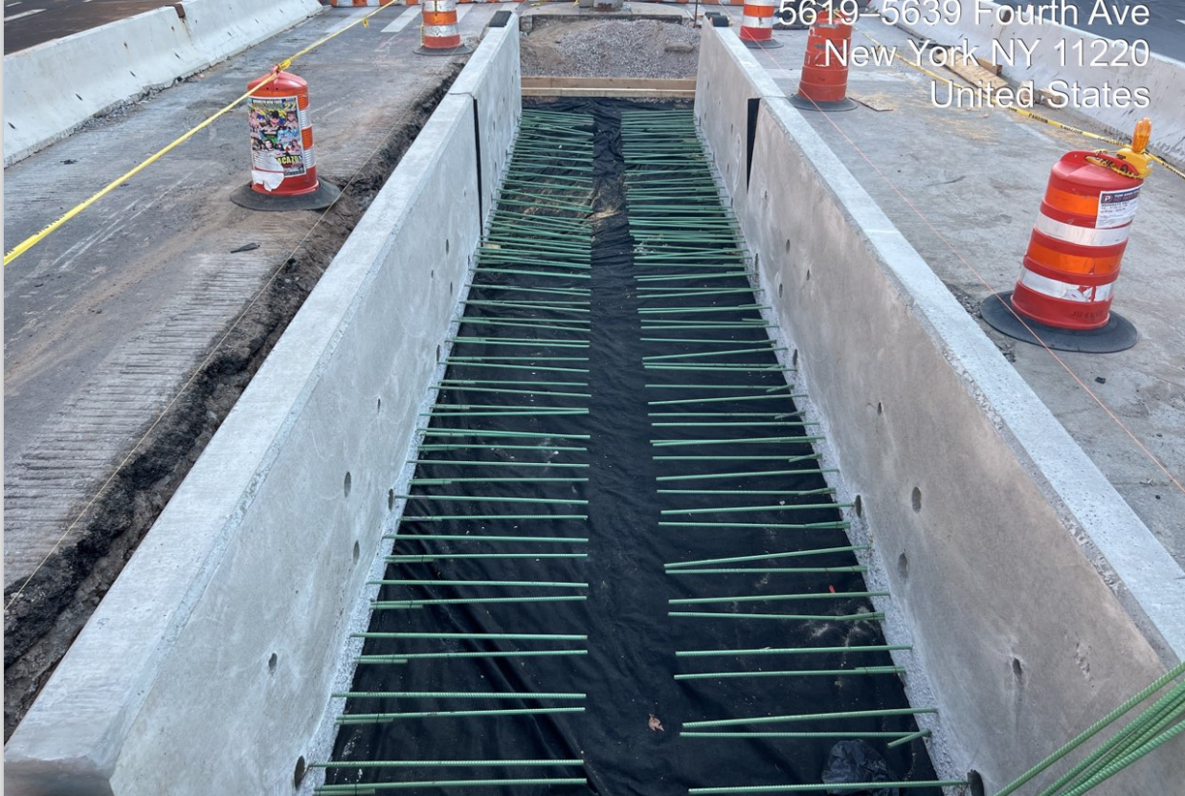
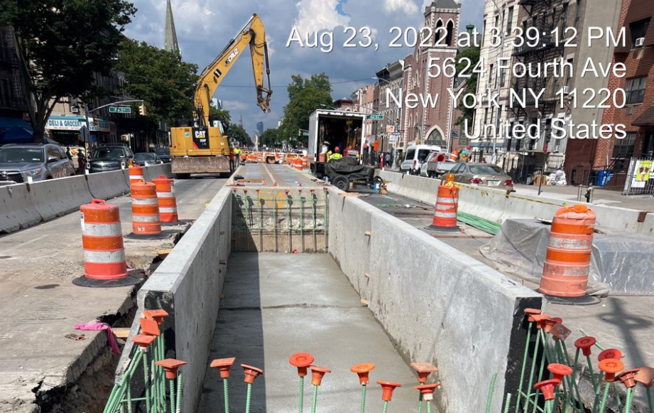
Placement of precast concrete wall:
16

Slide 17
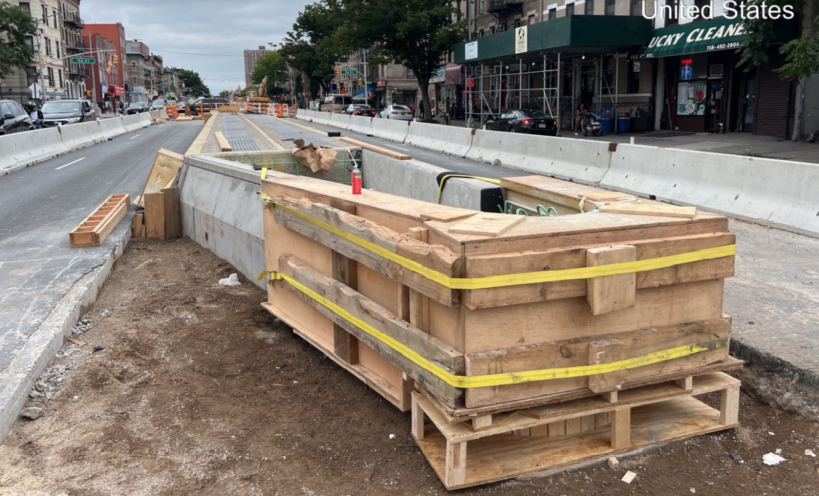
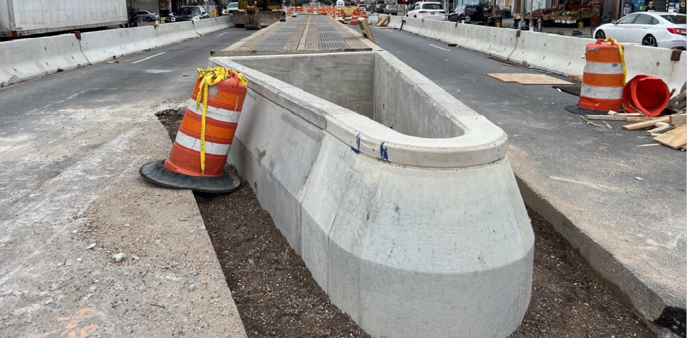
Reconstruction of new planter wall Placement of new planter wall
17

Slide 18
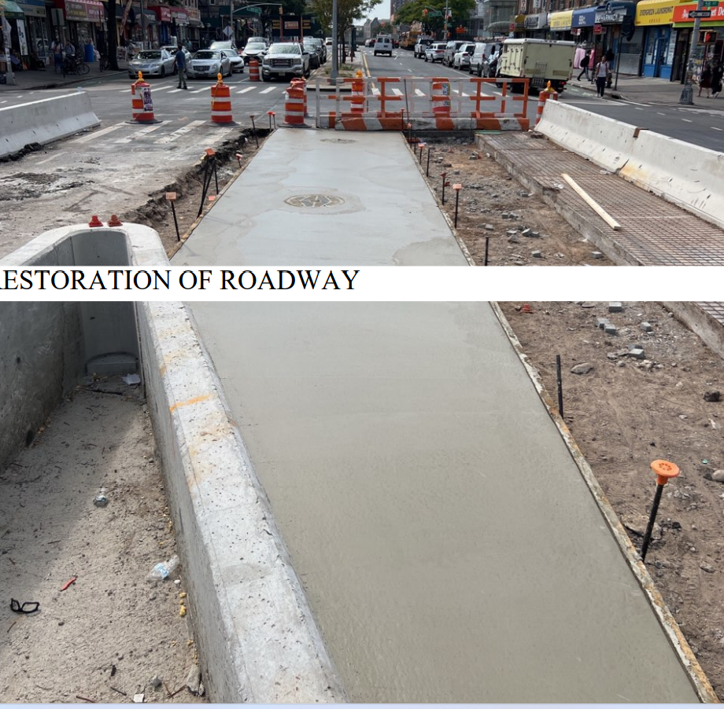
Median Restoration:
18

Slide 19
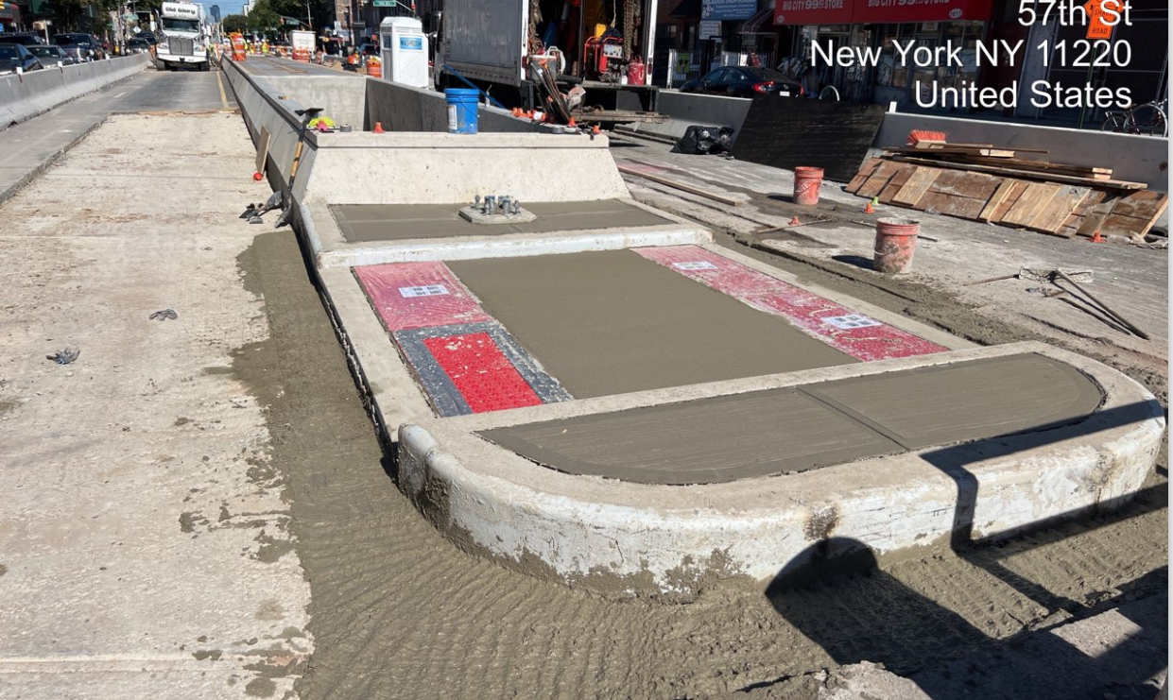
Construction of new pedestrian walkway (median rest area):
19

Slide 20
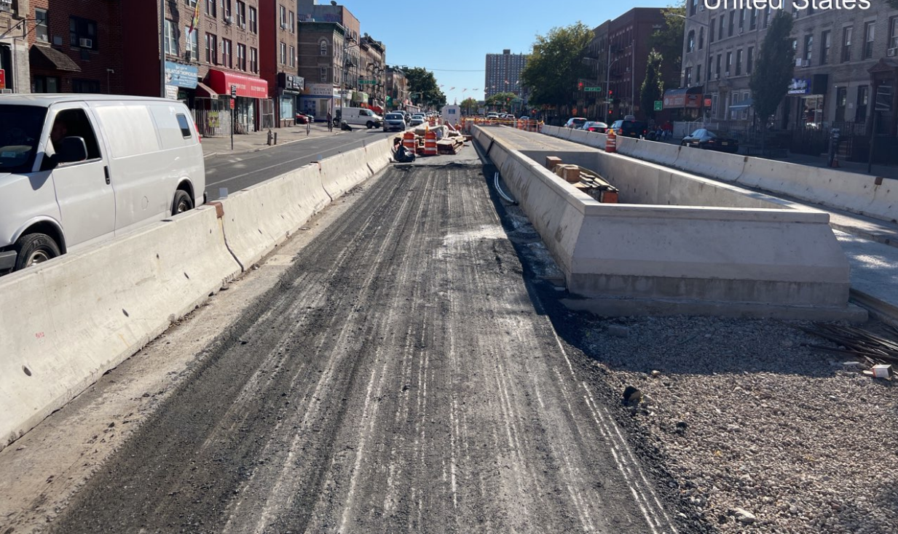
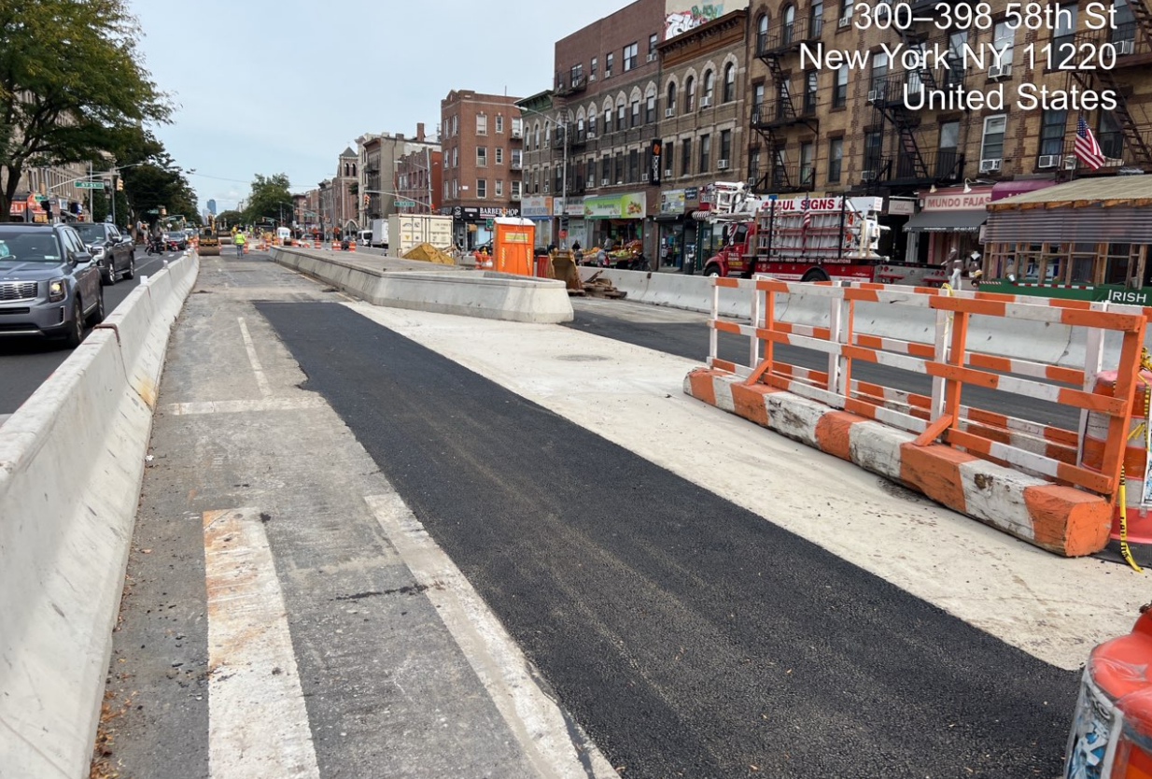
Roadway restoration:
20

Slide 21
COMMUNITY OUTREACH
DDC has assigned Judith Ogoe as the Community Construction Liaison (CCL). Judith is responsible for keeping the community engaged & informed by:
Being the first point of contact (Outreach, Communication)
Identifying & Coordinating (Attempt to mitigate construction impacts)
Providing regular updates in advance (Stakeholders may better plan)
Distributing Advisories throughout the impacted community
CCL contact information:
Name: Judith Ogoe
Email: 4thavesafetyphaseaccl@gmail.com
Field Office: 331 37th Street, Brooklyn, NY 11232
Telephone : 347-689-3850
DDC Website: www.nyc.gov/ddc
DDC Video: www.nyc.gov/webuild
During Non-Working hours, please call 311 and give the Project ID: HWK1669A
21

Slide 22
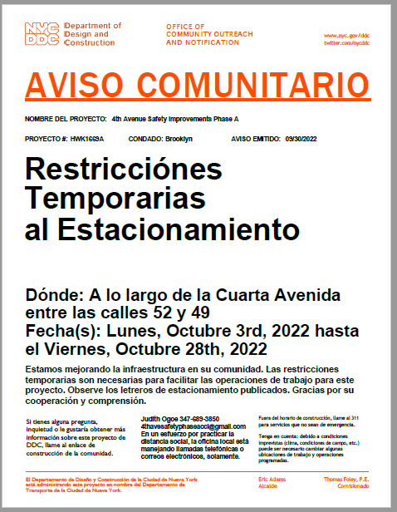
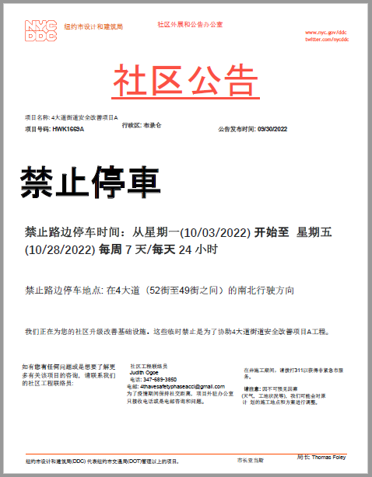
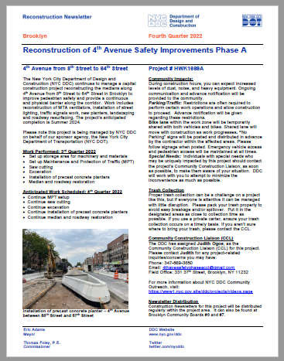
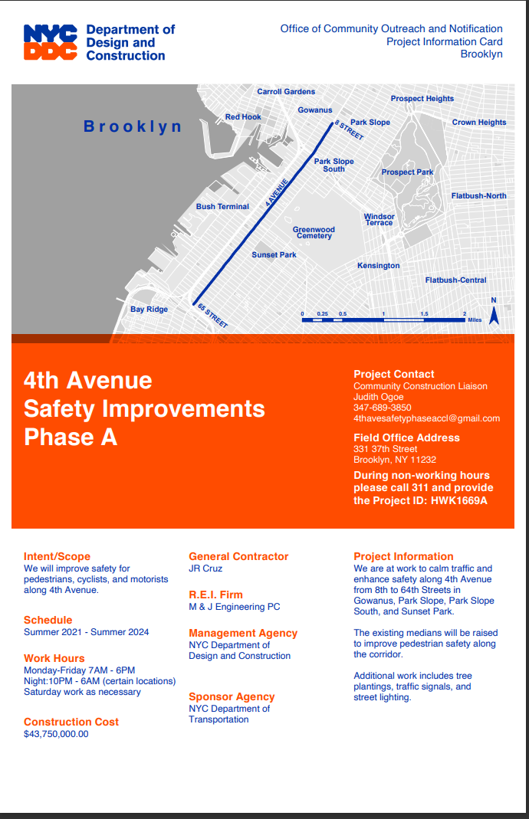
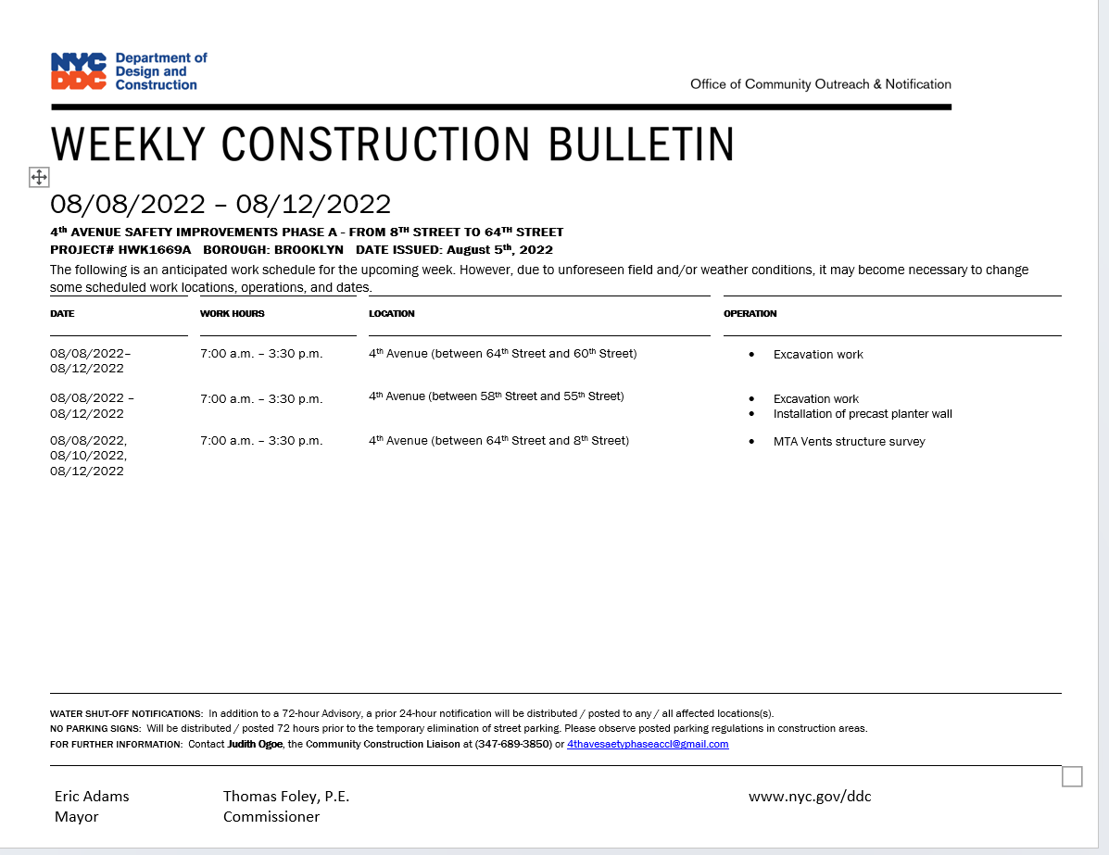
SAMPLE COMMUNICATIONS
advisory
newsletters
Project information
card
Look ahead
Weekly
bulletin
22

Slide 23
Thank you!
Q&A

