Slide 1

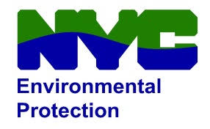
BRONX Community board 12
NYC Council districts 11, 12
New 48” Trunk water main
on East 233rd Street
PROJECT ID: HEd562
BOROUGH OF THE Bronx
Zohran K. Mamdani
Mayor
Eduardo del Valle Lisa Garcia
DDC Acting Commissioner DEP Commissioner
February 9th, 2026

Slide 2

AGENDA:
Scope of Work
Project Overview
Project Location
Lead Service Line Replacement Program
Typical Maintenance and Protection of Traffic
Community Impacts & Mitigation
Community Outreach
Q&A
HED562 – New 48” Trunk Water Main on East 233rd Street
Borough of Bronx
AGENDA

Slide 3
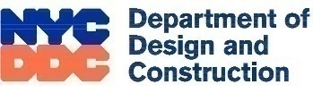
scope of Work
Installation of approx. 300 linear feet of 36-inch and 3460 linear feet of 48-inch trunk water mains and its appurtenances
(Butterfly Valves and Chambers, Blow-Offs, etc.)
Installation of approx. 7000 linear feet of distribution water main (6, 8, 12, & 20 inches)
Replace Shaft 3A Appurtenances
Installation of 15-inch and 18-inch Extra Strength Vitrified Clay Pipe, 12-inch and 16-inch Ductile Iron Pipe, and 24-inch and 30-inch Reinforced Concrete Pipe combined sewer
Con Edison gas installation
Catch basins/chute connections
Traffic signal/street lighting work
Curbs and sidewalks restoration
Roadway restoration
Tree planting, removal and pruning
HED562 – New 48” Trunk Water Main on East 233rd Street
Borough of Bronx
SCOPE OF WORK

Slide 4



Project overview
Managing Agency – NYCDDC
Sponsor Agency – NYCDEP
Contractor: JLJ IV Enterprises, Inc
Notice to Proceed Date: November 3rd, 2025
Anticipated Completion: End of 2028
2015
Design Start
Fall 2024
Design Completion
Summer/Fall 2025
Community Board Presentation; Letters of Eligibility to homeowners from DEP
Early 2026
Anticipated Construction Start
End 2028
Anticipated Construction Completion
HED562 – New 48” Trunk Water Main on East 233rd Street
Borough of Bronx
PROJECT OVERVIEW

Slide 5
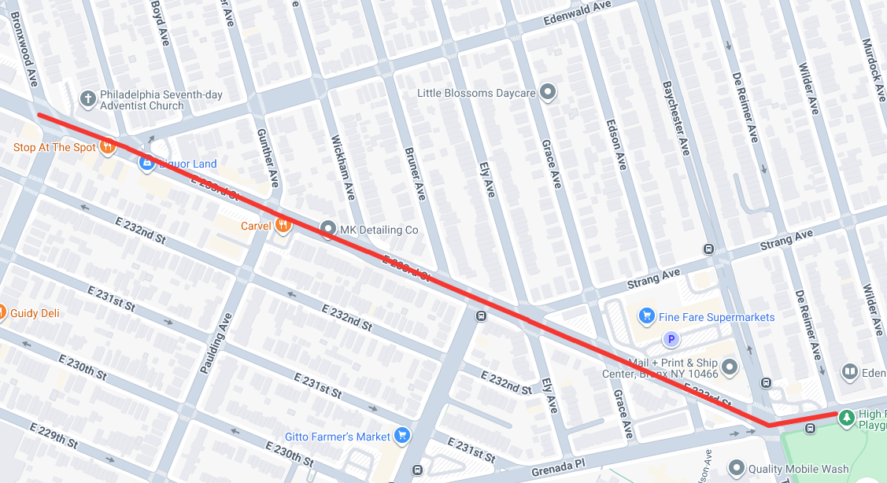
Project Location
East 233rd Street between Bronxwood Avenue and Wilder Avenue
Including intersections of East 233rd Street and:
•Bronxwood Avenue
•Edenwald Avenue
•Paulding Avenue
•Wickham Avenue
•Bruner Avenue
•Laconia Avenue
•Ely Avenue
•Grace Avenue
•Edson Avenue
•Baychester Avenue
•De Reimer Avenue
HED562 – New 48” Trunk Water Main on East 233rd Street
Borough of Bronx
PROJECT LOCATION

Slide 6
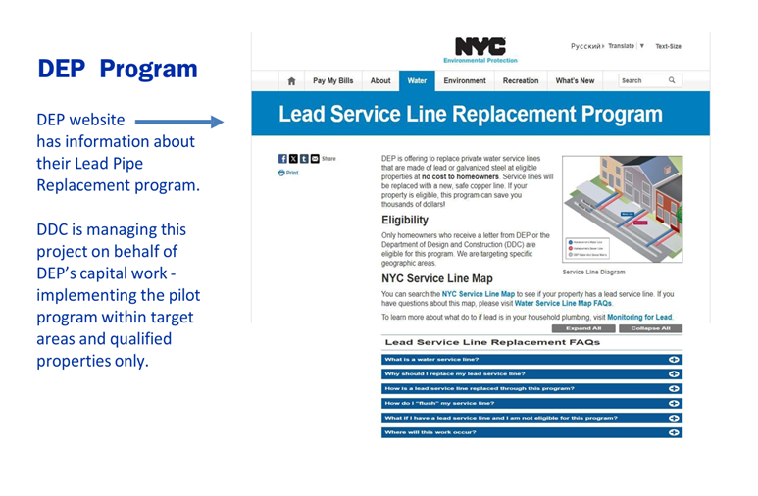
LEAD SERVICE Line REPLACEMENT Program:
Replacement of entire service line from the tap at the water main to the water meter inside the private property. New material for the service line will be copper.
Qualifications
The property must be located within the contract limits.
The existing service line for the property must be either lead or galvanized.
Existing pipe material to be confirmed via property inspections.
Consent forms must be signed by the homeowner the prior to the commencement of work.
HED562 – New 48” Trunk Water Main on East 233rd Street
Borough of Bronx
LEAD SERVICE LINE REPLACEMENT PROGRAM

Slide 7
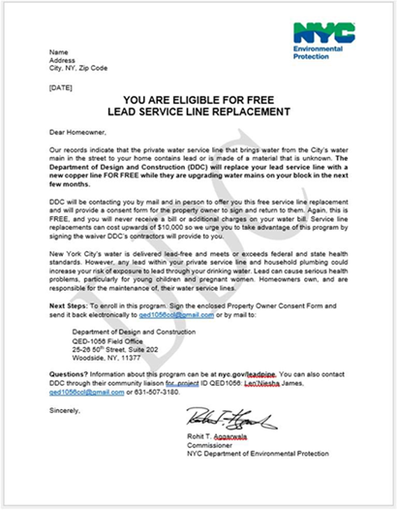
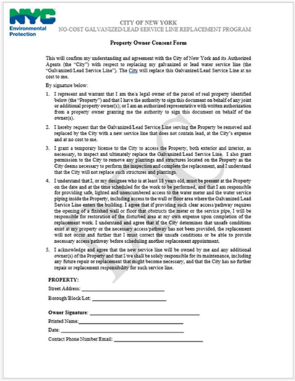
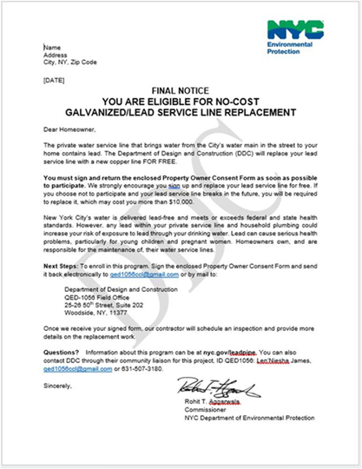
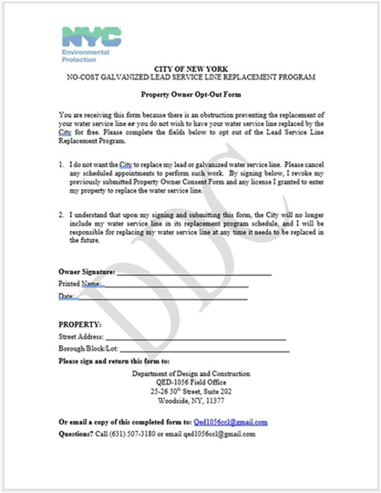
Lead service line replacement program cont’:
Lead Service Replacement is limited to targeted areas and properties identified or suspected to have lead lines. Replacement will only qualify for the following:
Only for confirmed lead lines on eligible properties.
Only with homeowner’s permission and signed consent form.
Only actual replacements – considered feasible based on field conditions.
NOTE: Lead service replacements will be performed in conjunction with water main operations with consent forms signed by the property owner.
Letter of Eligibility
Consent Form
Final Notice
Opt-Out Form
HED562 – New 48” Trunk Water Main on East 233rd Street
Borough of Bronx
LEAD SERVICE LINE REPLACEMENT PROGRAM CONT’

Slide 8
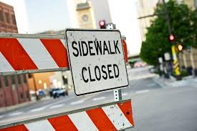
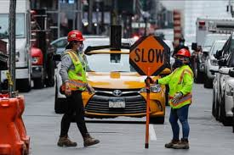
Traffic Patterns during construction
Contractor will maintain the following:
Personnel, signage and safe work site for pedestrians, vehicles and access to buildings and sidewalks.
Street access – maintain one lane for emergency and through traffic
HED562 – New 48” Trunk Water Main on East 233rd Street
Borough of Bronx
TRAFFIC PATTERNS DURING CONSTRUCTION

Slide 9
COMMUNITY IMPACTS DURING CONSTRUCTION
Driveway and parking access may be temporarily restricted when necessary; signs to be posted in advance.
Scheduled water main service shut-downs with advanced 72 and 24-hour notification
Garbage pick-up may be affected; we will coordinate with appropriate stakeholders and DSNY
Individuals with special needs should contact the CCL. DDC field staff will work to minimize inconvenience.
Roadway lane closures, as necessary
Temporary relocation of bus stops when needed, as coordinated with MTA Surface
Weekend hours for construction may be necessary; Typical construction hours are 7AM to 4PM, but can vary depending on work locations, as per DOT Office of Construction Mitigation and Coordination stipulations.
HED562 – New 48” Trunk Water Main on East 233rd Street
Borough of Bronx
COMMUNITY IMPACTS

Slide 10
Community Impacts and mitigations
Contractor shall:
Work within DEP Noise Code Regulations
Keep storage site areas clean and safe
Cover trucks delivering fill material
Provide professional rodent control inspector to monitor/maintain rodent control stations
Implement Dust Mitigation Plan
HED562 – New 48” Trunk Water Main on East 233rd Street
Borough of Bronx
COMMUNITY IMPACTS AND MITIGATIONS

Slide 11
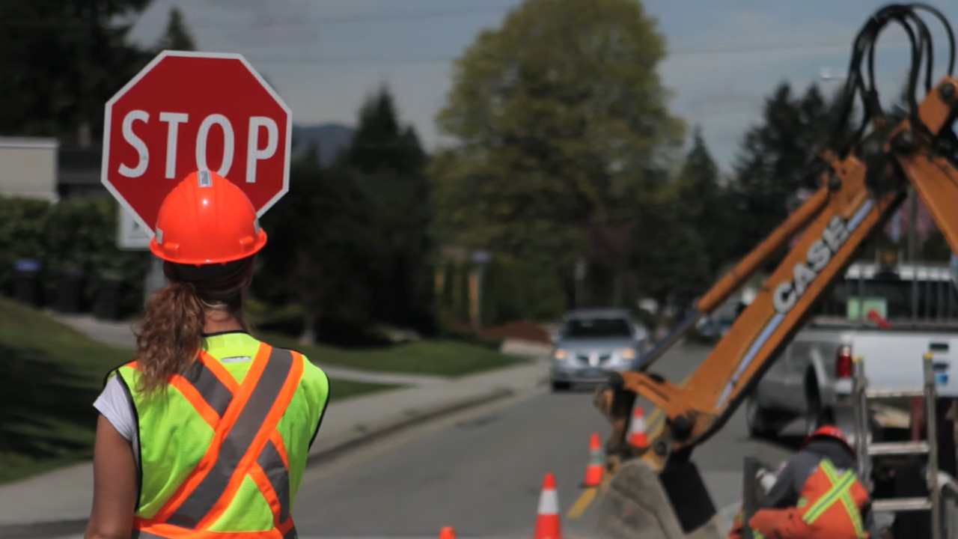
Community Impacts and mitigations (CONT.)
TRAFFIC PATTERNS
Contractors shall maintain the following:
Signage and personnel to ensure a safe work site for pedestrians and vehicles
Maintain pedestrian access to sidewalks, crosswalks and buildings
Local and Emergency traffic will be maintained at all times. Vehicular traffic will be maintained in accordance to DOT traffic stipulations; Pedestrian traffic will be maintained at all time.
Plate and open roadway traffic, when site is unattended/ not in use
HED562 – New 48” Trunk Water Main on East 233rd Street
Borough of Bronx
COMMUNITY IMPACTS AND MITIGATIONS

Slide 12
COMMUNITY OUTREACH PROCEDURES:
Community Construction Liaison (CCL) responsibilities are as follows:
First point of contact, maintain on-site presence and communications.
Identify, resolve, and/or proactively address issues and inquiries.
Distribute advisories and weekly construction activities newsletter.
Provide 72-hour and 24-hour (confirmation or cancellation) advisories for work impacts by email and door to door.
Attend community board monthly DSC meetings and other community meetings as necessary, to keep the community informed of the project schedule and impacts
HED562 – New 48” Trunk Water Main on East 233rd Street
Borough of Bronx
COMMUNITY OUTREACH PROCEDURE

Slide 13
COMMUNITY OUTREACH/ CCL (CONT.)
DDC’s Office of Community Outreach + Notification (OCON) works with CB’s, BID’s, local businesses, and other community stakeholders impacted by construction.
DDC has assigned a dedicated on-site Community Construction Liaison (CCL).
The CCL assigned to this project is Christopher Taylor; his information is listed below.
Email: East233rdstProjectCCL@gmail.com
Phone: (929) 391-4798
DDC OCON Lead: Jahneille Edwards, EdwardsJa@ddc.nyc.gov (718)391-3319
HED562 – New 48” Trunk Water Main on East 233rd Street
Borough of Bronx
COMMUNITY OUTREACH PROCEDURE

Slide 14
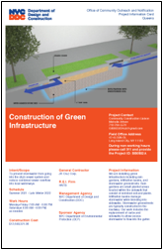
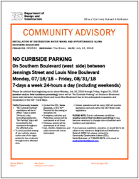
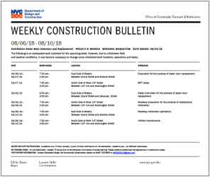
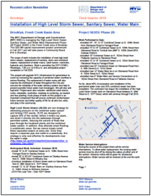
COMMUNITY construction LIAISON INVOLVEMENT
Keeping You Informed
The on-site CCL works directly with the project team. CCL will address community concerns, respond to inquiries, attend meetings, as needed, as well as distribute project related materials to keep the community informed and notified.
PROJECT​ INFORMATION CARD (PIC)​
​ ADVISORIES
WEEKLY ​LOOK AHEAD BULLETIN
QUARTERLY ​ NEWSLETTERS​
14
HED562 – New 48” Trunk Water Main on East 233rd Street
Borough of Bronx
COMMUNITY LIAISON INVOLVEMENT

Slide 15
Thank you
Q&A
Zohran K. Mamdani
Mayor
Eduardo del Valle Lisa Garcia
DDC Acting Commissioner DEP Commissioner

