Slide 1
CLICK TO EDIT HEADLINE TEXT
Edit text
REPLACEMENT OF WATER MAINS AND APPURTENANCES IN ORIENTAL BOULEVARD BETWEEN CORBIN PLACE AND PEMBROKE STREET
PROJECT ID# BED819
Brooklyn Community Board 15
October 26, 2022
Eric Adams
Mayor
Thomas Foley, P.E.
Commissioner
1
1

Slide 2
AGENDA
About the Project
Location
Construction Timeline
Outreach and Notification
Q & A
2

Slide 3
Why Is This Project Necessary?
Water mains in the Manhattan Beach are in need of replacement as they are over 100 years old.
Updated water mains will provide more reliable water supply to the area.
3

Slide 4
How Will This Project Benefit The Community?
Replacement of aging infrastructure will prevent unwanted water main breaks in the future.
New water mains improve water quality, delivery, flow and increase fire protection to the neighborhood overall.
Upgrading infrastructure to meet future demands will provide clean and safe drinking water for decades to come.
4

Slide 5
Which Areas Will Be receiving new water mains ?
The project area includes all mapped streets in Manhattan Beach with original water mains.
Approximately 51,600 linear feet (9.77 miles) of pipe will be used during this project.

Slide 6
Water Service Increases
Streets receiving a service increase -
Coleridge Street from Shore Blvd to Oriental Blvd (12” replacing 8")
Ocean Avenue from Shore Blvd to Hampton Avenue (12” replacing 8")
Girard Street from Shore Blvd to Oriental Blvd (12” replacing 8")
MacKenzie Street from Shore Blvd to Oriental Blvd (12” replacing 8")
Pembroke Street from Shore Blvd to Oriental Blvd (12” replacing 8")
Oriental Blvd from Pembroke Street to Oxford Street (12” replacing 8")
Oriental Blvd from Ocean Avenue to Corbin Place (20” replacing 12")
West End Avenue from Shore Blvd to Oriental Blvd (20” replacing 12")
Ocean Avenue from Oriental Blvd to Oriental Blvd (20” replacing 12")
6

Slide 7
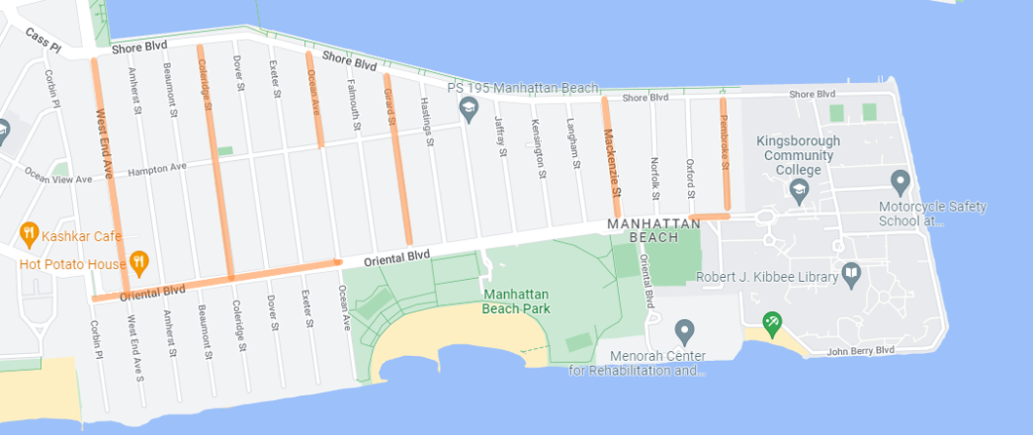
Water Service Increases
7

Slide 8
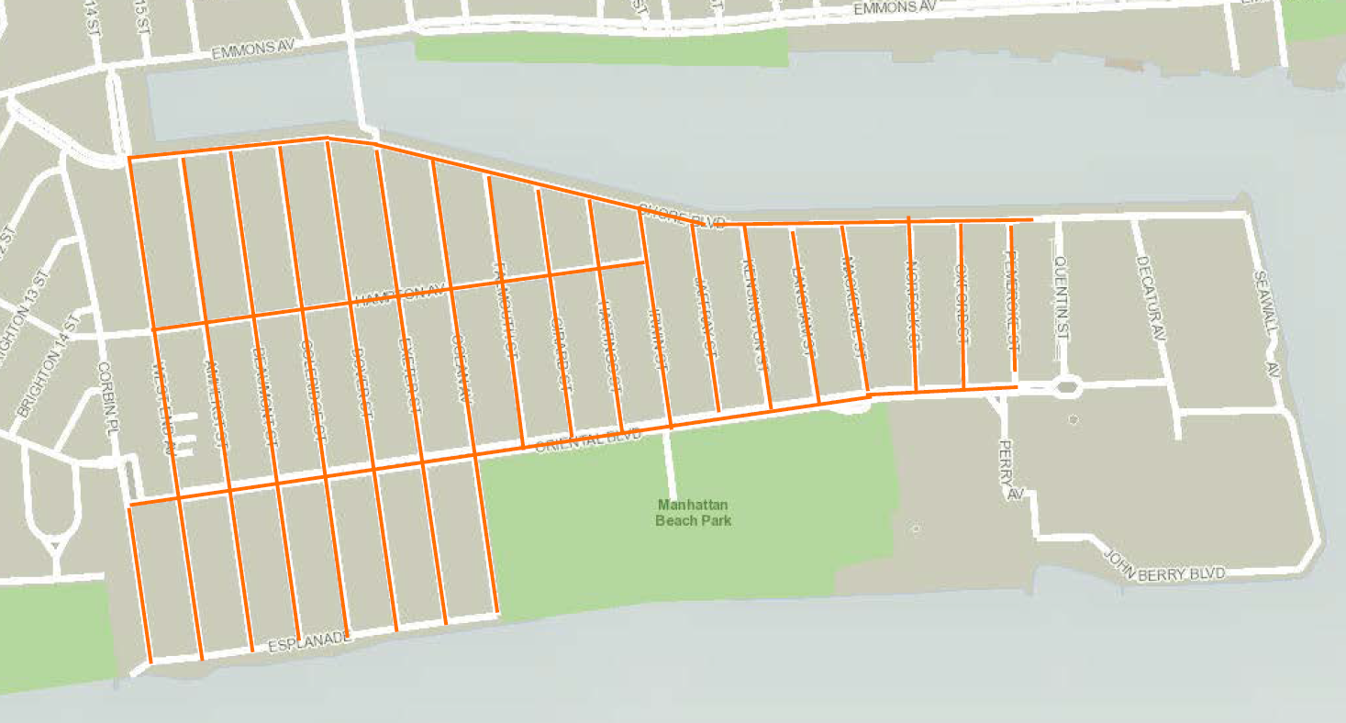
Total Project Work Area
This map shows the project total work area including work by private utilities, and upgrades to FDNY alarm system
8

Slide 9
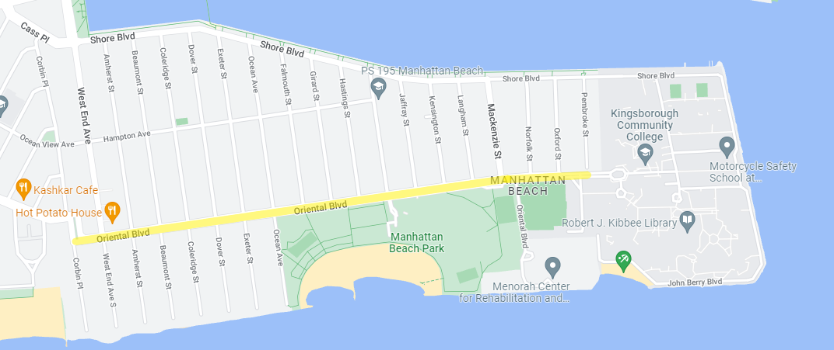
Project Stages
The project will start on Oriental Boulevard
Starting on Oriental Boulevard should allow us enough time to finish work near the beach in time for Memorial Day 2023.
All vehicles including EMS will have access to the roadway during construction, this includes access to:
Kingsborough Community College
Menorah Rehabilitation and Nursing home
As work progresses, the community will be informed of the next area of focus.

Slide 10
Working Hours During Construction
Typical Construction Activities
7AM to 6PM, Monday through Friday
Water shut-offs will occur from 8:30am to 4:30pm
If weekend work is necessary, operations will occur: Saturdays, 8AM to 4PM.
If working in proximity to schools, the Community Construction Liaison (CCL) and contractor will coordinate with the school prior to mobilization.
Contractor will follow all DOT & Street Activity Permit Office event embargos.
10

Slide 11
Construction Timeline
Anticipated Construction Schedule
Commencement: Fall 2022 Completion: Fall 2024
Project Total Cost: $35.3 Million
11

Slide 12
COMMUNITY OUTREACH
DCC’s Office of Community Outreach + Notification (OCON), will work with CB’s, BID’s, local businesses and other community stakeholders impacted by construction.
Community Construction Liaison (CCL)
DDC has assigned Tyler Reynolds of JED Engineering as the dedicated on-site Community Construction Liaison (CCL). The CCL can be reached at:
140 Brighton 11th Street
Ground Floor
Brooklyn, NY 11235
BED819CCL@Gmail.com
Office: (646)-560-2712
Cell: (917) 943-4903
12

Slide 13
COMMUNITY OUTREACH
The community will be provided advanced notification prior to the start and during construction.
Notices will include:
Project Information Card
Weekly Look Ahead Bulletins
Start Up Advisory
72-hour and 24-Hour Community Advisories
Start Up and Quarterly Newsletters
13

Slide 14
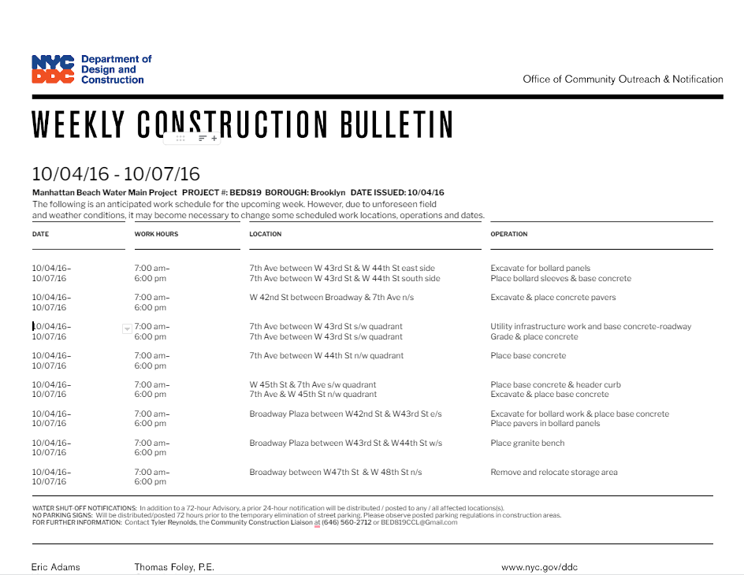
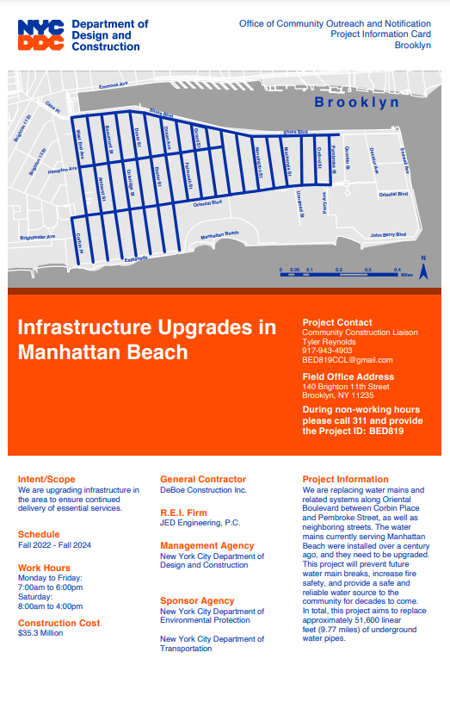
DDC Outreach Notices
14

Slide 15
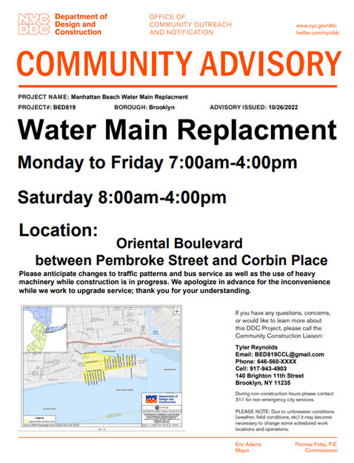
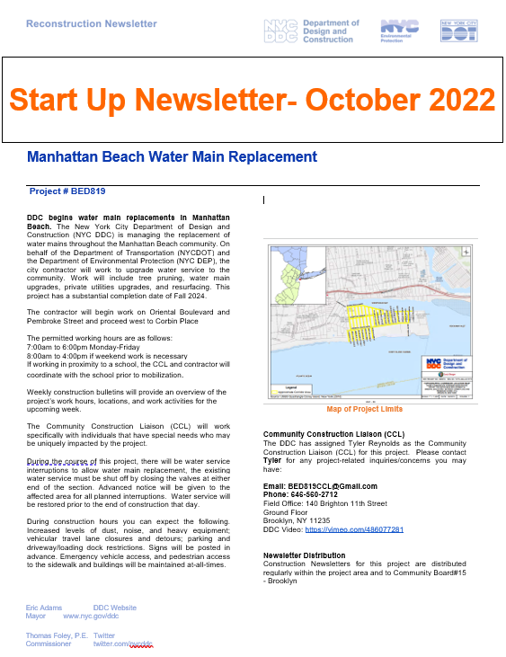
DDC Outreach Notices
15

Slide 16
THANK YOU!
Q&A

