Slide 1
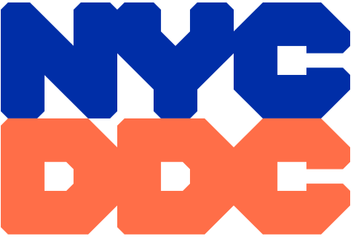
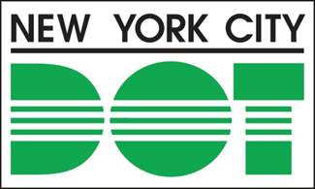
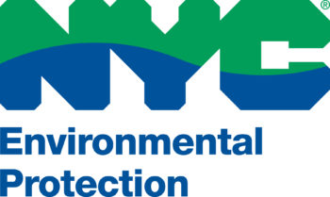
Inwood 10th avenue
safety improvements
PROJECT ID: hwm10inwd/SEN20008
BOROUGH OF Manhattan
P.S. 005 ELLEN LURIE SCHOOL - PTA MEETING
Zohran K. Mamdani
Mayor
Mike Flynn
NYCDOT Commissioner
Lisa Garcia
NYCDEP Commissioner
Paul A. Ochoa
NYCDDC Commissioner
SEPTEMBER 24, 2026

Slide 2

Agenda
Welcome
Project Location
Project Background
Project Goals
Existing Site Conditions
Proposed Improvements
Proposed School Loading Zone Area
Proposed Greenway Safety Measures
Tentative Project Schedule
Questions / Open Discussion

Slide 3
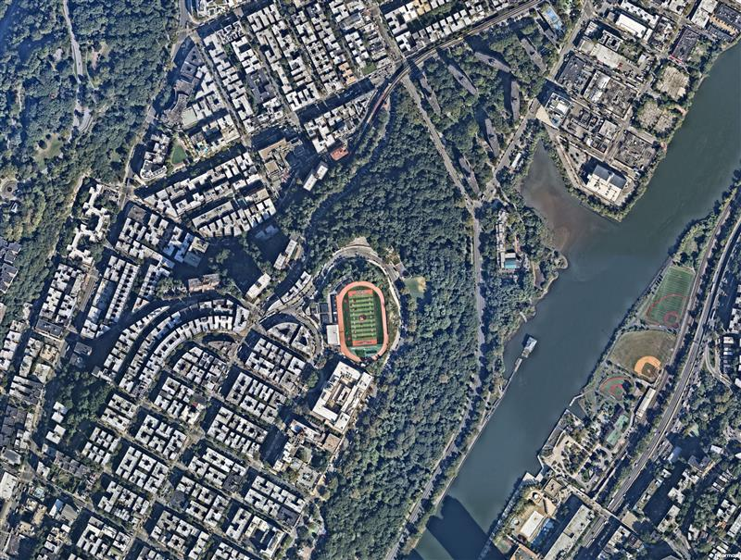
PROJECT Location
Fort Tyron
Site Three / Site Four
Inwood and Fort George Northern Manhattan, NY
Highbridge Park
Sherman Creek
Site One: Fort George Multisite
Site Two: Harlem River Drive Gateway
Site Three: Dyckman Rest Intersection
Site Four: Nagle Avenue El-Space Urban Design Corridor
Site Two
PS5
Roberto Clemente State Park
Site One
3

Slide 4
PROJECT Background
Site History
2017 – Dyckman St. Protected Bike Lane Installation
2017 – Dyckman Rest Intersection Upgrades
2018 – Inwood Rezoning
2023 – 10th Ave. Pedestrian Bridge Removal
2024 – Pedestrian Ramp Upgrades at 10th Ave.
Protected bike lanes added on Dyckman St.
Painted curb extensions added on 10th Ave. to improve safety and calm traffic
Ped ramps upgraded to meet ADA standards
Pedestrian islands added on Dyckman St.
Signal-controlled intersection installed at
Nagle Ave crossings
Daylighting added to improve visibility
Curb regulations updated to reduce congestion
Bike lane extended to improve connectivity
Inwood NYC Action Plan delivered $200 million of public investments for neighborhood preservation
Shifting focus to street-level safety improvements
New traffic signal and crosswalk installed at former bridge site
Traffic signals upgraded along 10th Ave.
New school safety signage installed
4

Slide 5
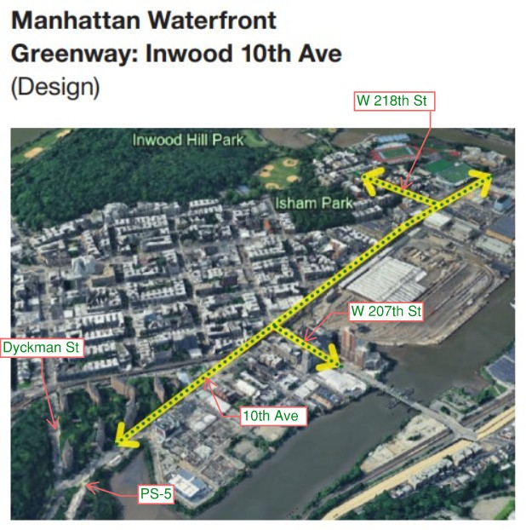
greenway project
Location is at the intersection of several critical bicycle routes
NYC DOT in conjunction with partner agencies recently completed planning work for the larger Manhattan Waterfront Greenway Plan
A second project (in design procurement), will continue north where this project ends
5

Slide 6
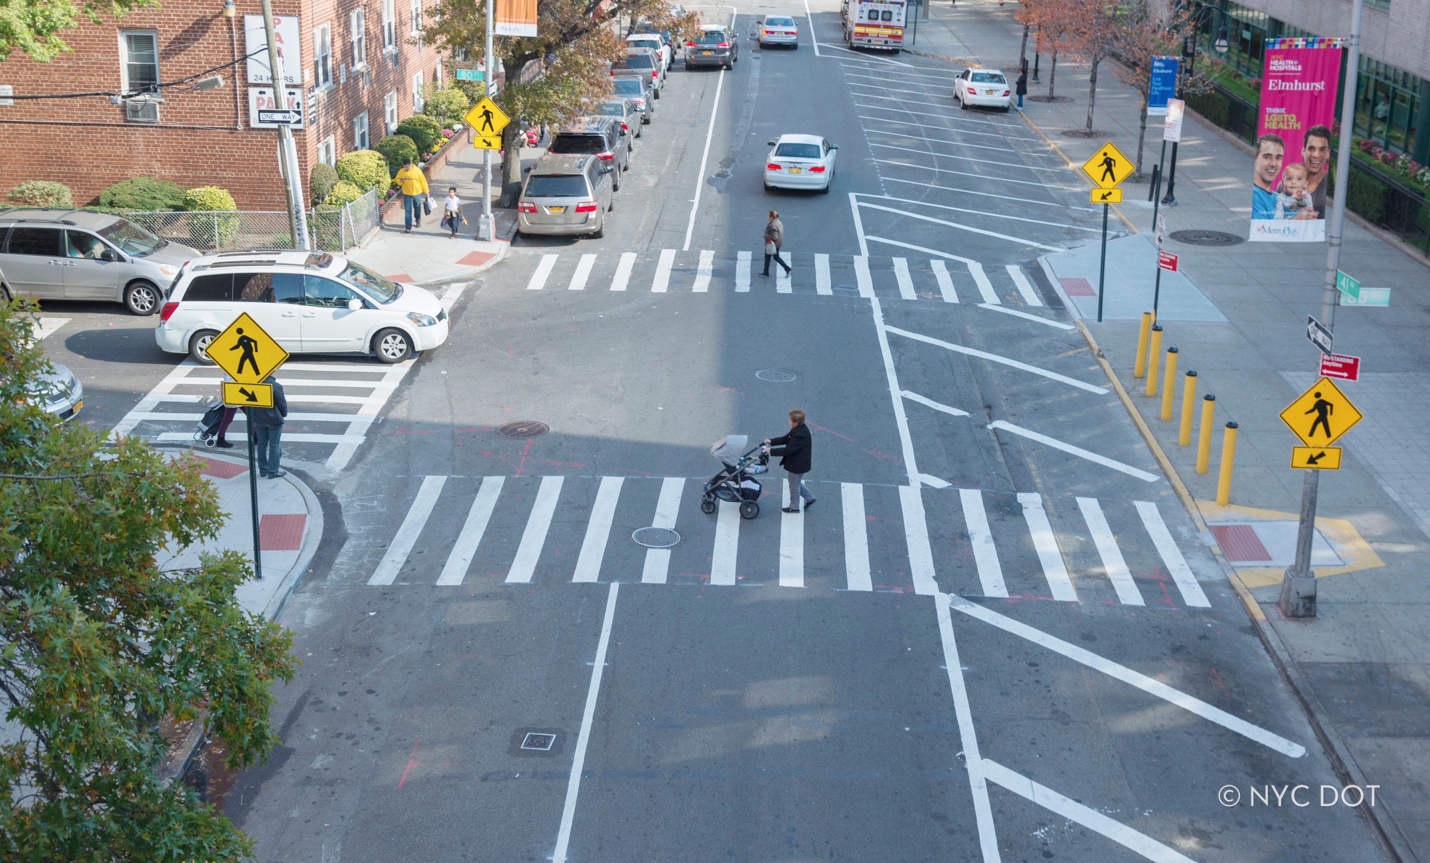
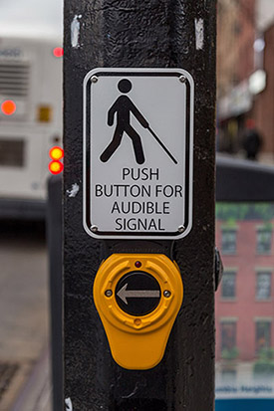
PROJECT Goals
Enhancing Pedestrian Safety
Improve pedestrian crossings at all intersections
Increase visibility and shorten crosswalks
Enhance bus-ridership safety with design improvements to bus stops
Install Accessible Pedestrian Signals (APS) to provide ADA compliant pedestrian access at all signalized intersections.
NYC Street Design Manual: Curb Extensions
6

Slide 7
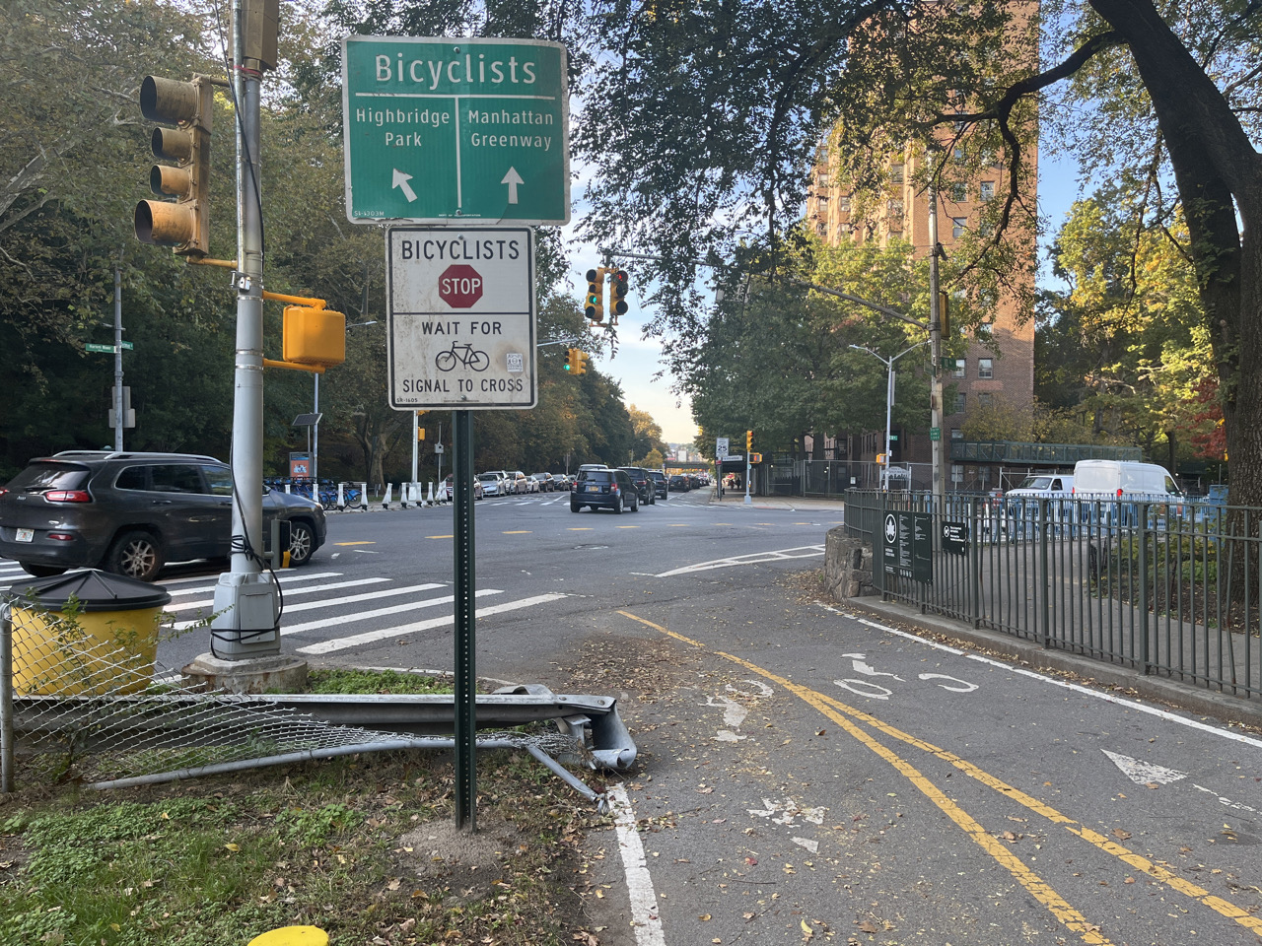
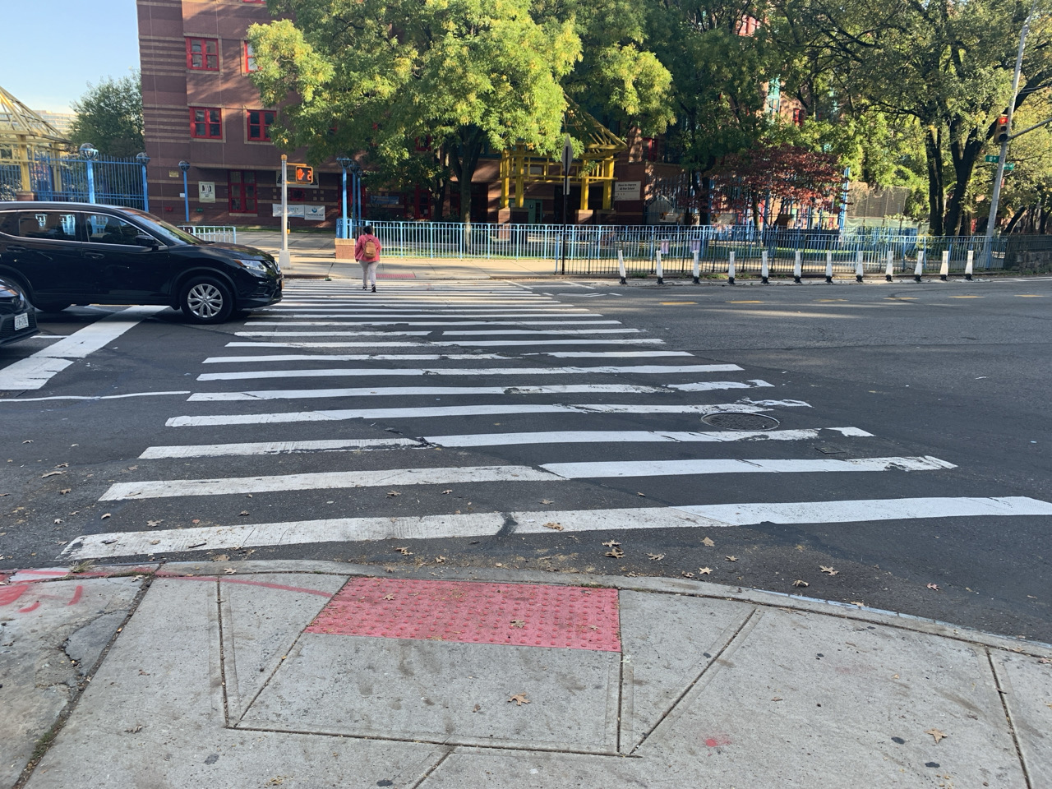
Existing site conditions
Harlem River Drive Gateway - Intersection of Harlem River Drive, 10th Avenue & Dyckman Street
Looking west towards the Harlem River Drive Gateway intersection from the existing bike path.
Looking northeast towards Ellen Lurie PS 5 in front of Dyckman Houses at Harlem River Drive Gateway Intersection.
Shared space between pedestrians & cyclists
Adjustment required for misaligned crosswalk adjacent to Public School 5 – Ellen Lurie
7
Notes:
Poor pedestrian infrastructure conditions and connectivity
Bicycle lane network lacks safety and efficient connectivity
Poor vehicle pavement markings and insufficient bike lane pavement markings
Cars park in bike lanes which is a safety hazard

Slide 8
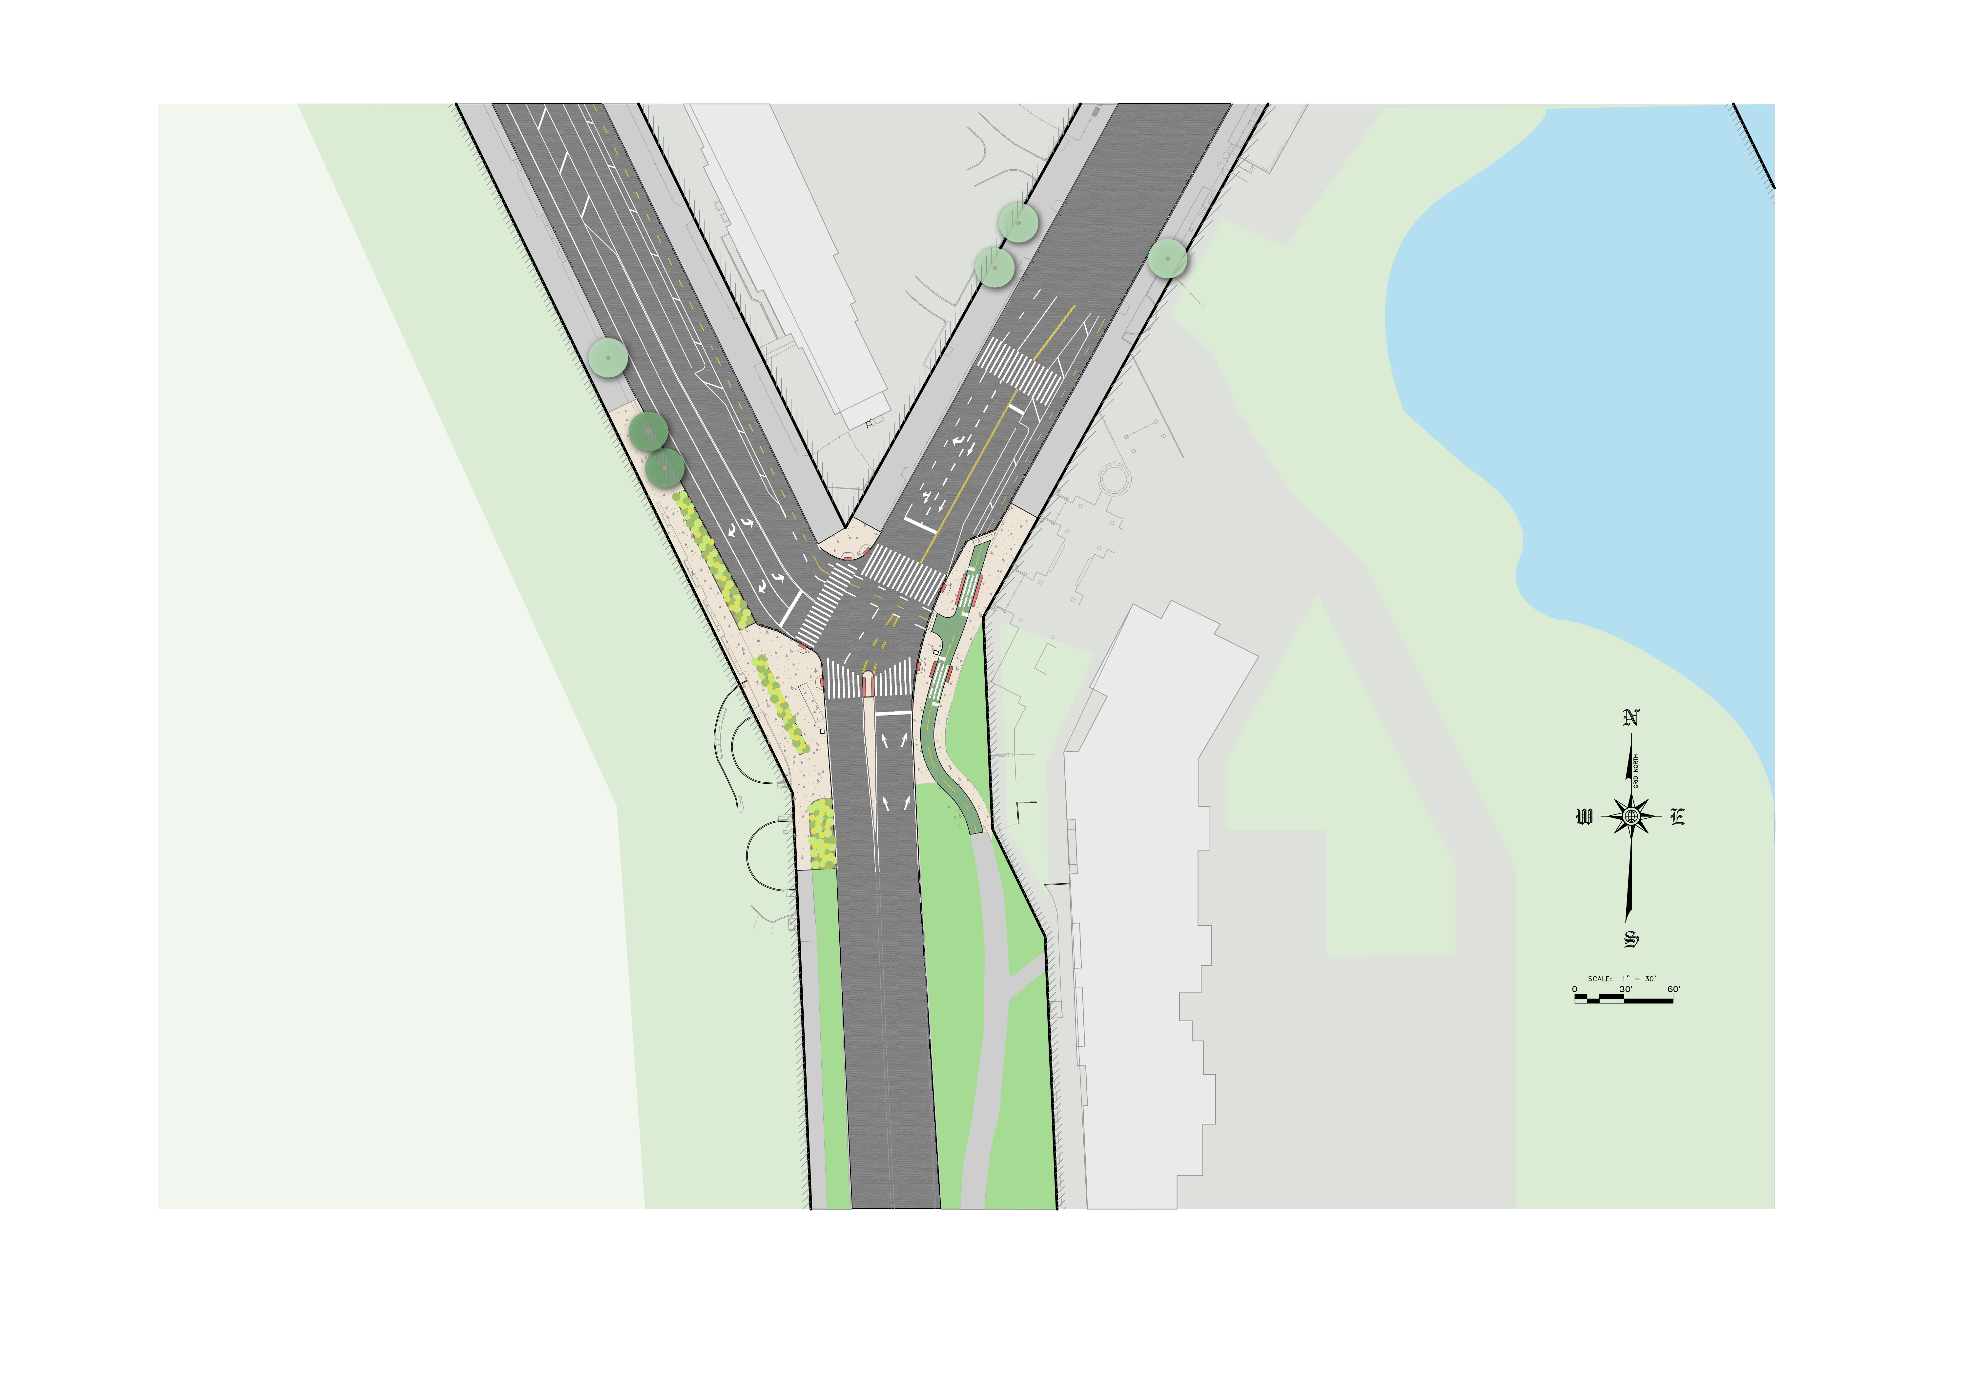
Proposed improvements
New Tree Plantings
Dyckman St.
10th Ave.
New Pavement
Proposed Wayfinding Sign
Proposed Traffic Signal With APS and Street Lighting
Proposed Bike Lane
Proposed Planting Areas
Relocated Citi-Bike Station
Proposed Wayfinding Sign
PS 5
Highbridge Park
Harlem River Dr.
8

Slide 9
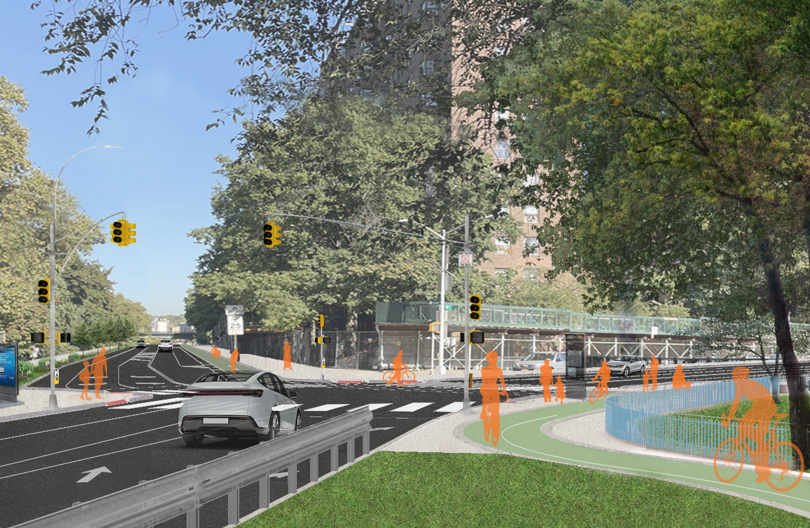
Proposed improvements
New Plantings and Curb Extension
Ellen Lurie PS 5
Existing Bike Lane
New Bike Path at Pedestrian Grade
Dyckman St.
10th Ave.
Harlem River Dr.
Looking northwest from proposed bike lane towards the intersection of 10th Ave., Harlem River Dr., and Dyckman St.
9

Slide 10
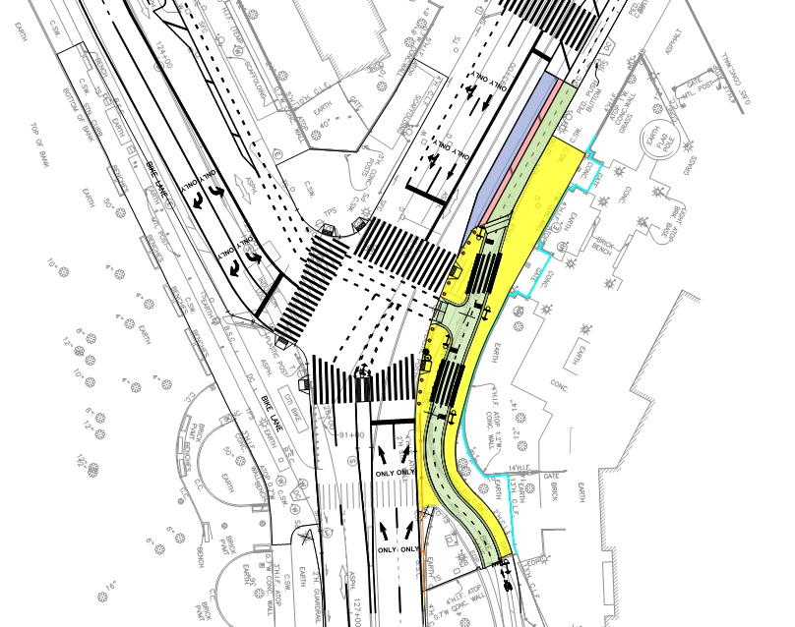

Proposed School loading zone area
Dyckman St.
10th Avenue
P.S. 5 Ellen Lurie School
Limits of Sidewalk
Harlem River Drive
Proposed Bike Lane
Proposed 3’ Buffer Lane for Students
10
School Bus Loading Zone

Slide 11
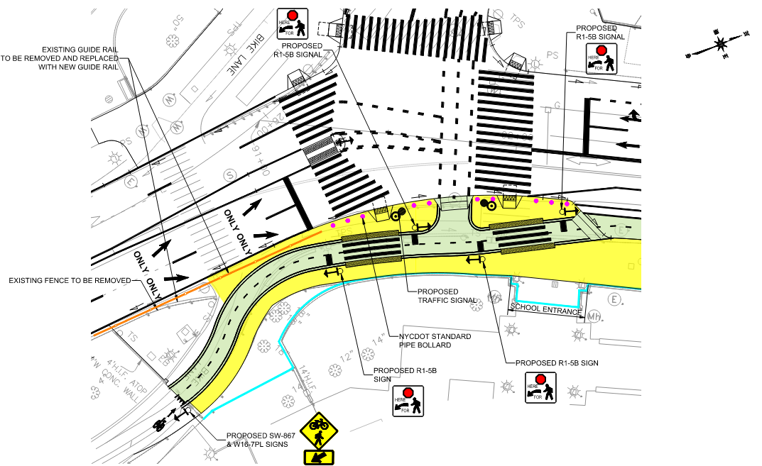

Proposed GREENWAY SAFETY MEASURES
Limits of Sidewalk
Proposed Bike Lane
New Guide Rail
NYCDOT Standard Pipe Bollard
Ellen Lurie P.S. 5 Property / Fencing Limits
11

Slide 12
Tentative project Schedule
      Estimated timelines are subject to change as project is still in design:
Fall 2023 – Project Start
End of Winter 2024 – Preliminary Design Start
Early Winter 2025 – Preliminary Design Approval
Summer 2027 – Design Completion
Summer 2028 – Anticipated Construction Start
Early Winter 2030 – Anticipated Construction End
Spring 2026 – P.S. 5 PTA Presentation & Feedback

Slide 13
Questions & open discussion
Thank you

