Slide 1
This webinar deck can be downloaded from the DCLA website
F Y 26 CAPITAL FUNDING REQUEST
www.nyc.gov/culture

Slide 2
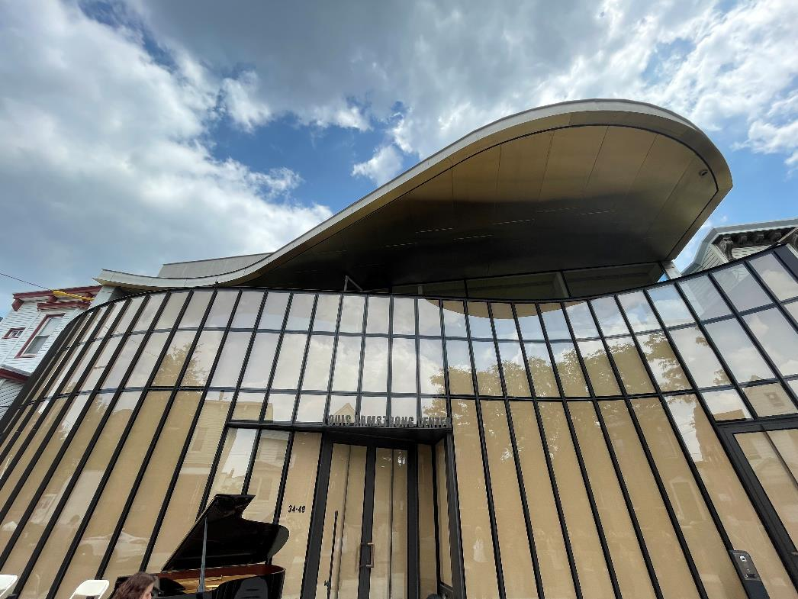
Section 1
Funding Basics
  Louis Armstrong Visitor Center

Slide 3
DCLA’s Goals for Cultural Capital Funding
DCLA’s goal for capital funding is to enhance the public’s experience of cultural life in New York City through projects that:
    Increase public access to cultural programming throughout the City
    Contribute to the vibrancy and diversity of the City’s communities
    Preserve and promote the highest quality cultural facilities, programs, and collections
    Maximize the effectiveness of public/private partnerships
    Address agency priorities such as accessibility for people with disabilities, environmental sustainability, and creating affordable workspace for artists, amongst other administration goals

Slide 4

City Budget Cycle
Each plan updates the City’s budget to reflect current capital allocations.
There are three major updates throughout a fiscal year.
F Y 25 Expenditure
Notification sent
September Plan
Preliminary Budget
(January Plan)
F Y 26 begins (July 1st)
Budget Adoption
Allocation letters sent
Executive Budget
(April Plan)
F Y 26 Funding
Request Submissions

Slide 5
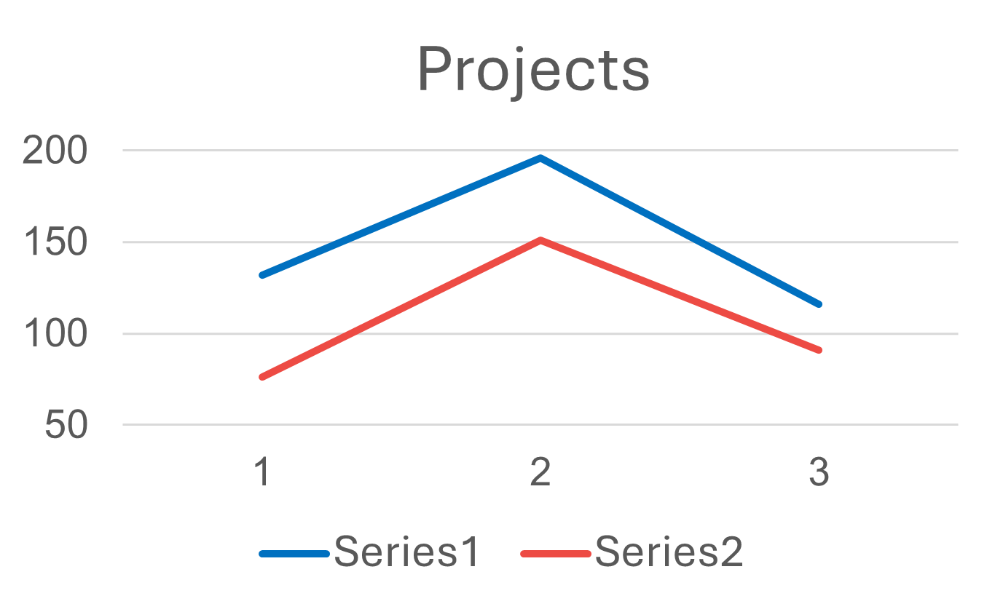
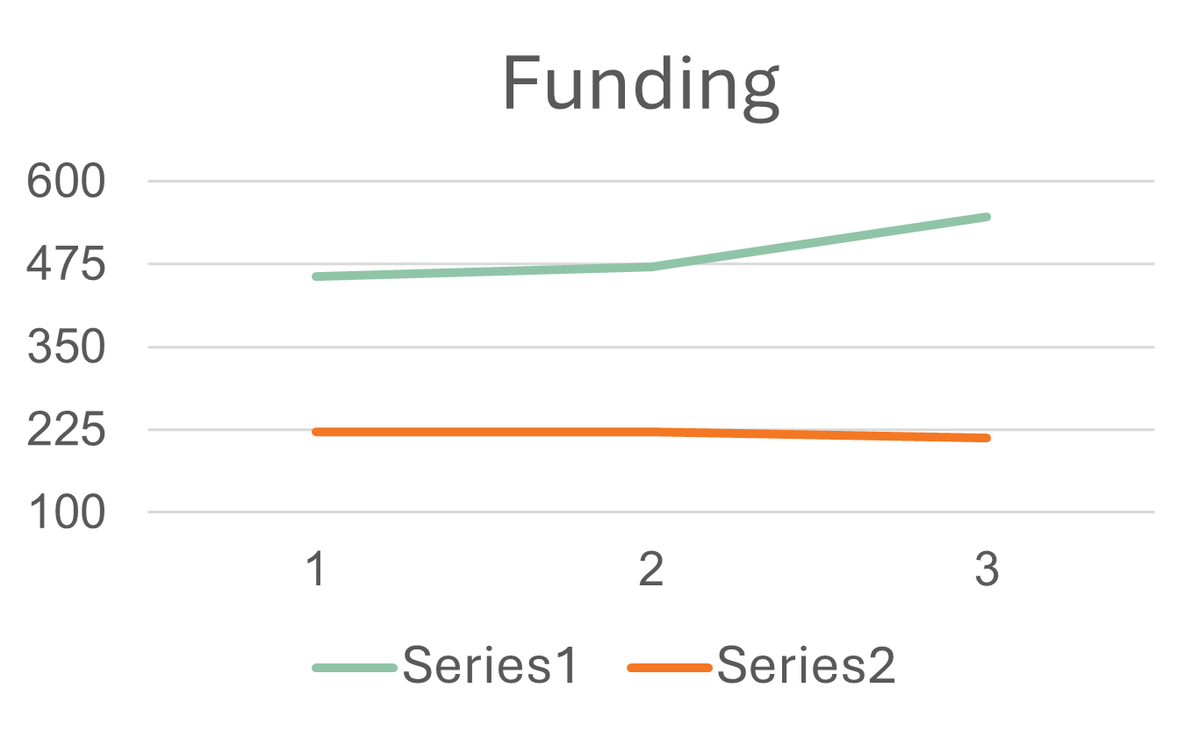

F Y 23 - F Y 25 Capital Funding
(in millions)
 | 2023 | 2024 | 2025
# Projects Requested | 132 | 196 | 116
# Projects Funded | 76 | 151 | 91
$ Amount Requested | $456m | $471m | $547m
$ Amount Allocated | $222m | $221m | $213m
On Average, more than 50% of projects were funded, but many of these projects received less than the requested amounts.

Slide 6

Capital Funding Basics
New York City allocates capital funding to cultural organizations on an
annual basis.
Capital appropriations are allocated by the:
  Borough Presidents
  City Council
  Mayor / DCLA
Unlike DCLA programmatic funding (CDF) which is an application process, the Capital funding process is known as a request
This means your request is reviewed and evaluated by DCLA and discussed with the elected officials from whom you request funds
Allocations are not grants and funding is spent by the City on behalf of the organization
All funds, regardless of source, are administered by DCLA and are subject to eligibility requirements and DCLA policies
A single project is often funded by a combination of funding sources.

Slide 7
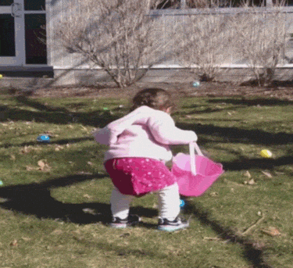

Fun Fact #1: Don’t Put All Eggs in One Basket
You should be discussing your project with DCLA as well as your Borough President, and City Council Members.

Slide 8
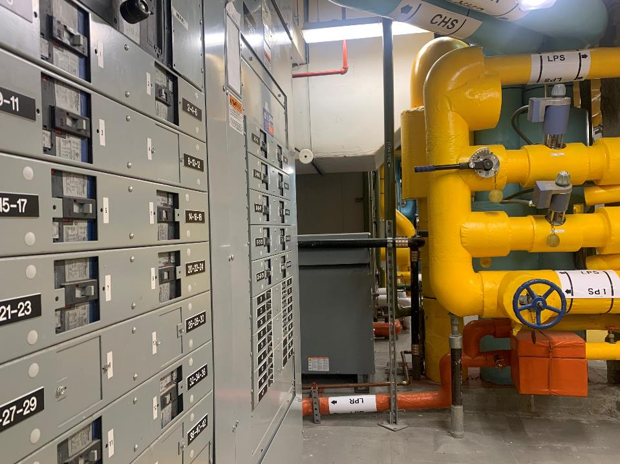
Section 2
Capital Eligibility
  Newly Built Mechanical Room
  at The Metropolitan Museum of Art

Slide 9
Who is Eligible to Request Funds
Baseline requirements for requesting capital funding are:
Your organization is a not-for-profit with documented tax-exempt status pursuant to Section 501(c)(3) of the Internal Revenue Service.
Your organization is one of the 34 CIG members located on City-owned property that receives institutional support or your organization has received a baseline CDF recommendation from the Department of Cultural Affairs in one of the past three fiscal years.
Your organization guarantees that any capital funding received from the City will not be used to advance or support sectarian activity, including (but not limited to) religious worship, instruction or proselytizing.
Your organization must demonstrate the capacity to take on the capital project for which funding is requested.
Your organization must demonstrate site control for the duration of design/construction in addition to the useful life of the project.

Slide 10
What Determines Capital Eligibility
Capital funds are secured by Government Bonds and are restricted for use through the Comptroller’s Accounting Directive 10 (AD10 or Directive 10), which covers the following:
Charges to the capital funds for improvements to capital assets can only
be made for projects that provide for a comprehensive betterment, defined as: Extensive, [physically] connected, and typically involving all four trades (electrical, plumbing, mechanical, and general construction).
A copy of Accounting Directive 10 and Frequently Asked Questions & Scenarios are accessible at the Comptroller’s website: https://comptroller.nyc.gov/services/for-city-agencies/comptrollers-directives-and-memoranda/directives-and-memoranda/
Additionally, the NYC charter, procurement rules, various local laws, City and agency policies, and a host of other regulatory agencies are all part of eligibility determination.

Slide 11
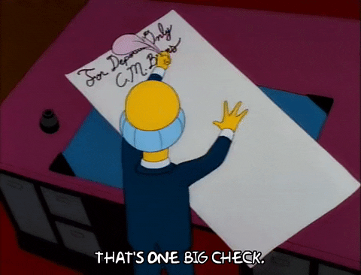

Fun Fact #2: City Funding is not a Blank Check
Do not expect to be reimbursed or to receive funds directly to your organization. City funds are expended on behalf of the organization.

Slide 12
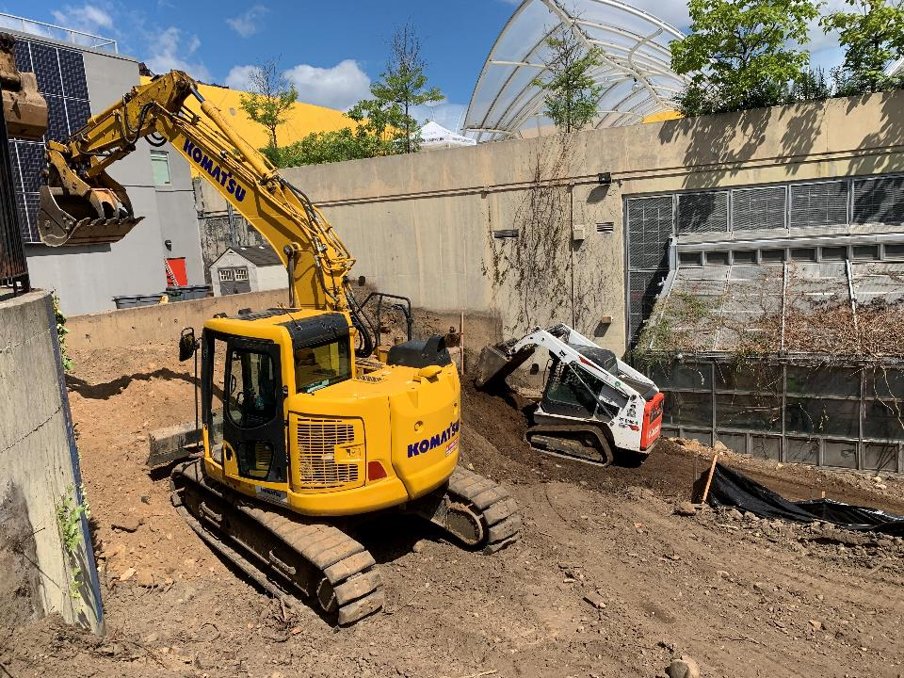
Section 3
Defining Your Capital Project
  Renovations to the Garden at Brooklyn Children's Museum

Slide 13
Types of Capital Projects
Based on Directive 10, the types of capital projects eligible for funding are:
Construction/Renovation
Equipment
Construction of a new facility
Expansion of an existing facility
Significant upgrade or renovation of existing contiguous space
Upgrade or replacement of a building system, e.g. HVAC
Equipment systems
(e.g. theatrical lighting)
Standalone equipment
(e.g. a piano)
Passenger vehicles
(10+ person capacity)
Work vehicles
(e.g. cargo van, truck, etc.)

Slide 14
Project Requirements
To determine if your project is eligible for City capital funding, it needs to meet the following requirements:
Comprehensive
Creates new asset/systems
Significant upgrade of an existing asset
City Purpose
Provides public benefit for improvement’s or equipment's useful life
Long-term
Investment
Equipment = 3 to 15 years
Construction/Renovation = 10 to 30 years

Slide 15


Project Financial Requirements
The minimum City contribution to a capital project on non-City owned property must be at least:
        $50,000 for equipment/$250,000 for minimally attached equipment
        $500,000 for construction/renovation (on non-City owned property)
        If your total project costs less than the minimum, your project is not eligible for capital funding
The project must be fully funded before it can be initiated:
  Any gap between funds available and total project cost must be closed through allocations of additional City funding or through private / non-City funding
Interfund Agreement Fee (IFA):
    An administrative fee of 2-15% will be deducted from your capital funding allocation to cover managing agency costs
    Talk to your Project Manager about what should be allocated for IFA
The City cannot pay for work completed prior to the appropriation.

Slide 16

Project Cost Estimating
When developing a construction project budget, the following should be considered:
Design Fee, 20%
General Conditions, 12%
Overhead and Profit, 15%
Design Contingency, 10%
Construction Contingency, 15%
Expanded Work Allowance, 10%
Interfund Agreement fee (IFA), 15%
Escalation fees calculated at a compounded rate of at least 8% per year to account for cost increases from the moment funds are awarded, up to and including design and the mid-point of construction
Other fees and expenses that may apply to your project include:
Estimating allowance, 15%
Phasing allowance, 15%
Accessibility allowance (local, state, and federal regulations), 20%
Asbestos and lead abatement allowances of 3% ($15,000 minimum)
Special inspections of at least 2% of the estimated bid amount
      (All mark-up percentages are based on construction costs)
Talk to your Project Manager about your cost estimate.

Slide 17
Ineligible Capital Costs Operational
Maintenance:
Repair/Maintenance work, e.g. roof patching
Painting & carpeting as standalone scope
Extended warranties
Maintenance agreements & service contracts
Studies:
Environmental assessments (as a stand-alone item)
Feasibility studies
Fixtures/Equipment:
Fixtures or equipment that require attachment to the property are ineligible unless additional legal requirements are met
Initial Outfitting
Organization-specific signage/donor plaques
Operational:
Employee salaries
Administrative expenses
Training
Other:
Fundraising, financing, owner’s rep, or legal fees
Custom databases
Unique or excessively expensive items
Any work completed prior to the appropriation

Slide 18


Fun Fact #3: City-funded Projects Take Time
Do not expect the project to follow your preconceived timeline.

Slide 19
Construction/Renovation Timeline
In most cases, the City (through DDC) will manage your construction project. Average ideal timeline:
1. Project Scope Creation:
Work with DCLA Project Manager to define scope
3. Project Design:
Consultant procurement and design is managed by DDC
5. Construction:
DDC holds all contracts and manages construction through C of O (if required)
3-9 Months
9
Months
12 - 18
Months
9
Months
6 - 48
Months
> 12
Mo
2. Front End Planning:
DDC will do initial feasibility and cost estimate reports
4. Construction Contract Bidding:
Once construction documents are finalized, project is bid out and contractors procured
6. Project Closeout:
Closeout with project evaluation and summary
Timeframes depend on the scale, budget and complexity of a project. Thia timeline represents optimal durations without delays and is based on complete submissions + timely actions.
There are many legal requirements that may result in delays such as Restrictive Covenants, subordination of existing mortgages, lease amendments, etc.

Slide 20
Project Requirements 1
Depending on the type of project, your organization must agree to the following requirements:
City Interest
Property must be either City-owned, or
If not City-owned, a Restrictive Covenant, and/or other documents as determined, must be executed
Restrictive Covenant
Required when capital funds are spent towards a renovation or a new construction project on non-City owned property
Ensures the City has first priority interest on the property; if it is owned by a third party (e.g. landlord, bank), the Restrictive Covenant must be agreed to and signed by that third party property owner
Security Agreement
Required when capital funds are used for moveable equipment systems that are not purchased by DCLA directly
Establishes the City’s legal interest in the equipment and ensures that City-funded equipment is used in furtherance of a public purpose

Slide 21
Project Requirements 2
Use Restriction
The improved property or purchased equipment must be used consistently with the mission of the organization for the duration of the useful life* of the improvement or equipment
Property must be either City-owned, or
If not City-owned, a Restrictive Covenant must be executed
Recorded Against
(Real) Property
Any current and future owners (or lessors) of property are bound by use restriction (during the covenant term)
First Priority Lien
Other liens against property (mortgages, financing, loans, etc.) must be subordinated to the City’s interest**
* The useful life of a project is based on its estimated physical life and the NY State Local Finance Law. Under Directive 10, the City may not fund any assets with a useful life that is less than three years. Your lease term must be equivalent to or longer than the useful life period defined for your project plus design and construction duration.
** If the property is owned by a third party and/or there are liens against the property (such as a mortgage), those parties will also be required to sign legal agreements related to the capital project.

Slide 22
Project Requirements 3
City-funded projects must comply with Local Laws and City Policies.
Here are some that typically apply to cultural capital projects:
Green Building Laws
Green Building Law and Regulations:
Local Law 51 of 2023 (revisions of L L 31/32 of 2016 and L L 86 of 2005) requires projects to implement sustainable design strategies to improve environmental performance
Applies to city-owned projects and non-city-owned projects that have City funding of 50% or more of total project estimate or funding over $10,000,000 AND a construction cost of $2,000,000 or more
Links provided on link page of this deck
It is important to understand these laws as they will likely impact your budget
Local Law 92/94
of 2019
A Local Law amending the New York City building code to require that roofs of certain buildings be partially covered in green roof or solar photovoltaic electricity generating systems

Slide 23
Project Requirements 4
City-funded projects must comply with Local Laws and City Policies.
Here are some that typically apply to cultural capital projects:
Local Law 1 of 2013: M/WBE
Ensures NYC certified minority and women owned business enterprises have greater access to public contracting opportunities
For more information, visit:
  Minority and Women-owned Business Enterprise (M/WBE) Certification Program
Local Law 51
of 2017:
Induction Loops
Requires that any capital project with an estimated baseline construction cost of $950,000 or more involving the construction of one or more “assembly areas” include the installation of an induction loop assistive listening system in at least one assembly area and “microlooping” each security, information or reception desk used for check-in
For more information and exemptions visit: Local Law 51

Slide 24
Project Requirements 5
City-funded projects must comply with Local Laws and City Policies.
Here are some that typically apply to cultural capital projects:
Local Law 58
of 1987: Accessibility
Mandates that the design and construction of buildings accommodate the accessibility needs of people with disabilities, including appropriate routes of movement in the interior and exterior of the building, interior room modifications, and adjustment of facilities: Local Law 58 of 1987
General Accessibility
Considerations
Accessibility requirements regulated by NYC Building Code A117.1 (City law) and 2010 ADA Standards for Accessible Design (Federal law)
Path of travel: An alteration that affects or could affect the usability of or access to an area of a facility that contains a primary function shall be made so as to ensure that, to the maximum extent feasible, the path of travel to the altered area and the restrooms, telephones, and drinking fountains serving the altered area are readily accessible to and usable by individuals with disabilities, including individuals who use wheelchairs, unless the cost and scope of such alterations is disproportionate to the cost of the overall alteration.

Slide 25


What to Plan for Post Construction
Once construction is complete, your building or space is your responsibility. It is essential to plan for the following post construction:
A maintenance plan for any new buildings and/or building systems (including trainings, maintenance contracts, etc.)
Needs for facility management
Additional staff to operate new space(s)
Operating expenses associated with the above
"Another flaw in the human character is that everybody wants to build and nobody wants to do maintenance.“ – Kurt Vonnegut

Slide 26

Capital Feasibility Planning (CFP)
DCLA intends to continue the Capital Feasibility Planning program in FY26. The program is designed to assist not-for-profit cultural organizations with 501(c)(3) status considering a capital construction or renovation project to identify a path for the organization to successfully define and initiate a capital project or recommend alternative strategies should a capital construction or renovation project be inadvisable.
Organizations will work with a consultant to conduct a review of their capital needs in relation to existing operating models to develop a feasible strategy scaled appropriately to align the organization’s capital needs with its administrative and fundraising capacity.
Applications will likely be due in April 2025 and more information will be shared throughout the winter. Updated information will be available here:
https://www.nyc.gov/site/dcla/cultural-funding/capital-funding-feasibility.page
Participation in the Capital Pre-Scoping and Feasibility Planning pilot program neither guarantees nor precludes organizations from accessing City capital funding.

Slide 27

Fun Fact #4: Go with the Flow
There are administrative processes that need to be followed.
Please be responsive and as detailed as possible.
We are here to help you through the process.

Slide 28

Equipment Systems and Vehicles
Equipment Systems:
  To be capitally eligible, equipment systems must be composed of a group of related elements. The elements are considered related if they are mutually dependent upon each other, and physically connected or connected through a wireless network.
  Each system or vehicle must be at least $50,000* (or $250,000 if minimally attached)
  Each system or vehicle must have a minimum useful life of 3 - 15 years
  OMB and the Comptroller have final determination over capital eligibility
  DCLA does not manage initial outfitting projects
  * Minimum funding ask must be $60,000

Slide 29
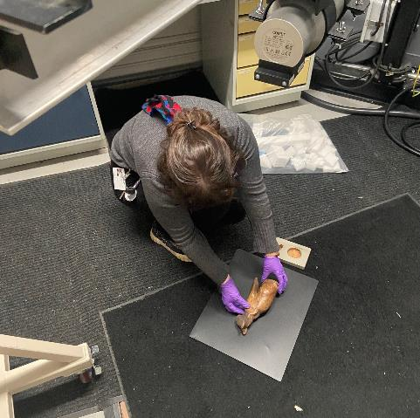
Common Types of Systems
Information Technology (IT)
Audio Visual
Sound
Theatrical Lighting
Seating
Vehicles and Heavy Equipment
Standalone systems (e.g. pianos)
    The F Y26 Funding Request Guidelines, part of the funding request document package, contains examples of eligible equipment.
  X-Ray at
  Brooklyn Museum

Slide 30
Equipment List & Cost Estimation
Equipment List Example
Type of Equipment | Make/Model | Qty | Unit Cost | Total Cost | Software
Lighting Control Console | ETC Ion XE | 1 | $15,000 | $15,000 | Y
Lighting Instrument | ETC Source 4 | 20 | $2,500 | $50,000 | N
Delivery |  |  | $2,500 | $2,500 | NA
Subtotal |  |  |  | $70,500 | NA
Contingency | 10% |  |  | $7,050
TOTAL COST |  |  |  | $77,550
For your equipment request:
Submit your list of equipment as an Excel document, not as a PDF
Read the Funding Request Guidelines for details on what components comprise a system
Include delivery on all requests
Include 10% contingency on all requests
Installation is covered on a project-by-project basis; check before including it on your request
Use MSRP/List Price for your cost estimation

Slide 31
Equipment List – Pre-review
Equipment Pre-Review:
Before submitting your equipment request through CapGrants, reach out to capitalrequest@culture.nyc.gov; we will pre-review your equipment list to ensure you are requesting eligible items and systems
Once requests are submitted to CapGrants, the equipment list cannot be changed
The pre-review is for the request process only
Further scope development will occur should your organization receive funding for equipment
Pre-review of equipment projects does not guarantee funding
A successful equipment project request starts with a pre-review with an Equipment Capital Project Manager

Slide 32
Equipment Timeline
In most cases, the City will procure the equipment for your organization. Average ideal timelines:
Equipment Systems or Standalone Equipment Projects
At least 29 – 40 months from start of Scope Development to Project Close
Scope Development
8 - 10 Months
OMB Review
3 Months
Procurement
11 - 16 Months
Order & Delivery
7 - 11 months
Vehicle and Heavy Equipment Projects
At least 24 - 30 months from start of Scope Development to Project Close
Scope Dev
6 – 10 months
OMB Review
4 months
Deliverables
6 - 8 months
Registration
5 months
Order & Payment
3 months
Timeframes depend on the scale, budget, and complexity of the project.
The timelines shown represent optimal durations without delays and are based on complete submissions and timely actions.

Slide 33
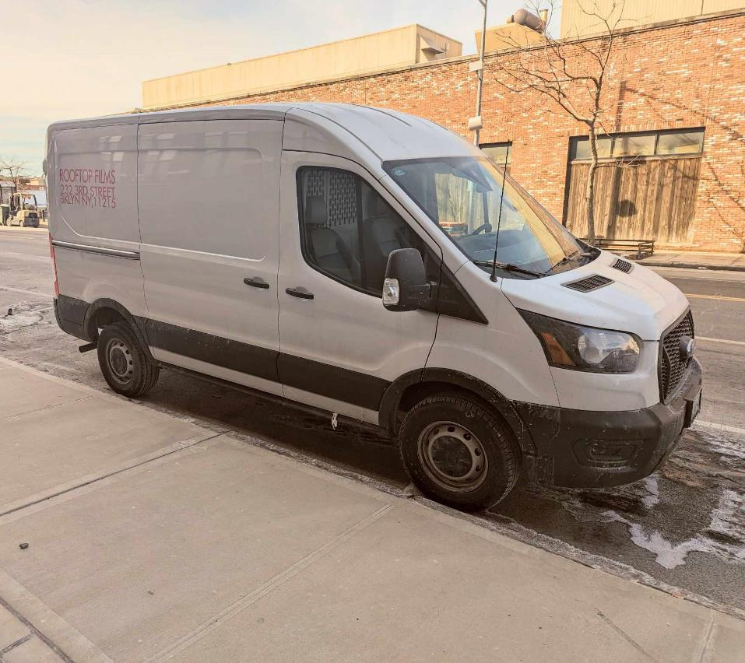
Section 4
F Y 26 Request Process
  Van for Rooftop Films

Slide 34
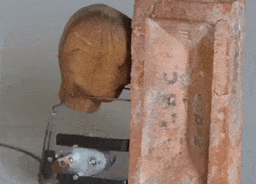
Submitting Your Request
  Preparation
  Request Documents
  Tips
  Upload Request

Slide 35

Preparation
Clearly define your capital project and draft the preliminary scope ensuring it conforms to the funding requirements outlined here
Gather cost estimates and take into consideration City requirements and markups when putting together final numbers
Prepare a detailed four-year organizational operating budget (for F Y 23-26)
Prepare a pro forma project budget of the capital project’s impact on your organization
Talk to your elected officials (Borough President, City Council, DCLA/Mayor) and present your project to them
Prioritize your projects if you submit more than one request
Contact a DCLA Capital Project Manager so that we can offer valuable feedback on eligibility and project scope

Slide 36
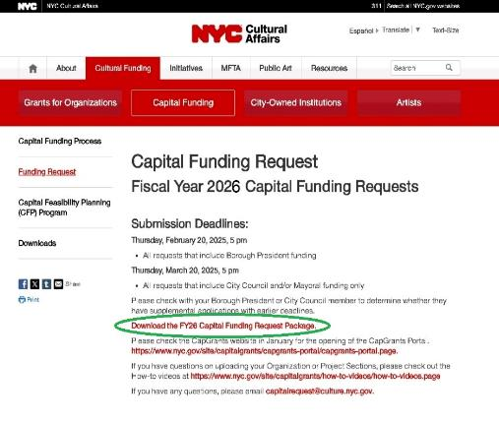
Download Documents
F Y 26 Cultural funding request documents can be downloaded at: Capital Funding Request - DCLA
All Request forms are fillable pdf documents: To properly enter information, you need the most recent version of Adobe Reader (free download here)
  Mac users: Open the forms in Acrobat Reader itself or by a mouse right click and “open with Acrobat Reader” (A double click will open a preview document that does not allow you to enter or save information)
  Character count in text boxes is limited: Be as clear and concise as possible in your answers

Slide 37
Request Package
The download package consists of:
  What’s New for F Y 26
  Instructions
  F Y 26 Funding Request Guidelines
  Organization Section
  Project Section Appendices (CR, EQ, and V)
  Reporting and Conflict of Interest Forms
  Acknowledgement Forms
Please read the F Y 26 Funding Request Guidelines before starting the request forms as it contains:
  Information on capital eligibility
  Instructions for filling out the appropriate appendix for your project
  A glossary of commonly used City administrative terms for capital projects
  Sample legal documents (e.g. Restrictive Covenant, License Agreement, Personalty Agreement)

Slide 38
Organization Section
Only one Organization Section is required, even if you submit multiple projects.
Organization Section provides background information on your organization
Amount Requested lists the total amount of funding you are requesting for all projects
Project List of your projects in order of priority
DCLA requires submission of the following ATTACHMENTS:
Organizational Chart
A diagram of your organization’s leadership and management structure, including the key positions in the organization and the names of personnel who currently hold those positions, paying particular attention to those roles that affect the capital project
Board of Directors
A current list of all board members and their professional affiliations
Four-Year Operating Budget (template provided)
Current operating budget and plan with detailed hard numbers for Fiscal Years 23 - 26, in an Excel file format, with detailed financial information (actual and projected), not to be confused with the Pro Forma Project Budget
Strategic Plan and/or Business Plan
A narrative explaining how the capital project fits into your organization’s long-term strategy, and, if applicable, capital plan, highlighting goals and the strategies to achieve them, both in terms of programming and budgeting; key figures, such as increased attendance or programming, should be explained

Slide 39
Project Sections
If you are requesting capital funds for multiple construction/renovation projects and/or multiple equipment systems, you are required to prepare separate Appendices (Appendix CR, EQ, and or V)
We strongly suggest prioritizing your requests as funding will be extremely limited
We strongly suggest you consider phasing larger projects so that you can begin a discrete scope even if you do not receive the full amount of your request
Each project should be a separate Appendix, e.g. two equipment systems (piano and lighting system) should be two Appendix EQ documents
Of the required supporting documentation for the Project Appendices, please note specifics for the following documents:
Pro Forma Project Budget – required for Appendix CR
A detailed financial spreadsheet that reflects:
Changes to income and operating expenses during design and construction
Changes to income and operating expenses once the project is complete and for a period after
Restrictive Covenant Acknowledgement
Organizations on non-City owned property are required (along with the landlord if the property is rented) to sign an acknowledgement form confirming all parties understand that a Restrictive Covenant is required for City-funded capital construction projects
Board signature required
Equipment/Standalone System – Landlord Acknowledgement
If you rent your space, your landlord will need to acknowledge that they are aware you are requesting funds from the City for equipment that will reside on their property
The equipment will either remain the property of the City or be subject to the City's first-priority lien
Use the check list at the end of each appendix for required documentation and other supporting documentation that may be required.

Slide 40
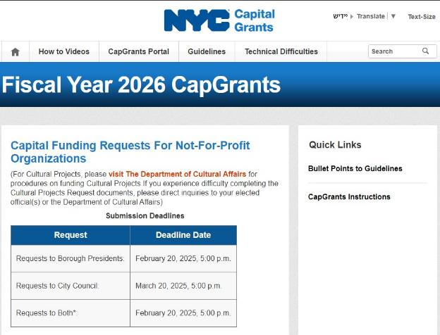
Uploading Your Request
CapGrants Home Page
Go to NYC CapGrants and click on the CapGrants Portal tab for instructions on uploading your request
Use this portal to officially submit your request to the City

Slide 41
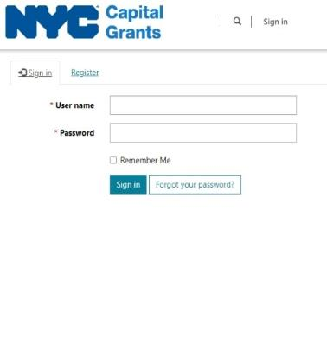
CapGrants User Registration
User Registration:
If you registered last year, you can sign in without creating a new account
Anyone can register for CapGrants
The system will send you a confirmation email, check your spam or junk folder if its not in your inbox
Once you confirm your email, you can start registering organizations and submitting projects
If you have any problems, please contact your project manager or email capitalrequest@culture.nyc.gov

Slide 42
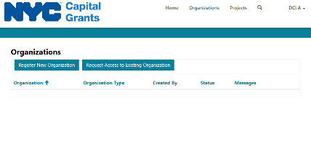
CapGrants Organization Registration
Organization Registration:
Determine who will create Admin account
Register organization as Cultural
Attachments should be uploaded in the original electronic file format; fillable PDF, Word, Excel, etc. (do not submit scanned versions of these documents)
Click “Submit organization” to finalize Organization section
You will not be able to submit a section until all required attachments are uploaded
Double check your work, once submitted you cannot edit this section
CapGrants will send an automated email to confirm organization registration
If you have any problems, please contact your project manager or email capitalrequest@culture.nyc.gov

Slide 43
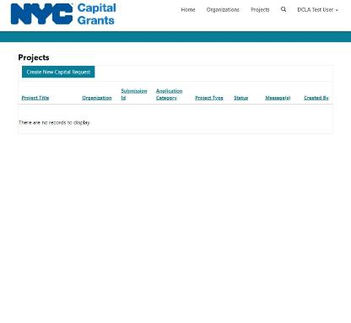
CapGrants Project Creation 1
Project Creation:
Click on the project tab at the top of the screen
Click on Create New Capital Request (not accessible until organization has been created)
Choose Project Type (choose Repurpose at DCLA direction only)
Enter information in all fields on the project screen
Three items to note:
  Click Add New Project Location, which will open a pop-up window, make sure you have pop-ups enabled for this site
  If you are requesting additional funding for an existing project, enter your existing Project ID
  Enter total City Council funding, then pick your individual Council member for them to review your request
  You can overwrite your uploads until you click submit
  Once you have confirmed that all information is correct, click submit
  No changes can occur once submit has been entered, double-check everything beforehand
  You will receive a confirmation email
If you have any problems, please contact your project manager or email capitalrequest@culture.nyc.gov

Slide 44


Fun Fact #5: Don’t Wait till the Last Minute
We recommend allowing extra time to submit your request due to the high
volume of submissions on the deadline dates.

Slide 45
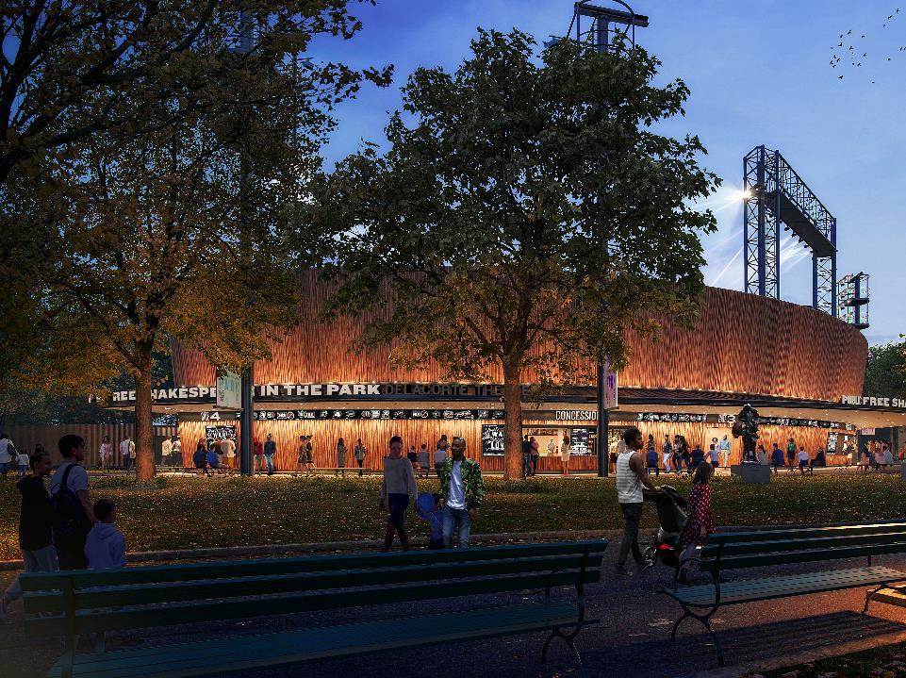
Section 5
Key Dates and Info
  Rendering of the Delacorte Theater Renovation

Slide 46

Capital Request – Key Dates
Request Forms Live Friday, December 16, 2024
Forms available for download
Borough President (BP) Thursday, February 20, 2025 at 5:00 pm
Submission deadline for all project requests that include BP Funding (i.e. BP funds only or BP and DCLA/CC)
If your request is to all three sources, the deadline is February 22.
City Council (CC) & DCLA Thursday, March 20, 2025 at 5:00 pm
Submission deadline for CC and/or DCLA (Mayoral) funds.
Please check with your Borough President or City Council member to determine whether they have supplemental applications or earlier deadlines. DCLA does not always have the most up to date information on this.
There will be no technical support after 4pm on either date.
You will not have the opportunity to submit your request after the given deadline.

Slide 47
Useful Links 1
DCLA: for instructions on downloading the Capital Funding Request Package and additional information
OMB CapGrants
Find information about your organization’s property:
In GOAT, the Geographic Online Address Translator, by NYC Planning
In ACRIS, the Automated City Register Information System by NYC’s Department of Finance
Borough President’s offices: Bronx – Brooklyn – Manhattan – Queens – Staten Island
City Council Members
The Speaker’s office: SpeakerScheduling@council.nyc.gov

Slide 48
Useful Links
Green Building Laws
      https://www1.nyc.gov/site/oec/green-building/green-building.page
      https://codelibrary.amlegal.com/codes/newyorkcity/latest/NYCcharter/0-0-0-1041
    DCAS ACE/ExCEL
Con Edison Energy Efficiency Rebates
NYSERDA New Construction/Renovation Energy Rebates

Slide 49

Fun Fact #6: Funding is Limited

Slide 50
We’re Here to Help
Andrew Burmeister
Assistant Commissioner
aburmeister@culture.nyc.gov
Sara Minard
Director
sminard@culture.nyc.gov
Victor Metoyer
Deputy Director
vmetoyer@culture.nyc.gov
Darren Brannon
Capital Project Manager
dbrannon@culture.nyc.gov
David Bryant
Capital Project Manager
dbryant@culture.nyc.gov
Eric Cecil
Capital Project Manager
ececil@culture.nyc.gov
Livia Bloom Ingram
Capital Project Manager
lingram@culture.nyc.gov
Joshua Downes
Capital Project Manager
jdownes@culture.nyc.gov
Stephanie Kingpetcharat
Capital Project Manager
skingpetcharat@culture.nyc.gov
Carolyn Sarkis
Capital Budget Analyst
csarkis@culture.nyc.gov
Questions? Talk to us!
capitalrequest@culture.nyc.gov

Slide 51


Fun Fact #7: You Made it to the End
You are one step closer to being an expert in City Capital funding. We still encourage you to review this seminar deck and reach out to us with questions!

Slide 52
Q & A
Q & A

