Slide 1
F Y 25 CAPITAL BUDGET SEMINAR
Construction/Renovation
(the seminar will begin shortly)
www.nyc.gov/culture

Slide 2

WELCOME
We will address questions at the end of the presentation
You can submit questions in the following ways:
      Q + A feature on Zoom
      Through emails to: capitalrequest@culture.nyc.gov
When you submit a question through any of the above options, please let us know your name and what organization you are with
All mics will remain muted throughout the presentation and Q + A

Slide 3


WHY WE ARE HERE
Overview of the capital funding process:
  What makes a cultural organization’s capital project successful
  What are the funding constraints and time frames
Initiate the process:
  Learn about the City agencies (DCLA, DDC, NYC/EDC, DCAS, OMB) involved in the process

Slide 4
CAPITAL PROJECTS: DCLA GOALS
Enhance the public’s experience of cultural life in New York City through projects that:
Increase public access to cultural programming throughout the City
Contribute to the vibrancy and diversity of the City’s communities and maximize the effectiveness of public/private partnerships
Preserve and promote the highest quality cultural facilities, programs and collections
YOUR ORGANIZATION CONTRIBUTES TO THESE GOALS
– THAT’S WHY YOUR PROJECTS HAVE BEEN FUNDED!

Slide 5
CITY BUDGET CYCLE
Each plan updates the City’s budget to reflect current project funding needs.
There are three major updates during the course of a fiscal year.
F Y 24
Expenditure Notification
September Plan
Preliminary Budget (January Plan)
F Y 25 begins (July 1st)
Budget Adoption
Allocation letters
Executive Budget
(April Plan)
F Y 26 Funding Request
Submissions

Slide 6
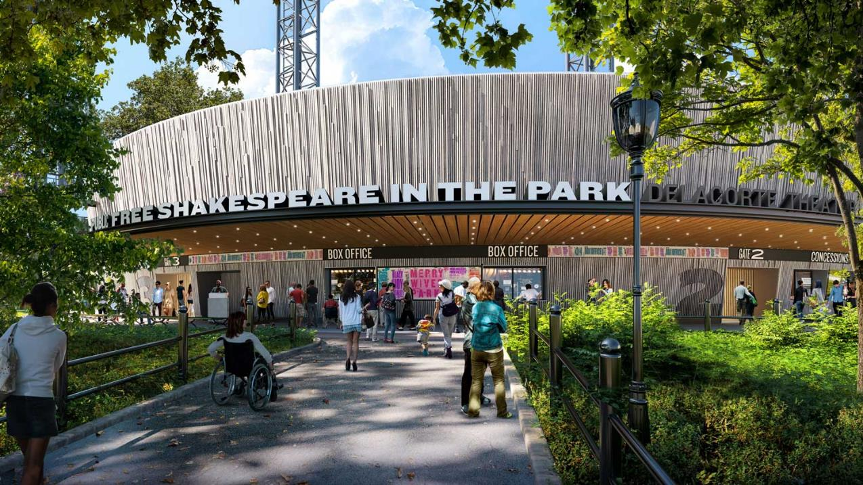
INITIAL REQUIREMENTS & EXPECTATIONS
  Delacorte Theater
  (Credit: Ennead Architects)

Slide 7

PUBLIC PURPOSE
Every project must further a public purpose, and the use of the improved property or purchased equipment must be consistent with the mission of the organization for the duration of the useful life of the improvement or equipment. Projects must establish a legal interest in the City funded asset by:
  enhancing City-owned property or
  on non-City owned property, by legal agreements such as the following:
  Restrictive Covenant
  When capital funds are being used for a capital improvement
  Security Agreement
    When capital funds are being used to purchase FF&E (e.g. computers, furniture, fixtures) (this is sometimes required on City-owned property)
The specific legal agreements will be determined by the City and depend on your particular property and project.
The cultural organization must have site control for the duration of the capital improvement’s useful life (10-30 years), measured from the date of substantial completion.

Slide 8
NON-CITY PROPERTY OWNERSHIP 1
The use of the improved property or purchased equipment must be consistent with the nonprofit mission of the organization for the duration of the useful life* of the improvement or equipment
Property must be either City-owned, or
If not City-owned, legal agreements such as a Restrictive Covenant must be executed
Use Restriction
Recorded against
Real Property
Any current and future owners (or lessors) of property are bound by use restriction (during the covenant term)
* The useful life of a project is based on its estimated physical life and the NY State Local Finance Law. Under Directive 10, the City may not fund any assets with a useful life that is less than three years. Your lease term must be equivalent to or longer than the useful life period defined for your project plus design and construction duration.

Slide 9
NON-CITY PROPERTY OWNERSHIP 2
First Priority Lien
Liens against property (mortgages, financing, loans, etc.) must be subordinated to the City’s interest
If the property is owned by a third party and/or there are liens against the property (such as a mortgage), those parties will also be required to sign legal agreements related to the capital project
Title Insurance
For privately owned property, organizations will also need to purchase title insurance insuring the amount of City funding and with the City as the named insured. Title insurance can be provided through an owner's policy or a mortgagee's policy and must ensure the City's interest through the Declaration of Restrictive Covenant. Costs for these types of policies can be found publicly and estimate $10k for a $3m project and $21k for a $7m project.​

Slide 10
FUNDING SPECIFICS
It’s important to remember that these funds are not a grant. They are City funds allocated in the City's capital budget and spent on behalf of your organization.
Organization agrees to:
  Follow the City’s process, adhere to Agency policy, comply with all requirements, and obtain approvals in order to successfully complete the project
  Initiate the project with DCLA and respond to City requests for information in a timely manner
Your funding allocation does NOT guarantee:
  Approval by government entities
  Disbursement of funding according to a pre-conceived timeline
  Disbursement of funding for a pre-conceived, unapproved scope of work or equipment purchase
  Disbursement of funding by a method that you prefer
YOUR ORGANIZATION MUST AGREE TO THESE
CAPITAL FUNDING CONDITIONS
NON-COMPLIANCE PUTS ALL CITY FUNDING AT RISK

Slide 11

FUNDING SECURITY
Funds are not safe until the contract registers

Slide 12
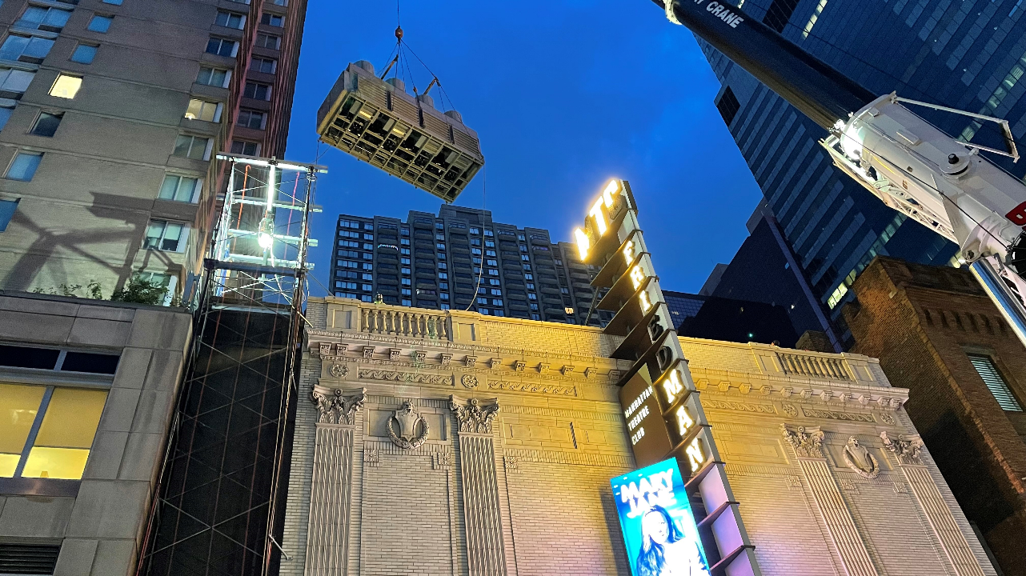
FULLY FUNDING THE PROJECT
Before the project starts, any gap between funds available and the project’s
total cost must be closed through other secured sources such as:
Board Donations
State and/or Federal Funds
Cash-in-hand
Other Non-City Funding
Chiller being craned in for MTC HVAC Project
(Photo Credit: JRM Construction Management)

Slide 13
ORGANIZATION RESPONSIBILITIES
Get scope and design approvals for all city-funded capital projects
  DCLA approval at design phase milestones
    (Scope Development, Schematic Design, Design Development, Construction Documents)
  DCLA approval prior to submission to PDC or LPC
  Provide accurate information on operating implications (increased costs, maintenance, security, etc.)
Operational Responsibilities:
  Filings with DOB, FDNY, etc.
  Violations
  Maintenance Plan
  Certificate of Occupancy
  Public Assembly permits
  Compliance with local laws and City agency policies
  Temporary repairs or other associated costs while the project is in scope development or design
Organizations should get DCLA approval for donor credit, naming rights, press announcements (including capital funding announcements) and signage

Slide 14
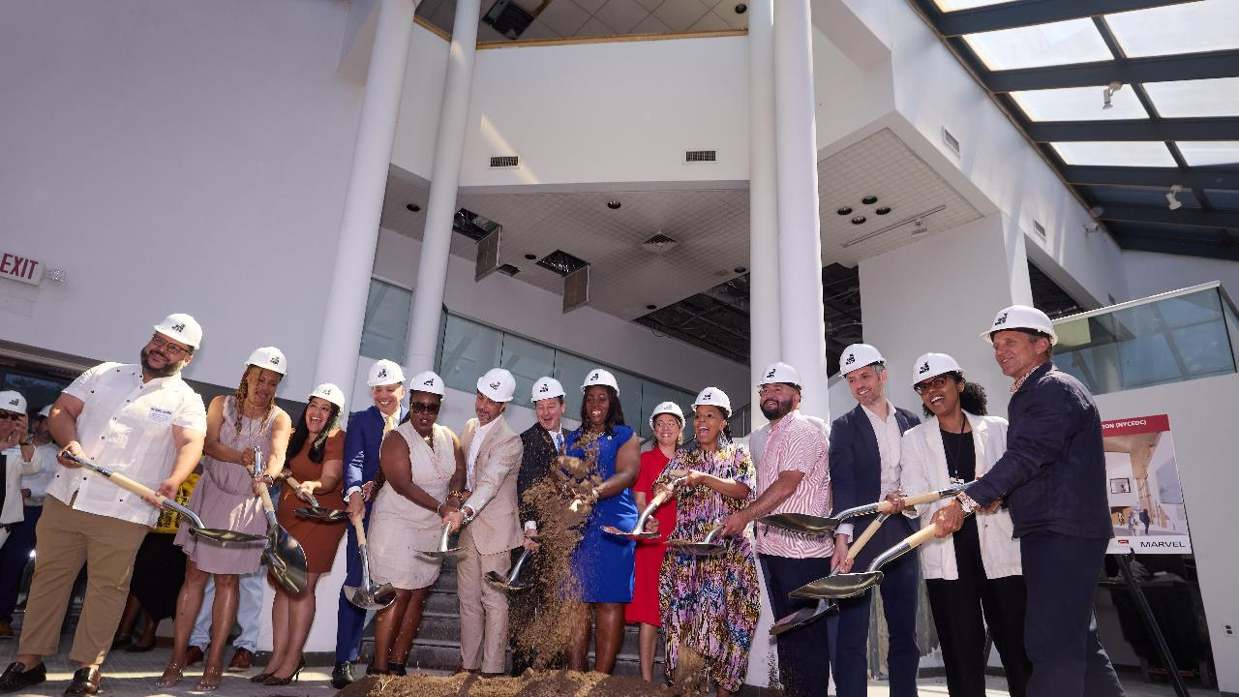
GETTING STARTED
Groundbreaking at The Bronx Museum of the Arts
(Photo Credit: Argenis Apolinario)

Slide 15
(RE)DEFINE YOUR PROJECT/PROJECT UPDATES
Since submitting your Capital funding request, things might have changed, e.g.
Your project was not fully funded
Design plans or your organization’s priorities changed
You received funding from a source other than the City
Perhaps your needs have changed and you don't require City funding
The actual project scope can be different from the project described in your funding request.
The project scope should realistically reflect the funding available in the active fiscal year.
Discuss your project in detail with your DCLA Project Manager as soon as possible so that we can initiate the administrative review and approval process.
Documents you should prepare for DCLA’s review:
DCLA’s Program, itemized project budget, and operations budget (all projects)
Design documents and cost estimates (if applicable)
FA and CCGs: Scope narrative, application package, board resolution, and DCLA Program form

Slide 16
THE FOUR KEY REVIEW STAGES
1) DCLA
Scope Review & Approval
Establishes project eligibility and feasibility
2) DDC/EDC/DCLA/DCAS
Scope Review & Project Administration
Works with architects, engineers and the organization to manage the design and construction process
Align scope and budget
3) OMB
Project Review & Approval
Reviews the project for capital eligibility, including scope eligibility and legal review
Issues Certificate to Proceed (CP)
4) COMPTROLLER
Project Review & Approval
Reviews and authorizes capital projects for conformity with applicable accounting standards and directives
Registers Contract

Slide 17
ELIGIBLE PROJECTS
Construction/Renovation
Construction of new facility
Expansion of existing facility
Upgrade/renovation of contiguous existing space
Upgrade/replacement of building system e.g. HVAC
$500K minimum initial City contribution for non-City owned property
Equipment
Equipment systems or standalone equipment (at least $50K)
$250K minimum for non-moveable equipment (e.g. seating system attached to the floor)
F Y 25 Equipment Workshop will be held on Tuesday, September 10

Slide 18
CAPITAL ELIGIBILITY: DEFINITIONS
Comprehensive
Create new asset/systems
Upgrade existing asset
City Purpose
Provides public benefit for useful life of improvement or equipment
Long-Term Investment
Construction/renovation: 10 - 30 years
Minimum City Contribution
Construction/renovation: at least $500K (for non-City owned property)

Slide 19
DIRECTIVE 10
CHARGES TO THE CAPITAL PROJECTS FUND
In order to attain capital eligibility, a project must comply with the Comptroller’s Directive 10 and its definition of comprehensive betterment:
Directive 10 defines comprehensive betterment as extensive, physically connected, and typically involved in all four trades (electrical, plumbing, mechanical, and general construction)
It specifically does not allow work in non-contiguous spaces unless functionally related, i.e. dependent upon each other and necessary for the asset to perform its primary purpose
If a project does not meet this definition of comprehensive betterment, the organization must demonstrate that the cost of renovations to different areas of a building or element of infrastructure must each be at least $50,000 minimum
https://comptroller.nyc.gov/services/for-city-agencies/comptrollers-directives-and-memoranda/directives-and-memoranda/

Slide 20
INELIGIBLE CAPITAL COSTS
Maintenance:
Repair/Maintenance work, e.g. roof patching
Painting & carpeting as stand-alone scope
Extended warranties
Maintenance agreements & service contracts
Studies:
Environmental assessments (as a stand-alone item)
Feasibility studies
Other:
Fundraising, financing, owner’s rep, or legal fees
Work performed prior to the capital allocation
Custom databases
Unique or excessively expensive
Operational:
Employee salaries
Administrative expenses
Training
Fixtures/Equipment:
Fixtures or equipment that require attachment to the property are ineligible unless additional legal requirements are met
Organization-specific signage/donor plaques

Slide 21
LOCAL LAWS AND CITY POLICIES 1
City-funded projects must comply with Local Laws and City Policies.
Here are some that typically apply to cultural capital projects:
Green Building Laws
Green Building Laws and Regulations:
There are multiple local laws around sustainability, energy reduction, etc. that may impact your projects
More information can be found here:
  MOEC Green Buildings
  NYC Charter - Green Building Standards
Local Law 92/94 of 2019:
Green Roofs
A Local Law to amend the New York City building code requiring that the roofs of certain buildings be partially covered in green roof or solar photovoltaic electricity generating systems

Slide 22
LOCAL LAWS AND CITY POLICIES 2
Local Law 1of 2013:
M/WBE
City-funded projects must comply with Local Laws and City Policies.
Here are some that typically apply to cultural capital projects:
City-funded projects must meet certain Local Laws and City Policies.
Here are some that typically apply to cultural capital projects:
Ensures NYC certified minority and women owned business enterprises have greater access to public contracting opportunities.
The City's M/WBE Program
Local Law 51 of 2017:
Induction Loops
Requires that any capital project with an estimated baseline construction cost of $950,000 or more involving the construction of one or more “assembly areas” include the installation of an induction loop assistive listening system in at least one assembly area and “microlooping” each security, information or reception desk used for check-in.
For more information and exemptions visit: Local Law 51 of 2017

Slide 23
LOCAL LAWS AND CITY POLICIES 3
City-funded projects must comply with Local Laws and City Policies.
Here are some that typically apply to cultural capital projects:
City-funded projects must meet certain Local Laws and City Policies.
Here are some that typically apply to cultural capital projects:
Local Law 58 of 1987:
Accessibility
Mandates that the design and construction of buildings accommodate the accessibility needs of people with disabilities, including appropriate routes of movement in the interior and exterior of the building, interior room modifications, and adjustment of facilities
Local Law 58 of 1987
General Accessibility
Laws
Accessibility requirements are regulated by NYC Building Code A117.1 (City law) and 2010 ADA Standards for Accessible Design (Federal law)
Path of travel: An alteration that affects or could affect the usability of or access to an area of a facility that contains a primary function shall be made so as to ensure that, to the maximum extent feasible, the path of travel to the altered area and the restrooms, telephones, and drinking fountains serving the altered area are readily accessible to and usable by individuals with disabilities, including individuals who use wheelchairs, unless the cost and scope of such alterations is disproportionate to the cost of the overall alteration.

Slide 24
LOCAL LAWS AND CITY POLICIES 4
City-funded projects must comply with Local Laws and City Policies.
Here are some that typically apply to cultural capital projects:
City-funded projects must meet certain Local Laws and City Policies.
Here are some that typically apply to cultural capital projects:
State/City Environmental
Review Act (SEQRA/CEQR)
Evaluates a project’s impact on the environment, e.g. purpose, appearance or condition of a structure or natural resource
DCLA/DDC will work with organizations to determine if these reviews are required for your project.
NYS DEC and MOEC CEQR Technical Manual
Interfund Agreement
Fees (IFA)
Applies to all capital projects. Does not apply to equipment purchases
An administrative fee that is deducted from your capital funding allocation
IFA ranges from 2-14%
Addressed in the NYC Comptroller’s Directive 10, Section 9.0

Slide 25
ADDITIONAL APPROVALS
Projects may be subject to additional approvals from the following agencies and commissions:
Landmarks Preservation​
Commission (LPC)
Approval required for any alteration, reconstruction, demolition or new construction affecting landmarked property
Documents, drawings and other materials describing proposed work reviewed and approved before issuance of permit
Fees for LPC permits when work requires DoB permit
Landmarks Preservation Comission
Public Design
Commission (PDC)
Approval required for exterior work on or above City-owned property
Conceptual, preliminary and final designs are reviewed and approved
Public Design Comission
Department of
Buildings (DoB)
Reviews and approves plans and permits for construction and renovation projects
Fees for inspections and permits performed by the DoB
Department of Buildings

Slide 26
OFFICE OF MANAGEMENT AND BUDGET
The Office of Management and Budget (OMB) reviews all project documentation:
  Capitally eligible project scope
  Itemized project budget, funding status, and operating expense implications
  Legal Agreements
  City ownership -OR- If non-City ownership, additional legal agreements (including Restrictive Covenant and/or Security Agreement)
Review time is estimated to be 90 days, but can be longer
Project must be fully funded before OMB will begin their review
If OMB approves the project, OMB will issue a Certificate to Proceed (CP)

Slide 27
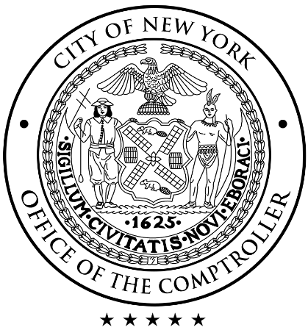
COMPTROLLER
With the CP in hand, the Managing Agency (DDC/NYC-EDC/DCLA) prepares compliance paperwork and awards a contract to the design consultant or contractor. The project is submitted to the Comptroller for registration.
The Comptroller verifies procedural compliance and accuracy of agreement information
Process includes 30 days for Comptroller review
Once the Comptroller’s office gives approval, the contract, purchase order, CCG or funding agreement is registered.
Note: Timelines from CP submission to Comptroller registration have been taking longer and should be considered when ascertaining your timelines.

Slide 28
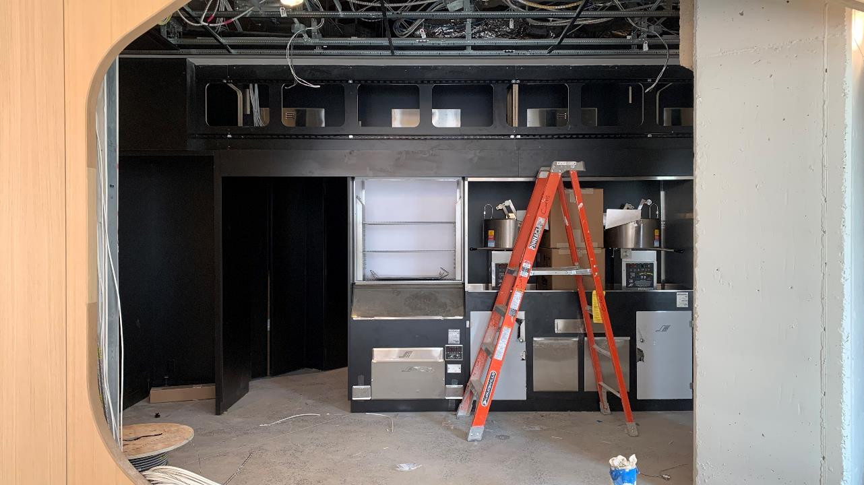
PROJECT MANAGEMENT & ADMINISTRATION
There are four ways cultural capital projects are managed:
1. DDC Managed (Design & Construction)
2. NYC/EDC Managed (Design & Construction)
3. Cultural Capital Grant (CCG): DDC
4. NYC/EDC Funding Agreement (FA)
Based on a project’s needs, and organization’s capacity, DCLA identifies an (the) appropriate managing Agency.
Construction at L10

Slide 29
INITIATING THE PROJECT
Step 1
Step 2
Step 3
DCLA and the cultural organization establish:
Public purpose
Capital eligibility
Project complexity
Organization capacity
City requirements
Project budget
DCLA and the
cultural organization
finalize the Program:
DCLA template prepared by the organization that
describes the scope of the project, overall development plan and project funding
DCLA determines the management path and initiates the project by sending the
Program and supporting documents to the appropriate managing agency:
DDC
NYC/EDC

Slide 30
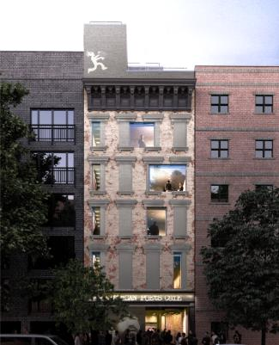
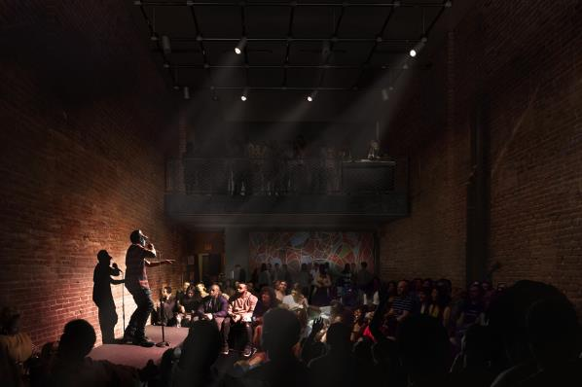
DDC MANAGED: CRITERIA
Generally, smaller cultural organizations that do not have the financial and operational resources and in-house experience to fund and manage capital projects in compliance with all City regulations benefit from DDC’s project management and design resources
Ideal for projects with limited private funding, where City funds must pay for design, or where city funds may be spread over multiple fiscal years
Design and construction phases are managed (DDC does not manage construction only)
Renderings for Nuyorican Poets Cafe
(Credit: Rice + Lipka Architects)

Slide 31
DDC MANAGED: OVERVIEW
DDC administers the project and its funding:
Procurement of consultants and contractors
Management of contracts for design and construction
Review of design
Regulatory approval review
Construction progress
Budget management and oversight
Compliance and payment administration
Project Team:
Cultural organization, DCLA, DDC and consultants
DDC Managed projects use both in-house resources and private consultants and contractors

Slide 32
DDC MANAGED: GETTING STARTED
Step 1: DCLA will ask the organization to complete a Program document providing information on the organization and project specifics. DCLA will use the information to submit the project information to DDC's Front End Planning (FEP) on the organization's behalf.
Step 2: FEP performs an initial review of all project documents followed by a site visit, resulting in a determination as to whether a project can move forward. The timeline for FEP reports varies.
FEP team generally considers:
  Completeness, feasibility and complexity of submitted scope
  Budget
  Legal requirements / Zoning / Code compliance
Two reports will be issued:
  Scope Verification Report – confirms the scope of the project, along with recommendations and risks (this must be approved before DDC team starts work on the Final Report)
  Final Report – includes the cost estimate, design and construction delivery method, project schedule, and DDC’s decision on whether the project is accepted for initiation
If your project is fully funded, reach out to your DCLA project manager for a Program document – if we don’t get to you first!

Slide 33
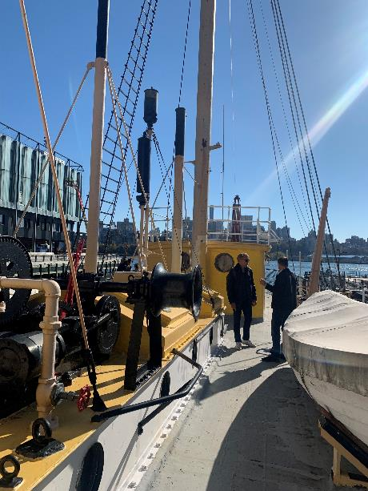
DDC MANAGED: DESIGN PROCESS 1
Project Excellence
DDC holds contracts for:
  20 firms for Architectural Design (5 small, 10 medium, 5 large)
  10 firms for Technical Design (5 small and 5 medium), and will be used for technical projects such as roof replacement, HVAC, and façade projects
Consultant selection will be on a rotational basis to ensure all firms have an equal opportunity to work on DDC projects and to reduce procurement timeline
Visit the DDC website for more information
Mini- RFP (Request for Proposal)
Architectural Design projects with unique characteristics or high complexity will use a mini-RFP to select a consultant from the Project Excellence list based on consultant’s design methodology, technical expertise, and relevant experience
Design Meeting Aboard SSSM’s Ambrose

Slide 34
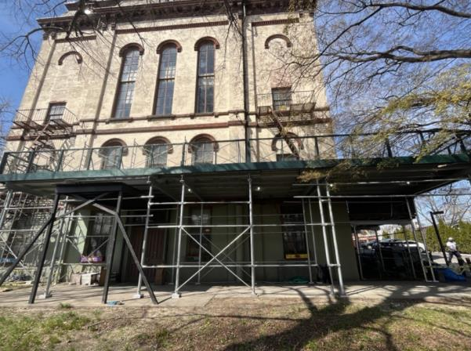
DDC MANAGED: DESIGN PROCESS 2
Additional Design Delivery Methods:
Stand Alone Contracts will be used for highly specific projects that require specialization outside the scope of Project Excellence firms (timeline for this process will be longer at around 9-12 months)
DDC In-House Design will be used for limited projects and under special circumstances
In general, DDC anticipates that design start will be 6-7 months from the date DDC officially accepts a project
Renovation underway at The Poppenhusen Institute

Slide 35
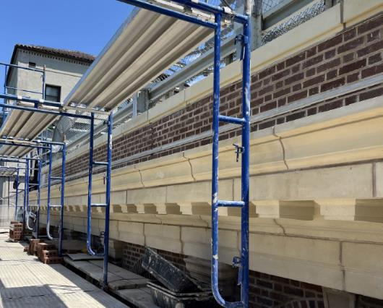
DDC MANAGED: CONSTRUCTION PROCESS 3
Design-Bid-Build / Competitive Sealed Bid
Project is advertised and the lowest responsible bidder is awarded construction contract
This is the most common method for DDC managed construction projects
DDC can bid projects to a Prequalified List (PQL) of contractors for projects that fit into some categories including General Construction, Landmark-quality, Roof and Façade
For projects over $3M on non-City owned property, Wicks law is in effect and mandates separate prime contracts for each major trade (General Construction, Plumbing, HVAC and Electrical) and will add complexity to the construction due to multiple contracts
The entire process from bid advertisement to award is 5-6 months (if a Certificate to Proceed has been approved)
Installation of brick parapet and cornice at the Heckscher Building
Photo Credit: Thornton Tomasetti

Slide 36
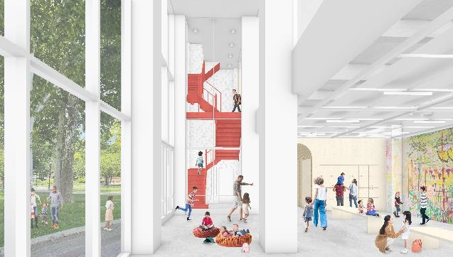
DDC MANAGED: CONSTRUCTION PROCESS 2
Additional Construction Delivery Methods:
Design-Build is fairly new process for DDC and is currently being used for stand-alone new buildings over $10M. It may be considered for cultural buildings on City-owned property with a construction cost of $3M or more.
Construction Manager-Build is brand new. It is a model of project management, under which a construction management firm is hired through an accelerated RFP process to manage the overall project, holding the underlying contracts for materials, labor and related services. More information coming.
Rendering for Queens Museum
(credit: Levenbetts Architects)

Slide 37
DDC MANAGED: TIMELINE
In most cases, the City will manage your construction project. Average timelines are:
1 | Project Scope Creation
Work with DCLA Project Manager to define scope
3 | Project Design:
Consultant procurement and design is managed by DDC (*timeline will depend on method)
5 | Construction:
DDC holds all contracts and manages construction through
C of O (if required)
3-9 Months
3-9
Months
12-26
Months
9
Months
10-32
Months
12 +
Mo
2 | Front End Planning:
DDC will do initial scope verification and cost estimate reports
4 | Construction Contract Bidding:
Once construction documents are finalized, project is bid out and contactors procured
6 | Project
Closeout:
Closeout with project
evaluation
and summary
OMB and Comptroller approval is required to engage a consultant. A Certificate to Proceed (CP) from OMB and a registered contract by the Comptroller will be needed at multiple steps.
Timeframes depend on the scale, budget and complexity of the project. This timeline represents optimal durations without delays and is based on complete submissions + timely actions. Compiling and approving legal requirements may result in delays (Restrictive Covenants, mortgage subordinations, lease amendments, etc).

Slide 38
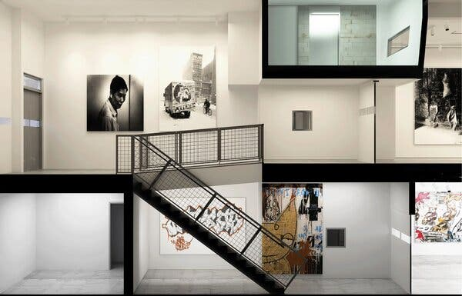
NYC/EDC MANAGED
EDC determines which projects they will manage
Projects must include an economic development focus (e.g. located within a redevelopment area and/or opportunity for job creation)
Project is technically complex and/or has special scheduling needs
Generally smaller cultural organizations that do not have the financial and operational resources to manage capital projects benefit from EDC’s project management resources
Ideal for projects with limited private funding or where the organization pays for design
Design is procured through a Request for Proposal (RFP); construction is managed by a pre-selected Construction Manager and a shortlist of contractors
Typically applies only to organizations on City-owned property
Rendering of ABC No Rio Building Interior
(Credit: Paul A. Castrucci Architects)

Slide 39
EDC MANAGED: TIMELINE
In most cases, the City will manage your construction project. Average timelines are:
1 | Project Scope Creation
Work with DCLA and EDC to define scope
3 | Project Design:
Design is managed by EDC; CM is usually brought onboard
5 | Construction:
Contracts are held with EDC and managed with a CM
3
Mo
4-6
Months
6-15
Months
9
Months
6-24
Months
3 +
Mo
2 | Design Procurement:
EDC will manage an RFP process to procure a consultant
4 | Construction Contract:
Procurement through CM; contracts held by EDC
6 | Project Closeout:
Closeout with project evaluation and summary
OMB and Comptroller approval is required to engage a consultant. A Certificate to Proceed (CP) from OMB and a registered contract by the Comptroller will be needed at multiple steps.
Timeframes depend on the scale, budget and complexity of the project. This timeline represents optimal durations without delays and is based on complete submissions + timely actions. Compiling and approving legal requirements may result in delays (Restrictive Covenants, mortgage subordinations, lease amendments, etc.)

Slide 40
COMMUNICATION FLOW CHART
For City managed projects, it is very important to follow a clear line of communication:
Design Consultant
Cultural
Organization
Sub-Consultants
Managing Agency:
DDC or EDC
DCLA
Contractors
Sub-Contractors

Slide 41
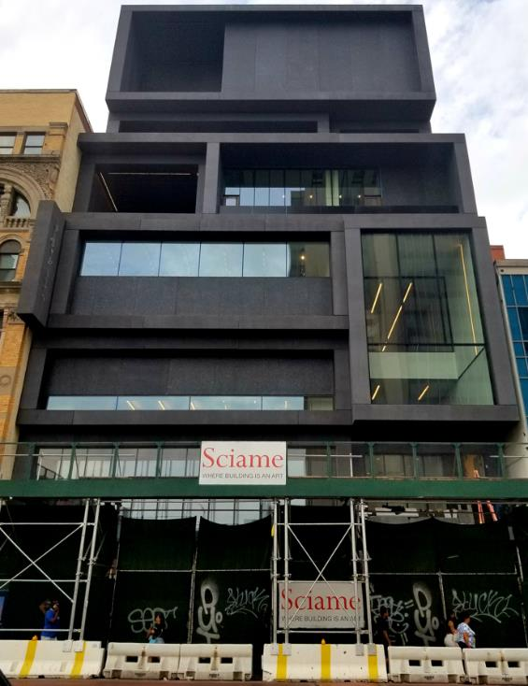
CCG: DDC CULTURAL CAPITAL GRANT
A Cultural Capital Grant allows a cultural organization to manage its own project while protecting
The City’s investment of public dollars. A CCG:
Guarantees scope at a fixed price; cost overruns are borne by the organization
Allows capital funds to be reimbursed to the organization; organization assumes all costs till reimbursement
Requires robust public-private funding partnerships
Requires organization to have dedicated staff with construction experience to manage the project through to end of contract
Organization must have prior experience managing capital projects successfully
Organization is responsible for compliance with all laws, policies and regulations associated with City funding
~2% City Administration Fee
New Construction of Studio Museum

Slide 42
CCG: DCLA REVIEW FOR ELIGIBILITY
The following is a sample of requirements to establish organizational capacity to manage a project:
Project Planning
Clear rationale for the project
Comprehensive, recent master plan or strategic plan; project is technically complex and has special scheduling needs
Project types include major renovation and construction
Familiarity with Compliance Paperwork (PASSPort, Insurance, RC etc.)
Project Managerial
Capacity
Relevant in-house project management experience, including staff with construction experience
Addresses future maintenance/operation impacts
Familiarity with approvals (ULURP, LPC, PDC etc.)
Organization
Managerial Capacity
Successful execution of mission
An actively engaged Board
Effective leadership/administration staff
Financial Capacity
Project requires significant private contribution, typically 50%
City funding is at least $1 million in current fiscal year
Capacity to fully finance project / cover all cost overruns
Capital campaign/plan with realistic goals
Institutional track record of successful fundraising campaigns

Slide 43
CCG: TIMELINE
If approved by DCLA, select organizations will manage their project through a Cultural Capital Grant (CCG) with DDC. Average timelines are:
2 | Greenlight Meeting:
Application to DDC and OMB for technical compliance review
4 | OMB Review:
OMB reviews scope for eligibility before issuing a Certificate to Proceed (CP)
6 | Certificate to Proceed:
OMB issues a CP
8 | Compliance Paperwork:
Additional paperwork before requisition
6 – 12
Months
3
Months
1-3
Months
4
Months
1
Mo
1-2
Mo
Dependent on Project
1 | Scope Development:
Work with DCLA project manager to define scope and prepare CCG application
3 | CCG Package Preparation:
Work with DDC to prepare the CCG package
5 | Legal Documents:
Finalization of:
legal agreement(s), restrictive covenant, and compliance paperwork
7 | Comptroller:
Comptroller reviews CCG before funds register
9 | Requisitions:
With funds registered, organization can request reimbursement for construction costs
Timeframes depend on the scale, budget and complexity of the project. The timeline shown represents optimal durations without delays and is based on complete submissions + timely actions.
Compiling and approving legal requirements may result in delays (Restrictive Covenants, mortgage subordinations, lease amendments, etc.)

Slide 44
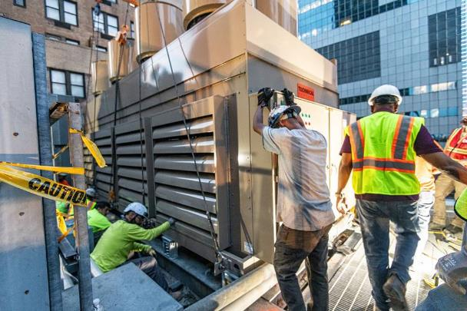
NYC/EDC FUNDING AGREEMENT
If City funding is allocated through a contract between EDC and a cultural organization, the following conditions apply:
EDC determines which projects they will manage
Project has an economic development focus
Organization has the capacity to implement and maintain its capital project
Project is technically complex and has special scheduling needs
Organization is responsible for any cost overruns
Specific requirements, approvals and the Funding Agreement (FA) process must be complete in order to receive funds
Project requires significant private contribution
City funding is at least $500K and a private match is required
Multiple projects on the same site are not allowed
Chiller being installed for MTC HVAC Project
(Photo Credit: JRM Construction Management)

Slide 45
NYC/EDC FUNDING AGREEMENT: TIMELINE
A small number of organizations will manage their own design and construction through a Funding Agreement (FA) managed by EDC. Average timelines are:
1 | Define Scope and Budget/ FA Intake:
Work with DCLA and EDC to define scope and budget
3 | Procurement:
EDC reviews contractor procurement and compliance
5 | OMB Review:
OMB reviews scope for eligibility before issuing a Certificate to Proceed (CP)
7 | Record RC:
Restrictive Covenant (for non-City owned property) is recorded with City
1-2
Months
4-8
Months
1-2
Mo
4
Months
1-3
Months
1
Mo
1
Mo
Dependent on Project
2 | Prepare Funding Agreement:
EDC will manage FA process including internal review, coordination with Law Dept. for FA and RC draft and OMB CP review
4 | Execute Funding Agreement:
EDC manages this phase internally
6 | Comptroller Registration:
Comptroller registers contract
9 | Requisitions:
With funds registered, organization can request reimbursement for construction costs
Timeframes depend on the scale, budget and complexity of the project. The timeline shown represents optimal durations without delays and is based on complete submissions + timely actions.
Compiling and approving legal requirements may result in delays (Restrictive Covenants, mortgage subordinations, lease amendments, etc.)

Slide 46
REPORTING
Further Reporting
On a yearly basis, organizations must certify that equipment acquired with funds administered by DCLA is being used in compliance with the terms and conditions outlined in the use or funding agreement.
Annual Use Certification
Annual Use Certification
The City began attaching compliance certificates to covenants in 2013. If you are a non-City owned building with a Restrictive Covenant, you are expected to submit a compliance certificate annually.
Compliance Certificate –
Real Property
Each year DCLA works with OMB to prepare the Asset Information Management System (AIMS) Reconciliation Report to track how organizations on City-owned property are keeping City assets in a “state of good repair” as required by your agreement with the City.
AIMS Report
DCLA is getting more and more requests for reporting out to other agencies on a variety of information, most notably around sustainability initiatives and other administration priorities. Please be prepared to receive questions throughout the capital process (from the request process through project closeout and beyond) from DCLA – we thank you for your cooperation in providing this important information in a timely manner!
Further Reporting

Slide 47

RIBBON CUTTING
Ribbon Cutting at Bronx Children’s Museum

Slide 48
We’re Here to Help
Andrew Burmeister
Assistant Commissioner
aburmeister@culture.nyc.gov
Sara Minard
Director
sminard@culture.nyc.gov
Victor Metoyer
Deputy Director
vmetoyer@culture.nyc.gov
Darren Brannon
Capital Project Manager
dbrannon@culture.nyc.gov
David Bryant
Capital Project Manager
dbryant@culture.nyc.gov
Eric Cecil
Capital Project Manager
ececil@culture.nyc.gov
Joshua Downes
Capital Project Manager
jdownes@culture.nyc.gov
Livia Bloom Ingram
Capital Project Manager
lingram@culture.nyc.gov
Stephanie Kingpetcharat
Capital Project Manager
skingpetcharat@culture.nyc.gov
Carolyn Sarkis
Capital Budget Analyst
csarkis@culture.nyc.gov
Questions?
Talk to us!
www.nyc.gov/culture

Slide 49
Useful Links
NYC Green Building Laws
DCAS Competitive Funding Programs ACE/ExCEL
Con Edison Energy Efficiency Rebates
NYSERDA New Construction/Renovation Energy Rebates
Comptroller’s Directive 10

Slide 50
Acronyms
ACCO Agency Chief Contracting Officer
CP Certificate to Proceed
DCAS Department of Citywide Administrative Services
DCLA Department of Cultural Affairs
DDC Department of Design and Construction
DLS Division of Labor Services (unit of SBS)
EEO Equal Employment Opportunity
EPP Environmentally Preferable Purchasing
MOCS Mayor’s Office of Contract Services
M/WBE Minority and Women-owned Business Enterprise
NYC/EDC NYC Economic Development Corporation
OMB Office of Management and Budget
PASSPort Database of vendor/contract management info
PPB NYC Procurement Policy Board
SBS Department of Small Business Services

Slide 51
Q & A
You can submit questions in the following ways:
      Q + A feature on Zoom
      Through emails to: capitalrequest@culture.nyc.gov
When you submit a question through any of the above options, please let us know your name and what organization you are with.
We will do our best to answer as many questions as possible. If we run out of time and find there are still many questions to answer, we will try to provide answers in a follow up email to those on the RSVP list. You can also email questions after the event to capitalrequest@culture.nyc.gov.

