Slide 1
Educación Financiera para Miembros de Cooperativas de Trabajadores
Tema 4: Creando un Negocio Rentable

Slide 2
Financial Education for Worker Cooperative Members
Introducción
Este plan de estudios fue creado como parte de un proyecto entre la oficina de empoderamiento financiero del Departamento asuntos del Consumidor de Nueva York y Make the Road Nueva York, con el apoyo de Citi Community Development para integrar herramientas de empoderamiento financiero y capacitación en el proceso de desarrollo de las cooperativas.
Consiste en 5 talleres de 2 horas:
Tema 1: Principios Básicos de Manejo o Gestión de Dinero y Presupuesto
Tema 2: Transacciones Financieras Básicas
Tema 3: Crédito
Tema 4: Creando un Negocio Rentable
Tema 5: Estados Financieros Básicos
Notes:
The goals are threefold:
To support and strengthen the financial health of individual members of workers cooperatives and to empower them to make the best possible financial decisions for themselves and ultimately their families
To ensure that the cooperative businesses are maximizing asset building and financial empowerment opportunities for their members, and
To develop individual-level and cooperative-level financial empowerment and asset building tools and practices for the broader New York City cooperative community

Slide 3
Financial Education for Worker Cooperative Members
Ejemplo Presupuesto Inicial
Nombre de la Compañía
Presupuesto Inicial
Costos de Iniciación
Compra de Inventario
Renovación
Depósitos de Alquiler
Mercadeo y Publicidad
Equipo de Oficina
Inmobiliario
Capital de Trabajo
Equipo Automotor
Otros Equipos
Seguros de Iniciación
Gastos Fijos Mensuales x (3-6) meses (recomendado)
Tarifas Iniciales de Contabilidad y Legales
Entrenamiento y Educación
Gastos Iniciales de Venta
Tarifas de Franquicias
Licencias y Permisos
Artículos de Oficina
Total_ | $ -

Slide 4
Financial Education for Worker Cooperative Members
Preguntas Para Pensar
¿Cómo sabemos si el negocio es rentable?
¿Cómo calculamos la ganancia?
¿Qué hacemos con las ganancias?
¿Cómo se calcula la ganancia de un miembro?
¿Qué significa una ganancia para el dueño de la cooperativa?

Slide 5
Financial Education for Worker Cooperative Members
Creando un negocio rentable:
Dos niveles de ganancia
Nivel 1:
¿El producto/ servicio genera ganancia?
Nivel 2:
¿El negocio genera ganancia?
Estado de Ingreso:
Ingresos (Ventas totales de bienes y servicios = unidades x precio)
- Costos directos (Materiales, embalaje, trabajo, transporte, etc.)
= Beneficio Bruto [NIVEL 1]
- Costos Indirectos (Alquiler, servicios públicos, administración, publicidad, etc.)
= Beneficio/Ganancia o Pérdida Neta [NIVEL 2]

Slide 6
Financial Education for Worker Cooperative Members
Creando un negocio rentable:
Nivel 1: ¿El producto / servicio genera ganancia?
¿El precio del producto o servicio cubre los costos directos y permite generar una ganancia?
Costos Directos: (ejemplos)
Materiales
Embalaje
Trabajo
Distribución/logística
Alquileres

Slide 7
Financial Education for Worker Cooperative Members
Creando un negocio rentable:
Nivel 2: ¿El negocio genera ganancia? ¿Si vendiendo el producto/ servicio genera una ganancia, cuantos productos/servicios usted necesitará vender para cubrir los costos indirectos del negocio?
Paso 1: Primero, determine el total de los costos indirectos por mes…
Costos indirectos son gastos que un negocio debe hacer regularmente sin importar el volumen de ventas. Ejemplos:
Personal Gastos administrativos Contabilidad/teneduría de libros Seguro Mercadeo Página de Internet Subscripciones | Viaje Entrenamiento/Certificaciones Alquiler Servicios públicos Mantenimiento Almacenamiento Disposición de la basura (aseo urbano)

Slide 8
Financial Education for Worker Cooperative Members
Ejemplo: Costos Indirectos en el Estado de Ingreso
Estado de Ingreso | Mes 1
GANANCIAS TOTALES | $ -
TOTAL GASTOS DIRECTOS | $ -
BENEFICIO BRUTO | $ -
COSTOS INDIRECTOS
Salarios de los Oficiales
Salarios de Empleados
Retención de los empleados
Beneficios de los Empleados
Responsabilidad de Seguros
Teléfono
Mercadeo / Publicidad
Viajes
Material de Oficina
Tarifas Legales
Tarifas de Contabilidad
Alquiler
Internet/Costos de la página de Internet
Servicios Públicos
Amortización
Otros Gastos
TOTAL GASTOS INDIRECTOS | $ -
GANANCIAS / (PERDIDAS) | $ -

Slide 9
Financial Education for Worker Cooperative Members
Creando un negocio rentable:
PASO 2: Siguiente, divida el total de los gastos indirectos por mes entre la ganancia por producto/servicio.
Análisis del Punto de Equilibrio | Total Gastos Indirectos Mensuales _________________ | = | # de productos/ servicios el negocio debe vender para cubrir gastos indirectos por mes
 | Ganancia por producto/ servicio
Recuerde! El negocio está generando ganancias solamente si vende más unidades de las que vende en su punto de equilibrio.

Slide 10
Financial Education for Worker Cooperative Members
Relacionado al Presupuesto Personal de la Casa
Un negocio puede proveer:
Cliente: Mi negocio es rentable.
Consejero: ¿El negocio puede cubrir todos sus gastos y pagarle un salario a usted que cubre el valor del tiempo que usted le dedica al negocio?
Cliente: Aun no.
Consejero: Entonces su negocio no es rentable todavía.
Ingreso complementario
Reemplazar ingreso

Slide 11
Financial Education for Worker Cooperative Members
Cuentas Internas de Capital
Un archivo llamado cuenta interna de capital es creado para cada miembro para registrar:
Cuánto pagó cada miembro por su parte en la cooperativa.
Cuánto de la ganancia le fue distribuido al miembro.
Cuánto de la ganancia fue reinvertido en el negocio y reservado para pagar impuestos.

Slide 12
Financial Education for Worker Cooperative Members
¿Qué es la cuenta interna de capital?
Su tarifa de membresía
2da. PARTE
Algunas ganancias de la cooperativa
Mas acerca de esto en un minuto.
Notes:
The internal capital account is an account within the coop that is assigned to you.
SO it is individual, in that is about one member.
It is internal, in that it is within the coop. You can think of it as having two parts. The first is your membership share, the second Is a place to keep some of the profits from the coop business.
We’re going to look at the membership share first, then talk about the profit part.

Slide 13
Financial Education for Worker Cooperative Members
Acciones de Membresía
Cuando usted se une a la cooperativa, usted se convierte en miembro al comprar acciones de la cooperativa. Cuando usted se va, se le devuelve esa cantidad. No aumenta o disminuye en valor.
Acciones pueden ser $5 o $5,000 dependiendo de la cooperativa.
Cada miembro tiene derecho a un voto en la cooperativa.
Notes:
When you work for a coop you are an employee. You may have the option of becoming a coop member and to do so, you have to buy a membership share of the coop.
A membership share does not increase or decrease in value like a share in a standard corporation.
This allows new members to join a successful co-op easily.
If the membership shares increased in value with the success of the company, talented workers without enough money could not become members easily.
In some coops, the share is very small, in others it is much higher. Sometimes people pay all of the membership share fee at once, other times they pay it in installments.
The holder of a membership share is entitled to one vote.
A membership share also gives the holder rights to an internal capital account and to a share of the profits.

Slide 14
Financial Education for Worker Cooperative Members
La Acción de Membresía está en su cuenta de capital.
Acciones de los Miembros: Todos los miembros tienen solo una acción
Notes:
Review: Each member has one share. This is in each individual internal capital account.

Slide 15
Financial Education for Worker Cooperative Members
Excelente Noticias: Su coop generó ganancia
¿Ahora que?
¿Pagar efectivo a sus miembros?
¿Mantener (retener) algo de las ganancias para reinvertir en la cooperativa?
Notes:
Now let’s turn to profits.
Excellent news, the coop is going great, there’s a profit.
NOW WHAT?
There are two choices. Pay out cash to members or keep some of that money to reinvest in the coop.
But WAIT: first we need to talk about what we mean by profit.

Slide 16
Financial Education for Worker Cooperative Members
¿Qué es Ganancia? En este caso, “Ingreso Neto”
Clientes: $75,000
Ingreso ganado a través de consumidores que compran sus bienes o servicios.
Alquiler:
(1,000)
}
Gastos/Costos de producir bienes o servicios para el consumidor.
Salarios:
(20,000)
Suministros:
(10,000)
Ingreso Neto: $43,800
Ingreso Neto =
Ingreso - Gastos
Notes:
We aren’t going to get into too many accounting terms, but we need to understand how the coop will calculate profit for the purposes of distributing it.
In this case, profit means “net income,” which is simply the amount brought in from customers, from the activities of the business.
If you sell donuts, it’s how much money you brought in from the sale of donuts. If you fix cars, it’s how much money you brought in from mechanics doing their work.
Other thing such as taxes and depreciation are involved in net income, but for now, we want to focus on this simple definition.
IMPORTANT: Net income does not include cash that comes into the company from loans or member fees. For example, if the member fee is $100 and 5 new members bought shares this year, that $500 is NOT part of revenue. That money did NOT come from customers and does not get reflected in net income.
Describing profit as net income makes sense for this reason: we want to know how much we’re making from the activities of the actual business, say selling donuts. 5 new members joining has nothing to do with selling donuts, so we don’t want it to be part of us thinking about the profit that the BUSINESS activities are leading to.

Slide 17
Financial Education for Worker Cooperative Members
¿Qué sucede en una compañía tradicional cuando hay ganancia?
La Compañía APPLE
Retiene $200 en la compañía (puede ser usado para equipo, edificios, etc.)
Ganancia=$300
Empleados de APPLE: no reciben acciones o ganancias, solamente salarios
Director General de Apple/Junta
Accionistas de APPLE (tienen acciones de APPLE)
Pagan $100 a los accionistas en dividendos si el total de 4 accionistas, cada uno dueño de 1 acción, cada uno recibe $25
Notes:
Ok, so we now know that we earned a profit. Great.
How do we decide what to do with it?
(Teacher note: this would be good to act out with students, get them out of their chairs, moving around, with signs: CEO, APPLE COMPANY, APPLE SHAREHOLDERS, APPLE EMPLOYEES) Use large boards/signs with money amounts on them so they can see how the money flows.
If a company decides to pay out some of the profits, it goes to shareholders. The CEO and company board make the decision about how much to pay out and how much to reinvest in the company.
So if you owned 10 share of Apple stock, and the Apple CEO and Board decides to pay out a $1dividend or share of profits/share, you get $10.
Let’s say a $300 profit was made by Apple. The CEO/board take that $300 and decide they will pay out $100 in dividends (to shareholders).
$200 is given to “APPLE COMPANY,”
$100 is given to shareholders, 4 of them in this example
Each of the shareholders gets ¼, or $25 each. Assume they each owned 1 share.
In a traditional corporation, workers are simply paid wages and that’s it. If there is a profit, they don’t get any of it. RED BOX.
In a coop, it’s different.
Let’s look at how it’s different.

Slide 18
Financial Education for Worker Cooperative Members
¿Qué sucede en una cooperativa cuando hay ganancia?
Negócio de la
Cooperativa
Empleados quienes no son miembros de la cooperativa no reciben parte de las ganancias
Reinvertir $200 en la compañía (equipo, edificio, etc.)
Ganancia=$300
Junta de la Cooperativa
Miembros de la Cooperativa
Pagan $100 a miembros de la cooperativa
División de $100 esta basado en horas de trabajo, no en acciones.
Notes:
Now let’s turn to a Coop.
Teacher Note: Act this out with students as well: COOP Board, Coop business, Coop members, and coop employees.
So now a $300 profit.
The coop board, which has representation from the members/workers, decides how to divide the profits.
They decide $200 reinvestment in the coop business
And $100 to be paid out to the coop members in cash.
Division of $100 is based on labor hours, not shares. Our next slide will explain what we mean by labor hours.
A note: if an employee is not a member, they do not receive a share of profits.

Slide 19
Financial Education for Worker Cooperative Members
¿Como la Cooperativa Determina Ddividendos?
División de dividendos: usualmente basados en el número de horas (horas de trabajo) miembros trabajaron en años anteriores.
Total horas trabajadas por todos los miembros en la cooperativa el año pasado = 50
Acciones de los miembros:
Todos los miembros son dueño solo de 1 acción
($5/acción.)
2h
1h
5h
3h
4h
Jane trabajó 4 horas, por lo tanto Jane obtiene 4/50, u 8% de los dividendos.
Notes:
(NOTE TO TEACHER: Can act this out with group)
IN a traditional company, you buy shares. In the coop, you buy one share, your member share.
Everyone has that one share. One vote. Notice, everyone paid $5 for their share.
Now, put that aside. (click through slide)
Each year, the coop adds up how many hours members worked. In this case 50 total hours.
Now, Jane worked 4 of these total hours, so she is entitled to 8% of the dividends or patronage dividend.
NOTICE: this is very different than in a traditional company where shareholders buy shares, could be 1 or 100 shares.
Remember: Each member always owns ONE member share. But each year, hours worked will determine dividend percentage for each member.
So if the whole coop worked 50 hours again next year, but Jane worked 5 hours, she would get 10% of dividends FOR THAT YEAR.

Slide 20
Financial Education for Worker Cooperative Members
Primera Decisión:
¿Cuánto se paga a los miembros y cuánto se mantiene en la cooperativa?
Negocio de la Cooperativa
Retiene $200 en la compañía
Ganancia=$300
Junta de la Cooperativa
Miembros de
la Cooperativa
Pagan $100 a miembros de la Cooperativa
Este dinero es pagado en efectivo a miembros de la cooperativa. En nuestro ejemplo, Jane obtiene $8, u 8% de $100. Jane paga impuestos en estos $8.
Notes:
A little review. We’ve made a profit, great.
Ok, so now the coop board has decided they are going to pay out $100 to members and keep $200 in the coop for investment.
First, let’s look at what happens to the $100 we’ve decided to pay out in dividends.
We are paying out $100, so we would calculate each members’ share based on their hours and then pay this out.
In Jane’s case, she is entitled to 8% of $100 or $8.00
Jane will also pay taxes on this $8.00

Slide 21
Financial Education for Worker Cooperative Members
Segunda Decisión:
¿Cómo se usa el dinero retenido por la cooperativa?
CUENTA INTERNA DE CAPITAL
Coop Retiene
$200
Cuenta Colectiva
Cuenta Individual
$150
$50
Impuestos Corporativos (15%)=$22.50
Jane aun obtiene 8% en dividendo, o $4 de los $50.
Total en Cuenta Colectiva = $127.50
Notes:
The coop board has determined that it is going to retain, or keep, $200 of the $300 profit in the business. Now the coop has some more decisions to make.
That money is retained in what’s called “INTERNAL CAPITAL ACCOUNT.”
One way to think of this is as an account that the company can go to when it needs money to buy equipment, new computers, a building.
If you sell donut and are planning to expand in the next year, you would want to retain some earnings in the internal capital account to pay for new mixers, ovens, and delivery trucks.
So back to this account. The board has decided to keep $200 in the coop.
A coop has the ability to then decide to divide that internal account between “collective account” and “individual accounts”.
And let’s assume that the coop decides they will divide the $200 between these accounts with $150 in collective and $50 in individual accounts.
First we look at taxes on the collective account, which at 15%, leaves $127.50 in the collective account. That’s settled.
On the individual account side, the same logic used to pay out the cash dividends is in play here. Remember, Jane worked 4 hours of the company’s total 50 hours. This was 8%.
So if Jane receive 8% of cash dividend, she also receives 8% of this internal dividend. In this case, 8% of $50 is $4.

Slide 22
Financial Education for Worker Cooperative Members
¿Que recibe Jane realmente?
Primero determinamos patrocinio basado en horas. Jane recibe 8%.
En cooperativas, esta cantidad total ($150) se llama “dividendo de patrocinio.”
Nota: no todos los dividendos de patrocinio son pagados en efectivo a los miembros.
Patrocinio total pagado a los miembros:
$100 en efectivo + $ 50 en cuentas internas = $150 de las ganancias para los miembros (Comenzaron con $300 de ganancia)
Jane recibe 8% del total del dividendo de patrocinio
$8 en efectivo + $4 en cuenta interna
Total = $12 (12/150= 8%)
4h
Jane recibirá $8 en efectivo y una notificación escrita por la distribución de los $4.
$8
$4
Notes:
First, each employees patronage percentage is determined. Remember, Jane worked 4 out of the total member hours of 50, so she gets 8%.
Now, total patronage that is going to members is the cash that is being paid out, PLUS the amount being put into their internal capital account.
This is important: That account is in your name, in Jane’s name. It is not cash paid out to you, but it is considered your investment.
In Jane’s case, she gets $8 in cash and $4 is put into her internal capital account.
At the end of each year, the coop should provide members with statements that show their balances in their individual accounts, much like one receives an end of year statement for a retirement account.
In coops, the total of cash paid out and allocation into an individual internal account is called a “Patronage dividend.” This is important for tax reasons. We will explain in a minute.

Slide 23
Financial Education for Worker Cooperative Members
Revisión de que hizo la cooperativa con las ganancias
Junta de la
Cooperativa
Cooperativa
Miembros
$300 Ganancia
=
$150
+
$50
+
$100
Paga $50 a cuentas individuales internas
$150 en cuenta interna colectiva
Paga $100 en efectivo a miembros
Patrocinio de Dividendo
Notes:
For now, it is important to understand that the coop started with $300 in profits, then made a decision about how to divide it.
$150

Slide 24
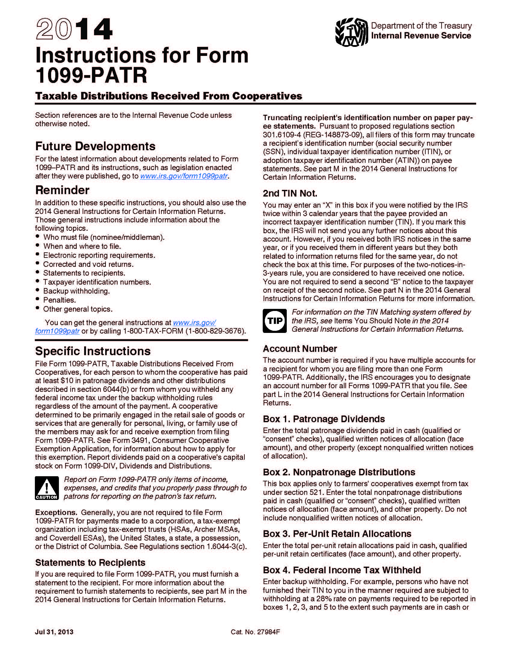
Financial Education for Worker Cooperative Members
¿Qué paga Jane en impuestos?
Miembros pagan impuestos en dividendo de patrocinio – ambos, el efectivo y la notificación escrita.
Jane paga impuestos en $12, los $8 en efectivo y los $4 en su cuenta interna de capital.
Notes:
Please note: Jane receives at least enough in cash dividend to cover the taxes she owes on internal account amount, so there is never an expectation that come up with cash to pay taxes on this amount.

Slide 25
Financial Education for Worker Cooperative Members
¿Por qué este es un buen negocio para la coop y para Jane?
La Cooperativa La cooperativa se beneficia porque paga menos en impuestos de lo que un negocio convencional pagaría. Esto significa que el dinero extra ahorrado en impuestos puede ser reinvertido en la coop, posiblemente generando mas ganancias. La cooperativa además puede usar los fondos para reinvertirlos en las cuentas internas, lo cual es menos costoso que pedir un préstamo a un banco o inversionista en caso de necesitarlo.
Jane
Si a la cooperativa le va mejor, a Jane le va mejor. Invertir en el negocio es importante.
La cuenta interna de capital de Jane actúa como una cuenta de ahorros o de retiro (por ejemplo, Roth IRA). Cuando ella retira fundos, ella no paga impuestos en esos retiros. Entonces, en lugar de invertir en la bolsa de valores, Jane está invirtiendo en su propio lugar de trabajo.
Cuándo recibe Jane un pago? La cooperativa decide cuando se hacen pagos y balancea las necesidades de la cooperativa con las necesidades de los miembros.
Notes:
The coop benefits because of the way corporations are taxed. This is beyond the scope of this lesson, but that’s why coops set up this kind of internal capital account.
Jane benefits because if the firm does better, Jane does better. This arrangement allows the firm to have to more cash (because of taxes) at a lower cost---they do not have to go to an outside bank or investor and pay them interest.
This internal capital account is a lot like a saving or retirement account. Many people have IRAs, Individual retirement accounts. They pay taxes on their money when they earn it, then put it into an IRA and it earns tax free returns over time. You can’t take it out without penalty. When you do take it out, you don’t pay taxes on it. This is similar.
Let’s look at an example

Slide 26
Financial Education for Worker Cooperative Members
Balance Cuenta Interna de Capital
Notes:
In the beginning of the coop’s life, there will likely be losses. We can see that in Year 1-3.
Then there may be some other dips, we see in years 12-14,
but overall, the returns build up in Jane’s account.
If the coop is doing well, Jane is doing well and so is her internal capital account.

Slide 27
Financial Education for Worker Cooperative Members
Resumen
Rentabilidad tiene dos niveles: ganancias brutas y ganancias netas.
Miembros de una cooperativa pagan por una membresía en la cooperativa.
Ganancias de la cooperativa pueden ser distribuidas a los miembros y/o retenidas en el negocio.
Las acciones de los miembros, ganancias distribuidas y ganancias retenidas son registradas en una cuenta de capital interna.
© June 2017. New York City Department of Consumer Affairs. All rights reserved.

