Slide 1


Financial Education for Worker Cooperative Members
Topic 2: Banking & Basic Financial Transactions

Slide 2

Financial Education for Worker Cooperative Members
Introduction
This curriculum was created as part of a project between the New York City Department of Consumer Affairs Office of Financial Empowerment and Make the Road New York, with the support of Citi Community Development to integrate financial empowerment tools and training into the cooperative development process.
It consists of 5 two-hour-long workshops:
Topic 1: Basic Money Management & Budgeting
Topic 2: Banking & Basic Financial Transactions
Topic 3: Credit
Topic 4: Creating a Profitable Business
Topic 5: Basic Financial Statements
Notes:
The goals are threefold:
To support and strengthen the financial health of individual members of workers cooperatives and to empower them to make the best possible financial decisions for themselves and ultimately their families
To ensure that the cooperative businesses are maximizing asset building and financial empowerment opportunities for their members, and
To develop individual-level and cooperative-level financial empowerment and asset building tools and practices for the broader New York City cooperative community

Slide 3
Financial Education for Worker Cooperative Members
Questions to Think About
What are the different types of depository financial institutions?
What are the different accounts offered?
What are some features of accounts?
How do you know which one is the right fit for you?
What are the necessary steps to open and maintain an account?

Slide 4
Financial Education for Worker Cooperative Members
Choosing an Institution
Banks
  For profit
  Insured by the FDIC up to $250,000 per depositor
  Owned by investors/shareholders
  Profits paid to the investors
Credit Unions
  Not for profit
  Owned by members - cooperatives
  Insured by the National Credit Union Share Insurance Fund (NCUSIF) up to $250,000 per depositor
  Profits normally go to reduce fees, interest rates
To choose wisely, compare fees, rates of return, services offered
Establish relationships with future needs in mind: mortgage loans, auto loans, business accounts and loans
Notes:
Credit unions are cooperatives, owned by members who elect the board of directors. It exists to serve it’s members. Sometimes it’s fees or interest charged is higher than a commercial bank because it will take risks for its members, and make loans or issue credit where a commercial bank will not.

Slide 5
Financial Education for Worker Cooperative Members
Opening an Individual Account
US Patriot Act—know your customer rules
  Banks are required to verify accountholder identity
  How this is done varies from institution to institution
Documentation needed
  Government issued identification—at least one
  (US or foreign passport, driver’s license, Mexican consulate-issued matrícula; some institutions may accept NYC ID. Varies by financial institution—some require 2 forms of government issued identification)
  Tax identification number – SSN or ITIN
  Proof of address
Notes:
Social security numbers are available only to those who are US citizens, registered aliens (green card holders), and those authorized to work. For all others, such as undocumented immigrants, an ITIN or individual identification number will be required.
Proof of address – examples: utility bill, bank statement, lease, sublease, a postmarked letter addressed to the person at that address
Instructor should leave time for cooperative speaker who will discuss NYC ID, and will talk about taking the worker – owners to institutions that accept the NYC ID to open a bank or credit union accounts

Slide 6
Financial Education for Worker Cooperative Members
Opening an Individual Account with a IDNYC
The following institutions accept the IDNYC for opening a bank account:
Amalgamated Bank
PNC
US Alliance
Brooklyn Cooperative Federal Credit Union
Carver Federal Savings Bank
East West Bank
First Republic Bank
Lower East Side People’s Federal Credit Union
Melrose Credit Union
Neighborhood Trust Federal Credit Union
Spring Bank
University Settlement Federal Credit Union
Urban Upbound Federal Credit Union
Check out http://www1.nyc.gov/site/idnyc/benefits/banks-and-credit-unions.page for information on branches, other documentation and minimum deposits.
Notes:
We’ll need to leave time here for someone from MRNY to talk to folks about getting an ID and bank account, but it dosen’t need to be in the curriculum.

Slide 7
Financial Education for Worker Cooperative Members
Basic Bank Services and Products
Types of Accounts
Basic Starter Accounts
Checking Account
Savings Account
Certificates of Deposit

Slide 8

Financial Education for Worker Cooperative Members
Questions to Ask When Choosing an Account
What fees are charged for maintenance and use of the account?
How many transactions are allowed each month? What is the cost per additional transaction?
Is there a required minimum balance?
Are deposits insured and up to what amount?
Does this account earn interest?
Are there additional charges (e.g., printing checks, stop payment on checks, use of ATM, getting assistance in person or on the phone)?
What additional fees are there for this account not listed in these materials?
How do these fees compare with what is currently paid for banking/check-cashing services?
Can I build a long-term relationship for future needs?
Notes:
This is a good place to mention “Take it to the Bank” website – in Spanish: http://comptroller.nyc.gov/takeittothebank/sp/index.php
In English: http://comptroller.nyc.gov/takeittothebank/
If internet is available, pull up the website
Financial counselor can help you pick a bank

Slide 9
Financial Education for Worker Cooperative Members
NYC SafeStart Account
NYC SafeStart Account is a ‘starter’ savings account—not a transactional account
The City of New York partnered with certain banks and credit unions in NYC to offer this special account for people new to banking or who are unbanked because of past problems managing their accounts. For banks and locations, see: http://www1.nyc.gov/site/dca/consumers/open-savings-account.page
Special features include:
  No monthly fees, provided minimum balances are met
  Minimum balance requirements of $25 (or less)
  ATM Card (no debit card)
  Leniency with ChexSystems
  No overdraft fees (no overdraft services provided)
Notes:
9

Slide 10
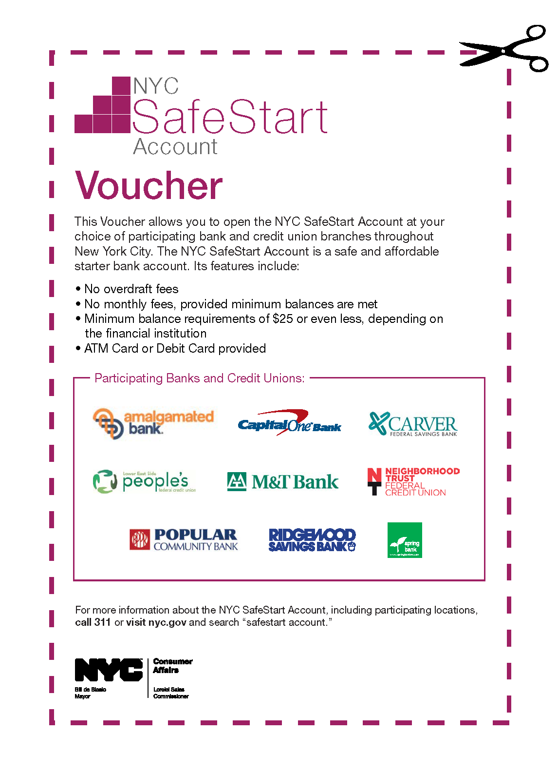
Financial Education for Worker Cooperative Members
NYC SafeStart Account Voucher
Clients who have a ChexSystems report can attend a one-on-one financial counseling session at a Financial Empowerment Center and receive a voucher as a ChexSystems waiver.
Notes:
10

Slide 11
Financial Education for Worker Cooperative Members
Checking Account
Transactional accounts facilitate regular payments through paper checks, internet banking and bill payment. Payments are drawn against amounts on deposit:
  Making Deposits
  Direct deposit—regular, electronically transmitted, funds available immediately; paychecks can be directly deposited into checking accounts
  Sign back of the check to deposit (“endorse” check)
  Writing Checks—written words prevail over numbers
  Cancelled Checks—checks which have been paid by drawer’s bank are returned to drawer (writer of check or payer)—now in electronic form
  Check Register—record of all deposits, withdrawals, fees deducted, and checks issued
  Balance check book—adding all deposits and deducting all checks issued, withdrawals and fees to know what is available to be drawn against
Notes:
11

Slide 12
Financial Education for Worker Cooperative Members
Checking Account
Checking Account Statement—Institution’s report of all transactions issued on a periodic basis (usually monthly)
Reconciliation with Bank Statement—Comparing check register and statement to account for all outstanding checks. Insures that payer knows amount actually available for use, what has been paid and received, and what is pending
Bill Payment
  Automatic arrangement to pay regular bills from account OR
  Online payments made each time bill becomes due
ATM Card – An Automated Teller Machine card may be issued in connection to a checking or savings account to allow consumer to transact business (e.g. deposits, withdrawals, transfers and check balances—not same as debit card)
  May have fees
Debit Card – Can be used at point of sale to pay for purchases (card must say “debit” on it, often combined with the ATM card—same card for both uses)
Notes:
12

Slide 13
Financial Education for Worker Cooperative Members
Checking Account
ATM Card - Automated Teller Machine Card
Issued by account holder’s bank
Allows account holder to conduct business transactions (withdraw, deposit, transfer between accounts) using an ATM (of issuing financial institution or other financial institution)
May be a fee for transactions conducted using ATMs of non-issuer financial institution
May be a charge imposed by issuer if ATM transactions exceed stated limit each month
May be the same card as the consumer’s debit card
No credit card logo (Master Card/Visa) if dedicated ATM card, cannot be used at point of sale

Slide 14
Financial Education for Worker Cooperative Members
Checking Account
Debit Cards
Debit cards are linked to existing accounts, e.g. checking or savings; not same as pre-paid reloadable debit card.
Fees: Point of sale—using debit card and a PIN number; may be monthly fees; annual fees; or a charge if exceeds set number of uses (account-linked card often combines ATM and Debit features—where there is a Visa/Master Card logo)
Access to Funds: Some institutions hold a multiple of the debited amount—making less of balance available until transaction clears

Slide 15
Financial Education for Worker Cooperative Members
Checking Account
Paying Through Debit vs. Credit
Debit Card—Money is withdrawn directly from account holder’s own funds, e.g. savings or checking: no balance, no access
Credit Card—Payment is made by issuer on consumer’s behalf; the consumer repays the issuer as invoiced
Notes:
15

Slide 16
Financial Education for Worker Cooperative Members
Checking Account
Overdraft—When a checking account goes below a zero balance.
  Overdraft Protection Plans: Banks cover transactions when the account has a negative balance with fees possibly exceeding the payment itself!
    This is extended not only to checks, but also ATM and debit card transactions
    The median overdraft fee is $27 (APRs of 1,000 – 3,500%)
  Consumers may be unaware they have overdrawn their accounts.
  THINK TWICE BEFORE OPTING INTO FEE-BASED OVERDRAFT PROTECTION PLANS! There are other options to explore.
Notes:
16
Banks make a big profit from fees for covering your over draft. For example in 2006, financial institutions generated $17.5 billion in fee income for covering $15.8 billion in overdrafts. They made a profit of $1.7 billion

Slide 17
Financial Education for Worker Cooperative Members
Checking Account
Alternatives to Fee-Based Overdraft
Overdraft line of credit
  Consumers can apply for an overdraft line of credit and pay interest on the overdraft, just like any other type of loan.
  Banks may also charge annual fees.
Linked savings account
  When the checking account is overdrawn, banks will automatically take funds from savings account to cover the transaction.
  Banks may also include transfer fees.
Linked credit card
  Any overdraft amount becomes a cash advance on the credit card.
  Consumers will probably be charged a cash-advance fee, and interest charges on the advance will start immediately.

Slide 18
Financial Education for Worker Cooperative Members
Checking Account
Overdraft Regulations
Financial institutions can no longer automatically enroll customers into their overdraft protection services for ATM and one-time debit transactions.
They need to ask consumers for permission, or to “opt in.”
Some banks have discontinued the practice, others continue to market the services to consumers.
Many consumer protection groups advocate that: “It’s best not to opt in.” However, be sure you know the consequences.

Slide 19
Financial Education for Worker Cooperative Members
Checking Account
Avoiding Overdraft
Keep track of all transactions, including ATM withdrawals, electronic payments and debit transactions.
Don’t forget to subtract any transaction fees.
Monitor the account balance and stay up to date on which transactions have cleared.
  Check by calling the bank or by looking online or at an ATM
Beware of debit holds
  Using a debit card at a restaurant, gas station, hotel or car rental agency may cause a “hold” to be placed on the account at an amount greater than the purchase.

Slide 20
Financial Education for Worker Cooperative Members
Savings Account
Earn interest, funds readily available
Paychecks can be directly deposited into accounts electronically
Arrange regular saving with automated transfers from checking, savings, or payroll
Features often include an ATM card or debit card
Notes:
20
The slides on how simple interest and compounding interest work were eliminated; as well as the Rule of 72 which shows how you can compute how long the money takes to double. That information is here in the notes for the instructor’s convenience if s/he thinks it is appropriate to cover
Simple interest: Calculating Interest Earned:
Principal (P) x Rate (R) x Time (T) = Simple Interest (I)
Generally on an annual basis – apportion if period is less than one year
Example: P = $100 R = 2% T = 1 yr.
Interest for one year is $2.00 ($100 x .02 = $2.00)
To calculate monthly interest: divide $2.00 by 12 months or $0.16/month
2. Compound Interest:
Interest earned on principal over time, plus interest earned on the interest.
Example:
In 2014, Maria kept a $100 deposit (P) for the full year (T) and earned a 2% interest (R).
P x T x R = Interest at the end of the year
($100) x (1yr.) x (.02) = $2.00
On January 1, 2015, she would have $102. Assuming she leaves $102 on deposit for all of 2015 year, on January 1, 2016 she would have a yield of $2.04 for a total of $104.04
Rule of 72:
Calculation of time it takes for money to double at a given rate of return
Assumes compounded interest annually
Divide 72 by rate of return = time it takes for money to double
For example if Client X earns 10% on her money, it would double in 7.2 years (72 divided by 10 = 7.2 years)
4. Note the other side of the coin: interest on debt grows in the same way

Slide 21
Financial Education for Worker Cooperative Members
Savings vs. Investments
Savings
  Funds set aside for short-term needs (usually defined as one year or less)
Investments are long-term
  Assets acquired for future income or benefit
  Increase by generating income (interest or dividends)
  Grow by appreciating in value
  Income earned and appreciation in value increases wealth
Notes:
21

Slide 22
Financial Education for Worker Cooperative Members
Savings vs. Investments
  Liquid savings readily available as cash and not intended for long-term investment
  Liquid savings—“forced savings,” e.g., over-withholding income tax in order to get a big refund
      Affects cash flow, may impact ability to manage funds
Notes:
22

Slide 23
Financial Education for Worker Cooperative Members
TIME – The Advantage of Starting NOW
STARTING TO SAVE EARLY – Assume a 3% Return
The following example shows you what a difference starting to save early can make.
In this case, we have student Julio beginning to save $1,000 per year beginning at the age of 16. By the time that Julio is 25 years old, he has saved $10,000. If he never puts any more of his own money into the account, at the rate of 3% per year, Julio will have $38,517.33 in his account by the time he is 50 years old. In other words, for his input of $10,000, he has gotten a return of $28,517.33.
Compare what happens to Mei who does not start to save until she is 26 years old.
Assuming Mei saves $1,000 per year for 25 years, at the rate of 3%, by the time Mei is 50 years old, she will have input $25,000 to have $36,323.01 in the account. Her return on her input of $25,000 is only $11,323.01. In other words, Mei put in two and half times the money that Julio did and yielded less than half of the money that Julio yielded.
Notes:
23

Slide 24
Financial Education for Worker Cooperative Members
TIME – The Advantage of Starting NOW
Notes:
24

Slide 25
Financial Education for Worker Cooperative Members
Certificate of Deposit
Certificates of Deposit or “Time Deposits”
Certificate evidencing a deposit for an agreed fixed term (date of maturity) at an agreed fixed rate of return or interest
Short or medium term (generally 3 months to 6 years)
Generally higher rates of return
Money removed before maturity date is subject to penalty
Notes:
25

Slide 26
Financial Education for Worker Cooperative Members
Accounts for Retirement and Education Savings
Consult a free financial counselor about:
MyRA Accounts
Individual Retirement Accounts (IRA)
529 Plans for your children’s education

Slide 27
Financial Education for Worker Cooperative Members
Accounts for Retirement and Education Savings
MyRA Accounts
No cost for set up
Automatic contributions directly from paycheck based on what you can afford
Can withdraw money at anytime with no tax, except for interest earned
Earns interest currently at 1.75% (4/2016)
Maximum $5,500/year deposit ($6,500 for those age 50 or over)
Notes:
These accounts can be

Slide 28
Financial Education for Worker Cooperative Members
Accounts for Retirement and Education Savings
Individual Retirement Account (IRA)
Money deposited earns interest tax free until it is withdrawn at age 59 ½ or later
Deposit of a maximum of $5,500/year for individual ($6,500 for age 50 and over) can help save you income tax

Slide 29
Financial Education for Worker Cooperative Members
Accounts for Retirement and Education Savings
529 Plans
Accounts that are managed by a state program or a specific college or university
Money is usually invested in stocks or other investments
Earnings or profit on the money is tax free as long as it is withdrawn to pay for education
Important to understand the benefits and limitations on these accounts
Notes:
Encourage the attendees to seek assistance of a financial counselor.

Slide 30
Financial Education for Worker Cooperative Members
Fringe and Alternative Financial Services
Reloadable prepaid debit cards
Check cashing stores
Money orders
Notes:
People use these fringe or alternative ways of handling money because they do not have access to a banking account. They do not realize that over time, these options cost them more than a bank account would to cash checks, and pay their bills. In addition to the costs, they are also not building a relationship with a financial institution that will help them in the future, for example for personal or business loans, or for a mortgage if they wish to buy a home.

Slide 31
Financial Education for Worker Cooperative Members
Reloadable Prepaid Debit Cards
Structured to not only spend but also add money as if adding to a bank account
Most cards charge higher fees than the basic checking accounts offered at mainstream financial institutions
Difficult to identify all the fees, which may include
  Adding money
  Calling customer service
  Getting a paper statement
Make sure the card is fully FDIC insured and offers Regulation E protections.
Opting for a checking account over a prepaid card may still be a better deal
Notes:
If a reloadable debit card is not FDIC (Federal Depository Insurance Company) insured, the buyer will lose the remaining balance if the card is lost because anyone who finds the card can drain the balance. If the card is FDIC insured, the buyer of the card can call and have the card cancelled, and get a new one with the balance that was on there. Be aware that the FDIC cards will require ID to purchase so that they can establish ownership.

Slide 32
Financial Education for Worker Cooperative Members
Check Cashing Stores
Must be licensed by NYS Department of Financial Services – their employees registered
Charges percentage of check amount for cashing
- Highest rate allowed: 2.01% of check
Accepts direct deposit of government and other funds such as EBT and payroll – may be linked to a debit card
Notes:
Most check cashing stores will charge the 2.01%, the highest fee allowed. Here’s a simple exercise of the attendees:
If you cash a $800 net pay check every two weeks, how much will you pay the check cashing store to cash that check? (Answer: .0201 X $800 = $16.08 per check; that means they would only have $783.92 left). Over one year (26 times a year) you will be paying $16.08 for every check or $418.08 for a year (26 X $16.08 = $418.08) That’s a full week’s net pay check! The 2.01% is also charged on the amounts directly deposited into the linked debit cards.

Slide 33
Financial Education for Worker Cooperative Members
Money Orders
Issued by various institutions including US Post Office, banks and alternative financial
Costs per money order varies, and amount per money order generally capped
Examples:
- Commercial bank: $5.00 for up to $1,000
- US Post Office: $1.25 up to $500; $1.65 for $500.01 up to $1,000
- CVS: $0.70 up to $500
Notes:
Have the attendees think about how much it costs to buy money orders to pay $900 rent using the various examples: (not to mention the time spent to purchase)
Commercial banks: 12 x $5.00 = $60.00
Post office: 12 X $1.65= $19.80
CVS: you will need 2 money orders - $1.40 x 12 = $16.80

Slide 34
Financial Education for Worker Cooperative Members
Summary
Banking with a financial institution may lower costs of transacting financial business and facilitate accumulation of assets
Banks are for-profit financial institutions—be aware of fees and costs, and compare
Credit Unions are non-profit financial institutions—may be willing to take more risks for members, but costs may be higher
Checking Accounts—maximize interest rates if available, minimize fees, i.e. overdraft fees, excess usage or third party ATM costs, etc.
Savings (short-term) vs. Investments (long-term)
CDs (understand features)
Consider future needs

Slide 35
Financial Education for Worker Cooperative Members
Summary
Checking Accounts – Necessary to transact daily business of paying bills, and centrally gathering funds before allocating for expenses, savings and expenses
Savings Accounts – Putting aside funds for short term goals with some interest yield
Certificates of Deposit – Short term goals, do not need immediate access to funds, low tolerance for risk (as compared to stock market) looking for predictable higher return than regular savings account
© June 2017. New York City Department of Consumer Affairs. All rights reserved.

