Slide 1
Public Meeting
April 3, 2025

Slide 2
Technology & Housekeeping
To Commissioners:
In-Person Participants:Please mute your microphone when you're not speaking and turn it on when needed
To Online Participants: Please mute your microphone when you're not speaking. Feel free to unmute and let us know when you'd like to offer a comment, since we cannot see you.
To All Participants: ​
Call participants in the order they have registered for public comment prior to meeting, then during today's meeting​
Closed Captioning:​ Closed Captioning will be displayed on the smaller screen​
​
To In-Person Participants:​
To submit a public comment, please add your name and affiliation to the sign in sheet by the door. We will call on you to speak in order received.​
To Online Participants:​
To submit a public comment, please submit your name, affiliation, and public comment via email to info@civicengagement.nyc.gov or via text to 917-587-9103. We will read comments in order received.

Slide 3
Agenda
Attendance​
Approval of Meeting Minutes from February 6, 2025
CEC Values Reaffirmation
Program Updates
Voter Language Assistance and May/June Primary Elections
Community Boards Member Trainings & Engagement
The People’s Money Participatory Budgeting
Borough Assembly Recap
Vote Phase Preview
Language Access, Volunteer Program, Engagement Strategies
Implementation Projects Presentations & April 30 Showcase
TRIE Neighborhood Initiative Updates
Digity Equity team introduction
Public Comment

Slide 4
Approval of Meeting Minutes

Slide 5
CEC Values Reaffirmation

Slide 6
Statement in Newsletter
Since our establishment, the Civic Engagement Commission has been charged with running several programs to serve residents of NYC and help build trust in government. We’ve focused our programming to increase representation among communities that are historically underrepresented and underserved including immigrants, individuals with limited English proficiency, people with disabilities, BIPOC, LGBTQ+ and more. As the rights of these populations are under attack, and many are feeling unsafe in their own neighborhoods, we believe that all New Yorkers deserve to have equal rights, feel safe in expressing their identities, and freedom to live their own lives without being in danger.
The CEC celebrates the inherent dignity, worth, and diversity of all New Yorkers. We believe all voices must be heard and respected in a democracy in order to create policies that promote the common good. We remain steadfastly committed to creating programs that center listening, relationship building, and care. Our Commission will continue to work to build, and earn, trust in our communities and prove that government can be, should be, and will be for all the people.

Slide 7
CEC Values Statement
To support and encourage New Yorkers to meaningfully participate in civic life, the CEC believes that active listening, as a process and practice, is central to building relationships and trust. We are committed to being practitioners of participatory democracy and affirm our responsibility and commitment to lift the power and voices of all NYC communities. We ground this work based on the following core values:
Dignity: We celebrate the inherent worth of all human beings by creating processes that center relationship-building, intentional listening, and care.
Manifesting Community Power: We support community leadership, provide education about how various systems of government work, and create pathways for engagement so that communities voice and manifest their power over decisions that impact their lives.
Collaboration: We believe that by working together with people affected by policies, we can identify and solve our collective challenges and build the interdependence required for a healthy resilient democracy.

Slide 8
CEC Values (continued)
Accessibility & Justice: We strive to create conditions that foster access to information and resources that enable community partnerships that are grounded in mutual agency and work to eliminate policies and practices that have disparate impacts on historically marginalized and underserved communities.
Accountability & Transparency: We facilitate honest dialogue with residents and interagency partners that centers their lived experiences and commits to continuous evaluation and improvement to strengthen the impact of processes and actions on outcomes.
Imaginative Ways of Working: We commit to reimagining what government processes can look like—opening up possibilities for new ways of engagement.
Dynamic Learning: We commit to foster mutual learning communities and amplifying voices and stories from community partners that inform our own practice.

Slide 9
Program Updates

Slide 10
Voter Language
Assistance Program

Slide 11
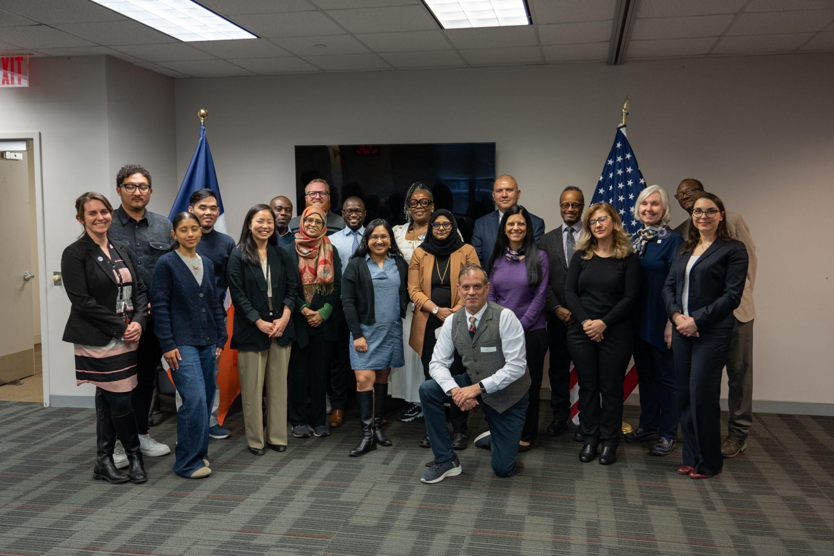
Poll Site Language Assistance Program – Language Assistance Advisory Committee
Nine new members recruited, 13 returning members
First meeting for 2025 cohort held February 27th; 2nd meeting
CEC Chair and Executive Director Dr. Sarah Sayeed, MOIA Commissioner Manuel Castro and MOECM Executive Director addressed LAAC
Notes:
Total of 551 voter assisted

Slide 12
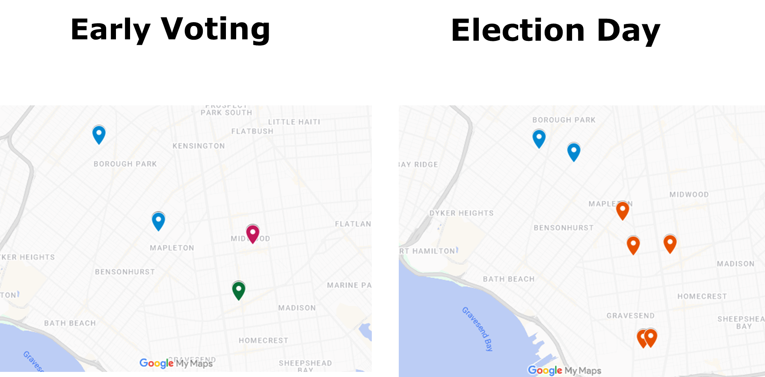
Voter Language Assistance Council District 44 Special Election- March 25
Languages served: Early voting- Yiddish (3), Russian (3), Arabic (1), Urdu (1) Election Day- Yiddish (2) Russian (5)
Notes:
4 EV poll sites with a total of 8 language services; 7 ED poll sites with total 7 language services; 100% of services delivered as planned

Slide 13
Upcoming Council District 51 Special Election- April 29
No poll sites overlapping with this district were served during early voting for the general election
One poll site to be served on Election Day April 29 (Korean)
Notes:
4 EV poll sites with a total of 8 language services; 7 ED poll sites with total 7 language services; 100% of services delivered as planned

Slide 14
VLA Program - June Primary Planning
RCV PSA and other collateral
Website content
Ethnic media ad buys (~$60k) & free ad placement
Pilot grant program for community organizations to do RCV/Voter rights info sessions with VLA communities
Notes:
Total of 551 voter assisted

Slide 16
Upcoming Custom Workshops
De-Escalation Trainings:
All trainings will be in the evening at their respective Borough Hall and have Chairs and District Managers invited.
Brooklyn Borough President: March 31
Bronx Borough President: April 5
Queens Borough President: April 8
Custom Parliamentary Procedures for Boards:
CB11 Manhattan: March 20, Motions and Minutes
CB8 Bronx: April 2, Effective Meetings, Motions, and Minutes
CB8 Manhattan: May 14, Effective Meetings, Motions, and Minutes
CB5 Bronx: May 28, Bylaws and Amendments

Slide 17
Partnering with FCBWG on Term Limits
We have been partnering with the Center for Urban Pedagogy and the Future of Community Boards Working Group to propose ideas to the Borough Presidents for how to prepare for term limits.
Options Included:
A) Printed Resource: What is a Community Board?
B) Interactive Toolkit: What is a Community Board?
C) Expansion Pack: What is City Government?
D) Convening a Citywide CB Leadership Conference

Slide 18
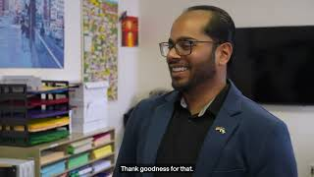
Why I Joined a Community Board

Slide 20
Process Overview and Engagement Strategy
Fall
Winter
Spring
Following FY
Phase 1: Idea Generation
Phase 2: Project Vetting and Development
Phase 3: Voting
Phase 4: Project Implementation
And Evaluation
Identify Themes
Light touch
Group discussion
Build awareness
Encourage future
involvement
Deliberative
Time intensive
Small group
Representative
Build leaders
Participatory
Shortest time commitment
Highest participation
Report back
Visible to public
Build trust
Show impact
* Borrows from Civic Assembly model

Slide 21
Process Cycle: Current Status
Fall
Winter
Spring
Following FY
Phase 1: Idea Generation
Phase 2: Project Vetting and Development
Phase 3: Voting
Phase 4: Project Implementation
And Evaluation
Year 2
Year 3
Complete
Complete
Complete
Complete
Complete
Upcoming
In process
Next FY

Slide 22
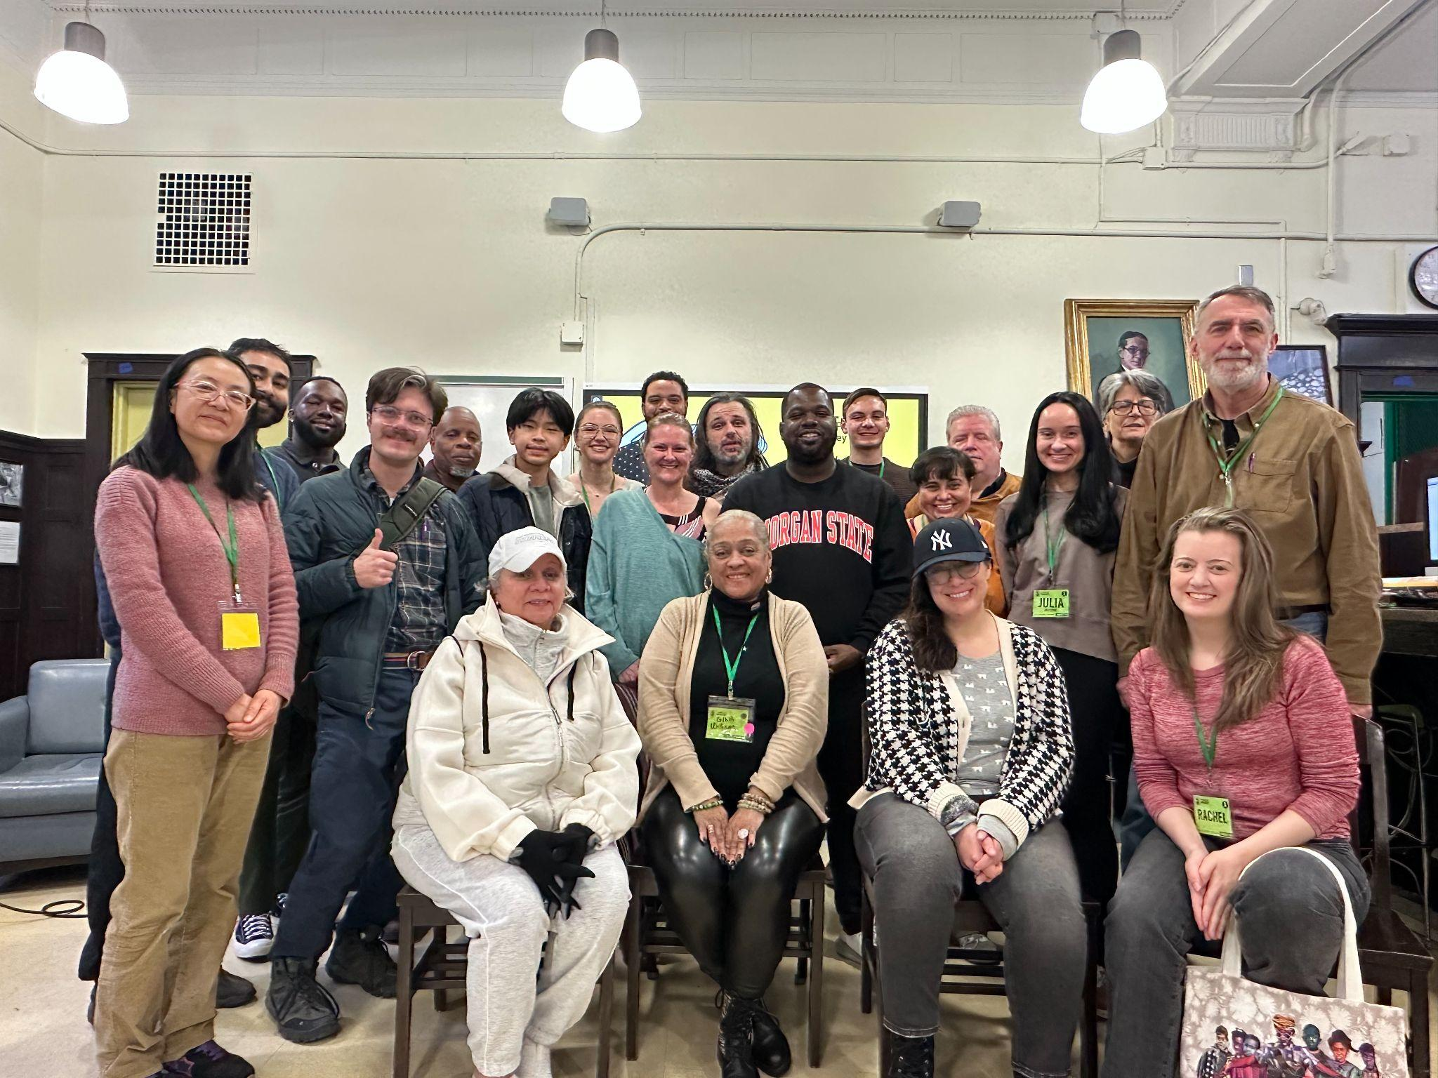
Borough Assembly Committees
115 Assembly members completed 6 sessions for a total of 20 hours
They met with six city agencies at an All Borough Session held in partnership with Columbia World Projects.
Our TRIE partners provide NEighborhood Needs Assessments and met with members in person in each borough
Across the city they reviewed 438 ideas of which 46 will be on our ballots
In addition we had researchers from Columbia University, Franklin and Marshall, and William & Mary observing and who be providing reports on what they saw
Manhattan Assembly Committee

Slide 23
PB Language Access Methodology
Current priority with emphasis on vote phase
Includes:
Legal Requirements - CEC Mandates, LL30 regulations
Demographic Analysis: how to determine what languages are most common in targeted areas, collaboration with community and external partners

Slide 24
PB Language Access (continued)
Using data to bring appropriate and adequate number of in-language materials
Tips for conducting proactive engagement with language communities
Training of Volunteers for cultural competency and LEP interactions
Tips on Interpretation
Best practices for Language communities by Phase

Slide 25
PB Language Access (continued)
Ballots for all 5 boroughs have been translated into all LL30 languages plus Yiddish and Italian
Language Access planning stages for voting phase to ensure inclusive participation
Ballots for flagship events have top 3 languages (after Spanish)
iPads will be used in case of additional language needs at flagship events

Slide 26
Volunteer Management Overview
This initiative is primarily organized and managed by the Outreach Team: Barbara Williams, Anthony Carrion, Catherine Gao and Samira Zeru
Thanks to the funding from the NYC Service Grant, we have the resources to recruit, train, manage, and retain volunteers effectively.
With the support of a dedicated Volunteer Coordinator, our team has successfully spearheaded volunteer efforts at the Civic Engagement Center (CEC) over the past two years.

Slide 27
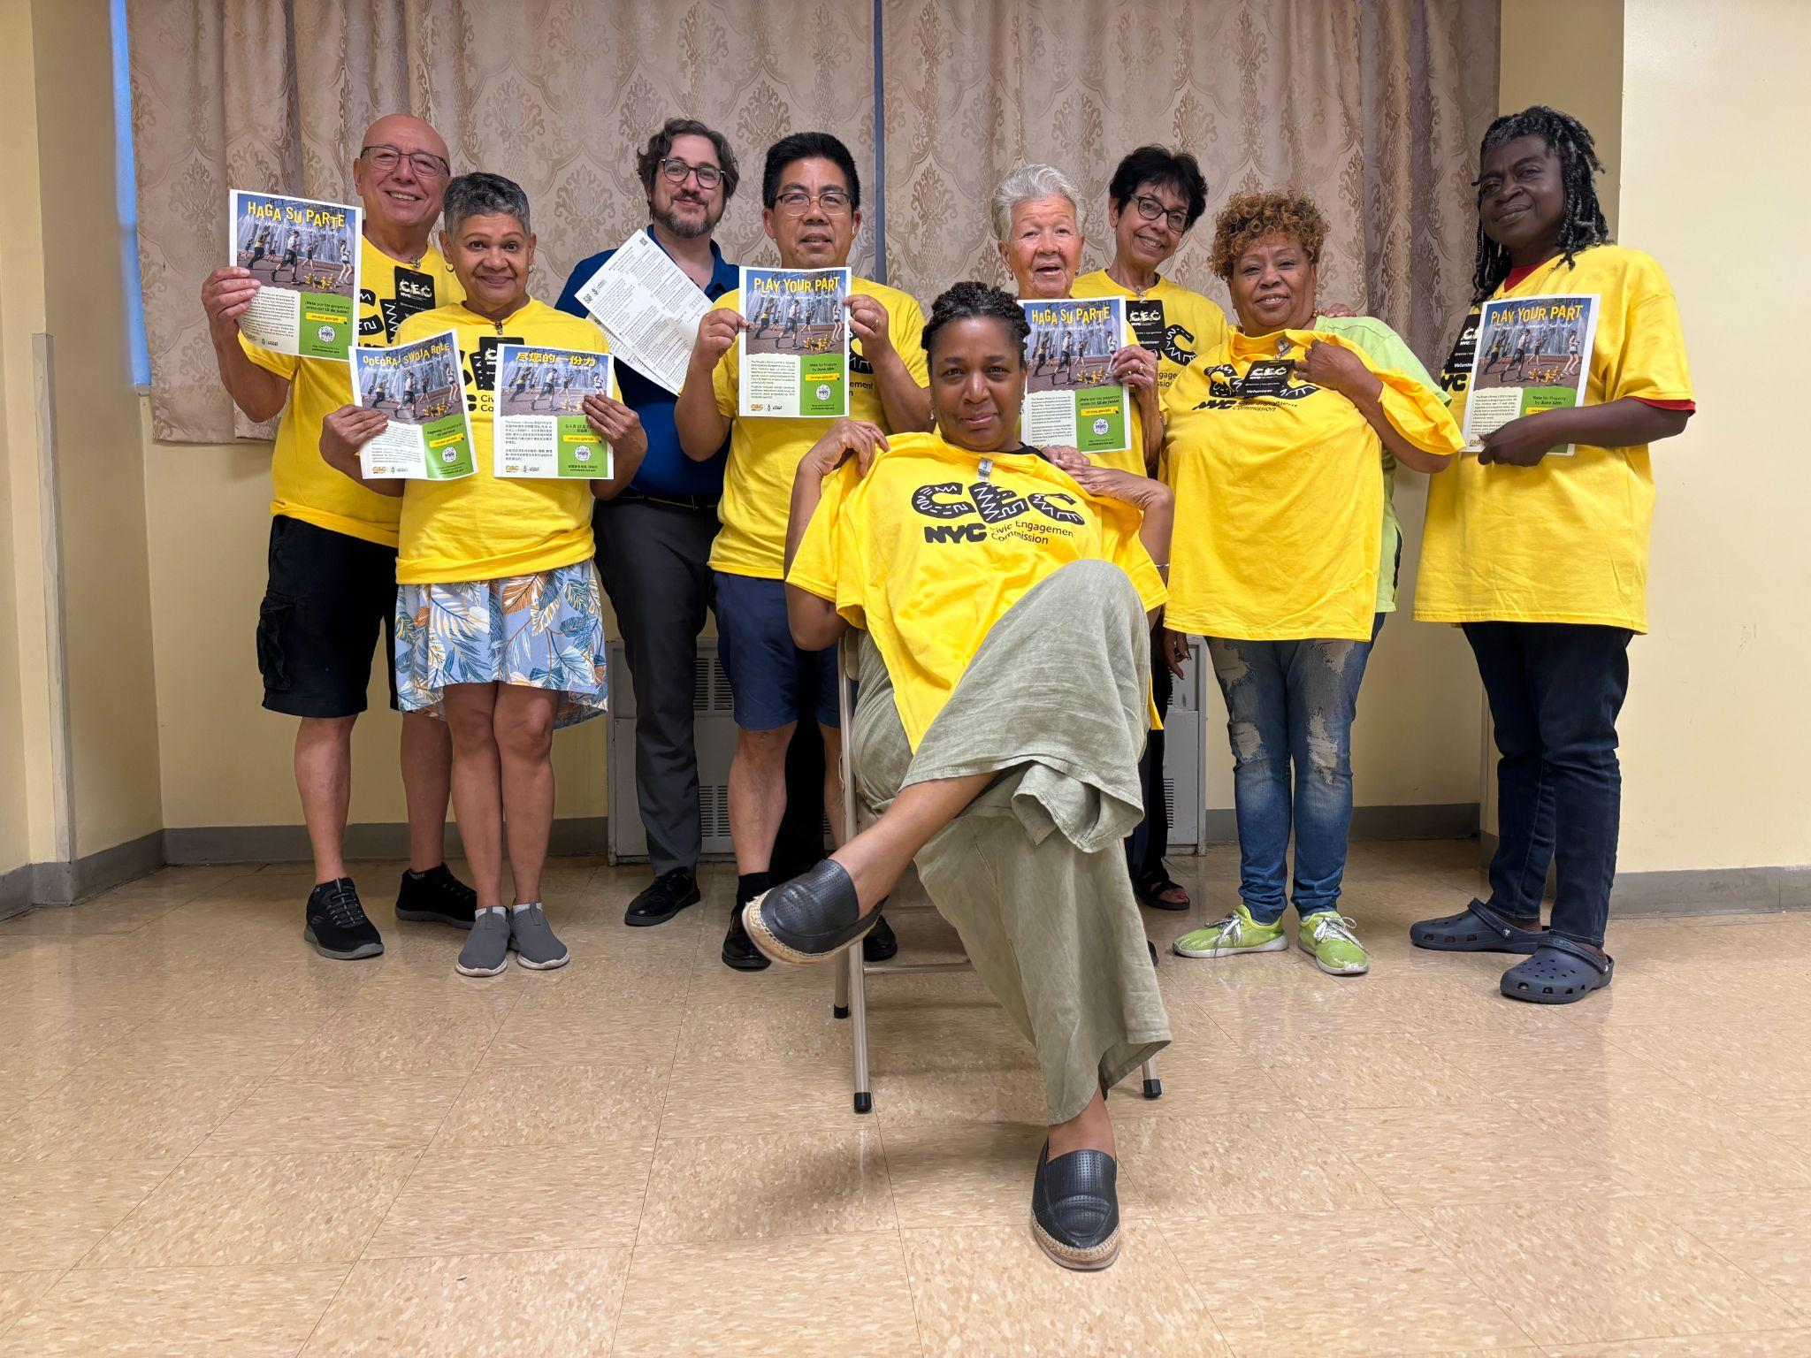
Ambassador Program

Slide 28
Ambassador Program
A Vote Ambassador is a volunteer who conducts in-person outreach - canvassing, tabling at events, etc. - in communities throughout New York City to increase voter participation in The People’s Money.
Third year of running this program with 33 volunteers who were retained over the first 2 years.
This year goal is to have 30 volunteers:8 volunteers Brooklyn, 8 volunteers in Queens, 8 volunteers Manhattan, 4 volunteers Bronx and 2 volunteers Staten Island.
Communities we will cover consist of geographic and language gaps from previous years.

Slide 29
Community Facilitators
A Community Facilitator (CF) is a trusted CEC representative who facilitates both virtual and in-person vote sessions to increase voter participation and public awareness.
10 to 12 CFs will be recruited from those who participated in Phase 1 Idea Generation
Each CF will facilitate 3 to 5 vote sessions

Slide 30
Vote Phase Engagement
Dates: Wed May 14- Wed June 25- 6 weeks, includes Primary Day
Partnerships with community based organizations
Partnerships in TRIE neighborhoods
Developing library partnerships
Events (Flagships & others)

Slide 31
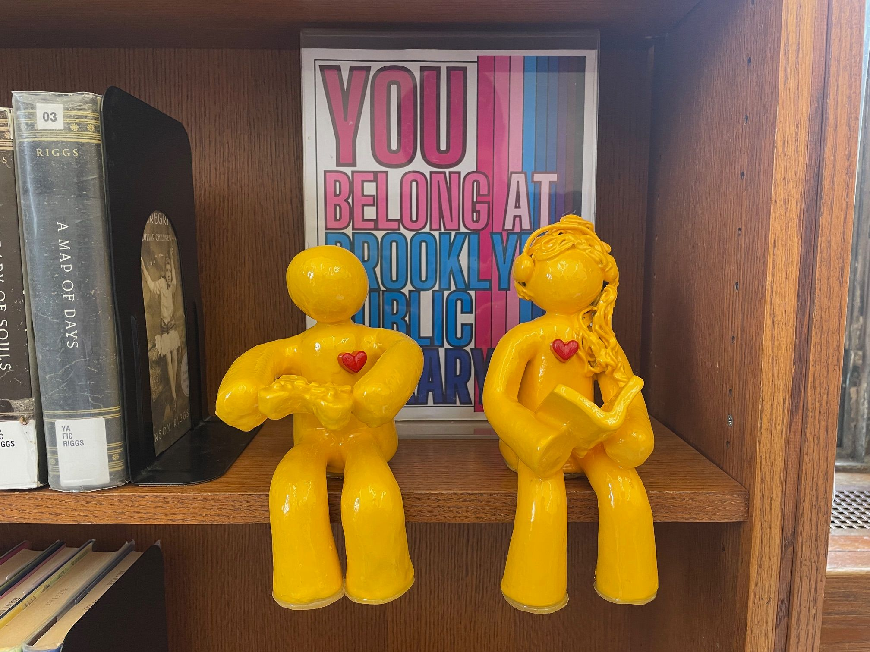
Library Partnerships
TRIE partners will host a Ballot Box in each of the 33 TRIE neighborhood Library Branches across the 5 Boroughs
Offering all other NYPL, BPL, QPL branch managers the opportunity to host a ballot box, or display a Library Specific Voting Poster
Prioritizing branches with high foot traffic and can attend a training session

Slide 32
Flagship Events
CEC will Be Hosting 5 Flagship Voting Events at the following locations
May 18 - Bronx Week Parade & Festival
May 24 - Brooklyn BAM Dance Africa
June 1 - Queens PRIDE Parade
June 7 - Staten Island Fatherhood & Family Fun Day
June 10 - Manhattan Museum Mile
We Invite You, Our Commissioners To Attend!!
Volunteers from Borough Assemblies will be there supporting us

Slide 33
Project Implementation

Slide 34
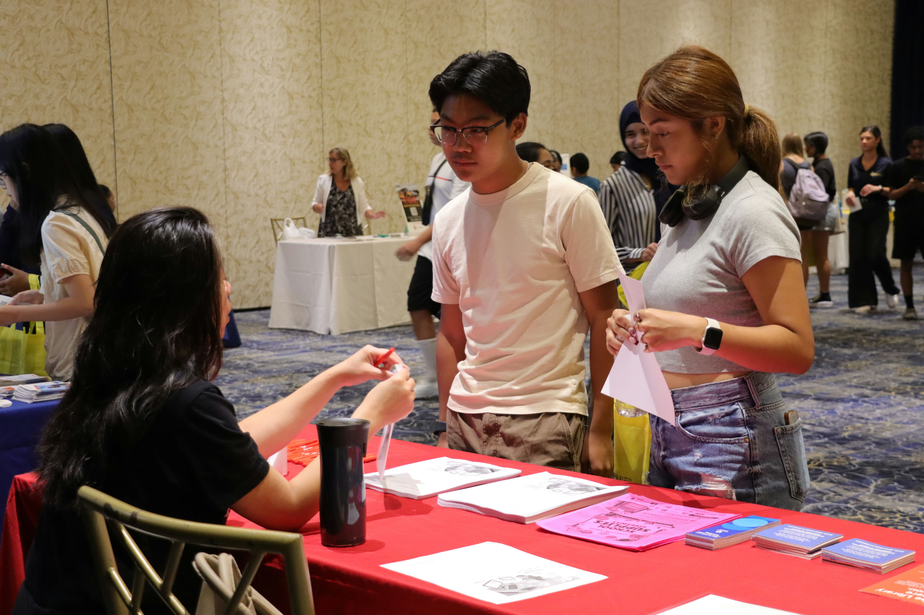
Building Success for High School Students
Implementing Partner: United Activities Unlimited
Neighborhoods: St George, Stapleton, Port Richmond, Tompkinsville and Mariner’s Harbor

Slide 35
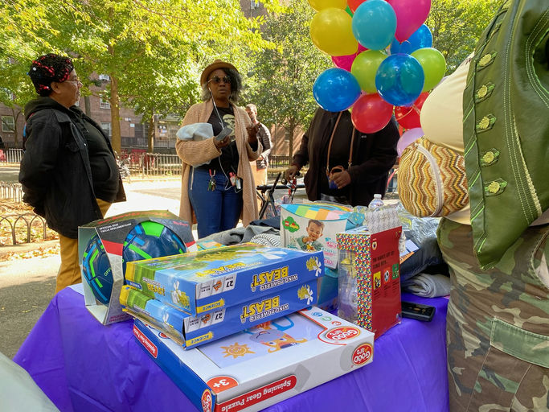
Mothers Matter
Implementing Partner: Multi Assistance Resource Center
Neighborhoods: Central Harlem, Morningside Heights, and Hamilton Heights

Slide 36
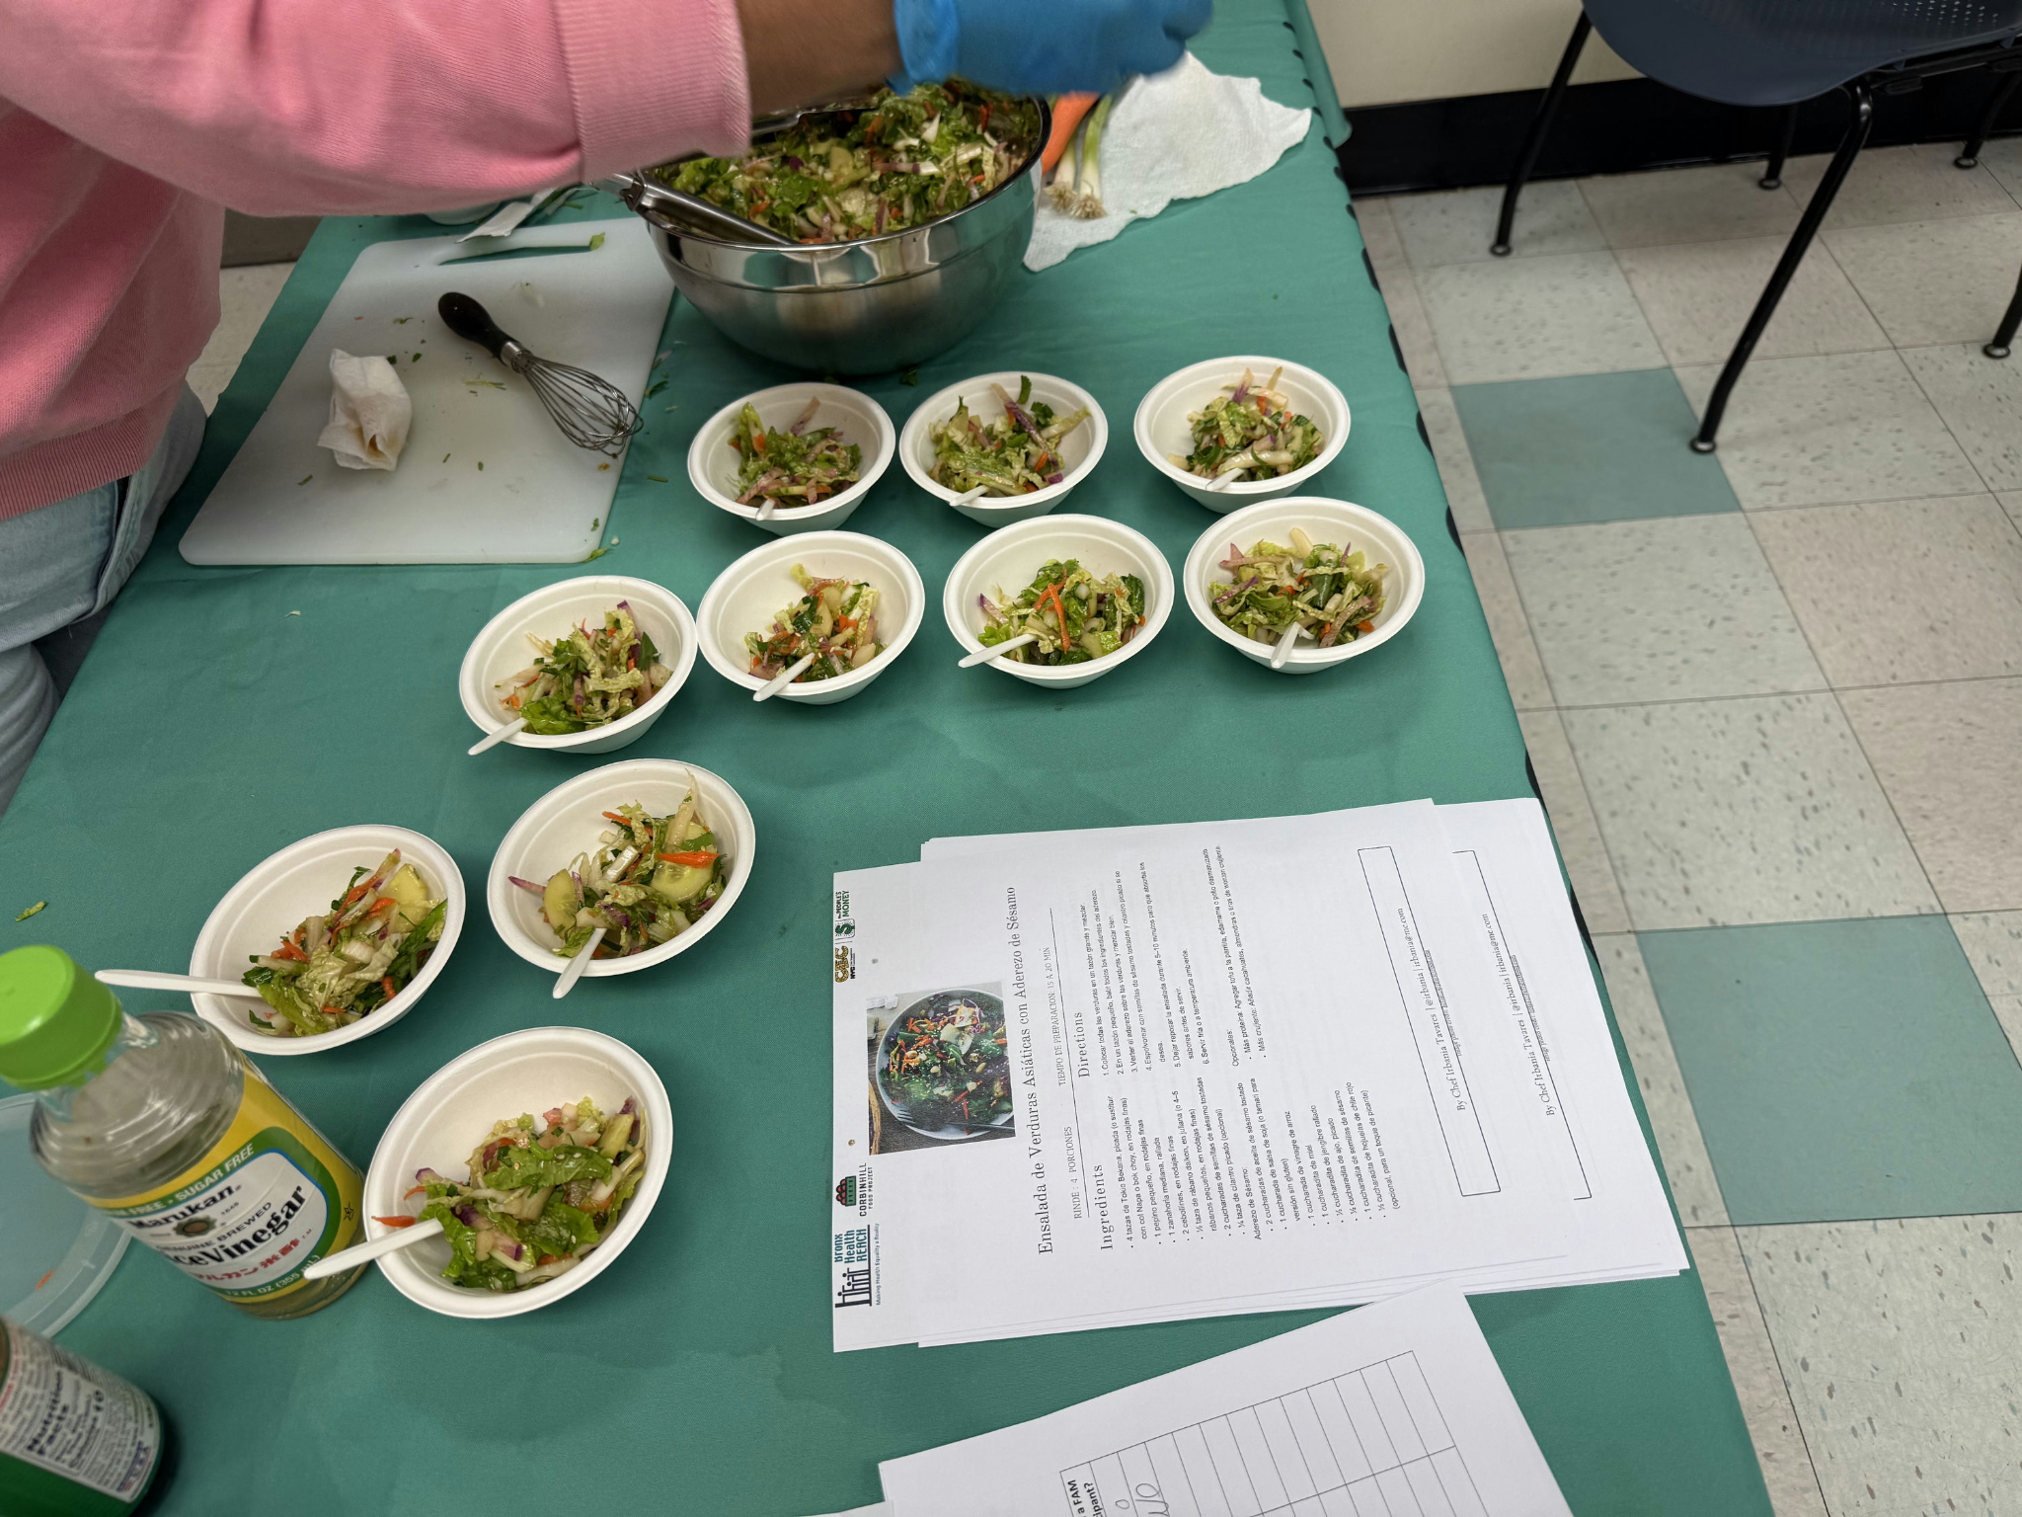
Slashing Bronx Hunger and Boosting Knowledge About Healthy Eating
Implementing Partner: The Institute for Family Health
Neighborhoods: Highbridge, Concourse, and Mt. Eden

Slide 37
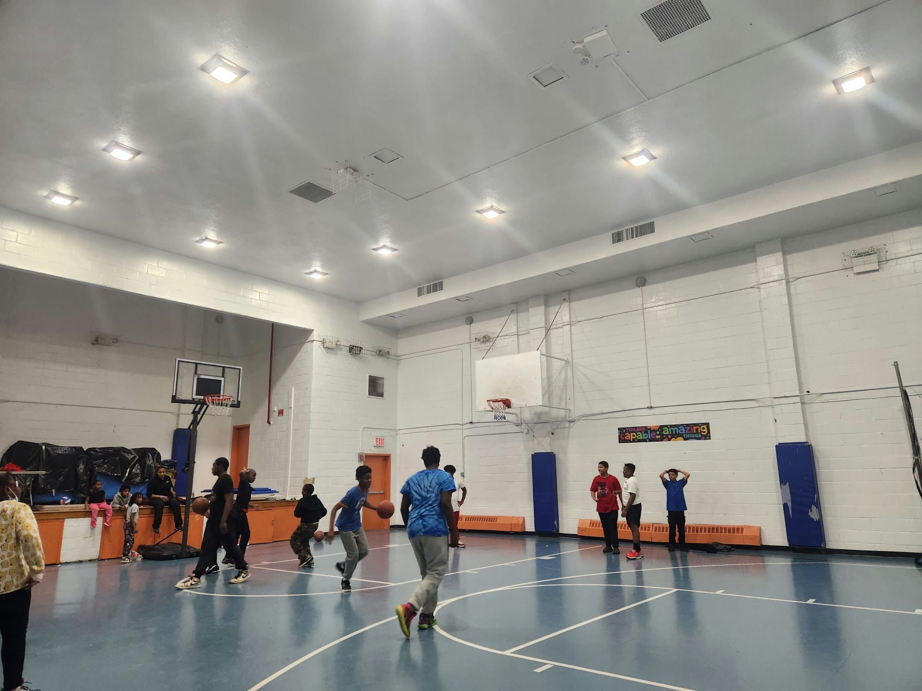
Youth Empowerment After School Workshops
Implementing Partner: Ocean Bay Community Development Corporation
Neighborhoods: Rockaway and Broad Channel

Slide 38
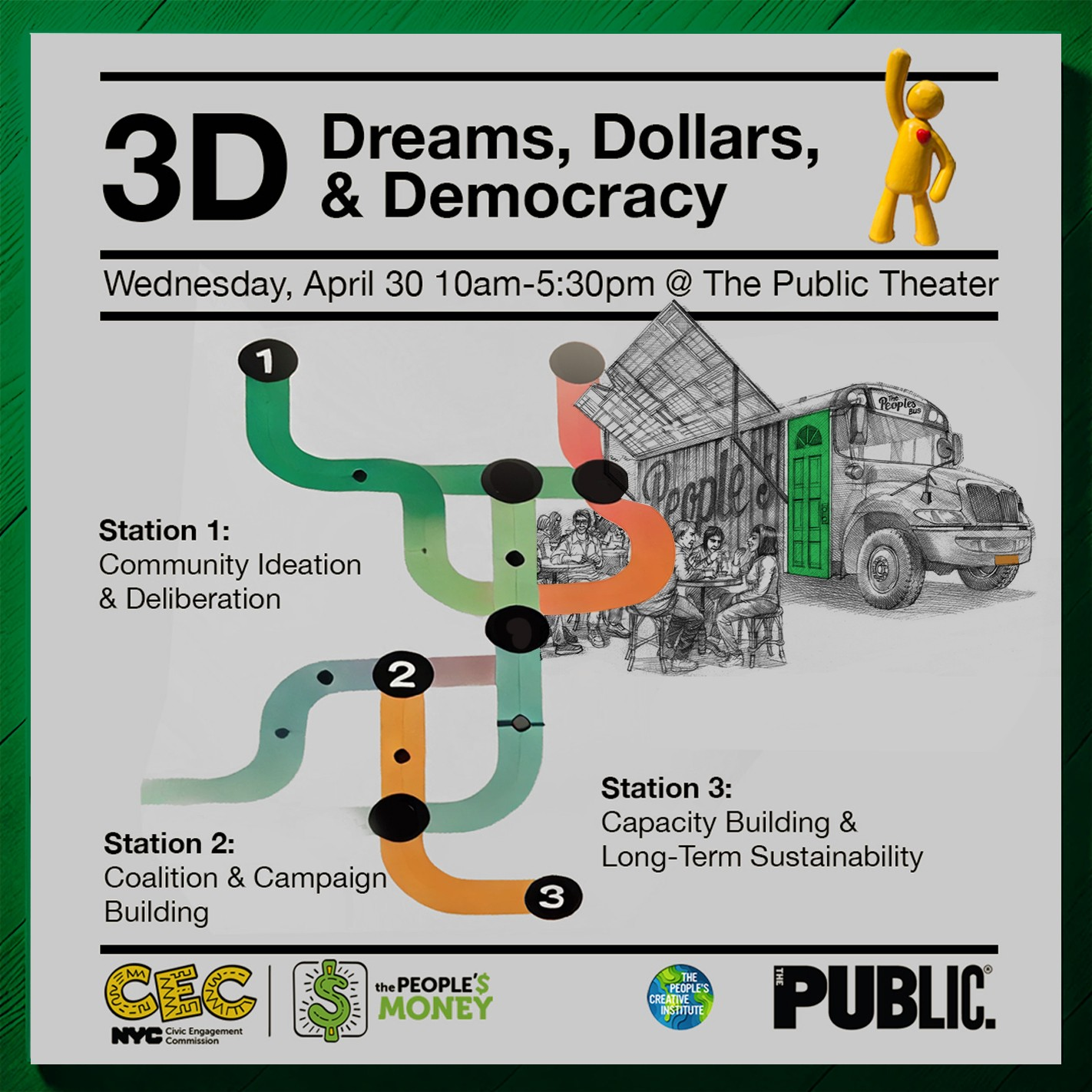
April 30th Showcase
The CEC will be co-hosting a showcase of the People’s Money with the People’s Creative Institute at the Public Theater
Through panels, presentations, and exhibits, we will engage in opportunities to promote:
Ideation and deliberation
Coalition and campaign building
Long-term sustainability of our process and projects
The audience will include our CBO partners, city agencies, foundations, practitioners, academics and researchers
We continue to seek engaging panelists and speakers, and invite your participation!

Slide 39
TRIE Neighborhood Initiative Updates
76 coalition meetings held so far, ~60 additional meetings to be completed by the end of June.
2 civic engagement workshops facilitated, ~29 additional workshops to be facilitated by the end of June.
Partners attended 2 capacity building trainings since the January including:
New School, Monitoring & Evaluation
NYC Campaign Finance Board, Ranked Choice Voting
TRIE Partners have been connecting with Implementation Partners to explore collaboration
2025 TRIE Vote Phase Deliverables include:
1500-2000 ballots each
Min. required activities designed to have partners reach diverse pockets of the TRIE Neighborhoods and maximize engagement

Slide 40
TRIE Timeline
Month | Milestones
April | Host coalition meeting to strategize around PB GOTV Submit draft Vote Plans Attend Vote Phase Training Attend Implementation x TRIE Third Quarterly Meeting
May | Submit Final Vote Plans Host Civic Engagement Workshops Begin bi-weekly vote phase check-ins with PB Coordinators
June | Attend final Implementation x TRIE Quarterly Meeting Host coalition meeting to close out program year Submit final reports and feedback surveys

Slide 41
Feedback from TRIE Partners about Coalition-Building
"Our collaboration has been seamless, and we're excited to be building a stronger, more resilient community together. We agreed that each organization should have the opportunity to pursue the RFP individually, with a commitment to support one another throughout the process. This collective approach enhances our chances of securing funding, which will allow us to broaden our resources and services for the community we proudly serve." - Jacob Riis Neighborhood Settlement, Queensbridge TRIE Partner on looking towards the Project Implementation RFI
“Another success within this coalition meeting was discussing the community mapping exercise. Coalition members were able to provide crucial insight on what their community members feel and would like to see within their community which in our neighborhood's case is public safety. Coalition members were providing in-depth analysis on recommendations clients and participants of the idea generation sessions provided which BronxWorks deemed helpful.“ - BronxWorks, Morrisania and Crotona TRIE Partner on the community mapping and needs assessment exercise
Notes:
First Quote - Jacob Riis, Queensbridge TRIE Partner on looking towards the Project Implementation RFI
Second Quote - BronxWorks, Morrisania and Crotona TRIE Partner on the community mapping and needs assessment exercise

Slide 42
Digital Equity Team (DET)

Slide 43
Public Comment

