Slide 1
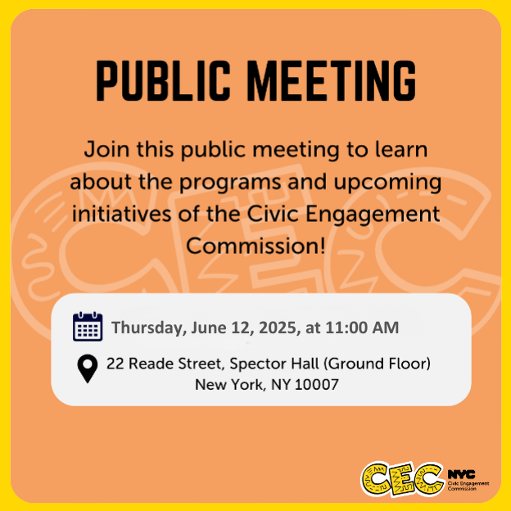
Public Meeting
June 12, 2025

Slide 2
Technology & Housekeeping
To Commissioners:
In-Person Participants: Please mute your microphone when you're not speaking and turn it on when needed
To Online Participants: Please mute your microphone when you're not speaking. Feel free to unmute and let us know when you'd like to offer a comment, since we cannot see you.
To All Participants: ​
Call participants in the order they have registered for public comment prior to meeting, then during today's meeting​
Closed Captioning:​ Closed Captioning will be displayed on the smaller screen​
​
To In-Person Participants:​
To submit a public comment, please add your name and affiliation to the sign in sheet by the door. We will call on you to speak in order received.​
To Online Participants:​
To submit a public comment, please submit your name, affiliation, and public comment via email to info@civicengagement.nyc.gov or via text to 917-587-9103. We will read comments in order received.

Slide 3
Agenda
Attendance​
Approval of Meeting Minutes from April 3, 2025
Poll Site Resolution - Vote
Program Updates
  Voter Language Assistance
  The People’s Money Participatory Budgeting
        Project Implementation
  Digital Equity Presentation
  Ad Campaigns—PB & VLA
  Relational Organizing
Independent Guest Office Guest Presentation
Public Comment

Slide 4
Approval of Meeting Minutes

Slide 5
Voter Language Assistance Methodology
Resolution

Slide 6
Program Updates

Slide 7
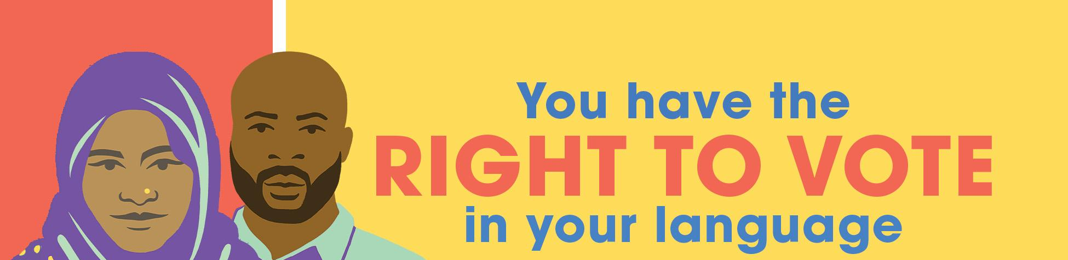
Voter Language
Assistance Program

Slide 8
American Community Survey Data 2017-2021
American Community Survey Data 2019-2023
Language | CVALEP Population | Percent Share
Arabic | 15,494 | 7.1%
Bengali | 12,226 | 5.6%
Chinese (incl. Mandarin, Cantonese) | 10,147 | 4.6%
French | 11,377 | 5.2%
Haitian | 20,961 | 9.6%
Italian | 15,934 | 7.3%
Korean | 4,652 | 2.1%
Polish | 14,225 | 6.5%
Russian | 85,845 | 39.2%
Urdu | 11,641 | 5.3%
Yiddish | 16,710 | 7.6%
Language | CVALEP Population | Percent Share (%)
Arabic | 17576 | 7.77%
Bengali | 13834 | 6.11%
Chinese (incl. Mandarin, Cantonese) | 12908 | 5.71%
French | 10772 | 4.76%
Haitian | 21518 | 9.51%
Italian | 14698 | 6.50%
Korean | 4858 | 2.15%
Polish | 13774 | 6.09%
Russian | 84308 | 37.26%
Urdu | 11679 | 5.16%
Yiddish | 20317 | 8.98%
7. Polling place allotment. The number of polling places that will receive oral language assistance services in a program eligible language will depend on such language’s share of the total CVALEP population in the program eligible jurisdictions. Each program eligible language’s percentage share of the total number of polling places served is as follows:

Slide 9

Senate District 22
Special Election
7 unique poll sites, total 14 language services over the last three days of Early Voting
21 Election Day poll sites with a total of 24 language services on Election Day May 20
32 voters assisted total
1 poll site (Korean) served
Council District 51 Special Election

Slide 10
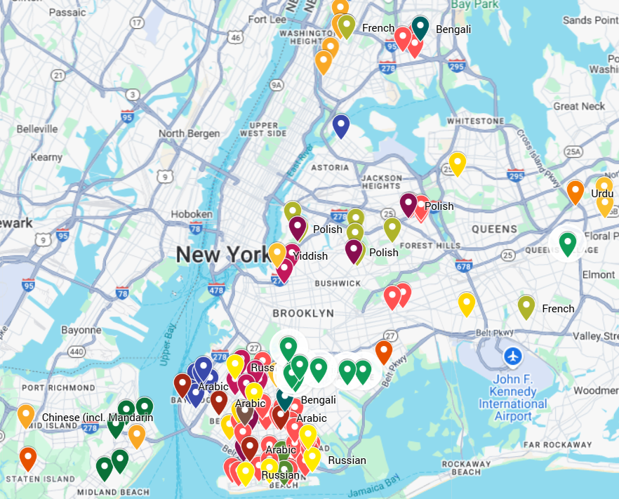
VLA Services for the June Primary Election
26 Unique Early Voting Poll Sites, total 46 language services
90 Unique Election Day Poll Site, total 94 language services

Slide 11
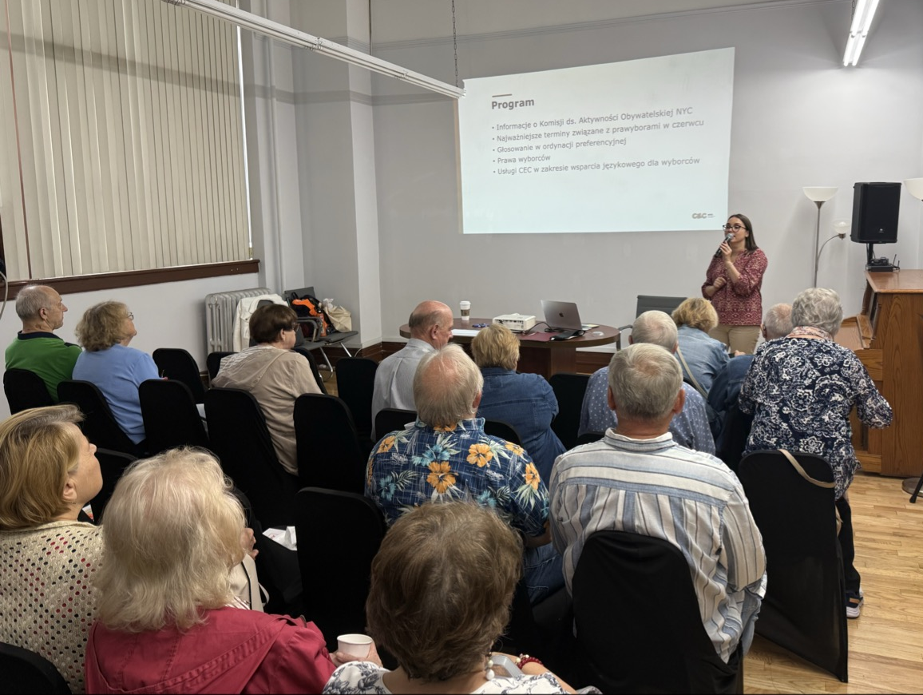
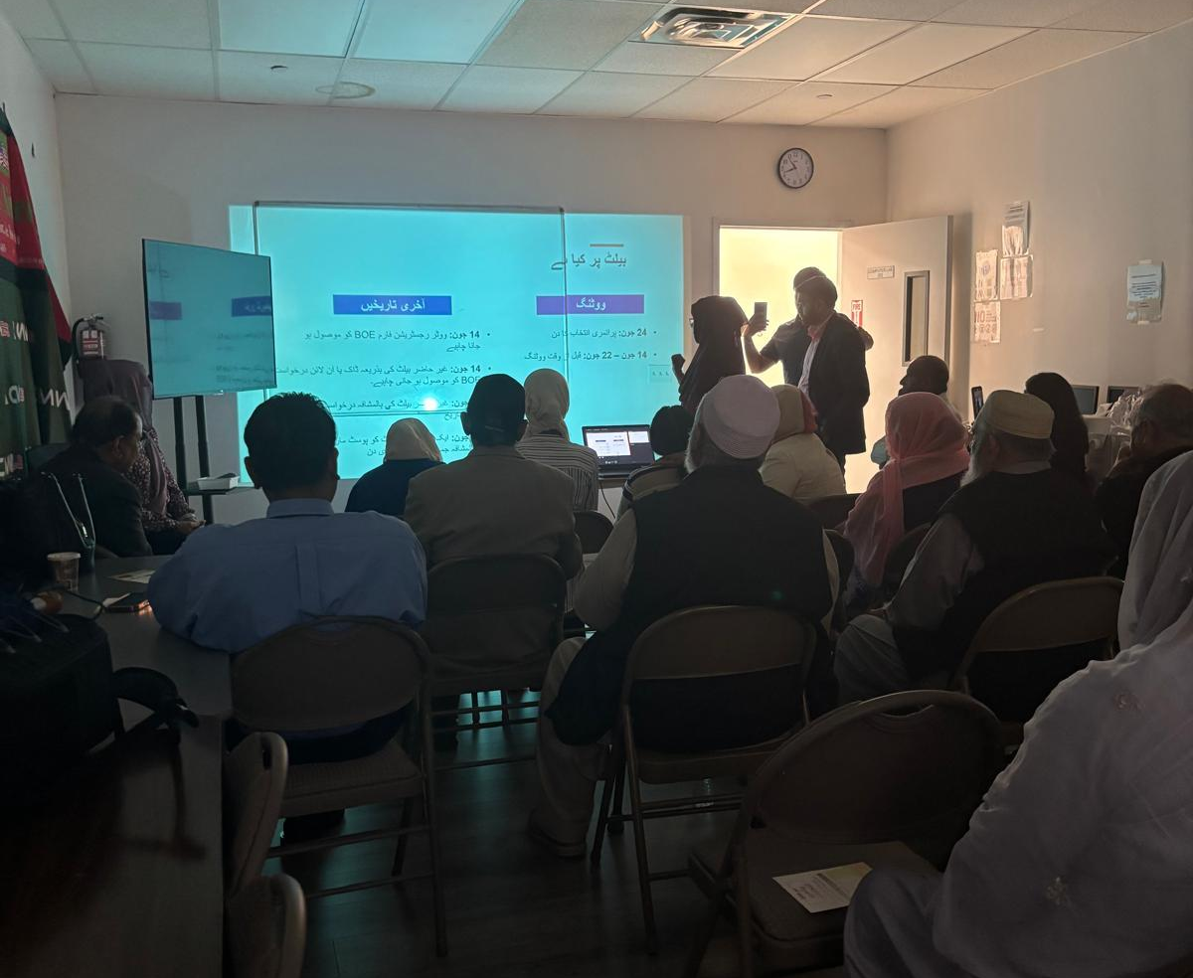
Voter Language Workshops
BX – Bengali: Parkchester BK - Bengali: Cypress Hills
BK - Haitian: Canarsie, Flatbush
BK - Polish: Greenpoint
BK - Arabic: Bay Ridge
BK - Russian: Brighton Beach, Coney Island, Sheepshead Bay
BK - Urdu: Bensonhurst, Brighton Beach, Midwood
SI - Korean: Willowbrook QN - Arabic: Astoria

Slide 12
Additional Outreach for Primary
Southern Brooklyn | Russian
68th Street and 5th Avenue in Brooklyn, NY 11220 | Arabic
Parkchester, BX | Bangla & French
Williamsburg Community | Yiddish
Little Haiti | Haitian
City-wide | Arabic
5210 4th Ave Brooklyn, NY 11220 | Arabic
211 Neptune Ave, Brooklyn, NY 11235 | Urdu
Bay Ridge | Arabic,
Parkchester | Bangla

Slide 13
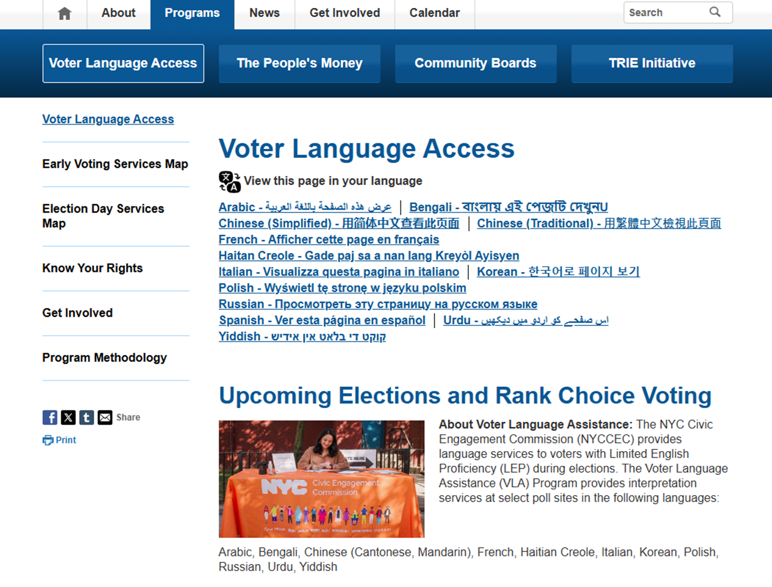
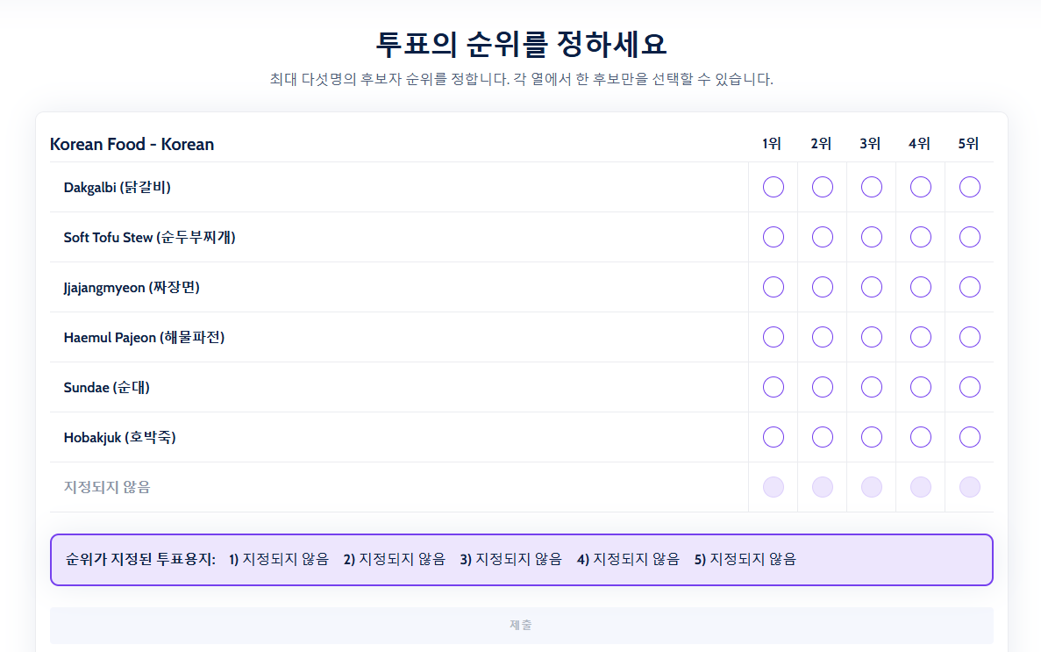
Website: on.nyc.gov/vla
Notes:
App.rankedvote.co/rv/v5adeo4fjd4lbc3v9/vote

Slide 14
Multi-language Digdital Toolkit
https://docs.google.com/document/d/172VqswyFJHkK6Ydm1TkOE_wZgHPlTY3ycxXIsow9pqI/edit?usp=sharing

Slide 17


Slide 18

The top 5 projects will be funded.
The Bronx Ballot ($200,000/project)
  Multi-Lingual Community Mental Health Program
  STEAM Enrichment for Bronx Youth and Teens
  Golden Years: Financial Guidance for Older Adults
  Connecting Veterans
  Support People with Housing Advocacy Groups
  Youth-Led Performing Arts Program
  Cross-Generational Support: Building Community Connections with Service
  Guiding Stars: Mentorship for Justice-Involved Youth & Emerging Adults
  Support for Parents and Guardians of Amazing Special Kids
  Healthy Food & Literary Nights for Families & Individuals

Slide 19
The top 5 projects will be funded.
The Brooklyn Ballot ($235,000/project)
  Youth Employment Training and Partnerships
  Young Parent Support and Classes
  Intergenerational Financial Education and Employment Workshops
  Job Training and Support for Employment for Single Parents
  Youth Led Community Ventures
  Youth LGBTQ+ Safe Space
  Community Kitchen with Classes
  Youth Job Training and Employment Opportunities
  Reducing Recidivism Rates
  Period Pantry for Feminine Hygiene Supplies and Education

Slide 20
The top 4 projects will be funded.
The Manhattan Ballot ($165,000/project)
  Youth Entrepreneurship Program
  Strengthening Mental Muscles
  Intergenerational Mentorships
  Cross-Cultural English classes
  Everyone Should be Able to Swim
  Start up Music Program for Children
  Parenting Classes with Childcare
  Learn to Grow and Cook Your Own Food
  Civic Education for All
  Vocational Training for Middle and High School Students

Slide 21
The top 5 projects will be funded.
The Queens Ballot ($195,000/project)
  Pathways to a Successful College Career
  Far Rockaway Community Justice Collective
  Housing Workshops for Older Adult
  Pathway to Professions for Youth
  Saving for Your Future
  Rosedale Cancer Support Network
  Speak Up NYC
  The People's Theater
  Justice-Impacted Fellowship Program
  Empowered with Opportunity

Slide 22
The top project will be funded.
The Staten Island Ballot ($190,000)
  Family, Food, and Conversation
  Staten Island Youth Internship Program
  Media Literacy Workshops
  Performance Arts Program for Youth
  Tenant Connect
  Drug Use and Overdose Prevention Education

Slide 23
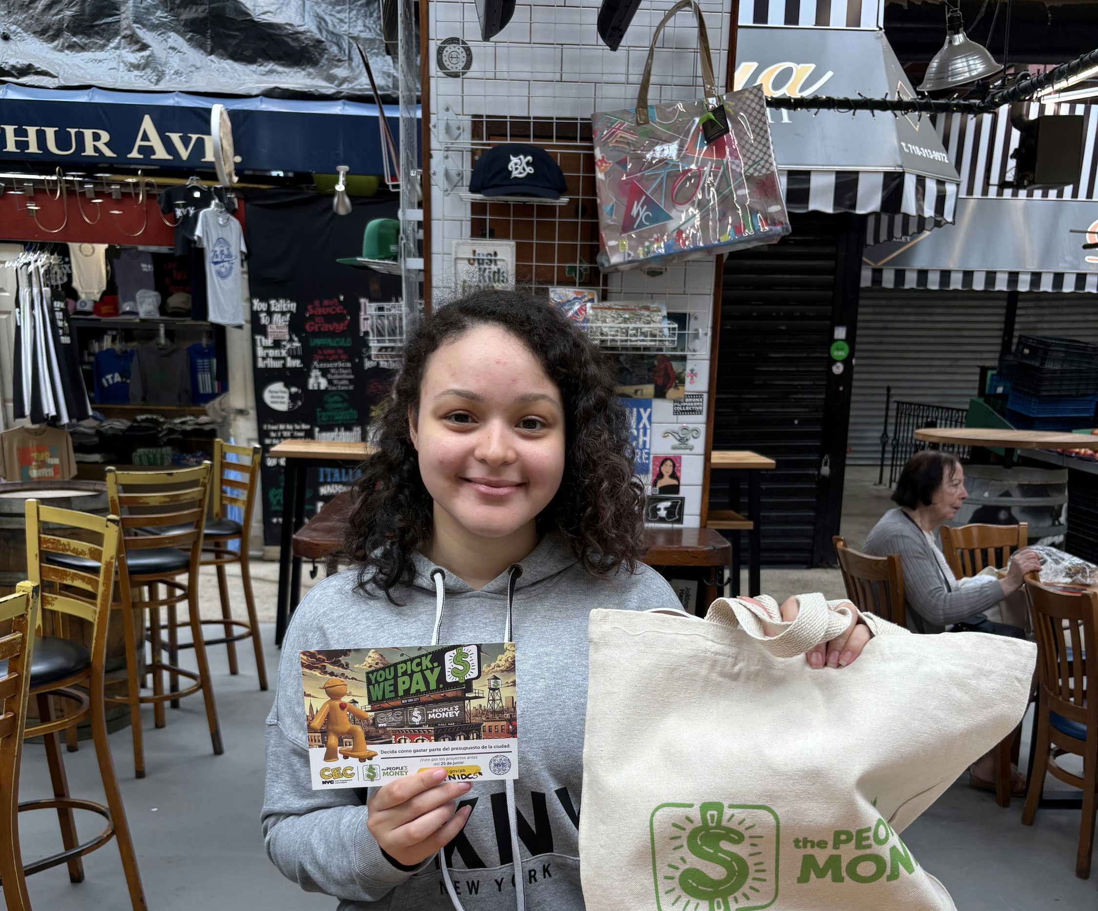
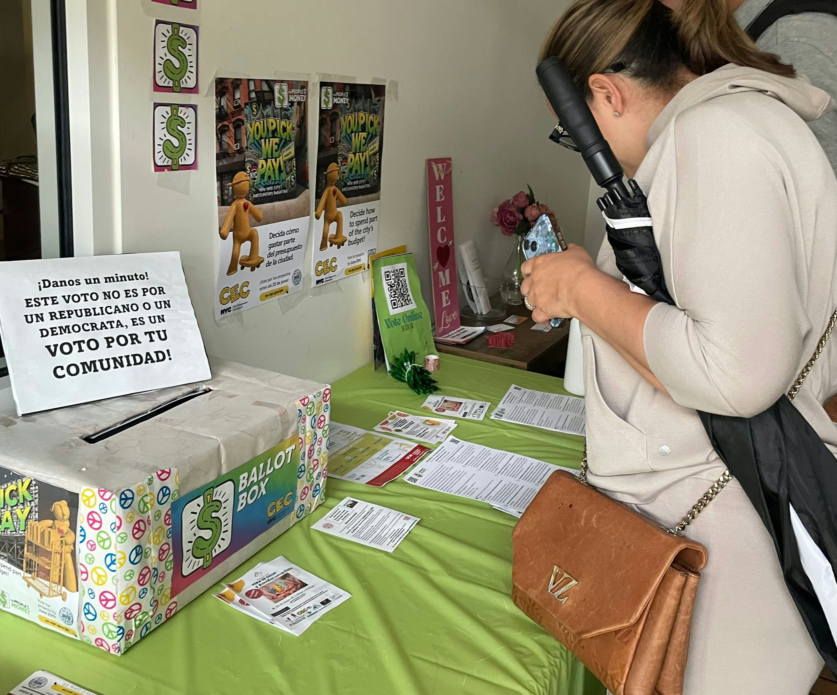
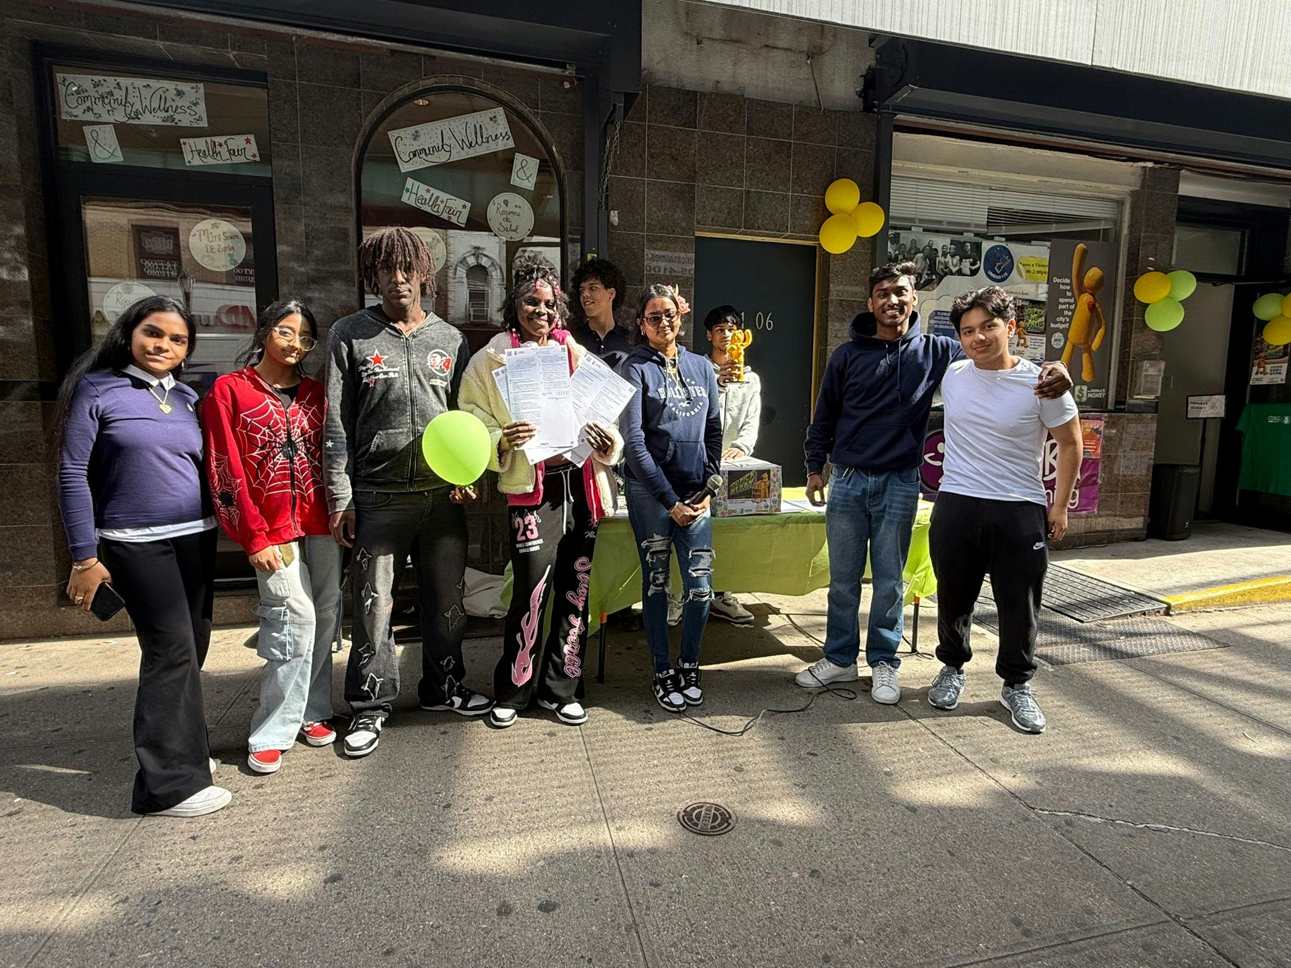
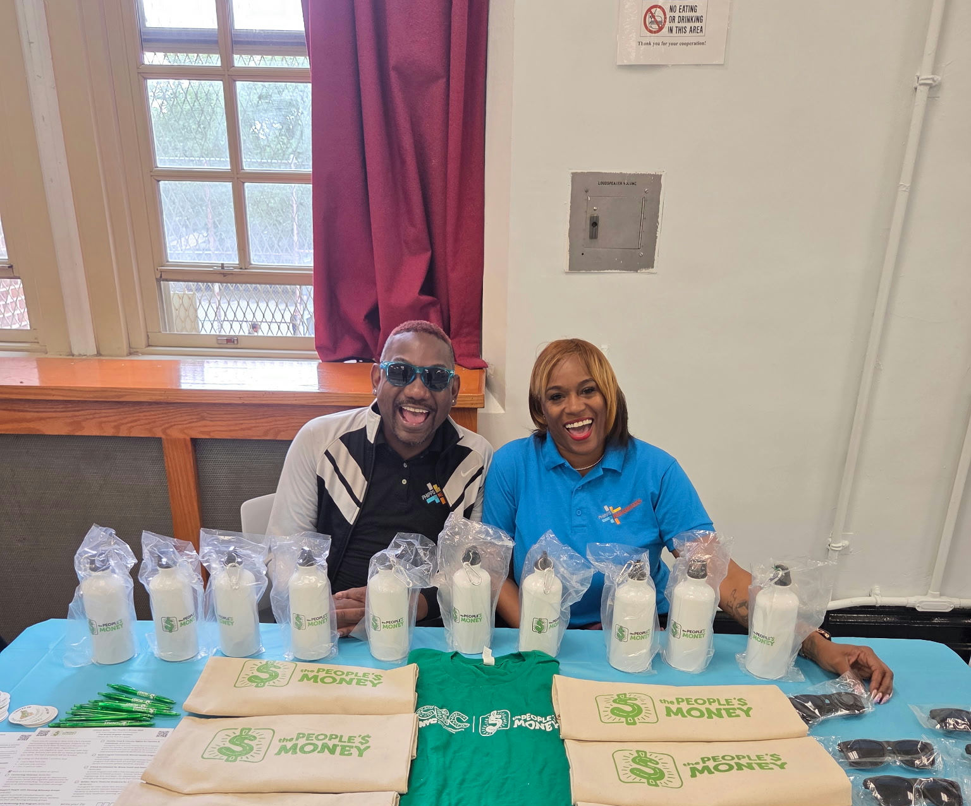

Slide 24
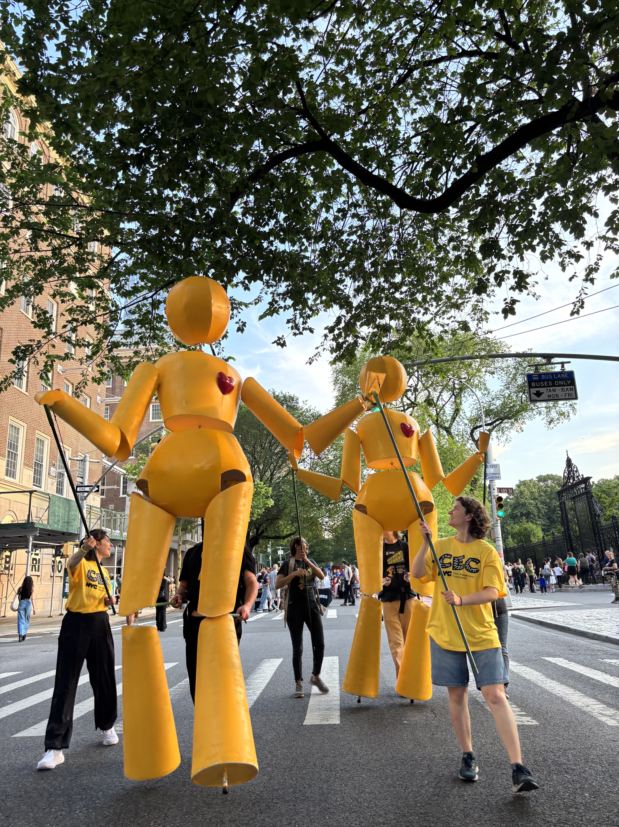
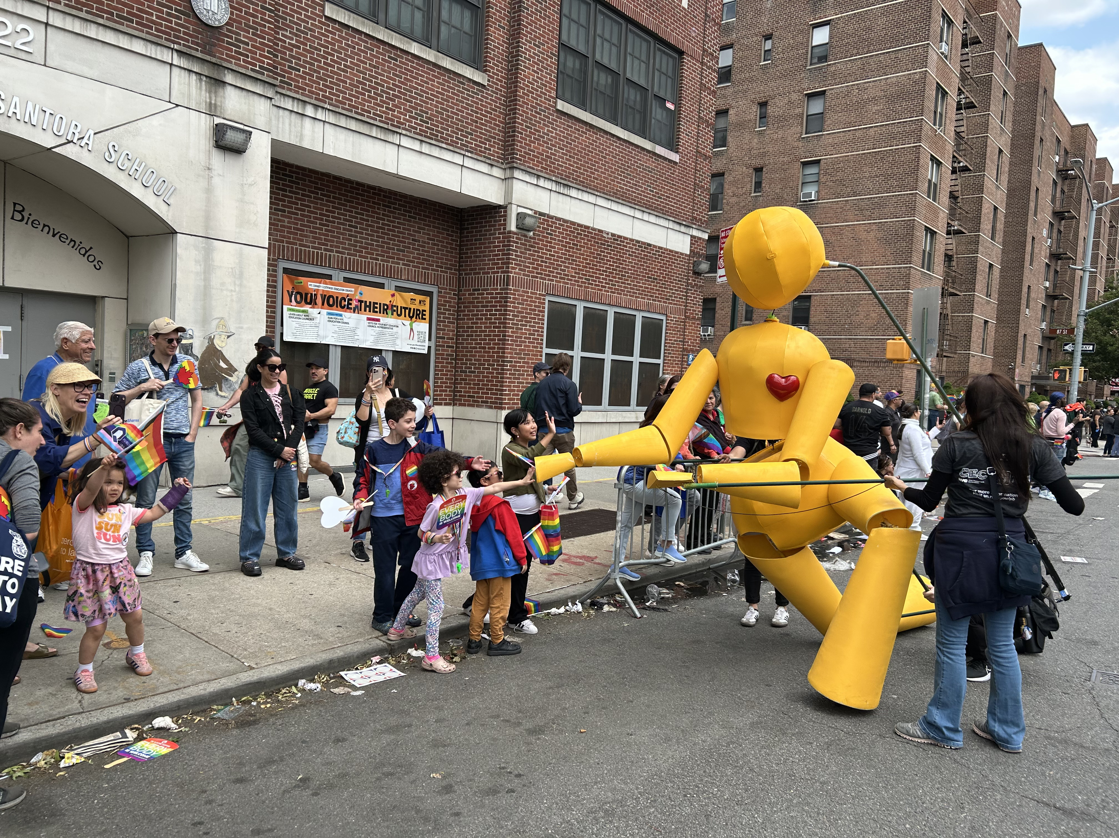
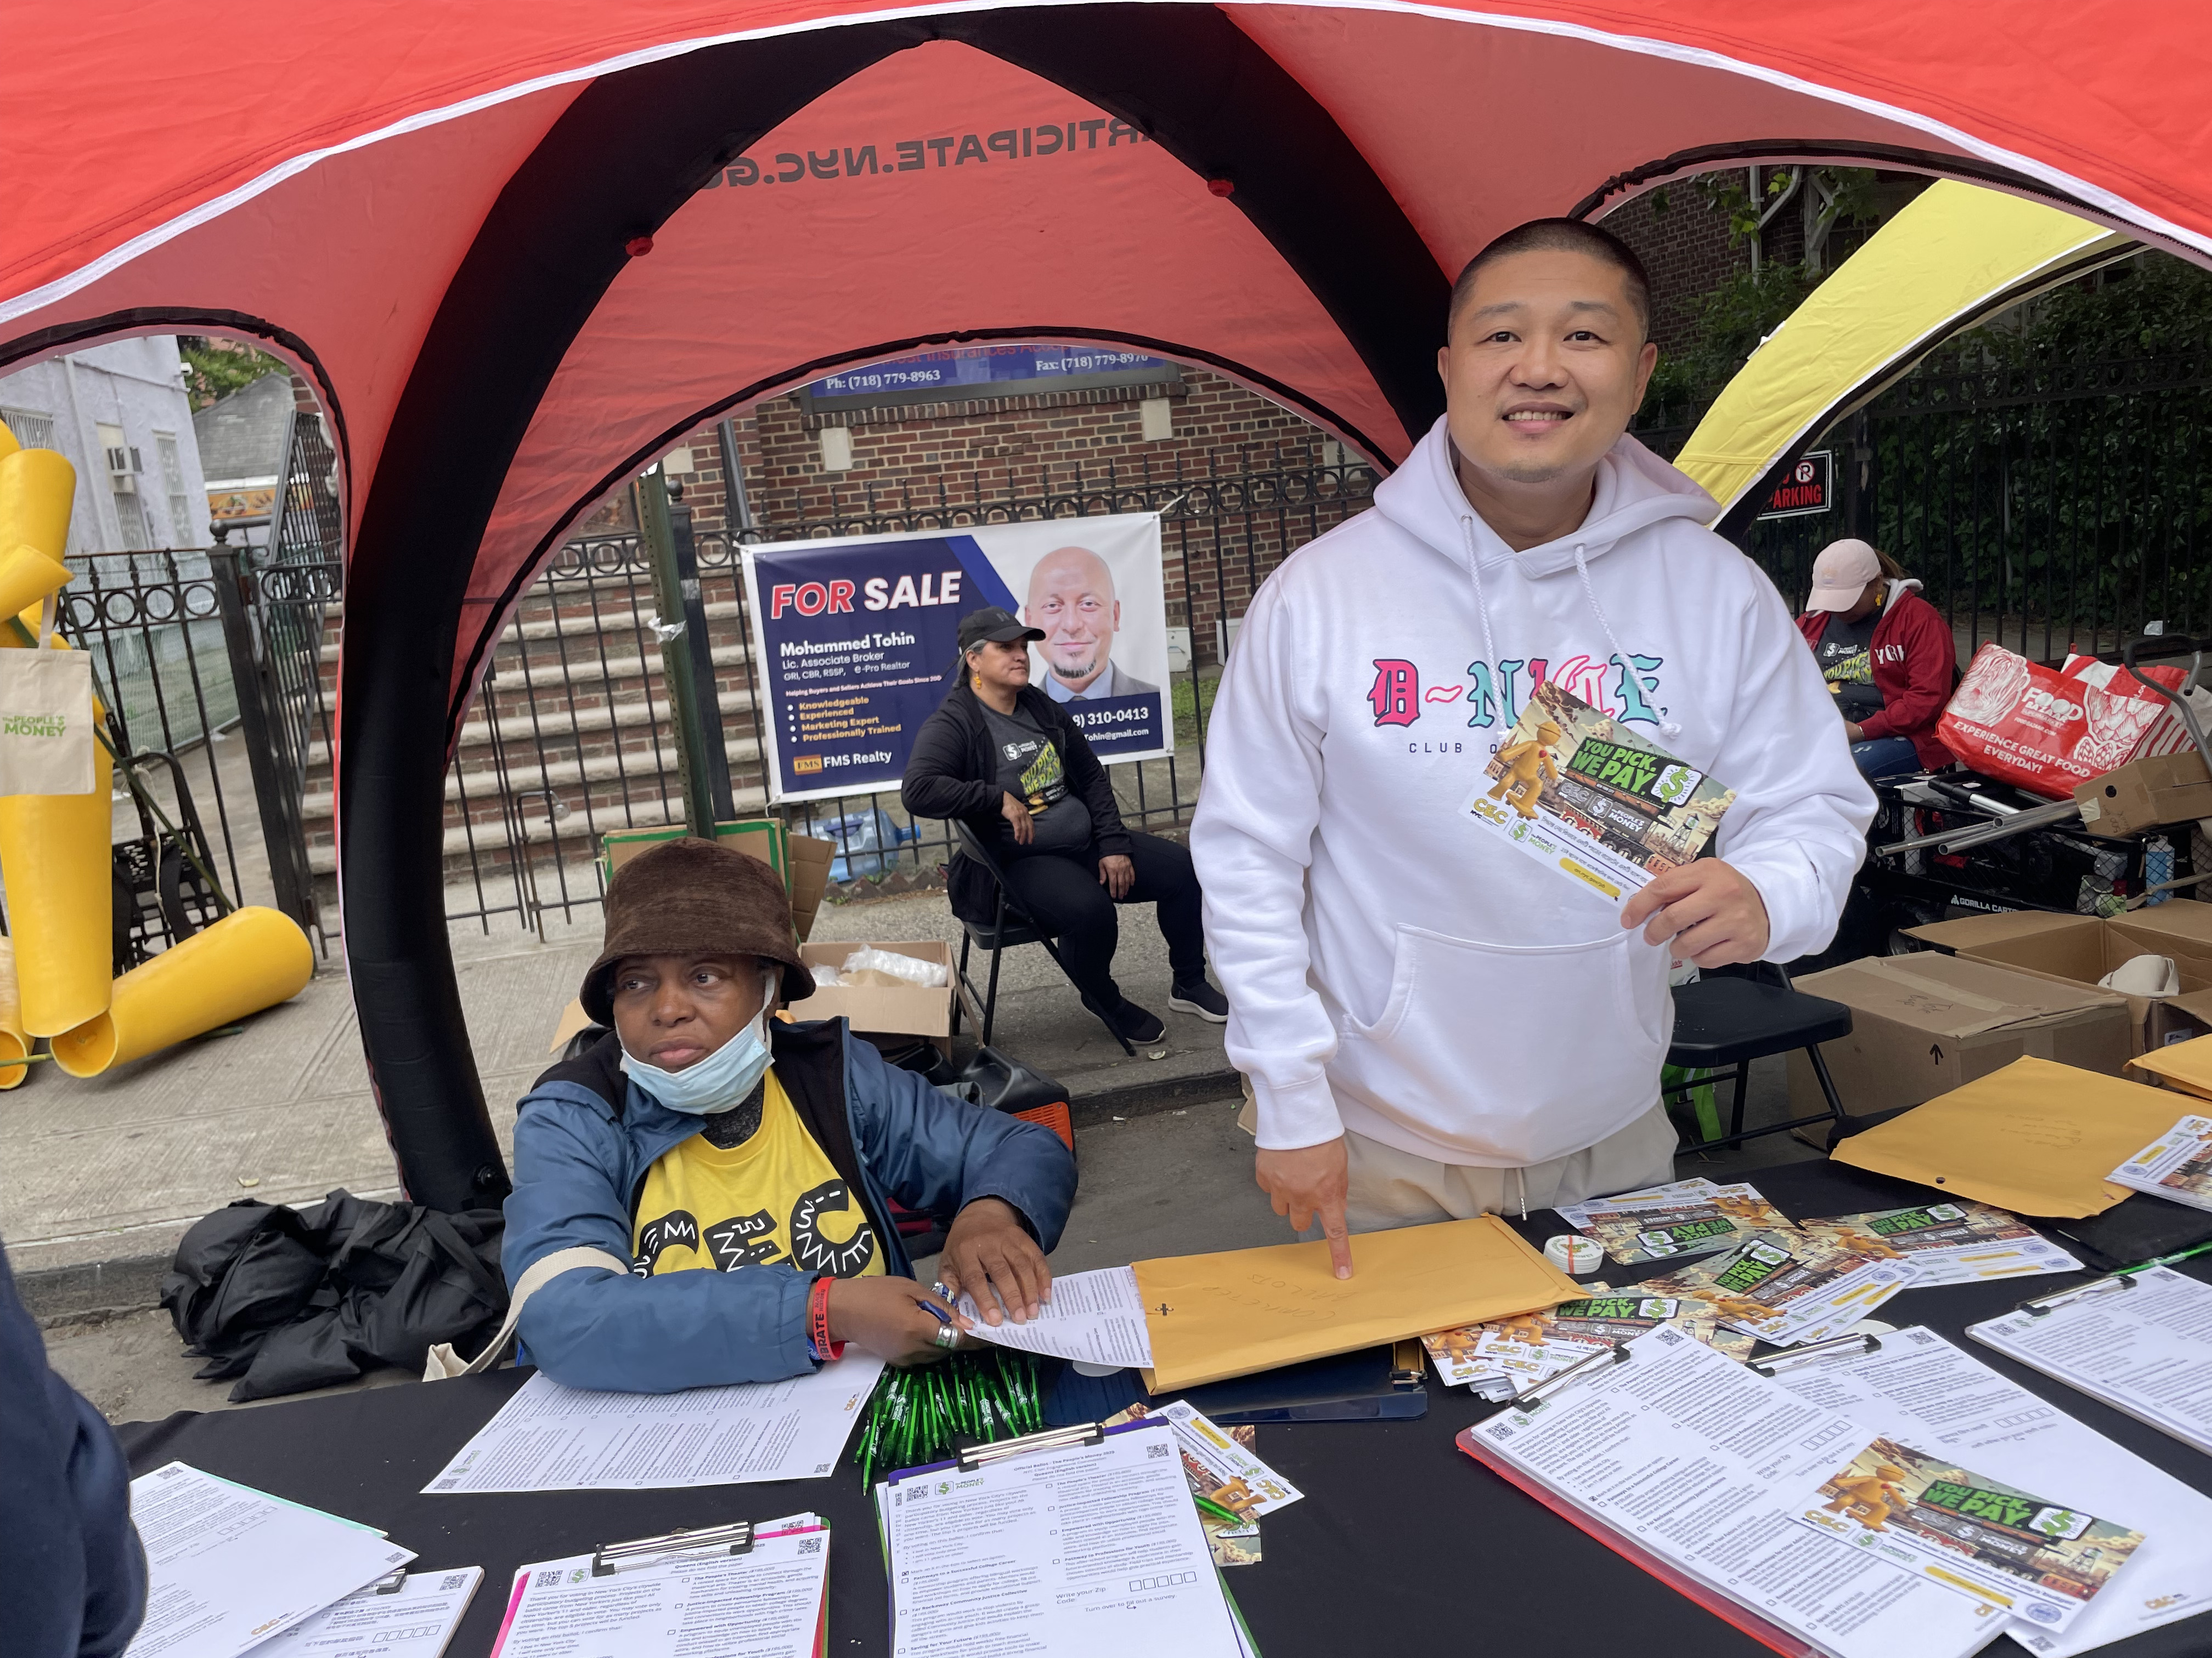
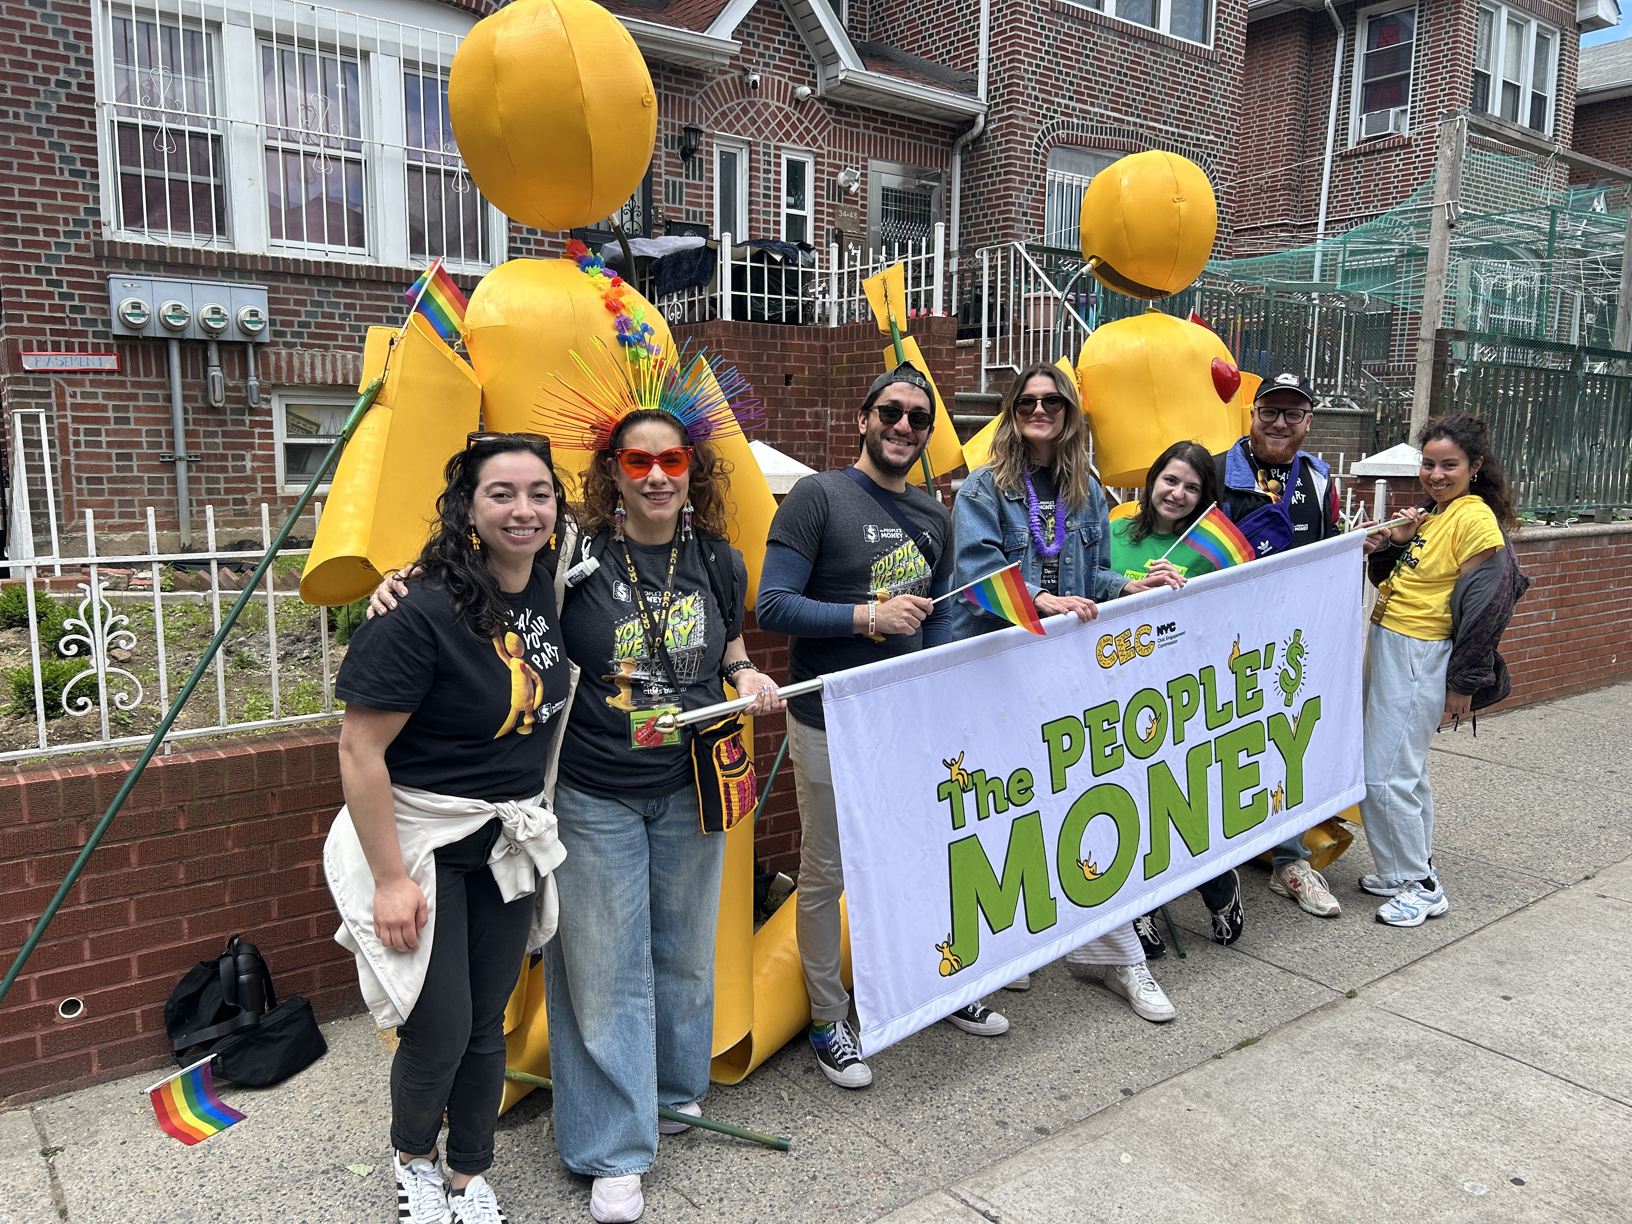
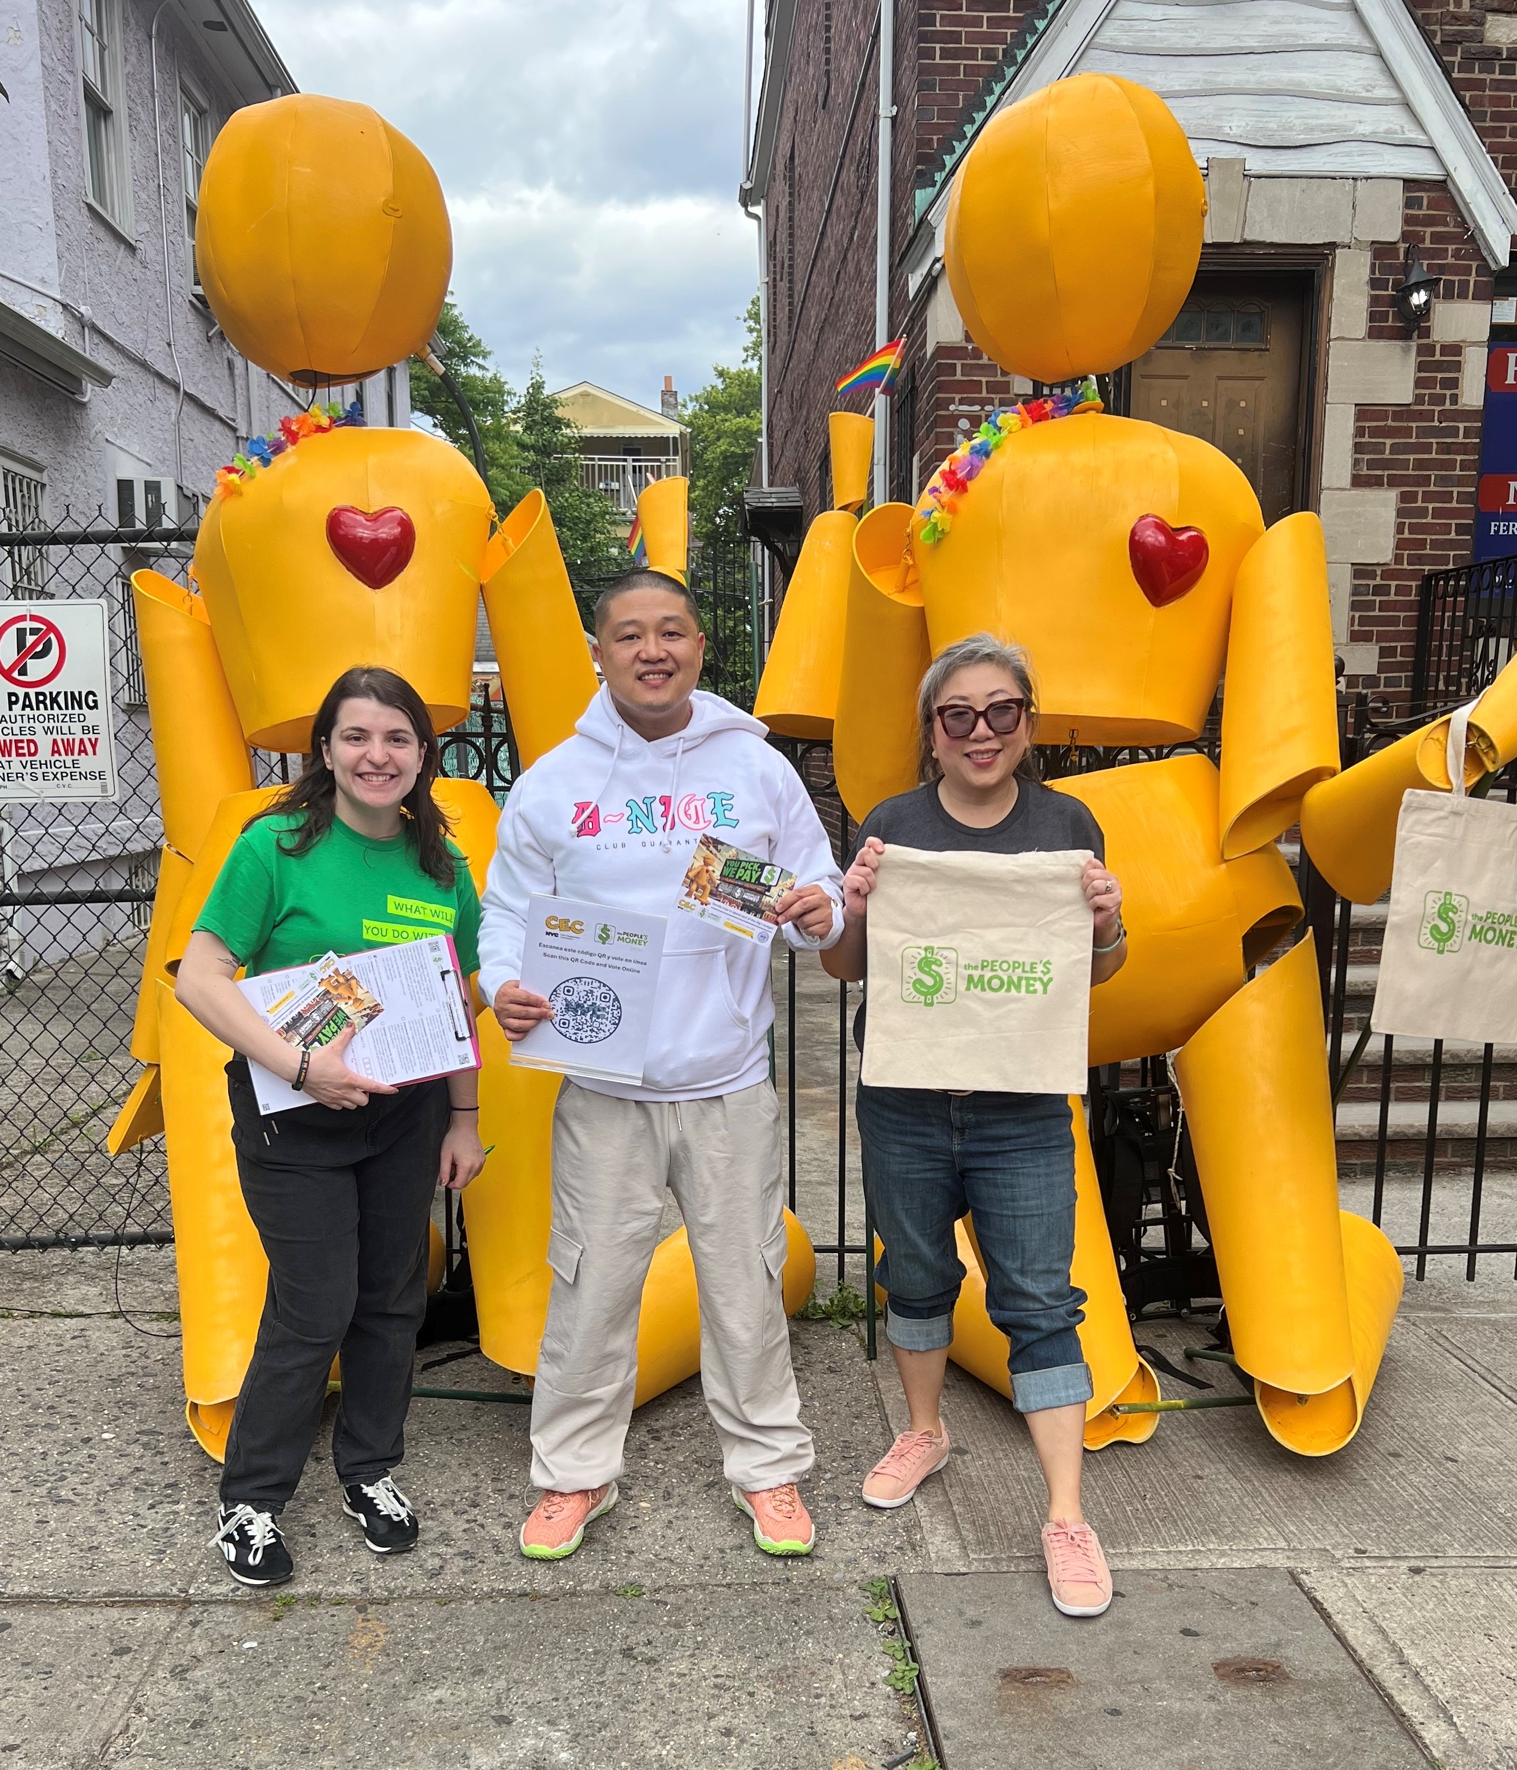
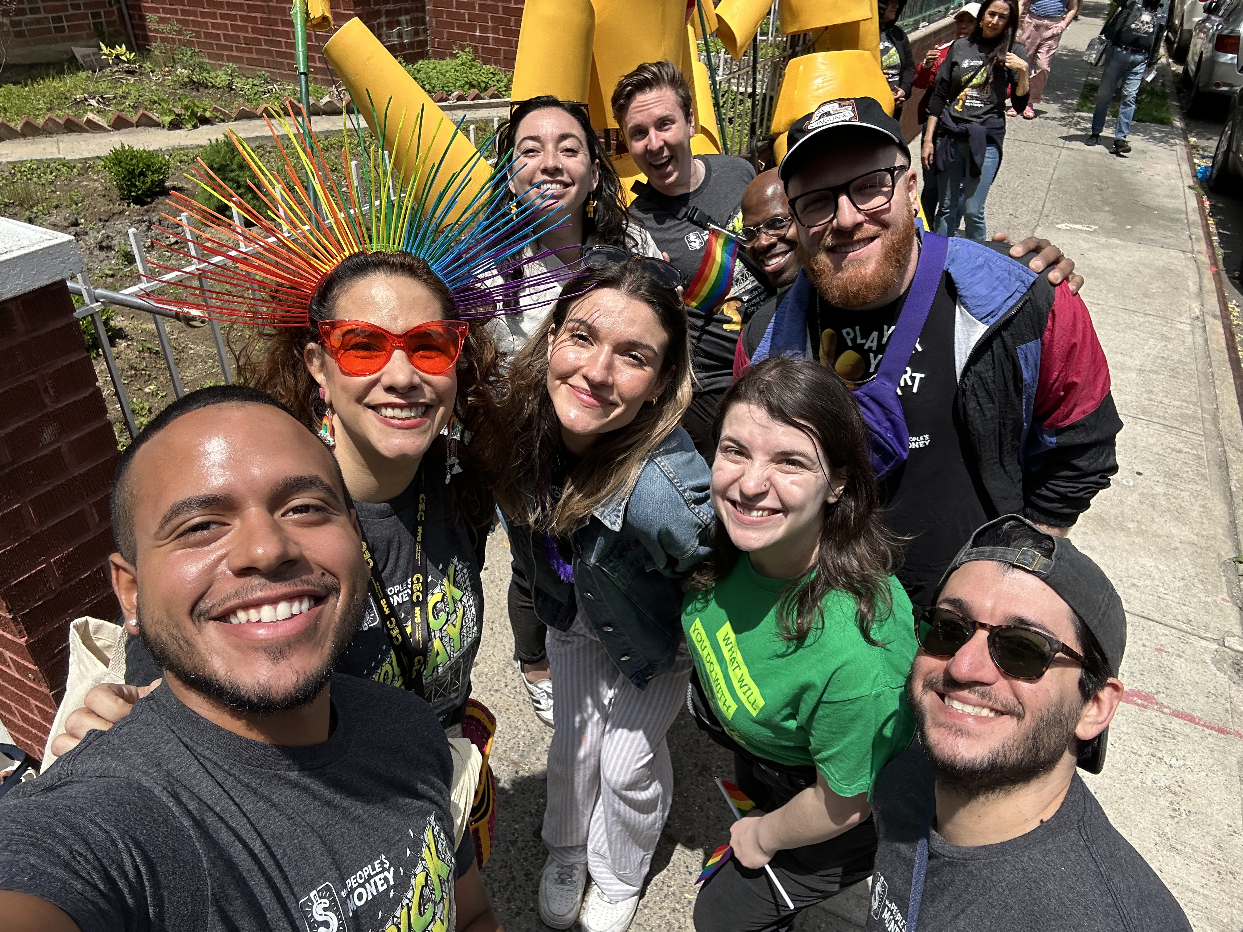

Slide 25
Votes Collected
Queens: 4,868 Paper + 2,586 Digital = 7,455 total
Brooklyn: 4,145 Paper + 1,535 Digital = 5,680 total
Bronx: 3,475 Paper +1,435 Digital = 4,910 total
Staten Island: 2,246 Paper + 698 Digital = 2,944 total
Manhattan: 1,383 Paper + 982 Digital = 2,365 total
All Boroughs: 16,119 Paper + 7,236 Digital = 23,255 Total
Totals as of Monday 6/9/25

Slide 26
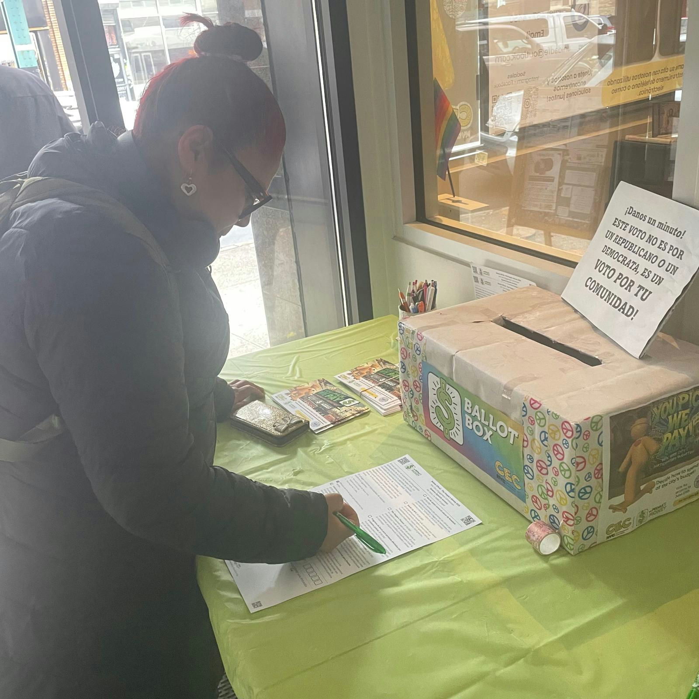
Ballot Boxes
Ballot Boxes are placed in :
24 Queens Public Libraries
25 Brooklyn Public Libraries
46 New York Public Libraries (BX, MH, SI)
118 Additional Partner Sites across the 5 Boroughs

Slide 27
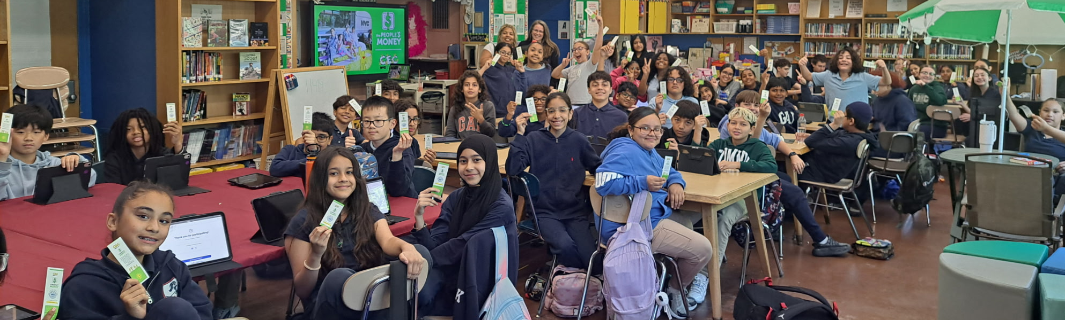
Schools
All School Partnerships
Pending School Vote Sessions | 5
School Vote Sessions w/ PB/TRIE Partners | 114
School Vote Sessions w/ Community Facilitators | 14
Total # of Confirmed School Partnerships | 128

Slide 28
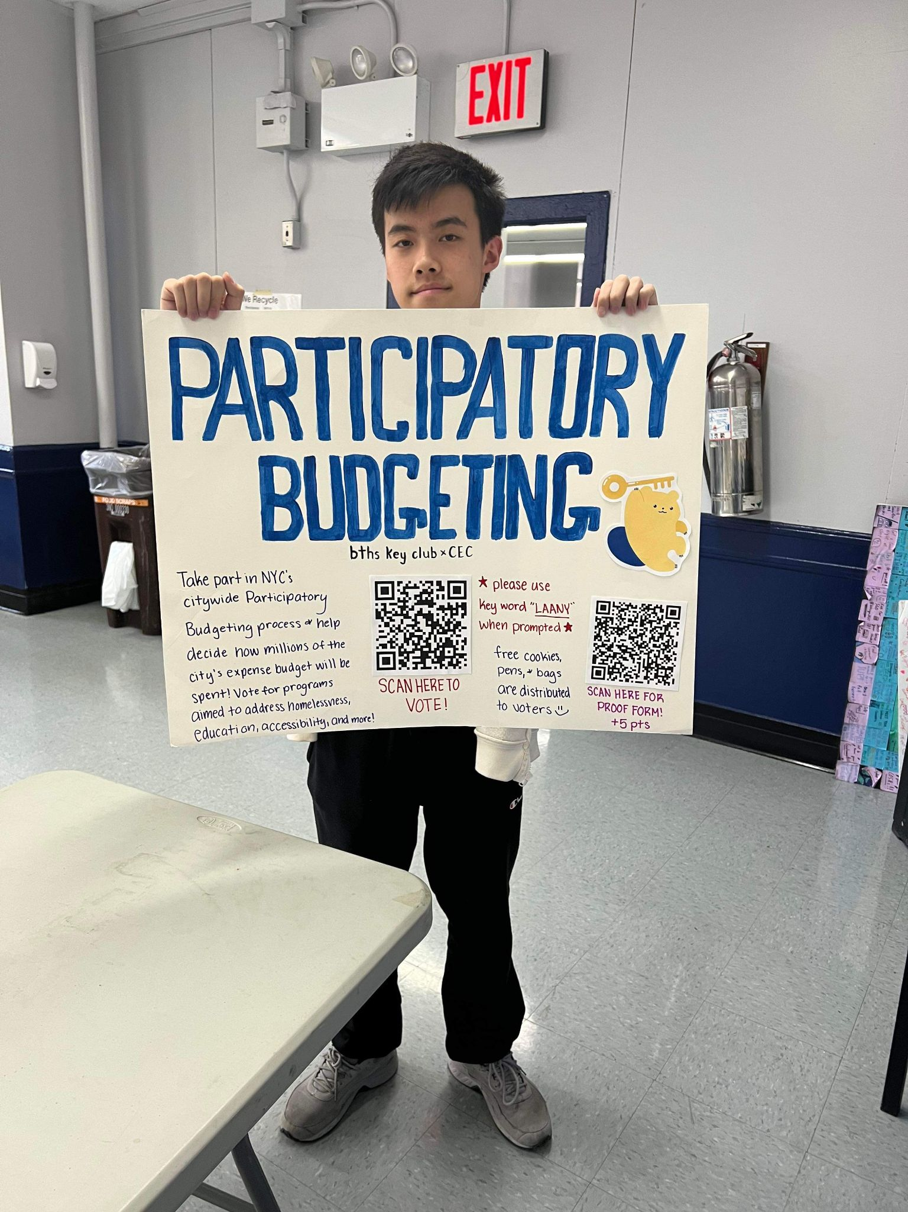
Community Facilitators
Vote Engagements
Completed Vote Engagements | 15
Upcoming Vote Engagements | 12
Total # of Vote Engagements | 27
Vote Engagement Types
Schools | 15
DFTA Older Adult Centers | 7
Other Community Partner (Non-profit, community groups, etc.) | 3
Community Events | 2
Total # of Vote Engagements | 27

Slide 29
PB Ambassadors Update
 | Volunteer Recruitment Goal | Volunteers Recruited
Bronx | 4 | 5
Brooklyn | 8 | 7
Manhattan | 8 | 6
Queens | 8 | 5
Staten Island | 2 | 2
Original goal 32 volunteers to cover 5 boroughs.

Slide 30
PB Ambassadors Update
Ballots Collected | Surveys collected
Manhattan 806 | Manhattan 727
Brooklyn 284 | Brooklyn 281
Queens 186 | Queens 73
Staten Island 334 | Staten Island
Bronx **** still pending | Bronx **** Still pending
** To date**

Slide 31
Project Implementation

Slide 32
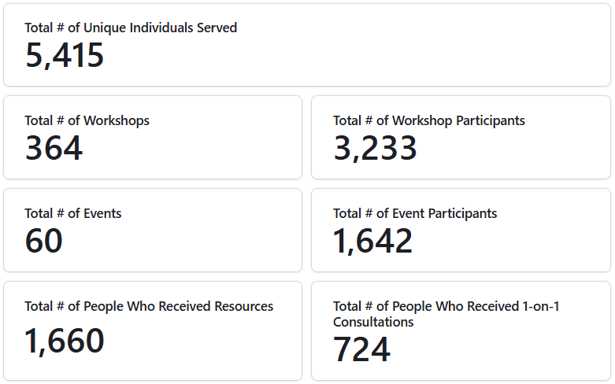
Project Reporting Updates

Slide 33
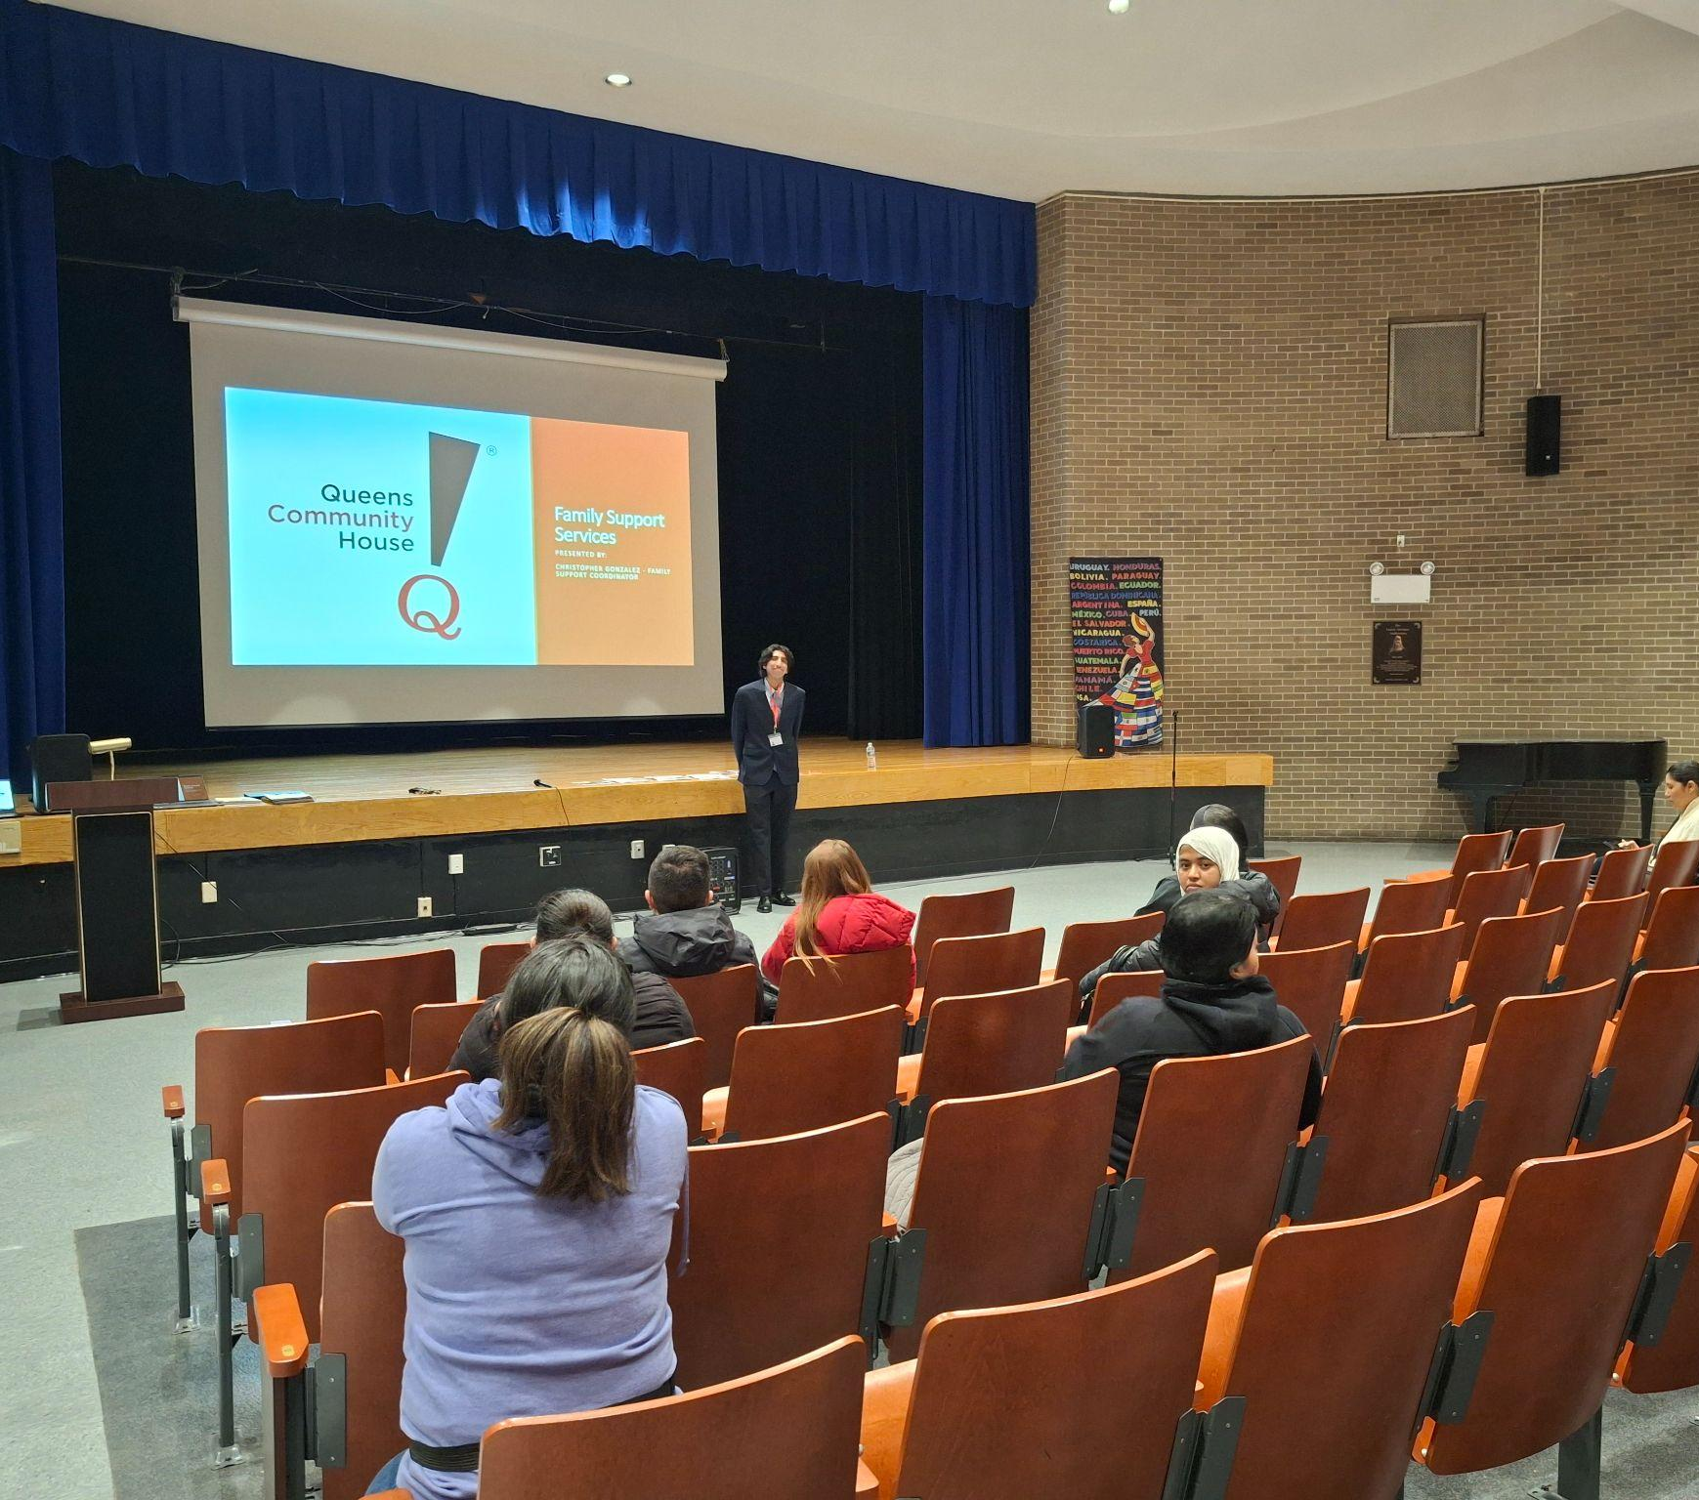
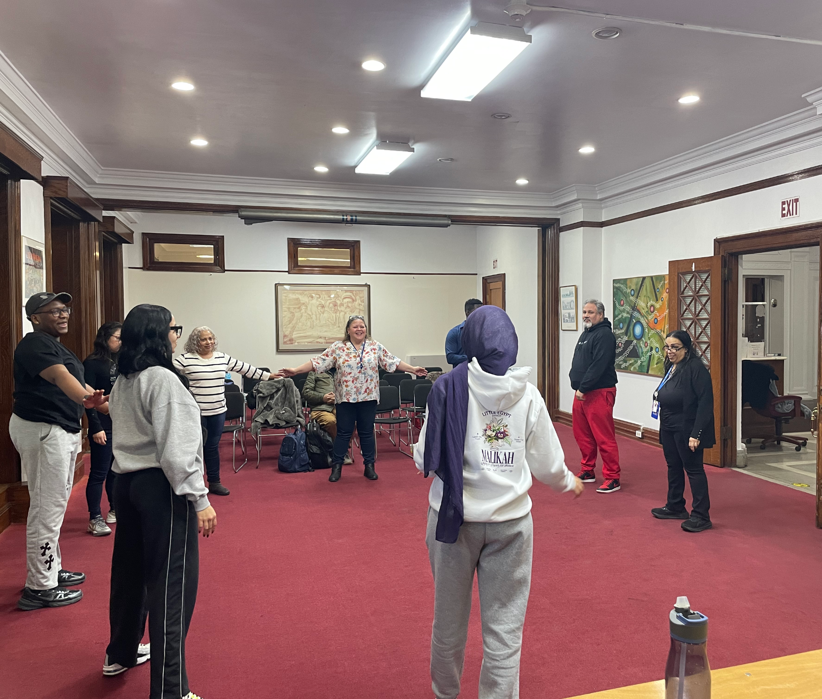
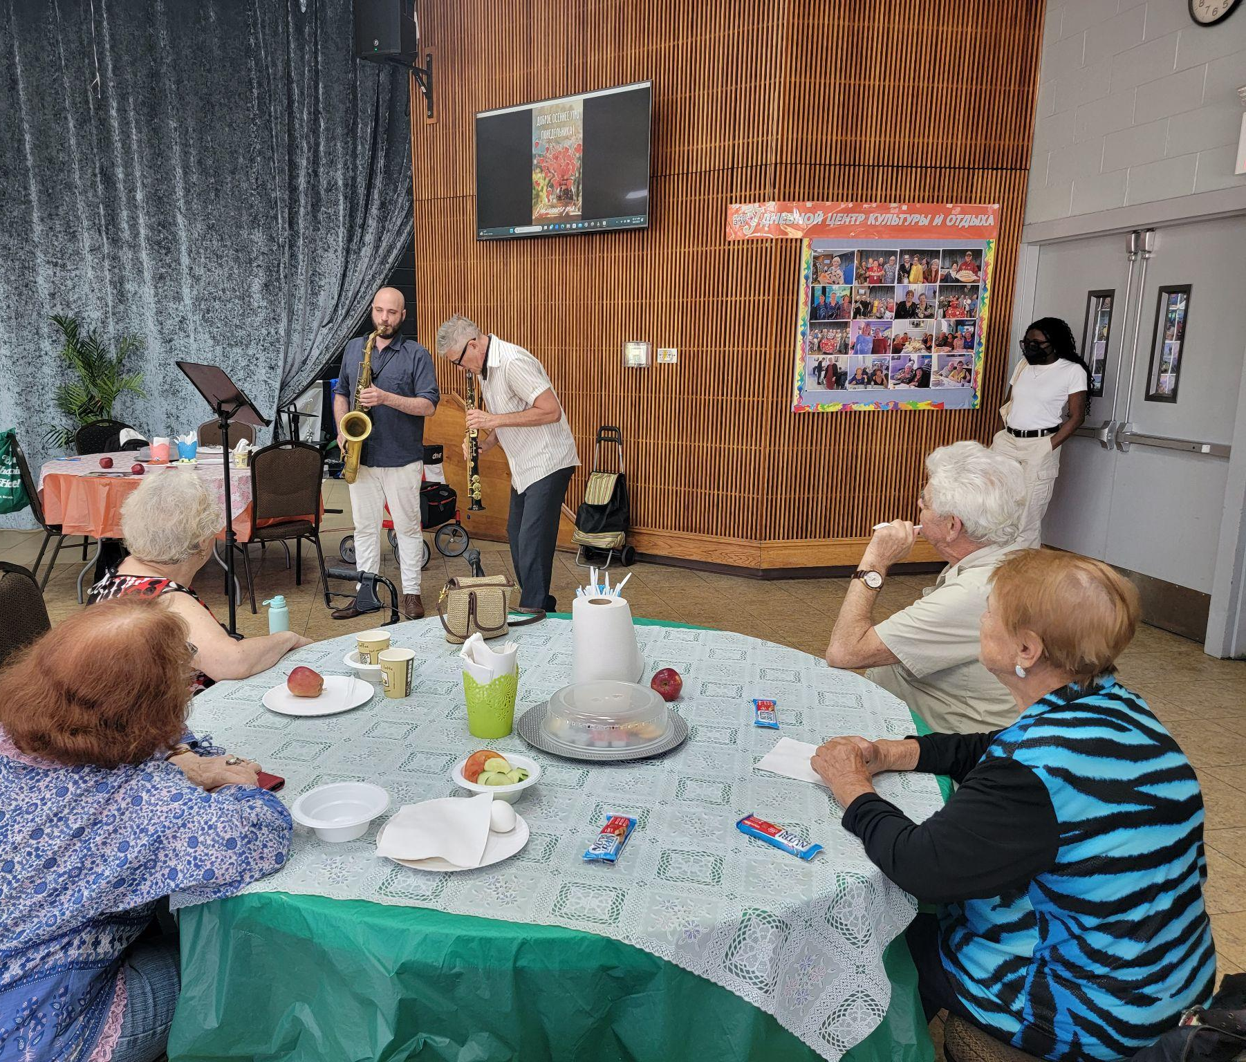
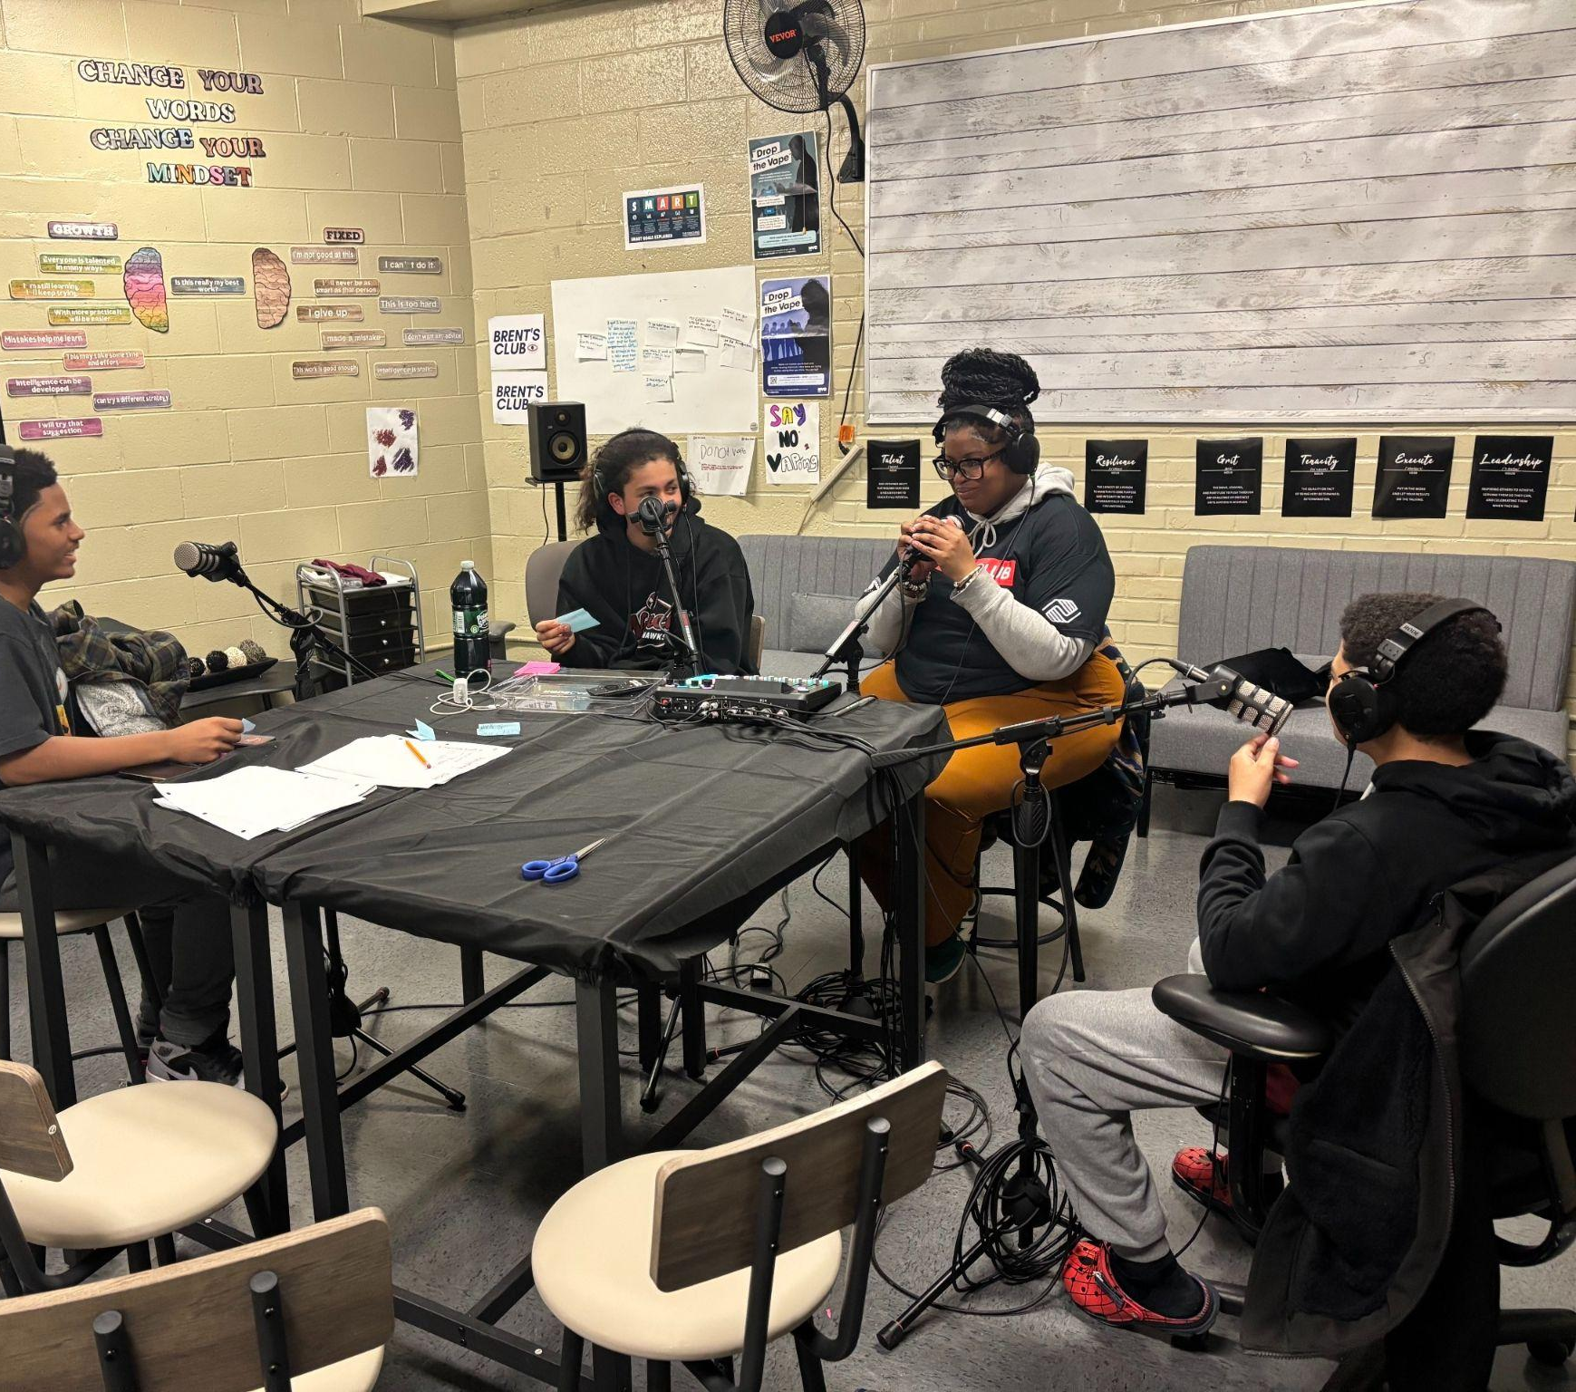
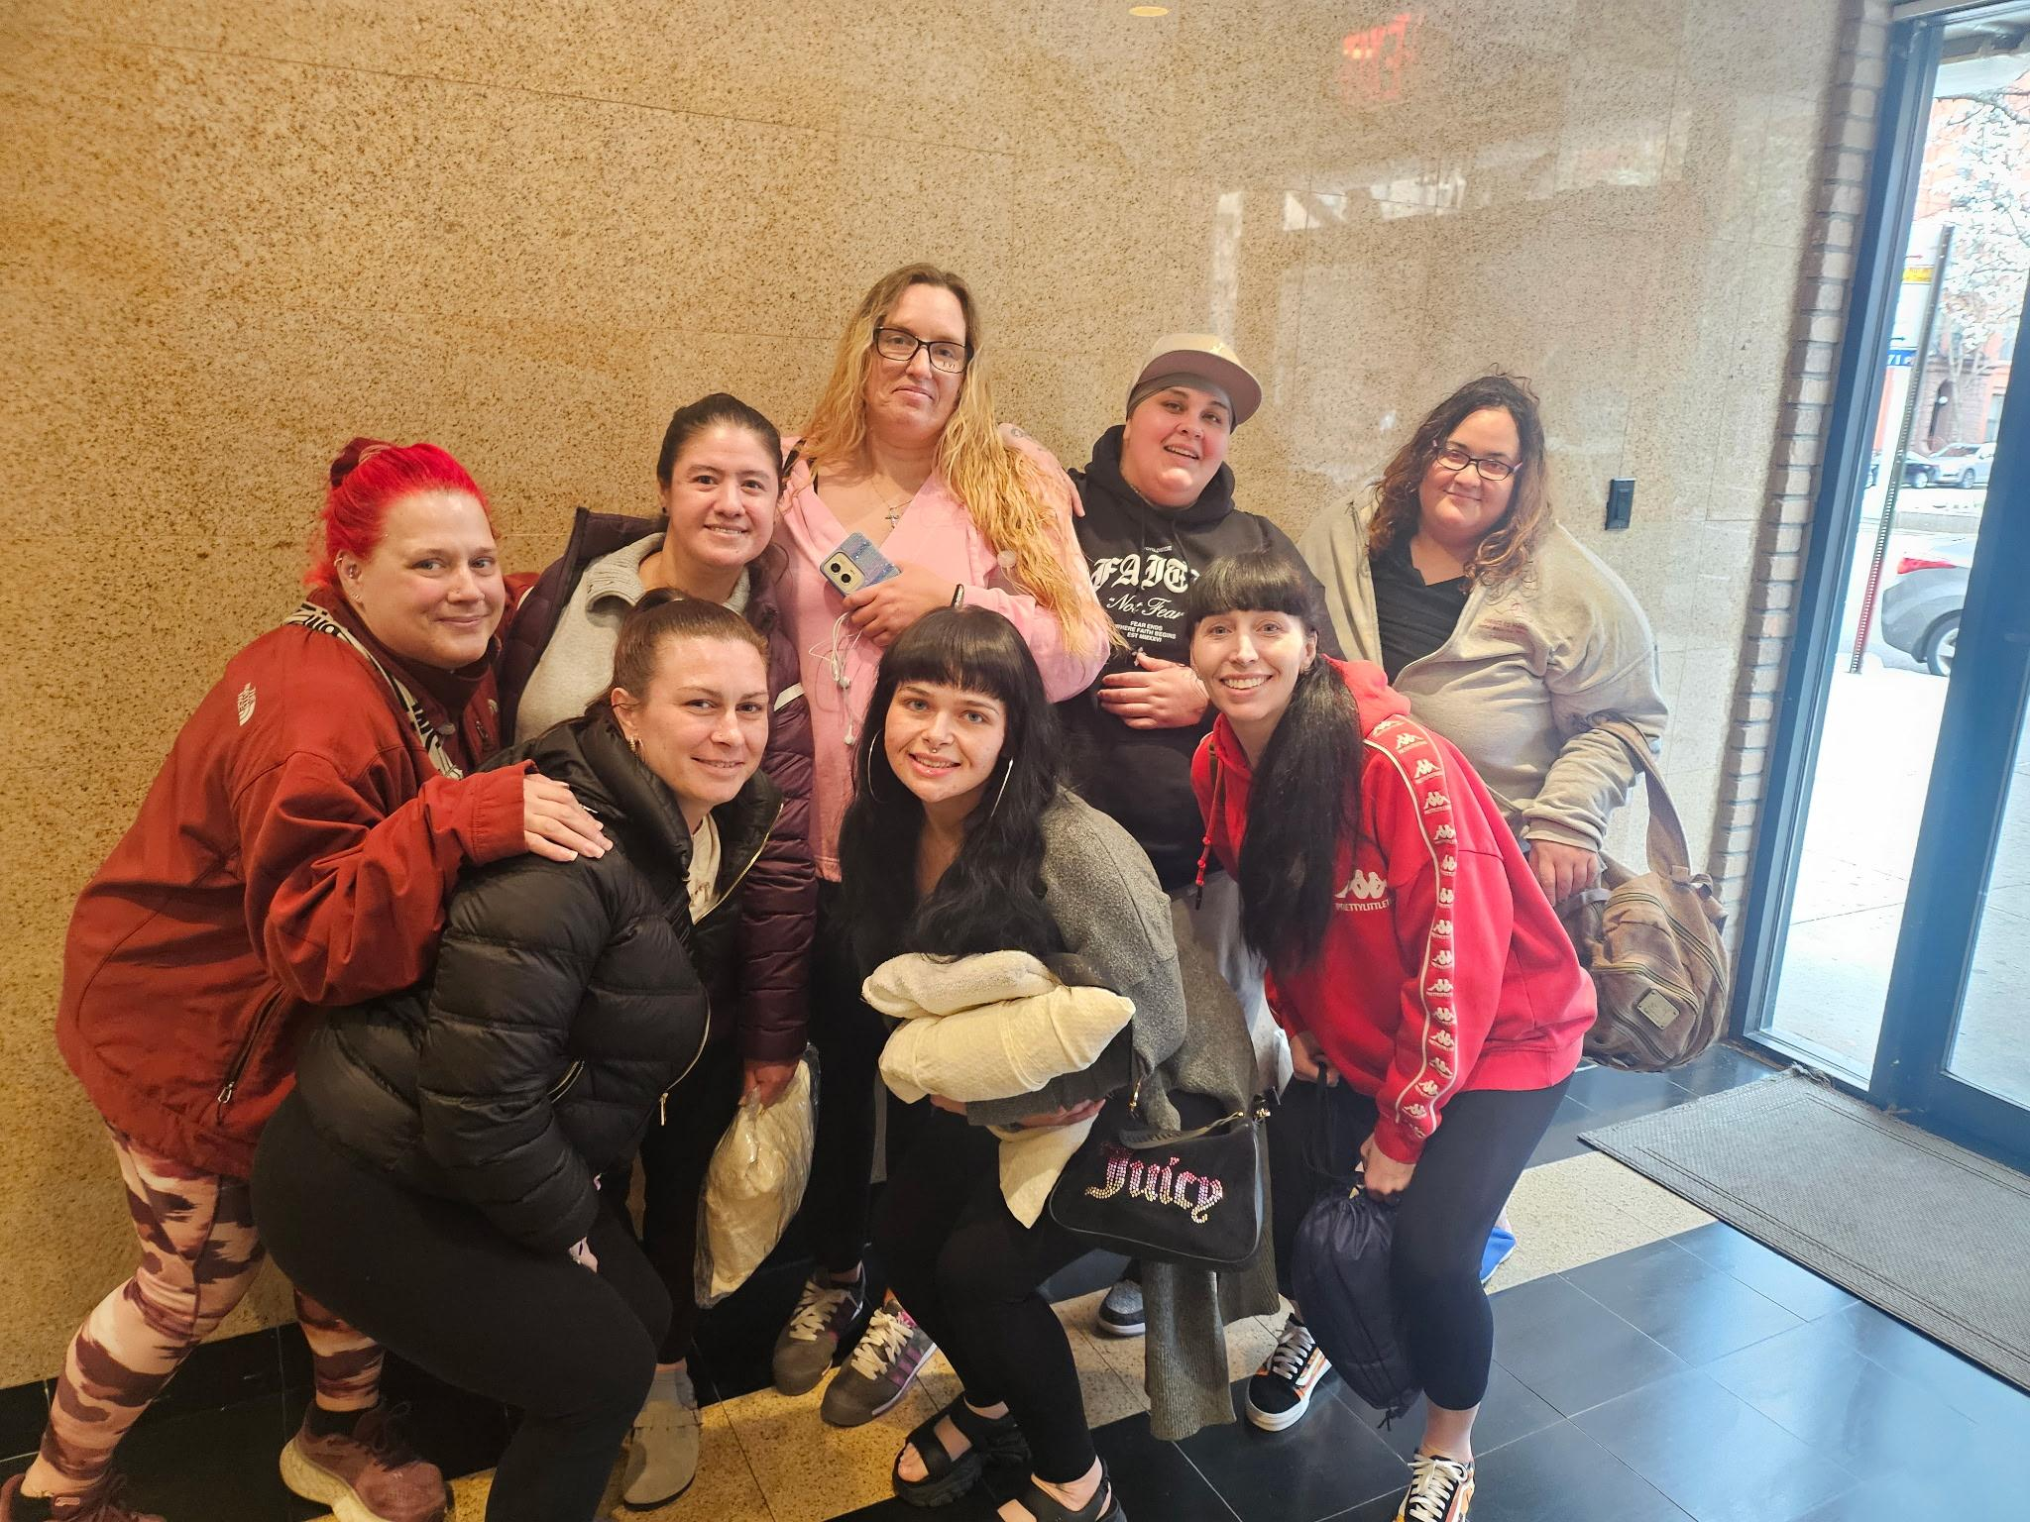
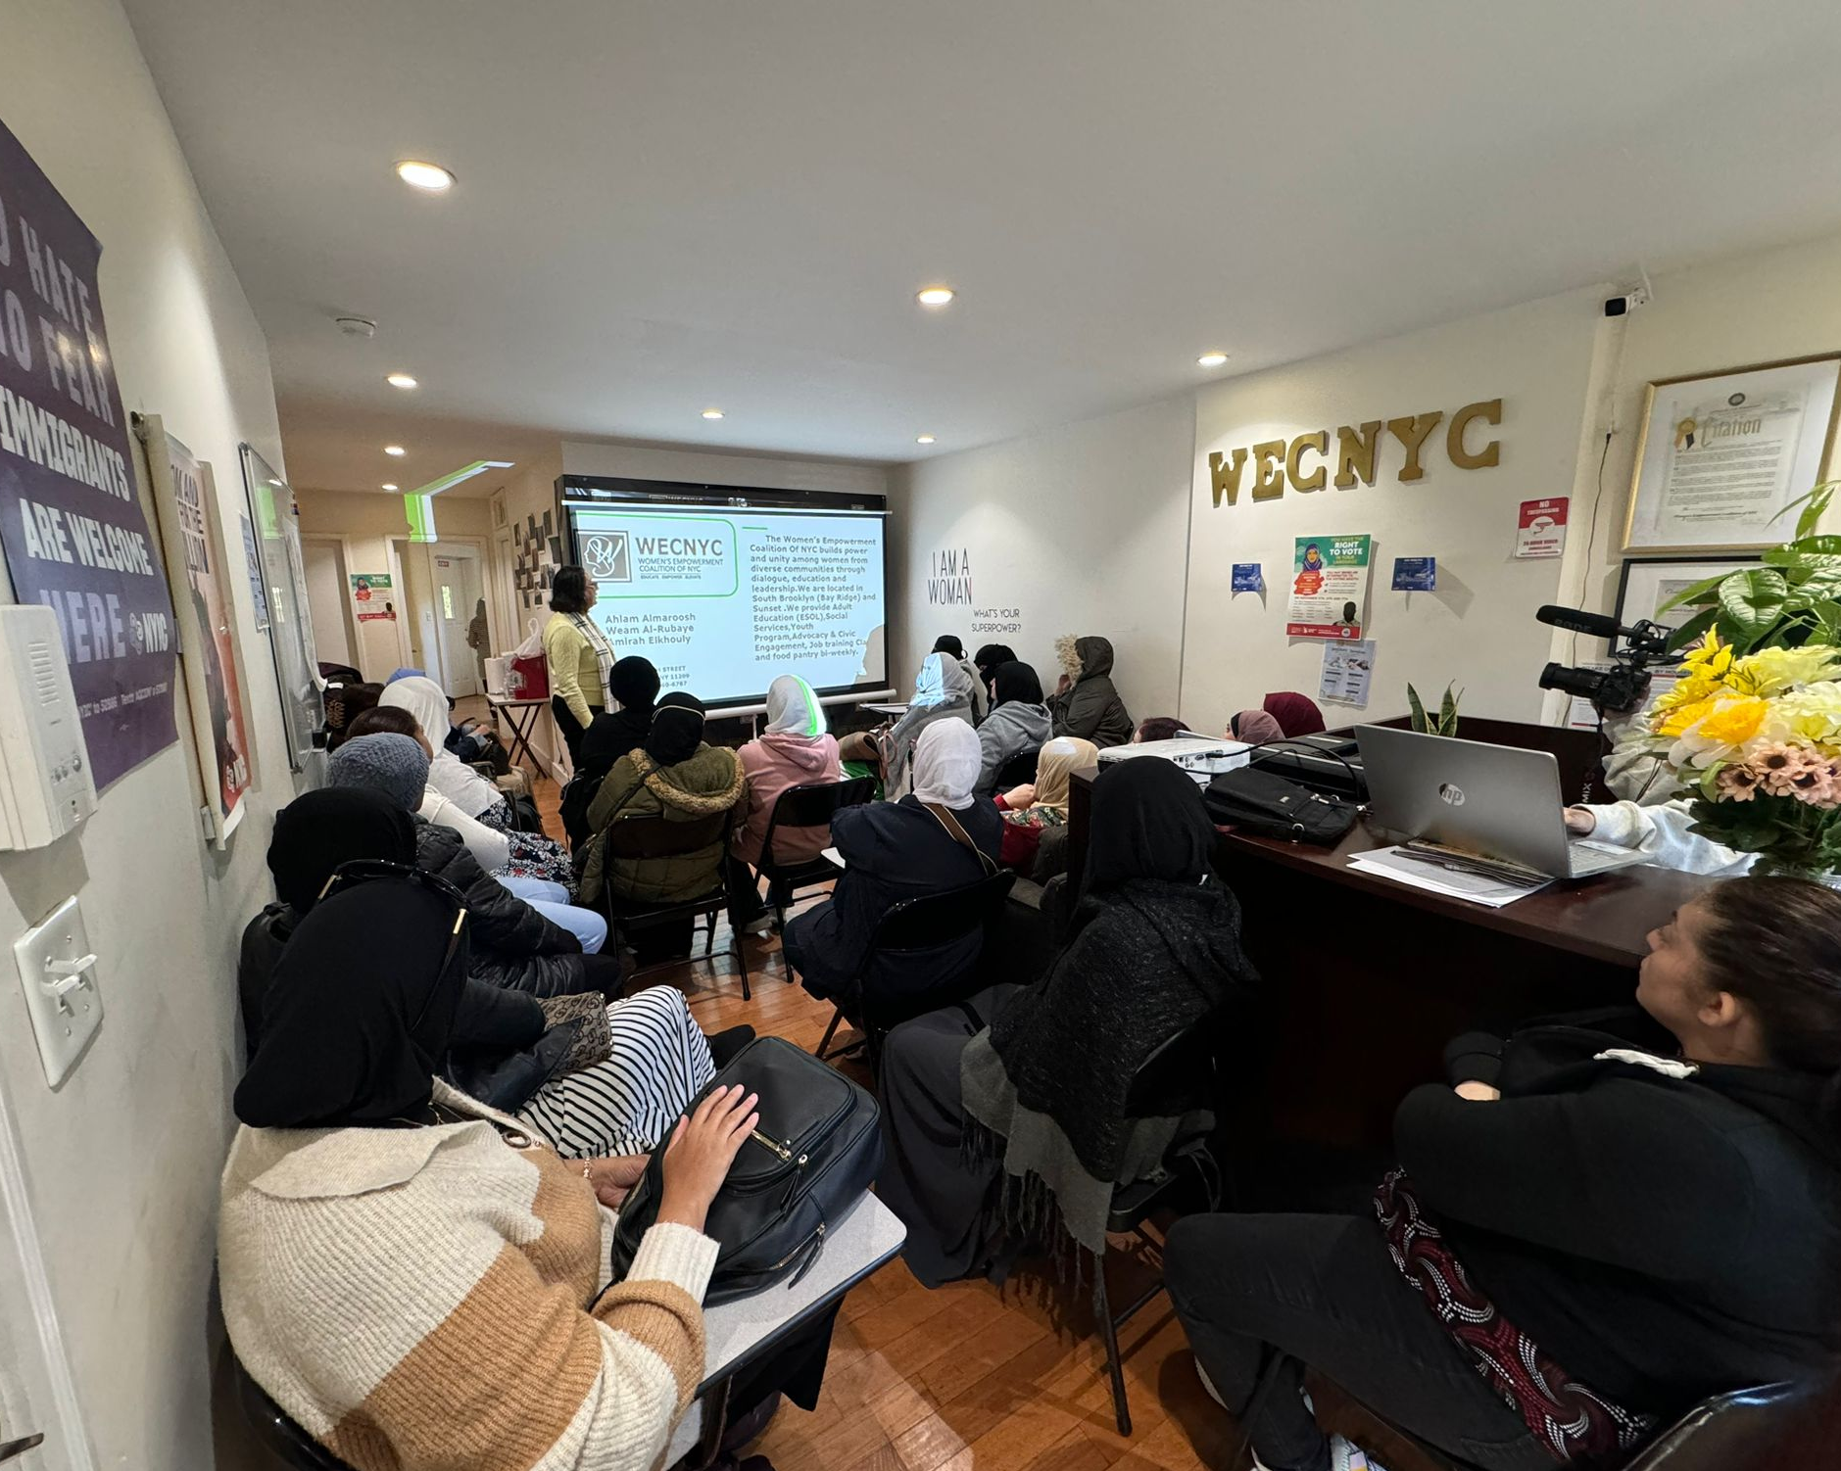
Connection Resource Center
Self-Defense Education for Women
Errands for Older Adults and People w Disabilities
Youth Enrichment Program with the Arts
Mothers Matter
Language and Job Recertification for Immigrants
Notes:
Lauren

Slide 34
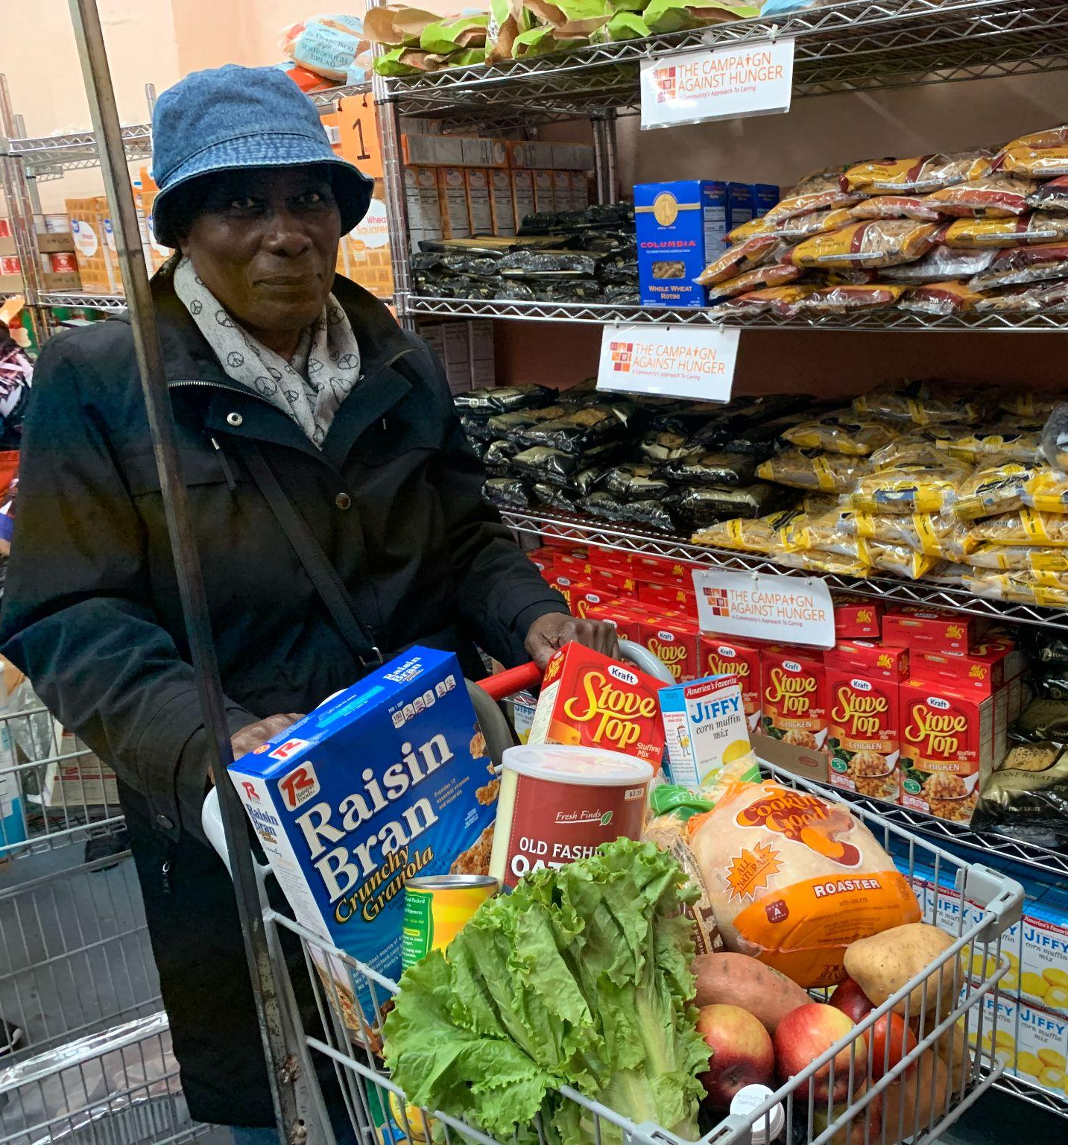
Project Stories
"Thanks to the support of the Mothers Matter Project, I was able to avoid eviction and stay in my home. They helped me navigate the resources available, and without them, I don't know where I'd be."
- Project Participant, Mothers Matter
“I used to think healthy food was too expensive and complicated. But now I know how to prep meals for the week with just a few ingredients. My kids even ask for the veggie stir-fry now!”
- Project Participant, Healthy Meals Partnership

Slide 35
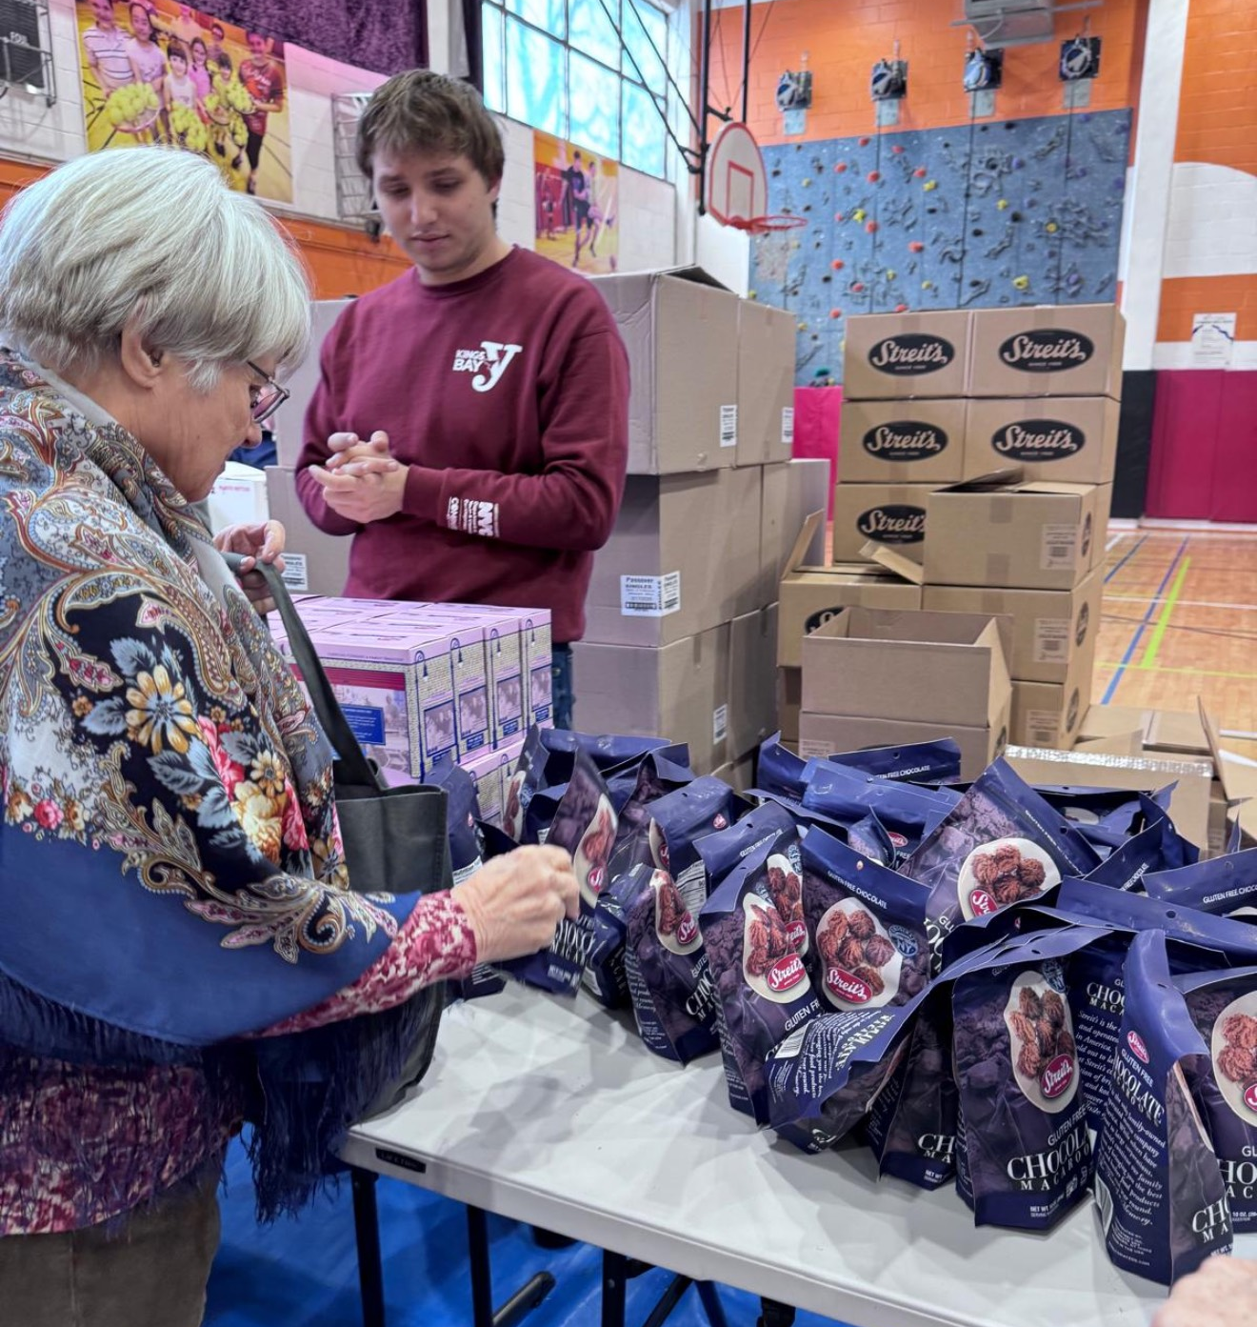
Project Stories
“Supporting the older population in our community means so much because it feels like I’m not only helping others but also honoring my own family.”
- Project Volunteer, Errands for Older Adults
“ I applied what I learned when someone I didn’t know started asking me questions about how long I have lived in the neighborhood. I remembered what [the facilitator] said about shortening the interaction and using the broken record method.”
- Project Participant, Self Defense Education

Slide 36
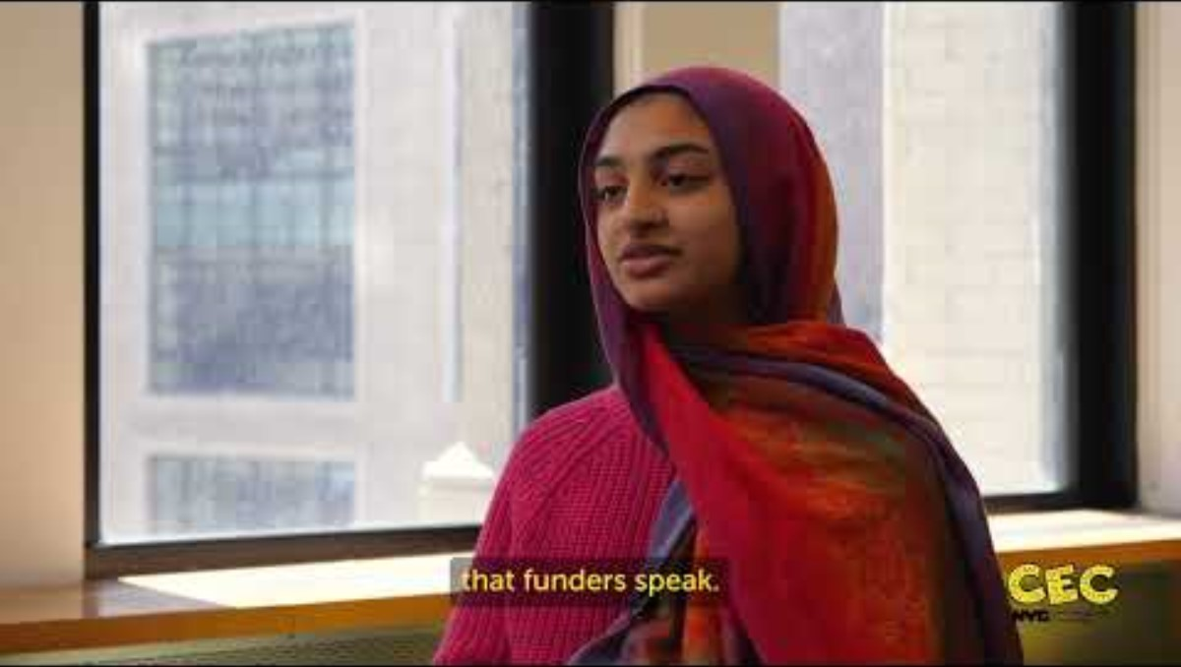
CBO Capacity Building Workshops

Slide 37
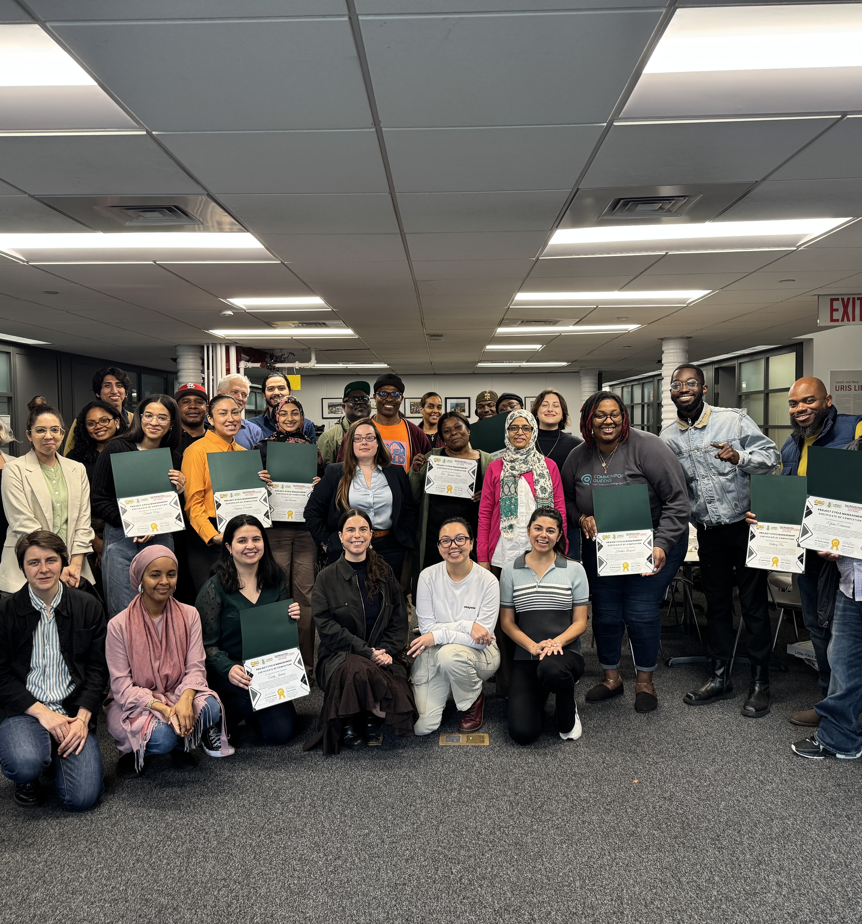
Workshop Reflections
“The workshops have positively impacted my project, giving me the tools to properly pivot where necessary - a lot of the data collected helped with this particular thing!”
- Project Implementation Partner
“They [the workshops] were helpful in helping us feel supported and learning how to build out a project from start to finish, giving us a better understanding of how to measure and evaluate impact in the work we do.”
- Project Implementation Partner

Slide 38
Digital Equity Team (DET)

Slide 39
PB & VLA
Ad Campaigns

Slide 40
VLA Media Plan Overview
Media | Planned Budget | % Allocation
Digital (May Election) | $6,812 | 9%
Digital (Ranked Voting) | $30,140 | 39%
Print ECM | $22,254 | 29%
Radio | $17,087 | 22%
RankDVote | $180 | 0%
Sub-total Media | $76,473 | 100%

Slide 41
VLA Media Plan – Print ECM & Radio
Summary by Language | # of Insertions | Budget
Russian (3x) | 8 | $1,800
Haitian (1x) | 4 | $2,000
Yiddish (3x) | 10 | $3,900
Polish (1x) | 2 | $600
Arabic (1x) | 4 | $2,000
Urdu (2x) | 7 | $4,100
Chinese (1x) | 4 | $2,958
Bengali (2x) | 5 | $2,600
Korean (1x) | 2 | $2,296
Total Allocation |  | $22,254
Station (2x) | Segment/ Language | Frequency | NET Cost
FREEDOM FM | Russian | 85 | $ 6,141.25
RUSA-FM | Russian | 85 | $ 6,141.25
Radio Soleil | Haitian Criole | 40 | $ 3,400.00
Radio Rampa | Polish | 18 | $ 1,404.20
Total Allocation |  | 228 | $ 17,086.70

Slide 42
PB Media Plan Overview
Media | Planned Budget | % Allocation
OOH | $100,000 | 63%
Digital | $20,000 | 13%
Digital ECM | $19,150 | 12%
Print ECM | $18,050 | 11%
QR Code Generator | $300 | 1%
Sub-total Media | $157,500 | 100%

Slide 43
PB Media Plan – Digital & OOH
Platform | Language | Investment | % of Budget
Facebook/IG | ENG | $4,000.00 | 20%
 | SPA | $7,000.00 | 35%
 | CH | $5,000.00 | 25%
 | Arabic | $2,000.00 | 10%
 | Haitian Criolle | $2,000.00 | 10%
Total Digital |  | $20,000.00 | 100%
OOH Options | Total Units | Budget Allocation
Interior Cards Subway | 1,000 Posters | $63,330
Subway "2-Sheet" Platform Posters | 140 Posters | $36,670
Total OOH |  | $100,000

Slide 44
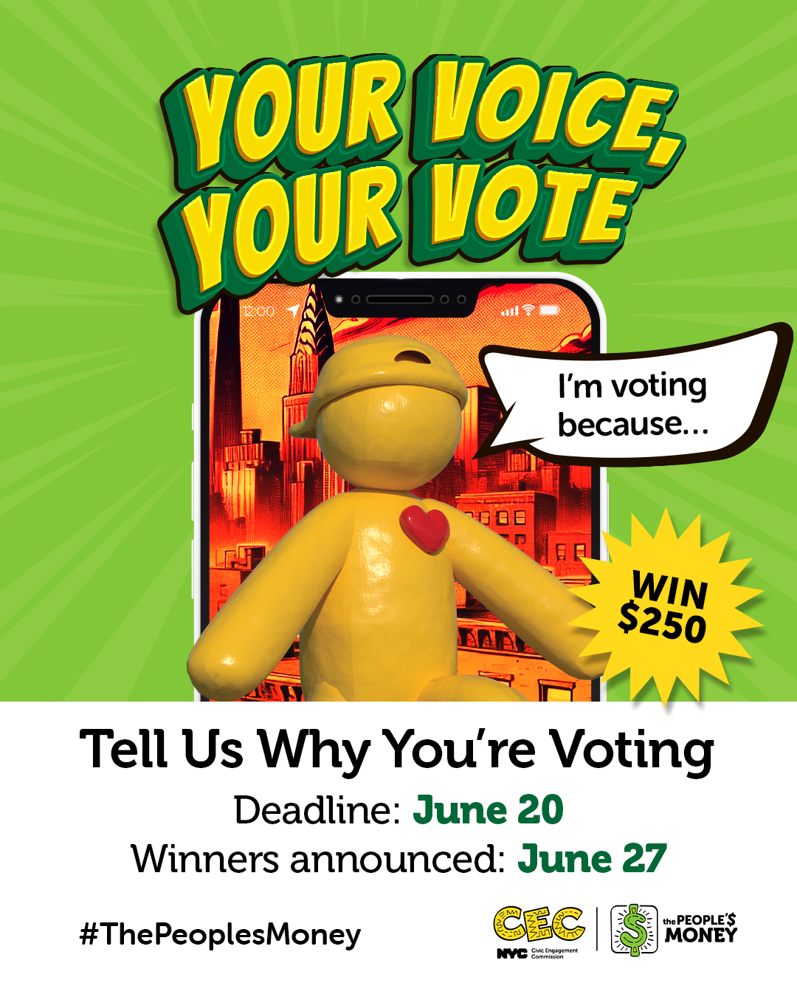
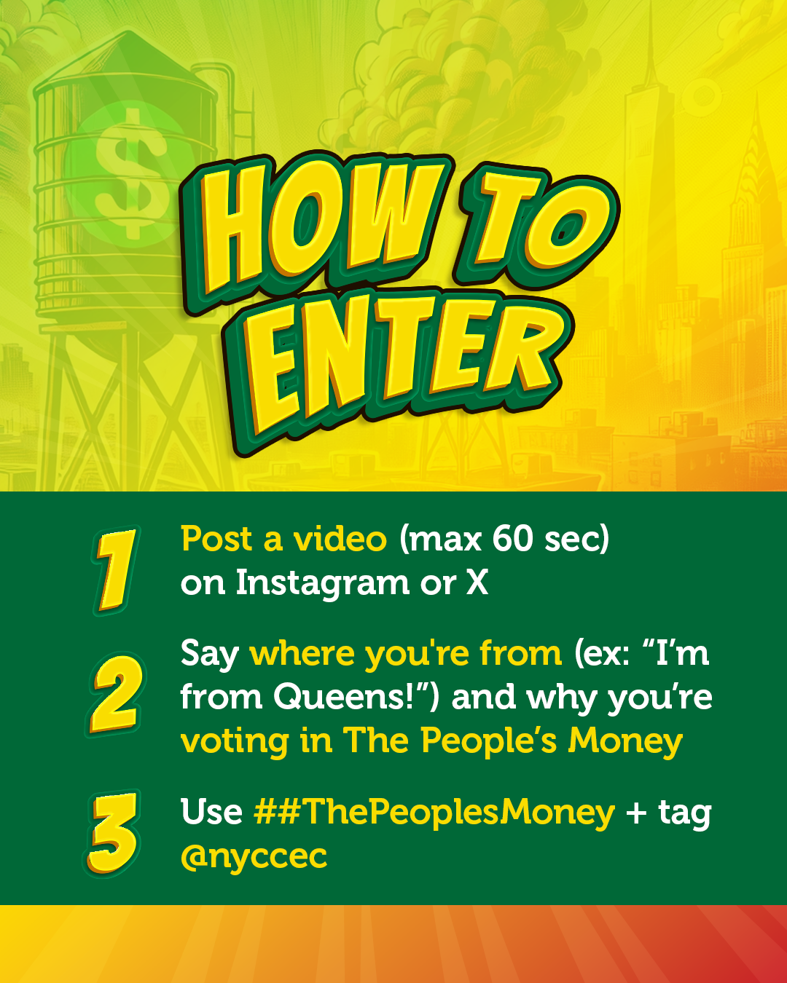
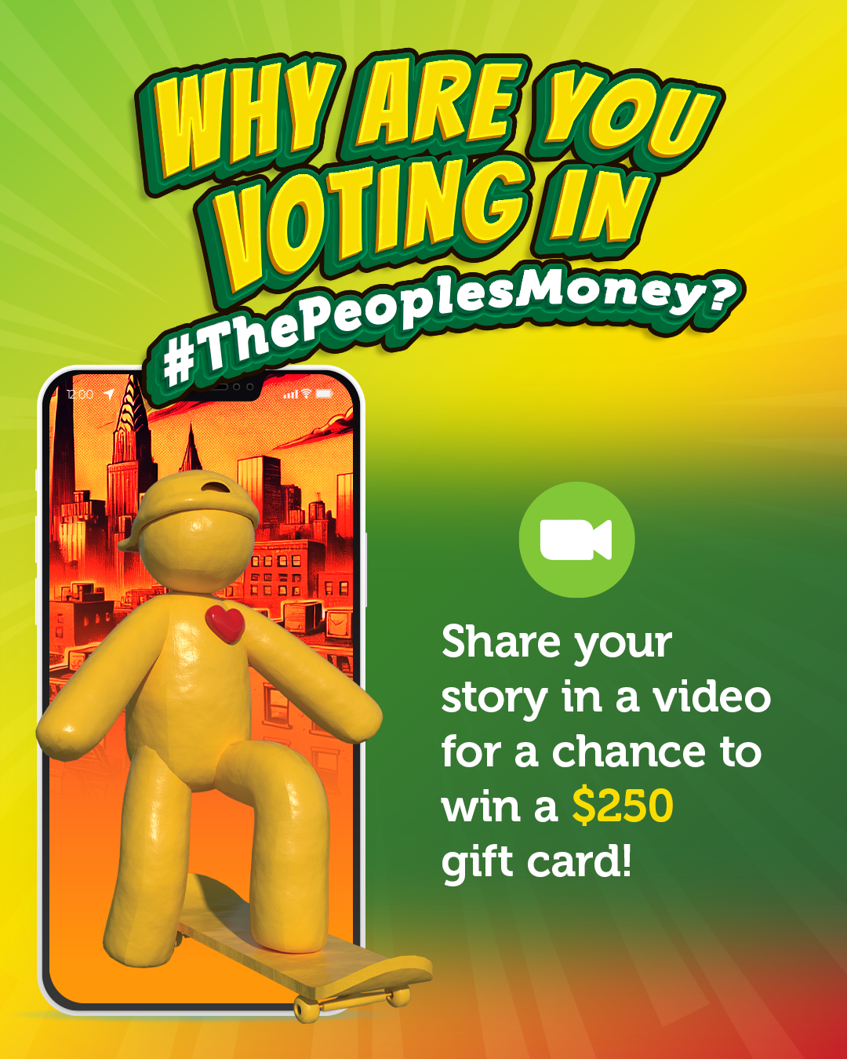

Social Media Competition: Your Voice, Your Vote!

Slide 45
Relational Organizing

Slide 46
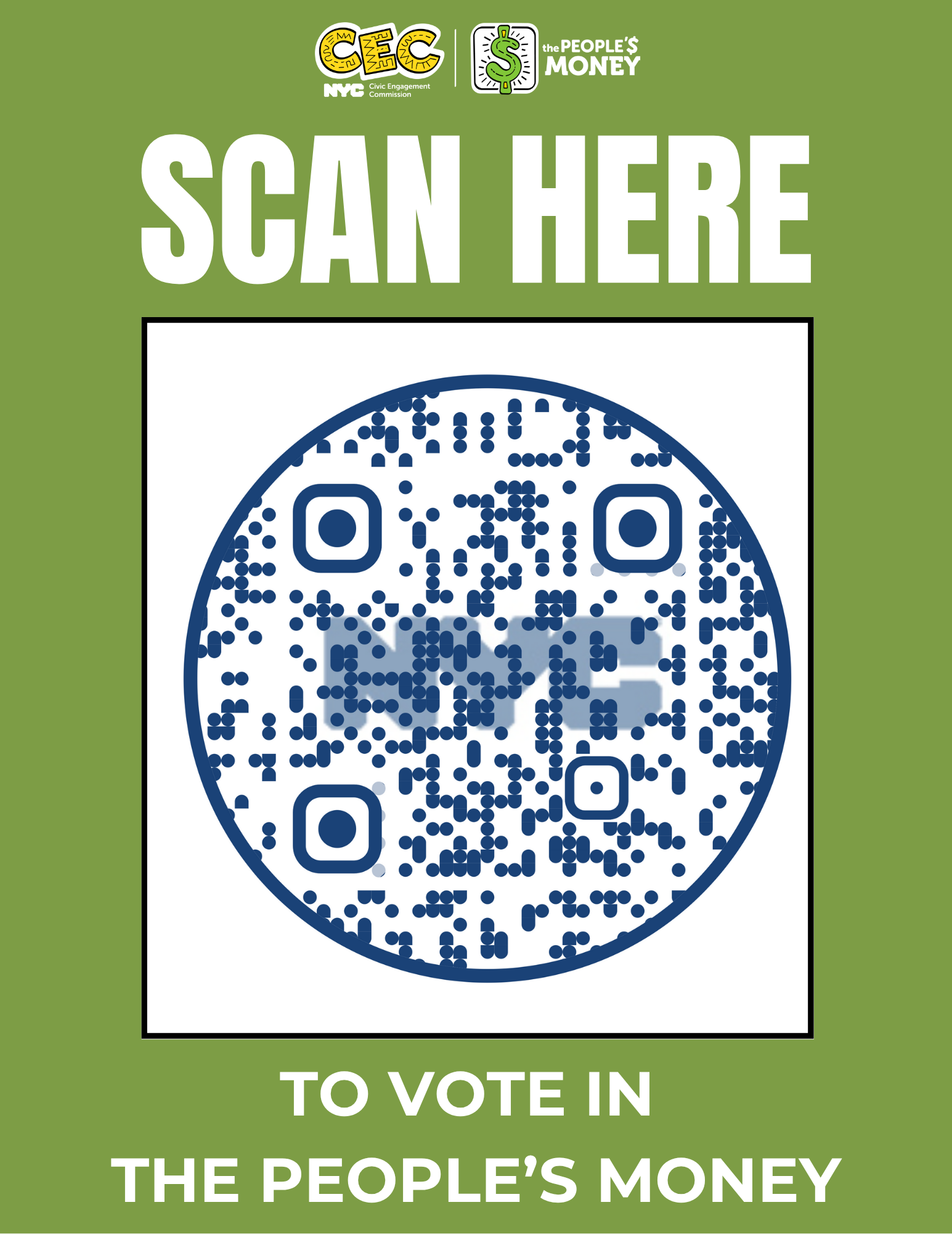
Commissioners' Support:
Step 1
It takes only a few minutes to
cast your ballot for community
projects you want to see
funded through the People’s
Money!

Slide 47
Commissioners' Support: Step 2
Have your family, friends & colleagues voted?
Reach out with a text message to at least 5 people:
Hi [INSERT NAME], have you heard about the People's Money? It's an opportunity to choose community projects to be funded by the City! It takes two minutes to participate. Go to on.nyc.gov/pb to decide!

Slide 48
Commissioner Support: Step 3
Send the social media toolkit to at least one organization contact that you know (sent via email)
Use the toolkit to participate in the social media day of action on June 18! Tag @nyccec
Feeling ambitious? Text more people, email more organizations! Host a virtual vote party with your friends and family, PPT slides are in the toolkit, choose your own music!

Slide 49
Independent Budget Office Presentation

Slide 50
Public Comment

