Slide 1
Public Meeting
February 6, 2025

Slide 2
Technology & Housekeeping
To Commissioners:
In-Person Participants:Please mute your microphone when you're not speaking and turn it on when needed
To Online Participants: Please mute your microphone when you're not speaking. Please unmute and let us know when you'd like to offer a comment, since we cannot see you.
To All Participants: ​
Call participants in the order they have registered for public comment prior to meeting, then during today's meeting​
Closed Captioning:​ Closed Captioning will be displayed on the smaller screen​.
​
To In-Person Participants:​
To submit a public comment, please add your name and affiliation to the sign in sheet by the door. We will call on you to speak in order received.​
To Online Participants:​
Closed Captioning:​ Closed Captioning is available online at https://bit.ly/CECCAPTIONS
To submit a public comment, please submit your name, affiliation, and public comment via email to info@civicengagement.nyc.gov or via text to 917-587-9103. We will read comments in order received.

Slide 3
Agenda
Attendance​
Approval of Meeting Minutes from December 6, 2024
Program Updates
Voter Language Assistance Program
Community Boards
Participatory Budgeting Program & TRIE Neighborhood Initiative
Implementation Capacity Building with Guest Speaker Mark Johnson
Public Comment

Slide 4
Approval of Meeting Minutes

Slide 5
Program Updates

Slide 6
Voter Language
Assistance Program

Slide 7
Voter Language Assistance
Finalized planning for the next six months
Working on educational ma
terials, outreach and marketing for the June primary
Preparing for Special Elections in Council Districts 44 and 51

Slide 8
Voter Language Assistance
Council District 44 Special Election services:
Seven poll sites on Election Day March 25th
Four poll sites & seven language services total on March 21st, March 22nd, and March 23rd
Notes:
ED: Russian 5 sites and Yiddish 2; EV: March 21st, 2 Yiddish sites; March 22nd, Russian 3, Arabic 1 and Urdu 1; Sunday: 2 yiddish, 3 Russian, 1 urdu, 1 Arabic)

Slide 9
Voter Language Assistance
Council District 51 Special Election services:
Likely two poll sites
Notes:
ED: Russian 5 sites and Yiddish 2; EV: March 21st, 2 Yiddish sites; March 22nd, Russian 3, Arabic 1 and Urdu 1; Sunday: 2 yiddish, 3 Russian, 1 urdu, 1 Arabic)

Slide 11
2025 Winter / Spring Community Board Workshops
Finished series of 8 HPD sponsored workshops: Tenants: Know Your Rights; Department of Buildings: Rules, Permits, Summons, and More; Energy Efficiency and Solar Power for Homeowners; Rental Housing Discrimination and Harassment. Workshops were attended by about 100 members.
Started scheduling in-person De-Escalation trainings, Bring the Temperature Down: De-Escalating Conflicts, with each Borough President. These workshops are designed to provide techniques to take the heat out of a conflict and "bring the temperature down”. Taught by former OATH employee Yuko Uchikawa.

Slide 12
2025 Winter / Spring Community Board Workshops
Completed video shoot for Day in the Life of a Community Board Member video. This video is intended to provide a glimpse into the responsibilities and role of a board member. A real board member and district office were used in the making! Coming soon!
Scheduled Monitoring & Evaluation workshops at the request of the Brooklyn BP, and will be offering them to the other boroughs as well.
Continuing our partnership with the Future of Community Boards Working Group to support research by Center for Urban Pedagogy about the effect of term limits on community board (in coordination with the Borough President’s offices).

Slide 13
The People’s Money Cycle: Current Status
Fall
Winter
Spring
Ongoing Thru FY
Phase 1: Idea Generation
Phase 2: Borough Assemblies
Phase 3: Voting
Phase 4: Project Implementation
And Evaluation
Year 1
Year 2
Complete
Complete
Complete
Complete
In Process!
Complete
Complete
Complete
In process
Year 3 Complete!

Slide 14
Idea Generation Outcomes per Borough
Participants Sessions Held Ideas Submitted
Bronx | 2249 | 110 | 736
Brooklyn | 2335 | 105 | 818
Manhattan | 1930 | 104 | 914
Queens | 2025 | 103 | 768
Staten Island | 1157 | 56 | 344
Total* | 9725 | 480 | 3591
*Numbers reported here are based on partner event reports per borough

Slide 15
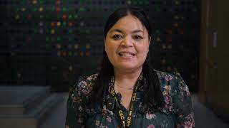
BAC Summary Video
Notes:
play video: BAC Summary Video Updated 2024 - YouTube

Slide 17
Borough Assemblies
We have completed three of the six Borough Assembly meetings
Every borough has 20 to 25 members who filled out our application and were randomly selected based on the demographics of their borough.
Sessions 1 and 2 consisted of exercises to introduce the members to each other and examine the ways people think. Tools included:
People, Task, Listen, Act: an exercise where people move to the area that describes themselves, and a video about Critical Thinking.

Slide 18
Borough Assemblies
Session 2 brought all the boroughs together. In partnership with Columbia University we met at The Forum on W125th St and almost 100 members heard from four city agencies and one non-profit on their programs and priorities. They were DOHMH, DYCD, SBS, MOCEJ, and Arts and Democracy (non-profit)
Next week the members will start to hear from our TRIE partners about neighborhood concerns.
And lastly, we have recruited three students from Columbia to observe report back on the Assembly meeting. The objective is to learn about the flow of information and how the members incorporate it into their decision making

Slide 19
TRIE

Slide 21
TRIE Monthly Meetings
December TRIE Meeting
Introduced Community Needs Assessment & Resource Mapping Exercise
Discussed core concepts of the civic engagement workshop: power, love, and justice
January TRIE Meeting
Reflected on the experience of completing the needs assessment & resource mapping exercise
Reviewed upcoming logistics for the Borough Assemblies
Discussed guidelines for customizing the civic engagement workshop

Slide 22
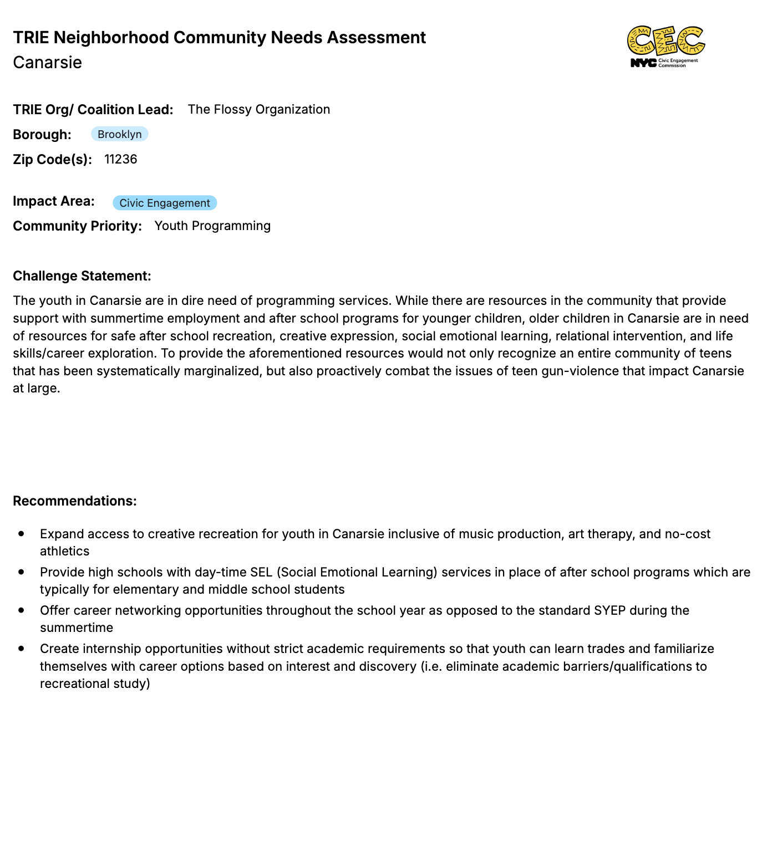
Community Needs Assessments & Resource Mapping Exercise
In partnership with their coalitions, we asked TRIE organizations to:
Identify a top community need/issue to highlight to the Borough Assemblies
Map local resources and service providers that focus on the identified need, and assess gaps and limitations
Develop a challenge statement that describes the unmet need, affected community, and assessment of why the need persists.
Prepare recommendations of ideas that might address the issue.

Slide 23
Civic Engagement is People Power Workshop
The Civic Engagement is People Power Workshop is designed to have participants:
Understand the meaning of civic engagement and the different forms it may take
Reflect on the importance of leading with love and working together to create meaningful change
Consider ways they could get involved in their community, in particular, with your organization!
Each organization will host a minimum of one workshop, each customized to the unique audiences served.
The workshops incorporate civic engagement modules- topics include voting, volunteering, advocacy and organizing, and community boards.
TRIE Civic Engagement Workshops will be hosted from now until June 2025, and are in the process of being confirmed.

Slide 24
PB Project Implementation

Slide 25
Project Implementation
Planning
October - January
Goal: Identify the desired impact and determine activities, outputs, and outcomes for the project.
Deliverables: Needs Assessment; Stakeholder Analysis; Project Logical Framework; Final Project Plan
Implementation
January - October
Goal: Successfully implement an impactful project.
Deliverables: Project Implementation in Assigned TRIE Neighborhoods; Completion of Project Timeline; Reaching Project Targets and Goals
Evaluation
April - October
Goal: Evaluate and report out on the impact of the project in the community.
Deliverables: Capacity Building Workshops; Monthly Progress Reporting; Mid-Project Report; Final Report

Slide 26
Recap of deliverables that have been completed so far:
Onboarding Training
Monthly Meetings
6 In-Person Capacity Building Workshops
1-on-1 Check-Ins with CEC Liaison
Needs Assessment/Stakeholder Analysis
Logical Framework
Final Project Plan
Pre/Post Surveys
Baseline Data Collection (In-Progress)

Slide 27
Upcoming Deliverables
CEC Partnership
Monthly Progress Reporting
1-on-1 Check Ins
CEC Site Visits
Project Cycle Management Workshops
Next Workshops (02/09, 2/14)
Finalize Surveys
Conduct Baseline Data Collection

Slide 28
Monthly Progress Reporting
Organizations must submit monthly progress reports starting the month they begin to implement their project.
Implementation will in either January or February, depending on the project timeline and implementation plan.
Goals and Objectives:
Track and Highlight Progress and Success
Strengthen Project Delivery
Promote Project Sustainability

Slide 29
Organizations Will Report:
Section | Reporting Info
Activities & Outputs | Total number of people served during the reporting period Summaries and descriptions of all quantitative outputs relating to the project activities (including the number of workshops, events, referrals, resources distributed, counselling sessions, goals for events and workshops, etc.)
Outcomes | Detailed descriptions of observed outcomes Description of the ways in which the project is making an active difference in the community/for a specific participant/for your organization Testimonials from participants/key stakeholders to support the observed outcomes
Outreach & Accessibility | Populations served Language access Types of support/incentives provided to participants Collaborations with the TRIE partner and other local orgs
Notes:
Akwasi

Slide 30
Organizations Will Report:
Section | Reporting Info
Challenges | Any difficulties encountered during implementation, such as low participant turnout, staffing shortages, partnership difficulties, policy or institutional barriers, etc Steps taken or plans to address these challenges and improve future outcomes.
Photos & Flyers | The best photos from the reporting period! Event flyers!
What’s Next? | Important upcoming dates (including recruitment deadlines, the next planning meeting, the next event, the next workshop, etc) Flyers for upcoming activities that we can help promote ahead of time.
Notes:
Akwasi

Slide 31
Implementation Capacity Building
With Professor Mark Johnson

Slide 32
Public Comment

Slide 33
Thank You!
@NYCCEC | nyc.gov/cec

