Slide 1
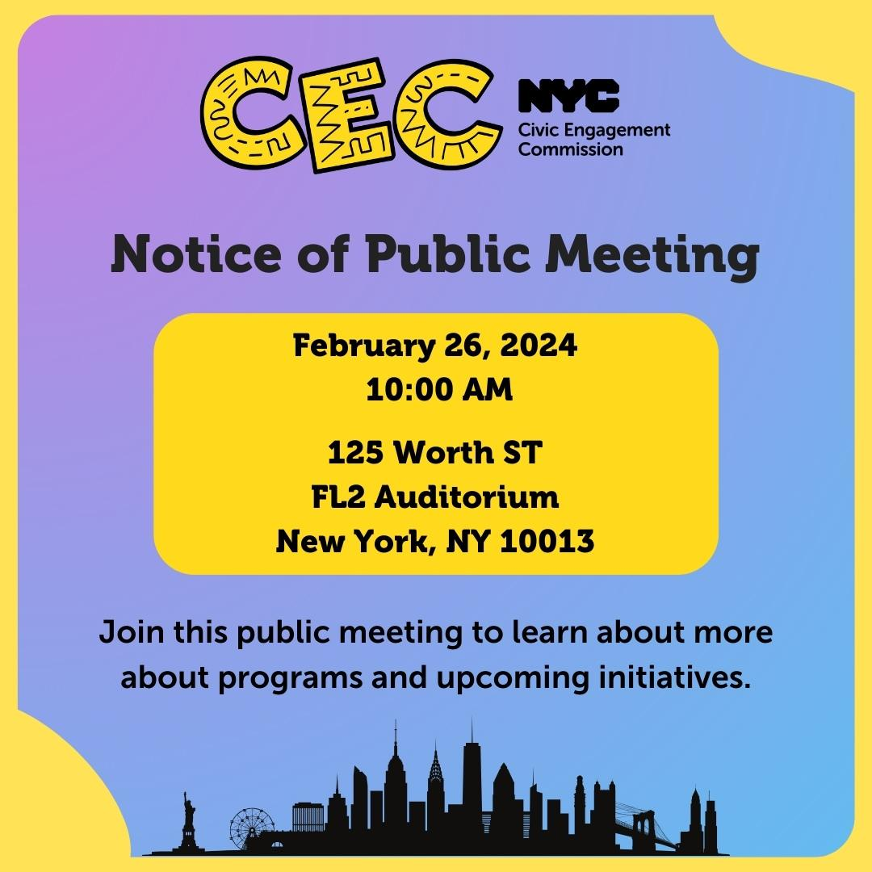
Public Meeting
Feb 26, 2024
Public Meeting
Feb 26, 2024
@NYCCEC | nyc.gov/cec

Slide 2
Technology & Housekeeping
To Commissioners:
In-Person Participants:Please mute your microphone when you're not speaking and turn it on when needed
To Online Participants: Please mute your microphone when you're not speaking. Please unmute and let us know when you'd like to offer a comment, since we cannot see you.
To All Participants: ​
Call participants in the order they have registered for public comment prior to meeting, then during today's meeting​
Closed Captioning:​ Closed Captioning will be displayed on the smaller screen​.
​
To In-Person Participants:​
To submit a public comment, please add your name and affiliation to the sign in sheet by the door. We will call on you to speak in order received.​
To Online Participants:​
Closed Captioning:​ Closed Captioning is available online at https://bit.ly/CECCAPTIONS
To submit a public comment, please submit your name, affiliation, and public comment via email to info@civicengagement.nyc.gov or via text to 917-587-9103. We will read comments in order received.

Slide 3
Agenda
Attendance​
Approval of Meeting Minutes from December 4, 2023
Program Updates
Language Access
Community Boards
Participatory Budgeting:
Borough Assembly Process
TRIE and GOTV
Implementation of PB projects and Sustainability
Guest Speaker: Linda Tigani, Commission on Racial Justice
Public Comment

Slide 4
Approval of Meeting Minutes

Slide 5
Program Updates

Slide 6
Poll Site Language
Assistance Program

Slide 7
Voter Language Assistance
Preparing for the April 2nd Presidential Primary
Poll Site Language Assistance Program renamed Voter Language Assistance
Branding project (logo, color palette) underway

Slide 8
2024 Language Assistance Advisory Committee Updates
2024 Cohort Applications
Total: 35 Applicants
New Applicants: 24 Applicants
Returning Members: 11
New members: 8 new
Inaugural meeting scheduled for February 29th

Slide 9
Language Access for Participatory Budgeting
Phase 2: Project Vetting / Development
Interpreters were provided based on need of Borough Assembly Committee
Participants utilized interpreters to communicate with fellow members and to fully participate in BAC sessions
Manhattan, Staten Island, and Queens utilized 1 Spanish consecutive interpreter each
Brooklyn utilized 1 Arabic consecutive interpreter
Phase 3: Voting
Each of the 5 borough ballots will be translated into all Voter Language Assistance languages
Once ballot text is finalized, translation process will begin including vetting of final translation for quality and appropriate localization

Slide 11
Workshops completed in 2024 to date
Housing Workshops 6 workshops were held in January, all coordinated with HPD: All workshops were hosted on Zoom
Housing Discrimination and Harassment (113 registered, 39 attended)
Introduction to Home Ownership (132 registered, 50 attended)
Introduction to DOB (180 registered, 86 attended)
Total Registered 426 Total Attended 175 41% attendance
Total by time 12:00pm – 118ppl 6:30pm - 57ppl
CEC Language Access Workshops Three workshops conducted by JP Wojciechowski, the CEC Language Access Coordinator, and were held in early February
February 6 @ 12:00pm (52 registered, 20 attended)
February 8 @ 12:00pm (29 registered, 13 attended)
February 13 @ 6:30pm (24 registered, 3 attended)
Total Registered 105 Total Attended 36 34% attendance

Slide 12
Upcoming Workshops
CONFLICT RESOLUTION
Conducted by Yuko Uchikawa (formerly with OATH)
UPDATE ON THE PRELIMINARY BUDGET
Conducted by Independent Budget Office
FAIR HOUSING & AFFORDABLE HOUSING
Conducted by Department of Housing and Preservation
AND MORE TO COME!

Slide 14
Process Overview and Engagement Strategy
Fall
Winter
Spring
Following FY
Phase 1: Idea Generation
Phase 2: Project Vetting and Development
Phase 3: Voting
Phase 4: Project Implementation
And Evaluation
Identify Themes
Light touch
Group discussion
Build awareness
Encourage future
involvement
Deliberative
Time intensive
Small group
Representative
Build leaders
Participatory
Shortest time commitment
Highest participation
Report back
Visible to public
Build trust
Show impact
* Borrows from Civic Assembly model

Slide 15
Process Cycle: Current Status
Fall
Winter
Spring
Following FY
Phase 1: Idea Generation
Phase 2: Project Vetting and Development
Phase 3: Voting
Phase 4: Project Implementation
And Evaluation
Year 1
Year 2
Complete
Complete
Complete
Complete
Complete
May 1 - June 12
In process
Next FY

Slide 16
Cycle 2: Phase 2
Feedback from Assembly Members
It was an honor to be part of this team!
This is one of the best experiences I’ve had so far.
Thank you, it was an empowering experience.
This year we had over 1100 applicants to be on the Borough Assembly Committees. From that pool we ended up with 106 randomly selected Assembly Members
Six meetings per borough were held between January 7 and February 4.
The five committees had a total of 438 ideas to review and we ended up with 46 moving to the final ballots

Slide 17
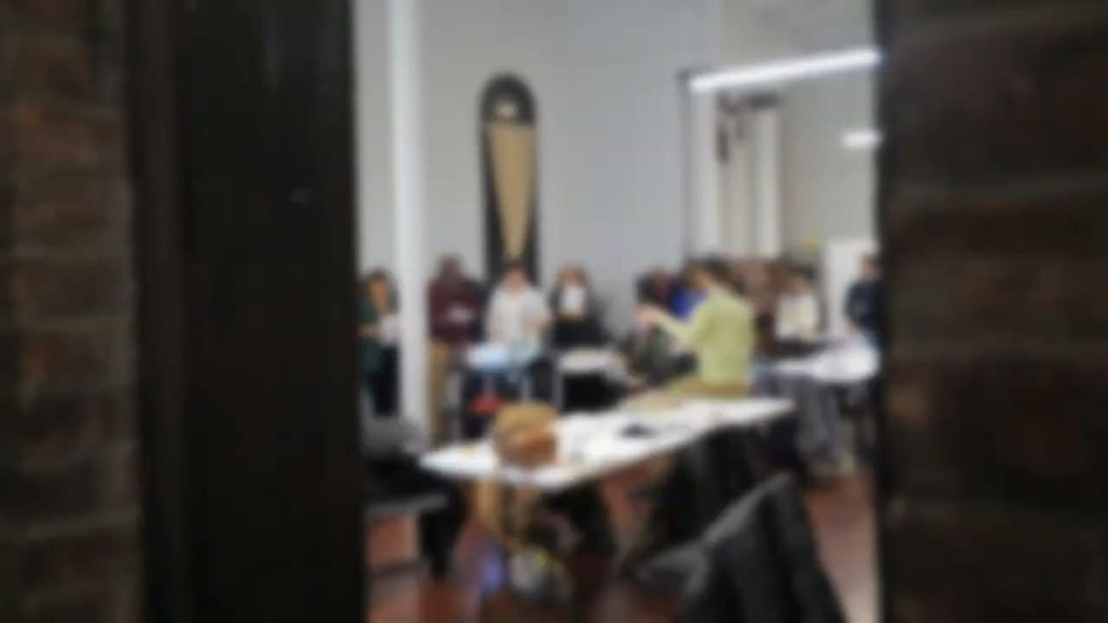
Borough Assembly Committee Process

Slide 18
TRIE Updates
Updates on the 2023-2024 TRIE Initiative

Slide 19
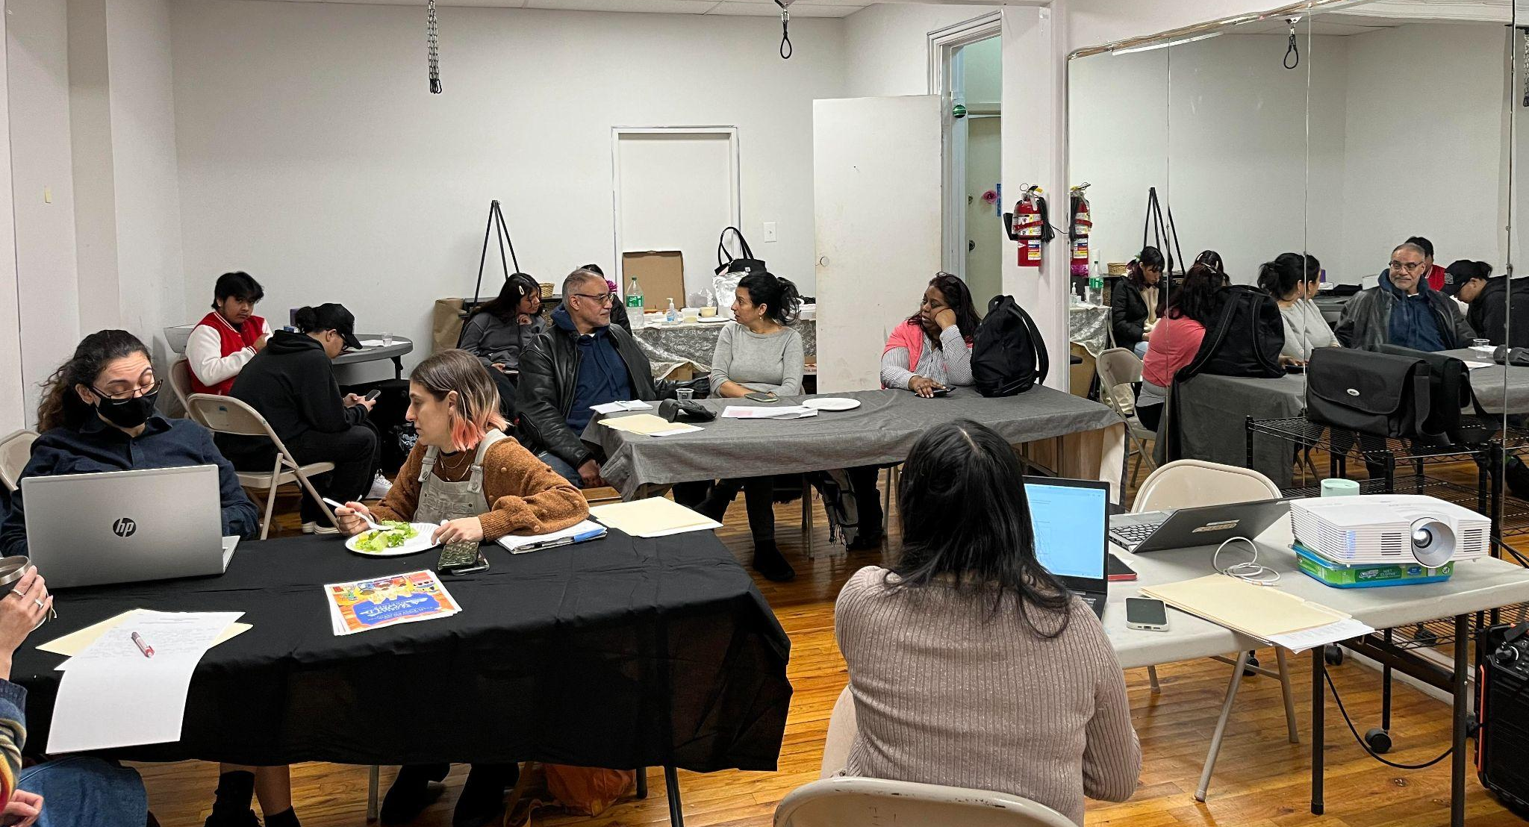
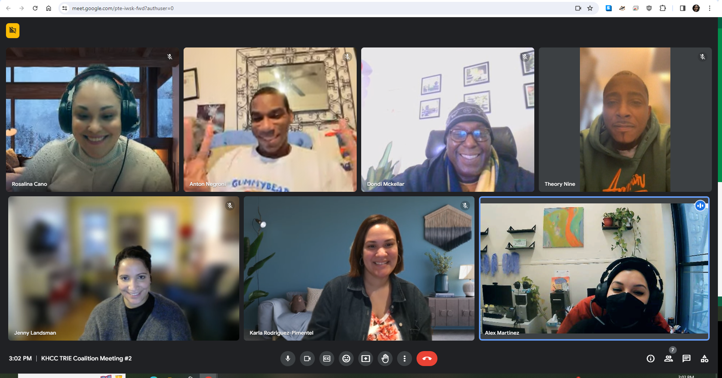
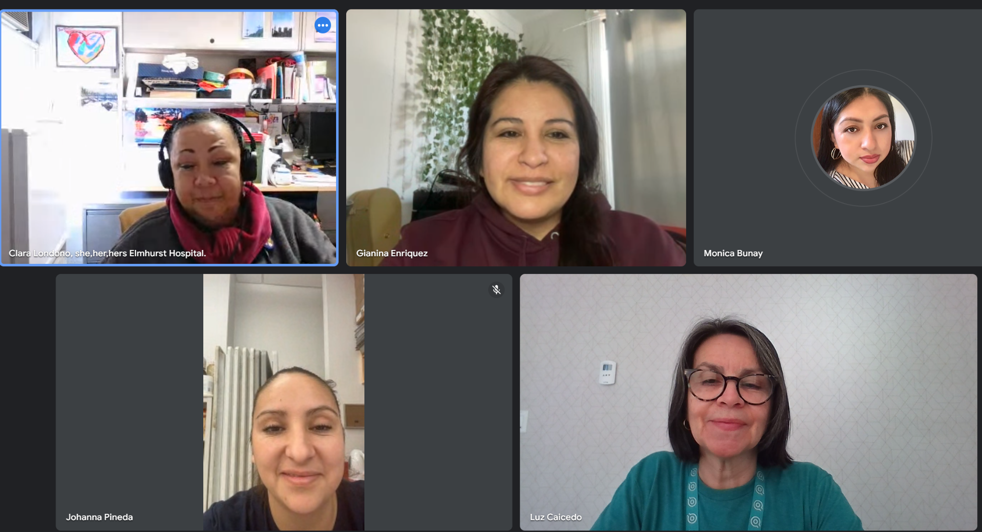
TRIE Coalition-Building
Deliverable:
Ongoing
Partners have created and/or sustained neighborhood coalitions of at least 3 organizational partners to collaborate on civic engagement initiatives including:
The People’s Money (Idea Generation, Presenting at the BAC meetings, GOTV)
Nov. 2023 GOTV efforts
Civic Engagement Workshops

Slide 20
TRIE & The People’s Money
Deliverables:
January - February 2024
Partners attended their respective BAC meetings to share neighborhood priorities
May 1 - June 12 2024
Partners will aim to collect 2,000 Ballots per TRIE Neighborhood

Slide 21
TRIE & Civic Education
Deliverable:
March - June 2024
Partners will pilot a civic engagement workshop that aims to:
Define civic engagement in terms of power, love, and justice
Share examples of different types of civic engagement, including coalition and movement building, and PB
Call participants to action with volunteerism and the People’s Money

Slide 22
Poll Site Worker / Interpreter
Marches, protests, demonstrations, rallies, phone banks, etc.
Checking In On Your Neighbor
Participatory Budgeting
Donating (food, money, clothes)
Organizing
Speaking at Town Halls
/ Public Hearings
Civil Disobedience
Voting
Building Community Coalitions
Civic Engagement Spectrum
Running For Office
Attending a Community Meeting / Event
Contacting / Visiting Your Representative
Volunteering
Signing / Writing Petitions / Letters of Support
Voter Registration Drive Outreach
Leadership / Membership:
Community Boards, PTAs, Tenant Associations, Block Associations, etc.
Staying Informed / Sharing Resources
TRIE & Civic Education (cont.)
Notes:
Civic Engagement is a spectrum from low touch to high touch, or individual to collective actions.

Slide 23
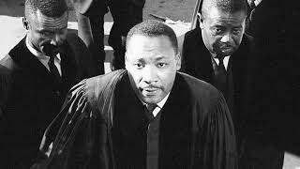
Power + Love = Justice
“Power without love is reckless and abusive [immoral power], and love without power is sentimental and anemic [powerless morality]. Power at its best is love implementing the demands of justice, and justice at its best is power correcting everything that stands against love.”
Martin Luther King Jr.
Excerpt from “Where Do We Go From Here?” (August 1967)
TRIE & Civic Education (cont.)
Notes:
Civic Engagement consists of all the ways that people use their power to seek justice for their community. Why? Because of their love for the community.

Slide 24
Cycle 1: Phase 4
Updates on Project Implementation

Slide 25
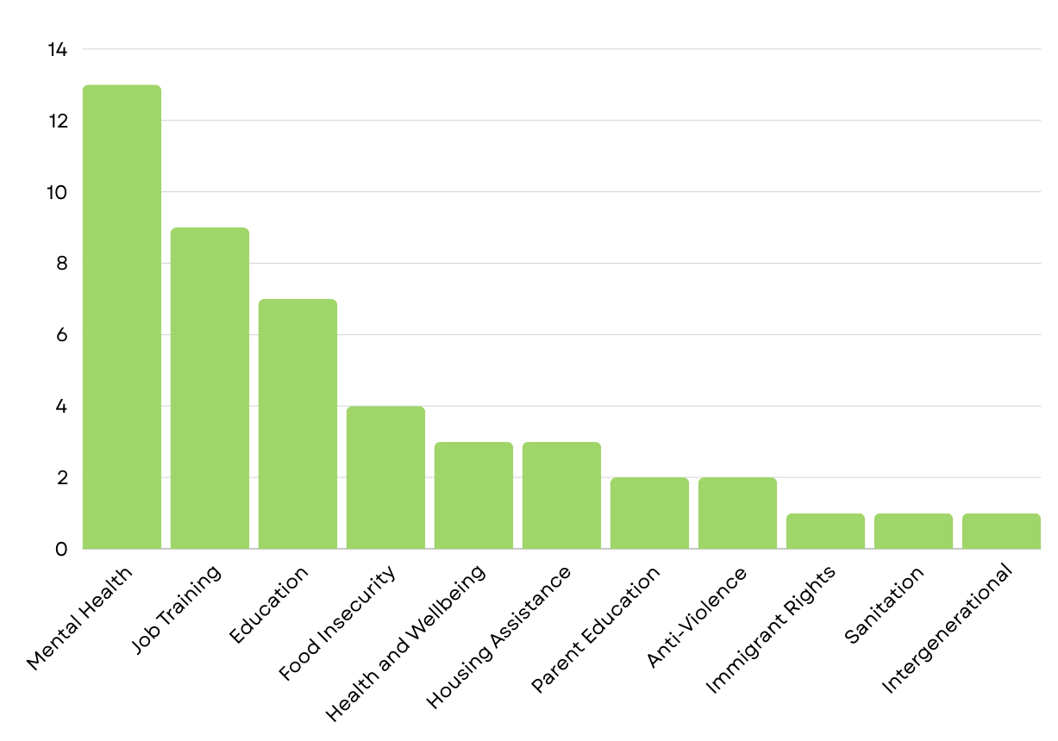
Winning Projects
Total Projects: 46
13 Borough Projects
33 Neighborhood Projects
16 projects’ intended audience is youth and 14 are intergenerational!

Slide 26
Partners
44 CBO Partners

Slide 27
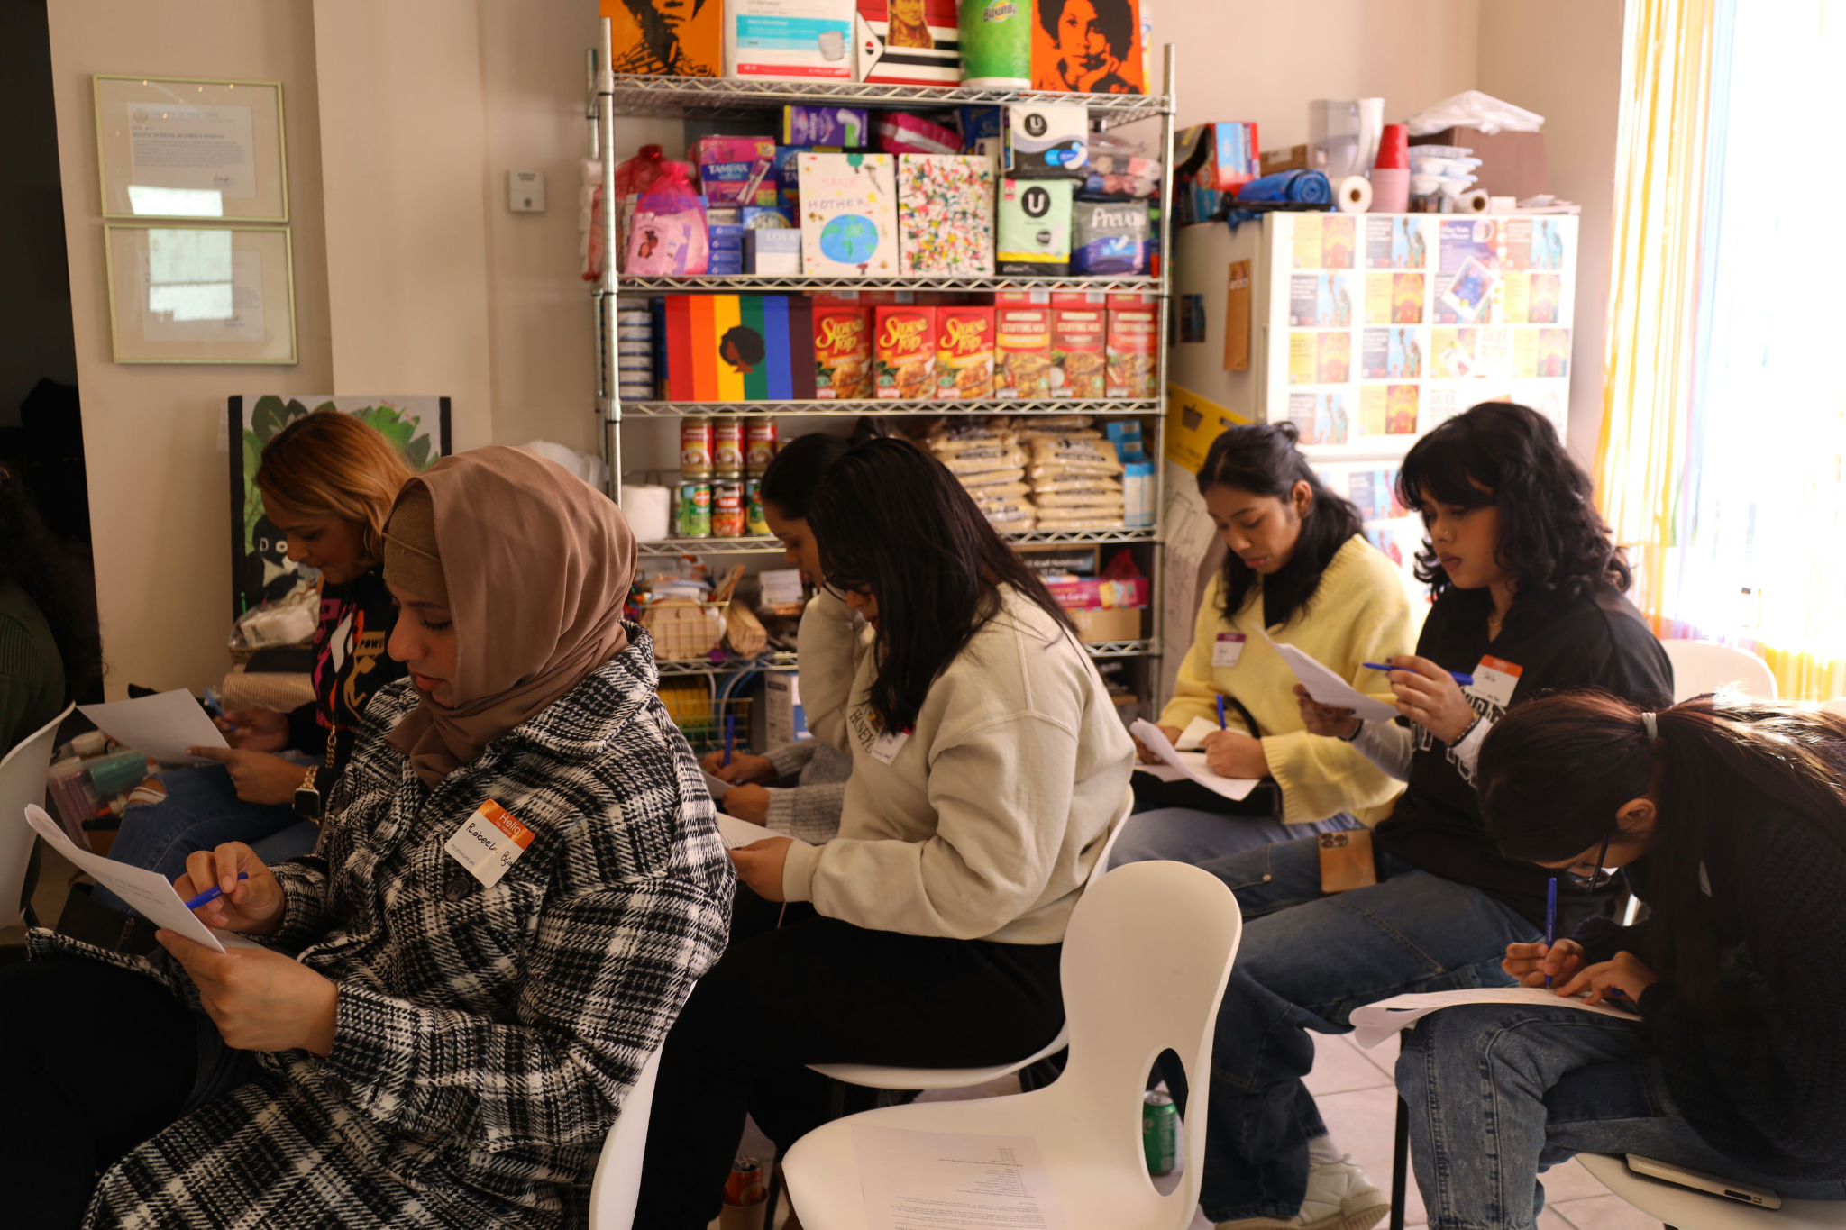
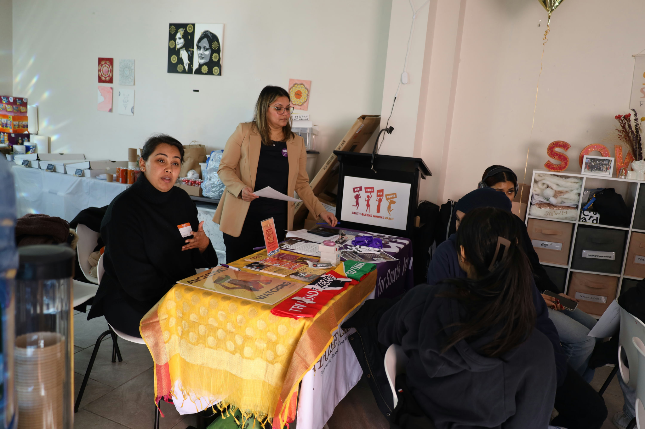
Implementation
So far, organizations are doing the following (and more!):
Restorative Justice Circles for PS 21 Students
Asylum Storytelling Workshops
Intergenerational Tech Classes
Financial Literacy Workshops for Students at Bronx Lab High School
Food Access Expansion in Inwood and Washington Heights
Mental Health First Aid Training
Culinary Entrepreneurship for Youth Ages 14 to 24
Workshops on Intersections of Mental Health and Gender Based Violence

Slide 28
Participate.nyc.gov
To learn more and stay updated on each of the projects visit participate.nyc.gov.

Slide 29
Sustainability
Project Design
Involving community members in design and planning processes to foster ownership and responsibility.
Conducting thorough needs assessments to ensure that project activities are relevant and responsive to local priorities.
Monitoring and Evaluation
Capacity Building: Using monitoring and evaluation to build capacity, foster partnerships, and integrate projects into existing structures.
Advocacy: Organizations can use M&E to showcase a project’s success.

Slide 30
Sustainability
How else can we promote sustainability of the projects?
Knowledge Sharing
More Partnership Opportunities
Additional Capacity Building
Suggestions?

Slide 31
Linda Tigani
Chair & Executive Director, NYC Commission on Racial Equity

Slide 32
Thank You!
@NYCCEC | nyc.gov/cec

