Slide 1
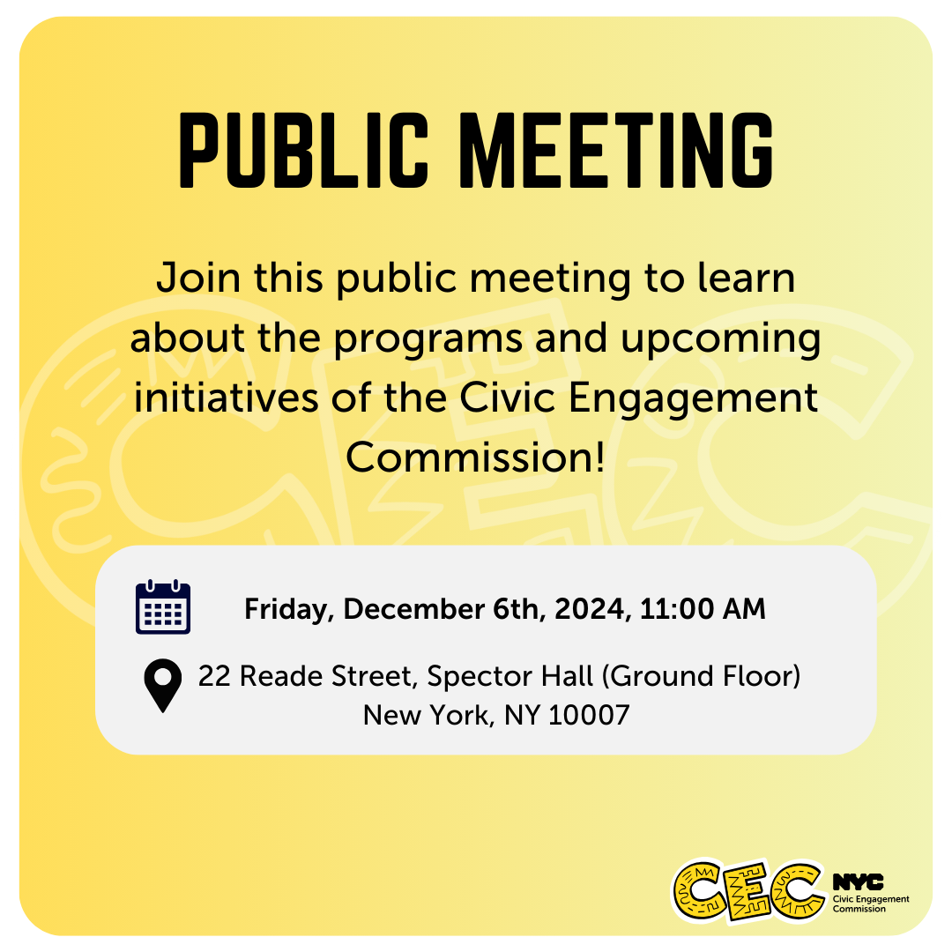

Public Meeting
December 6, 2024

Slide 2
Technology & Housekeeping
To Commissioners:
In-Person Participants:Please mute your microphone when you're not speaking and turn it on when needed
To Online Participants: Please mute your microphone when you're not speaking. Please unmute and let us know when you'd like to offer a comment, since we cannot see you.
To All Participants: ​
Call participants in the order they have registered for public comment prior to meeting, then during today's meeting​
Closed Captioning:​ Closed Captioning will be displayed on the smaller screen​.
​
To In-Person Participants:​
To submit a public comment, please add your name and affiliation to the sign in sheet by the door. We will call on you to speak in order received.​
To Online Participants:​
Closed Captioning:​ Closed Captioning is available online at https://bit.ly/CECCAPTIONS
To submit a public comment, please submit your name, affiliation, and public comment via email to info@civicengagement.nyc.gov or via text to 917-587-9103. We will read comments in order received.

Slide 3
Agenda
Attendance​
Approval of Meeting Minutes from September 18, 2024
Poll Site Methodology Resolution
Racial Equity Planning
  Drashti Brahmbhatt, Director of Equity Planning & Technical Assistance, Mayor’s Office of Equity & Racial Justice
  CEC Participation Resolution
Program Updates
  Voter Language Assistance Program
  Participatory Budgeting Program & TRIE Neighborhood Initiative
  Community Boards
  Language access
New Partnerships
Public Comment

Slide 4
Approval of Meeting Minutes

Slide 5
Resolution on Voter Language Assistance Metholodology

Slide 6
 | ACS 2016-2020 |  | ACS 2017-2021
 | CVALEP Population Estimate | Percent Share (%) | CVALEP Population Estimate | Percent Share (%) | Percent change: ACS 2020 to 2021
Russian | 79988 | 38.7 | 85845 | 39.2 | 0.49
Haitian | 20636 | 10.0 | 20961 | 9.6 | -0.42
Italian | 16036 | 7.8 | 15934 | 7.3 | -0.48
Arabic | 15581 | 7.5 | 15494 | 7.1 | -0.47
Yiddish | 15484 | 7.5 | 16710 | 7.6 | 0.14
Polish | 12860 | 6.2 | 14225 | 6.5 | 0.27
Bengali | 11601 | 5.6 | 12226 | 5.6 | -0.03
Urdu | 11220 | 5.4 | 11641 | 5.3 | -0.11
French | 10443 | 5.0 | 11377 | 5.2 | 0.14
Chinese (incl. Mandarin, Cantonese) | 8853 | 4.3 | 10147 | 4.6 | 0.35
Korean | 4127 | 2.0 | 4652 | 2.1 | 0.13
Notes:
~5.6% increase in total VAL CVALEP population

Slide 7
Racial Equity Plan
NYC Mayor’s Office of Equity and Racial Justice

Slide 8
Racial Equity Planning
New York City has started its first-ever, citywide racial equity planning process to address racial inequities. As a part of this process, the NYC Mayor's Office for Equity and Racial Justice (MOERJ) will work across city agencies to set goals, track progress, and make continuous improvements to eliminate racial disparities and promote fairness for all residents.
City agencies have been trained by MOERJ and are beginning work on their agency’s racial equity plan this summer. MOERJ is providing direct support and guidance to agencies throughout the planning process to ensure the production of strong plans.
Timeline
January-February 2024: Updated timeline published, and preparations made to kick off racial equity planning process.
March-May 2024: Planning process kicks off and drafting of agency plans underway.
June-Aug 2024: Draft plans reviewed, and Citywide Racial Equity Plan prepared.
September-October 2024: Preliminary Citywide Racial Equity Plan released and reviewed.
November 2024: Final Citywide Racial Equity Plan published.
December 2024: Preliminary TCOL measure and methodology published.
March 2025: Final TCOL measure published.

Slide 9

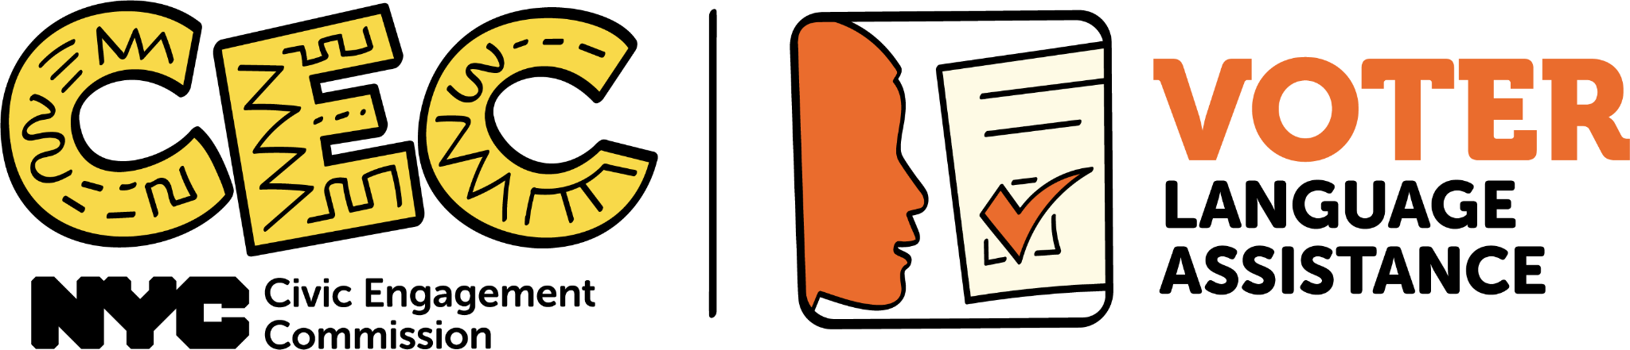
NYC CIvic Engagement Commission Logical Framework
Impact | NYC CEC aims to create a more inclusive and just city for all New Yorkers.
Mission | Our mission is to support and encourage New Yorkers to meaningfully participate in civic life. The CEC believes that active listening, as a process and practice, is central to building relationships and trust. The CEC is committed to being practitioners of participatory democracy and affirm our responsibility and commitment to lift the power and voices of all NYC communities.
Civic Participation
Voter Accessibility
Capacity Building
Select Outcomes
TRIE Partners
To increase agency among low income and diverse New Yorkers to define priority challenges and strategies to address them.
To strengthen the ability of community based organizations to improve the conditions of the people living in their neighborhood.
To increase the technical capacity of Community Board members to carry out their duties.
Increase the voter participation of Low English Proficiency (LEP) individuals in elections.
To increase influence among low income and diverse New Yorkers on how the city allocates funding to invest in community priorities.

Slide 10
Short Term
Goal: Ensure that all CEC public facing material is accessible to diverse communities through meeting Local Law 30 and plain language requirements
  Outcome: By 2026, 100% of our information assets are available in all Local Law 30 languages.
  Strategies:
· Collaborate with programmatic teams to compile an inventory of information assets and determine workflow for remaining translation
· Develop rubrics to assess the accessibility, clarity, and cultural competence of our public facing asset
· Leverage Language Advisory Committee (LAC) to ensure translations are culturally competent
Goal: Develop culturally competent communication and outreach strategies that leverage the arts to engage New Yorkers of diverse backgrounds
  Outcome: By 2026, 100% of artistic and communication strategies pass a rubric assessing accessibility and cultural competence.
  Strategies:
· Develop rubrics to assess the cultural competency of our communication and artistic strategies
· Collaborate with arts and culture organizations to increase New Yorker engagement with The People’s Money process

Slide 11
Medium Term
Goal: Develop disaggregated data pipelines for all programmatic work so that we can determine how we reach diverse communities and identify any potential disparities
  Outcome: By 2028, 100% of program lanes have data analytics dashboards created and integrated.
  Strategies:
· Collaborate with programmatic teams to develop data collection tools and strategies to measure how we are reaching diverse communities
Goal: Increase the technical capacity of Community Board members to carry out their duties to reduce poverty, discrimination, and inequality
  Outcome: By 2028, ensure that at least 75% of Community Board members who received capacity building training report an increase in knowledge on equity, and particularly racial equity.
  Strategies:
· Source and provide capacity building trainings on topics such as youth outreach, conflict resolution, fair and affordable housing, diversity and accessibility, the city’s budget, language access, parliamentary procedures, home ownership, harassment and discrimination, and the 2021 legislation on racial equity reports for rezoning
· Work to increase attendance and re-enrollment to workshops
· Create outreach strategies to target each community board by deploying CEC staff to attend at least one CB session a year

Slide 12
Medium Term
Goal: Reduce language barriers for voters who need interpretation assistance in elections
  Outcome: By 2028, increase representation of New York voters who prefer interpreter assistance in poll sites.
  Strategies:
· Facilitate language forums to inform voters of their rights to language services, ability to bring interpreters to the poll site, and information on what’s on the ballot
· To increase voter language accessibility in NYC poll sites by providing interpretation services
Goal: Collaborate with other agencies to introduce and encourage the usage of participatory processes to determine agency resource allocation
  Outcome: By 2028, pilot with at least two city agencies a participatory budgeting process.
  Strategies:
· Engage with city agencies to have them facilitate their own Idea Generation Sessions as part of The People’s Money
· Engage with city agencies to have them support the planning and management of the projects that get to be implemented through The People’s Money

Slide 13
Long Term
Goal: Invest in historically underserved neighborhoods to strengthen civic infrastructure
  Outcome: By 2034, spend more than 80% of participatory budgeting programmatic budget on diverse partnerships.
  Strategies:
· Apply lessons learned from data analysis to proactively seek diverse partners that are led by and that service CEC priority populations that we have not been able to work with before
· Enhance our budget management databases and practices to better report on demographic information from the organizations that we fund such as diversity in their boards in the case of 501c3, the diversity of the leadership, and other relevant information to assess that we are empowering through our operation budgets organizations led by CEC priority populations
· Increase capacity building for partnerships to generate greater impact on communities CEC serves
Goal: Increase agency among low income and diverse New Yorkers on how the city allocates funding to invest in community priorities
  Outcome: By 2034, reach 100% of equitable representation in idea generation sessions, borough assembly committees, and the voting process in all boroughs in terms of race, ethnicity, and gender identity as captured by most up to date census data.
  Strategies:
· Identify and address barriers to participation for priority populations and residents of TRIE equity neighborhoods
· Advocate for more funding to the participatory budgeting program to scale impact

Slide 14
Challenges
Staff Time
Competing expectations
New demands and requirements from legislation
Requirements from Mayoral Initiatives
Standardizing all agencies lead to frameworks that do not translate to our needs
  Voter utilization is relative to type of election, and voter turnout

Slide 15
Long Term
Goal: Invest in historically underserved neighborhoods to strengthen civic infrastructure
  Outcome: By 2034, spend more than 80% of participatory budgeting programmatic budget on diverse partnerships.
  Strategies:
· Apply lessons learned from data analysis to proactively seek diverse partners that are led by and that service CEC priority populations that we have not been able to work with before
· Enhance our budget management databases and practices to better report on demographic information from the organizations that we fund such as diversity in their boards in the case of 501c3, the diversity of the leadership, and other relevant information to assess that we are empowering through our operation budgets organizations led by CEC priority populations
· Increase capacity building for partnerships to generate greater impact on communities CEC serves
  Indicators:
· Number of priority populations specific partners
· Number of distinct TRIE organizations funded
· Percent of total PB funding for partners serving

Slide 16
Long Term
Goal: Increase agency among low income and diverse New Yorkers on how the city allocates funding to invest in community priorities
  Outcome: By 2034, reach 100% of equitable representation in idea generation sessions, borough assembly committees, and the voting process in all boroughs in terms of race, ethnicity, and gender identity as captured by most up to date census data.
  Strategies:
    Identify and address barriers to participation for priority populations and residents of TRIE equity neighborhoods
    Advocate for more funding to the participatory budgeting program to scale impact
  Indicators:
· Percent of idea generation sessions held with priority populations and/or in TRIE equity neighborhoods
· Percent of ideas produced from sessions in equity neighborhoods and/or from high priority populations
· Percent of diversity represented in each Borough Assembly Committee
· Percent of voters self-identifying residence in a TRIE equity neighborhood
· Percent of voters self-identifying with at least one high priority population

Slide 17
Program Updates

Slide 18
Voter Language
Assistance Program

Slide 19
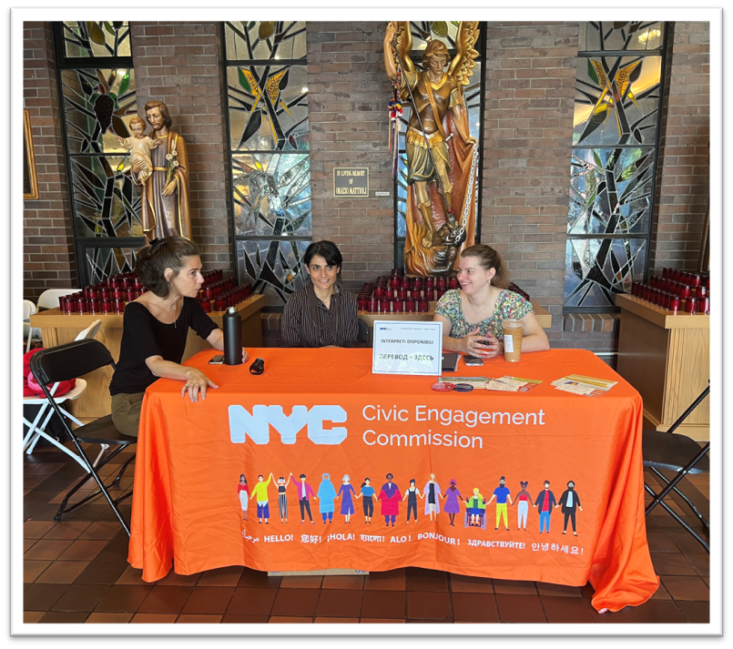
November 2024 General Election Services & Staffing
Services on November 2nd, 3^{rd*}, and 5th
*Yiddish Early Voting services provided November 1st and November 3rd
77 staff members on Nov 2nd and 3rd
217 interpreters and 18 supervisors served on Election Day
Notes:
Split primaries for April and June 2024 saw a 1% increase over the June 23 utilization rate

Slide 20
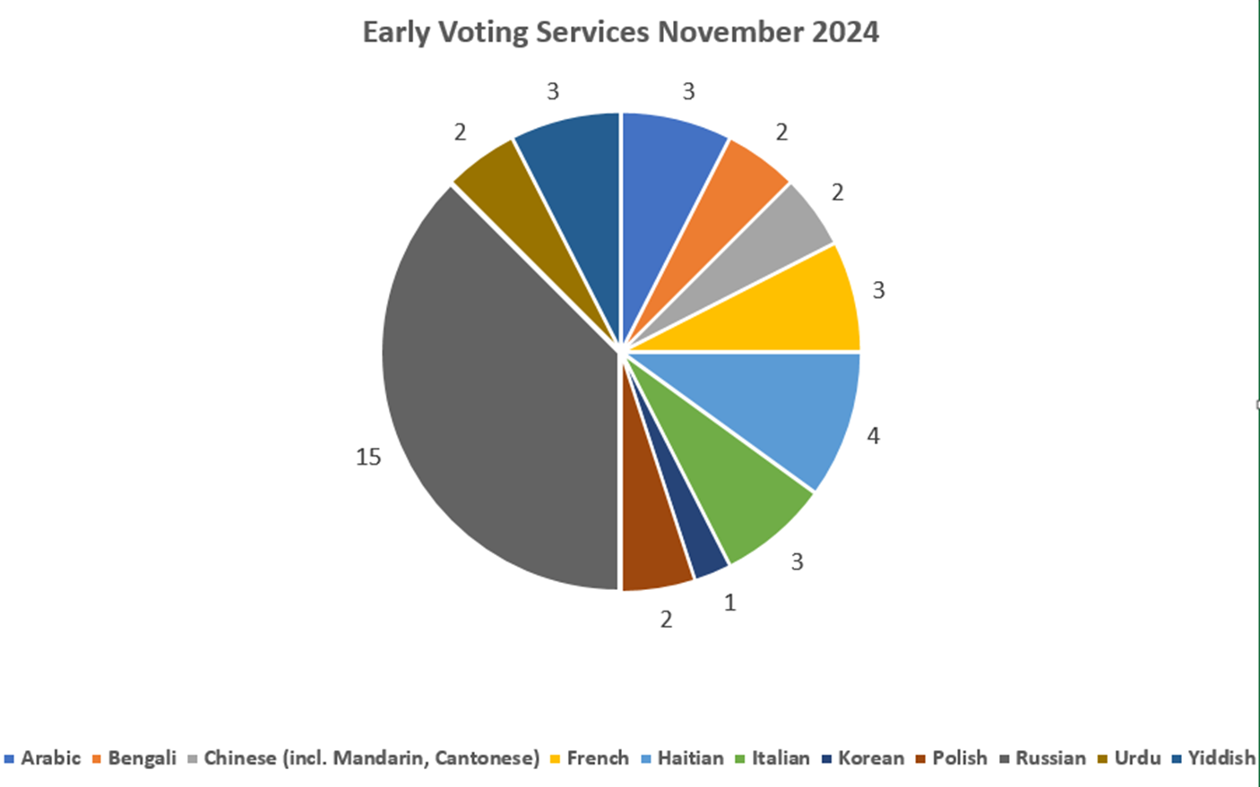
Voter Language Assistance - November 2024
Notes:
Split primaries for April and June 2024 saw a 1% increase over the June 23 utilization rate

Slide 21
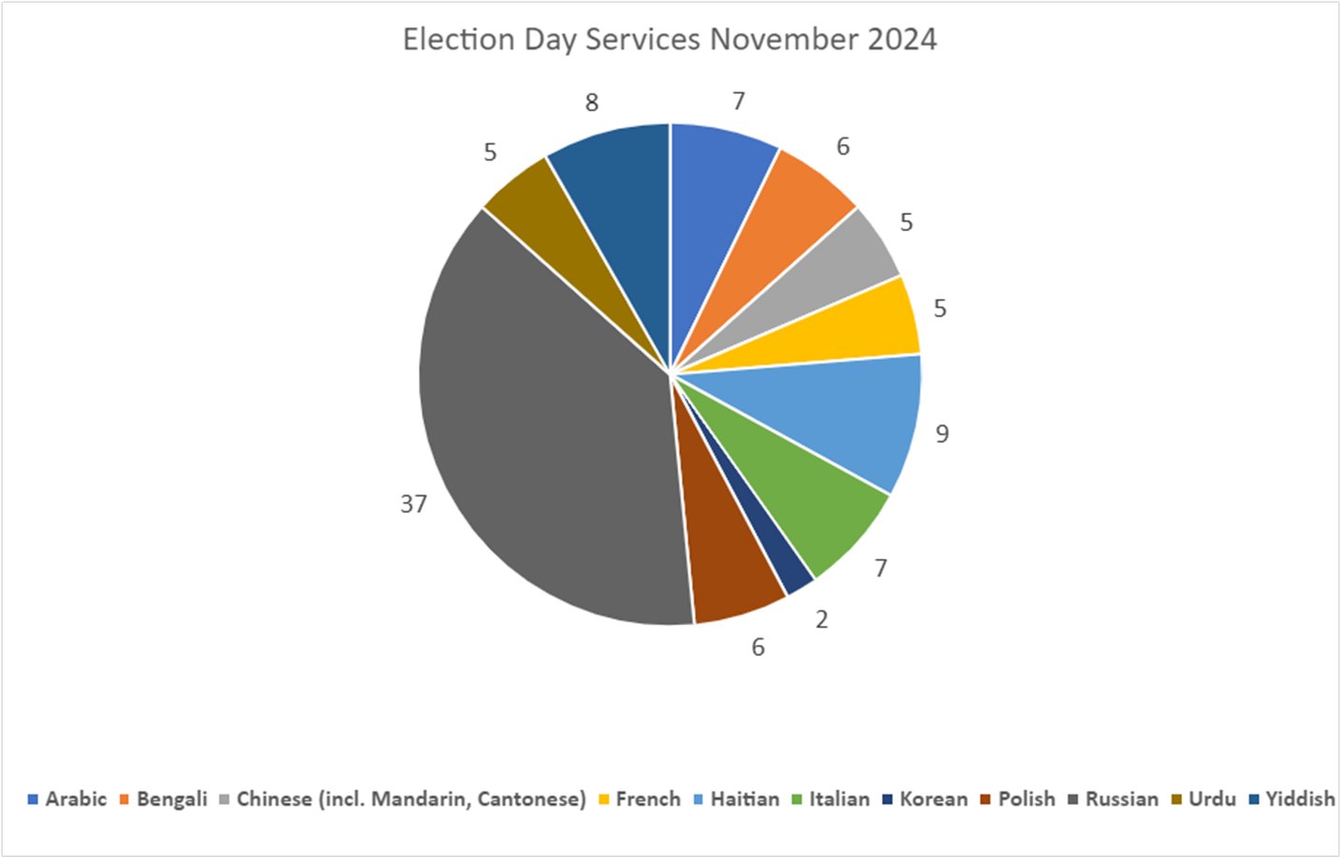
Voter Language Assistance - November 2024

Slide 22

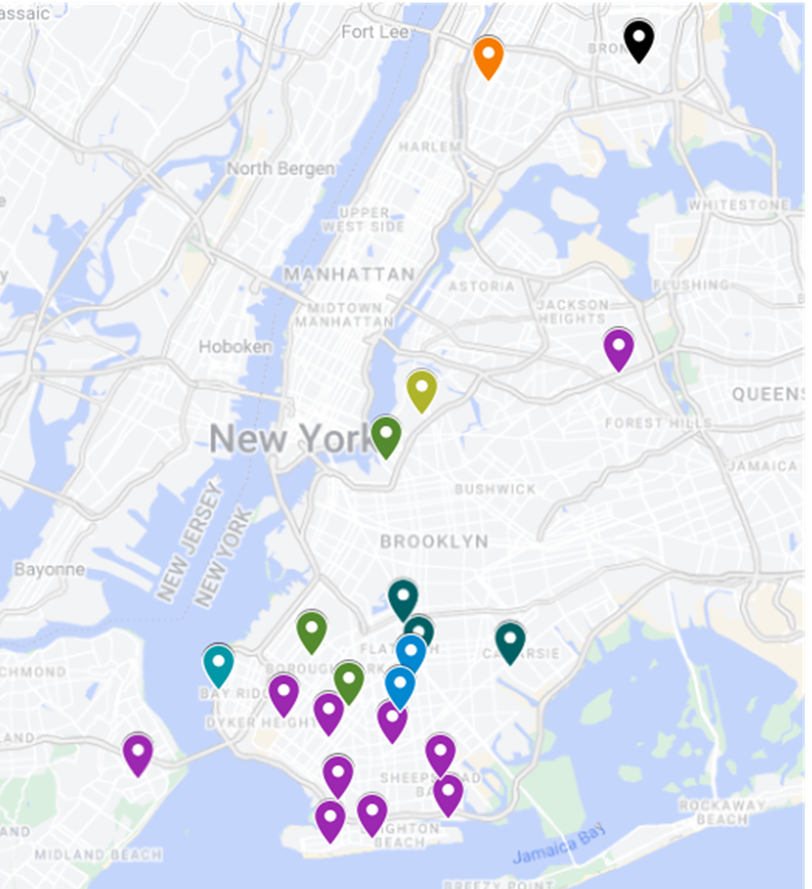

Slide 23

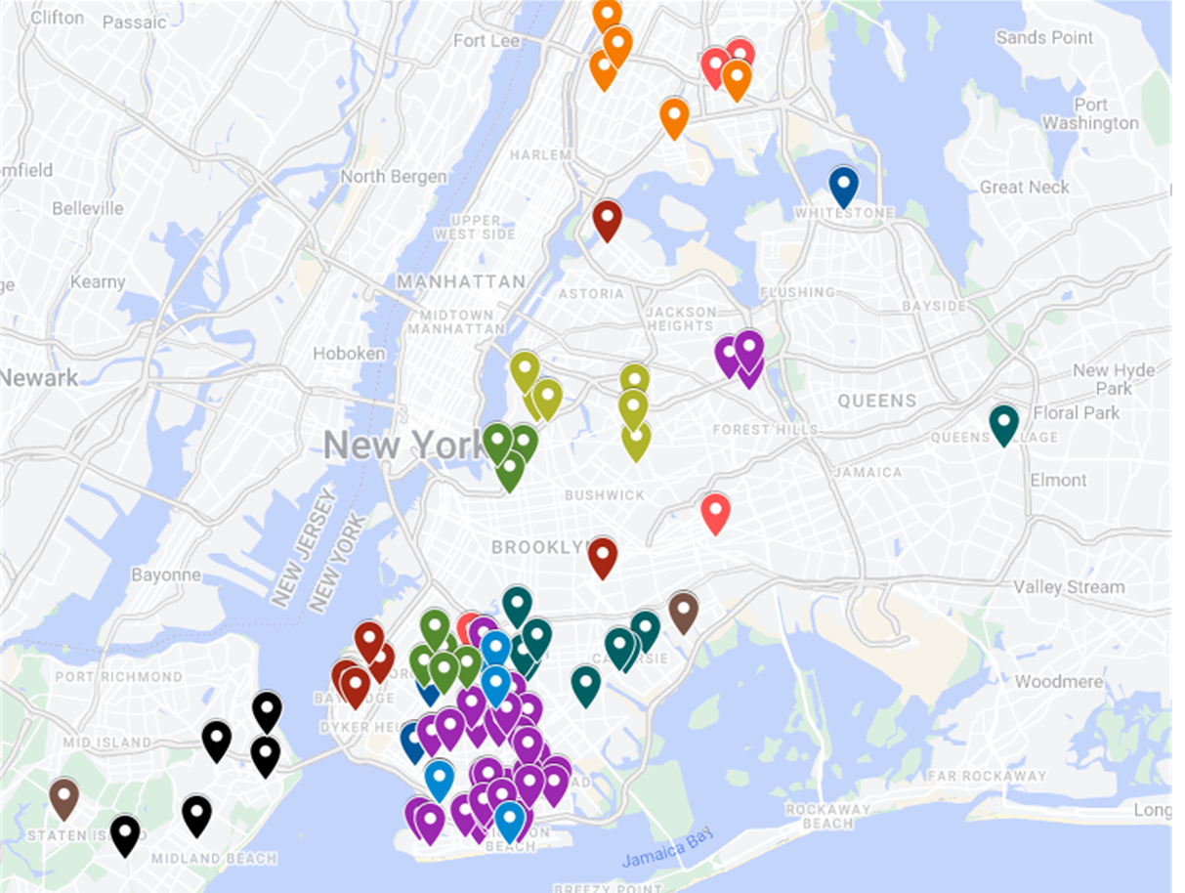

Slide 24
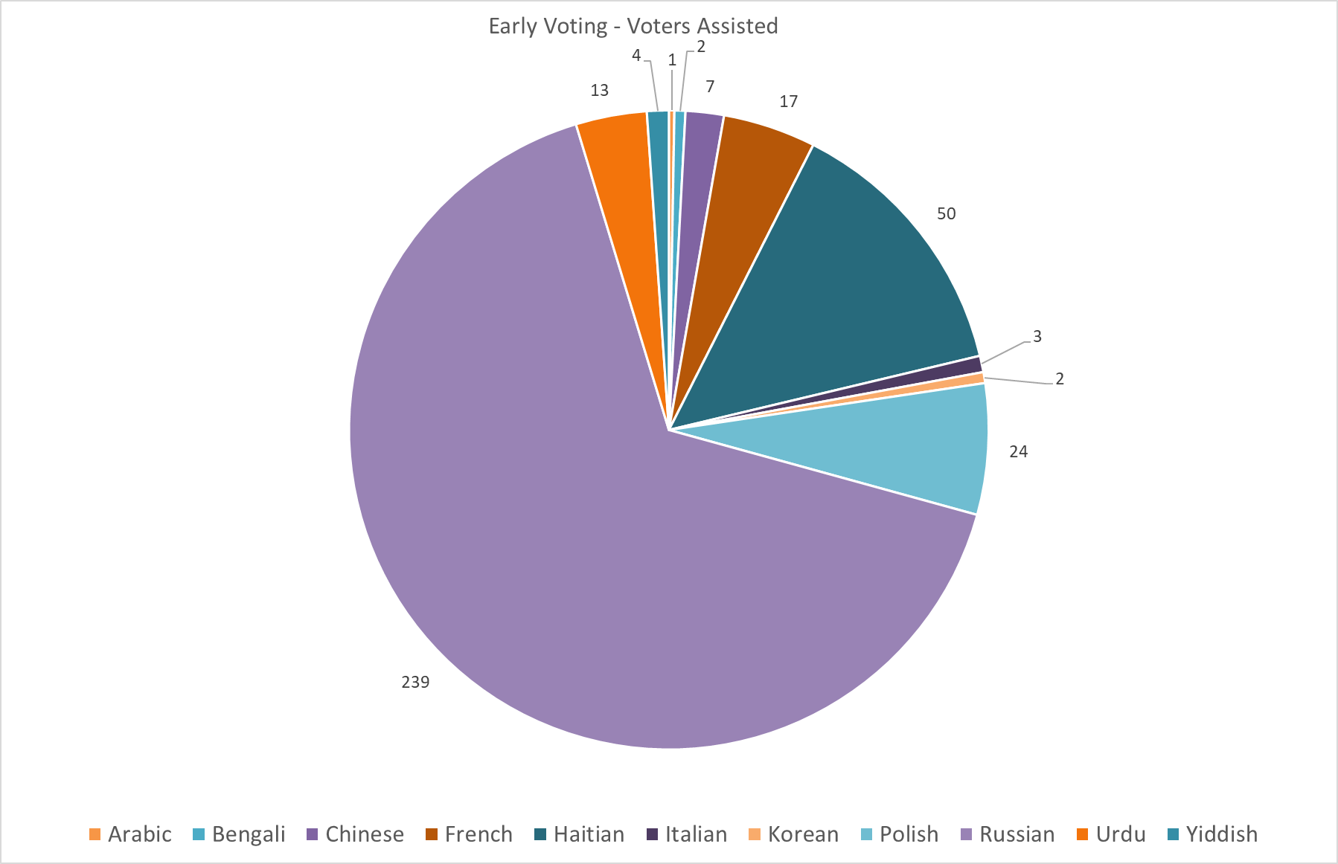
Voter Language Assistance - Early Voting
Arabic | 1
Bengali | 2
Chinese | 7
French | 17
Haitian | 50
Italian | 3
Korean | 2
Polish | 24
Russian | 239
Urdu | 13
Yiddish | 4

Slide 25
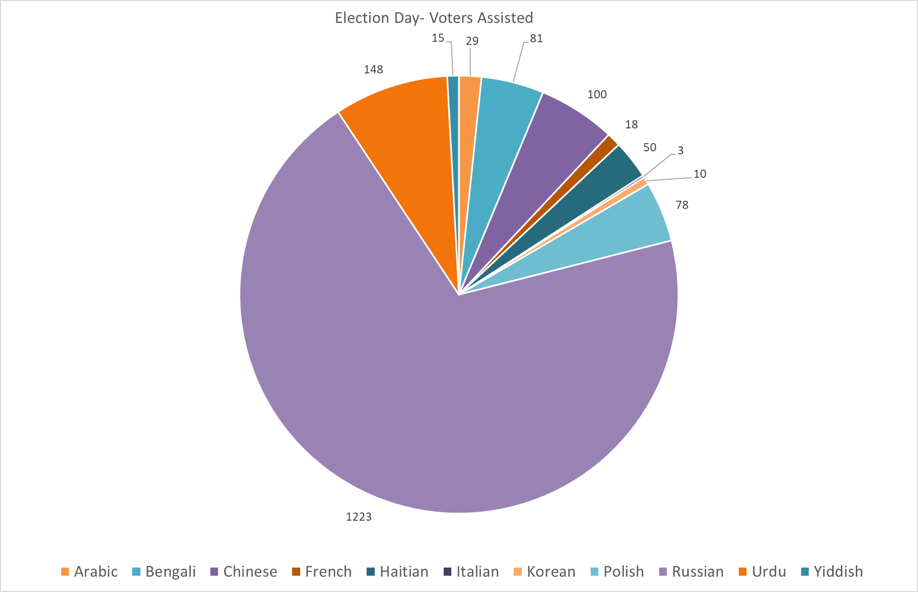
Voter Language Assistance - Election Day
Arabic | 29
Bengali | 81
Chinese | 100
French | 18
Haitian | 50
Italian | 3
Korean | 10
Polish | 78
Russian | 1223
Urdu | 148
Yiddish | 15

Slide 26
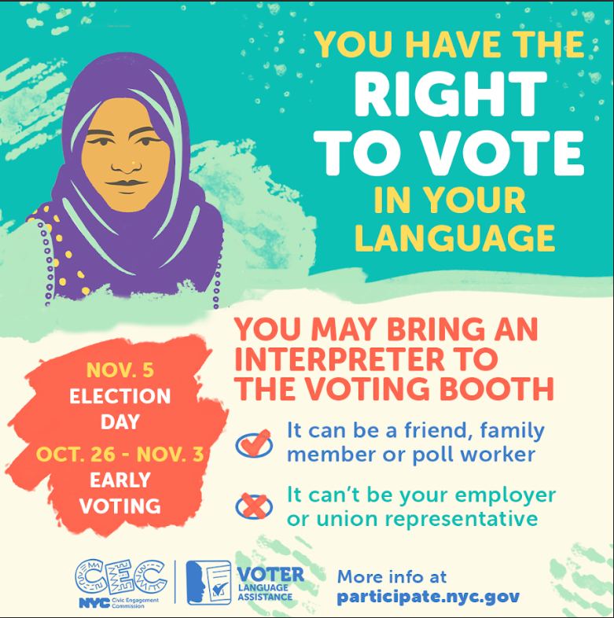
VLA Marketing & Outreach​
In-language VLA graphics ran on LinkNYC kiosks in poll site geographies and FY EYE PSA network.
Geo-targeted, META ads (~$3,000) reached 74,000 unique social media users​.
VLA PSA ran on Taxi TV, NYC Life, NYC Gov
100+ CBOs in poll site geographies received digital toolkit​.
CEC staff held presentation on VLA services at 5 Community Board meetings​.
3 voter education forums held: Polish in Greenpoint; Russian in Sheepshead Bay, Brooklyn; Arabic online​ – Total ~200 attendees reached.

Slide 27
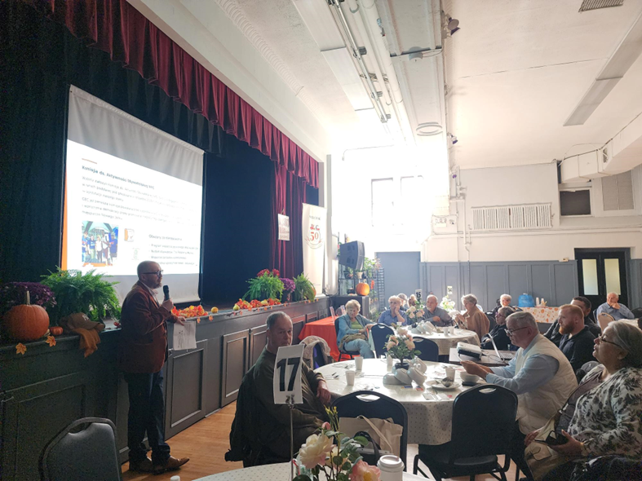
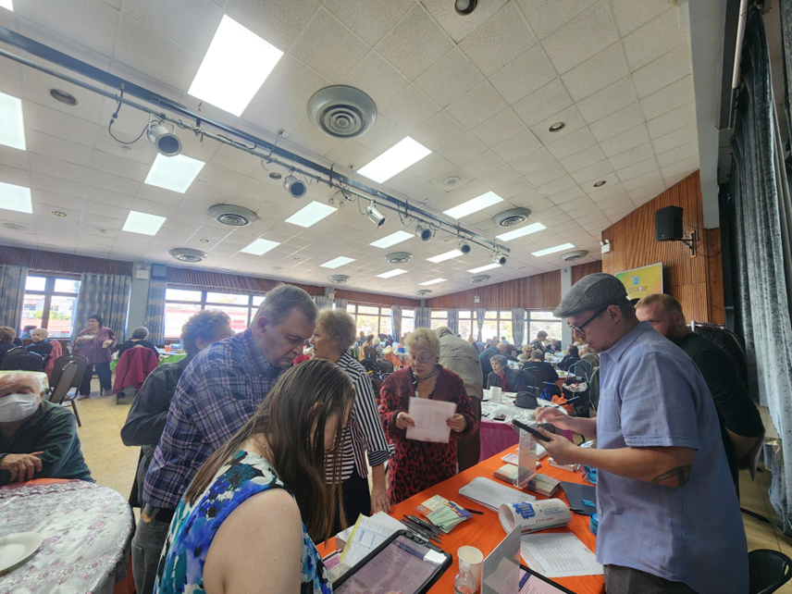
Language Assistance Advisory Committee Contributions​
Supported Polish, Russian, and Arabic voter education forums​.
Distributed palm cards and posters to organizations and businesses in poll site geographies​.
Distributed the VLA multi-language toolkit​.
Prepared in-language video messages for distribution in social media (Russian, Mandarin, Urdu, Italian)​.
Sent emails to more than 20,000 recipients.
Posted on Social Media. ​

Slide 28
Voter Language Assistance - Look Ahead
Recruit for and launch new LAAC Cohort.
Plan for June 2025 primary - outreach strategy, ad buys, operational plan, etc.
Assess feasibility for a new VLA website with mirror versions for all VLA languages.
Refresh Ranked Choice Voting collateral.

Slide 29
Language Access Across Programs

Slide 30
Upcoming plans
Conduct Language Access training for new CEC hires in mid-December
  Will cover topics such as LL30, language access principles, interpretation / translation differences, language access integration into CEC Programs
Make new language access airtable base and request form operational by end of December
Support BAC sessions for the next phase of PB with interpreters as needed beginning in January

Slide 31
Upcoming plans
Translation Style Guide for all programs: draft for mid January
Language Access Methodology for The People’s Money: draft for mid February–with implementation starting with 2025 voting phase

Slide 32


Slide 33
2025 Winter / Spring Community Board Workshops
Dept of Records and Information Services (CB Staff Only)
New York City Records Management
December 9 and January 10
Housing Preservation and Development
Homeowner / Tenant series: Intro to Dept of Buildings; Energy Efficiency and Solar Power; Rental Housing Discrimination and Harassment; Tenants: Know Your Rights
Ten sessions in January
De-Escalation Training (in person per borough)
Five sessions coordinated with Borough Presidents.
Monitoring & Evaluation Training (Two part workshop)
Brooklyn - January 29 & February 5
All Boroughs - February 19 & 26
New Program: We will also be offering limited individualized workshops in topics of interest starting with Parliamentary Procedures and the City Budget.

Slide 34


Slide 35




The People’s Money Cycle: Current Status
Fall
Winter
Spring
Ongoing Thru FY
Phase 1: Idea Generation
Phase 2: Borough Assemblies
Phase 3: Voting
Phase 4: Project Implementation
And Evaluation
Year 1
Year 2
Complete
Complete
Complete
Complete
Begins in January!
Complete
Complete
Complete
In process
Year 3 Complete!

Slide 36
Cycle 3, Phase 1: Idea Generation
The People's Money IG phase ran for 6 weeks from ​Oct 11th- Nov 24th 2024
Worked with 170 Community Partners
  28 TRIE partners
  46 Tiers 1-3 Partners
  91 Tier 4 partners (hosting orgs)
  25 Community facilitators
Partner Debrief is scheduled for December 11th @ 10am on Zoom, Register here
Phase 1: Idea Generation

Slide 37
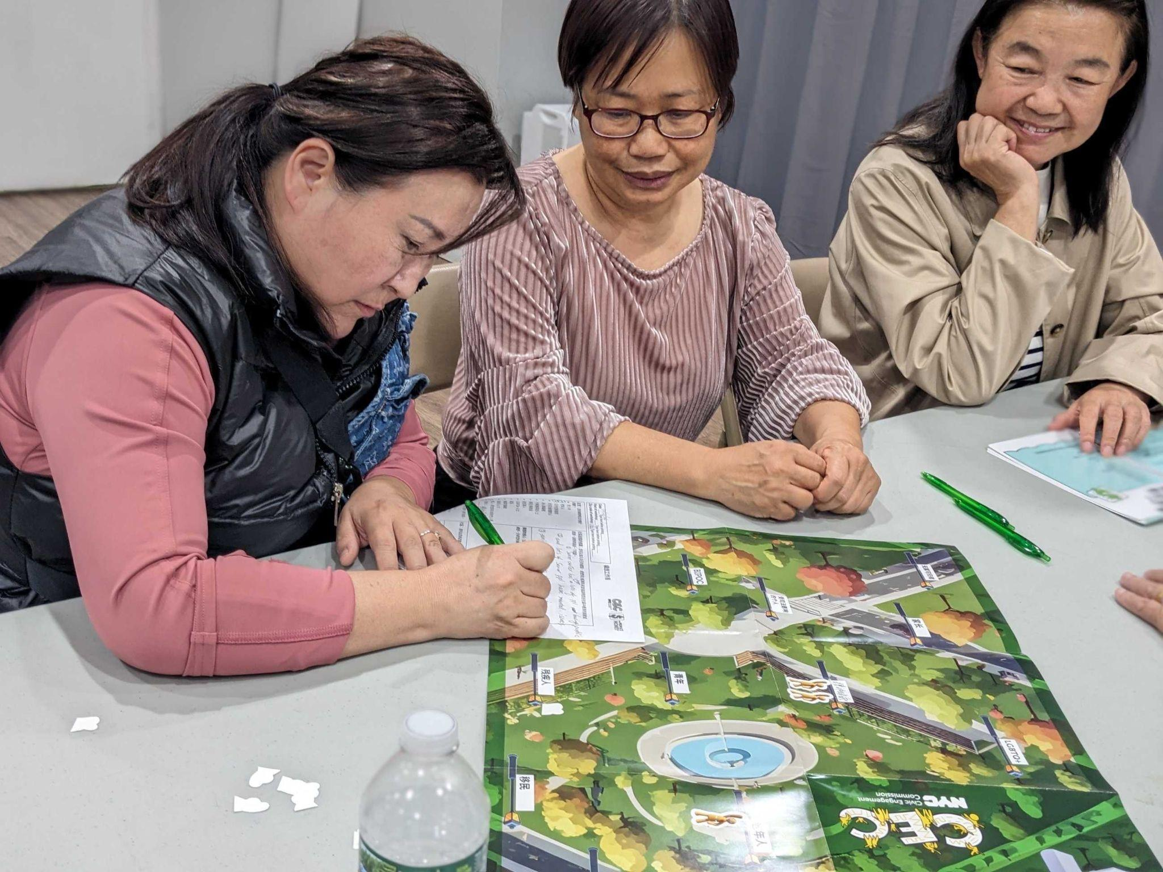
Idea Generation 2024
The Commission funded 170 community partners, to host in person idea generation sessions in all five Boroughs and 33 Equity Neighborhoods​.
​
Sessions Held:
509 Sessions
Ideas Generated:
3,429 ideas submitted
Participants Engaged:
9,564
These numbers are subject to change as we are still in process!

Slide 38
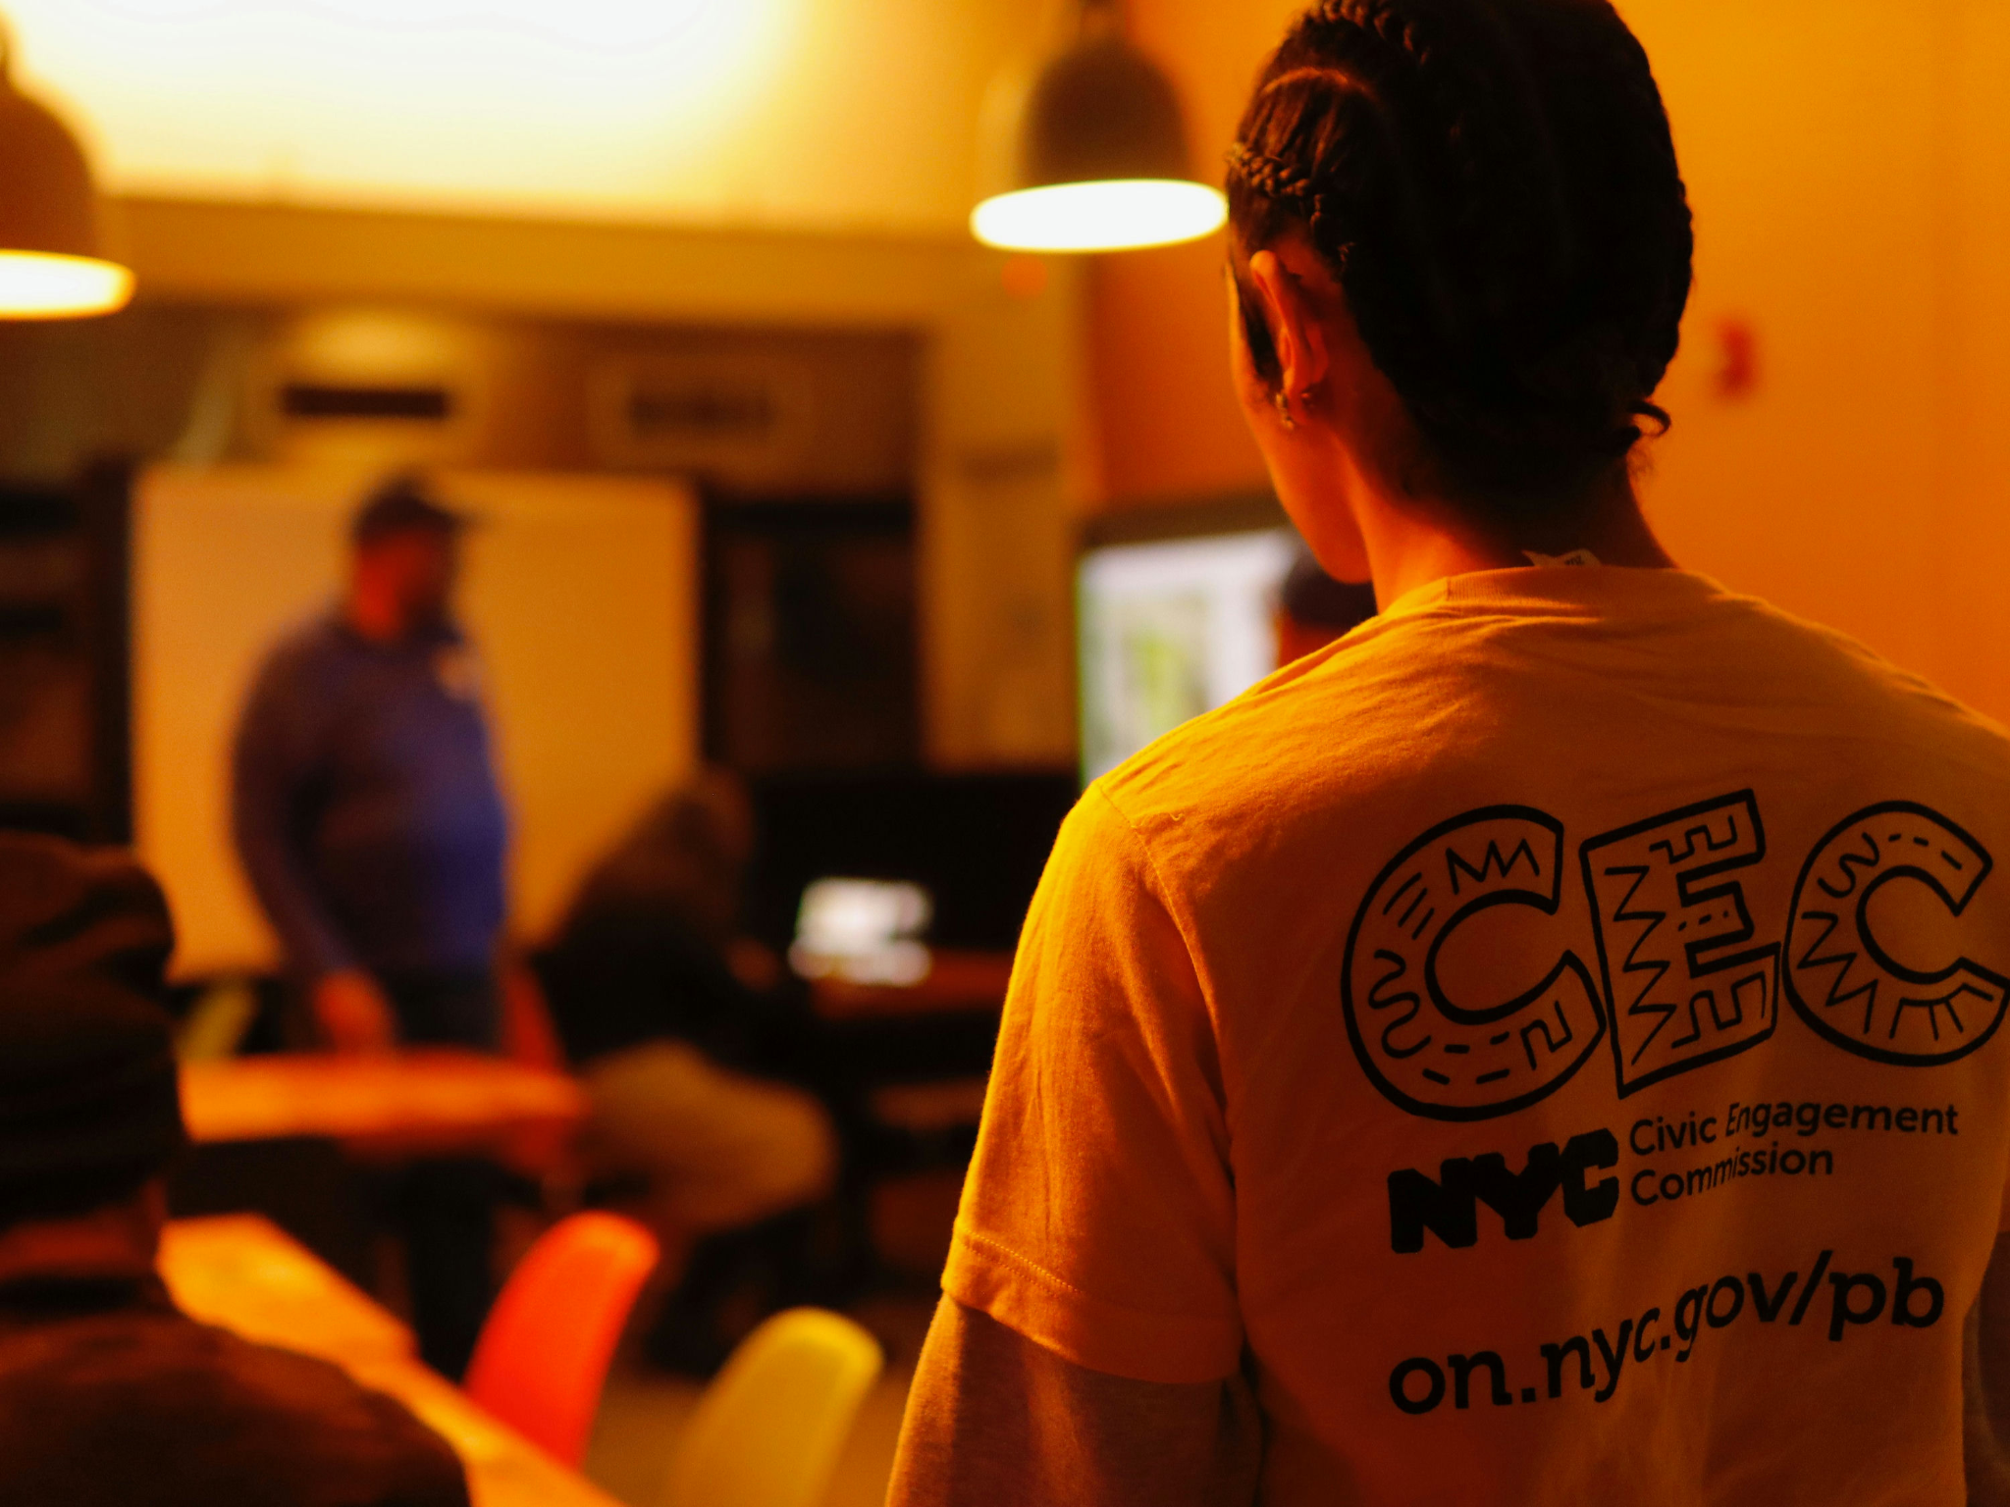
Idea Generation 2024
Exit Surveys Collected:
3,499
Borough Assembly Applications Collected:
1,359
38% EXIT survey response rate!
(We are still Counting!)

Slide 39
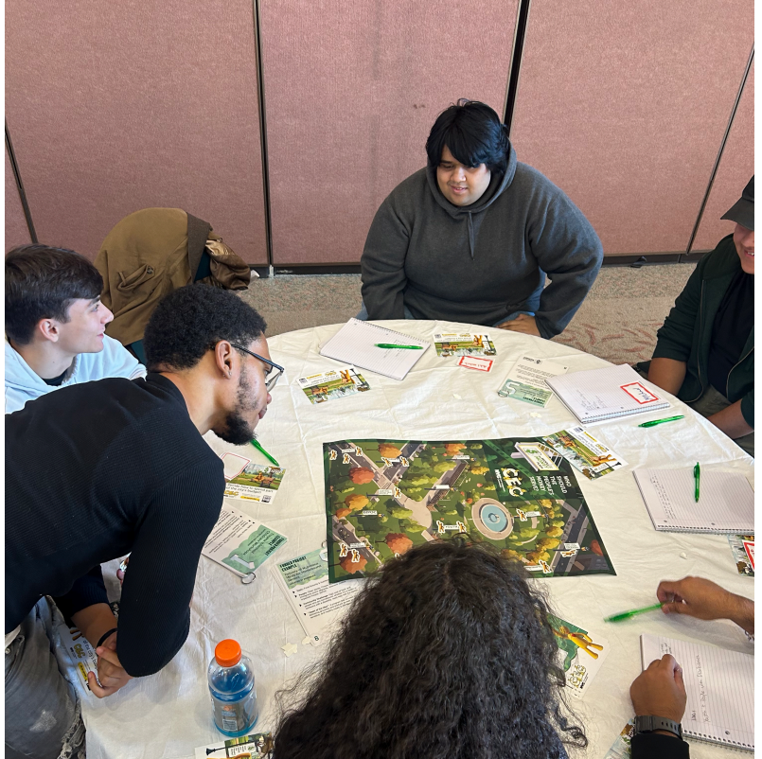
“We really enjoy being a part of citywide participatory budgeting, and especially the engaging conversations we get to have with participants - it's inspiring!”
What we’ve heard from partners
“This experience has also strengthened our relationship to the community because of our CONSISTENCY engaging the community through the PB process from year to year.”
“It was wonderful and improves every year.”

Slide 40
Comparing Cycles 1-3
 | Cycle 1 | Cycle 2 | Cycle 3 | % Change from year 2
Date | 09/12-11/19 [8.5 weeks] | 10/10-11/19 [6 weeks] | 10/11-11/24 [6.5 weeks] | -
Partners | 82 (50 PB, 32 TRIE) | 100 (70 PB, 30 TRIE) | 170 (46 PB, 28 TRIE, 98 Tier 4) | 70%
Workshops | 523 | 441 | 509 | 16%
Participants | 12,344 (avg. 24 per session) | 9,215 (avg. 21 per session) | 9, 564 (avg. 16 per session) | 6%
Ideas | 2,022 | 1,943 | 3,429 | 76%
Surveys | 3,771 | 3,349 | 3,499 | 5%
BAC Apps | 409 | 1,157 | 1,359 | 17%

Slide 41
Next Steps: Borough Assemblies?
Staff vets the 3,429 submitted ideas for eligibility and categorizes ideas into impact areas
Staff bundles ideas into like categories and prepares them for borough assembly members to review
Borough Assemblies begin January 21st

Slide 42
Tier 4 Outreach

Slide 43
Tier 4 Single Session Goals
Created and Managed a new program called Tier 4 Idea Generation Session
Team Consisted of
  Barbara Williams, Benjamin Solotaire, Anthony Carrion, Catherine Gao, Samira Zeru, Dan Botting
Recruit 75 organizations, including libraries, to host one session. Some paid, some unpaid
Hire 25 Community Facilitators to run 75 single idea sessions for the host partners

Slide 44
Tier 4 Single Session Final Numbers
Community Facilitators - 23 (2 dropped out due to personal reasons)
Final Number of Partners/Hosts - 89
  Non-profits - 46
  Libraries - 33
  Council Members - 2
  Older Adult Centers - 4
  Shelters - 4
Total Number of Sessions Held - 102

Slide 45
TRIE

Slide 46
2024 TRIE Neighborhood Initiative (TNI)
The CEC is partnering with 30 CBOs across 31 TRIE Neighborhoods to:
Build and maintain local coalitions
Participate and support the People’s Money, including project implementation!
Develop and facilitate the CEC’s Civic Engagement is People Power Workshop
TRIE Neighborhood Partner/Coalition Gaps:
Lower East Side and Chinatown, and
Fordham and University Heights

Slide 47
TRIE Initiative Key Highlights
Coalition Building
Since Oct., TRIE partners led 32 coalition meetings with neighborhood stakeholders to raise awareness about the People’s Money, strategize ways to get community members involved, and exchange resources and information about local events
The People’s Money
The first quarterly Implementation x TRIE Partner meeting brought together organizations implementing projects and/or conducting community outreach to make connections and generate ideas for collaboration to strengthen program delivery

Slide 48
TRIE Initiative Key Highlights cont.
Civic Engagement Workshop - “Civic Engagement is People Power”
Goals of the workshop include defining civic engagement and the relationship between concepts of power, love, and justice, seeing examples of different types of civic action, and learning about opportunities to get started!
The deck includes customizable modules on topics, such as advocacy and organizing, community boards, voting, and volunteering.
Partners will be trained on the workshop content later this month, and will facilitate them in the spring.
Capacity-Building Training
Equity Data Mapping with Equity NYC
Monitoring & Evaluation with Mark Johnson

Slide 49
Implementation

Slide 50
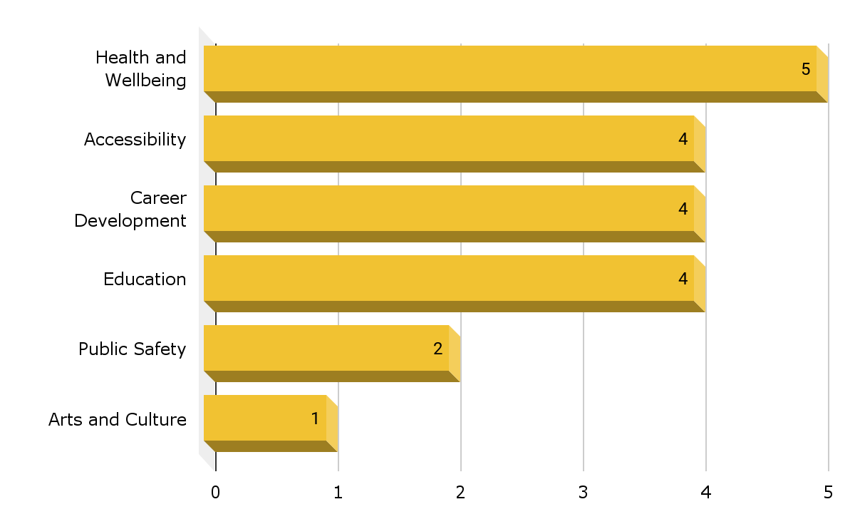
Winning Projects - Impact Areas
Health and Wellbeing - 5
Accessibility - 4
Career Development - 4
Education - 4
Public Safety - 2
Arts and Culture - 1

Slide 51
Winning Projects - Brooklyn
Project | TRIE Neighborhood(s) | Funding
Life Prep for High School Students | Bedford Stuyvesant | $200,000 each
Language and Job Recertification Information for Immigrants | Sunset Park
Errands for Older Adults and People with Disabilities | Coney Island, Brighton Beach
Path to Success: Positive Money Habits | Brownsville, East NY, Starrett City, Cypress Hills, Bushwick
Home Repair Liaisons for Older Adults | Flatbush, Canarsie, East Flatbush

Slide 52
Winning Projects - Queens
Project | TRIE Neighborhood(s) | Funding
Healthy Meals Partnership | Richmond Hill, South Ozone Park, Queens Village, Jamaica, South Jamaica, Hollis, St. Albans, Rochdale, Springfield Gardens | $170,000 each
Youth Empowerment After School Workshops | Rockaway, Broad Channel
Connection Resource Center | Briarwood, Woodhaven
Bridging the Skills Gap: Job Training for High Schoolers | Queensbridge
Connectivity Program for Seniors | East Elmhurst, Corona

Slide 53
Winning Projects - The Bronx
Project | TRIE Neighborhood(s) | Funding
Job Training for Young Adults and Adults in Trade Work | Morrisania, Crotona, Mott Haven, Melrose, Hunts Point, Longwood | $174,000 each
College Prep and Career Readiness for Youth | Williamsbridge, Norwood, Olinville, Edenwald, Wakefield, Kingsbridge, Kingsbridge Heights, Bedford Park
Creative Mental Wellness Program for Families with Children | Belmont, East Tremont, Fordham, University Heights
Slashing Bronx Hunger and Boosting Knowledge About Healthy Eating | Highbridge, Concourse, Mt. Eden
Youth Activity and Enrichment Program with the Arts | Soundview, Clason Point, Castle Hill, Unionport

Slide 54
Winning Projects - Manhattan & Staten Island
Project | TRIE Neighborhood(s) | Funding
Mothers Matter | Morningside Heights, Hamilton Heights, Central Harlem | $150,000 each
Restorative Justice for Youth | East Harlem
Self-Defense Education for Women | Washington Heights, Inwood
Resource Outreach for People with Disabilities | Lower East Side, Chinatown
Building Success for High School Students | St. George, Stapleton, Port Richmond, Tompkinsville, Mariner’s Harbor | $180,000

Slide 55
Implementation Timeline
Sept, 2024 - Oct, 2025
Project Planning (Sept, 2024 -Dec, 2025)
Needs Assessment
Logical Framework
Pre/Post Survey Design
Project Implementation (Dec, 2024 -Oct, 2025)
Project Execution
Data Collection
Project Progress Reporting
Project Reporting (Oct, 2025)
Mid-Project Report
Final Impact Report

Slide 56
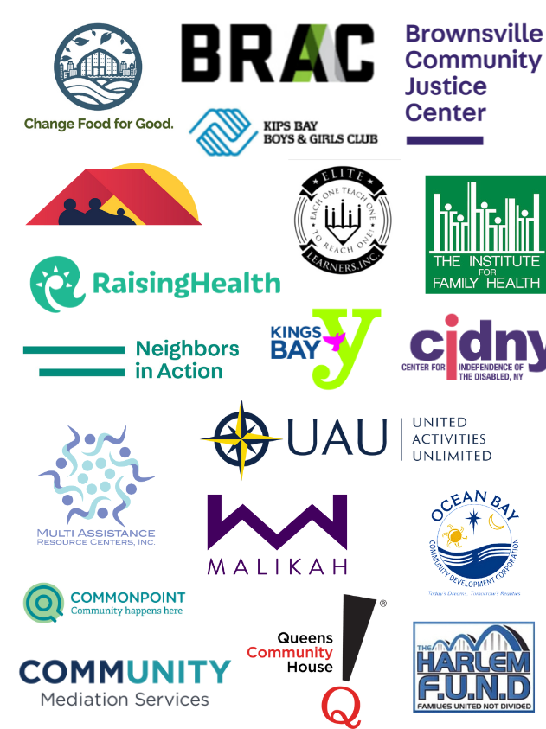
Implementing Partners
19 Implementing Partners
Change Food for Good
Kingsbridge Heights Community Center, Inc.
Kips Bay Boys and Girls Club, Inc.
The Bronx River Art Center, Inc.
The Institute for Family Health
Academy of Medical & Public Health Services d.b.a. RaisingHealth Partners
Center for Justice Innovation: Brownsville Community Justice Center
Center for Justice Innovation: Neighbors in Action
Elite Learners, Inc.
Kings Bay YM-YWHA
Center for Independence of the Disabled, NY
Malikah Inc.
Multi Assistance Resource Centers
The Harlem Fund
Community Mediation Services
Ocean Bay Community Development Corporation
Queens Community House
Samuel Field YM & YWHA dba Commonpoint
United Activities Unlimited, Inc

Slide 57
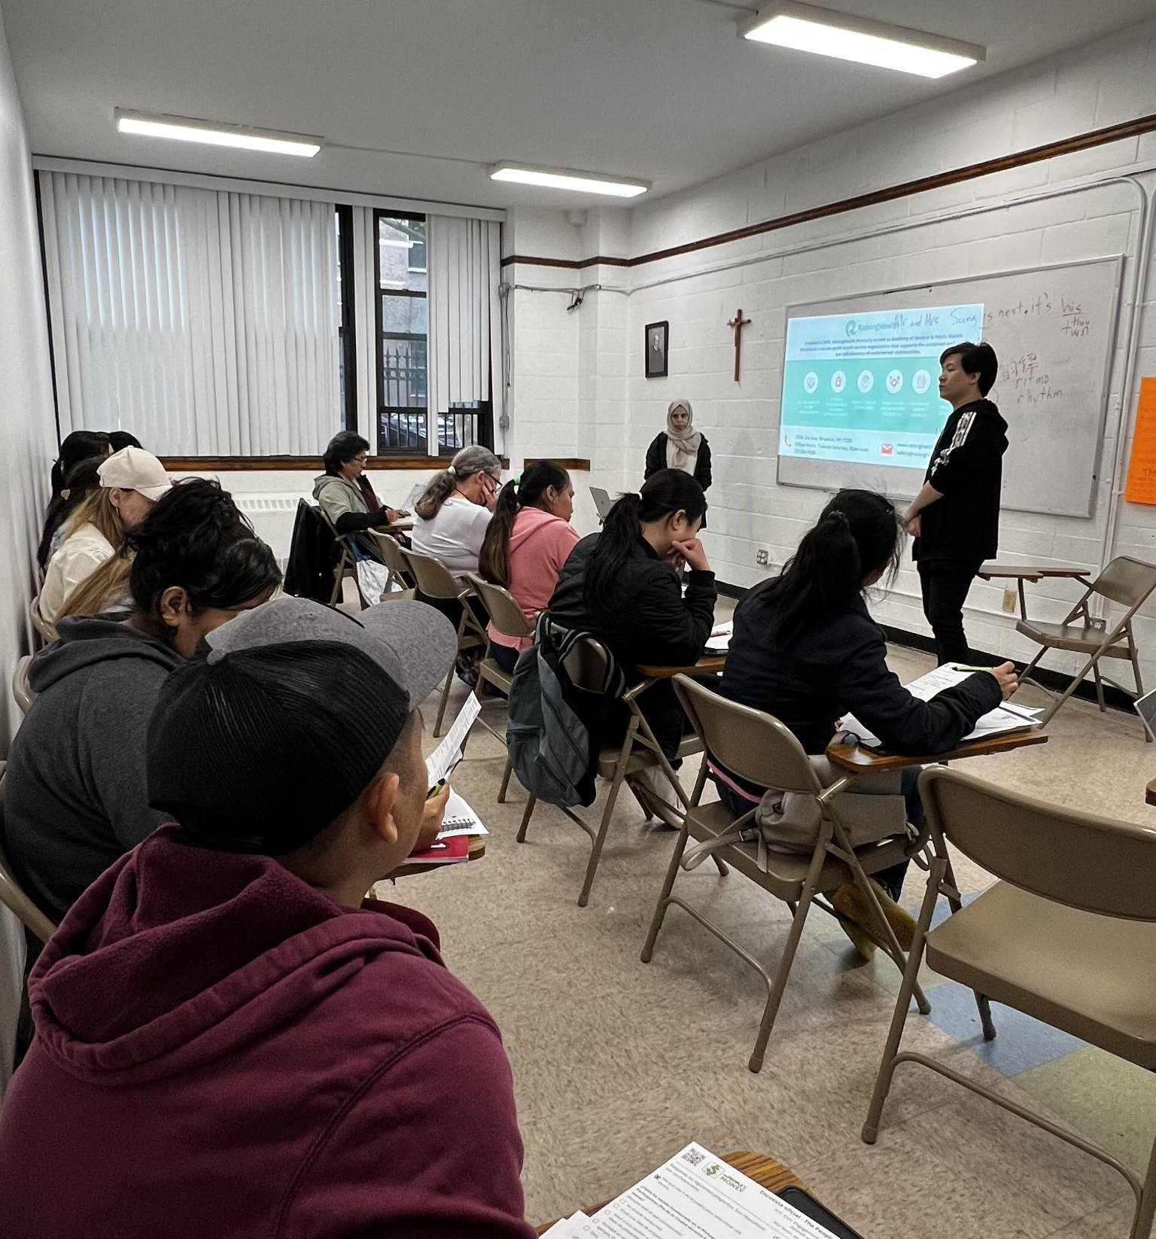
Capacity-Building Workshops
We are requiring organizations to participate in an in-person cohort-based Project Cycle Management capacity-building initiative at The New School to support the planning, implementation, and monitoring of the projects.

Slide 58
Capacity-Building Curriculum Changes
Year 1
(46 CBOs)
Resources/Logistics
6 In-Person Workshops
5 Student Assistants
4 Cohorts of 12 CBOs
Curriculum/Assignments
Needs Assessment
Logical Framework
Pre/Post Survey
Year 2
(20 CBOs)
Resources/Logistics
10 In-Person Workshops
4 Student Assistants
2 Cohorts of 10 CBOs
Longer Planning Period
Individual Zoom or In-Person Support
Curriculum/Assignments
Needs Assessment
Stakeholder Mapping
Logical Framework
Pre/Post Surveys

Slide 59
Public Comment

Slide 60

Thank You!
@NYCCEC | nyc.gov/cec

