Slide 1
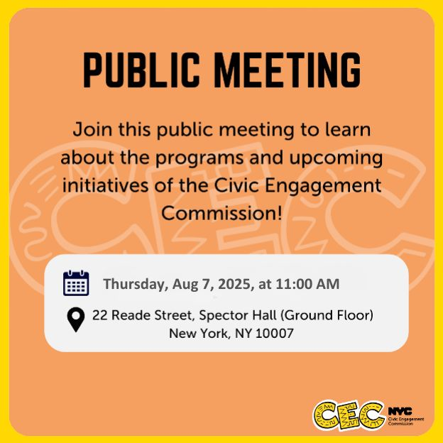
Public Meeting
Aug 7, 2025

Slide 2
Technology & Housekeeping
To Commissioners:
In-Person Participants: Please mute your microphone when you're not speaking and turn it on when needed
To Online Participants: Please mute your microphone when you're not speaking. Feel free to unmute and let us know when you'd like to offer a comment, since we cannot see you.
To All Participants:
Call participants in the order they have registered for public comment prior to meeting, then during today's meeting
Closed Captioning: Closed Captioning will be displayed on the smaller screen
To In-Person Participants:
To submit a public comment, please add your name and affiliation to the sign in sheet by the door. We will call on you to speak in order received.
To Online Participants:
To submit a public comment, please submit your name, affiliation, and public comment via email to info@civicengagement.nyc.gov or via text to 917-587-9103. We will read comments in order received.

Slide 3
Agenda
Attendance
Approval of Meeting Minutes from June 12, 2025
CEC Values Statement
Program Updates
Voter Language Assistance in the Primary
Community Boards
The People’s Money Participatory Budgeting
Project Implementation
Winning Projects (Cycle 3)
Vote Results & Participant Demographics
Requests for Information (RFI)
TRIE Neighborhood Initiative Program Logo
Update on CEC Staff Strategic Planning
Public Comment

Slide 4
Approval of Meeting Minutes

Slide 5
Values Statement

Slide 6
CEC Values Statement (revised 7/31)
The Civic Engagement Commission’s purpose is to promote participation in civic life, enhance civic trust, and strengthen democracy in New York City. Our programs provide education and support to residents so they can take part in civic life.
The CEC believes that active listening is central to building relationships, understanding and trust with New Yorkers. We affirm our responsibility to lift the power and voices of underserved and underrepresented NYC communities. To build a more inclusive, fair, and just city for all New Yorkers, we ground this work in the following core values:
DIGNITY
We affirm the equal worth of human beings regardless of identity or ability. We commit to being responsive to residents’ needs and concerns, and to delivering our programs with respect and care.

Slide 7
CEC Values Statement (revised 7/31)
ACCOUNTABILITY
We commit to being transparent and regularly sharing information with New Yorkers about our processes and decisions. We commit to improving our programs based on feedback from the communities we serve.
COLLABORATION
We commit to working with communities and prioritizing their lived experiences. This is essential to solve our collective challenges. We commit to fostering spaces for dialogue and amplifying the voices and stories of community partners.
ACCESSIBILITY
We commit to work towards removing barriers to information and resources for our communities. We will promote justice for marginalized and underserved communities. We will communicate keeping in mind plain language, different abilities, and language access.

Slide 8
CEC Values Statement (revised 7/31)
CREATIVITY
We commit to inviting New Yorkers into spaces filled with beauty, joy, and hope. We honor everyone’s story by using art, music, and storytelling to bring people together. We believe creativity, play, and imagination are essential for a thriving democracy.
MANIFESTING COMMUNITY POWER
We commit to supporting community leadership. We will provide education about government systems and processes. These actions will allow communities to exercise power over decisions affecting their lives.

Slide 9

Voter Language Assistance

Slide 10
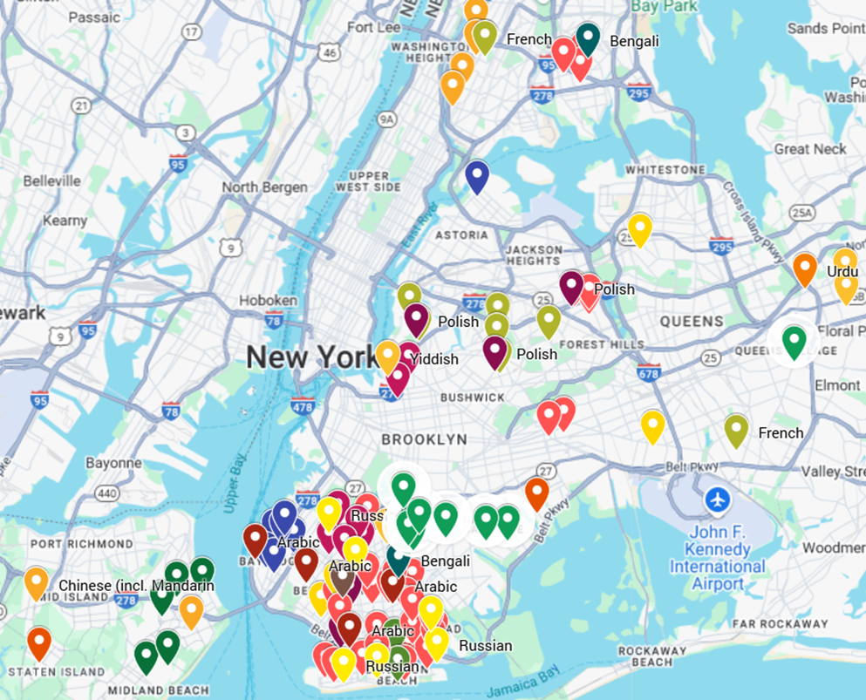
June Primary VLA Services
100% of services delivered as planned:
•26 Unique Early Voting Poll Sites, total 46 language services
•90 Unique Election Day Poll Site, total 94 language services

Slide 11
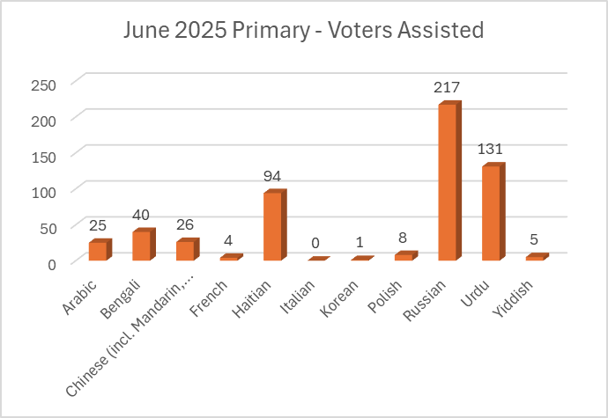
Utilization
Total: 569 voters assisted 551 - Language Assistance
18 - General Assistance

Slide 12
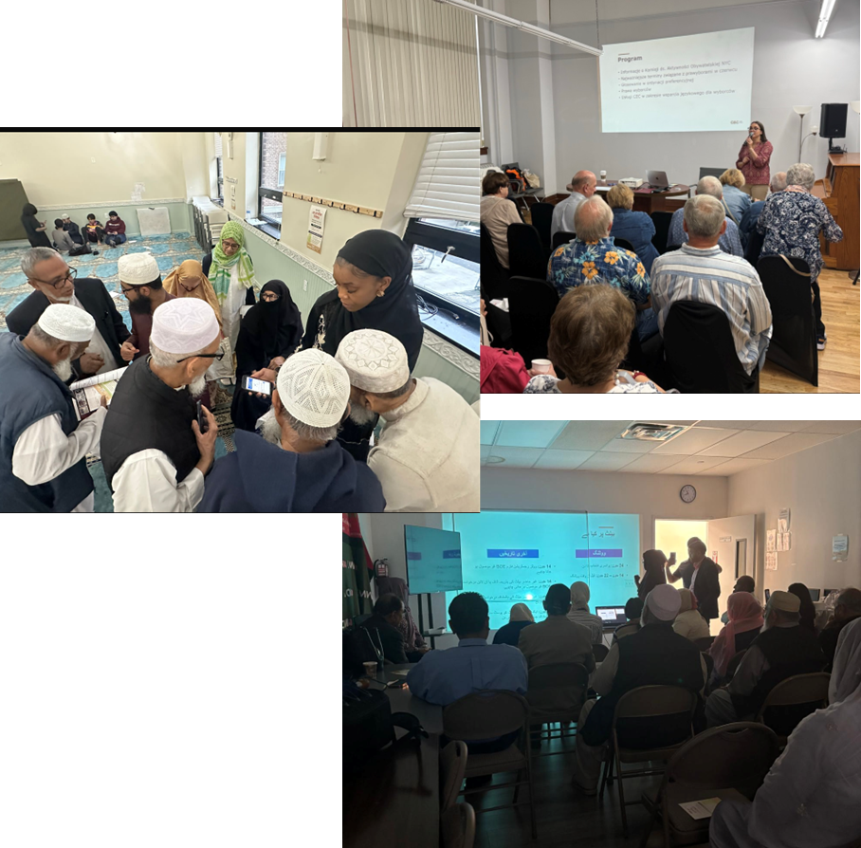
13 CBO-led RCV/Voting Rights Workshops
BX – Bengali: Parkchester BK - Bengali: Cypress Hills
BK - Haitian: Canarsie, Flatbush
BK - Polish: Greenpoint
BK - Arabic: Bay Ridge
BK - Russian: Brighton Beach, Coney Island, Sheepshead Bay
BK - Urdu: Bensonhurst, Brighton Beach, Midwood
SI - Korean: Willowbrook QN - Arabic: Astoria

Slide 13
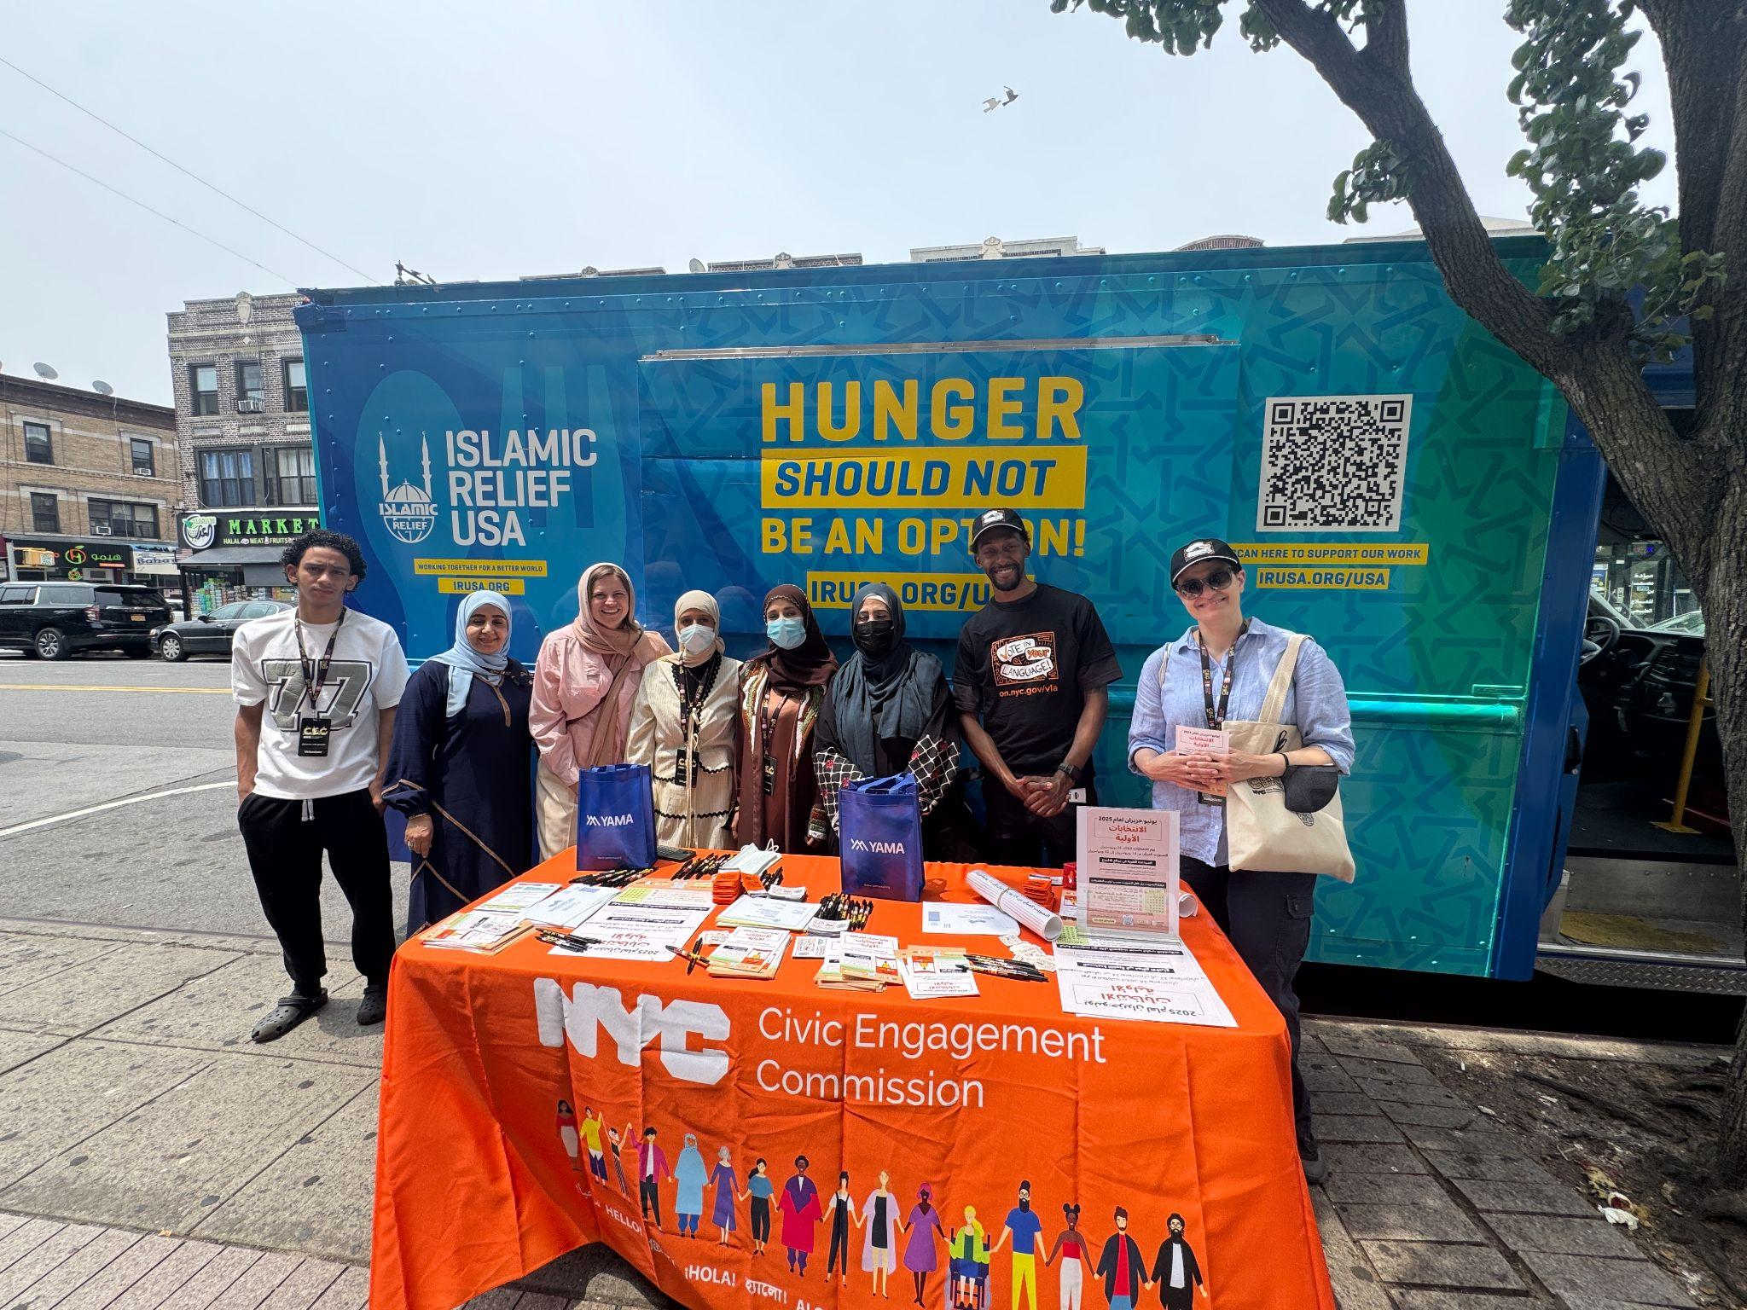
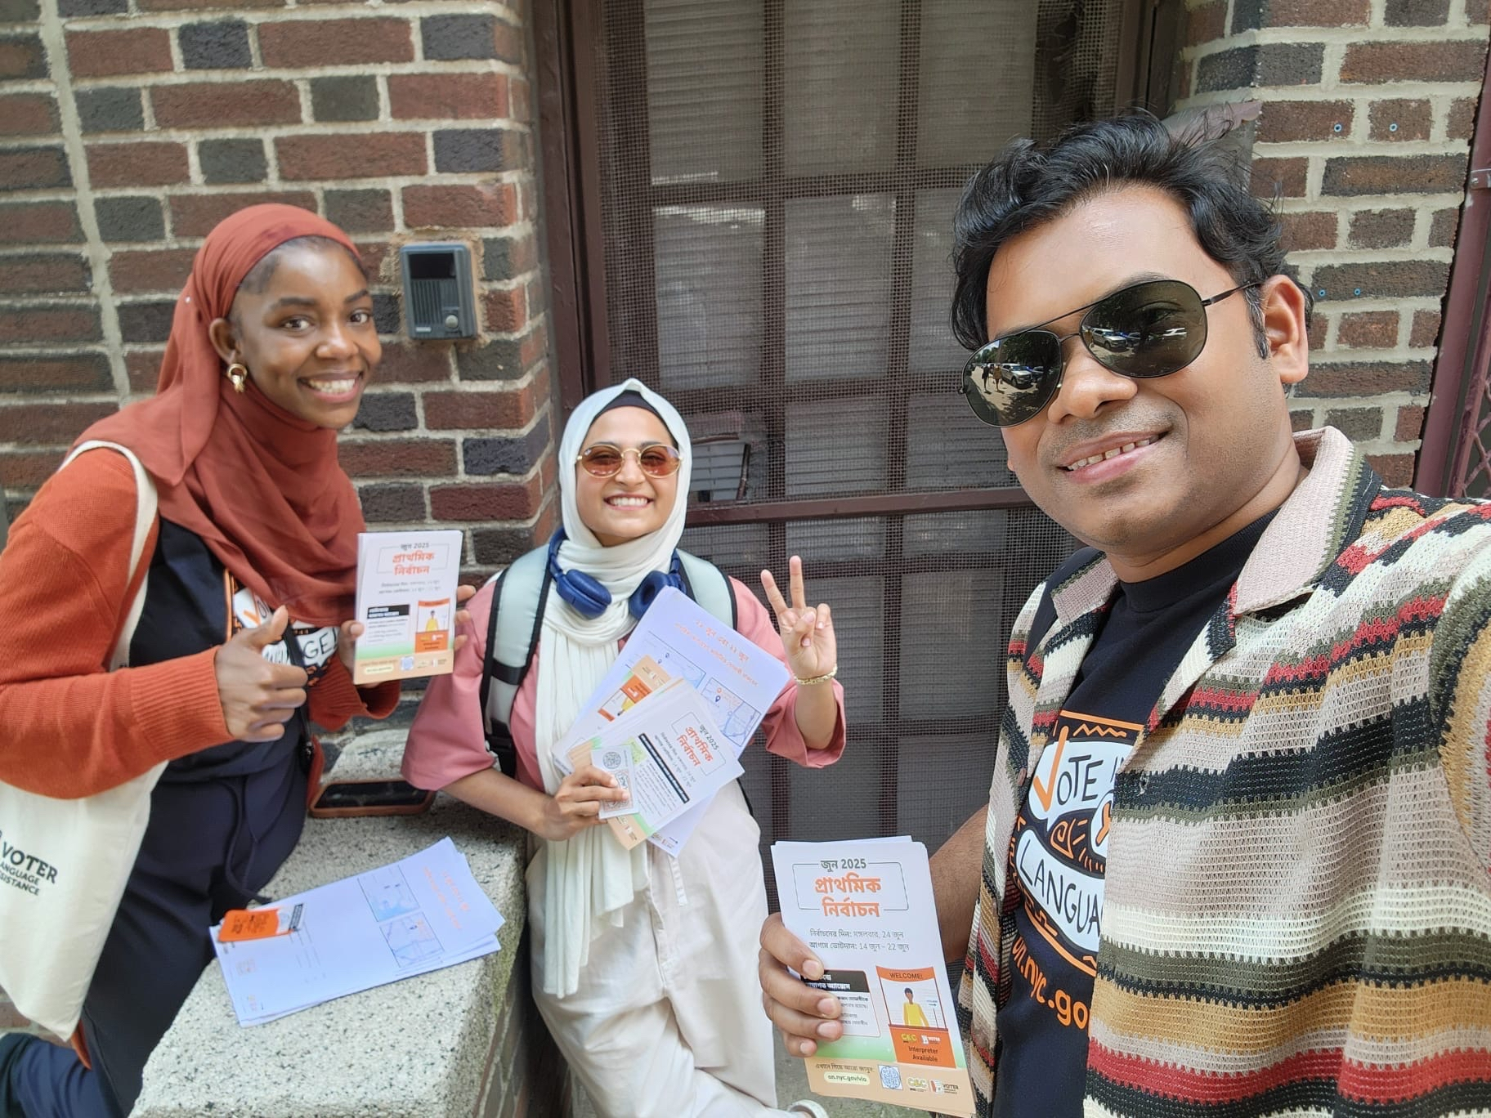
Additional Outreach
Sheepshead Bay, BK | Russian
Sunset Park, Bay Ridge (BK) & Citywide Virtual | Arabic
Parkchester, BX | Bangla & French
Flatlands, BK | Haitian
Brighton Beach and Bath Beach, BK | Urdu

Slide 14


Slide 15
Plans for 2025/2026
Building relationships with Borough President offices
Have started having conversations about what they are looking for and workshops that will help them
Offering more customized workshops
Based on last spring smaller in person workshops help build personal relationships and increases trust in CEC by being responsive to what a board needs
While customized workshops are effective we will continue to offer some all city workshops to keep us on the radar of all board members
Working with FCBWG towards term limit preparedness
Options discussed include a video or one pager explaining term limits; offering Gov 101 workshops for new members; and a possible citywide gathering of leadership
Working with DCAS to roll out NYCityLearns to all board members

Slide 16
The People’s Money

Slide 17
Project Implementation
Winning Projects
Vote results

Slide 18
Project Implementation

Slide 19
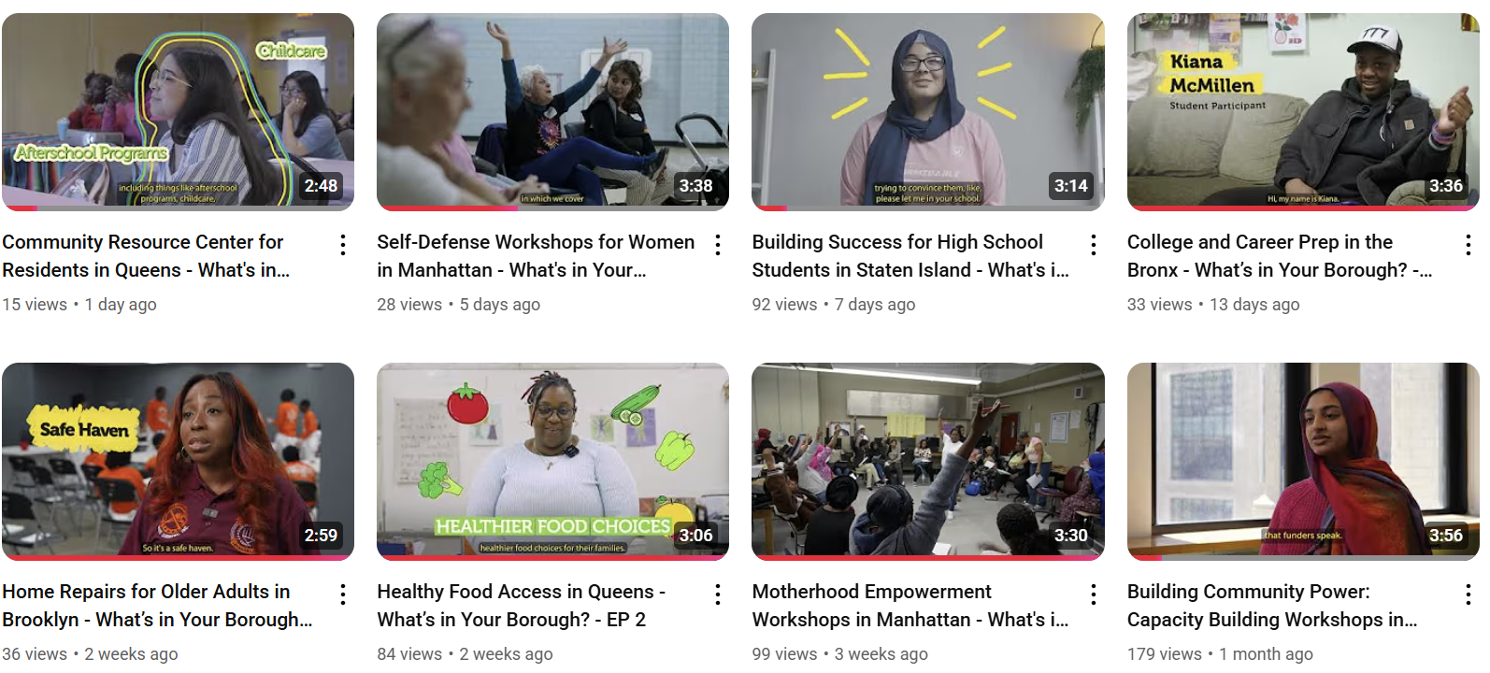
“What’s in Your Borough?” Videos

Slide 20
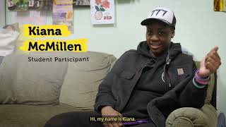
Notes:
Bron

Slide 21
Vote Results

Slide 22
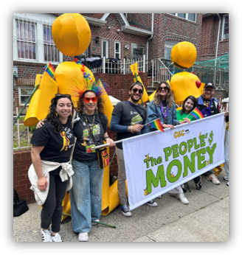
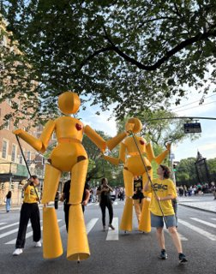
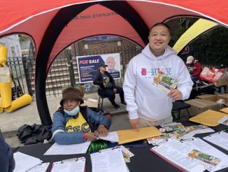
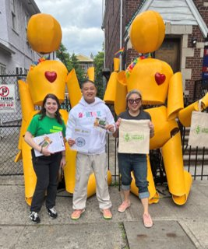
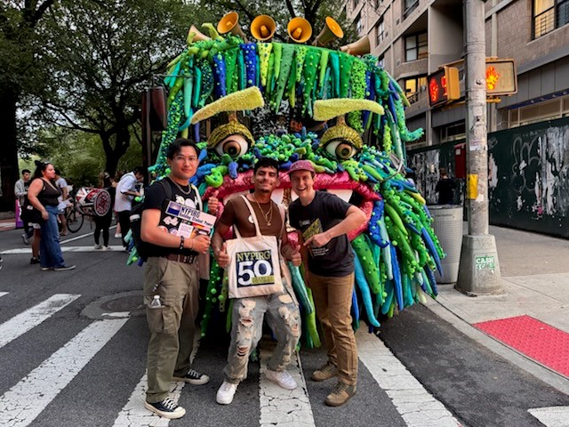
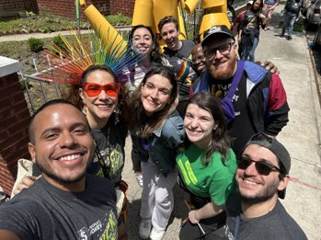

Slide 23
131,527 Votes were cast!
Votes Collected
Queens: 5,241 Digital + 31,906 Paper = 37,147 Votes​
Brooklyn: 5,181 Digital + 26,995 Paper = 32,176 Votes​
Bronx: 3,351 Digital + 25,975 paper = 29,326 votes​
Staten Island: 1,168 Digital + 10,182 Paper = 11,310 Votes​
Manhattan: 3,640 Digital + 17,888 Paper -= 21,528 Votes ​
Total Votes: 18,581 Digital + 112,946 Paper = 131,527!
This is our vote tally as of 8/4/2025

Slide 24
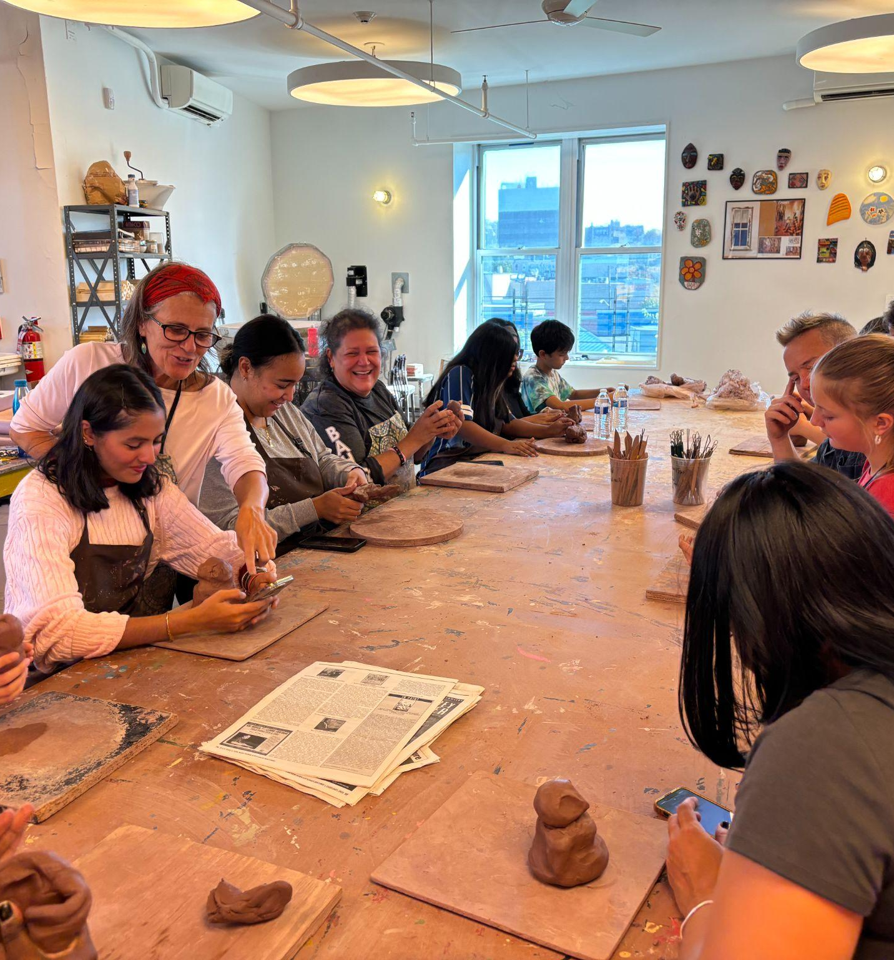
The Bronx
Youth-Led Performing Arts Program
Healthy Food and Literary Nights for Families and Individuals
STEAM Enrichment for Bronx Youth and Teens
Support People with Housing Advocacy Groups
Support for Parents and Guardians of Amazing Special Kids

Slide 25
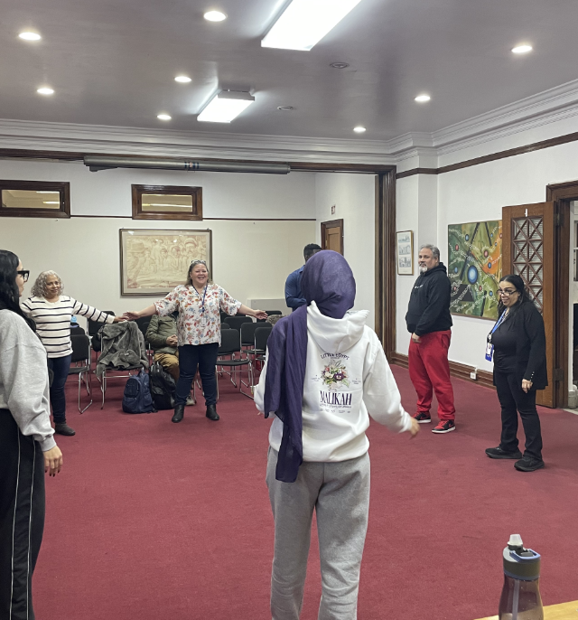
Manhattan
Youth Entrepreneurship Program + “The People’s Design by Community” Fellowship Program
Learn to Grow and Cook Your Own Food
Everyone Should be Able to Swim
Vocational Training for Middle and High School Students

Slide 26
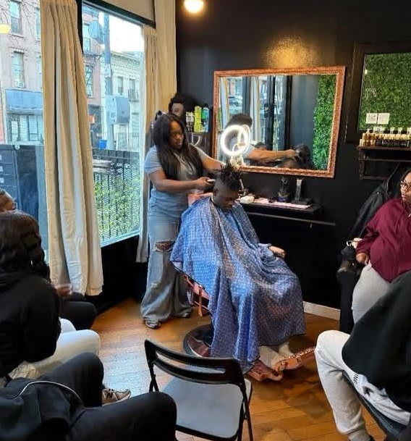
Brooklyn
Youth Job Training and Employment Opportunities
Youth Employment Training and Partnerships
Job Training and Support for Employment for Single Parents
Community Kitchen with Classes
Young Parent Support and Classes

Slide 27
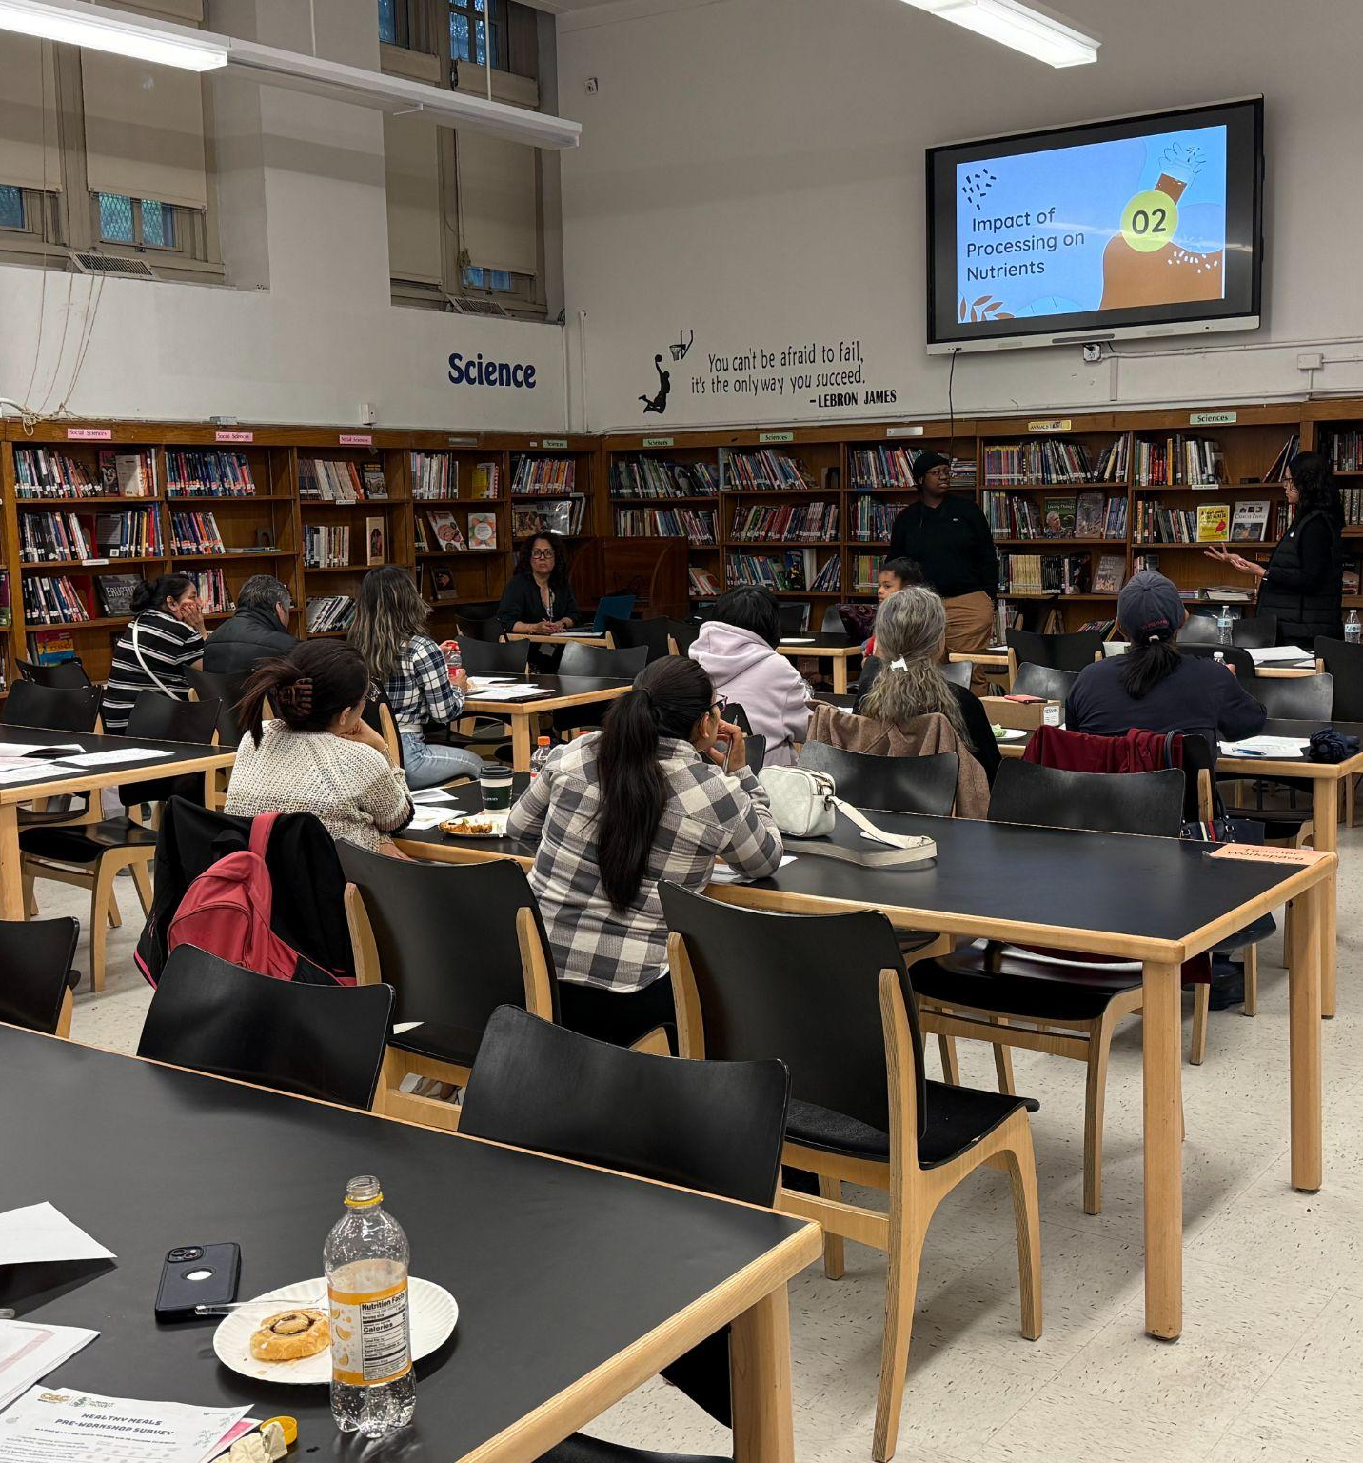
Queens
Pathways to Professions for Youth
Saving for Your Future
Housing Workshops for Older Adults
Pathways to a Successful College Career
Empowered with Opportunity

Slide 28
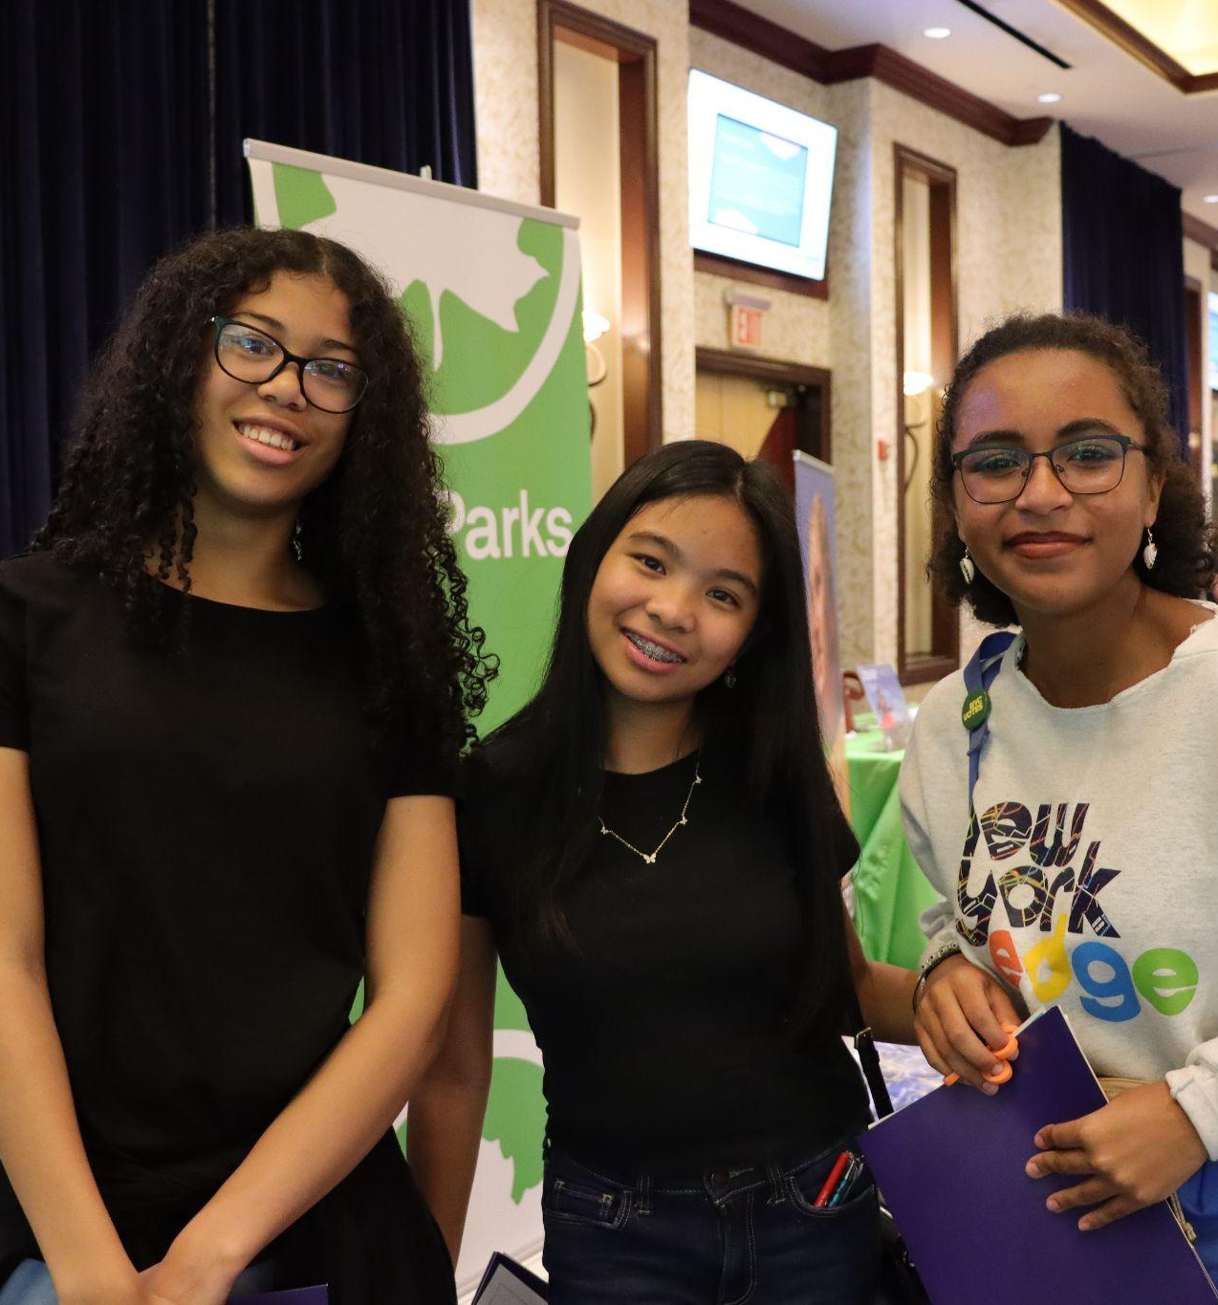
Staten Island
Staten Island Youth Internship Program

Slide 29
Survey Responses

Slide 30
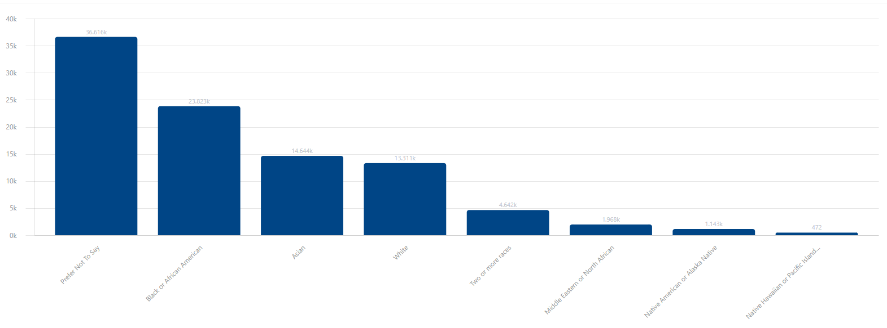
Race & Ethnicity: Race
73.42% survey response rate!
Prefer not to say
Asian
White
Two or more races
Black / African American
Middle Eastern/ North African
Native American or Alaska Native
Native Hawaiian/ Pacific Islander
White
Participant Self Reported Race

Slide 31
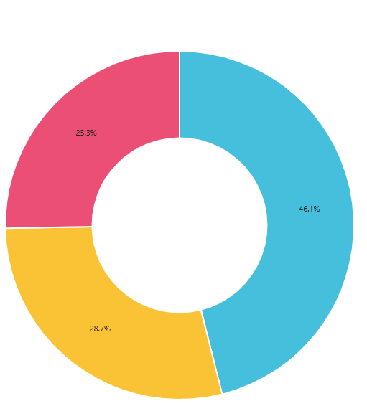

Race & Ethnicity: Hispanic or Latino
28.7 % of respondents identify as Hispanic or Latino

Slide 32
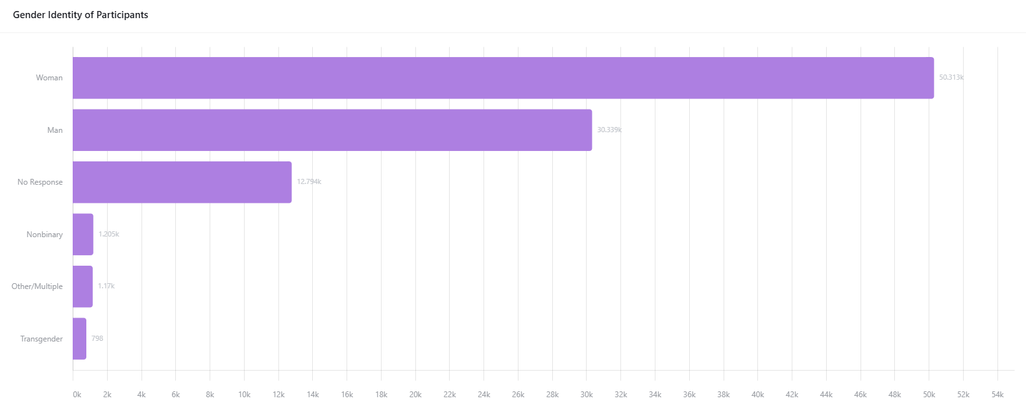
Gender Identity
Over 50% of respondents identify as Women

Slide 33
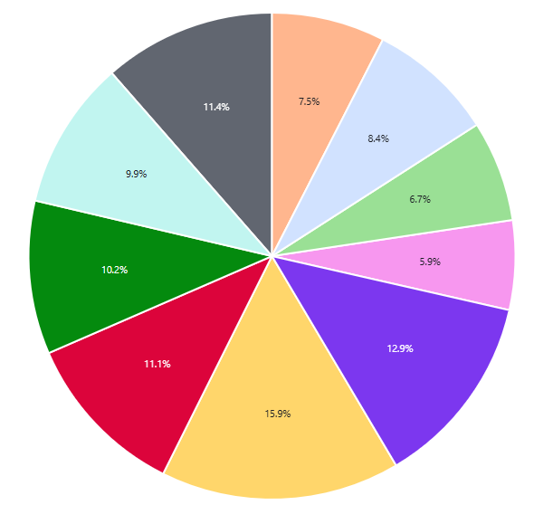
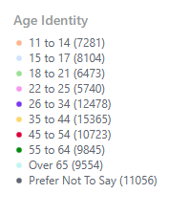
Age Distribution
17.98 % of those who answered the age question were 11-17
11.50% of those who answered the age question were 65 +

Slide 34
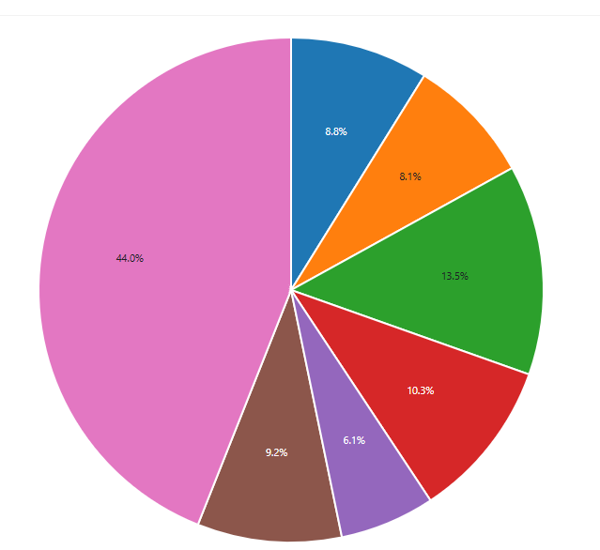
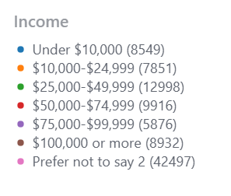
Household Income
Low Income NYers are overrepresented in our participants
30.42 % of participants make under $50,000 a year

Slide 35
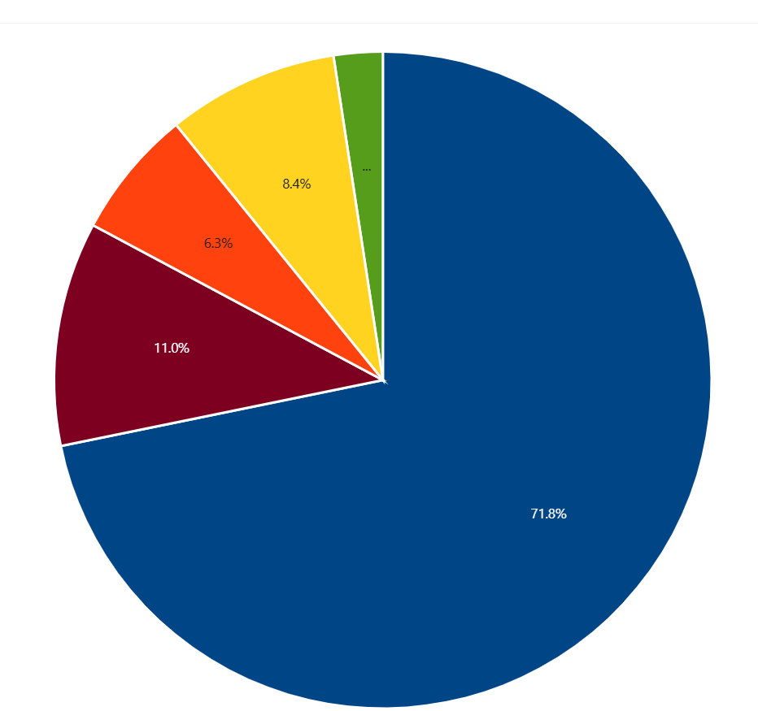
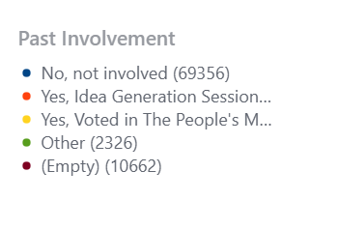
Past Involvement with the People’s Money
71.8% of people were not previously involved !
We reached many new participants this year!

Slide 36
Requests for Information (RFIs)

Slide 37
RFIs: Project Implementation
Application Link:
Who we are looking for: 501(c)3 nonprofit organizations or MWBEs operating in NYC to implement 1 of 20 expense projects that received the most votes in the People’s Money!
Funding: $150K - $250K depending on the borough
Application Timeline: July 28th to September 5th, 2025
Partnership Timeline: October 2025 - October 2026
Basic Deliverables:
Project Cycle Management Workshops
TRIE Neighborhood Stakeholder Engagement
Project Implementation, Outreach, and Reporting

Slide 38

RFIs: The People’s Money and Design by Community (DxC) Pilot:“The People’s DxC”
The People’s DxC is seeking a community-based partner to implement:
One (1) The People’s DxC fellowship program, and
One (1) The Youth Entrepreneurship Project, the designated expense project for this pilot. The project was voted in Cycle 2 of The People's Money, NYC’s citywide Participatory Budgeting (PB) process.
Funding: $80,000 in addition to the Project Implementation Funding
Application Timeline: July 28th to September 5th, 2025
Partnership Timeline: 1 Year and 10 months
October 2025 - November 2026: The People’s DxC fellowship
September 2026 - September 2027: Implementing the Youth Entrepreneurship Program
Notes:
This funding opportunity is in partnership with the Service Design Studio at the Mayor’s Office for Economic Opportunity
The People’s Money determines what projects get funded, and DxC determines how the project gets funded
The Studio partners with a CBO & 6 community fellows which the CBO recruits and hires to create hyper-local solutions using community-centered service design
Solutions that are grounded in the lived experience of affected people
Recognizes community members as experts
The program will happen over the course of 1 year and 10 months.

Slide 39
RFIs: PB Idea Generation
Application Link: on.nyc.gov/pbrfi
Who we are looking for: 6 501(c)3 nonprofit organizations or MWBEs operating in NYC, or groups with a fiscal sponsor, to host Idea Generation Sessions with residents in 3 of the 5 boroughs.
Funding: $9,000 to $15,000, depending on number of sessions
Application Timeline: July 22nd to August 18th, 2025
Partnership Timeline: September 2025 - November 2025
Basic Deliverables:
Host and Facilitate 6-10 one-hour long Idea Generation Sessions
Use their social media and email networks to promote the People’s Money
Recruit a minimum of 20 participants to attend each Idea Generation sessions

Slide 40
RFIs: TRIE Neighborhood Initiative
Application Link: on.nyc.gov/trierfi
Who we are looking for: 501(c)3 nonprofit organizations or MWBEs operating in NYC, or groups with a fiscal sponsor, to build a neighborhood coalition and lead civic engagement efforts in 11 TRIE Neighborhoods.
Funding: up to $60K
Application Timeline: July 22nd to August 18th, 2025
Partnership Timeline: September 2025 - July 2026
Basic Deliverables:
Sustaining a neighborhood coalition yearlong
Hosting 5 Idea Generation Workshops
Supporting the Borough Assemblies
Collecting 2000 Neighborhood PB Ballots
Customizing and facilitating 1 Civic Engagement Workshop

Slide 41

New Logo!
Notes:
Worked with Time of Day to design the new logo for the TRIE Neighborhood Initiative
HJ lead internal design conversations and feedback rounds, and worked with Jorwell to coordinate with the vendor
TREE Imagery: Network-Building, Growing Roots, Thriving Together, etc.

Slide 42
Report on Work with Hyphens & Spaces

Slide 43
Strategic Priorities
Maximize Impact Within Charter Boundaries
Serve as many New Yorkers as possible within our charter's scope and spirit
Prioritize Participatory Budgeting (PB) as our largest engagement platform
All team members should be prepared to support PB's success and ongoing development
Foster Collaborative Resource Utilization
Collaborate thoughtfully to leverage resources and networks across programs
Rally around under-resourced initiatives like TRIE and VLA to strengthen their impact
Identify and develop cross-team synergies to enhance overall effectiveness
Cultivate Intentional Team Culture
Improve team infrastructure, efficiency, effectiveness, and communication

Slide 44
Public Comment

