Slide 1
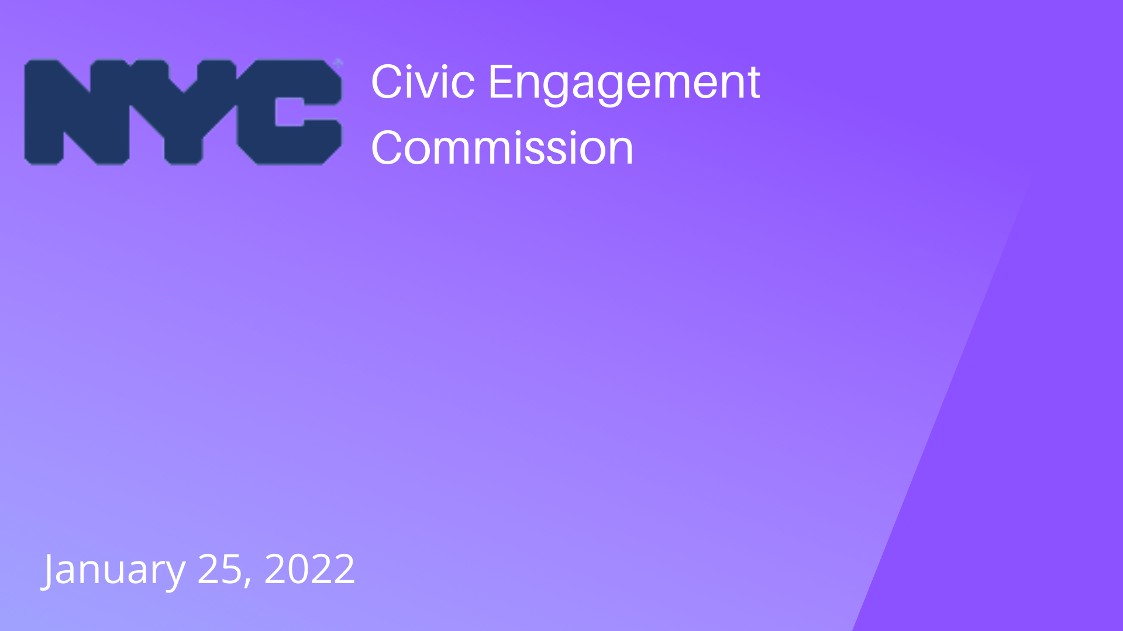
January 25, 2022

Slide 2
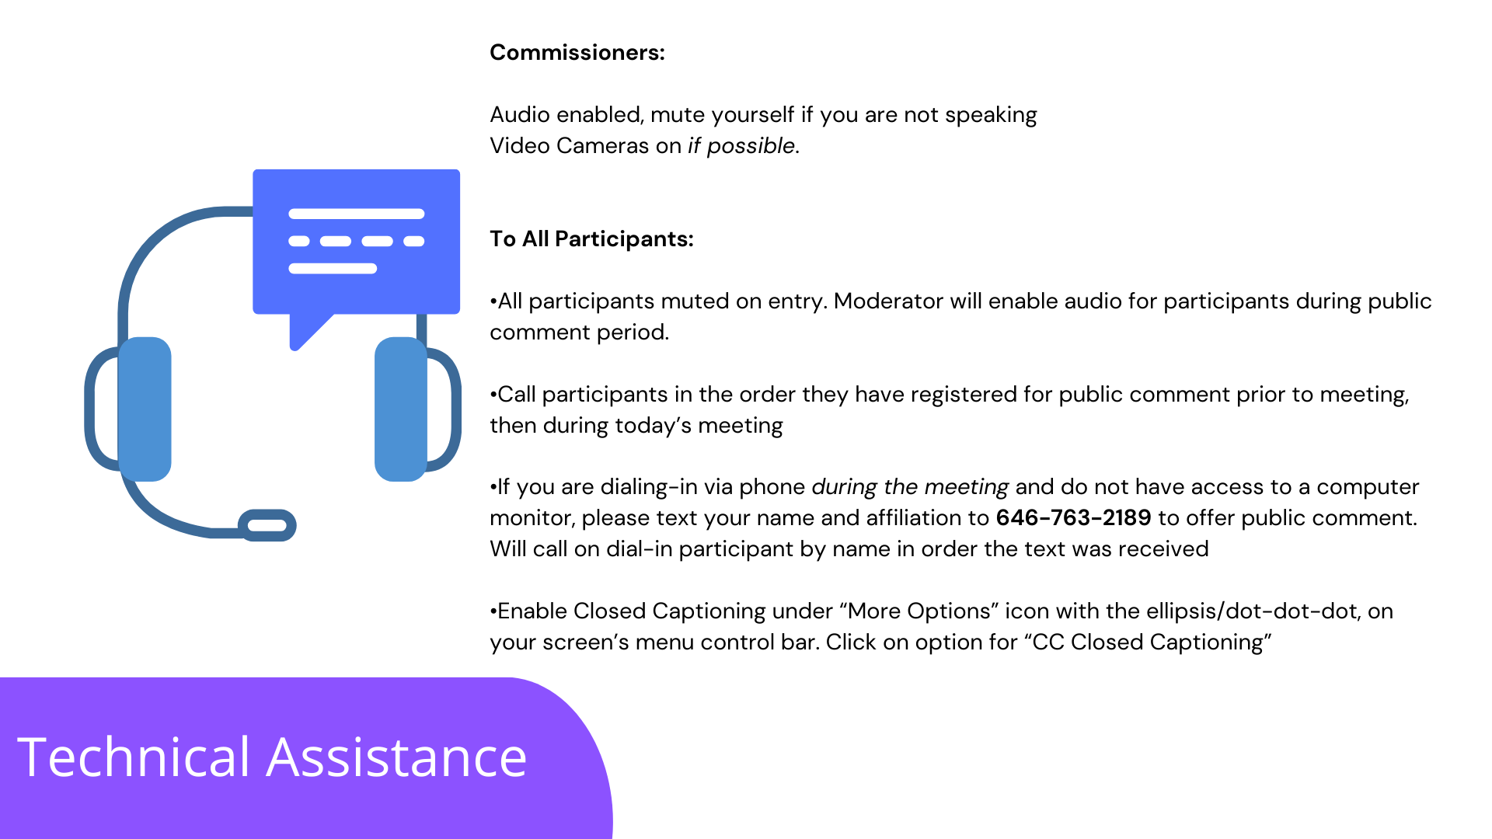
Technical Assistance
Commissioners:
Audio enabled, mute yourself if you are not speaking
Video Cameras on if possible.
To All Participants:
All participants muted on entry. Moderator will enable audio for participants during public comment period.
Call participants in the order they have registered for public comment prior to meeting, then during today’s meeting
If you are dialing-in via phone during the meeting and do not have access to a computer monitor, please text your name and affiliation to 646-763-2189 to offer public comment. Will call on dial-in participant by name in order the text was received
Enable Closed Captioning under “More Options” icon with the ellipsis/dot-dot-dot, on your screen’s menu control bar. Click on option for “CC Closed Captioning”

Slide 3
Agenda
I. Attendance
II. Approval of Minutes from December 14, 2021
III. Program updates & discussion
IV. Public Comments
a. Staff Introductions
d. Community Board Trainings
e. Poll Site Language Assistance Program
c. Participatory Budgeting
b. DemocracyNYC

Slide 4
Civic Engagement Commission Program Updates
January 25, 2022

Slide 5
Community Boardrainings 2022
DemocracyNYC is a nonpartisan initiative of the City of New York focused on increasing voter participation and civic engagement in NYC. Part of that mission is to encourage every eligible New Yorker to make their voice heard at the ballot box. DemocracyNYC also works to address and eliminate historic barriers to voting through public education, outreach, and policy reform efforts. ​ ​ Pursuant to an Executive Order signed last December, DemocracyNYC is now a program of the Civic Engagement Commission. ​ ​ The goal of the Executive Order is to establish a unified program focused on increasing voter participation and civic engagement in New York City.
Democracy NYC Merger

Slide 6
Key Accomplishments
Student Voter Registration Drives
Ranked Choice Voting education campaign
Pandemic response: NYC Elections Consortium
Absentee voting
Legislative and policy work
BOE/election administration
Early voting
Automatic voter registration/online voter registration

Slide 7
Student Voter Registration Drive (SVRD) & Civics Week
Civics Week is a week-long celebration of youth voices and civic engagement in an effort to build a more active citizenry.
Part of DOE’s Civics for All initiative, Civics Week brings together a coalition of citywide partners including CEC/DemocracyNYC, the Mayor’s Public Engagement Unit (PEU), and civic leaders to help teach students K-12 the skills of civic engagement, the foundations of government and the democratic process, and the importance of registering to vote.
In-person Student Voter Registration Drive.
March 7-11, 2022

Slide 8
Community Board Updates
Community Engagement
Public Agenda: Public Agenda is a nonpartisan research and public engagement organization dedicated to strengthening democracy and expanding opportunity for all Americans.
Workshops are intended to provide a planning guide to help community boards decide what kind of engagement works best for them. Workshop will discuss conventional engagement, thick engagement and thin engagement among other public engagement processes.
Borough based workshop tentative schedule:
Monday, Feb. 28: Brooklyn & Staten Island
Thursday, March 3: Queens
Monday, March 14: The Bronx
Monday, March 21: Manhattan
Community board application deadline:
The Bronx: March 4, 2022
Manhattan: March 1, 2022
Queens: February 16, 2022
Brooklyn: March 4, 2022
Staten Island: Application open all year

Slide 9
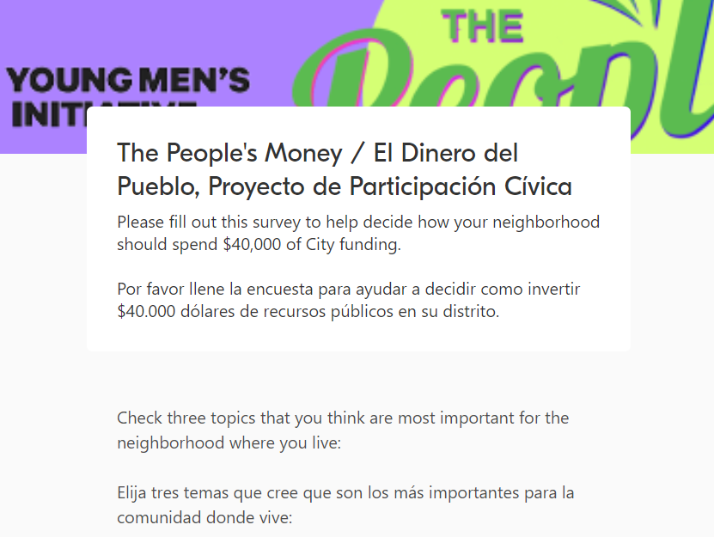
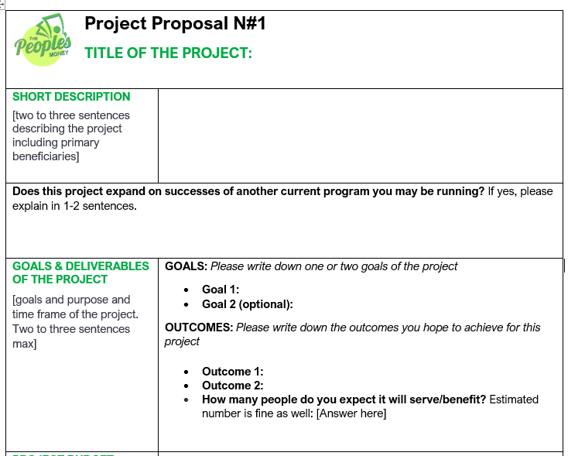
Process Timeline
Community Needs
Assessment
August - September
CEC vets proposals and approves
Nov 22nd - Nov 25th
Project Implementation
February – June 30th 2022
Voting period
Dec 6 - Jan 31
Project Proposal Development
October - November
Electronic ballots & paper ballots are created
Nov 25th – Dec 3rd
Winning Projects are announced by
February 9th
Polis Survey:
Identifying Areas for Investment
June - July
Notes:
For the community needs survey, we received 7500 responses that informed the top priority areas

Slide 10
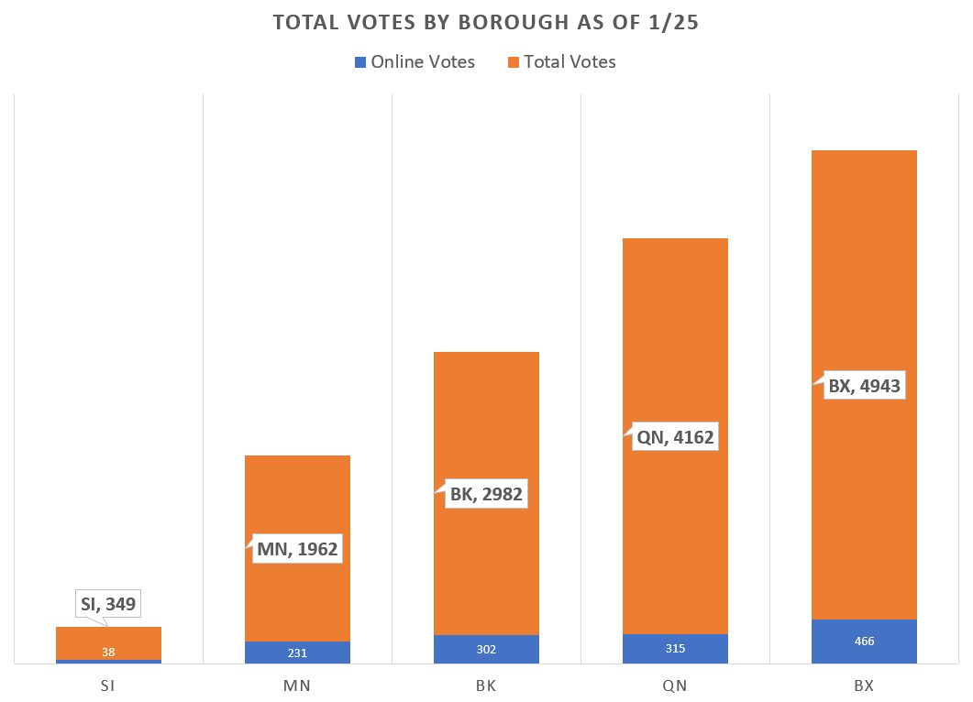
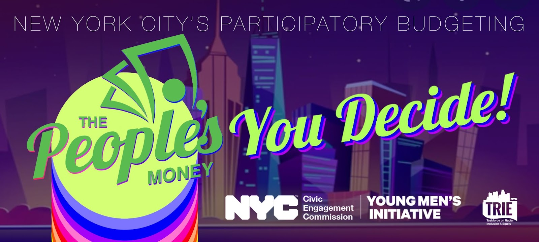
Update: The People’s Money NYC TRIE Neighborhood Initiative is investing $1.3M to support recovery in the 33 neighborhoods hardest hit by COVID-19 ($40,000 per neighborhood)
Extended voting deadline to 1/31
Added option to vote via link (no account needed, in addition to paper ballots and ability to vote via phone)
14,398 votes cast as of 1/24
1 TRIE Neighborhood
5 TRIE
Neighborhoods
9 TRIE Neighborhoods = BK, QN, BX
Notes:
1. Open up Government: Allow residents a greater role in budgeting decisions, and inspire increased transparency in New York City government.
2. Expand Civic Engagement: Engage more people in politics and the community, especially young people, people of color, immigrants, low-income people, the formerly incarcerated, and other marginalized groups.
3. Develop New Community Leaders: Build the skills, knowledge, and capacity of community members.
4. Build Community: Inspire people to more deeply engage in their communities, and to create new networks and organizations.
5. Make Public Spending More Equitable: Generate spending decisions that are fairer and reflect the entire community’s needs, so resources go where they are needed most.

Slide 11
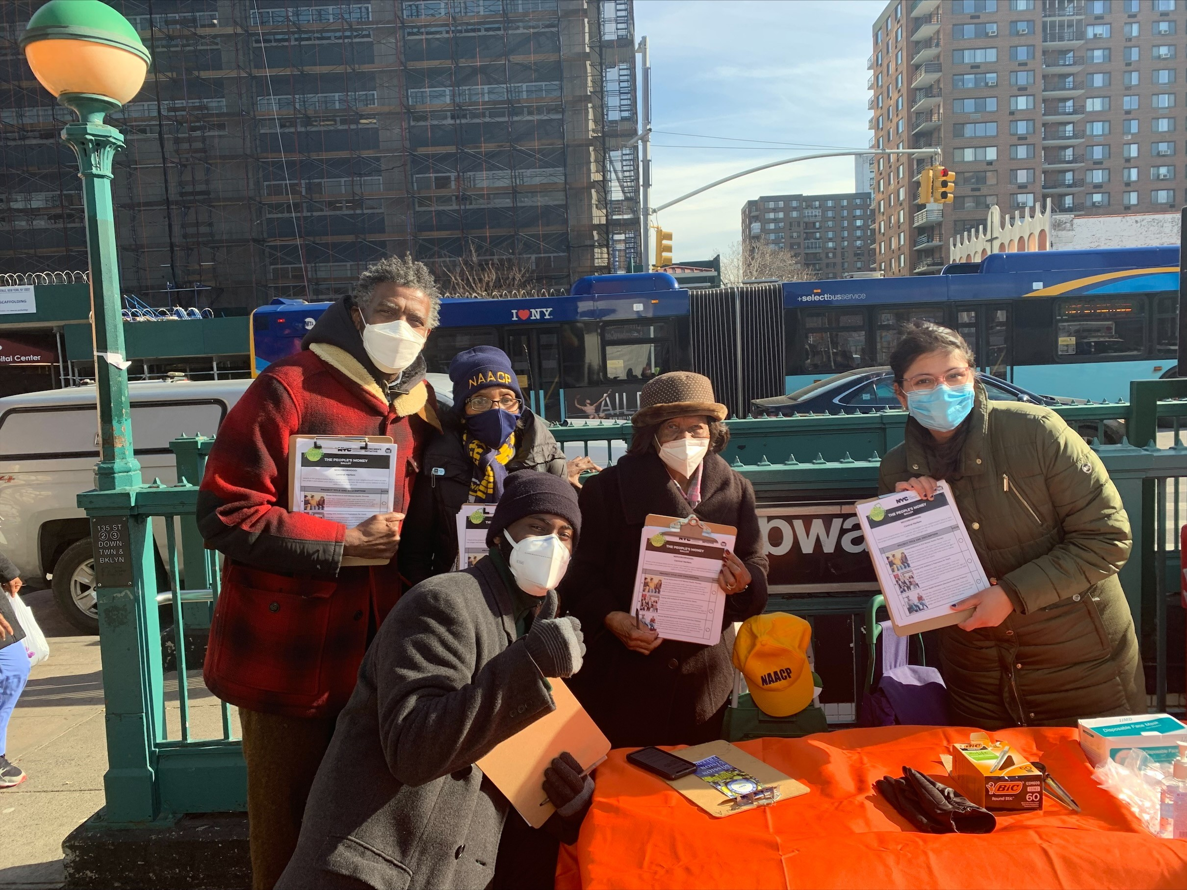
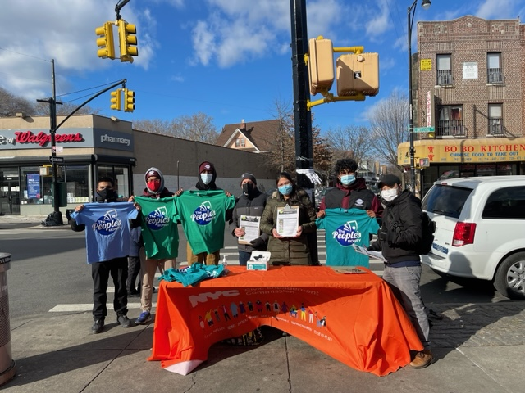
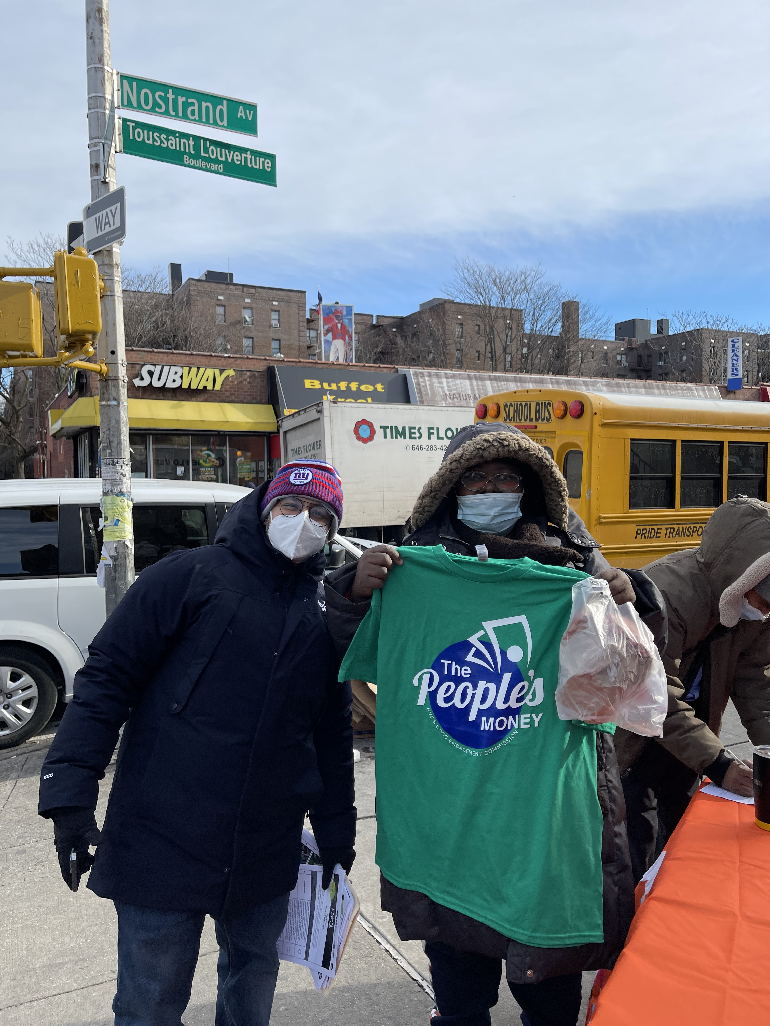
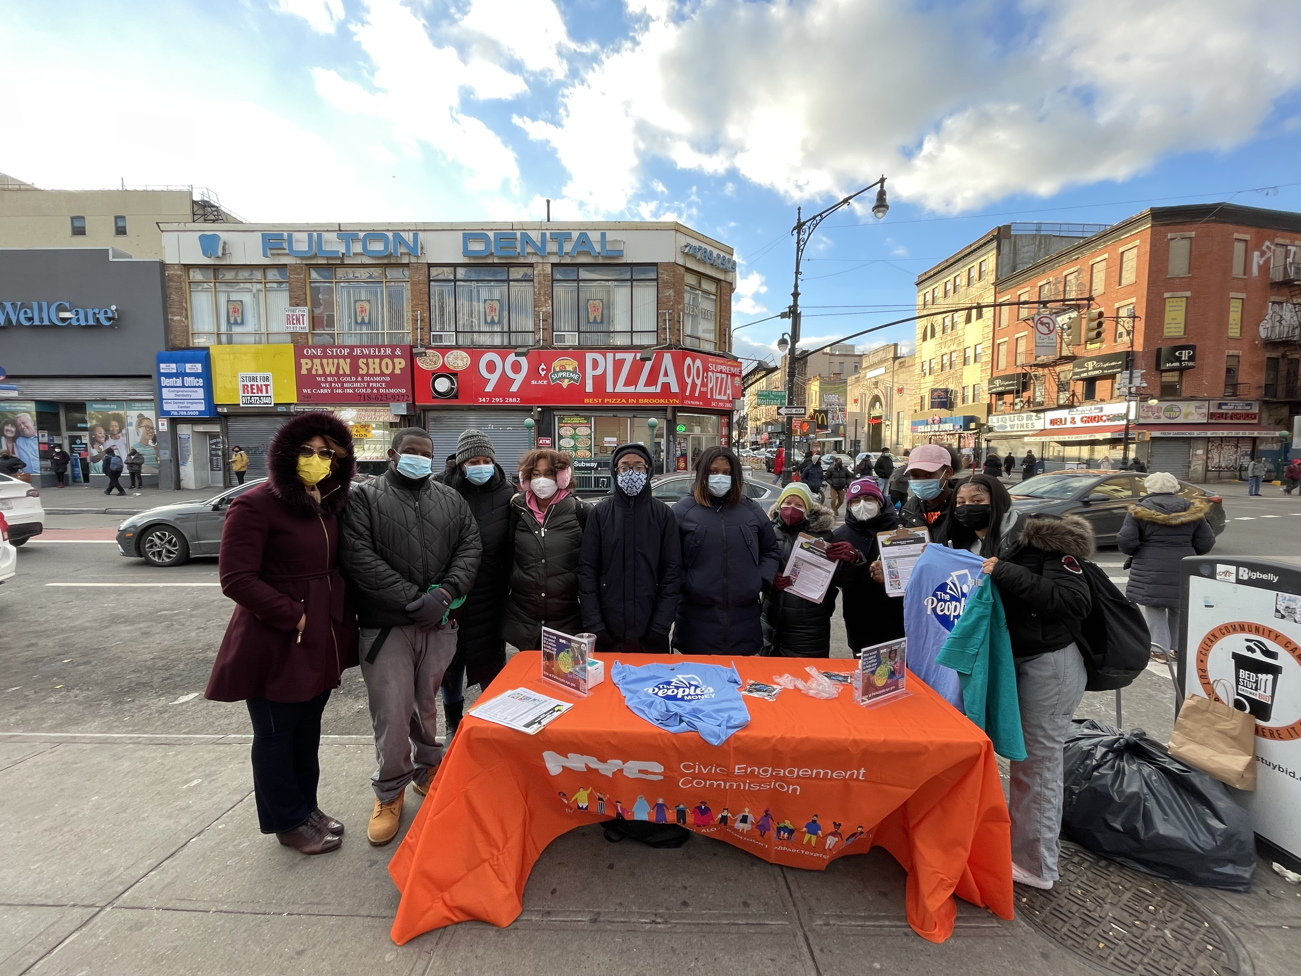
The People's Money Outreach
Total Events:
Dates: January 10-22nd
Events: 15 completed
Upcoming Events
Parkchester on the 27th
Jackson Heights, Morrisania on the 28th
Kew Gardens on the 3rd
Total Ballots Collected:
2,437 ballots collected at GOTV activities
Partners
Neighborhood Coalitions
Mayor's Public Engagement Unit
Public libraries
Councilmembers
Geographic Spread:
Queens: 6 events
Brooklyn: 7 events
Bronx: 4 events
Staten Island: 1 event
Manhattan: 1 event

Slide 12
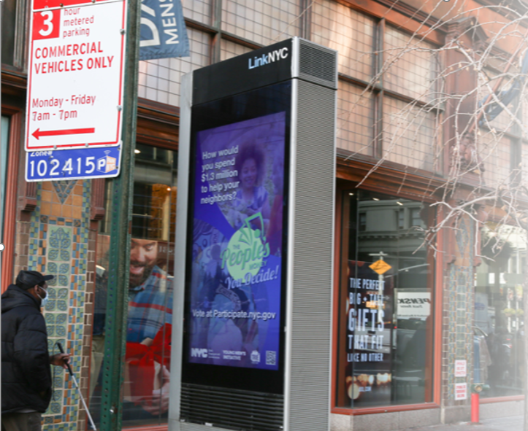
Instagram/Facebook language- and geo-targeted paid social media (English, Spanish, Arabic, Bengali, Chinese, Korean, Polish, Russian, Urdu)+ livestream audio ads (Bengali, Haitian Creole, Polish, Urdu): 4,503,800 impressions
Bus shelters at 100 TRIE neighborhood locations: 27,464,732 impressions
LinkNYC kiosks in TRIE neighborhoods: 1,091,504 impressions
Multilingual paid community and ethnic radio: (2) :30 spots in English, Spanish, Bengali, Haitian Creole, Mandarin, Cantonese, Polish, Russian, and Urdu
The People’s Money:
Media Summary

Slide 13
Language Assistance Advisory Committee
Applications closed Jan 7, 2022
Received 57 applications Upcoming Plans:
LAAC launch 2/17 @6:30pm (Virtual)
LAAC members will co-lead outreach in language communities they represent.
January- June 2022 Overview
January Finalize LAAC members
February 17 at 6:30pm: LAAC Kick Off
March 17 Data Meeting
April 14 Community Engagement Planning Meeting
May 12 Community Engagement Execution
June Primary Election

Slide 14
Voter Participation Deadlines
Friday, June 3, 2022
Voter Registration Deadline
Monday, February 14, 2022
Deadline to Change Party Affiliation
Saturday, June 18, 2022- Sun, June 26, 2022
Early Voting
Tuesday, February 15, 2022
Special Election Assembly District 60 in Brooklyn & Assembly District 72 in Manhattan
Tuesday, June 28, 2022
Primary Election Day

Slide 15
Public Comment Period

