Slide 1



New York Community Bank
a Division of Flagstar Bank, N.A.
Banking Development District (BDD)
Brooklyn CB3 Presentation
November 6, 2023 – 7PM

Slide 2
Banking Development District (BDD) Overview
The Banking Development District Program is Administered by the NYS Department of Financial Services (NYS DFS) and was established in 1977.
Designed to encourage the establishment of branches in areas where there is a demonstrated need for banking services in order to promote individual wealth, community development, and revitalization in underserved communities.
BDD Banks are a source of capital for local businesses, which promotes job creation; funding for mortgages, which increases home ownership and allows for home improvement.
Allows community residents to cash checks, pay bills, and transmit money inexpensively compared to check cashers and the like.
Encouragement for Banks to lend within designated area; hire locally; support local non-profit organizations engaged in first-time homeownership, affordable housing, small business development and community development services.
2

Slide 3
NYCB, a Division of Flagstar, N.A.
Background
New York Community Bank (NYCB) was established as Queens County Savings Bank in April of 1859.
December 2022 – Merged with Flagstar Bank; March 2023, acquired Signature Bridge Bank from the FDIC.
New York Community Bancorp, Inc. is the parent company of Flagstar Bank, N.A., one of the largest regional banks in the country.
Flagstar Bank, N.A. operates 436 branches across twelve states, including strong footholds in the Northeast and Midwest and markets in the Southeast and West Coast.
NYCB, a Division of Flagstar Bank, N.A., currently has 11 branches in Brooklyn.
In 1Q’24, all branches will be branded as Flagstar (new logo).
3

Slide 4
NYCB BDD History and Successes
Highly experienced and successful with Banking Development District Branches.
Consistently reinstated by the NYS Department of Financial Services – Clear evidence of successful management and community engagement of BDD’s.
One BDD Branch in Corona, Queens – 19 years (since 2005).
Two in Long Island – Brentwood and Wyandanch (2014 & 2015 respectively).
Consistently acknowledged for lending and community services year over year.
4

Slide 5
Why a BDD in Brooklyn’s CB3?
Highly experienced and successful with Banking Development District Branches.
Provide Banking Services and Financial Education in Underserved Community.
Hire locally and engage with non-profit organizations aligned with Community Reinvestment Act goals and Objectives.
Provide capital for Affordable Housing initiatives in partnership with the City of New York, and for Small Business Development programs in partnership with community organizations.
Promote the OnBank program for unbanked community residents (offering low or no fees).
5

Slide 6
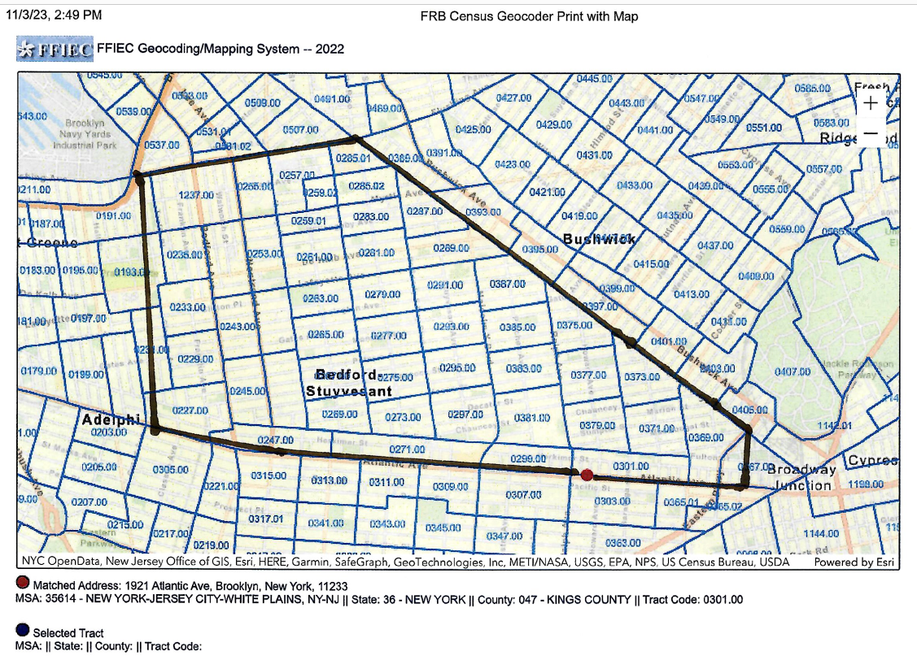
Proposed BDD Market Area in CB3.

Slide 7
Thank You!
30

