Slide 1
NYC DEPARTMENT OF CORRECTION
DIVISION OF PROGRAMS AND COMMUNITY PARTNERSHIPS

Slide 2
AGENDA
IMPACT – Interventions to Make Profound & Continuous Transformations
Family Engagement
Tablet Update + Premium Content

Slide 3
IMPACT
Interventions to make profound and continuous Transformations
Intervention Specialists & Social Workers
The IMPACT Team is comprised of Social Workers and Intervention Specialists who provide the following:
Behavioral and Community-Centered Interventions
Wellness Checks
Grief Counseling
Crisis Interventions
New Admission Orientation
Individual and Targeted Counseling:
Self-Injurious Behavior

Slide 4
IMPACT
Behavioral and Community-centered Interventions
Behavioral and Community-Center Interventions
Program Goals:
Proactive Engagement with referred PIC to decrease likelihood of engagement in incidents
Decrease Incident Rates with PIC who have demonstrated histories of violence or misconduct
Collaborate with multidisciplinary partners on addressing PIC conduct
Program Benefits:
Improved communication regarding root cause of problematic or concerning behavior with the support of key stakeholders (staff, family, support systems);
Provides an opportunity for PIC to receive feedback from individuals who have knowledge and familiarity of their personhood beyond the institutional setting.

Slide 5
IMPACT
Targeted 1:1 Sessions
Self-Injurious Behavior
Session Overview
An IMPACT team member meets with a Person-in-Custody based on a report of self-injurious behavior
DOC’s follow-up is secondary and provides additional support to PIC after they are seen by Mental Health (CHS).
The IMPACT team documents each session outlining the PIC’s triggers and identifies replacement coping strategies. Collaboration with Correctional Health Services and referrals are made to support the person in custody.
Targeted Counseling provides an avenue for ongoing engagement with a DOC Social Worker, Intervention Specialist, and/or their assigned Associate Correctional Counselor or Program Counselor for 1-1 Counseling.
The IMPACT team outlines a Supportive Services Plan if ongoing support (beyond 3 sessions) is needed with a DOC Social Worker or Intervention Specialist.

Slide 6
IMPACT
Interventions to make profound and continuous Transformations

Slide 7
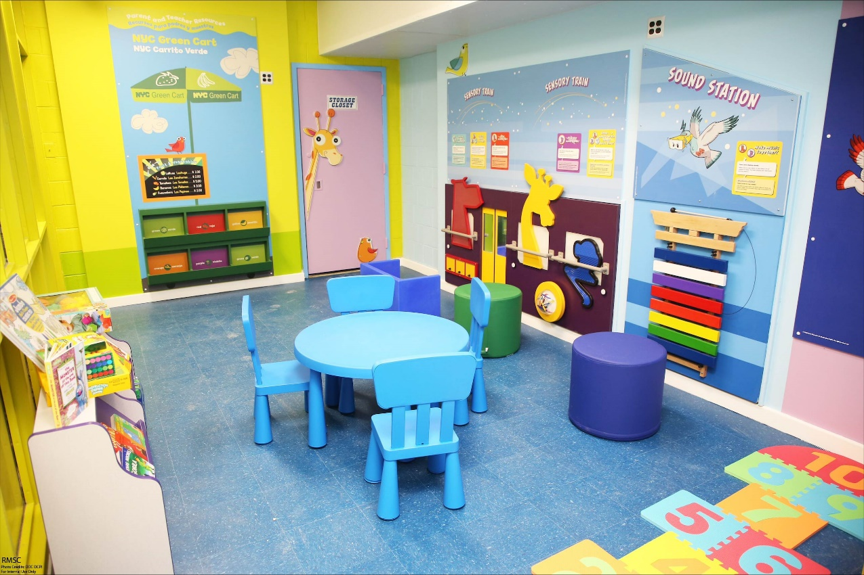
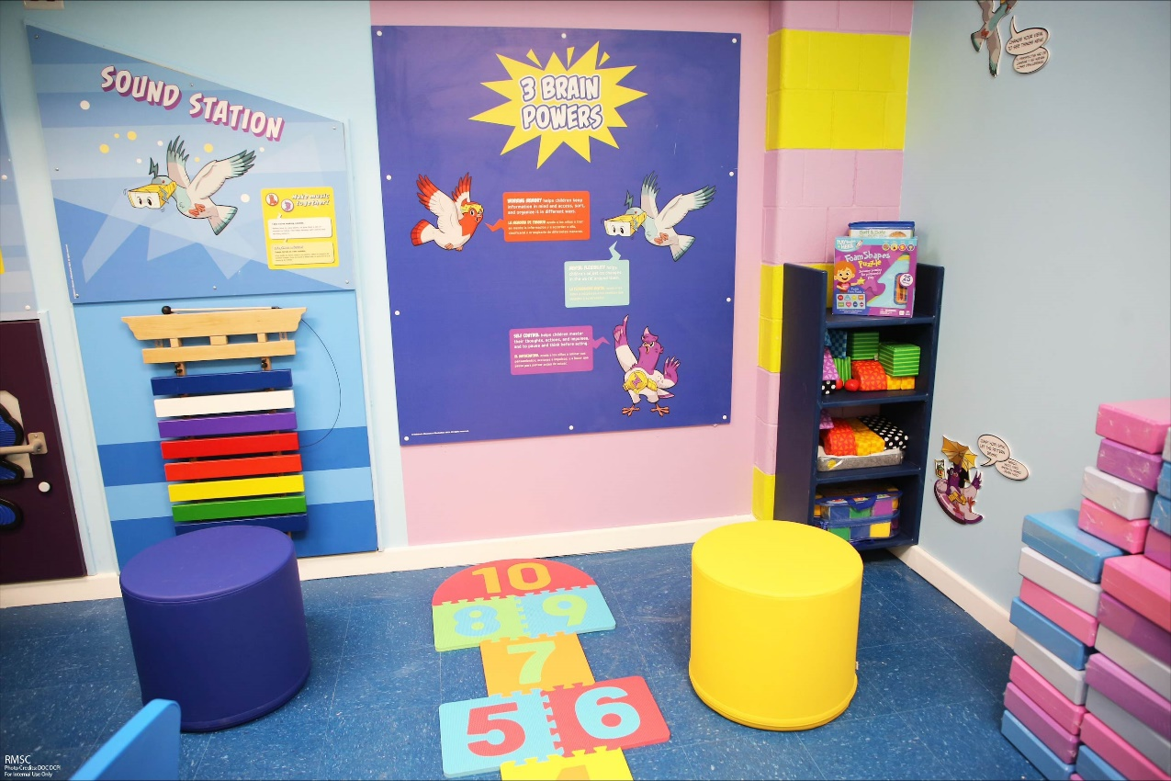
Family engagement
Cmom child-friendly visit hubs
In 2022, DOC resumed working collaboratively with CMOM to continue off-island visitations and create interactive exhibits in each visit area to promote playful interactions and bonding between incarcerated parents and their children.
In May and June of 2024, the first visit hubs launched in RMSC and GRVC
The goal is to expand child friendly visit spaces to all jails and to central visits. OBCC is the next facility we hope will receive a CMOM installation.
The new hubs represent an interactive space where children can bond with their incarcerated parents.
RMSC CMOM Child Friendly Visit Hubs

Slide 8
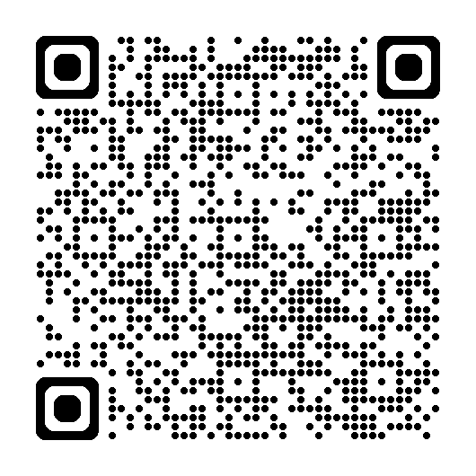
Family engagement
Cmom child-friendly visit hubs IN ACTION

Slide 9
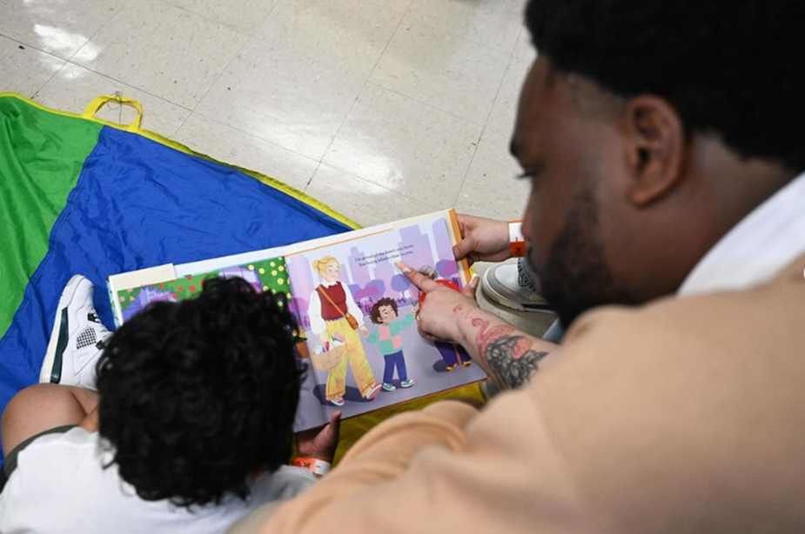
Family engagement
Cmom child-friendly visit hubs
GRVC CMOM Child Friendly Visit Hubs
RMSC CMOM Child Friendly Visit Hubs

Slide 10
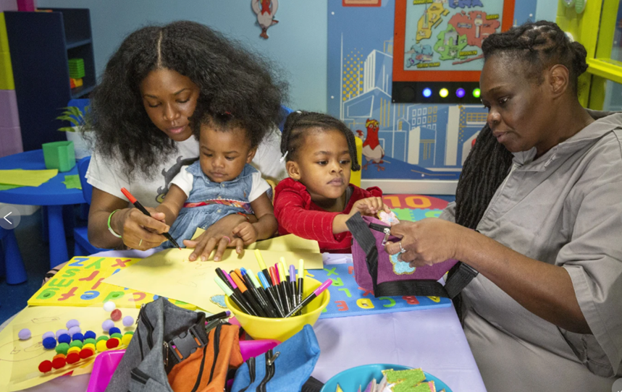
Family engagement
Cmom child-friendly visit hubs
RMSC CMOM Child Friendly Visit Hubs
GRVC CMOM Child Friendly Visit Hubs

Slide 11
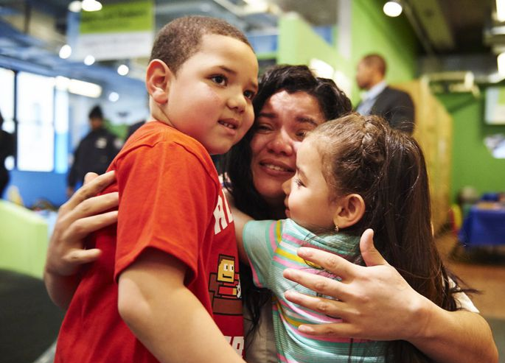
Family engagement
DOJ grants and cmom visits
2 DOJ grants to promote child-friendly visits
4 Visit Facilitators to work in facility visit areas
Child-friendly furniture and activities in all visit areas
Expanded provider-led Visitation and Family Assistance program to OBCC
Enhanced training for Visits Staff
Continued partnership with the Children’s Museum of Manhattan (CMOM) to facilitate monthly visits at the museum.
Children’s Museum of Manhattan Visit

Slide 12
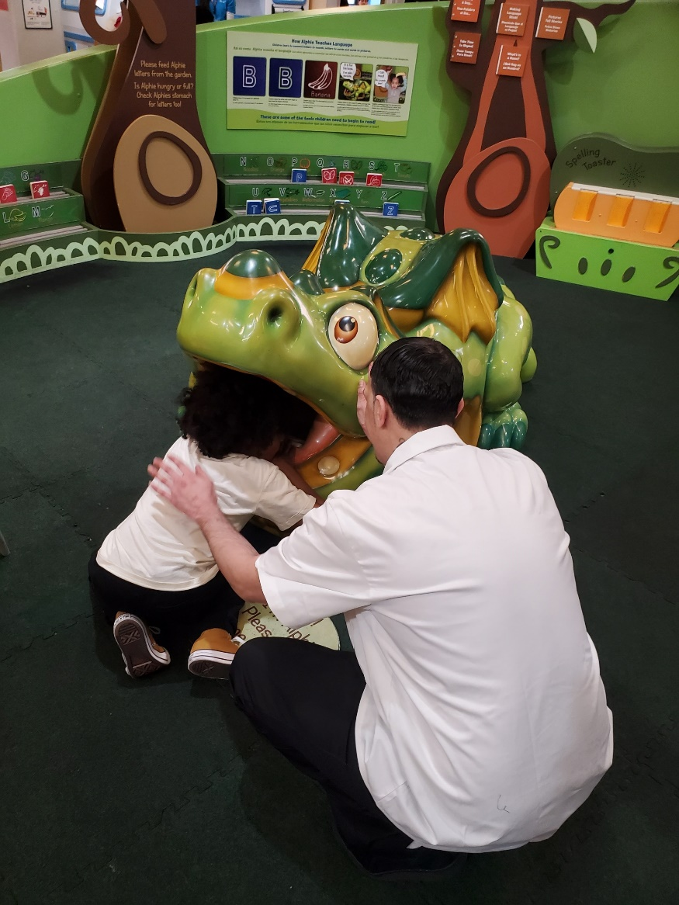
Family engagement
DOJ grants and cmom visits – BY THE NUMBERS
Visit Facilitators
Our Visit Facilitators served 1291 persons in custody and 877 children between January – June 2024.
Visitors, especially mothers and children, have shared appreciation for the transformed waiting areas and opportunity to take home a photo with their loved ones.
OBCC and GRVC currently have a Visit Facilitator, and we are expanding to other jails and Central Visits.
CMOM
Since resuming CMOM visits in October 2022, 238 persons in custody and 695 family members have participated in this program.
Jurisdictions from around the country are building on the success of CMOM and developing similar partnerships with local children’s museums.
Children’s Museum of Manhattan Visit

Slide 13
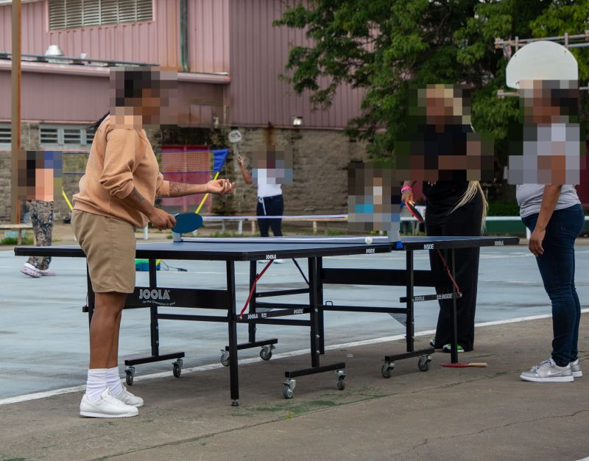
Family engagement
Community engagement days
Community Engagement Days are opportunities for incarcerated parents and their children to spend time together, share a meal, and work on structured arts and crafts projects, fostering opportunities for parents and children to bond while sharing positive experiences.

Slide 14
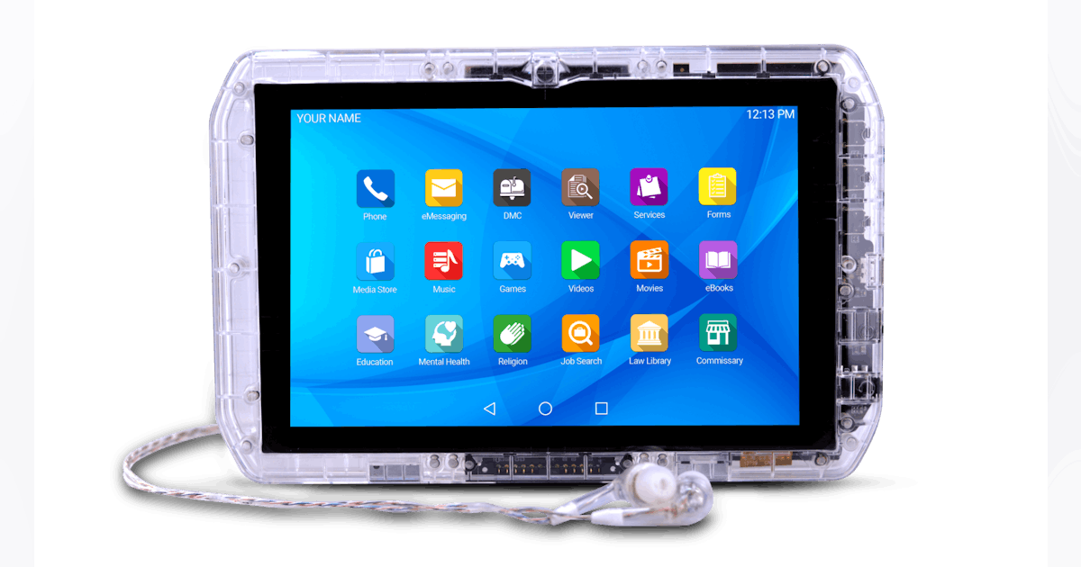
Tablet Distribution
Overview of Tablet Distribution to eligible PIC As of 8/30/2024
80% of Eligible Persons in Custody are Assigned a Tablet

Slide 15
TABLETS
APPLICATIONS OVERVIEW
My Account
Phone
Forms + Grievance
Podcasts
Edovo
Honest Jobs
FYI App
Comm Center
Law Library (Lexis Nexus)
Chasing the Dragon
Lantern
Office Suite
Viewer App
Calculator
Commissary
FM Radio
Music Player
KA Lite
My Agreements
Clock App
Help App
eBook App
TYRO
Media Store

Slide 16
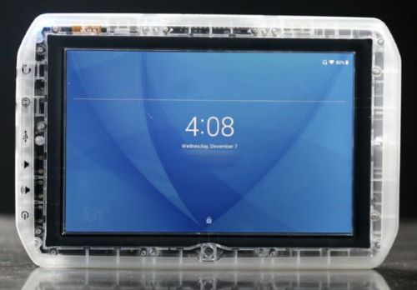
TABLETS
PREMIUM CONTENT OVERVIEW
Premium content is made accessible via the Media Store application. The Media Store offers a diverse selection of movies, music, TV shows, and games.
Previously, our tablets primarily provided access to applications designed to promote personal and religious growth, as well as educational self-study. The only entertainment previously available was FM Radio and four (4) preinstalled games.

Slide 17
WHO’S GOT TALENT
TABLET TALENT SHOW OVERVIEW
Who’s Got Talent is a Talent Show celebrating the diverse skills and creativity of the persons in our custody by showcasing a variety of performances, including music, dance, comedy, and other talents.
The Program Goals are to:
Provide a platform for self-expression.
Foster community spirit.
Highlight the positive and artistic contributions of participants.
People in custody can vote for their favorite talent via the tablet.
Currently we have the final six contestants!
The final six will perform for a live audience.
The recording of the show will be uploaded where persons in custody can vote for their finalist.

Slide 18
WHO’S GOT TALENT
TABLET TALENT SHOW PROCESS
AUDITIONS: Over 100 PICs were interested in auditioning in the Division of Program’s “WHO’S GOT TALENT”. All facilities were represented. Three episodes memorialized the auditions:
Don't Get Packed Up
Meet the Contestants- Introduces the talent selected to participate in the talent show.
Behind the Scenes- Clips that highlighted special moments during our auditions.
The auditions resulted in the advancement of 41 contestants.

Slide 19
WHO’S GOT TALENT
TABLET TALENT SHOW PROCESS
ROUND ONE: Contestants were divided into five (5) different Groups. Each group resulted in 2 videos (“Who’s Got Talent” and “Level Up”), totaling 10 videos.
Who Got Talent Episodes: Group of contestants showcasing their talent in a 1-2 minute video.
Level Up Episodes: Votes have been submitted for the corresponding “Who’s Got Talent” Episode.
ROUND TWO: Contestants with the most votes from each of the 5 groups level up to Round 2.
The process continues until we have a finalist!

