Slide 1
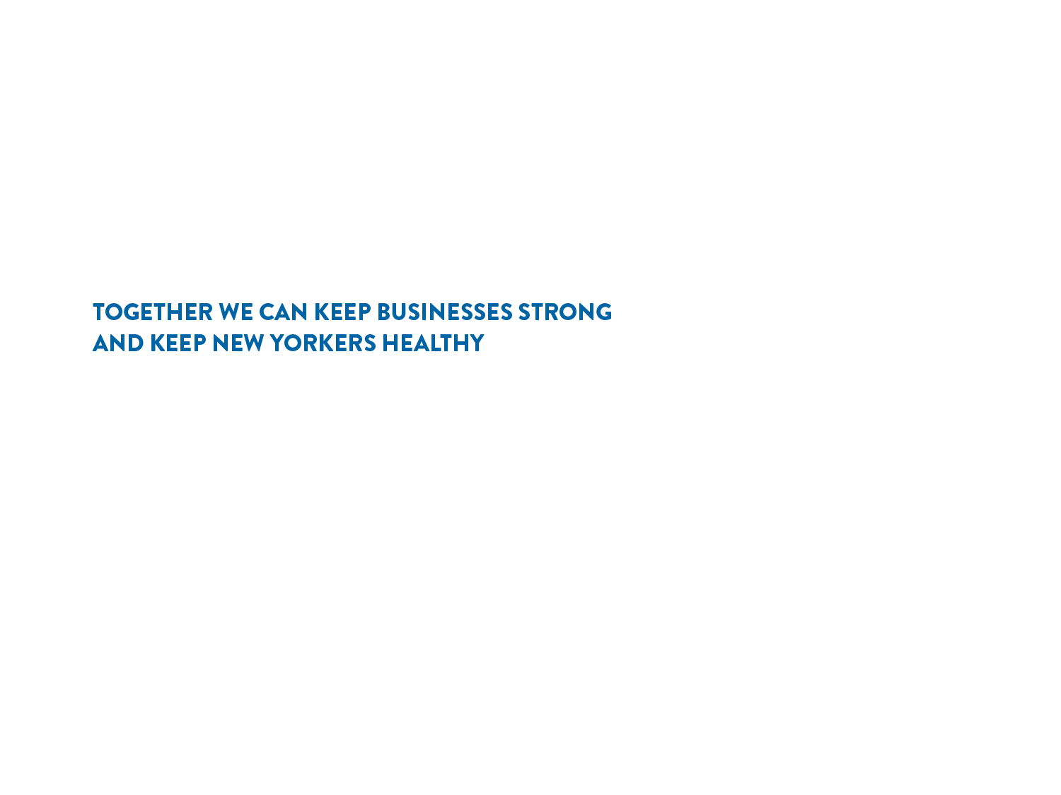

Slide 2
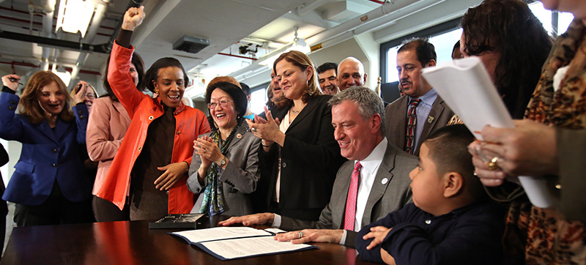
“The benefits of paid sick leave extend far beyond the positive impact on individual families. It's also about making our businesses run better, and protecting the health and welfare of their customers.”
- Mayor Bill de Blasio

Slide 3
What we will cover
  Overview of the law
  Which employers must comply with the law
  Which employees are covered/not covered by the law
  Notice of Employee Rights
  Accrual and rate of pay for sick leave
  Use of sick leave
  Compliance
  Q & A

Slide 4
OVERVIEW OF THE LAW

Slide 5
NYC’S Paid Sick Leave LAW
NYC is the 7th jurisdiction to guarantee access to sick leave for employees under the Earned Sick Time Act (Paid Sick Leave Law).
More than 1 million NYC employees will now have the right to sick leave.

Slide 6
NYC’S Paid sick leave LAW
Certain employers must comply with the law starting April 1, 2014.
Under the law, covered employees have the right to use sick leave for the care and treatment of themselves or a family member.

Slide 7
WHICH EMPLOYERS MUST COMPLY WITH THE LAW

Slide 8
Which employers must provide sick leave?
Employers with 5 or more employees or 1 or more domestic workers must provide paid sick leave.
Employers with less than 5 employees must provide unpaid sick leave.

Slide 9
HOW SHOULD EMPLOYERS CALCULATE NUMBER OF EMPLOYEES?
Employers should count full-time, part-time, and temporary employees who work more than 80 hours per calendar year.
If the number of employees changes every week:
Existing employers (Operating more than 1 year as of April 1, 2014): | New employers (Operating less than 1 year as of April 1, 2014):
Count average number of employees paid per week during the prior calendar year. | Count average number of employees paid per week during first 80 days of operation.

Slide 10
WHICH EMPLOYEES ARE COVERED/NOT COVERED
BY THE LAW

Slide 11
Which employees are covered?
Employees who work more than 80 hours in NYC per calendar year are covered.
Includes:
  Full-time employees
  Part-time employees
  Transitional jobs program employees
  Undocumented employees
  Employees who are family members but not owners
  Employees who live outside of NYC but work in NYC
Notes:
Note: If your employer has an existing policy allowing employees to use sick leave, the policy must meet or exceed the requirements of the law.

Slide 12
Which employees are not covered under the law?
Employees who work 80 hours or less a calendar year in NYC.
Students in federal work study programs.
Employees whose work is compensated by qualified scholarship programs.
Employees of government agencies.
    Participants in Work Experience Programs (WEP).

Slide 13
Which employees are not covered under the law?
    Certain employees subject to a collective bargaining agreement.
For most employees: | For employees in the grocery or construction industries:
Agreement must expressly waive the law’s provisions and provide comparable benefit. | Agreement must expressly waive the law’s provisions but does not have to provide comparable benefit.

Slide 14
which Employees are not covered under the law?
  Physical Therapists, Occupational Therapists, Speech Language Pathologists, Audiologists licensed by NYS Department of Education.
  Not covered if:
    Call in for work at will.
    Determine own schedule and assignments.
    Paid average hourly wage 4x the federal minimum wage.
Notes:
* to see which independent contractors are not covered go to: labor.gov and search “Independent Contractor”
* Clarify employees subject to collective bargaining
* If your employer has an existing policy allowing employees to use sick leave, the policy must meet or exceed the requirements of the Paid Sick Law

Slide 15
which Employees are not covered under the law?
    Independent contractors.
    Not covered if they do not meet definition of an employee under NYS Labor Law.
    Factors include how much supervision, direction, and control employer has over services being provided.

Slide 16
What is a Calendar Year?
Used to determine rate of accrual, when leave is available for use.
Means any consecutive 12-month period of time determined by employer.
Employers must include their calendar year in the required written Notice of Employee Rights.
Notes:
* Will talk specifically about written notice later in presentation

Slide 17
NOTICE OF EMPLOYEE RIGHTS

Slide 18
Notice of employee rights
Employers must give covered employees the Notice of Employee Rights created by DCA.
Notice is available in English, Spanish, Arabic, Bengali, Chinese, French-Creole, Italian, Korean, and Russian.
Existing employees (Already employed before April 1, 2014): | New employees (First employed on or after April 1, 2014):
Must get Notice by May 1. | Must get Notice on first day of employment.
Required Notice is on DCA website: nyc.gov/PaidSickLeave.

Slide 19
Notice of employee rights
Employers are not required to keep or maintain a copy of the Notice signed by the employee; however, saving signed copies is recommended for record keeping.
Employers can give employees the Notice in person, by regular mail, or by email. Save email receipts.

Slide 20
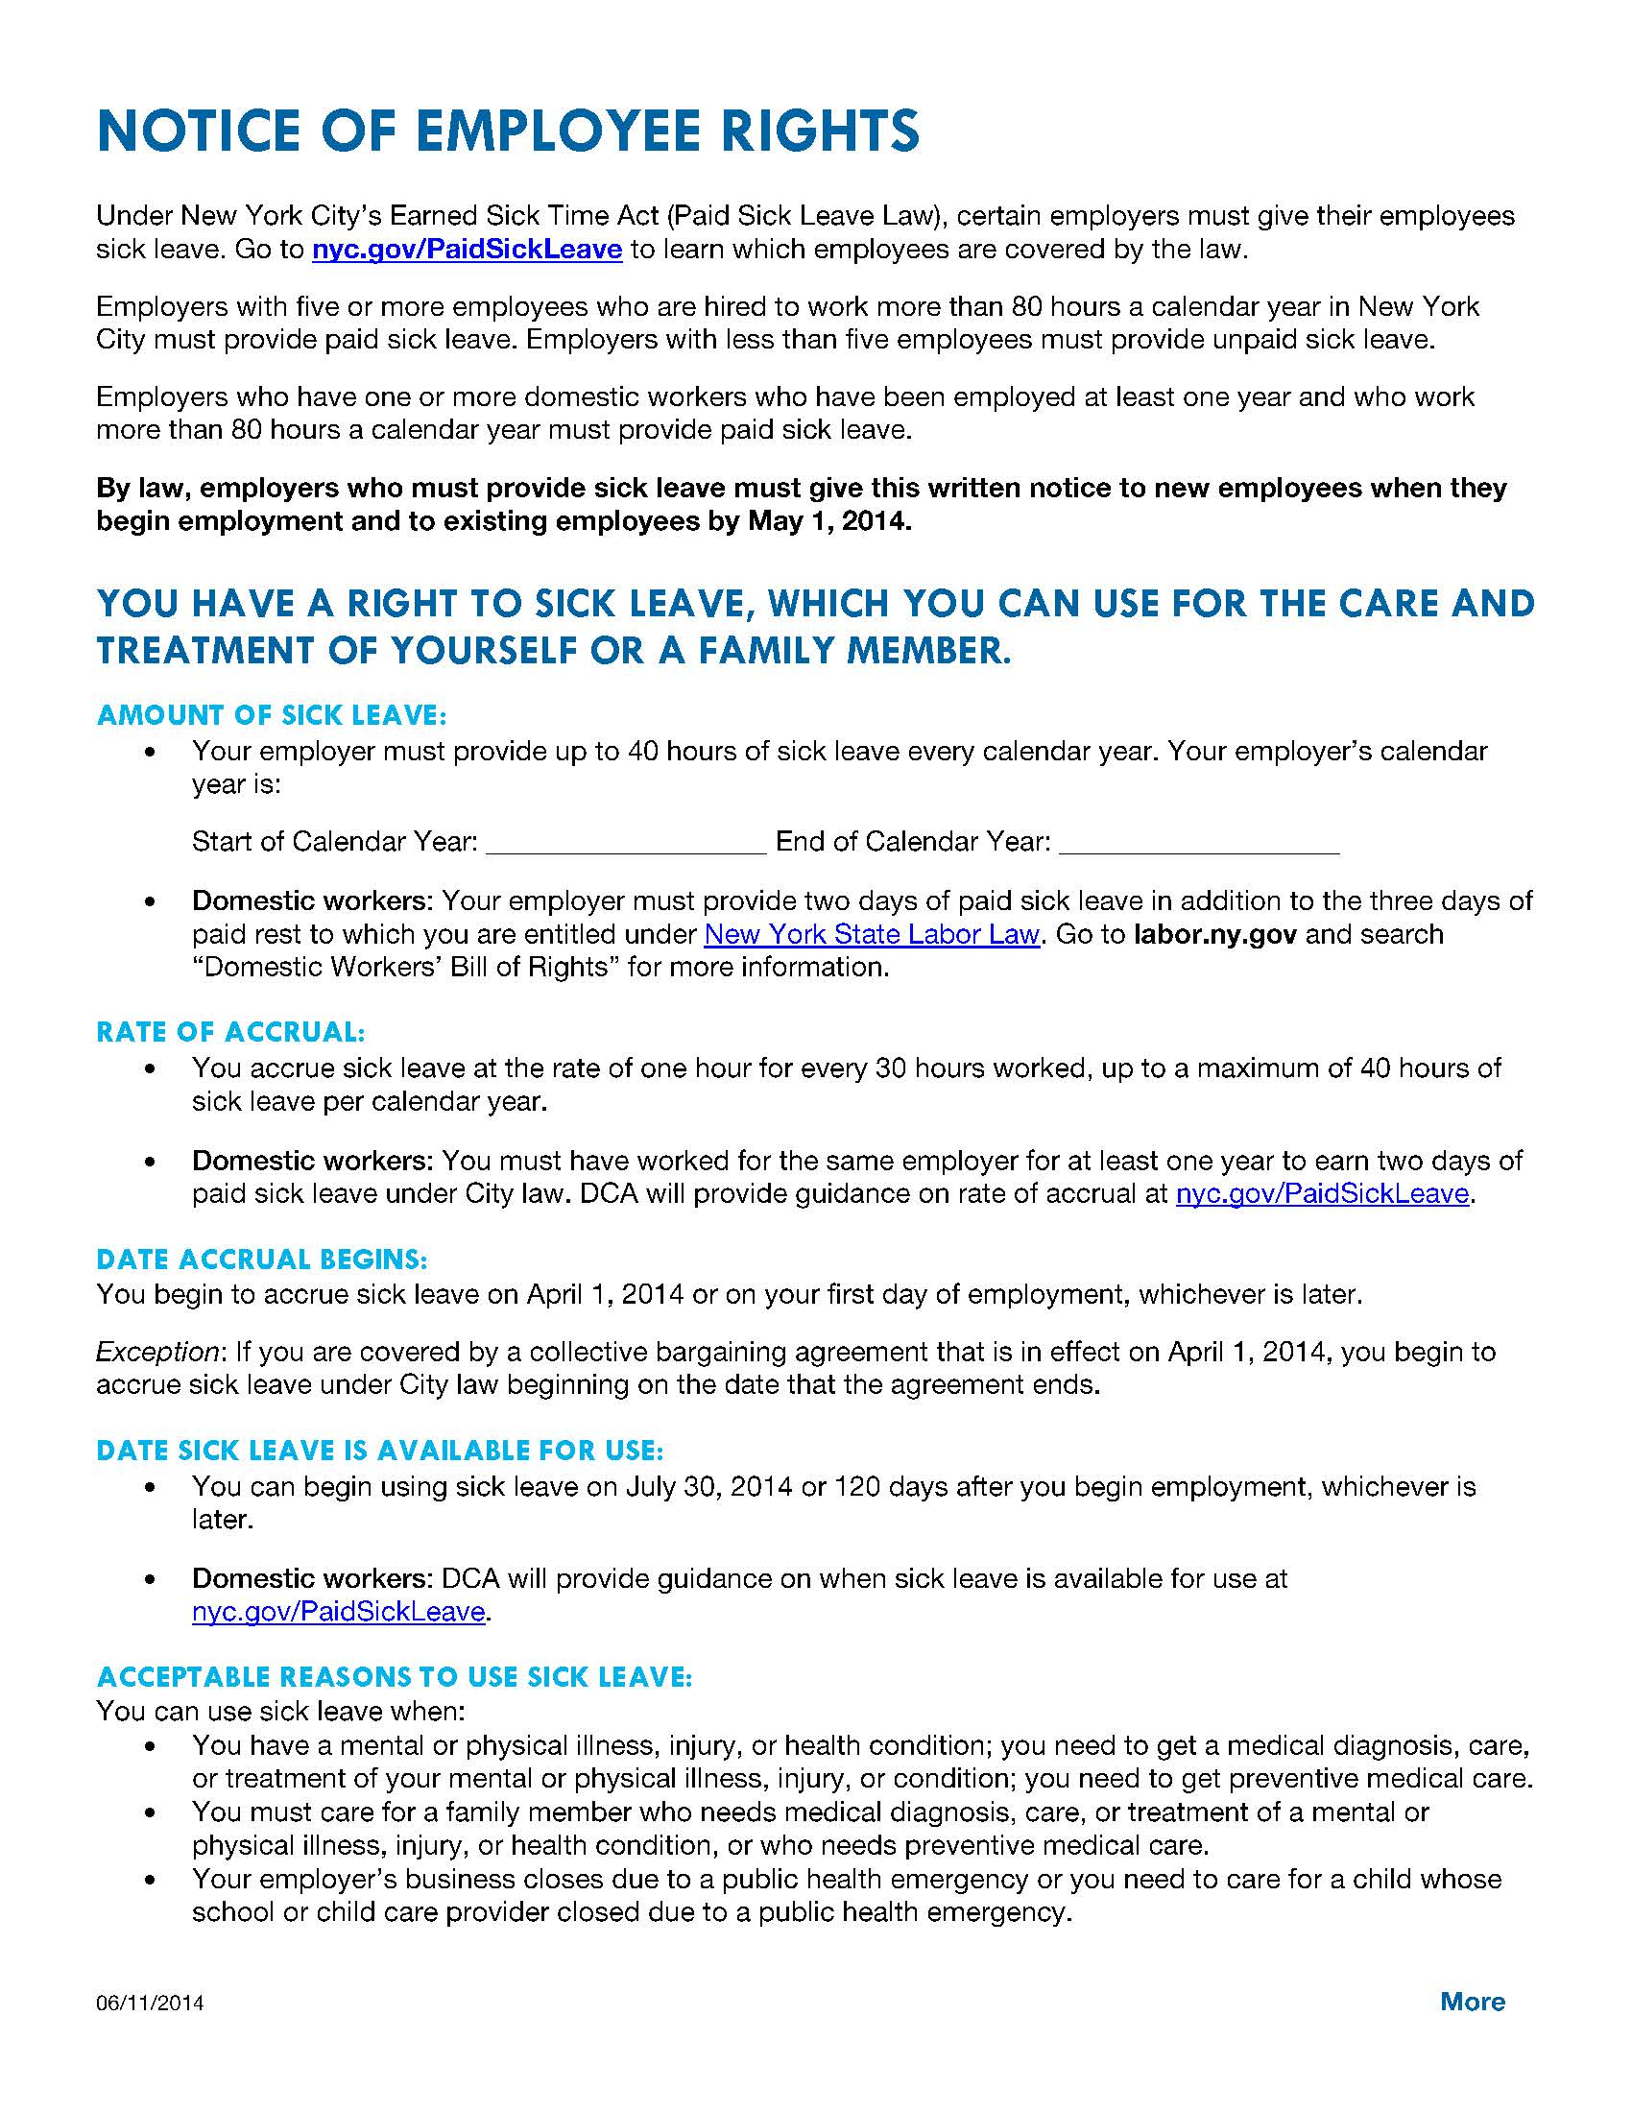
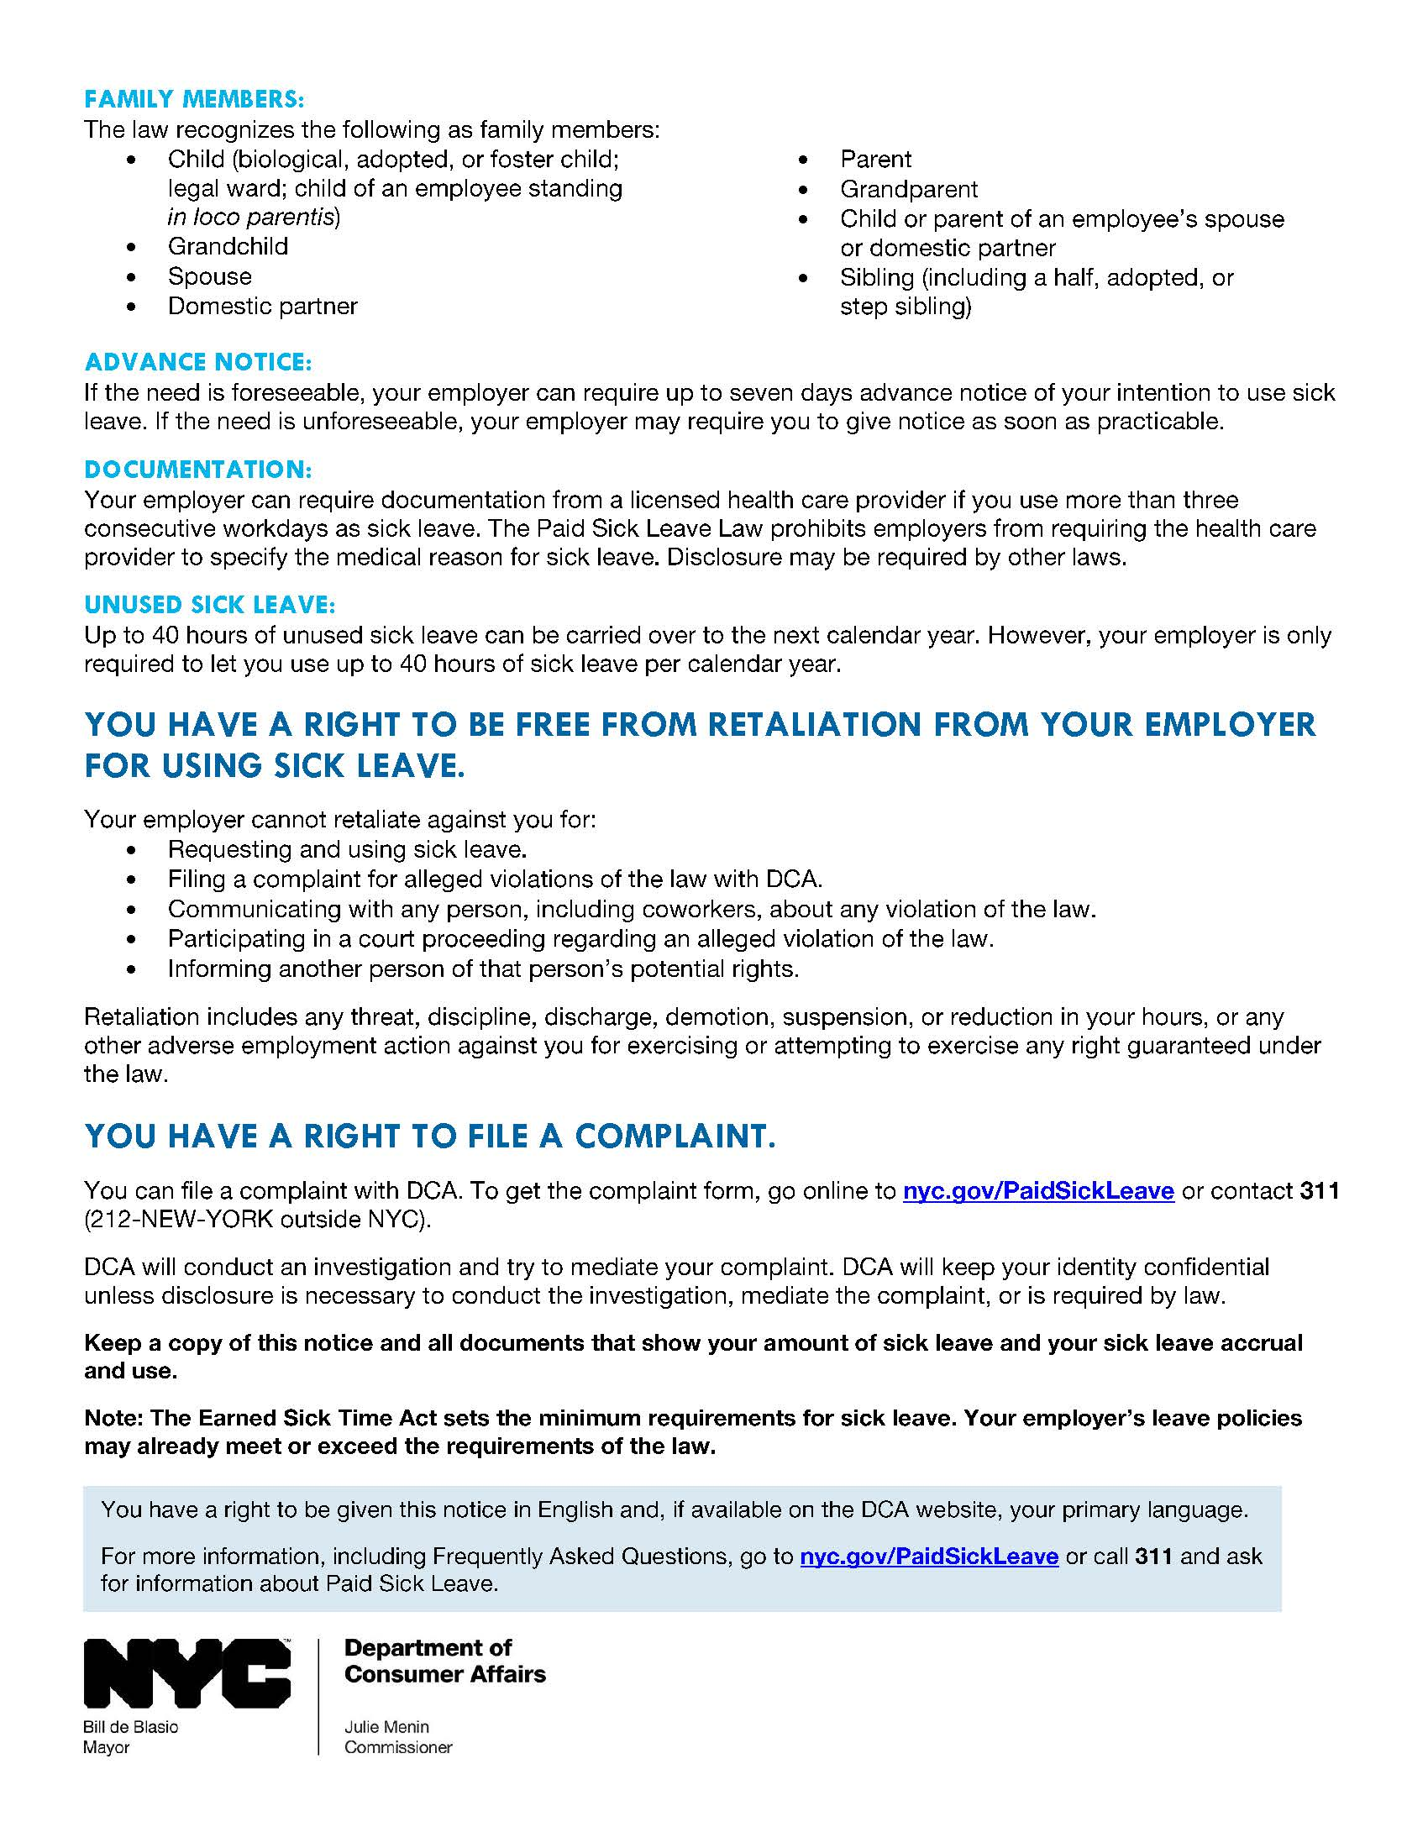
What IS IN notice of employee rights?
  Accrual rate and information on how to use sick leave.
  Employer’s calendar year.
  Right to be free from retaliation.
  Right to file a complaint.

Slide 21
ACCRUAL AND RATE OF PAY
FOR SICK LEAVE

Slide 22
How does accrual work FOR EMPLOYEES?
An employee earns 1 hour of sick leave for every 30 hours worked.
An employee can accrue up to 40 hours of sick leave per calendar year.
 | Date Accrual Begins | Date Accrued Sick Leave Available for Use
Existing employee | April 1, 2014 | July 30, 2014
New employee | First day of employment | 120 days after first day of employment

Slide 23
WHAT ABOUT COLLECTIVE BARGAINING AGREEMENTS?
Employees covered by a collective bargaining agreement in effect on April 1, 2014 begin to accrue sick leave on the day the agreement ends.

Slide 24
What is the rate of paid sick leave?
Employers with 5 or more employees pay employees at their regular hourly rate but no less than $8 per hour (minimum wage).
  This includes employees whose salary is based on tips or gratuity.

Slide 25
RECAP: Employees
Number of Employees | Amount of Sick Leave per Calendar Year | Paid or Unpaid Sick Leave | Rate of Pay
5 or more | Up to 40 hours | Paid | Regular hourly rate but no less than $8 per hour (minimum wage)
1- 4 | Up to 40 hours | Unpaid | Not Applicable

Slide 26
OVERVIEW: Domestic workers
Number of Employees | Amount of Sick Leave per Calendar Year | Paid or Unpaid Sick Leave | Rate of Pay
1 or more domestic workers | 2 days after one year working for same employer | Paid | Regular hourly rate but no less than $8 per hour (minimum wage)
  City leave is in addition to 3 days of paid rest under NYS Labor Law.
  Accrual and use of sick leave follow NYS Labor Law.
Notes:
*DCA will provide guidance at nyc.gov/paidsickleave on the date accrual begins and the date in which it is available for use.

Slide 27
Use of sick leave

Slide 28
What are Acceptable reasons to use sick leave?
Employees can use leave for themselves or a family member for:
  Mental or physical illness, injury, or health condition.
  Medical diagnosis, care, or treatment of above.
  Preventive medical care.
Business closes due to a public health emergency.
Care of child whose school or child care provider closed due to a public health emergency.

Slide 29
Who is a family member under the law?
  The law recognizes the following as a family member:
  Child (biological, adopted, or foster child; legal ward; child of an employee standing in loco parentis)
  Grandchild
  Spouse
  Domestic Partner
  Parent
  Grandparent
  Child or parent of an employee’s spouse or domestic partner
  Sibling (including a half, adopted, or step sibling)

Slide 30
WHAT HAPPENS TO unused sick leave?
Employees can carry over up to 40 hours of unused sick leave to the next calendar year.
Employees continue to accrue up to 40 hours of sick leave in addition to the sick leave carried over from the previous year.
Employers are only required to allow employees to use up to 40 hours of sick leave per calendar year.

Slide 31
CAN EMPLOYER PAY AN EMPLOYEE FOR unused sick leave?
An employer can pay an employee for unused sick leave at the end of the calendar year. This is not required.
Employees cannot carry over sick leave if:
  The employer pays them for the unused sick leave. AND
  The employer gives employee up to 40 hours of sick leave on the first day of the new calendar year.

Slide 32
WHAT HAPPENS TO Unused sick leave FOR RehireS?
If an employee is rehired within 6 months, the employer must reinstate previously accrued sick leave.
  Exception: Employer paid employee for unused sick leave when employee left.

Slide 33
MUST employee give ADVANCE notice to use sick leave?
If the need is foreseeable, employer can require up to 7 days advance notice before employee uses sick leave.
  Example: scheduled doctor’s appointment
If the need is unforeseeable, employer may require employee to give notice as soon as practicable (reasonable).
  Example: accident

Slide 34
Can employer set minimum increments for sick leave?
An employer can set reasonable minimum increments for the use of sick leave, but the minimum cannot be more than 4 hours per day unless otherwise permitted by state or federal law.

Slide 35
DOES employee NEED A DOCTOR’S NOTE?
Employers can require documentation from a licensed health care provider if employee uses more than 3 consecutive workdays as sick leave.
  Employers cannot require provider to specify the medical reason for sick leave.
  Note: A workday does not need to be a full day if the employee works part time.
Employers may require employee to provide written verification that employee used sick leave for sick leave purposes.

Slide 36
WHAT ABOUT AN EMPLOYER’S EXISTING LEAVE POLICIES?
The Paid Sick Leave Law sets the minimum requirements for sick leave.
An employer’s existing leave policies may already meet or exceed the requirements of the law.

Slide 37
COMPLIANCE

Slide 38
WHAT DOES RIGHT TO BE FREE FROM RETALIATION MEAN?
An employer cannot retaliate against employees for requesting or using sick leave.
Retaliation includes any threat, discipline, discharge, demotion, suspension, or reduction in hours, or any other adverse employment action against employee.

Slide 39
WHAT records ABOUT sick leave MUST EMPLOYER KEEP?
Employers must keep and maintain records documenting compliance with the law for at least 3 years.
Employers must keep any health related information confidential.
Notes:
* Provide example template employers could use

Slide 40
How does THE complaint PROCESS WORK?
Employees have 2 years to file a complaint with DCA.
DCA will keep the employee’s identity confidential unless disclosure is necessary to investigate, mediate, or is required by law.
DCA will contact employer by mail for written response. Employers must respond to DCA within 30 days.

Slide 41
How does THE complaint PROCESS WORK?
DCA will conduct a fair investigation of the complaint.
If there is a violation, DCA will work with the employer and the employee to try to resolve the complaint through mediation.
DCA will also work with the employer to come into compliance with the law.

Slide 42
What happens when MEDIATION DOESN’T WORK?
If employer receives a notice of violation, the employer has the opportunity to:
  Settle the violation without a hearing. OR
  Appear before an impartial judge at DCA’s Adjudication Tribunal.
  Employers must make records available to DCA upon notice at an agreed upon time.
The judge will hear testimony from DCA, the employer, and any witnesses.

Slide 43
What RELIEF DO EMPLOYEES HAVE UNDER the law?
Under the law, a judge may order the following relief:
  Full compensation, including lost wages and benefits, $500 and appropriate equitable relief for each time employer punished employee for taking sick leave (not including termination).
  Full compensation, including lost wages and benefits, $2,500 and appropriate equitable relief (including reinstatement) for each time employer fires employee for taking sick leave.
  3x the wages employee should have been paid for each time employee took sick leave but wasn’t paid or $250, whichever is greater.
  $500 for each time employee was denied sick leave or was required to find replacement worker, or each time employee was required to work additional hours without mutual consent.

Slide 44
What are Maximum penalties under the law?
The law outlines the following maximum penalties:
  $500 for first violation.
  Up to $750 for a second violation within 2 years of a prior violation.
  Up to $1,000 for subsequent violations that occur within 2 years of any previous violation.
  Up to $50 for each employee who was not given the required written notice.

Slide 45
will all employers be subject to penalties starting april 1, 2014?
All employers must comply with the law starting April 1, 2014.
Up to October 1, 2014, certain employers will have the opportunity to ensure compliance without a penalty and a first violation before this date will not be counted:
Employers with 1-19 employees
Manufacturing businesses

Slide 46
APRIL 29 PUBLIC HEARING and opportunity to comment
DCA held a public hearing on Tuesday, April 29 on proposed Rules to clarify provisions in the Paid Sick Leave Law.
DCA will be reviewing testimony.
Monitor nyc.gov/PaidSickLeave for updates and final Rules.

Slide 47
DCA IS HERE TO HELP
Paid Sick Leave materials, including required Notice of Employee Rights, are available:
  Online at nyc.gov/PaidSickLeave
  Contact 311 (212-NEW-YORK outside NYC)
Contact DCA with questions:
Call 311 and ask for information about Paid Sick Leave
Email PaidSickLeave@dca.nyc.gov
Use online Live Chat at nyc.gov/BusinessToolbox
(Businesses only)

Slide 48
DCA IS HERE TO HELP
DCA is conducting Paid Sick Leave trainings in all 5 boroughs:
  For the list of scheduled trainings in all 5 boroughs, visit nyc.gov/PaidSickLeave
  To schedule a training specifically for your organization, email PaidSickLeave@dca.nyc.gov

Slide 49
DCA IS HERE TO HELP
For general inquiries:
  Visit nyc.gov/consumers
  Contact 311 (212-NEW-YORK outside NYC)
Use online Live Chat at nyc.gov/BusinessToolbox (Businesses only)

Slide 50
QUESTIONS?

Slide 51
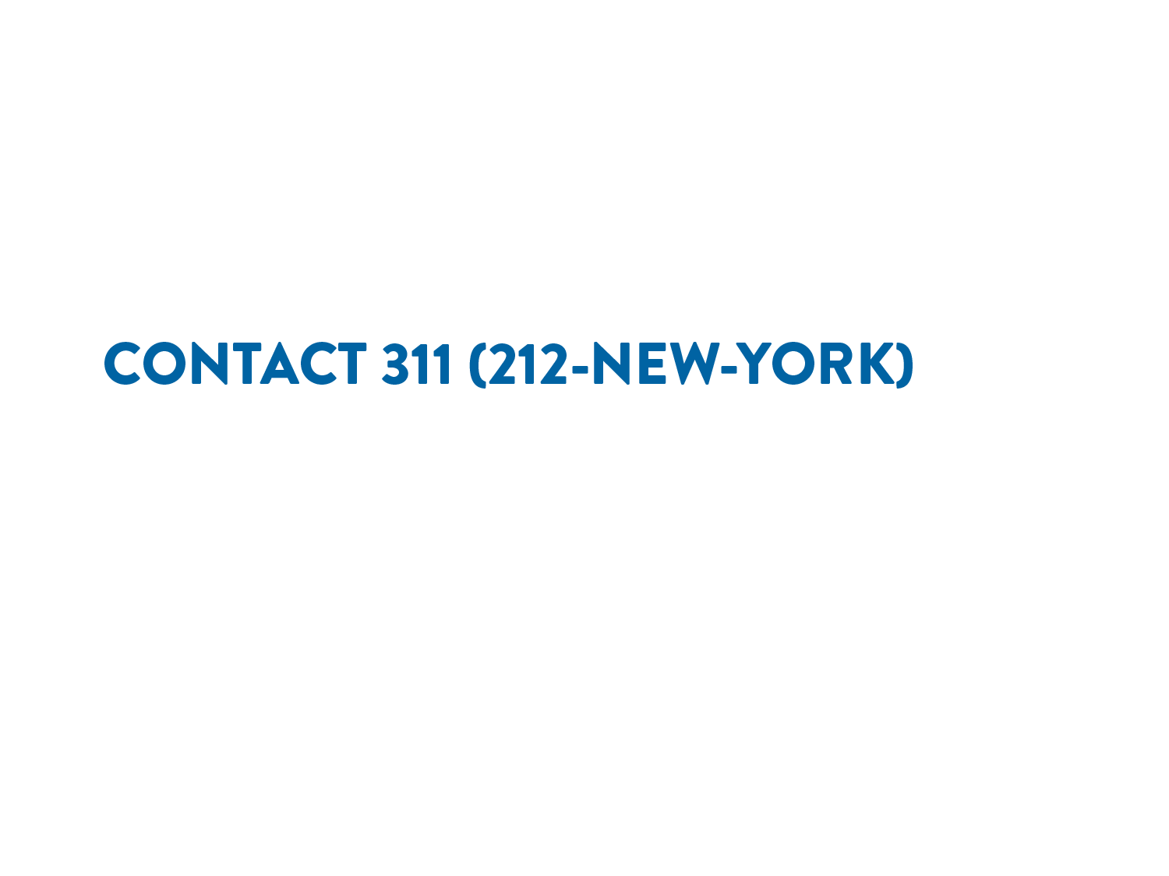
Updated 01/21/2015

